Slide 1

[app name]:<语雀笔记>\n

Slide 2
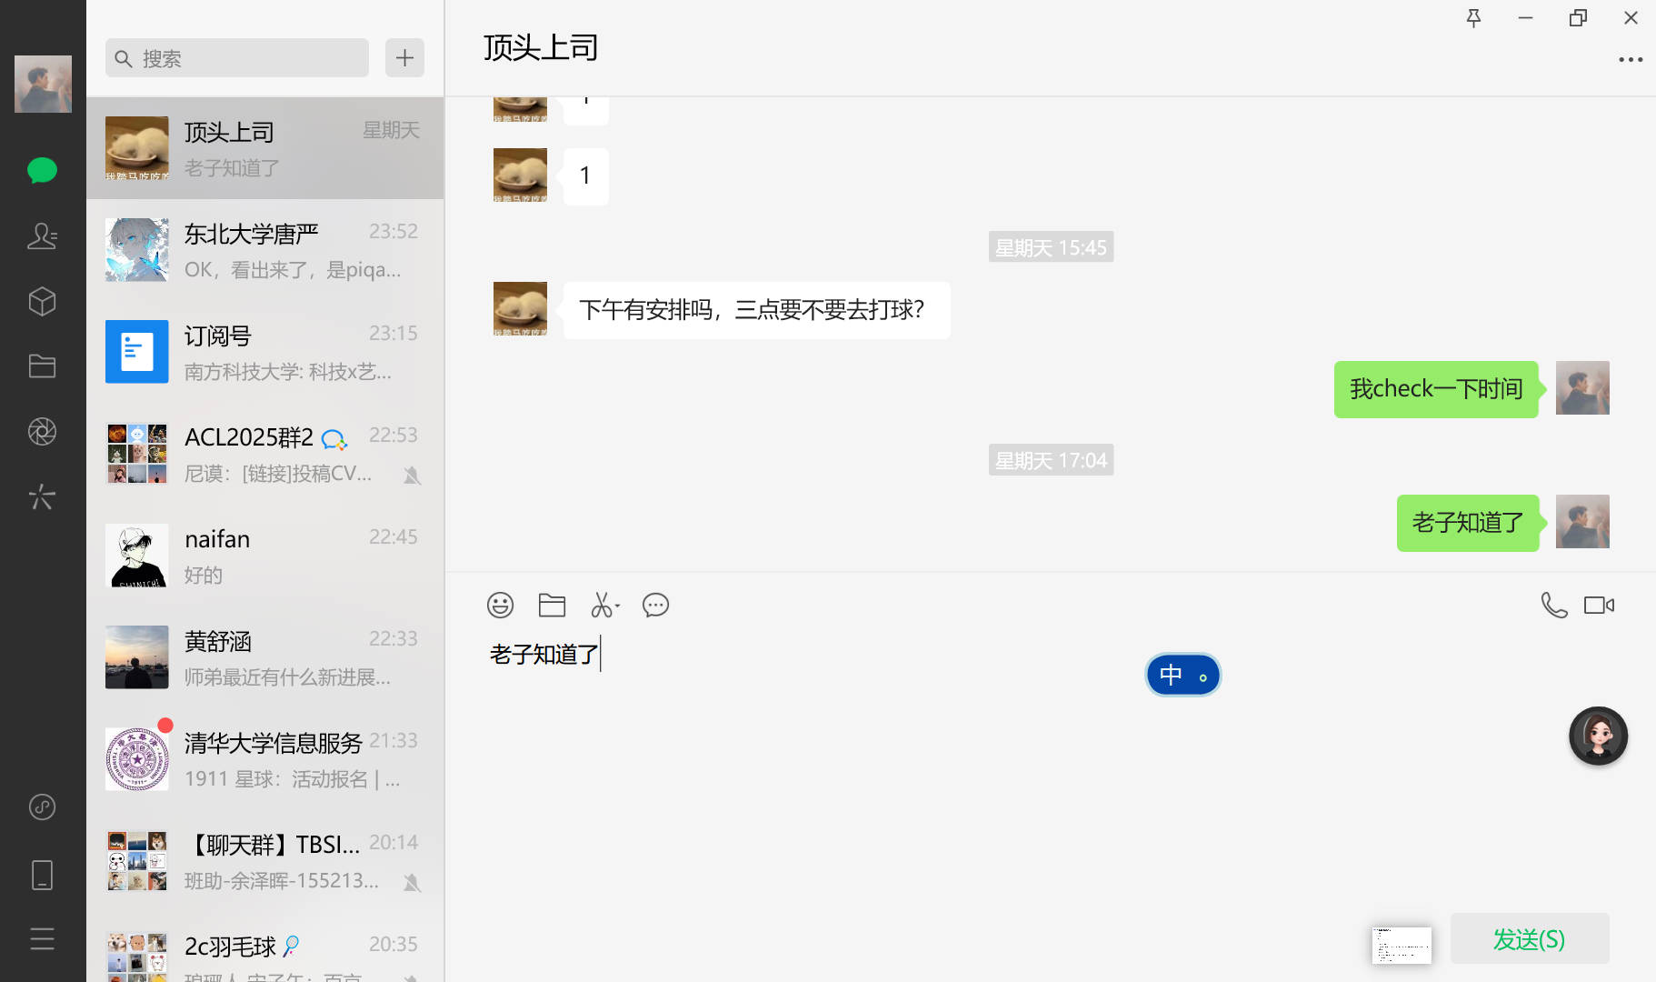
[app name]:<wechat>\n

Slide 3

[app name]:<red alert>\n

Slide 4
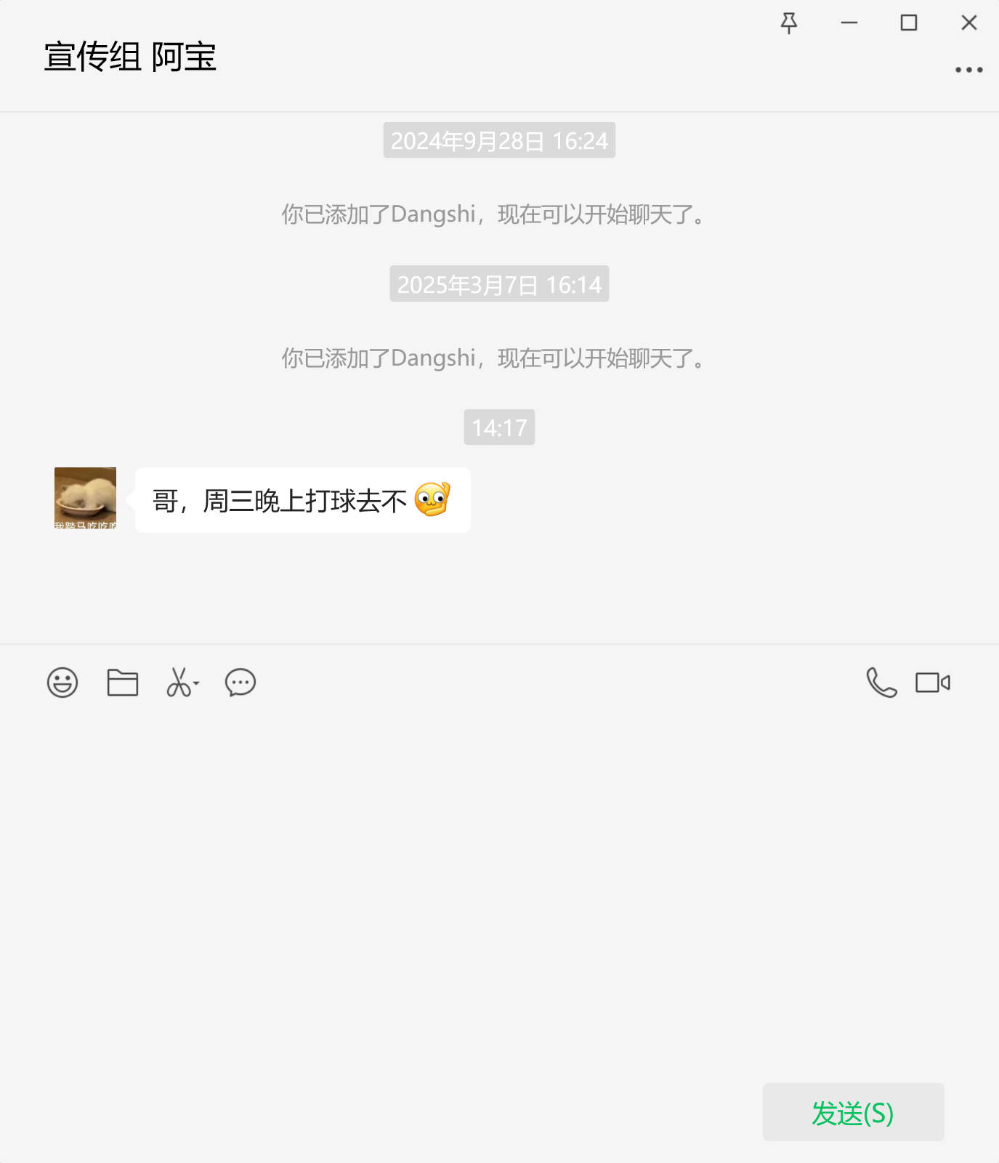
[app name]:<语雀笔记>\n

Slide 5
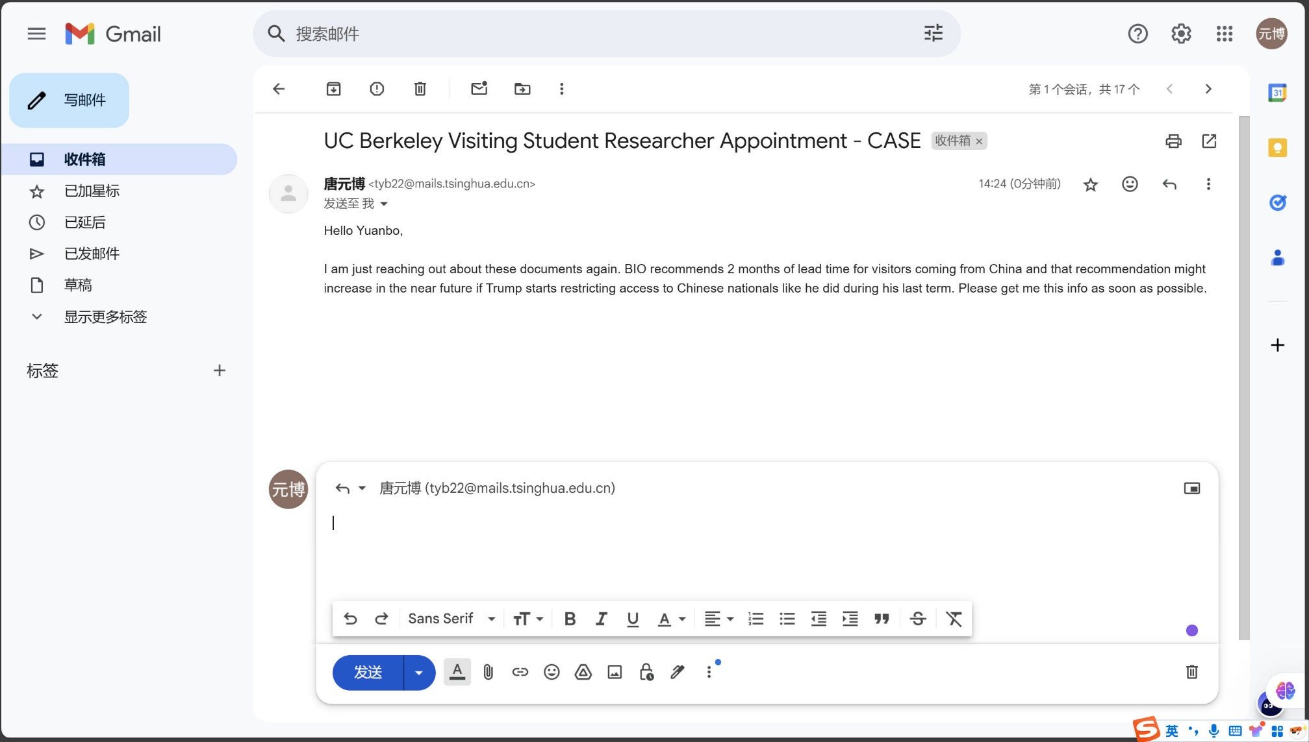
[app name]:<edge>\n

