Slide 1
Pathlet Learning for Compressing and Planning Trajectories
分享人： 唐元博,彭志远
分享时间：2021/11

Slide 2
Pathlet Learning for Compressing and Planning Trajectories
代码整体框架实现
代码运行结果
轨迹分割案例分析
本周主要工作：

Slide 3
Pathlet Learning for Compressing and Planning Trajectories
step1
step2
伪代码：

Slide 4
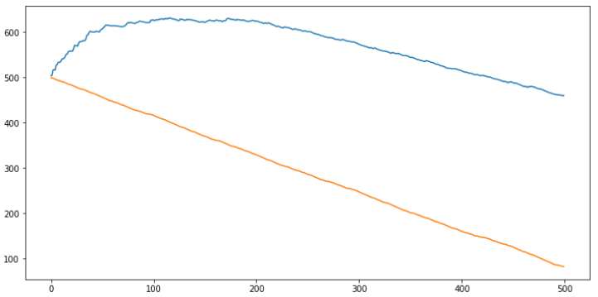
Pathlet Learning for Compressing and Planning Trajectories - result

Slide 5
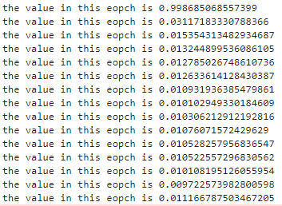
Pathlet Learning for Compressing and Planning Trajectories - result

Slide 6
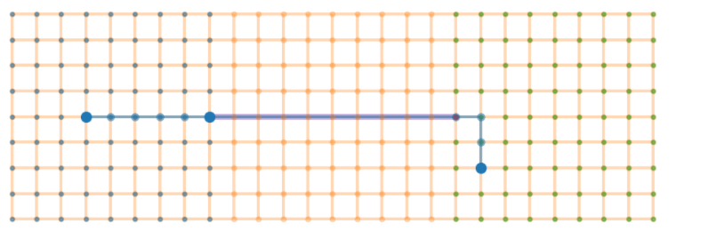
Pathlet Learning for Compressing and Planning Trajectories - case study

Slide 7
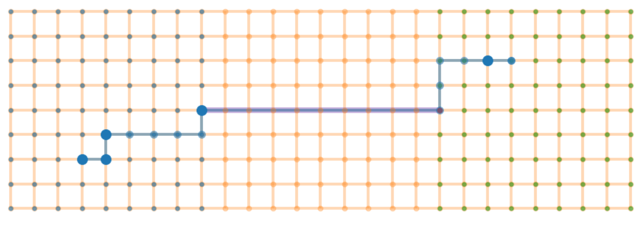
Pathlet Learning for Compressing and Planning Trajectories - case study

Slide 8
Pathlet Learning for Compressing and Planning Trajectories - analysis
字典生成影响因素
轨迹数据集的密度
lamda的选取
字典元素长度限制

Slide 9
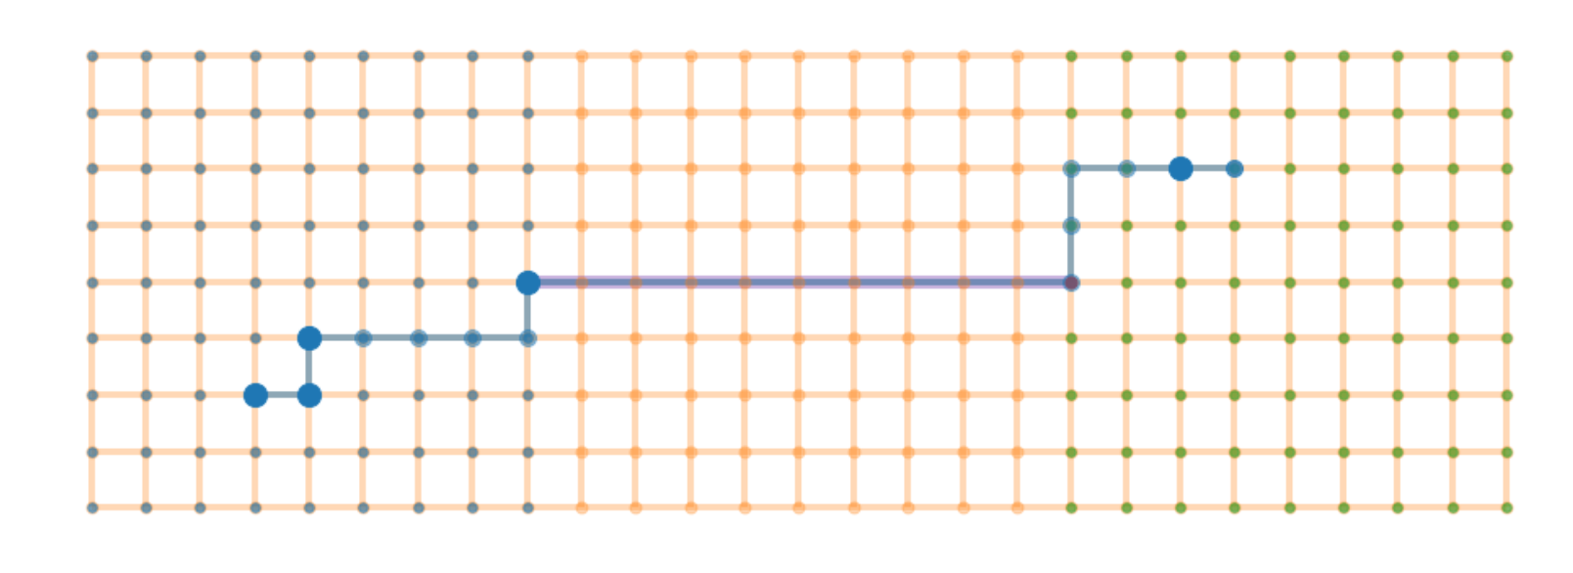
Pathlet Learning for Compressing and Planning Trajectories - analysis
字典生成影响因素
轨迹数据集的密度
lamda的选取

Slide 10
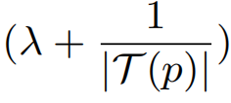
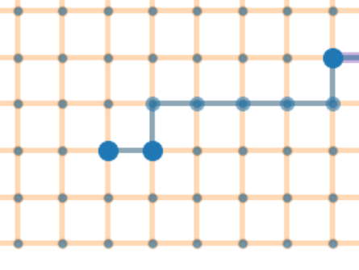
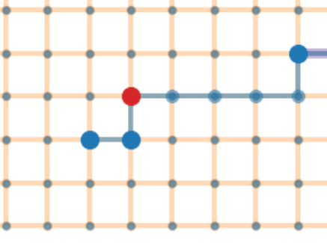
Pathlet Learning for Compressing and Planning Trajectories - analysis
b
Plan1 : la+1/T(b)
Plan2 : la+1/T(b1)+la+1/T(b2)
Diff : la+1/T(b1)+1/T(b2)-1/T(b)
a

Slide 11
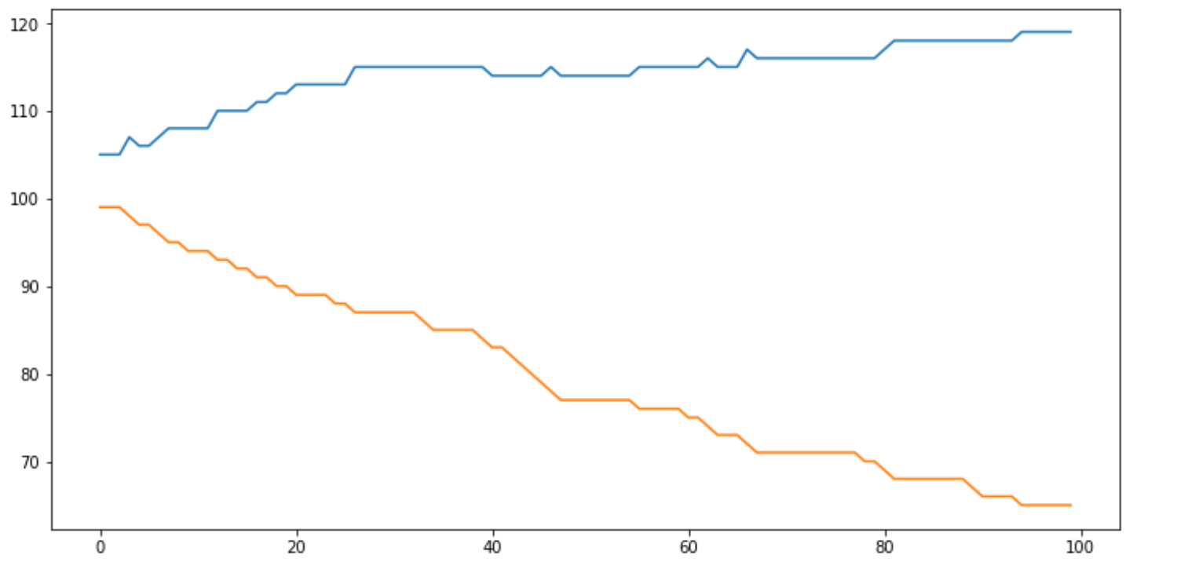
Pathlet Learning for Compressing and Planning Trajectories - analysis

