Slide 1
Project 1: Climate Service Management
Team # 03 Jiyu Shi
Xiaoyu Wang
Yuan Liu
Zhongao Tang
1
Xiaoyu Wang

Slide 2
Overview
Introduction
System design
System implementation
Demo
Conclusions and future work

Slide 3
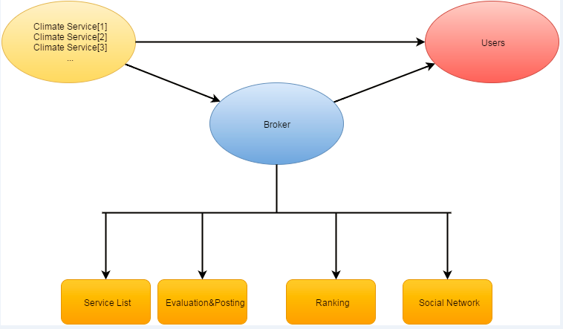
Introduction
Extra Functionalities:
Sign in and sign up
Add friends
Rank the services based on usage frequency

Slide 4
System Design
Front-End
Back-End
List all climate services in order
User evaluate a service
User search a service
Comment
@ and #
Complete database
User account validation
Fetch data from database to Frontend
Handle request and save data

Slide 5
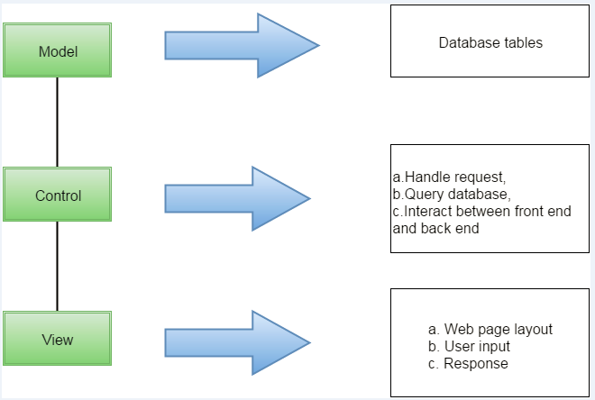
System Design

Slide 6
System Implementation - Frontend
Components
Main page
Sign-up page
Service page
Searching pages
Tools
Bootstrap
Javascript, Jquery, Ajax
API calls in controller

Slide 7
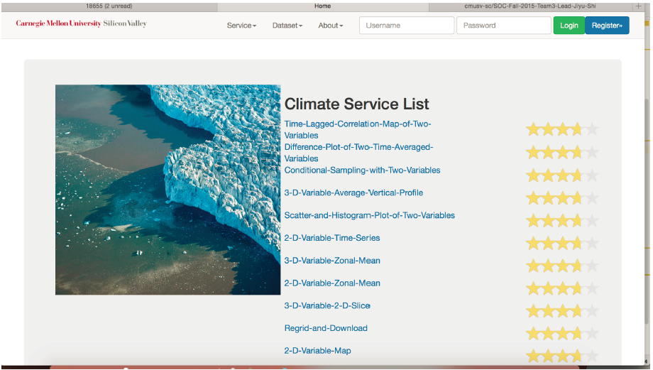
Home Page
Service list sorted by grades
Bootstrap’s Star-rating plug-in
Call API in controller to get the service list.

Slide 8
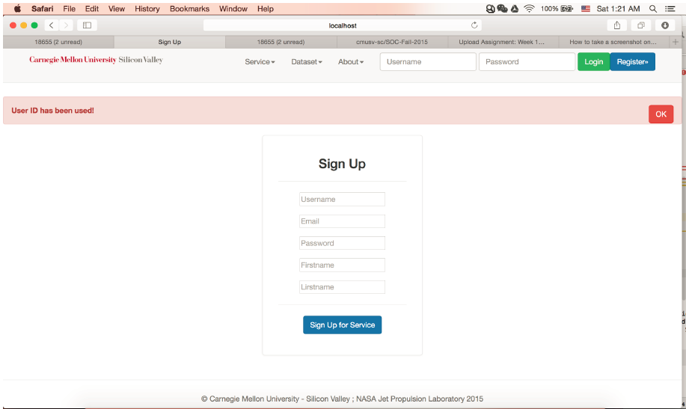
Sign Up
Call API in controller to sign up.

Slide 9
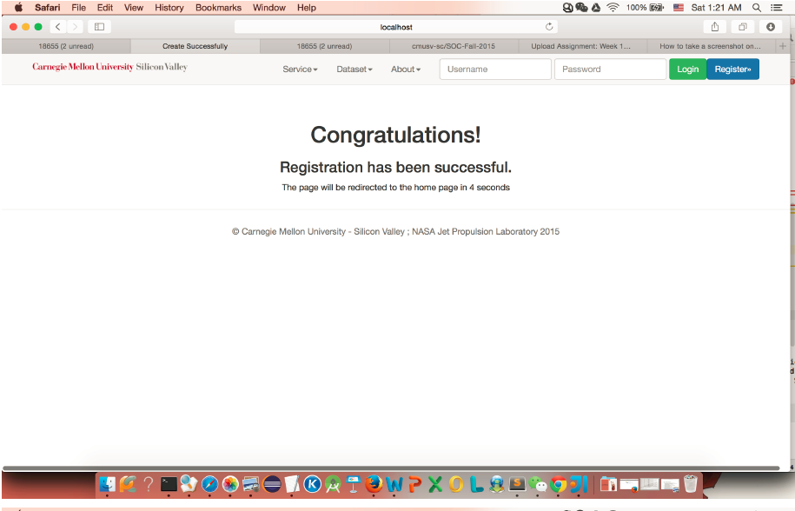
Successfully Sign Up

Slide 10
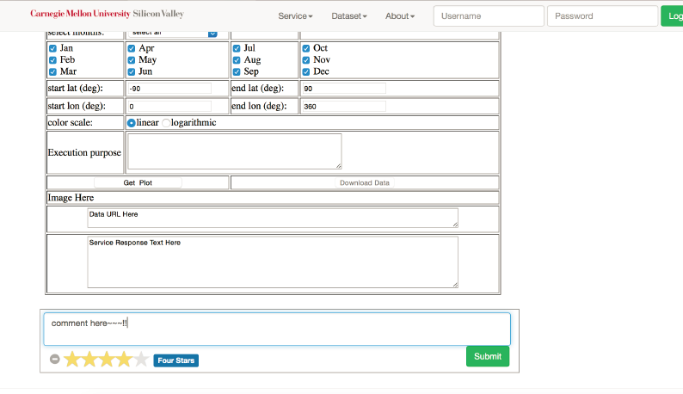
Service Comment
Service page
Frame to display a service
Comment area
Post comment to server by Ajax

Slide 11
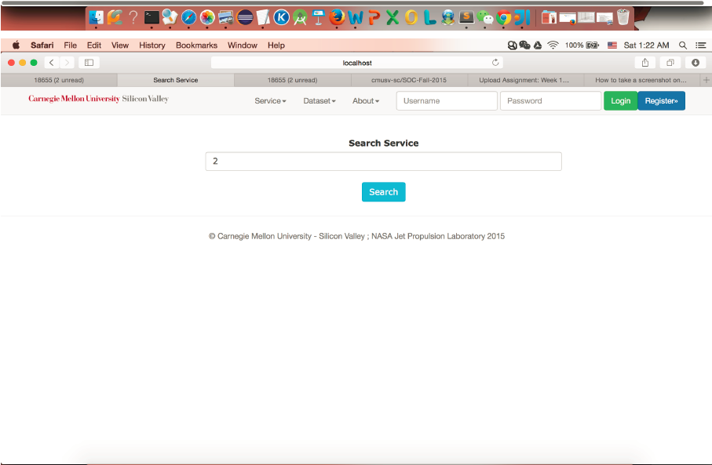
Search
Search page in a searching box
Get top 3 grades climate services
Get top 3 most recently used climate services
Get top 3 clicks climate services
Call APIs in controller to get searching results

Slide 12
System Implementation-Backend
Database design
added controllers
Added models
Communication protocols

Slide 13
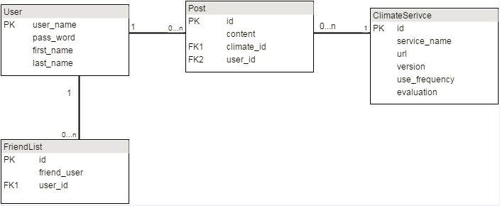
System Implementation-Backend
Database design

Slide 14
System Implementation-Backend
ADDED CONTROLLERS & MODELS:
Post
PostRepository
PostControlller

Slide 15
System Implementation-Backend
COMMUNICATION STRATEGY:
RESTUL API
JSON

Slide 16
Demo

Slide 17
Future Implementation-Backend
User home page
User send message between each other

Slide 18

Question?

