Slide 1

Project Immortality
Using GitHub To Make Your Work Live Forever
Tan Ho
July 27, 2022

Slide 2
The Life and Times of a Machine Learning Project
Import some data 📖
Do some wrangling 🤠
Throw it into a model 🧠
Tweet a plot 🎉
{…most projects die here} 💀

Slide 3
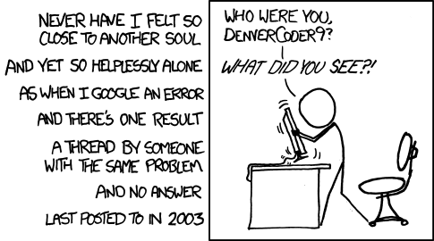
Sometime later…

Slide 4






Who This Talk Is For

Slide 5

About Me
Self-taught R developer
Hobby NFL analysis ▶ data science career
Maintain nflverse/ffverse R packages and data pipelines

Slide 6

ffopportunity
Uses NFL play by play data
Expected Fantasy Points
Measures the value of player opportunities in fantasy football
github.com/ffverse/ffopportunity

Slide 7
Imports nflverse play by play data
Does some data wrangling
Trained an xgboost model
Generated some predictions
…now what?

Slide 8
How can I make ffopportunity live on?
Can someone run my code and build on this project?
Can new predictions be automatically generated?
Where can I store data?

Slide 9


Can someone run my code and build on it?

Slide 10
Make It a Package
Not (necessarily) for CRAN
Add a DESCRIPTION
Wrap code in functions

Slide 11

Can new predictions be automatically generated?

Slide 12
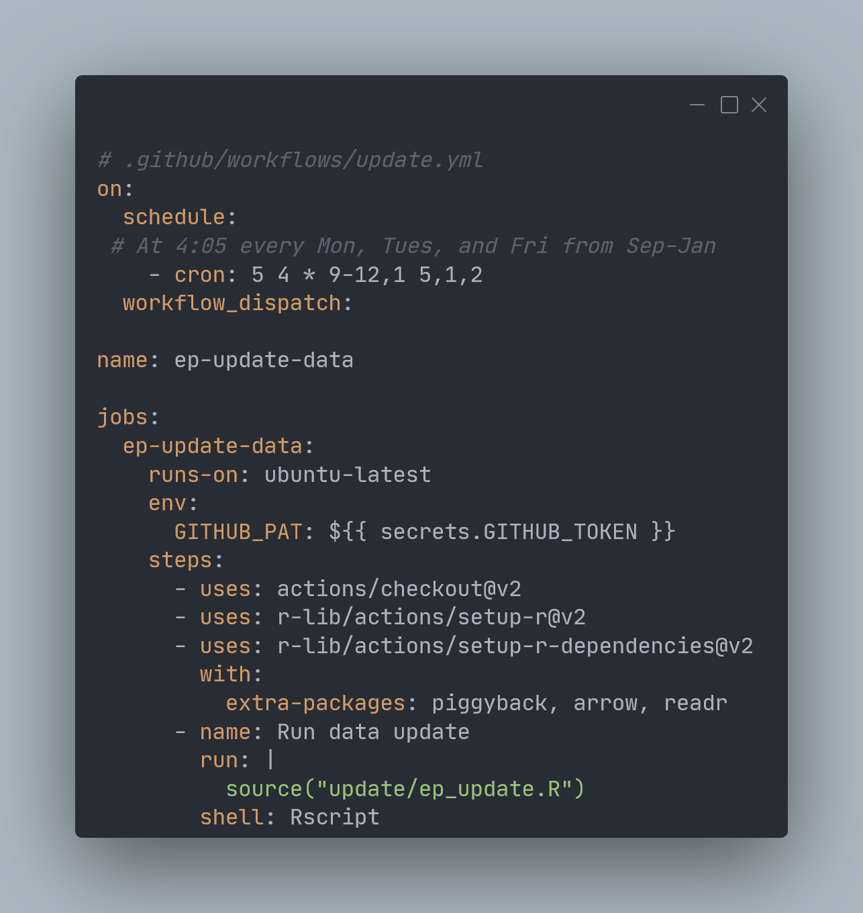
Add GitHub Actions

Slide 13

Where can I store the data?

Slide 14
Three Common Problems with GitHub Data Repositories
File Size Limits
Inefficient binary data storage
Commit history chaos

Slide 15
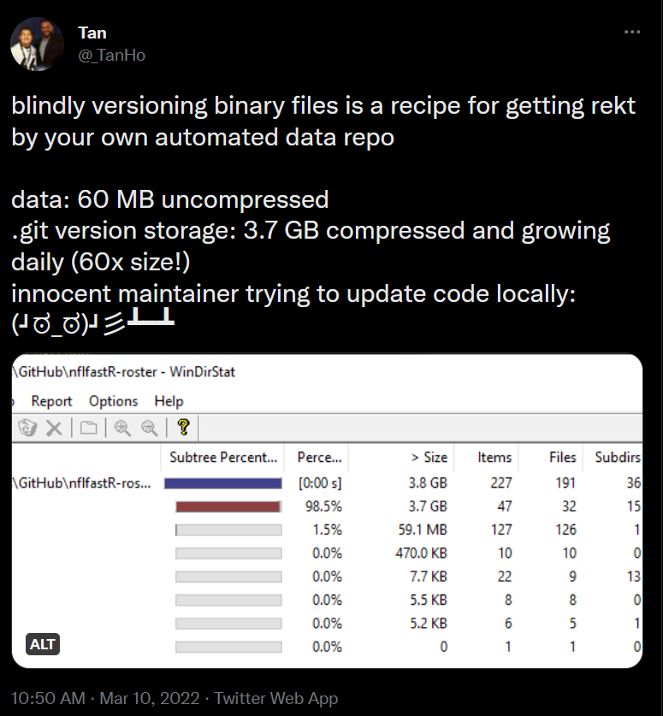
Blind version control is bad!

Slide 16
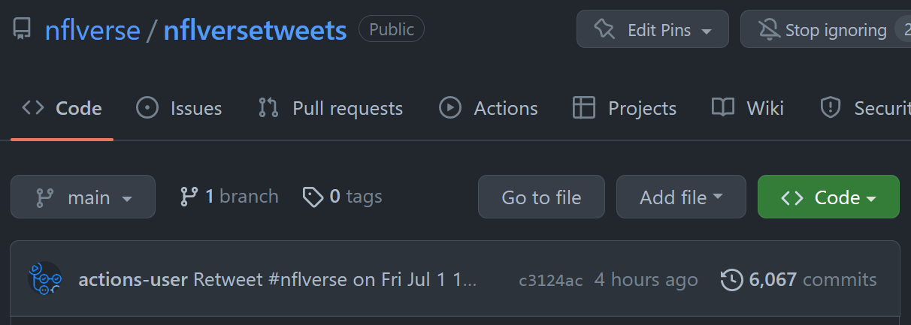
GitHub Data Repo Problems: Commit History Chaos!

Slide 17

Meh Solutions
Git Large File Storage
Amazon S3 buckets
Dropbox (?)

Slide 18

Better Solution
GitHub Releases!

Slide 19

GitHub Releases
Friendly file size limits
Versioning by choice
Keeps commit history clean
Data stays with your project

Slide 20
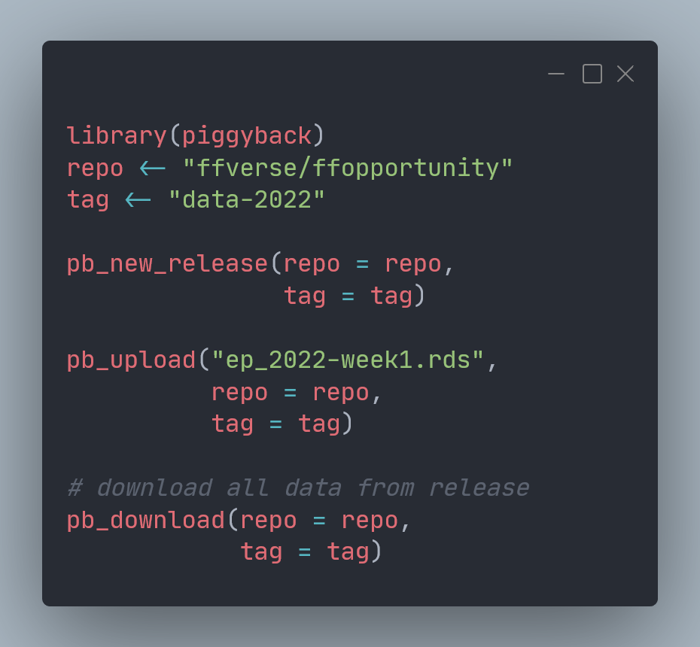

{piggyback}
asdf

Slide 21
Recap

Slide 22

Project Immortality With GitHub
GitHub R Packages
Install and run
GitHub Actions
Automation
GitHub Releases
Store data with your project

Slide 23
Resources
Packages
R Packages book by Hadley Wickham & Jenny Bryan https://r-pkgs.org
GitHub Actions
r-lib/actions https://github.com/r-lib/actions/
GHA with R book as https://orchid00.github.io/actions_sandbox/
GitHub Releases
piggyback pkg https://github.com/ropensci/piggyback
ffopportunity https://github.com/ffverse/ffopportunity
Notes:
Add a blog or resources page
Here’s where to get started with GitHub Actions, releases, packages

