Slide 1

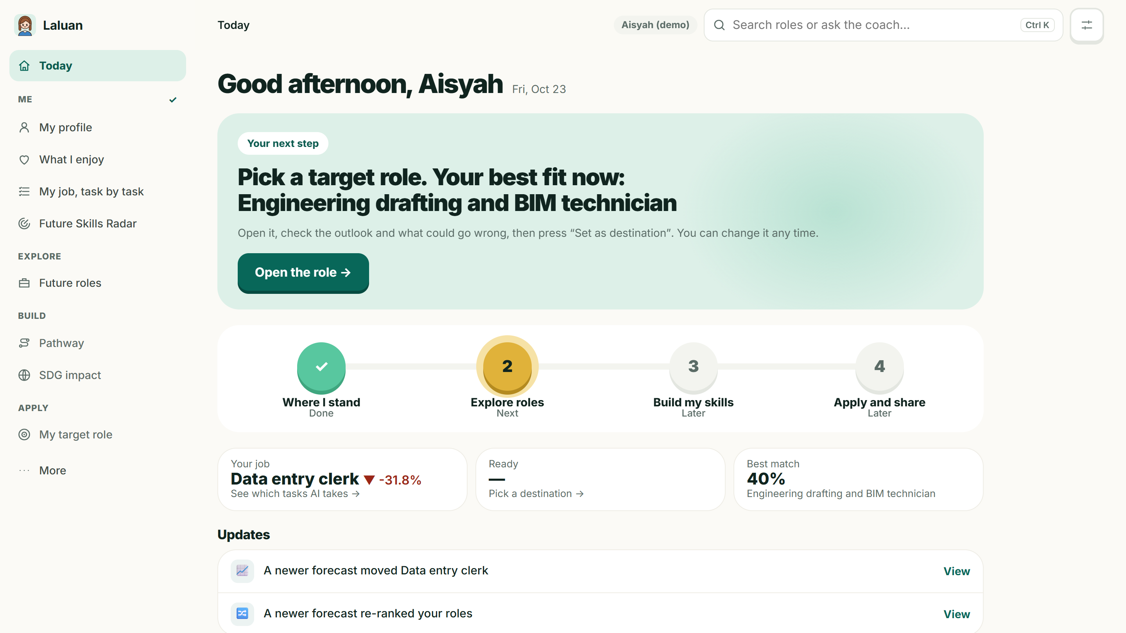
Judging Laluan? Open the demo profile in one click → laluan-psi.vercel.app
LALUAN
See where your career goes before AI changes it.
Laluan proposes. You decide.
Every number shows its working.
A career GPS for Malaysian workers and students in the AI era.
Made in UTM · XMUM Hackathon 2026 · Domain 1: Aiversecity Future-Ready Workforce
Notes:
This is Laluan, Malay for "path": a career GPS for Malaysian workers and students. It shows where your career is heading before AI changes it, proposes a route, and leaves the decision to you. Every number in it opens to its source.

Slide 2



AI reached the desk before the training did.
THE CURRENT REALITY
Problem-Solution Fit · 25%
56%
26%
600K+
use AI at work
have had AI training
need reskilling
of Malaysian professionals already use AI tools in their job.
Fewer than half of the people using AI were ever trained for it.
Malaysian workers who need reskilling within 3–5 years.
TODAY'S ANSWERS
Job portals show today's openings, not where jobs are heading.
Chatbots guess the future with no sources and invent courses.
Skills lists go out of date before they are published.
Sources: Hays Asia Salary Guide 2025 · MOSTI
02 / 17
Notes:
More than half of Malaysian professionals already use AI at work, but only about a quarter were ever trained for it, and MOSTI says over six hundred thousand workers need reskilling within five years. The tools people turn to don't help: portals show today's openings, chatbots guess with no sources, and skills lists go stale.

Slide 3
Clerical work shrinks; AI-adjacent work grows
WHY NOW
Problem-Solution Fit · 25%
Laluan forecast · 23 Oct 2026
22%
of formal jobs churn by 2030
170 million created and 92 million displaced worldwide (WEF).
600K+
Malaysian workers to reskill
within three to five years, says MOSTI. Most have little time or budget.
WHO WE BUILD FOR FIRST
Clerks and service staff facing AI tools, graduates choosing a first job, and the HR teams and career centres advising them.
Bars: Laluan's 2030 baseline outlook (WEF 2025 Fig. 2.3 adjusted by Malaysian signals, snapshot 23 Oct 2026). Cards: WEF 2025 Fig. 2.1 · MOSTI
03 / 17
Notes:
WEF expects clerical roles to shrink fastest. Laluan's own forecast, which adds Malaysian job ads, OpenDOSM and research signals to the WEF baseline, agrees: bank tellers, data-entry clerks and administrative assistants fall by a quarter or more by 2030, while AI-adjacent roles grow. The people in the first group have the least time and money to experiment, so that is who Laluan is built for first.

Slide 4

Same question. Very different answer.
ONE WORKER'S QUESTION
Problem-Solution Fit · 25%
Synthetic demo profile · live app
Aisyah, data-entry clerk in Shah Alam · 9 years of invoice entry · her team just adopted an AI invoice reader
Question
● Asking a chatbot
● With Laluan
Will my job exist in 2030?
A paragraph of opinion
−13% slow · −31% baseline · −52% fast, all sourced
Which tasks go first?
General guesses
3 of 5 core tasks: “AI does it” (O*NET tasks, team-labelled)
Where should I aim?
A list of popular jobs
AI operations specialist: 37% fit, +45% by 2030
Is the move worth it?
No figures
Grows in all 3 futures; pays RM 3,431 a month more
What do I learn first?
Courses that may not exist
6 catalogue courses, about 397 hours, all free
My personal details
Sent to the model as typed
Name, IC, phone, email removed before any AI reads them
Same answer for every name?
Not checked
Identical across 8 Malaysian names: 59 of 59 checks pass
Measured, not claimed: every figure on the right is from the live app and its approved forecast of 23 Oct 2026.
04 / 17
Notes:
Aisyah is a data-entry clerk whose team just adopted an AI invoice reader. A chatbot gives her a paragraph. Laluan shows her job shrinking in all three futures, which tasks AI takes first, and a best match, AI operations specialist, that grows 45 percent and pays more, with a free 397-hour plan. Every figure here comes from the live app.

Slide 5





Four stops from today's job to the next one.
THE PRODUCT
Problem-Solution Fit · Clarity
Aisyah's results from the live app
1 Where I stand
2 Explore roles
3 Build my skills
4 Apply and share
YOU
YOU
YOU
YOU
Upload a CV (PDF, Word, scan or photo), paste text, answer a short quiz, or speak.
Pick an AI speed (slow, expected, fast or custom), a year to 2030, and an SDG goal.
Set a destination, tick off courses as you finish, and prove each skill level.
Look at real openings, practise an interview, and share your plan.
LALUAN
LALUAN
LALUAN
LALUAN
Removes name, IC, phone and email before any AI reads it
Reads your skills; you confirm the list
Shows which of your job's tasks AI takes
Ranks 23 roles in 17 fields: 60% fit + 40% outlook
“Why this rank?”, forecast x-ray, pay, pros and cons
Tipping point: when your job turns declining
Ordered pathway from 38 checked courses: hours, RM cost
HRD Corp-claimable first for workers
Skill tree: 3 proof questions a level
Open jobs in Malaysia from current job ads
5-question interview practice with feedback
Career identity statement and a Future Card
AISYAH
Data entry clerk: −32% by 2030. 3 of 5 tasks: “AI does it”.
AISYAH
#1 Drafting & BIM technician: 40% fit, +35% by 2030.
AISYAH
3 courses, about 37 hours, 2 free. Biggest gap: CAD and BIM.
AISYAH
Interview practice opens with “why BIM?”, then CAD and BIM.
Also live: Future Skills Radar · AI coach that only suggests · re-planning when a forecast changes · HR and class views · EN, BM, 中文
05 / 17
Notes:
Laluan is one route with four stops. You start with a CV or a short quiz, and it shows which of your tasks AI takes: for Aisyah, three of five. It ranks 23 roles and explains each rank; her best is BIM technician at 40 percent fit and 35 percent growth. It builds an ordered, costed plan, 37 hours for her, and helps her apply with real openings and interview practice.

Slide 6
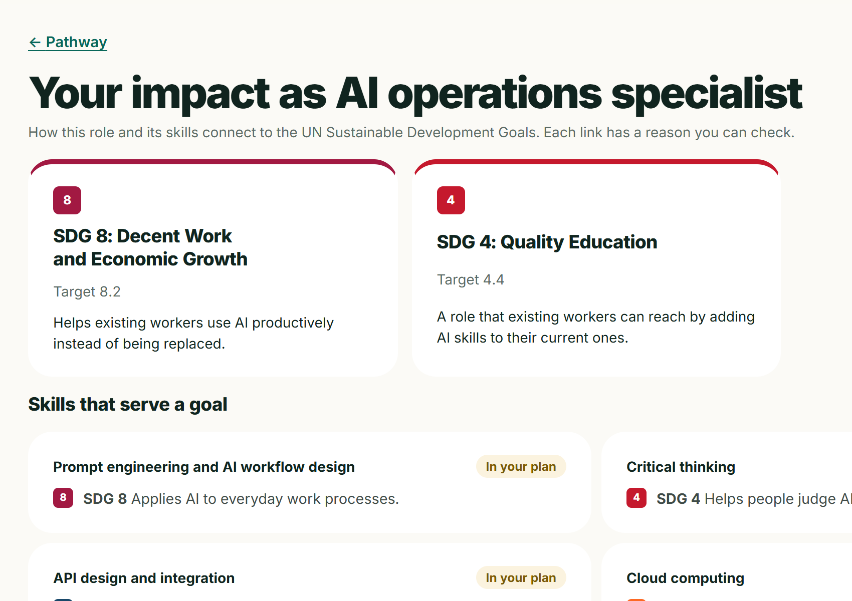



Built for SDG 4 and SDG 8, with a reason each
SDG IMPACT
SDG 4 · SDG 8 · Impact
4
SDG 4
Quality Education
A reason for every link
23 roles and 51 skills each link to an SDG target, with a sentence you can check.
4.4 Relevant skills for decent jobs
4.3 Affordable technical and vocational learning
The SDG lens
Pick a goal: “6 of your top 10 roles serve SDG 8”, the best role for it and the cost in fit and hours.
8
SDG 8
Decent Work and Economic Growth
LINKS PER GOAL
Impact across Malaysia
8
31
9
17
4
12
8.5 Full and productive employment
Which goals users are heading for, as totals; groups under 3 are hidden.
8.2 Productivity through innovation
16
5
12
5
13
4
12 goals linked in all; the counts are role and skill links in backend/data/sdg_map.json. Targets: United Nations, sdgs.un.org/goals.
06 / 17
Notes:
This is an SDG hackathon, so the SDG link is part of the product, not a logo. Laluan is built for SDG 4, skills for decent jobs, and SDG 8, decent work. Every one of the 23 roles and 51 skills links to an SDG target with a written reason. The SDG lens lets Aisyah pick a goal and see which roles serve it and what that choice costs her, and the impact view adds up which goals Laluan users across Malaysia are heading for.

Slide 7
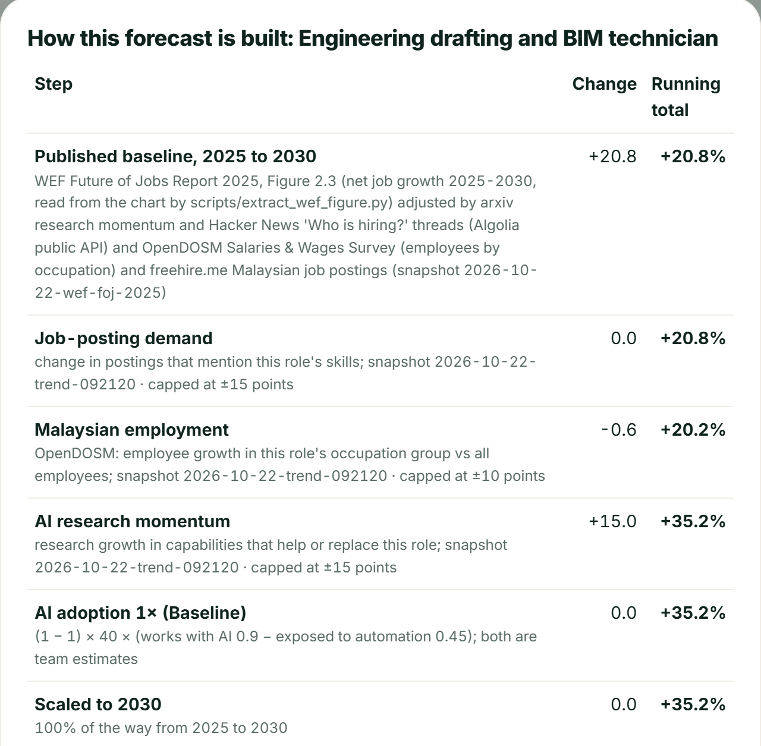



Every percentage opens to the steps behind it.
THE FORECAST ENGINE
Innovation & Creativity · 30%
Live x-ray · BIM technician
FIVE SIGNALS, EACH CAPPED
WEF Future of Jobs 2025
base
Published baseline by role, 2025 to 2030
Malaysian & global job ads
±15
Change in postings that mention the role's skills
OpenDOSM employment
±10
Growth of the role's occupation group in Malaysia
arXiv / OpenAlex research
±15
Momentum of AI capabilities that help or replace it
AI adoption scenario
0.5–2×
Slow, baseline, fast, or any speed from 0.5× to 2×
Rank = 60% skill fit + 40% outlook
80% ranges · backtest published · declining roles rank last
07 / 17
Notes:
This is the forecast x-ray from the live app. Each role's outlook starts from the WEF baseline, then adds capped points from job ads, Malaysian employment and AI-research momentum, under the AI speed you choose. A transparent formula, not a black box, so anyone can check every step, with ranges and a published backtest.

Slide 8
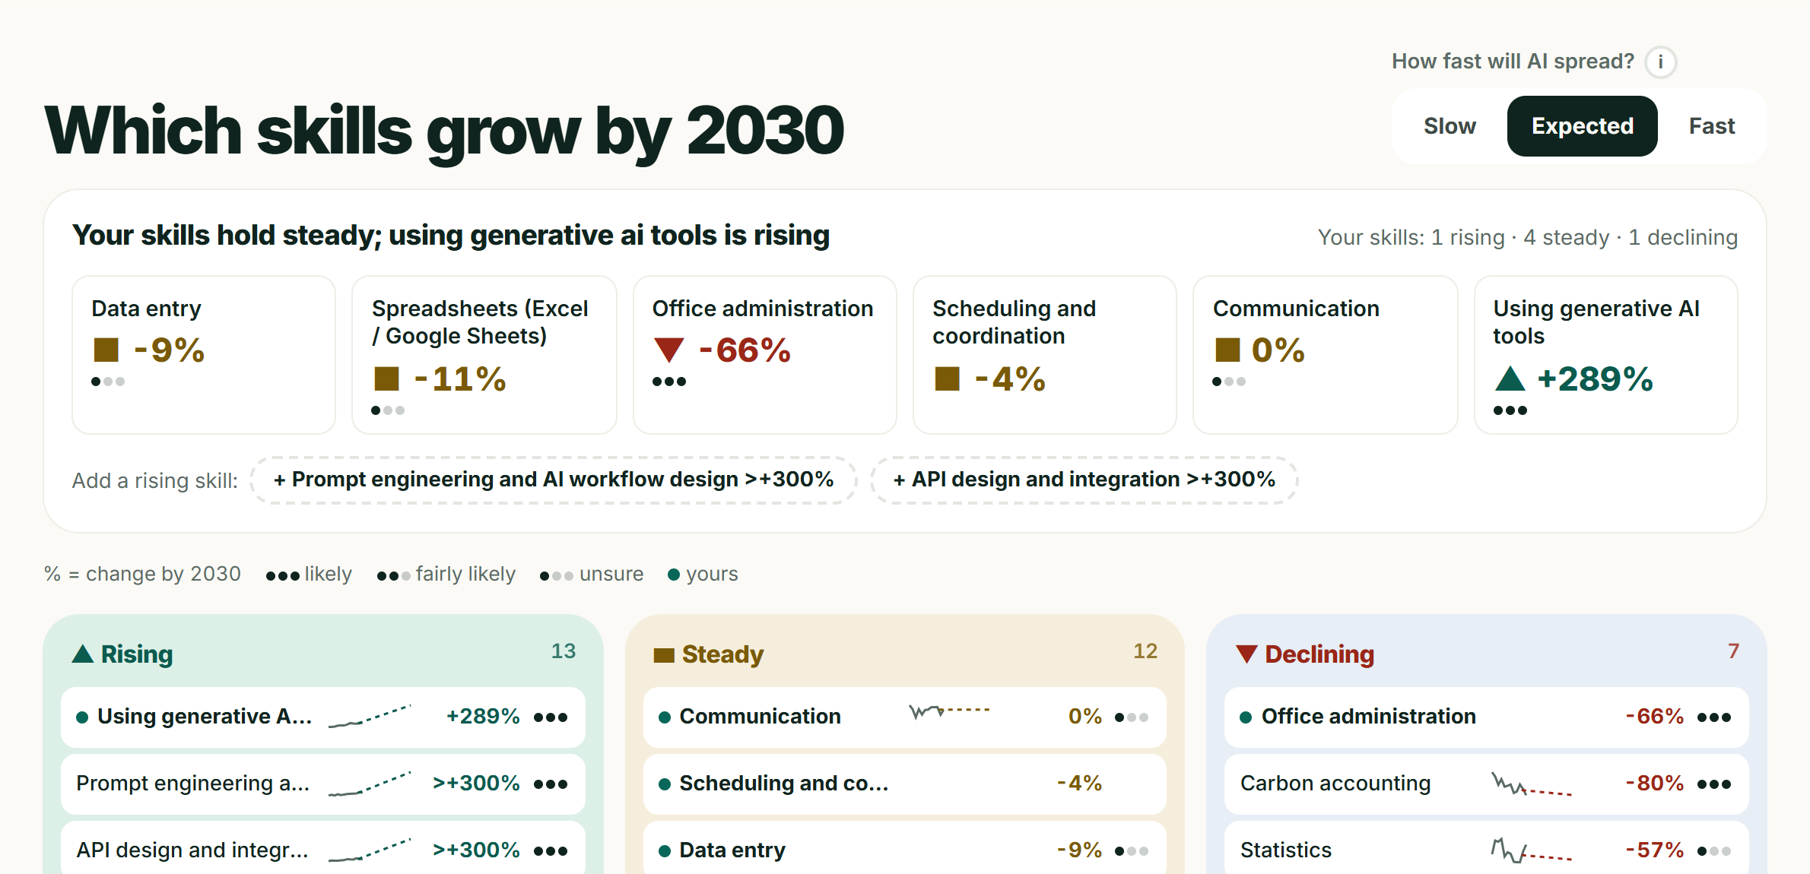





Public signals, approved by a person each time
THE TREND SIGNAL LAYER
Innovation & Creativity · 30%
AI research
arXiv, OpenAlex fallback, papers with a Malaysian institution
Malaysian job ads
freehire.me: postings per role and per skill, newest openings
Global hiring
Hacker News “Who is hiring?” threads
Developer attention
Stack Overflow, GitHub, npm and PyPI activity
Malaysian statistics
Collect
Forecast
Wait
Approve
Live
OpenDOSM labour force, sector employment, salaries, prices
weekly, GitHub Actions
to 2030, 80% ranges
snapshot pending
by a named person
dated on Sources
If a source fails, the last approved forecast stays live and arXiv falls back to OpenAlex. Every snapshot, and who approved it, is listed on the Sources page.
08 / 17
Notes:
The forecast is only as good as its signals, so we use many public ones on top of the WEF baseline: research papers, Malaysian and global job ads, developer activity and Malaysian official statistics. A weekly job collects them and builds a new dated forecast, but nothing changes for users until a person approves it by name, after seeing a before-and-after table. If collection fails, the last approved forecast stays live.

Slide 9
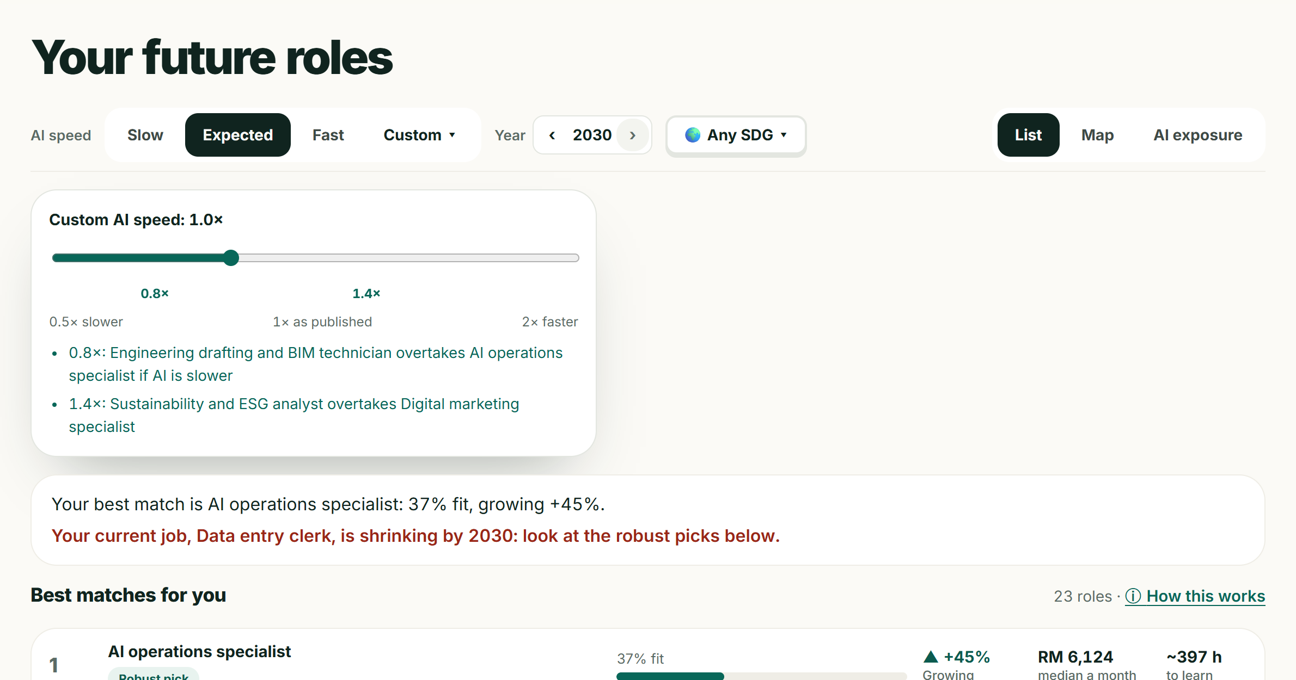
Three futures, and the speed where hers flips
THREE FUTURES
Innovation & Creativity · 30%
Live app · Aisyah demo
Her best match in three futures
+29%
+45%
+65%
slow
baseline
fast
TIPPING POINT
Below 0.8× AI speed, BIM technician overtakes AI operations specialist. Drag the slider from 0.5× to 2× to see it.
Why this rank? It is arithmetic
0.6 × skill fit + 0.4 × outlook + preference = 0.48
Robust pick: top five in all three scenarios.
Figures from the live app's approved forecast of 23 Oct 2026. Outlooks are estimates with 80% ranges, labelled Likely or Uncertain.
09 / 17
Notes:
Nobody knows how fast AI will spread, so Laluan never shows one future. Aisyah's best match, AI operations specialist, grows 29, 45 or 65 percent depending on the AI speed, and stays in her top five in every scenario. She can drag her own AI speed: below 0.8 times, the BIM technician role overtakes it. And every rank opens to its arithmetic: 60 percent skill fit, 40 percent outlook, plus a small preference bonus.

Slide 10
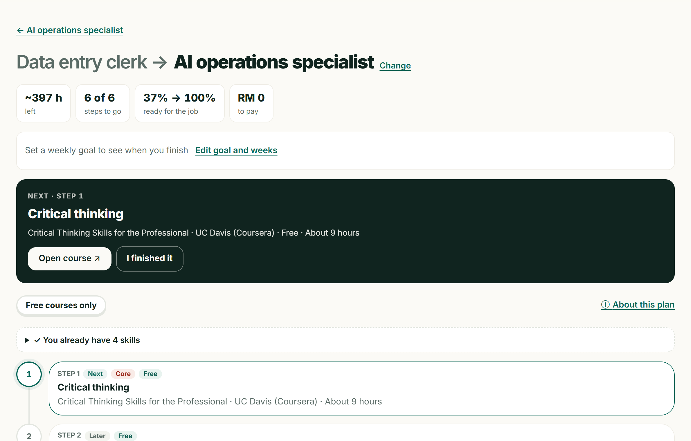



A plan she can start this week: 397 h, RM 0
THE PATHWAY
Problem-Solution Fit · 25%
Live app · Aisyah → AI operations specialist
6
397 h
RM 0
37%
steps
of learning
all free or free to audit
ready now, 100% at the end
Courses only from the catalogue
38 link-checked courses, 32 free or free to audit, with hours, RM price and the date checked.
HRD Corp first for workers
Claimable programmes come first; students get free routes.
Tick, then prove it
Readiness and Today update at once; three questions prove each skill (practice, not a certificate).
Into her calendar
A weekly goal says when she'll be ready; download a calendar file.
Her plan: Critical thinking → Cloud → Data visualisation and SQL → Python → Project management → Prompt engineering and APIs.
10 / 17
Notes:
Once Aisyah sets a destination, Laluan builds an ordered plan from a catalogue of 38 link-checked courses: six steps, about 397 hours, and zero ringgit, because every course is free or free to audit. For workers, HRD Corp-claimable courses come first. She ticks a course when she finishes and her readiness rises, proves each skill with three quick questions, and can put the plan straight into her calendar.

Slide 11
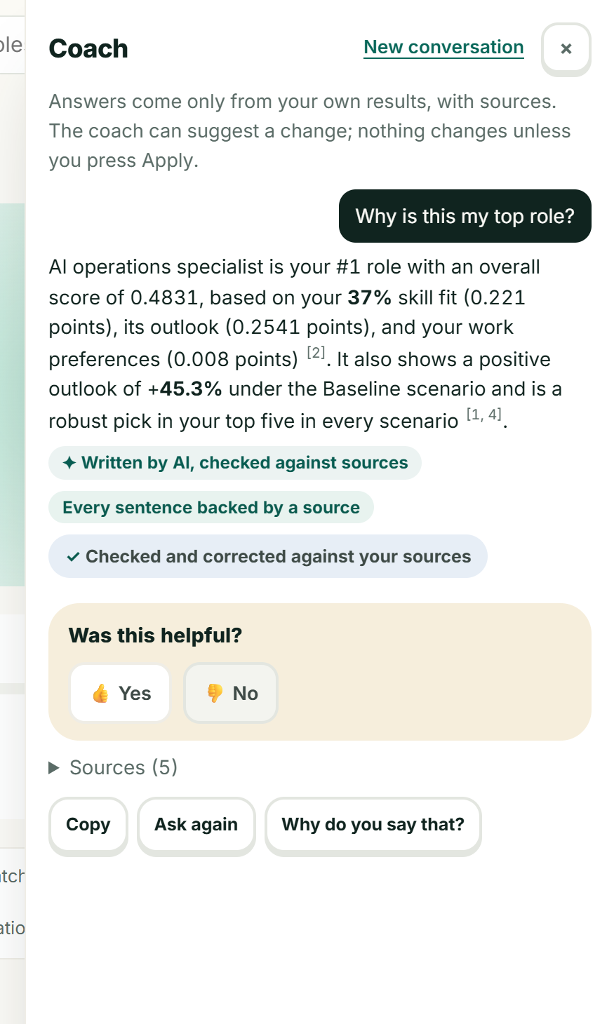



A coach that cites, checks itself and suggests
AI COACH
Human-centred AI · Safety
Numbered sources
Answers only from her own results, each claim tagged [1], [2]…
Every sentence checked
Unsupported sentences are rewritten or removed, and the answer says so.
Details removed first
Names, phone, email and IC numbers never reach the model.
Trick prompts refused
“Ignore your instructions…” gets a calm refusal; nothing changes.
Suggests, never acts
A change of scenario or goal waits for her to press Apply.
Models: Qwen2.5-7B on RunPod reads CVs · Gemini writes answers · no key: rules
11 / 17
Notes:
The coach is where most career chatbots go wrong, so ours is fenced in. It answers only from Aisyah's own results, with numbered sources, and checks every sentence against them: unsupported sentences are rewritten or removed, and the answer says so. Her name and phone number are removed before the AI sees the question, trick prompts are refused, and it can only suggest a change: nothing moves until she presses Apply.

Slide 12
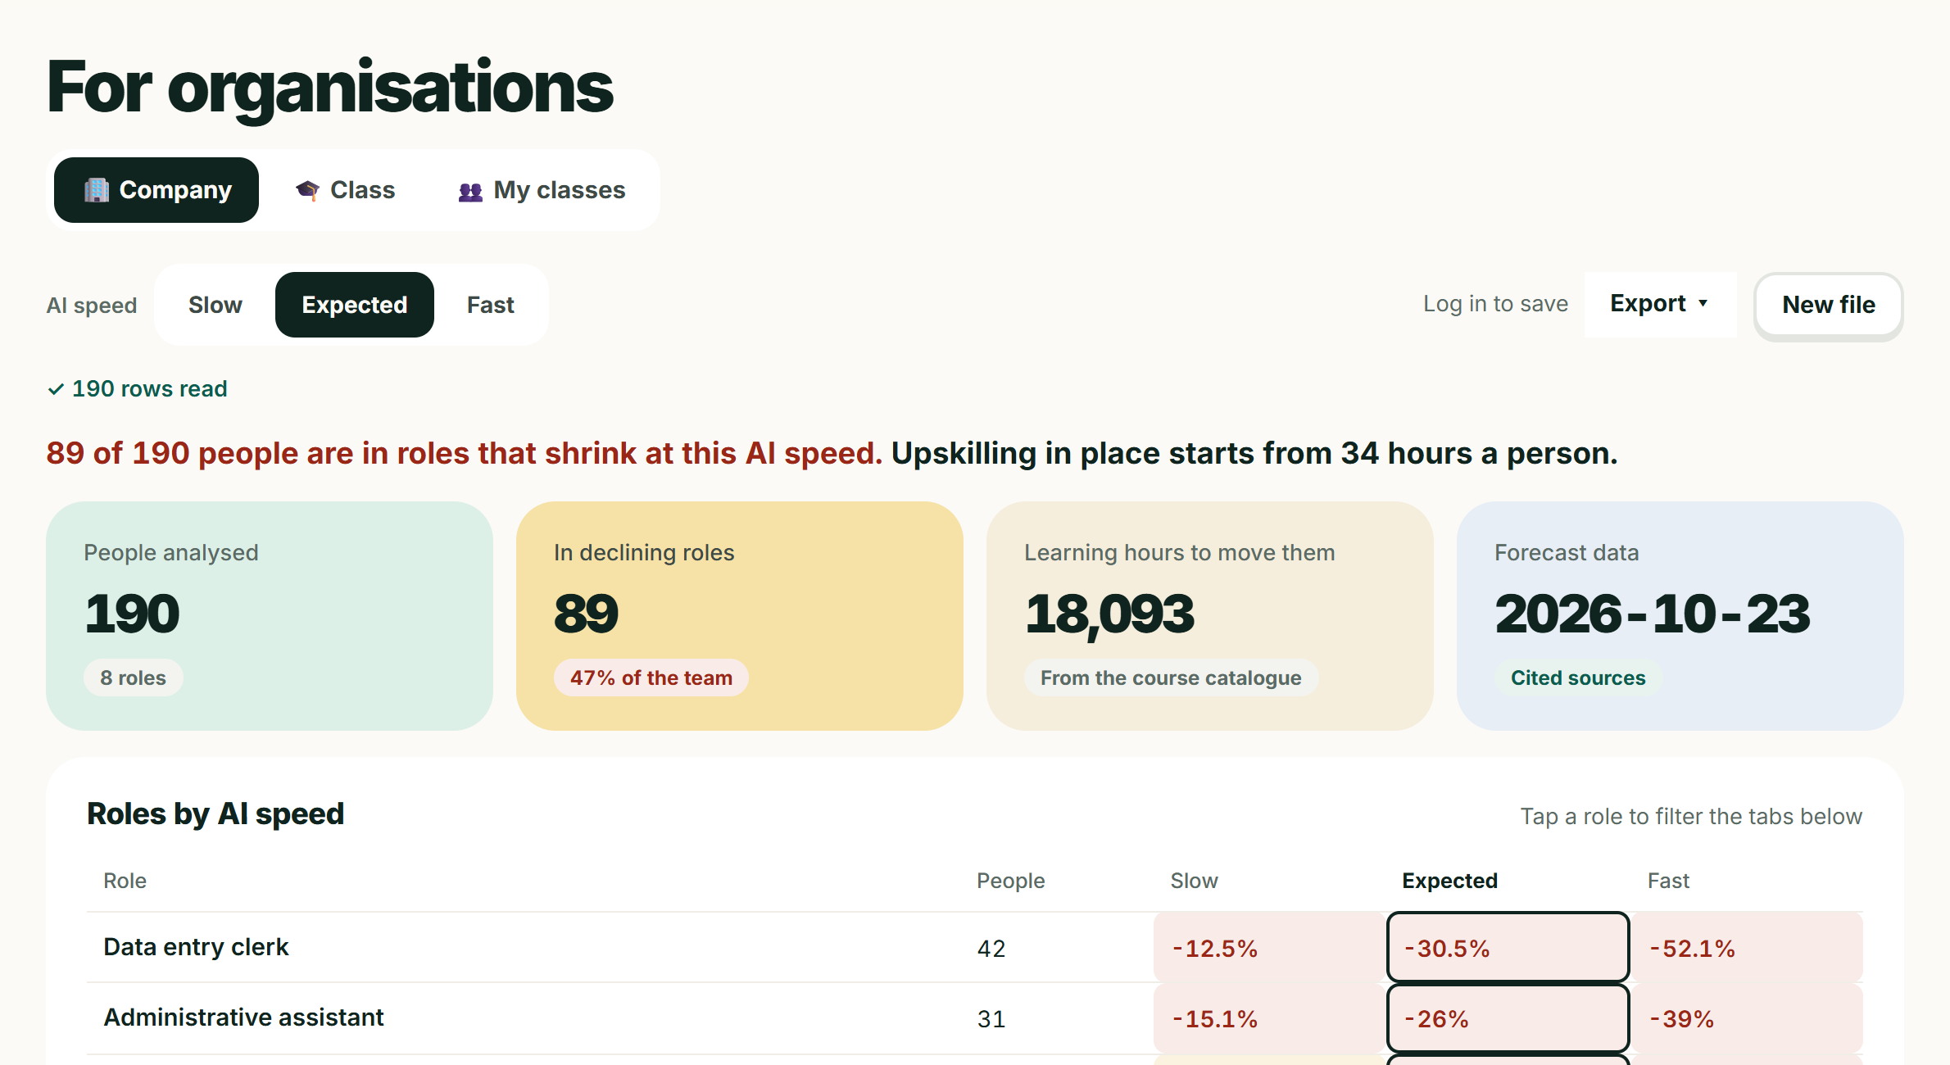


For HR teams and career centres: totals only
FOR ORGANISATIONS
Problem-Solution Fit · Impact
Synthetic sample data
HR and L&D teams
190 staff in the sample company; 89 in roles that shrink.
Cheapest moves: upskill in place, or the nearest growing role.
HRD Corp training-grant plan; CSV and PDF export.
TVET and university career centres
52 students in 5 programmes; the top shared gap is analytical thinking (20 students).
Counsellors see only what students choose to share.
Totals only. Files with name, email, IC, phone or staff-ID columns are refused; groups under 3 are hidden; Laluan never ranks people for hiring.
12 / 17
Notes:
The same engine works for groups. An HR team loads an anonymous file of roles and skills: in the sample company of 190 staff, 89 are in roles that shrink, and Laluan finds the cheapest reskilling moves with an HRD Corp training-grant plan to export. A career centre gets the same view for a class. Results are totals only, and files with names, emails, IC numbers or staff IDs are refused.

Slide 13

Four tiers, one approval gate.
SYSTEM ARCHITECTURE
Feasibility of Build · 25%
Deployed · laluan-psi.vercel.app
USERS
WEB APP · VERCEL
API · FASTAPI IN DOCKER ON RENDER
DATA
Worker or student
Intake
CV · OCR · PII scrubber
Matching
Rank · x-ray · tipping
Supabase Postgres
Profiles · progress · trend snapshots · review decisions
HR / L&D team
React 18 + TypeScript
Vite build · installable
EN · BM · 中文
Google login (Supabase)
Strict CSP · Sentry
Pathway
Courses · grounding
Coach & interview
Guardrails
Career centre
Reference data in git
23 roles · 38 courses · skills · SDG links · translations
Workforce & class
Totals only
Admin review
Approve / reject
Admin reviewer
Rate-limited
per IP, per profile, in total
AI providers (optional)
Gemini · RunPod: Qwen CV reader, Whisper, OCR
Scrubbed text only.
If AI is down, rules answer.
TREND
ENGINE
Public sources
WEF · job ads · DOSM
Collectors
Weekly / on demand
Dated snapshot
Never edited
Forecast 2030
3 futures · ranges
Person approves
Before/after table
Live: rankings update
Saved to Postgres
13 / 17
Notes:
Users reach a React app on Vercel in three languages, which calls a FastAPI service in Docker on Render with six modules. Profiles and trend snapshots live in Supabase Postgres; roles and courses are versioned in git. AI models are optional and only see scrubbed text. Along the bottom, the trend engine builds dated forecasts, and nothing reaches the rankings until a person approves it.

Slide 14
Our hardest risk is data, so we measure it
HARDEST RISK
Feasibility of Build · 25%
14 / 19
59 / 59
500+
0
clear trends held direction
fairness checks pass
backend tests
CVs stored
vs 12 for “everything rises”; sizes still rougher than “no change”
3 profiles and 5 CVs under 8 Malaysian names: identical results
run on every push, with 63 frontend and accessibility tests
read in memory; personal details removed before any AI
IF SOMETHING FAILS
Noisy trend
shrunk towards no change, shown with 80% ranges
Data source down
the last approved forecast stays live; arXiv → OpenAlex
RunPod cold or down
Qwen → Gemini on scrubbed text → skills dictionary
No AI key at all
matching, forecasts and pathways still run: rules and templates
Backtest of 21 Oct 2026, published on the Radar. Fairness check public at /api/fairness and on the Sources page; it runs in CI.
14 / 17
Notes:
Our hardest risk is the trend data: job ads and paper counts are noisy. So we measure it in the open. Our backtest says the direction of change held for 14 of 19 clear trends, better than assuming everything rises, though sizes are still rougher than a no-change guess, and we publish that. Fairness, tests and fallbacks are checked on every push, and the app keeps working with no AI key at all.

Slide 15
What is not done yet, and what comes next
WHAT COMES NEXT
Feasibility · Clarity
Not done yet
Next, in Phase 2
• Demo people, CVs, companies and classes are synthetic
• Human scoring with a counsellor is not recorded yet
• Forecast sizes are rougher than a “no change” guess
• 23 roles and 38 courses: a starting catalogue
• Free hosting wakes up slowly after idle hours
• Run the review kit with a counsellor and native BM and 中文 speakers
• Pilot the class view with a TVET or university career centre
• Add Malaysian providers and HRD Corp programmes
• Sharpen forecast sizes, not just direction
• Always-on hosting, no wake-up delay
PHASE 2 TARGETS, FROM OUR PROPOSAL
≤ 5 min
≥ 80%
100%
≥ 70%
≥ 70%
CV to a costed plan
skill-reading recall
recommendations cited
plan steps free
counsellor agreement
15 / 17
Notes:
We want to be honest about what is not done. Everything is synthetic, the human evaluation with a counsellor is not recorded yet, and forecast sizes are still rough. In Phase 2 we would run the review kit with a career counsellor and native speakers, pilot the class view with a career centre, grow the catalogue, and hold ourselves to the targets at the bottom.

Slide 16
Four people, one route
THE TEAM
Made in UTM
TH
SS
CC
TY
Tan Hong Sheng
Shirlyn Siew Yu Jye
Chek Chee Him
Thim Yee Song
Team leader · Product manager
UI/UX designer
Frontend developer
Backend developer
@tanhongsheng050204-code
@shirlynsyj83
@thebalanceder
@song-0707
BUILT WITH
RunPod 3 endpoints: Qwen2.5-7B, Whisper, OCR
Replit clean cloud test environment
Gemini coach, interview feedback, summaries
Supabase Postgres, row-level security, login
Vercel + Render web app and Docker API
GitHub Actions tests and weekly refresh
16 / 17
Notes:
We are Made in UTM, four students from Universiti Teknologi Malaysia. Tan Hong Sheng led product, Shirlyn designed the experience, Chek Chee Him built the frontend and Thim Yee Song the backend. We built Laluan with the sponsor tools: RunPod runs our open models and OCR, and Replit was our clean test environment.

Slide 17




People stay in charge. Try it live today.
TRUST & PROOF
Human-centred AI · Impact
Human approval
Privacy by design
Fairness, tested
Nothing invented
Trend updates wait for a person to approve, or reject with a reason.
Names, IC, phone and email removed before AI reads text. CVs never stored.
Run under 8 Malaysian names; rankings must be identical.
Courses only from a checked catalogue; AI text checked against sources.
59 / 59
500+
63
0
fairness checks pass
backend tests on every push
frontend and accessibility tests
CVs stored
See where your career goes
before AI changes it.
Open the demo profile
laluan-psi.vercel.app
4
SDG 4 · Quality Education
8
SDG 8 · Decent Work
github.com/tanhongsheng050204-code/SDC-HACKATHON-2026-XMUM---Made-In-UTM
17 / 17
Notes:
People stay in charge: trend updates need a named approval, personal details are removed before any AI reads them, and no course can be invented. Every profile is run under eight Malaysian names and must rank identically, 59 checks out of 59. Laluan is live today: open the demo profile and see where Aisyah's career goes. Thank you.

