Slide 1
Telecommunication Network Routing System occupying Minimum Number of Channels
Tani Hossain
Fatma Noor
Kushal Khatri
Dhruval Patel
Jahnavi Boya
Mounika Koduri

Slide 2
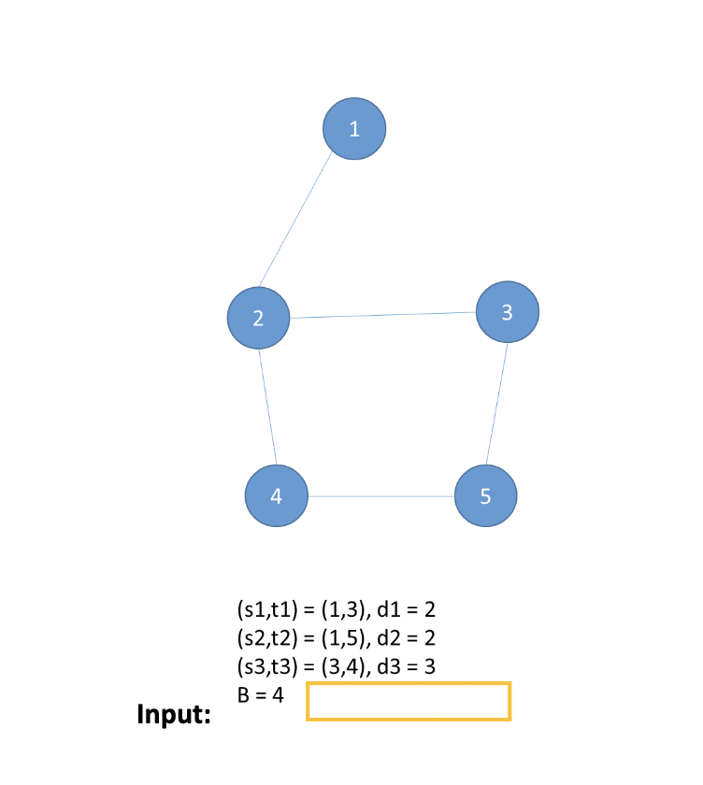
Problem parameters
Telecommunication optical network represented by a multigraph G
Each edge of the graph represents a signal transmission channel with a bandwidth B
k transmission demands
Each demand i has
a source s_{i}
a destination t_{i}
size d_{i}

Slide 3
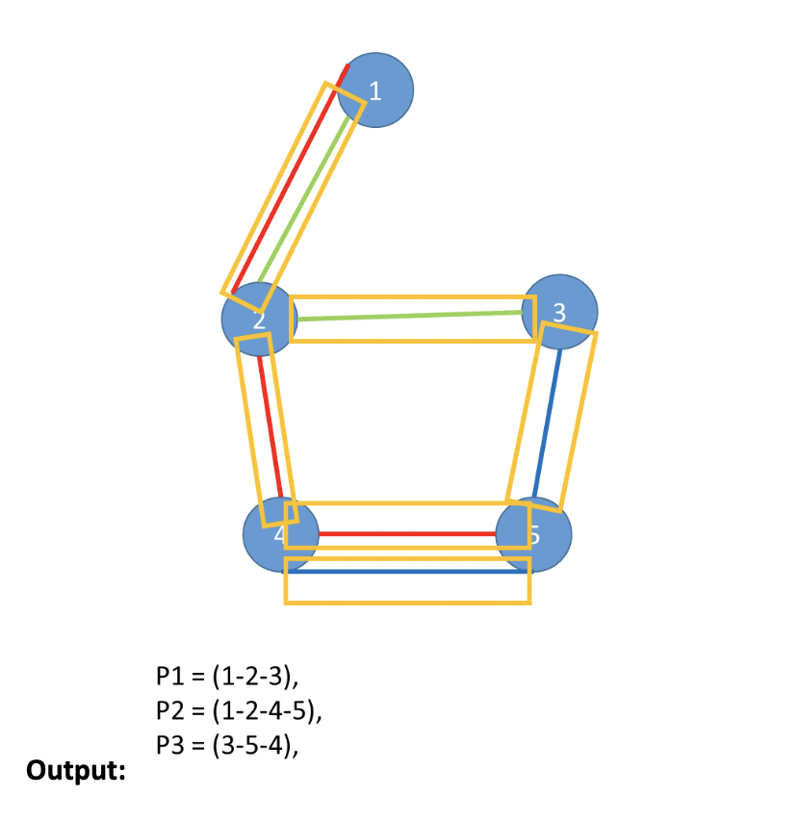
Problem statement
Routing of all transmission demands, in such a way that number of used transmission channels are minimum

Slide 4
Assumptions
The optical network will be a connected graph: there will always be a path between source and destination
The network graph edges are undirected
Demand size will always be less than Bandwidth
Multiple demands possible from same source and destination
There can be multiple paths for each transmission demands

Slide 5
Problem division – Two parts
Path Finding
Bin Packing

Slide 6
Why Bin Packing?
Let’s Assume,
Channels with fixed bandwidth as bins with fixed capacity
Transmission demands with different sizes as tasks with various durations
Need to route the demands in such a way so that minimum number of Channels/Bins needed

Slide 7
Initial Naive approach
Took any of the existing path between source and destination
Generated cost list for all the demand paths
Size of cost list: ∑(# of edges in path) for all demands
Passed the whole cost list to Bin Packing Algorithm
Find number of channels needed

Slide 8
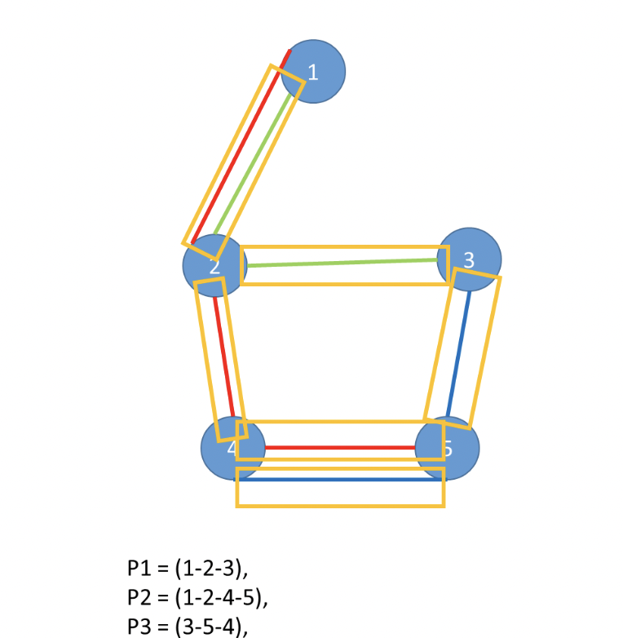
Challenges with Initial approach
For the Given Graph:
Expected output = 6
Output Received = 5

Slide 9
Analyzing Initial approach
List of sizes = [2, 2, 2, 2, 2, 3, 3]
Capacity = 4
Bins = [[2, 2], [2, 2], [2], [3], [3]] => 5
Channels = [[2, 2], [2], [2], [2], [3], [3]] => 6
=>2
=>2
=>3

Slide 10
deciding factors
Edges not shared by demands will always need a whole channel, even if channel is not filled to capacity
We need to apply bin packing only to shared edges
Number of channels required can differ largely based on the selected paths
Therefore, path selection is the most critical part for solving this problem

Slide 11
Two Approaches
Greedy Algorithm
Local Search

Slide 12
Approach 1 – Greedy Algorithm
A greedy algorithm is an algorithmic strategy that makes the best optimal choice at each small stage with the goal of this eventually leading to a globally optimum solution.
Here, we have taken shortest path from source to destination for each demand

Slide 13
Approach 1 – Steps
Select shortest path for each demand and store it
To find number of transmission channels for the selected path list:
Find overlapping edges
List costs for each overlapping edge
Do bin packing for edge overlapping edge cost list
Add number of acquired bins for edge to # of channels
Add 1 channel for each Non-Overlapping edge
Return total # of channels

Slide 14
Approach 2 – Local Search
Local search is a heuristic method for solving computationally hard optimization problems
The local search algorithm explores and evaluates different solutions (search space) by applying local changes until an optimal solution is achieved or certain iterations are computed.
Hill climbing, simulated annealing, tabu search are some of the local search algorithms
Here, we are using hill climbing approach for finding minimum # of channels

Slide 15
hill climbing approach
Hill climbing algorithm is a local search algorithm which continuously moves in the direction of increasing elevation/value to find the peak of the mountain or best solution to the problem.
It terminates when it reaches a peak value where no neighbor has a higher value.
A node of hill climbing algorithm has two components which are state and value.
Local maximum is a state which is better than its neighbor states, but other better states exist
Global maximum is the best possible state of state space landscape.
Current state is a state in a landscape diagram where an agent is currently present.

Slide 16
Hill climbing Components
State: Index of paths to be selected from all possible paths
Value: List of selected paths for each iteration
Neighbors: Any state other than the current state
Optimal Neighbor: neighbor whose objective function value is less than current state
Objective Function(Min): Calculating number of channels for selected path
Iteration bound: Number of times to run the iterations

Slide 17
Approach 2 – Steps
Find all possible paths for each demand
At first, Select one path for every demand randomly – this is our initial state value
Find number of transmission channels for the selected path list
Get optimal neighbor for the current state by comparing objective functions
If different current state and neighbor state have same objective value, take random neighbor state to avoid local maxima
If neighbor state is same as current state terminate because that means no other optimal solution is left
Otherwise, terminate when exceeds the iteration bound

Slide 18
Input and visualizing outputs
Random input generator for testing
Generated Random graph
Generated number of demands and demand configuration randomly based on the given graph
Output
Showing necessary steps for each algorithm
Finally showing number of channels acquired from both the approaches

Slide 19
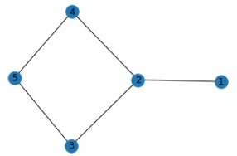
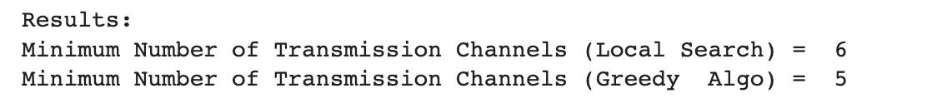
Output for Given Graph
Shortest Path List for Greedy: [[1, 2, 3], [1, 2, 3, 5], [3, 2, 4]]

Slide 20
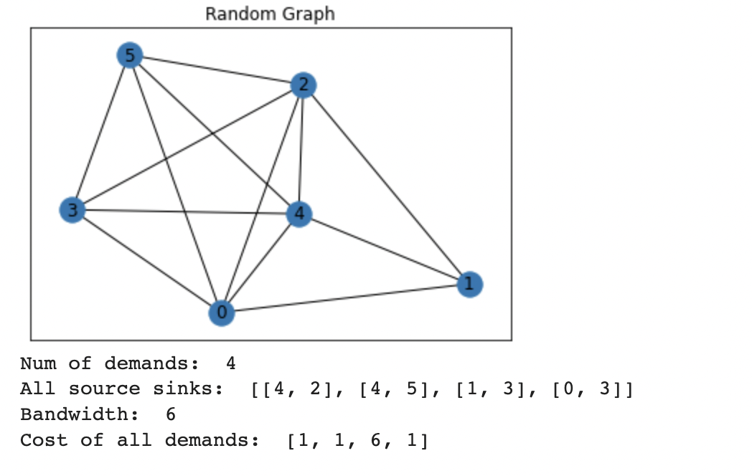
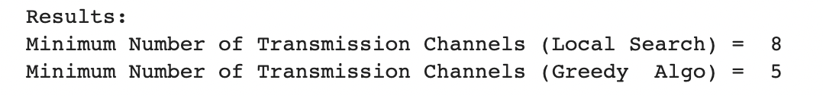
Some Example results

Slide 21
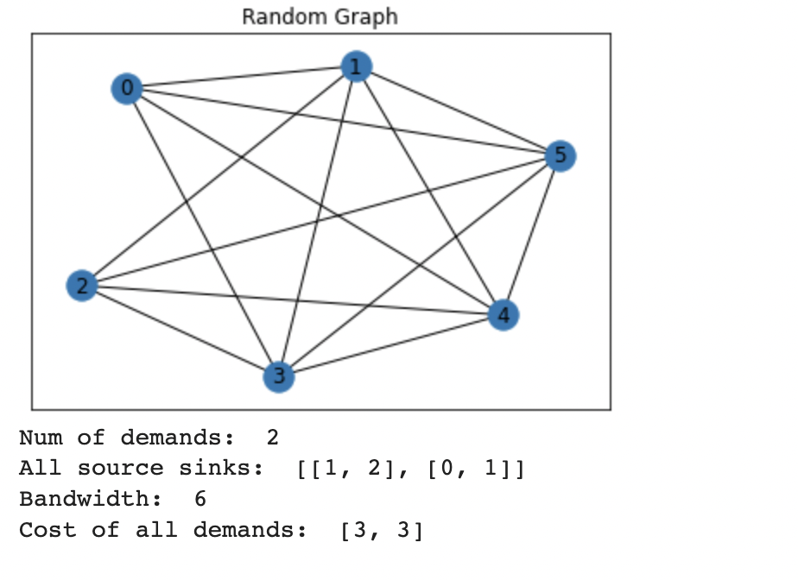
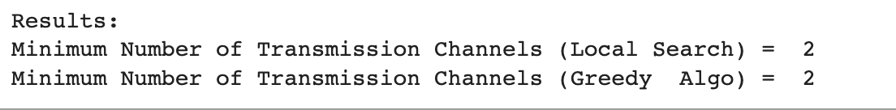
Some Example results

Slide 22
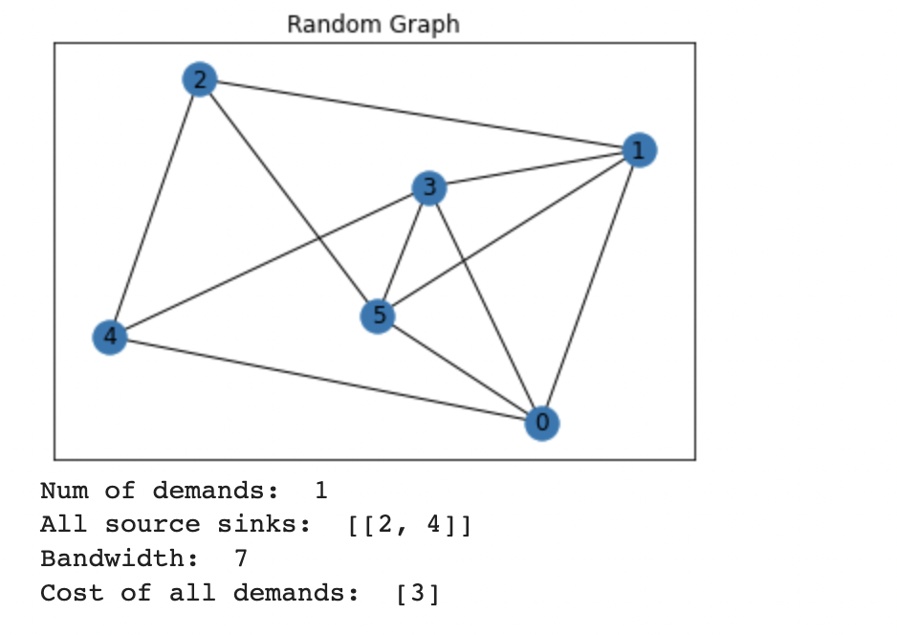
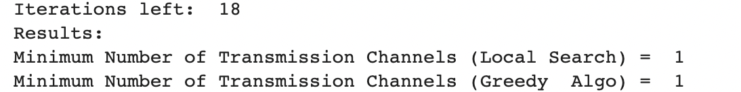
Some Example results

Slide 23
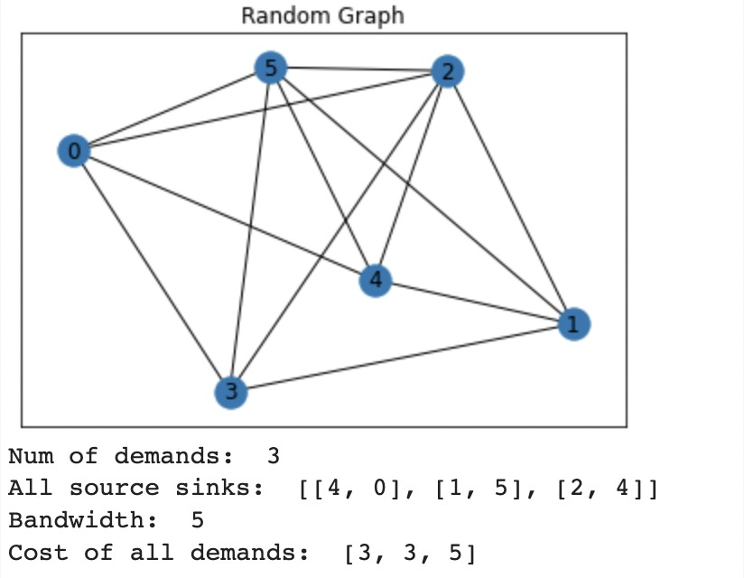
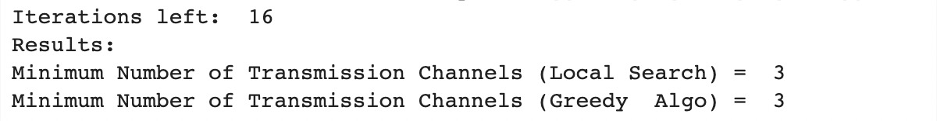
Some Example results

Slide 24
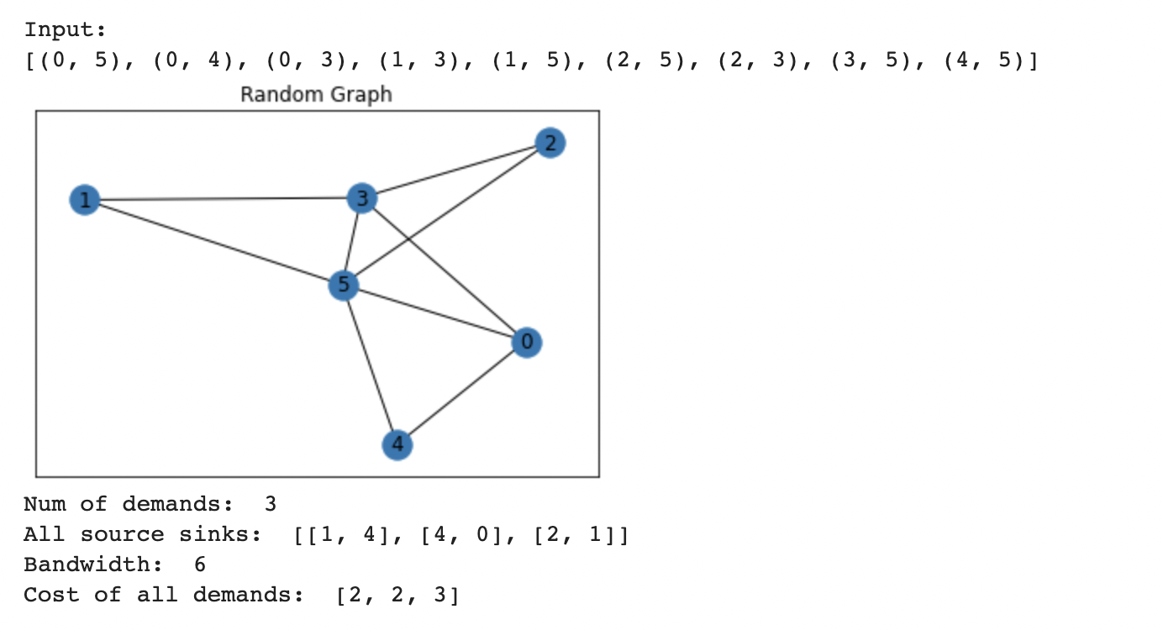
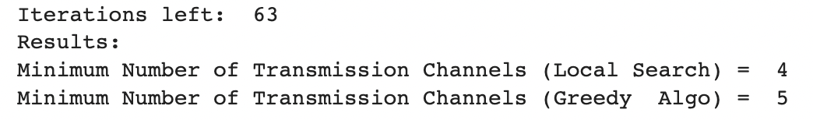
Some Example results
Local search solution state path: [[1, 5, 0, 4], [4, 0], [2, 5, 1]]
Greedy Algorithm Shortest path: [[1, 5, 4], [4, 0], [2, 3, 1]]
Local search does not take shortest path still gives optimal solution

Slide 25
Comparison between Two approaches
Approach 1
Approach 2
Greedy approach uses momentary optimal combination
Assumes current solution is optimal so, no extra iterations needed
Generates consistent results every time for the same set of input
Results can vary depending on which shortest path we select if there exist multiple shortest paths
Local Search checks a number of combinations of paths
Local search takes much more iteration to give a result compared to greedy in this case
Solution can defer for the same set of input as random states are taken every time
Results can be same even if we start with different initial states

Slide 26
Conclusion
It is not guaranteed that any of the approaches used will give optimal solution
Local search will converge and give us optimal solution if it completes
However, to complete local search and get global maxima it takes a lot of time
An iteration bound was introduced to terminate the search after a certain time
When local search is terminated by iteration bound, there remains a possibility of getting local maximum
Therefore, in our case we will suggest Greedy Approach as it consumes less time/iteration and produces same output for same input
Nevertheless, for more complicated and larger graphs Local search will be better than Greedy Algorithm
The larger the iteration bound is the better the local search outcome will be

Slide 27
Implementation
Install binpacking before executing the code
Two versions of the code added
For given graph
For random graphs
Each version includes both the approaches
Google Colab Link

Slide 28
Thank you

