Slide 1

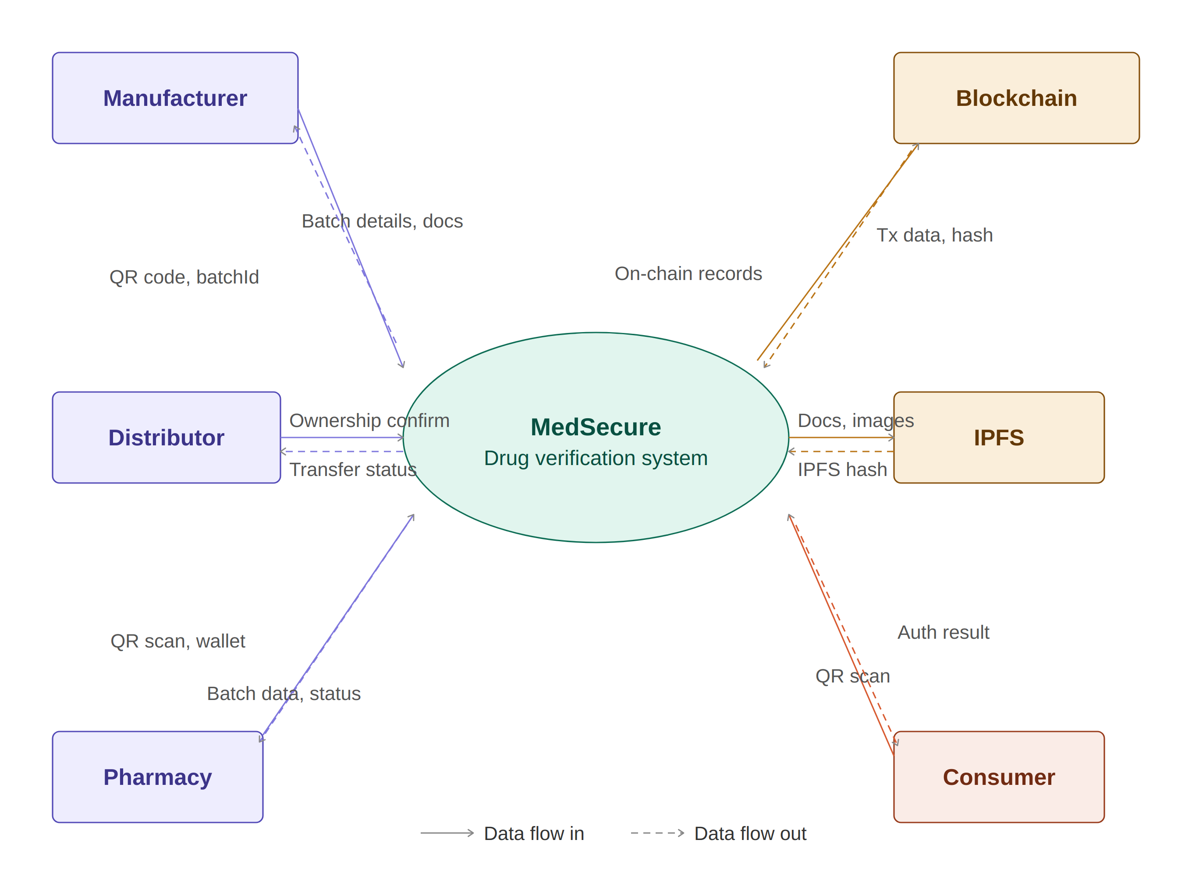
MEDSECURE: BLOCKCHAIN & AI-POWERED
COUNTERFEIT MEDICINE DETECTION
Brief Description:
MedSecure is a final-year B.Tech project that tackles the growing problem of fake medicines in the supply chain. It uses Ethereum blockchain to permanently record every medicine batch from the moment it is made, through distributors and pharmacies, all the way to the consumer. Every transfer of ownership is locked on-chain — meaning nobody can alter the history. A computer vision module (powered by OpenCV) compares live packaging photos against the original manufacturer images to detect counterfeits. Consumers simply scan a QR code on the medicine box to instantly verify whether it is genuine — no technical knowledge required.
Principle:
The system's core relies on Ethereum smart contracts that enforce strict rules — only the current owner of a medicine batch can transfer it to the next party. Medicine data and packaging images are stored on IPFS (a decentralised file system), with only the reference hash written on-chain. A QR code is generated for each batch; once a unit is sold, the QR is permanently locked to prevent re-use by counterfeiters. The computer vision module uses ORB feature matching and SSIM comparison to produce an authenticity confidence score — above 75% means genuine.
Beneficiaries:
Benefits:
Consumers buying medicines
Pharmacies & retail chemists
Medicine manufacturers
Distributors & wholesalers
Drug regulatory authorities
Healthcare organisations
Protects patients from counterfeit drugs
Full, tamper-proof supply chain history
Instant QR-based verification for anyone
AI-powered packaging fraud detection
No single point of failure (decentralised)
Helps regulators trace recalled medicines
Technologies Used:
Ethereum & Solidity
Smart contracts on Sepolia testnet via Foundry
IPFS
Decentralised document & image storage
Next.js + Viem + Wagmi
Web frontend with MetaMask wallet integration
OpenCV (Python)
ORB feature matching + SSIM for packaging auth
PostgreSQL
Off-chain audit logs, QR scan & session records
Solidity Smart Contract
On-chain role-based access, lifecycle state machine
Department | B.Tech CSE (8th Semester)
College | ITM SLS Baroda University, Vadodara
Team Members | Tanisha Katariya | Vraj Sondagar | Ayushi Patel | Krutang Panchal
Guide | Prof. Shivangi Mateida, SoCSET, ITM SLS Baroda University, Vadodara

