Slide 1
Introduction to Programming
Veriables and Constants
Demo lecture #2
Presented By
Tania Malik

Slide 2
Agenda
Veriables
Constants
Data Type

Slide 3


Slide 4
Can we work with Data that is randomly float arround?

Slide 5
Can we work with Data that is randomly float arround?
  The answer is NO

Slide 6

Variables

Slide 7
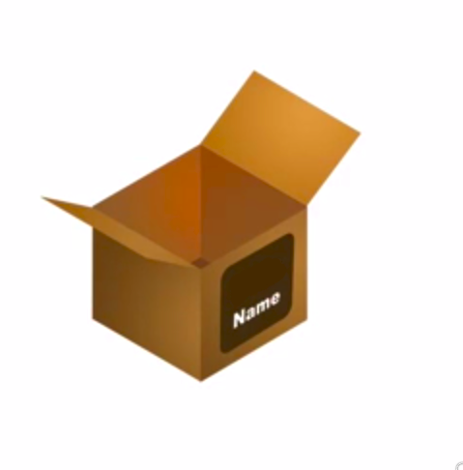
Variables

Slide 8
Variables
“Tania”

Slide 9
Variables
“Tania”

Slide 10
Variables
“Malik”

Slide 11
Variables
“Malik”

Slide 12
Constants
“Maalik”

Slide 13
Constants
“Maalik”

Slide 14

Constants
Malik
“Maalik”

Slide 15

Data Type

Slide 16

Data Type

Slide 17
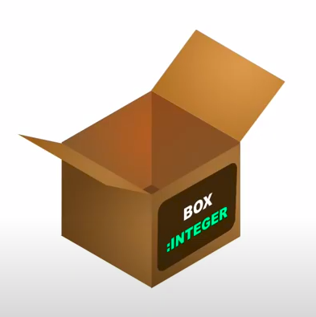
Data Type

Slide 18
Data Type

Slide 19
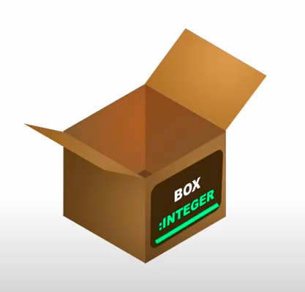
Data Type
100

Slide 20
Data Type
100

Slide 21
Data Type
200

Slide 22
Data Type
200

Slide 23
Data Type
“Mario”

Slide 24
Conclusion
Variable and constants in programming are the places to store the data. Their name may have different data types to identify the type of value stored.
Variable value can be changed during program execution however, as the name suggest constant value cannot be modified once it is defined.

Slide 25
In C programming, which primitive data types are avialable for defining veriables and constants?

Slide 26
Course Text Book
Lecture slides in odp and pdf
Useful resources:
https://www.w3schools.in/c-tutorial/variables/
https://www.w3schools.in/c-tutorial/constants/
https://www.geeksforgeeks.org/constants-vs-variables-in-c-language/
https://www.tutorialspoint.com/compile_c_online.php
http://www.c4learn.com/c-programming/c-variable/

