Slide 1


Healthcare Analysis
By: Abhishek,Khushvir
Tania,Gurpreet,Manpreet
College Name
Roll No
Stream

Slide 2

Company
Profile
Certification: ISO 9001:2015 Certified
Specializations:
- Web Development
- Mobile Application Development
- Custom Software Development
- UI/UX Design
- Hosting Services
- Digital Marketing
Services:
- Advanced IT solutions supporting the entire business
- Consulting to system development
- Deployment
- Quality Assurance
- 24x7 Support
Headquarters: Jalandhar
Branch Office: Hoshiarpur

Slide 3

Table of Content
Project Explanation
Technology Used
Data preprocessing
Main Objectives
Preventions
Future scope
Screenshots
Conclusion
Thankyou

Slide 4

Project Explanation
Here we will discuss about health diseases and other causes of deaths and we will figure out how to focus on prevention.

Slide 5





Technology used
For frontend
For backend

Slide 6
Data Preprocessing
Data collection
Data integration
Data understanding
Data analyze
Data visualization

Slide 7

Main Objectives
Improve patient outcomes
Increase accessibility
Health Promotion and Disease Prevention
Support healthcare

Slide 8

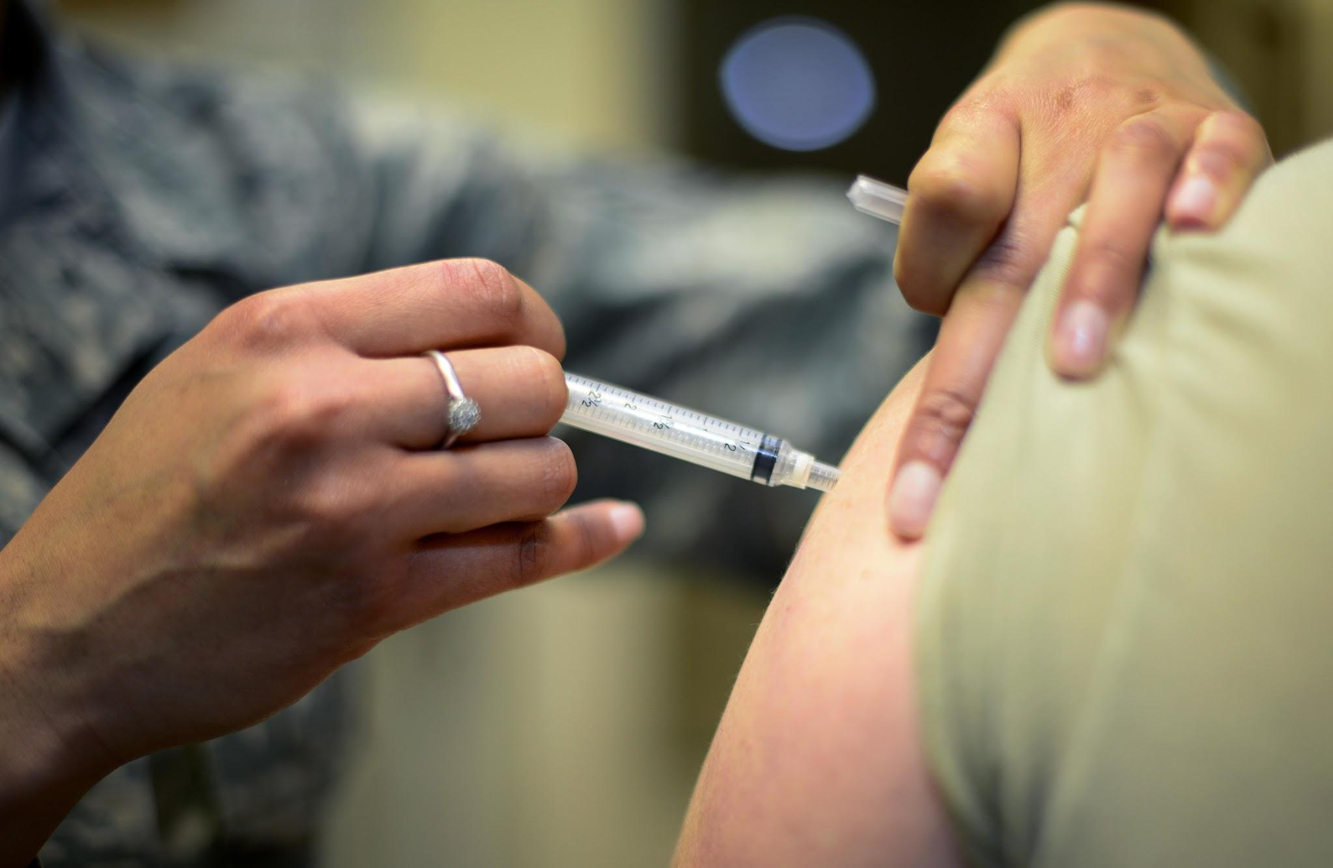


Preventions
Vaccination Programs
Health Education
Environmental Factors
Public Health Policies

Slide 9

Future Scope
The future scope of healthcare projects is vast and promising due to ongoing advancements in technology, increased focus on patient-centered care, and evolving healthcare needs worldwide.

Slide 10
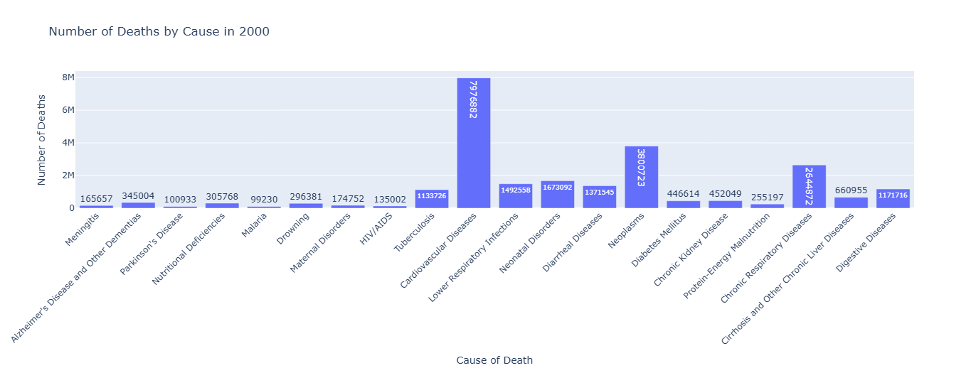
SCREENSHOTS

Slide 11
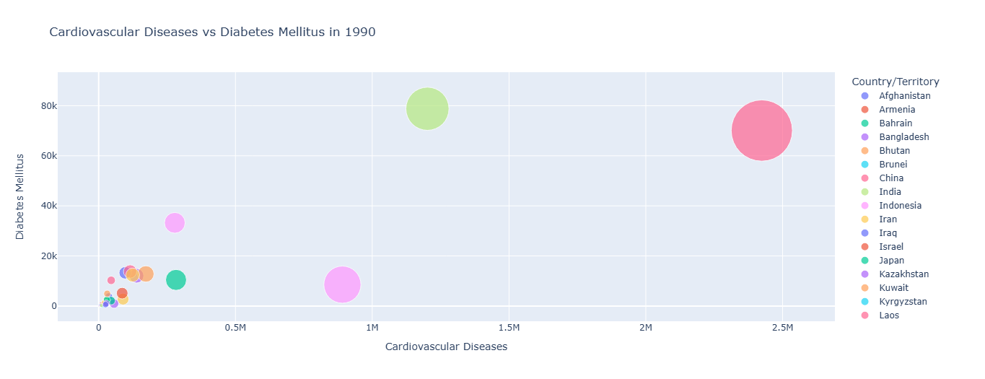

Slide 12
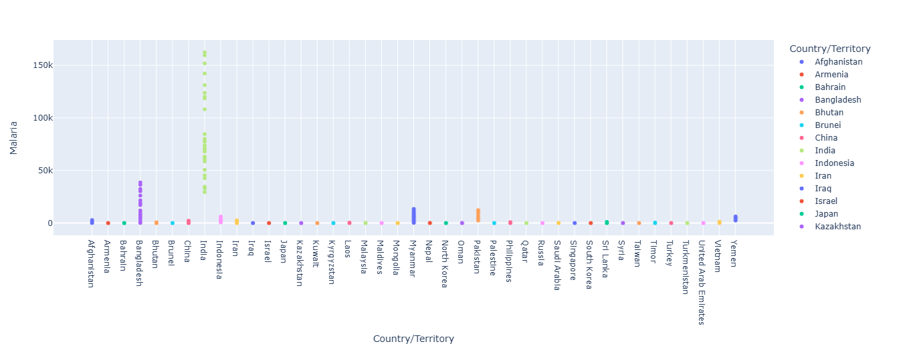

Slide 13

CONCLUSION
Impact on Patient Care
Technological Advancements
Improved disease prediction and Diagnosis
Acknowledgments: Acknowledge the contributions of team members who supported the project.

Slide 14
THANKS!
Any questions?

