Slide 1


Healthcare Analysis
By: Abhishek,Khushvir
Tania,Gurpreet,Manpreet
College Name
Roll No
Stream

Slide 2

Company
Profile
Certification: ISO 9001:2015 Certified
Specializations:
- Web Development
- Mobile Application Development
- Custom Software Development
- UI/UX Design
- Hosting Services
- Digital Marketing
Services:
- Advanced IT solutions supporting the entire business
- Consulting to system development
- Deployment
- Quality Assurance
- 24x7 Support
Headquarters: Jalandhar
Branch Office: Hoshiarpur

Slide 3

Table of Content
Project Explanation
Technology Used
Main Objectives
Preventions
Future scope
Screenshots
Conclusion
Thankyou

Slide 4

Project Explanation
Here we will discuss about health diseases and other causes of deaths and we will figure out how to focus on prevention.

Slide 5





Technology used
For frontend
For backend

Slide 6

Main Objectives
Improve patient outcomes
Increase accessibility
Health Promotion and Disease Prevention
Support healthcare

Slide 7

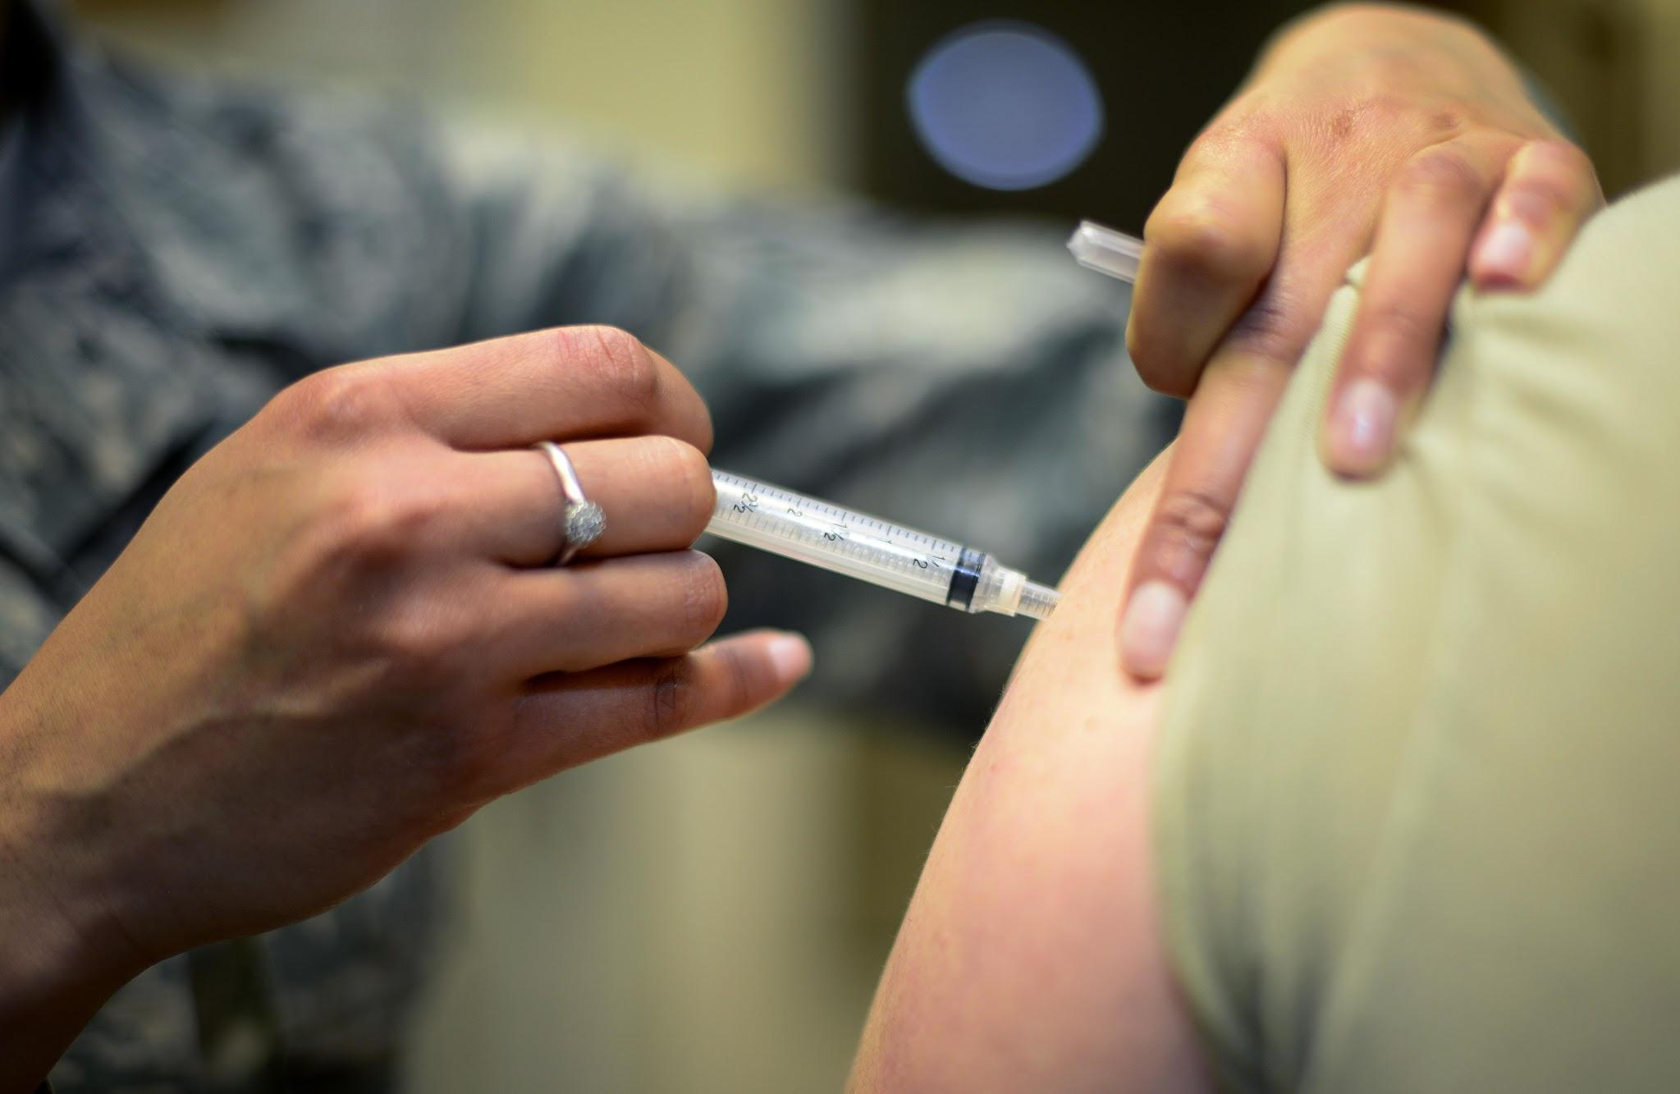


Preventions
Vaccination Programs
Health Education
Environmental Factors
Public Health Policies

Slide 8

Future Scope
The future scope of healthcare projects is vast and promising due to ongoing advancements in technology, increased focus on patient-centered care, and evolving healthcare needs worldwide.

Slide 9
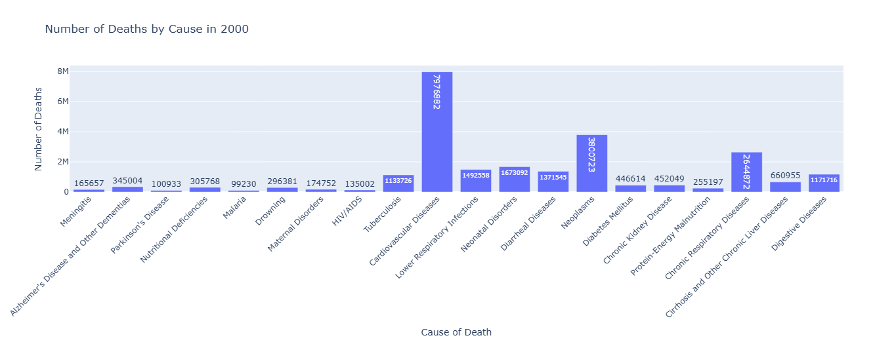
SCREENSHOTS

Slide 10
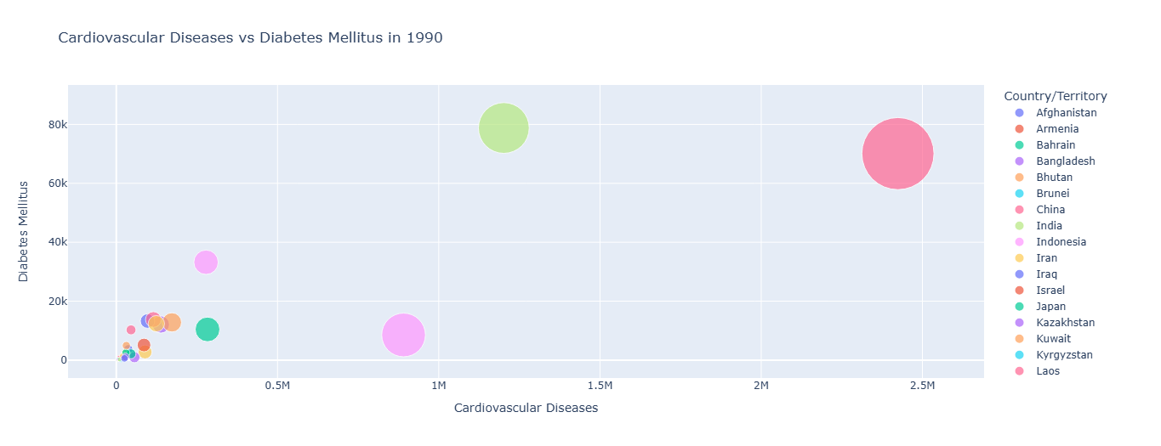

Slide 11
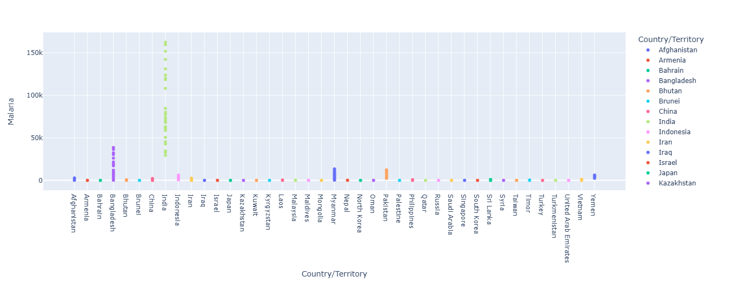

Slide 12

CONCLUSION
Impact on Patient Care
Technological Advancements
Improved disease prediction and Diagnosis
Acknowledgments: Acknowledge the contributions of team members who supported the project.

Slide 13
THANKS!
Any questions?

Slide 14

User Functionality
Register
Login
View Products

Slide 15
Data Preprocessing
Data collection
Data integration
Data understanding
Data analyze
Data visualization

