Slide 1




Poor Spending Behaviour Warning System
TEAM 4

Slide 2

Agenda
Business Problem
Data Analytic Methodology
Analysis Results
Business Implication
Actionable Recommendation

Slide 3
Business Problem

Slide 4
Problem
Rising Delinquency Rates (particularly for younger customers).
Large number of defaults.

Slide 5



Solutions
We offer an interpretable ML model that:
Monitors the chance of delinquencies/defaults of current customers.
Gives insight into the risk of offering new customers credit cards
Provides ideas to increase customer loyalty

Slide 6
Problems with solutions
Rising Delinquency Rates (particularly for younger customers).
  Will monitor current behaviours of customers to detect for possible delinquencies in the future.
Large number of defaults.
  Will enhance the ability to assess the risk of approving a credit card application

Slide 7
2) Data
Analytics Methodology

Slide 8
Methodology
Chose the business problem: default and delinquencies
Monitored all datasets to find factors affecting default and delinquencies
Found accuracy rates for models
Combined the results from all datasets
Proposed business solution
DelinpquencyDelinquency

Slide 9
3) Analysis Results

Slide 10
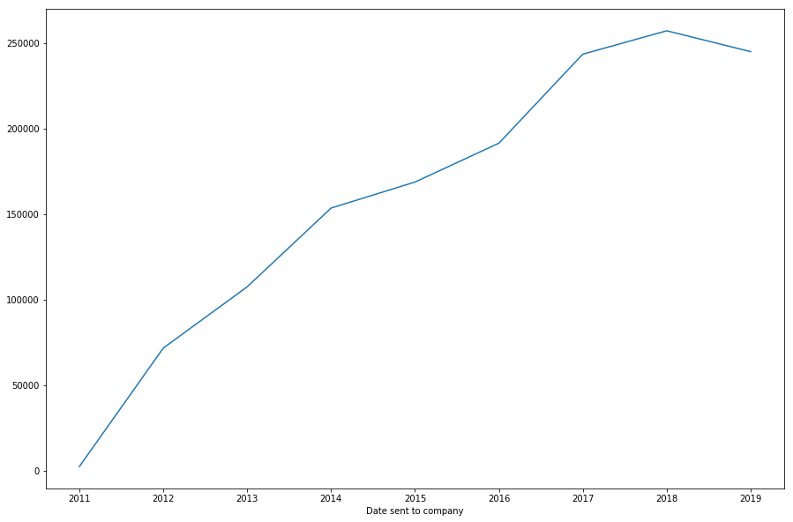
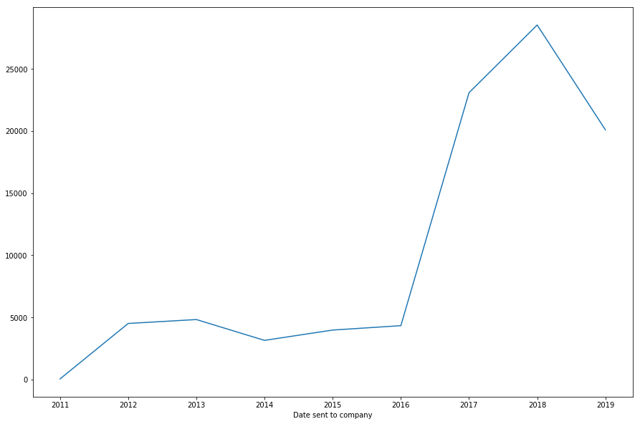


How satisfied are customers?
Not very - particularly recently

Slide 11
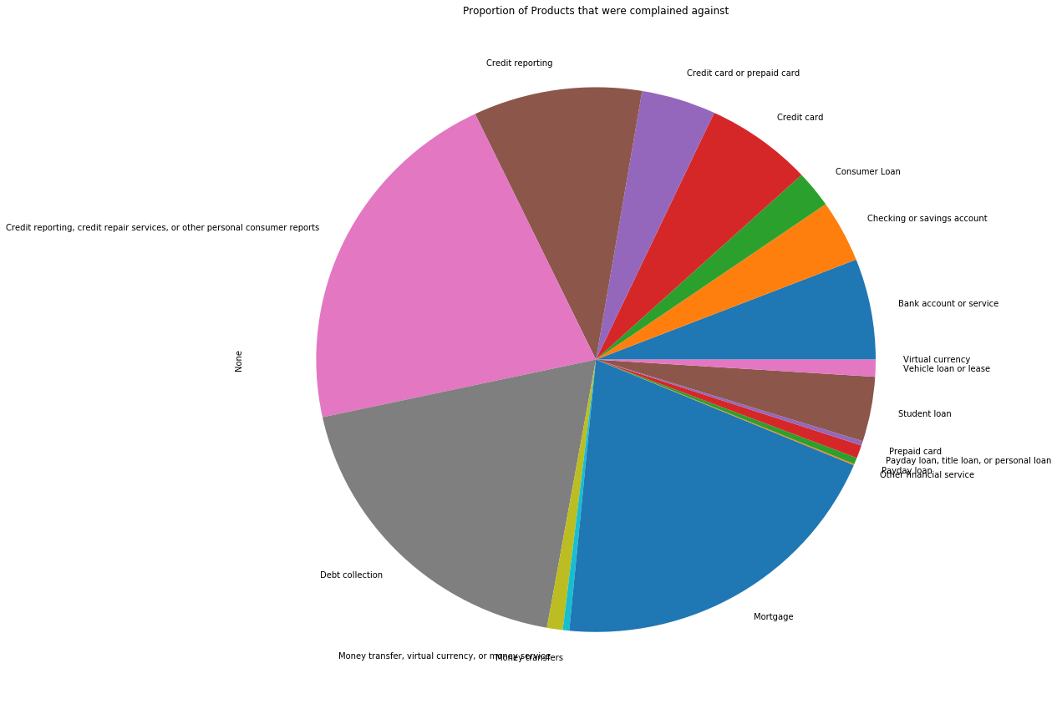
What are customers complaining about?
A large proportion Credit Reporting

Slide 12
Credit card application (dataset 3)
Replace string values.
Logistic Regression.
Coefficient values analysis.

Slide 13
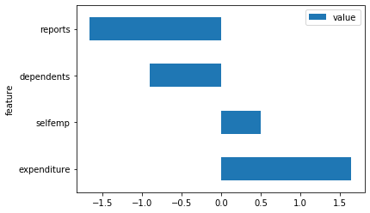
Analysis
Most important coefficient values
Credit card application (dataset 3)
Algorithm:
Logistic Regression
Accuracy rate: 98%

Slide 14
Analysis
Acceptance features
Expenditure
Self employee
Rejecting features
Reports
Dependents
Larger Successful
Credit card application (dataset 3)
Algorithm:
Logistic Regression
Larger Unsuccessful
Accuracy rate: 98%

Slide 15
Customer Loyalty (Dataset 2)
Dropping missing data.
Logistic Regression.
Train & Test.

Slide 16
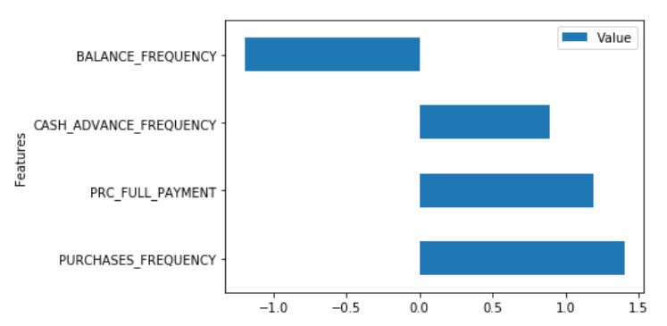
Graph of Features vs Coefficient

Slide 17
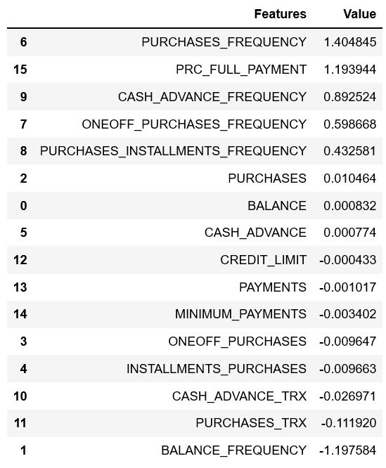
Analysis
Higher Tenure Value = Better Customer Loyalty
Accuracy rate: 86%
Top Features that affects Tenure
Purchases Frequency
Percentage of Full Payment paid by User
Cash Advance Frequency
Balance Frequency (inverse relationship)

Slide 18
Credit risks (dataset 4)
Replace string values.
Classification trees.
Threshold values analysis.

Slide 19
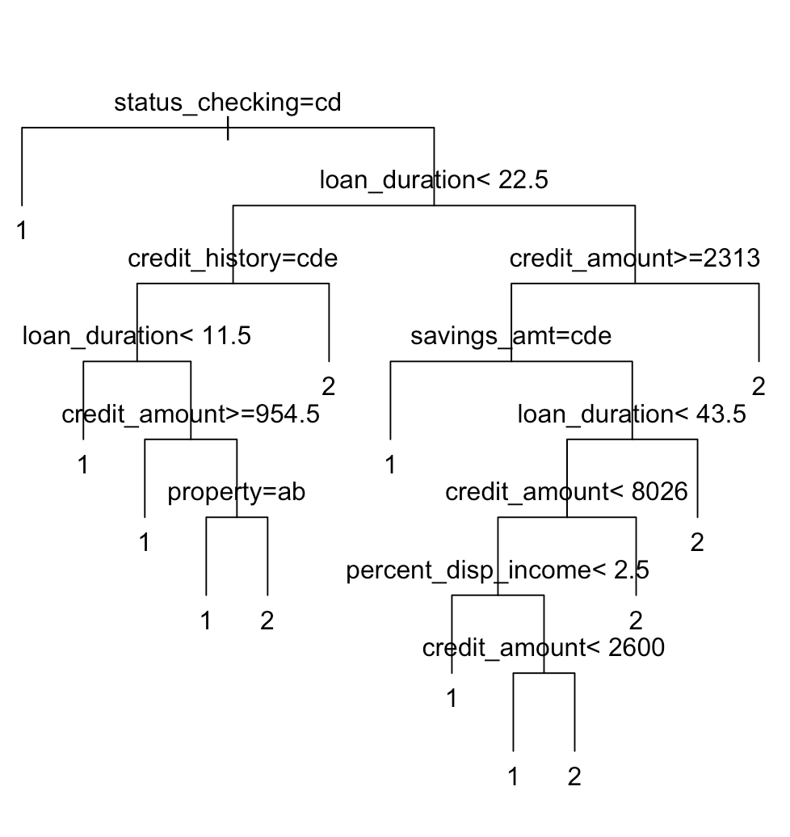
Analysis
1: good
2: bad
Status checking
Loan duration
Credit amount
Credit history
Savings amount
Property
Percent of disposable income
Credit risk (dataset 4)
Algorithm: Classification tree
Accuracy rate: 75%

Slide 20
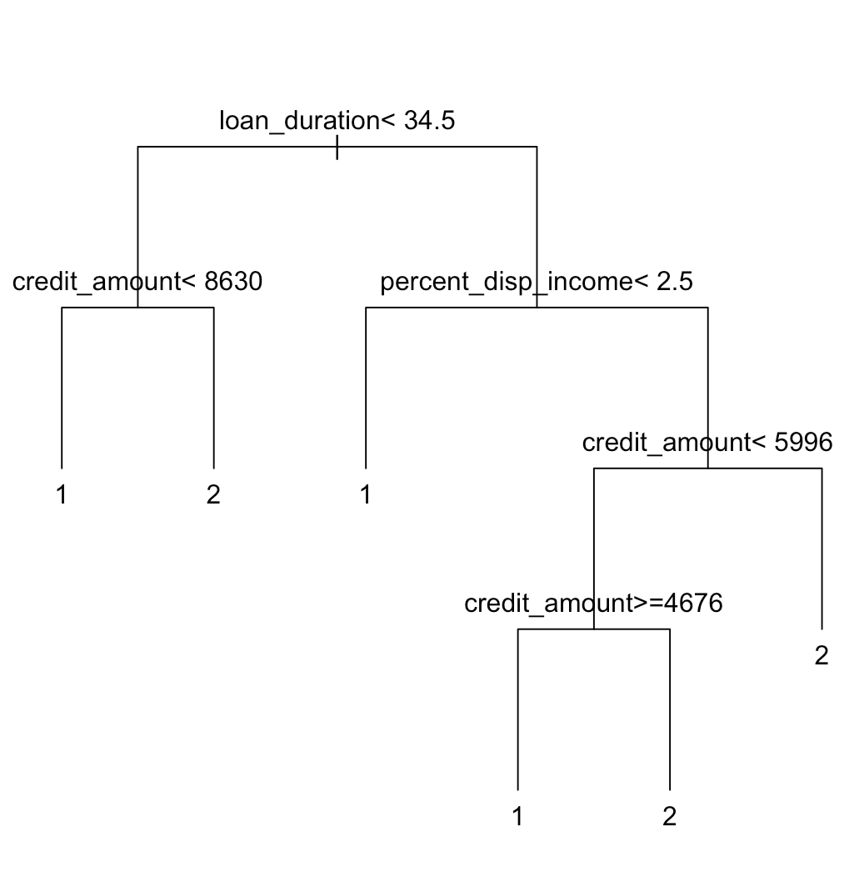
Analysis
1: good
2: bad
loan duration < 34.5
+ credit amount >= 8630
loan duration >= 34.5
+ percent. of disp income < 2.5
+ cred. amount < 4676
loan duration >= 34.5
+ percent. disp. income < 2.5
+ cred. amount >= 5996
Credit risk (dataset 4)
Algorithm: Classification tree
Accuracy rate: 75%

Slide 21

Credit Default (Dataset 5)
Data Preparation
Classification tree
Threshold values analysis

Slide 22
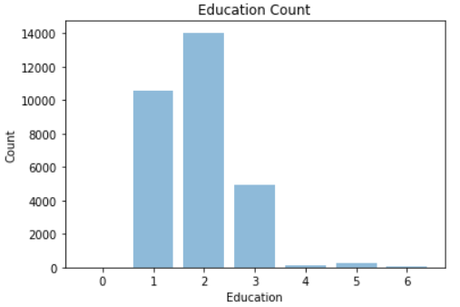
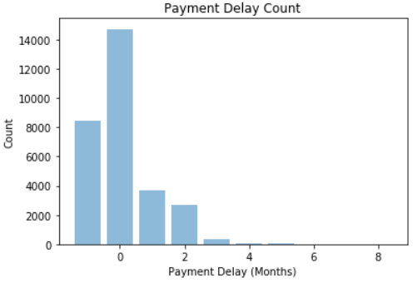
Prep
Replacement of anomalous values
Aggregation of Payment Punctuality
Credit risk (Dataset 5)
Algorithm: Decision Tree Classification
Accuracy rate: 67%

Slide 23
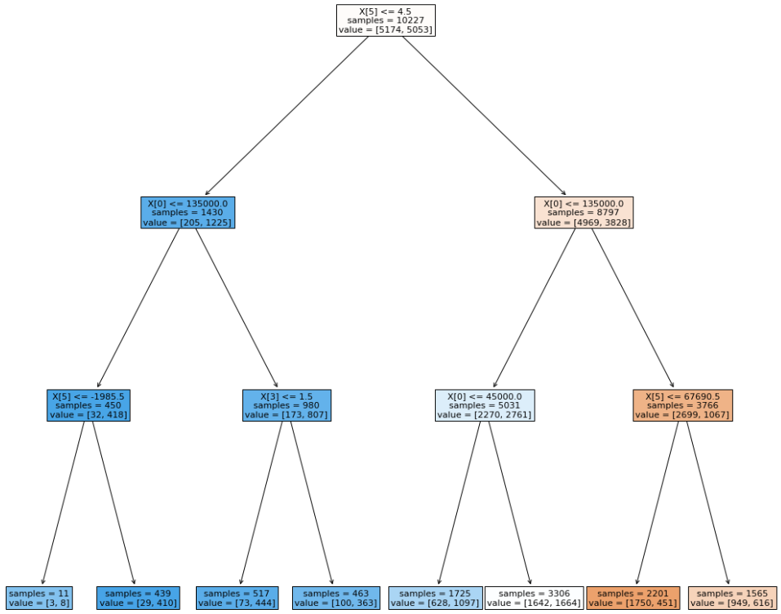
Analysis
Limit Balance
Sex
Education
Marriage
Age
Bill Amount
Credit risk (Dataset 5)
Algorithm: Decision Tree Classification
Accuracy rate: 67%

Slide 24
4) Business Implications

Slide 25
How does this tie into industry?
The key factors (from all datasets) that affect defaults/delinquency were:
Expenditure
Nr. Reports
Purchases Frequency
Loan duration
Limit balance

Slide 26
5) Actionable Recommendations

Slide 27
How Should AmEx use this analysis?
Run application data of all current customers through model.
If customers meet ineligibility criteria - blacklist them from new credit card applications.
This will result in a reduction of default and delinquency rates.

Slide 28
Thank You!

