Slide 1
DDS Final Project Presentation DDSAnalytics Talent management solution
Yang Zhang
For a link to the rmarkdown, see link

Slide 2
Outline
Data EDA
Modeling
Attrition
Monthly Incomes

Slide 3
Executive Summary
We use the employee dataset to do an EDA first, then further modeling the attrition using a few different criteria, identifying factors that related to attrition. The top factors related to attrition I identified within this analysis are:
Age/TotalWorkingYears
MonthlyIncome/JobRole
Overtime/DistancefromHome
The top factors related to monthly incomes I identified within this analysis are:
Job level
Job role
YearsatCompany/TotalWorkingYears
There are a few learning about the dataset:
It appears that sales has a higher attrition rate.
Factors related to work-life balance appear important to attrition.
No apparent gender differences are found in attrition and monthly incomes.

Slide 4
Outline
Data EDA
Classification Model for Attrition
Regression Model for Monthly Incomes

Slide 5
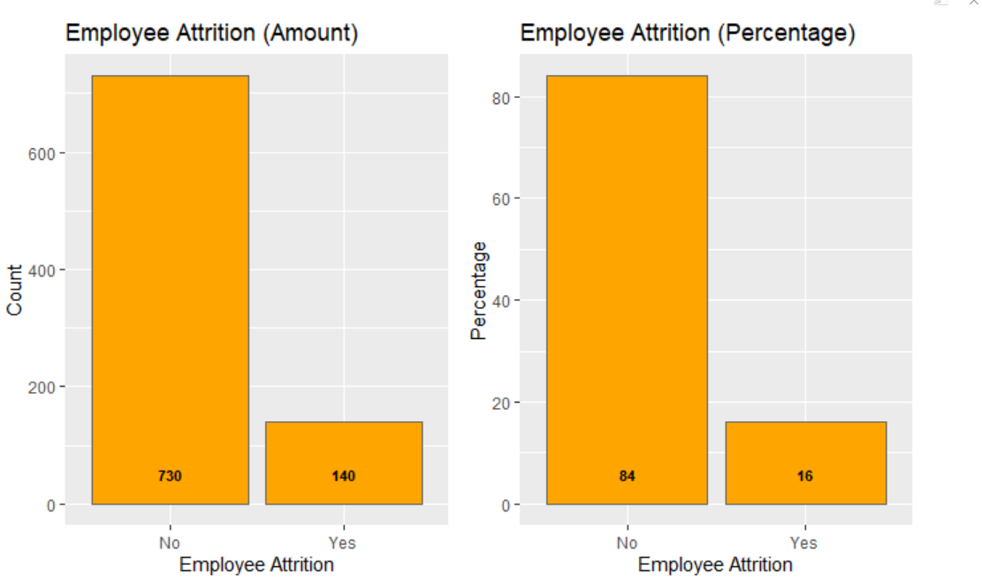
Data Overview
870 Data points
36 Variables
No missing values
21 numeric variables, 15 character variables

Slide 6
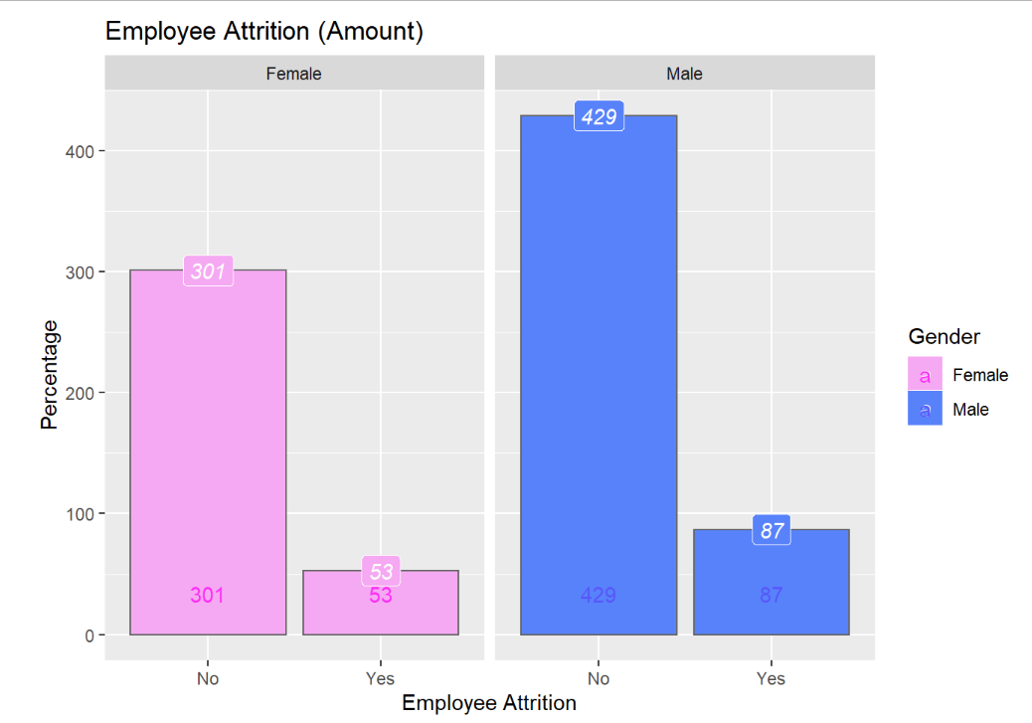
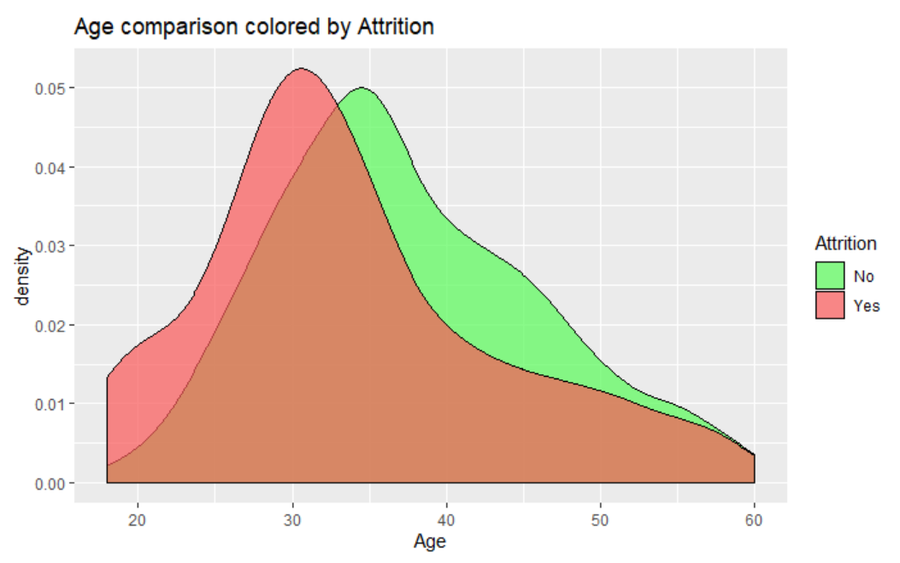
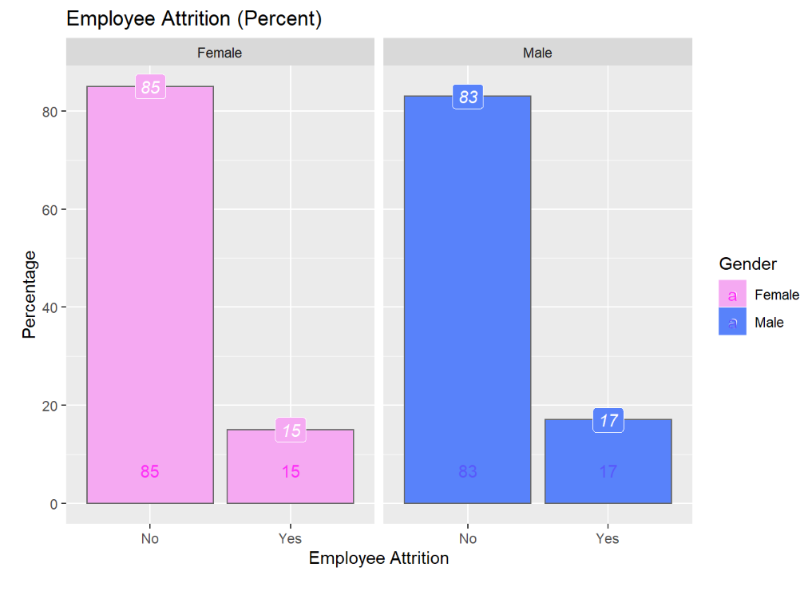
Attrition variation by Gender/Age
We see no obvious difference in attrition rates by gender.
We see younger people has a higher attrition rate.

Slide 7
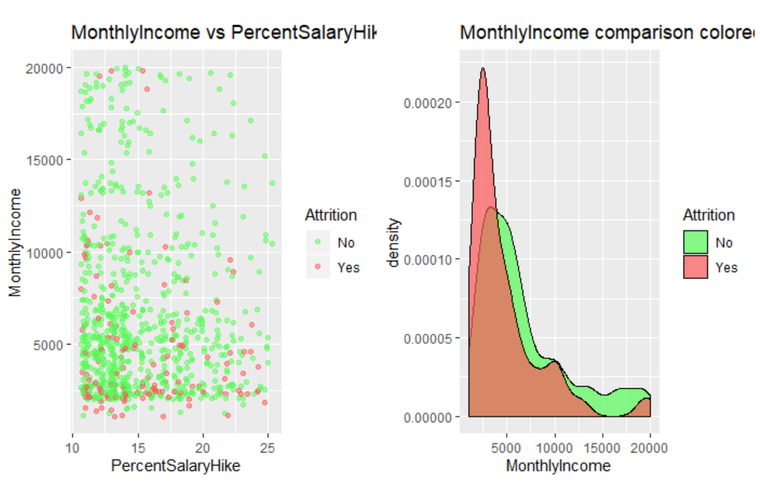
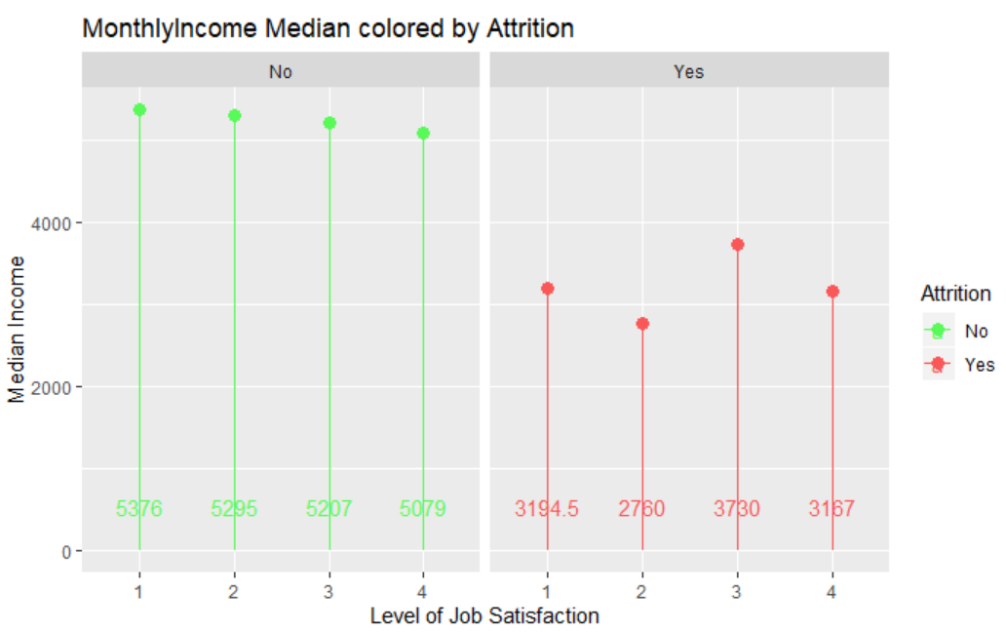
Attrition variation by MonthlyIncomes
The group of attrition people has averaged lower monthly incomes.
The lower monthly incomes appears across all levels of job satisfaction.

Slide 8
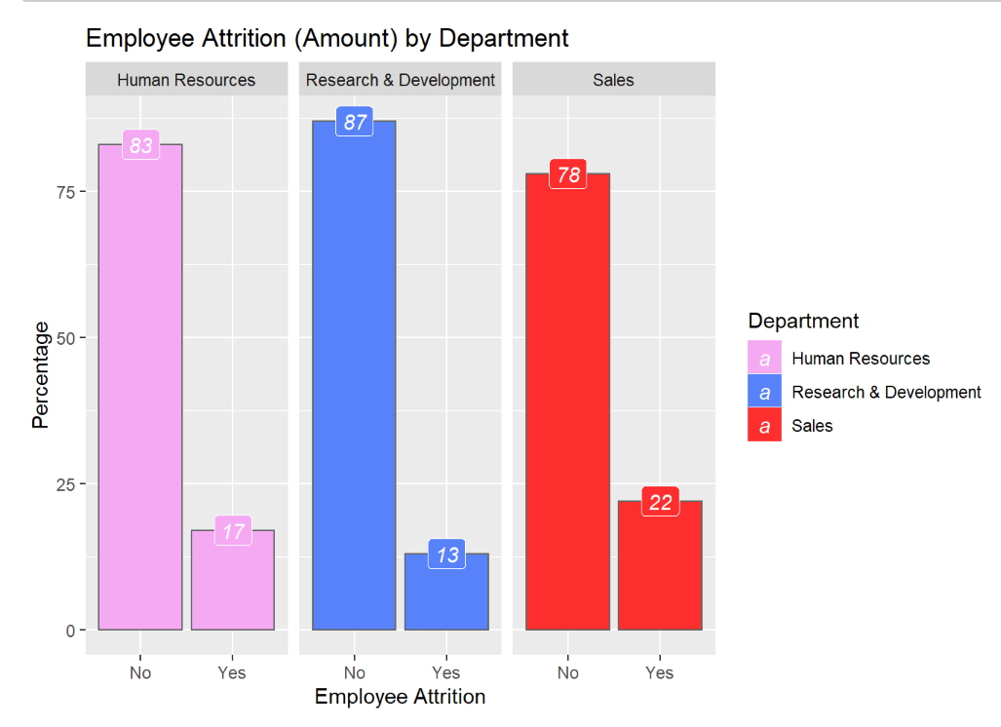
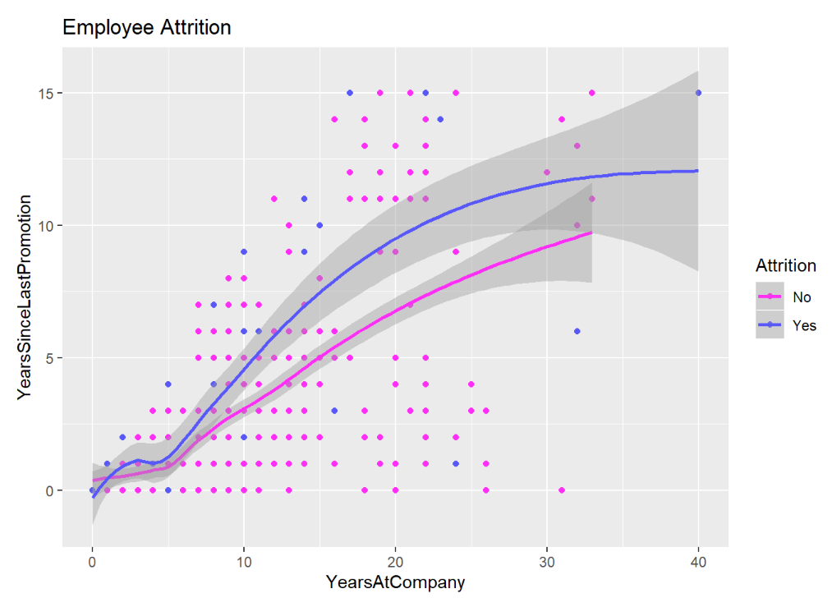
Attrition variation by Department/Working Years
Sales has higher attrition rate than the other two departments.
Differences observed from the two group with people stay long in company without promotion.

Slide 9
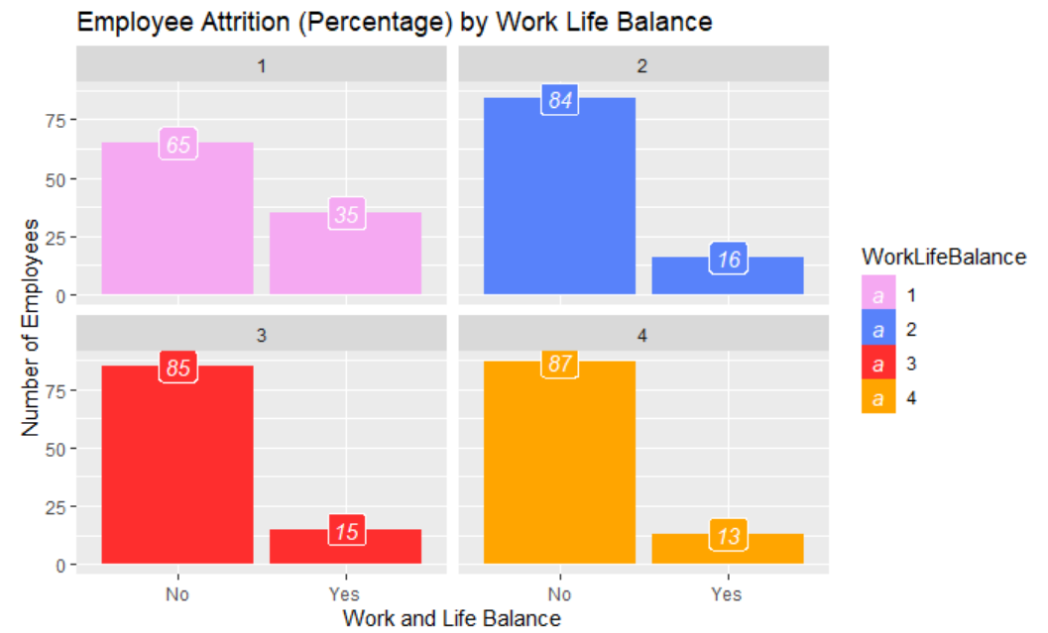
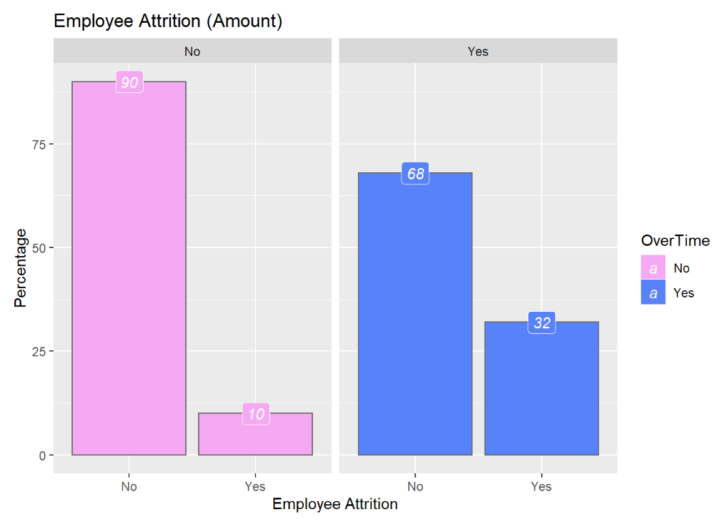
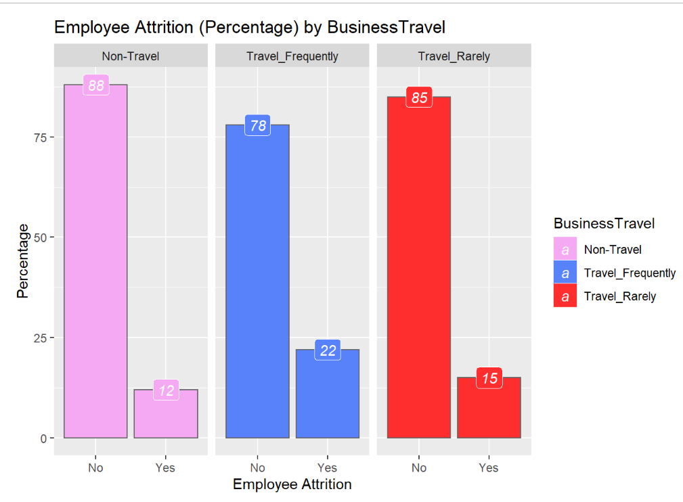
Attrition variation by Work Life Balance
We observe differences in attrition rate with quite a few parameters related to work-life balance:
Overtime
Business Travel
Work Life Balance Rate

Slide 10
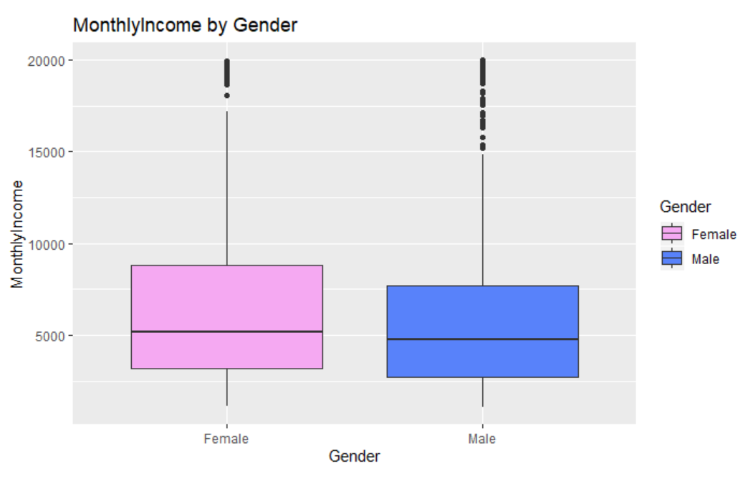

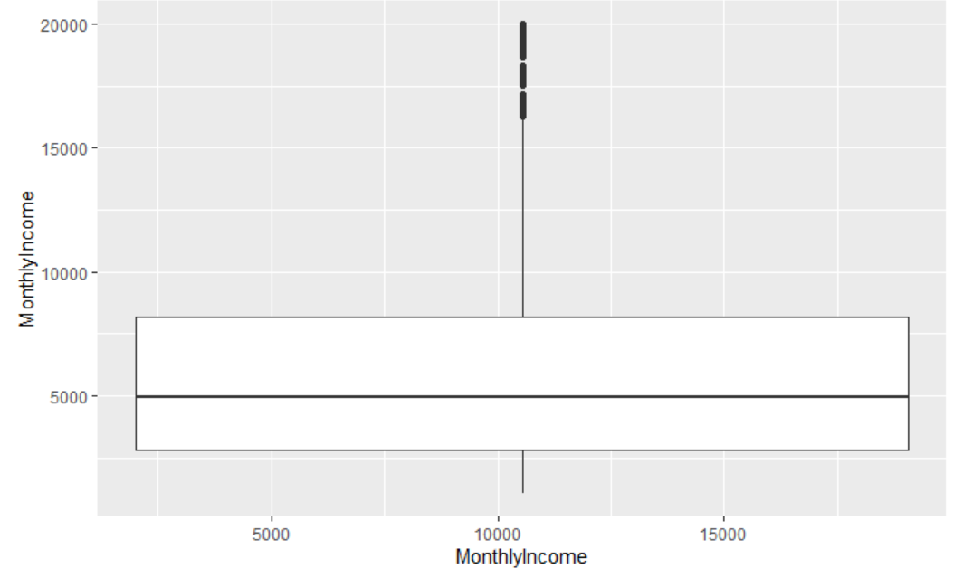
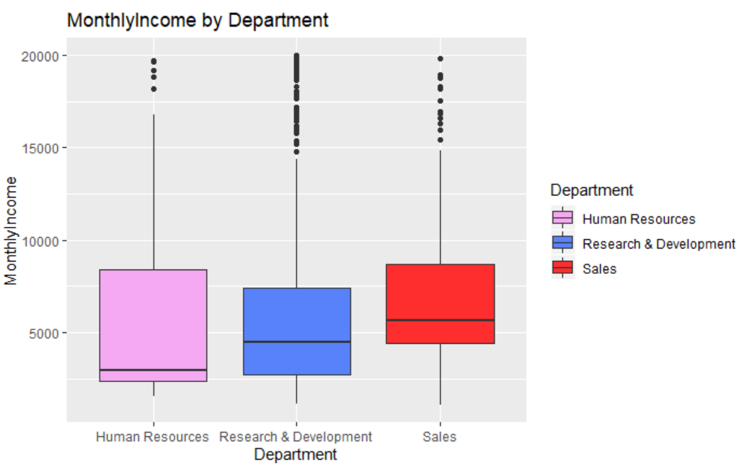
Monthly Incomes by Gender/Department
The distribution of monthly income is heavily right skewed.
We learn the monthly income comparisons across gender and departments.

Slide 11
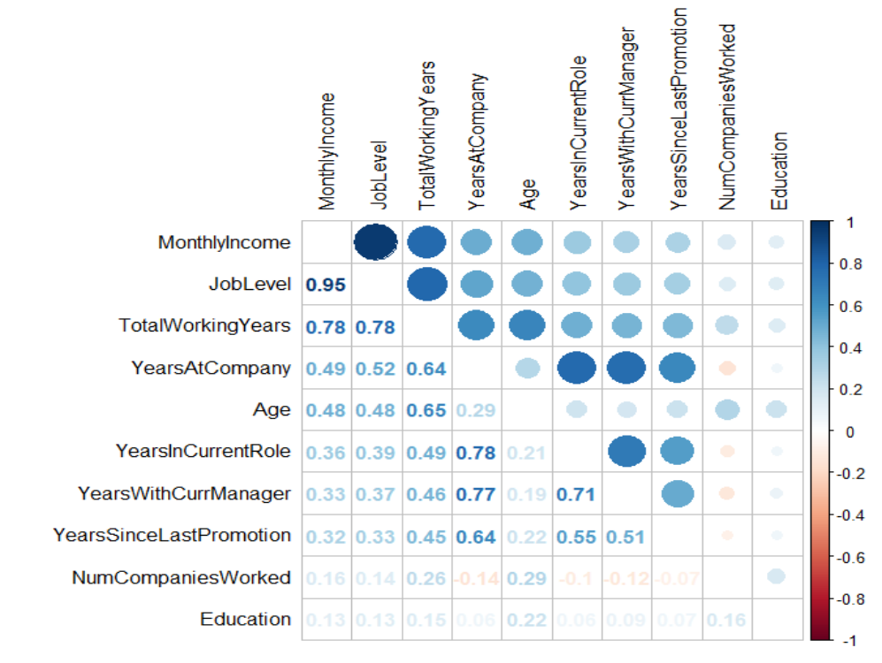
Monthly Incomes correlation Matrix
From the correlation matrix, we learn that Monthly incomes are higher linearly related to the following factors:
Joblevel
Total Working Years
YearAtCompany
Age

Slide 12
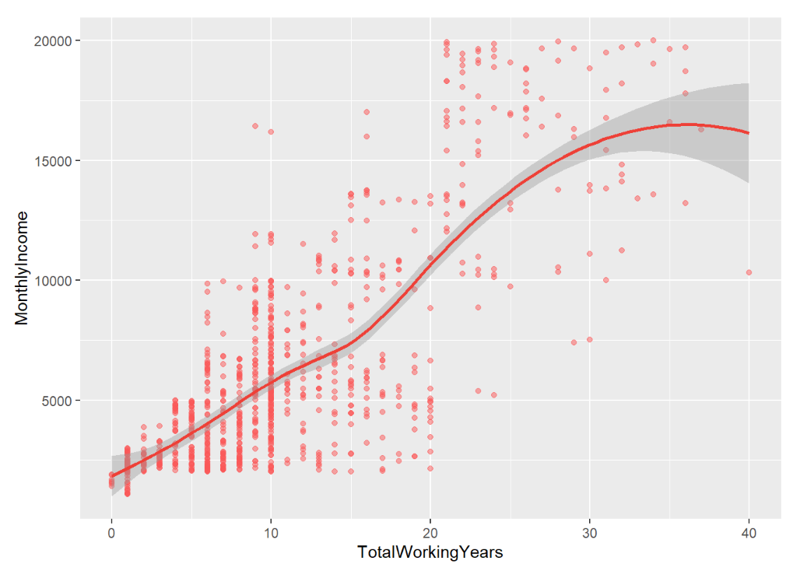
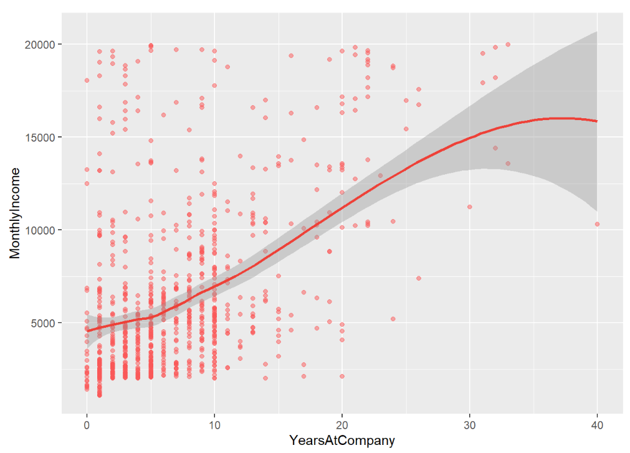
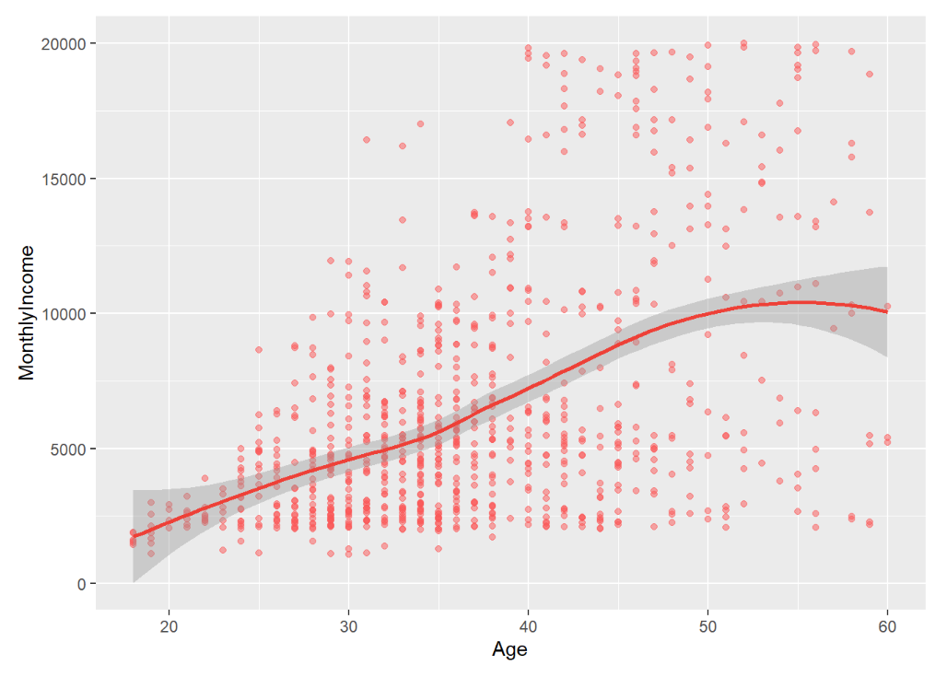
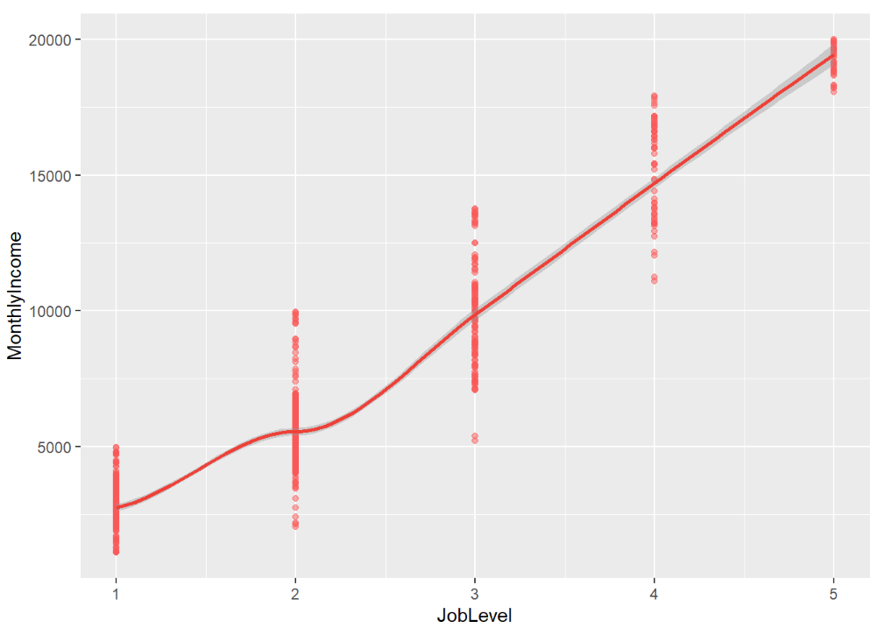
Monthly Incomes with top correlated variables
We plot the relationship of the previous key parameters against monthly income and find positive trends in spite of scatter.

Slide 13
Outline
Data EDA
Classification Model for Attrition
Regression Model for Monthly Incomes

Slide 14
Data Categories and Utilization
Examples:
Variables with no information
"Over18", "EmployeeNumber", "EmployeeCount","ID","StandardHours“
Numeric variables
E.g., MonthlyIncomes, TotalYearsatCompany
Ordinal variables
E.g., EnvironmentSatisfaction, BusinessTravel
Categorical variable
E.g., MaritalStatus, EducationField
3. All Variables
2. Nums + Ordinals
1. Numeric Variables

Slide 15
Modeling for Attrition Classification
Data | Model | Sensitivity/Specificity
1. Only Nums | KNN | 0.95/0.12
1. Only Nums | Naïve bayes | 0.86/0.45
2. Nums + Ordinals | Naïve bayes | 0.87/0.50
2. Nums + Ordinals | KNN cat | 0.95/0.17
2. Nums + Ordinals | Random Forest | 0.98/0.12
3. All | Naïve bayes | 0.84/0.62
3. All | Random Forest | 0.98/0.12
High sensitivity but low specificity for KNN and Random Forest methods.
Naïve bayes works best with more even sensitivity and specificity.
With more variables included we see an increase in both sensitivity and specificity.

Slide 16
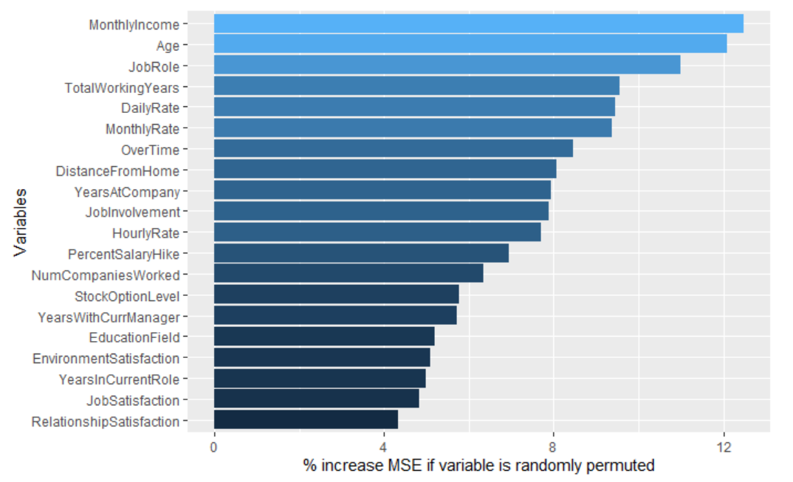
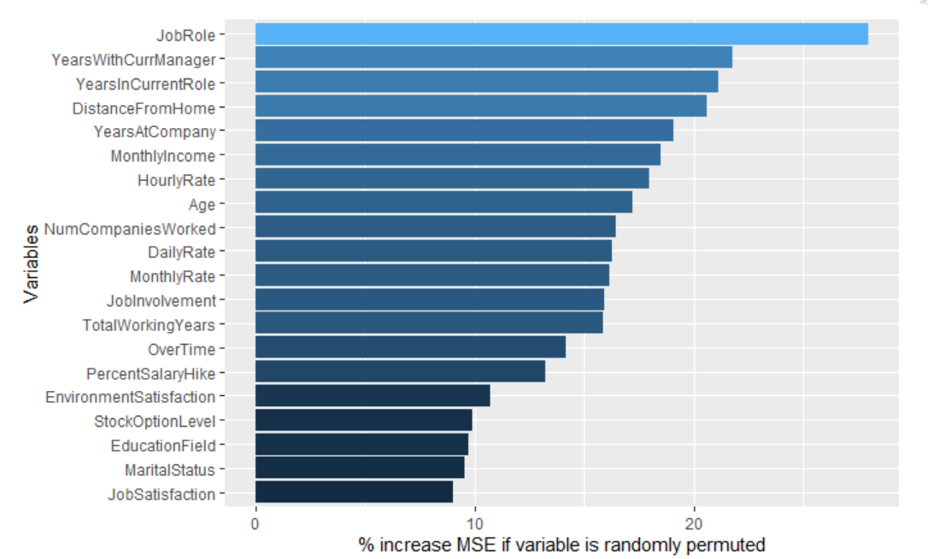
Modeling for Attrition Classification: Drop Variables
Increased sensitivity and specificity by dropping variables with low importance.
Feature Importances with Data2
Using Naïve bayes
Data | Variables | Sensitivity/Specificity
2. Nums + Ordinals | All | 0.87/0.50
2. Nums + Ordinals | Drop unimportant vars | 0.88/0.62
3. All | All | 0.84/0.62
3. All | Drop unimportant vars | 0.88/0.64
Feature Importances with Data3

Slide 17
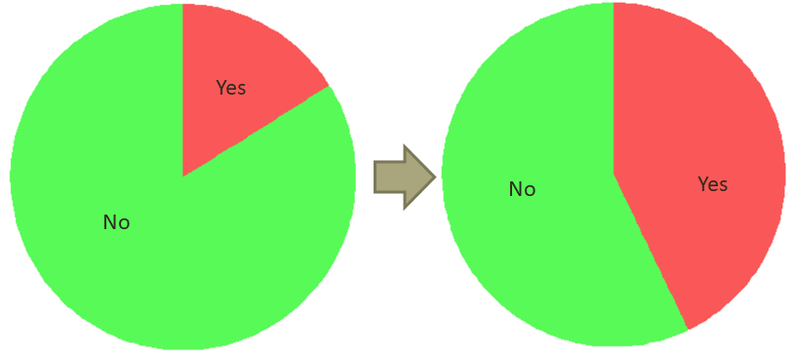
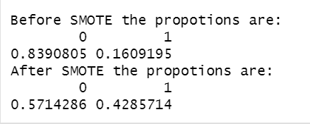
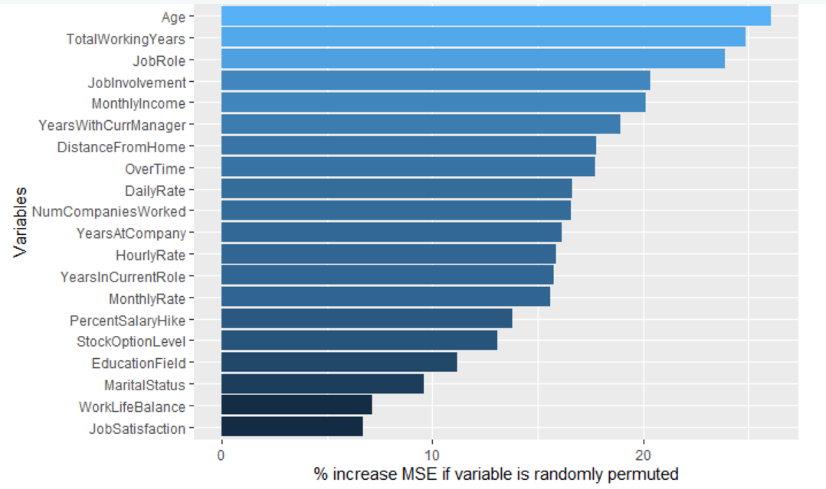
Modeling for Attrition Classification: Solve Imbalance
Deal with Imbalance
Features that show repeatedly include:
Age/TotalWorkingYears
MonthlyIncome/JobRole
Overtime/DistancefromHome
Feature Importance with Selected Vars
Data | Model | Sensitivity/Specificity
Before Balance | Naïve bayes | 0.88/0.64
After Balance | Naïve bayes | 0.63/0.76
Before Balance | Random Forest | 0.98/0.12
After Balance | Random Forest | 0.85/0.60
Further drop vars | Random Forest | 0.85/0.62

Slide 18
Outline
Data EDA
Classification Model for Attrition
Regression Model for Monthly Incomes

Slide 19
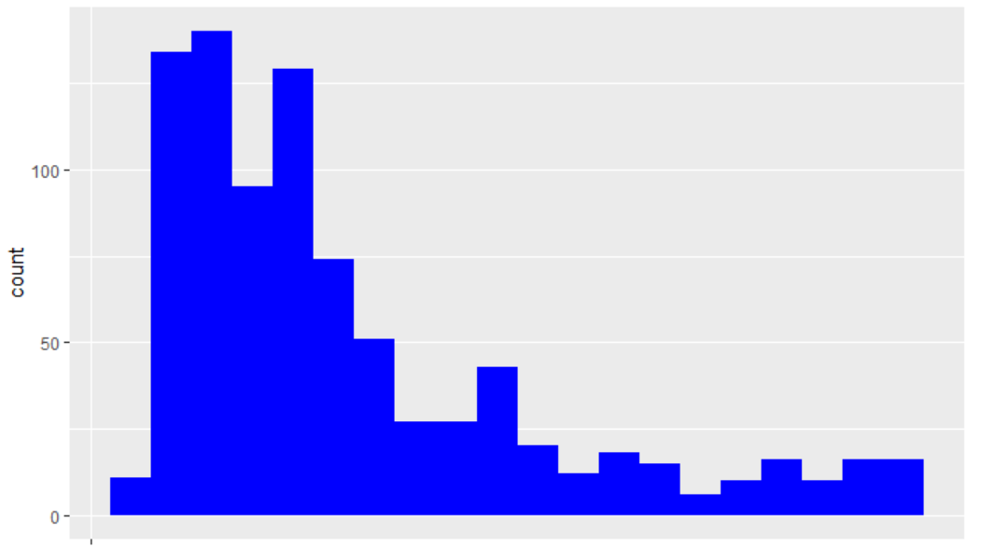
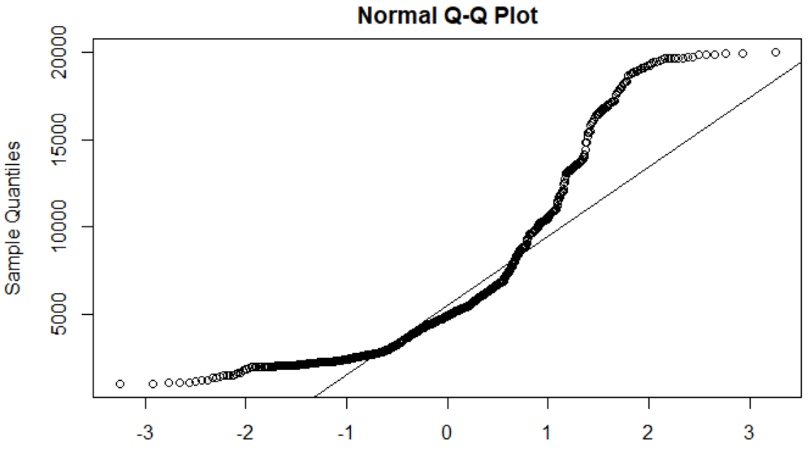
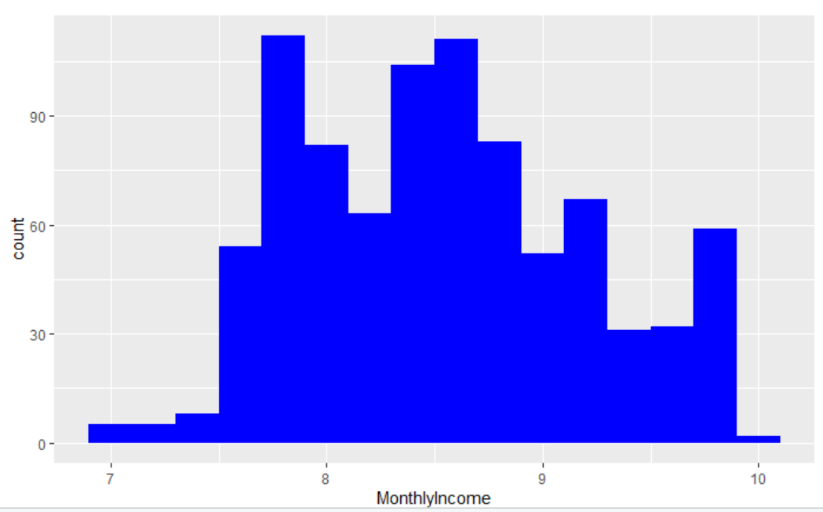
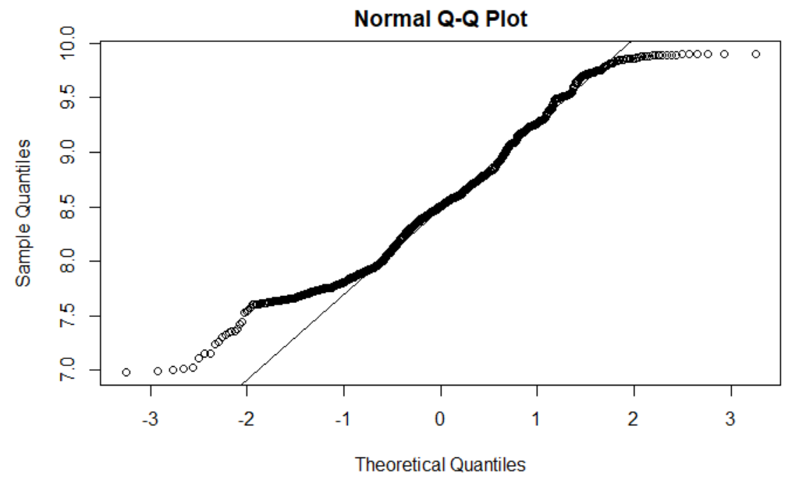
Response Variable MonthlyIncomes Need Transformation
Log transformation is performed on responsive variable so it’s more normal distributed.

Slide 20
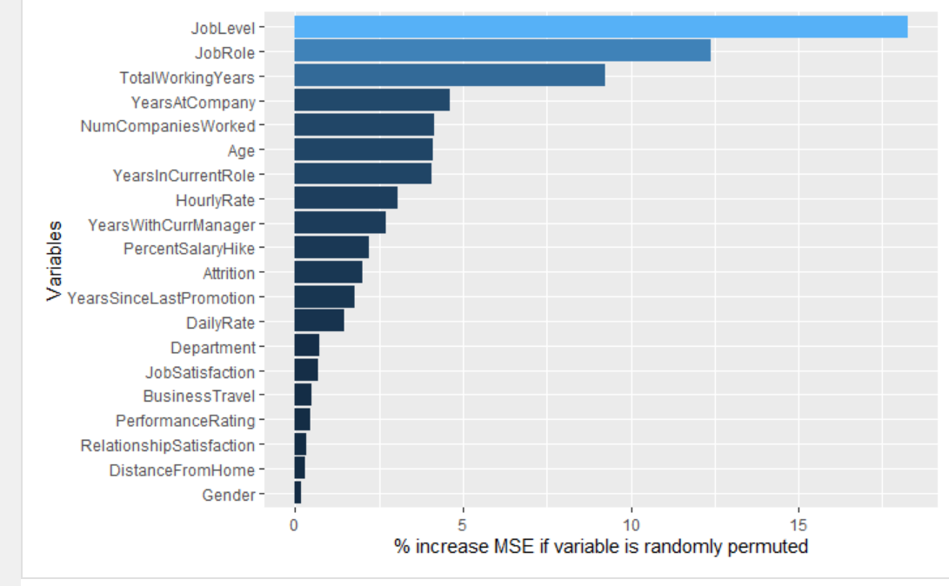
MonthlyIncomes Regression Modeling using Multi-linear and random forest
Data | Model | RMSE
Org Data | Multi-lm | 2838.815
Transform Data | Multi-lm | 1610.904
Transform Data | Random Forest | 1144.745
Selected Vars | Multi-lm | 1599.487
Selected Vars | Random Forest | 1235.659
Feature Importance with Data2
Most related factors :
Job level
Job role
YearsatCompany
TotalWorkingYears

Slide 21
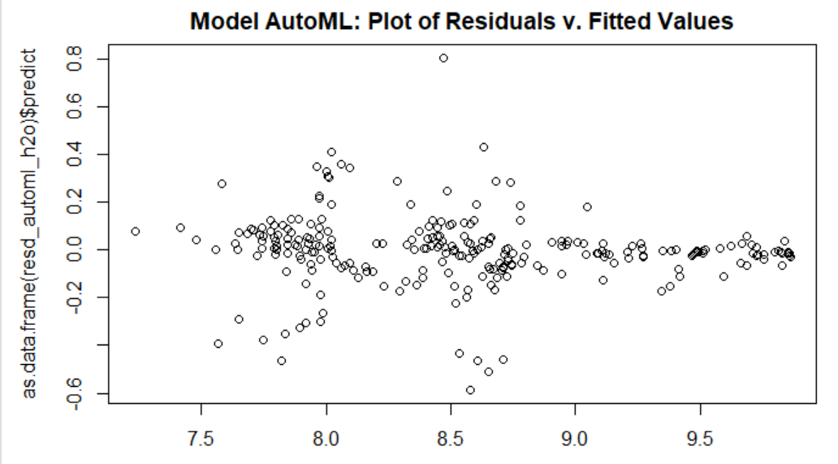
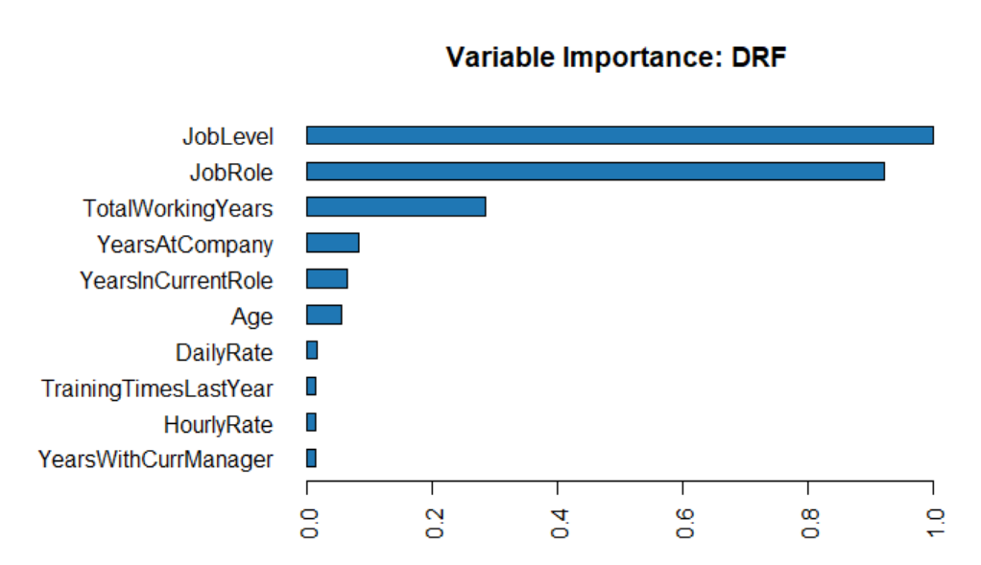
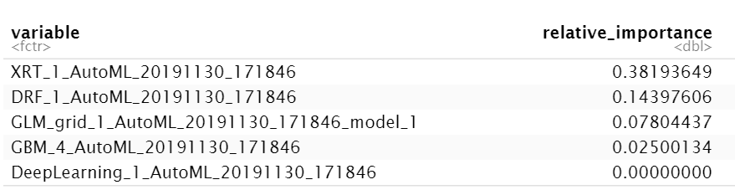
MonthlyIncomes Regression Modeling using AutoML
Data | Model | RMSE
Transform Data | Random Forest | 1144.745
Transform Data | AutoML | 752.4351
Ensemble Model

Slide 22
Our Recommendations
It is crucial to improve the organization’s talent management in the following aspects:
Overtime may cause people to leave the company
People stayed without raising salary, job level or promotions tends to leave.
Higher tendency on leaving in Sales Department.

Slide 23
Backups

Slide 24
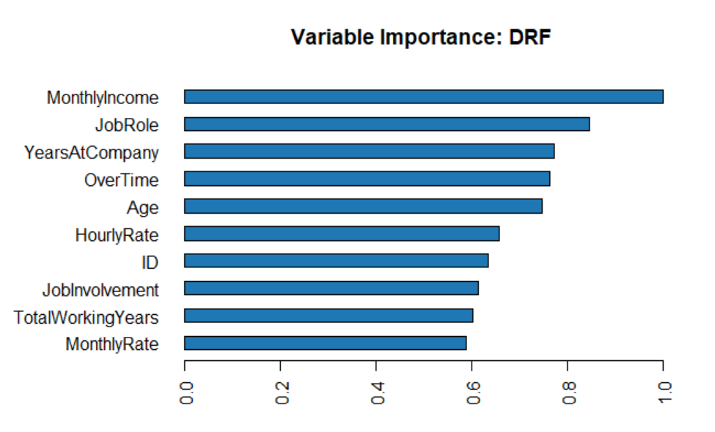

Slide 25


Modeling for Attrition Classification: Solve Imbalance
Yes
No
Yes
No

Slide 26
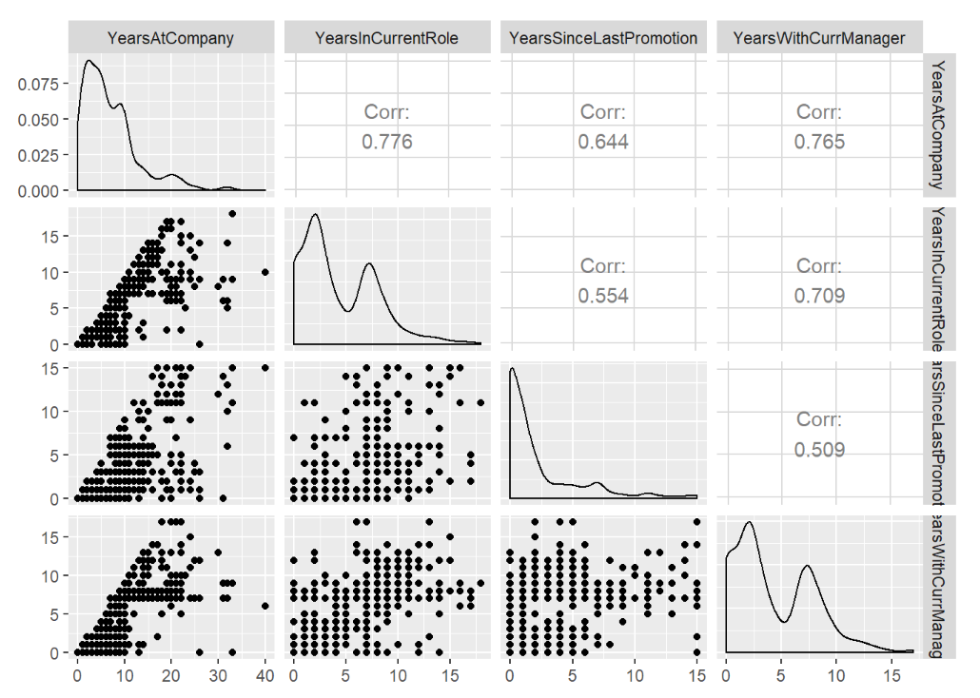
Monthly Incomes: colinearity variables?
Evaluate the parameters that seems to highly related so possibly have colinearity.
After evaluation it may not be such a series issue.

