Slide 1
Intro to Data Science
This document is for the exclusive use of Deep Dive bootcamp participants during the bootcamp. This document may not be shared or duplicated

Slide 2
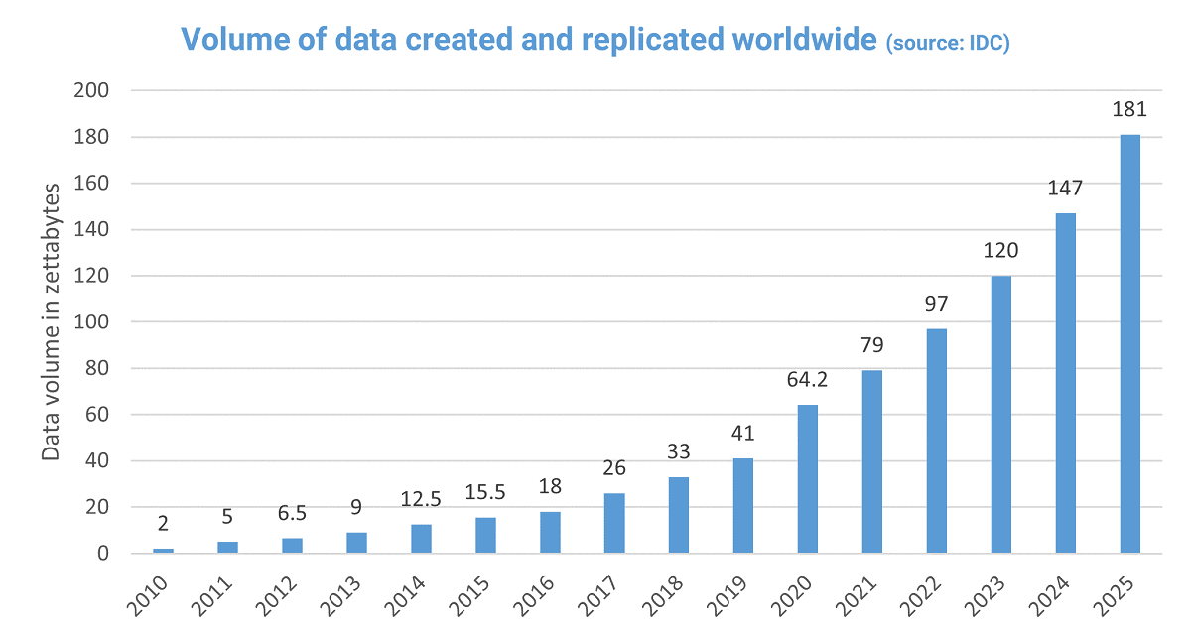
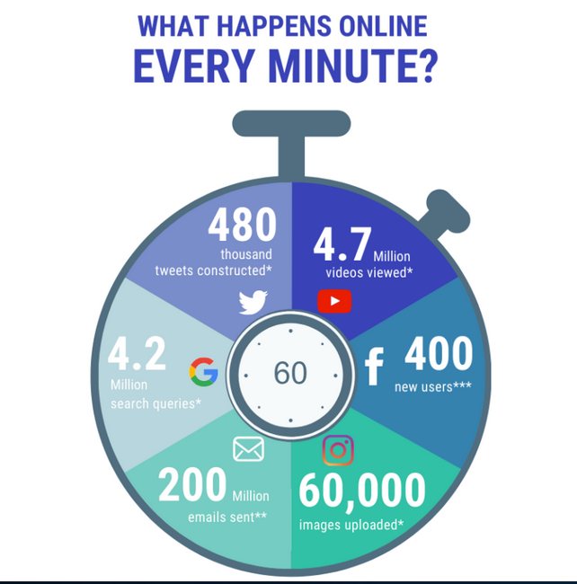
The Data Revolution
Images from https://www.nodegraph.se
This document is for the exclusive use of Deep Dive bootcamp participants during the bootcamp. This document may not be shared or duplicated

Slide 3
What Can Data Do?
Show historical trends
and performance
Predict future events & ramifications of actions
Present
Past
Future
Show current state of business
This document is for the exclusive use of Deep Dive bootcamp participants during the bootcamp. This document may not be shared or duplicated
Notes:
Orienteering.
Where are we at?
How did we get here?
Where are we going?

Slide 4
Why Now?
Algorithmic Advances
Explosion of Data
Data Science
Increases in Computing Power/Storage
Availability and
Accessibility
This document is for the exclusive use of Deep Dive bootcamp participants during the bootcamp. This document may not be shared or duplicated
Notes:
Also: Accessibility with mobile devices ( smartphones, tablets, laptops ) and cloud computing; see Google CoLab, GitHub CodeSpaces, Kaggle

Slide 5

Who Can Benefit From Data?
Not just mega-organizations or tech
Non-technical use cases
  Sports teams: Maximizing bang for buck
  Health/medicine: Reactive to preventative
  Retail: Recommending products, predicting customer behavior
This document is for the exclusive use of Deep Dive bootcamp participants during the bootcamp. This document may not be shared or duplicated
Notes:
Money Ball

Slide 6
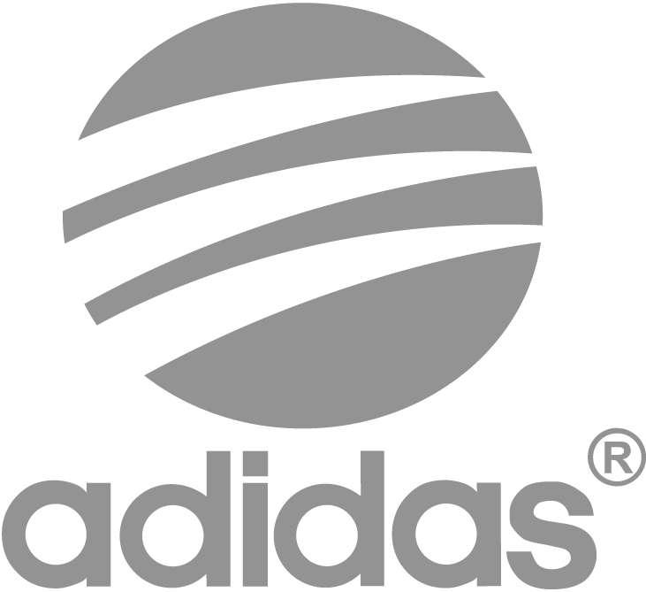
Ways to Use Data
Predict
Predict outcomes such as customer behavior, product prices, or health measures
Adidas use predictive analytics to forecast product demand and personalize marketing by analyzing past purchase data, browsing behavior, and demographics. This helps anticipate what customers will buy and when.
https://appinventiv.com/blog/retail-predictive-analytics/
https://commons.wikimedia.org/wiki/File:Oevlk_-_Volvo_VNL.jpg
Notes:
FUSE makerspace: sensors to monitor equipment

Slide 7

Ways to Use Data
Cluster
Behavior segmentation, pinpoint marketing, filtering nuisance material
Starbucks leverages its loyalty app to track customer purchase habits and visit frequency. This data allows them to segment customers based on their routines (e.g., morning coffee, afternoon break) and send targeted offers and promotions at the most relevant times via push notifications and email.
https://www.salesmate.io/blog/behavioral-segmentation/
https://commons.wikimedia.org/wiki/File:Salesforce_Users_Email_list.png

Slide 8
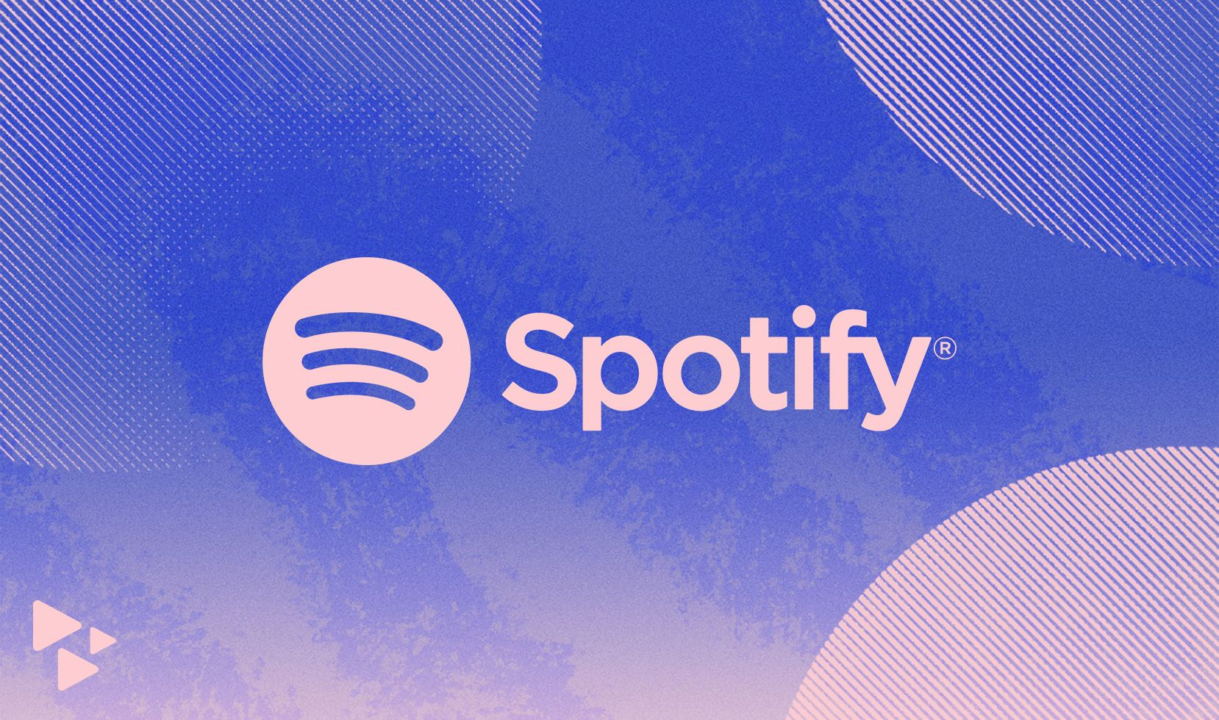
Ways to Use Data
Optimize
Price points, marketing campaigns, inventory levels
Spotify analyzes listening habits and preferences to segment users and deliver highly targeted marketing campaigns for new artists, playlists, and events. This pinpoint approach increases the effectiveness of their marketing spend.
Use robust optimization on a model of their inventory system that was fit to historical data
https://artists.spotify.com/en/blog/introducing-new-audience-segmentation-on-spotify-for-artists

Slide 9
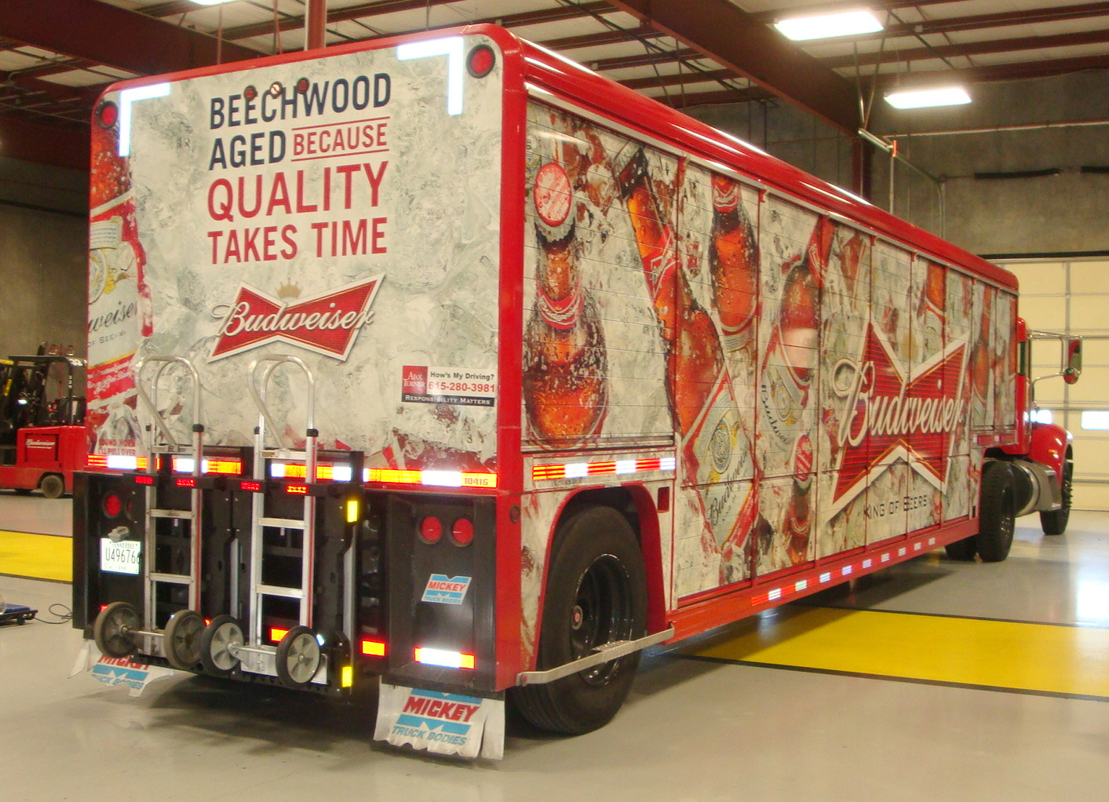
Ways to Use Data
Detect
Fraudulent activity, cyber-attacks, objects in images, process anomalies
Example: Anheuser-Busch InBev
Launched a platform called "BrewRight" that monitors transaction activity across 100 countries and uses machine learning to identify fraud and corruption.
Used to help ensure compliance with the Federal Corrupt Practices Act
https://www.ab-inbev.com/news-media/innovation/how-brewright-is-rooting-out-corruption-at-ab-inbev-and-beyond/
https://commons.wikimedia.org/wiki/File:Budweiser_Beer_Anheuser_Busch_InBev_Brewing_Company.jpg

Slide 10

Ways to Use Data
Recommend
Recommend movies, books, or other items for purchasing
Amazon uses a sophisticated recommendation engine that considers purchase history, browsing behavior, items in the cart, and more to suggest products. You'll see "Customers who bought this item also bought," "Recommended for you," and personalized ads. (General knowledge of Amazon's recommendation system)
https://www.shiprocket.in/blog/amazon-recommendation/
https://commons.wikimedia.org/wiki/File:Netflix-new-icon.png

Slide 11
Who Can Benefit From Data?
You
personal finance
health
social network
professional network (jobs)
This document is for the exclusive use of Deep Dive bootcamp participants during the bootcamp. This document may not be shared or duplicated

Slide 12
What is Data Science?
Artificial Intelligence (AI)
The development of a machine that can simulate human behavior.
Machine Learning (ML)
The process of a machine learning from data and making decisions without explicit programming.
Deep Learning (DL)
A term associated with a ML algorithm involving artificial neural networks that work to mimic neurons in the brain.
Data Science (DS)
The process of using data analytics, statistics, and programming to solve business problems.
AI
ML
DS
DL
This document is for the exclusive use of Deep Dive bootcamp participants during the bootcamp. This document may not be shared or duplicated

Slide 13
What is Data Science?
“Vocal critics have variously dismissed the term as a superfluous label (after all, what science doesn't involve data?) or a simple buzzword that only exists to salt resumes and catch the eye of overzealous tech recruiters. … In my mind, these critiques miss something important. Data science, despite its hype-laden veneer, is perhaps the best label we have for the cross-disciplinary set of skills that are becoming increasingly important in many applications across industry and academia.” – Jake VanderPlas in “Python Data Science Handbook”

Slide 14
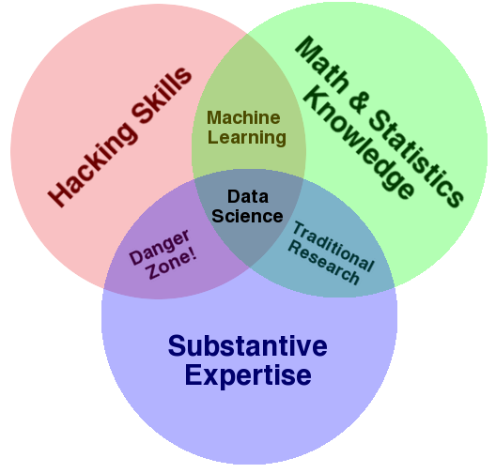
What is Data Science?
Drew Conway - The Data Science Venn Diagram
This document is for the exclusive use of Deep Dive bootcamp participants during the bootcamp. This document may not be shared or duplicated

