Slide 1
HAPTER 2
Overview of Business Processes

Slide 2
INTRODUCTION
Questions to be addressed in this chapter include:
  What are the basic business activities in which an organization engages?
    What decisions must be made to undertake these activities?
    What information is required to make those decisions?
  What role does the data processing cycle play in organizing business activities and providing information to users?
  What is the role of the information system and enterprise resource planning in modern organizations?

Slide 3
INFORMATION NEEDS AND BUSINESS ACTIVITIES
Businesses engage in a variety of activities, including:
  Acquiring capital
  Buying buildings and equipment
  Hiring and training employees
  Purchasing inventory
  Doing advertising and marketing
  Selling goods or services
  Collecting payment from customers
  Paying employees
  Paying taxes
  Paying vendors
Each activity requires different types of decisions!

Slide 4
INFORMATION NEEDS AND BUSINESS ACTIVITIES
Businesses engage in a variety of activities, including:
  Acquiring capital
  Buying buildings and equipment
  Hiring and training employees
  Purchasing inventory
  Doing advertising and marketing
  Selling goods or services
  Collecting payment from customers
  Paying employees
  Paying taxes
  Paying vendors
Each decision requires different types of information.

Slide 5
INFORMATION NEEDS AND BUSINESS ACTIVITIES
Types of information needed for decisions:
  Some is financial
  Some is nonfinancial
  Some comes from internal sources
  Some comes from external sources
An effective AIS needs to be able to integrate information of different types and from different sources.

Slide 6
INTERACTION WITH EXTERNAL AND INTERNAL PARTIES
AIS
External
Parties
The AIS interacts with external parties, such as customers, vendors, creditors, and governmental agencies.

Slide 7
INTERACTION WITH EXTERNAL AND INTERNAL PARTIES
AIS
Internal
Parties
External
Parties
The AIS also interacts with internal parties such as employees and management.

Slide 8
INTERACTION WITH EXTERNAL AND INTERNAL PARTIES
AIS
Internal
Parties
External
Parties
The interaction is typically two-way, in that the AIS sends information to and receives information from these parties.

Slide 9
BUSINESS CYCLES
A transaction is:
  An agreement between two entities to exchange goods or services; OR
  Any other event that can be measured in economic terms by an organization.
EXAMPLES:
  Sell goods to customers
  Depreciate equipment

Slide 10
BUSINESS CYCLES
The transaction cycle is a process:
  Begins with capturing data about a transaction
  Ends with an information output, such as financial statements

Slide 11
BUSINESS CYCLES
Many business activities are paired in give-get exchanges
The basic exchanges can be grouped into five major transaction cycles.
  Revenue cycle
  Expenditure cycle
  Production cycle
  Human resources/payroll cycle
  Financing cycle

Slide 12
BUSINESS CYCLES
Many business activities are paired in give-get exchanges
The basic exchanges can be grouped into five major transaction cycles.
  Revenue cycle
  Expenditure cycle
  Production cycle
  Human resources/payroll cycle
  Financing cycle

Slide 13
REVENUE CYCLE
The revenue cycle involves interactions with your customers.
You sell goods or services and get cash.
Give
Goods
Get
Cash

Slide 14
BUSINESS CYCLES
Many business activities are paired in give-get exchanges
The basic exchanges can be grouped into five major transaction cycles.
  Revenue cycle
  Expenditure cycle
  Production cycle
  Human resources/payroll cycle
  Financing cycle

Slide 15
EXPENDITURE CYCLE
The expenditure cycle involves interactions with your suppliers.
You buy goods or services and pay cash.
Give
Cash
Get
Goods

Slide 16
BUSINESS CYCLES
Many business activities are paired in give-get exchanges
The basic exchanges can be grouped into five major transaction cycles.
  Revenue cycle
  Expenditure cycle
  Production cycle
  Human resources/payroll cycle
  Financing cycle

Slide 17
PRODUCTION CYCLE
In the production cycle, raw materials and labor are transformed into finished goods.
Give Raw
Materials &
Labor
Get
Finished
Goods

Slide 18
BUSINESS CYCLES
Many business activities are paired in give-get exchanges
The basic exchanges can be grouped into five major transaction cycles.
  Revenue cycle
  Expenditure cycle
  Production cycle
  Human resources/payroll cycle
  Financing cycle

Slide 19
HUMAN RESOURCES/
PAYROLL CYCLE
The human resources cycle involves interactions with your employees.
Employees are hired, trained, paid, evaluated, promoted, and terminated.
Give
Cash
Get
Labor

Slide 20
BUSINESS CYCLES
Many business activities are paired in give-get exchanges
The basic exchanges can be grouped into five major transaction cycles.
  Revenue cycle
  Expenditure cycle
  Production cycle
  Human resources/payroll cycle
  Financing cycle

Slide 21
FINANCING CYCLE
The financing cycle involves interactions with investors and creditors.
You raise capital (through stock or debt), repay the capital, and pay a return on it (interest or dividends).
Give
Cash
Get
cash

Slide 22
BUSINESS CYCLES
Thousands of transactions can occur within any of these cycles.
But there are relatively few types of transactions in a cycle.

Slide 23
BUSINESS CYCLES
EXAMPLE: In the revenue cycle, the basic give-get transaction is:
  Give goods
  Get cash

Slide 24
BUSINESS CYCLES
Other transactions in the revenue cycle include:
Handle customer inquiries
Take customer orders
Approve credit sales
Check inventory availability
Initiate back orders
Pick and pack orders
Ship goods
Bill customers
Update sales and Accts Rec. for sales
Receive customer payments
Update Accts Rec. for collections
Handle sales returns, discounts, & bad debts
Prepare management reports
Send info to other cycles
Note that the last activity in any cycle is to send information to other cycles.

Slide 25
BUSINESS CYCLES
Click on the buttons below if you wish to see the transactions that occur in the other cycles:
Expenditure
Cycle
Human Res./
Payroll Cycle
Production
Cycle
Financing
Cycle

Slide 26
BUSINESS CYCLES
Transactions in the expenditure cycle:
MAJOR GIVE-GET:
Give cash; get goods or services
OTHER TRANSACTIONS
Requisition goods and services
Process purchase orders to vendors
Receive goods and services
Store goods
Receive vendor invoices
Update accounts payable for purchase
Approve invoices for payment
Pay vendors
Update accounts payable for payment
Handle purchase returns, discounts, and allowances
Prepare management reports
Send info to other cycles

Slide 27
BUSINESS CYCLES
Transactions in the HR/payroll cycle:
MAJOR GIVE-GET:
Give cash; get labor
OTHER TRANSACTIONS
Recruit, hire, and train employees
Evaluate and promote employees
Discharge employees
Update payroll records
Pay employees
  Process timecard and commission data
  Prepare and distribute payroll
Calculate and disburse tax and benefit payments
Prepare management reports
Send info to other cycles

Slide 28
BUSINESS CYCLES
Transactions in the production cycle:
MAJOR GIVE-GET:
Give labor and raw materials; Get finished goods
OTHER TRANSACTIONS
Design products
Forecast, plan, and schedule production
Requisition raw materials
Manufacture products
Store finished goods
Accumulate costs for products
Prepare management reports
Send info to other cycles

Slide 29
BUSINESS CYCLES
Transactions in the financing cycle:
MAJOR GIVE-GET:
Give cash; get cash
OTHER TRANSACTIONS
Forecast cash needs
Sell securities to investors
Borrow money from lenders
Pay dividends to investors and interest to lenders
Retire debt
Prepare management reports
Send info to other cycles

Slide 30
BUSINESS CYCLES
Every transaction cycle:
  Relates to other cycles
  Interfaces with the general ledger and reporting system, which generates information for management and external parties.

Slide 31
Finished Goods
Revenue
Cycle
Expenditure
Cycle
Production
Cycle
Data
Funds
General Ledger
and Reporting
System
The revenue cycle
  Gets finished goods from the production cycle
  Provides funds to the financing cycle
  Provides data to the General Ledger and Reporting System
Human Res./
Payroll Cycle
Financing
Cycle

Slide 32
Revenue
Cycle
Expenditure
Cycle
Raw
Mats.
Production
Cycle
Data
Funds
General Ledger
and Reporting
System
The expenditure cycle
  Gets funds from the financing cycle
  Provides raw materials to the production cycle
  Provides data to the General Ledger and Reporting System
Human Res./
Payroll Cycle
Financing
Cycle

Slide 33
Finished Goods
Revenue
Cycle
Expenditure
Cycle
Raw
Mats.
Production
Cycle
Data
General Ledger
and Reporting
System
Labor
The production cycle:
  Gets raw materials from the expenditure cycle
  Gets labor from the HR/payroll cycle
  Provides finished goods to the revenue cycle
  Provides data to the General Ledger and Reporting System
Human Res./
Payroll Cycle
Financing
Cycle

Slide 34
Revenue
Cycle
Expenditure
Cycle
Production
Cycle
General Ledger
and Reporting
System
Labor
The HR/payroll cycle:
  Gets funds from the financing cycle
  Provides labor to the production cycle
  Provides data to the General Ledger and Reporting System
Data
Human Res./
Payroll Cycle
Financing
Cycle
Funds

Slide 35
Revenue
Cycle
Expenditure
Cycle
Production
Cycle
Funds
Funds
General Ledger
and Reporting
System
The Financing cycle:
  Gets funds from the revenue cycle
  Provides funds to the expenditure and HR/payroll cycles
  Provides data to the General Ledger and Reporting System
Data
Human Res./
Payroll Cycle
Financing
Cycle
Funds

Slide 36
Revenue
Cycle
Expenditure
Cycle
Production
Cycle
Data
Data
Data
General Ledger
and Reporting
System
Information for
Internal & External Users
Data
Data
The General Ledger and Reporting System:
  Gets data from all of the cycles
  Provides information for internal and external users
Human Res./
Payroll Cycle
Financing
Cycle

Slide 37
BUSINESS CYCLES
Many accounting software packages implement the different transaction cycles as separate modules.
  Not every module is needed in every organization, e.g., retail companies don’t have a production cycle.
  Some companies may need extra modules.
  The implementation of each transaction cycle can differ significantly across companies.

Slide 38
BUSINESS CYCLES
However the cycles are implemented, it is critical that the AIS be able to:
  Accommodate the information needs of managers
  Integrate financial and nonfinancial data.

Slide 39
TRANSACTION PROCESSING:
THE DATA PROCESSING CYCLE
Accountants play an important role in data processing. They answer questions such as:
  What data should be entered and stored?
  Who should be able to access the data?
  How should the data be organized, updated, stored, accessed, and retrieved?
  How can scheduled and unanticipated information needs be met.
To answer these questions, they must understand data processing concepts.

Slide 40
TRANSACTION PROCESSING:
THE DATA PROCESSING CYCLE
An important function of the AIS is to efficiently and effectively process the data about a company’s transactions.
  In manual systems, data is entered into paper journals and ledgers.
  In computer-based systems, the series of operations performed on data is referred to as the data processing cycle.

Slide 41
TRANSACTION PROCESSING:
THE DATA PROCESSING CYCLE
The data processing cycle consists of four steps:
  Data input
  Data storage
  Data processing
  Information output

Slide 42
TRANSACTION PROCESSING:
THE DATA PROCESSING CYCLE
The data processing cycle consists of four steps:
  Data input
  Data storage
  Data processing
  Information output

Slide 43
DATA INPUT
The first step in data processing is to capture the data.
Usually triggered by a business activity.
Data is captured about:
  The event that occurred
  The resources affected by the event
  The agents who participated

Slide 44
DATA INPUT
A number of actions can be taken to improve the accuracy and efficiency of data input:
  Turnaround documents
EXAMPLE: The stub on your telephone bill that you tear off and return with your check when you pay the bill.
The customer account number is coded on the document, usually in machine-readable form, which reduces the probability of human error in applying the check to the correct account.

Slide 45
DATA INPUT
A number of actions can be taken to improve the accuracy and efficiency of data input:
  Turnaround documents
  Source data automation
Capture data with minimal human intervention.
EXAMPLES:
  ATMs for banking
  Point-of-sale (POS) scanners in retail stores
  Automated gas pumps that accept your credit card

Slide 46
DATA INPUT
A number of actions can be taken to improve the accuracy and efficiency of data input:
  Turnaround documents
  Source data automation
  Well-designed source documents and data entry screens
How do these improve the accuracy and efficiency of data input?

Slide 47
DATA INPUT
A number of actions can be taken to improve the accuracy and efficiency of data input:
  Turnaround documents
  Source data automation
  Well-designed source documents and data entry screens
  Using pre-numbered documents or having the system automatically assign sequential numbers to transactions
What does it mean if a document number is missing in the sequence?

Slide 48
DATA INPUT
A number of actions can be taken to improve the accuracy and efficiency of data input:
  Turnaround documents
  Source data automation
  Well-designed source documents and data entry screens
  Using pre-numbered documents or having the system automatically assign sequential numbers to transactions
What does it mean if there are duplicate document numbers?

Slide 49
DATA INPUT
A number of actions can be taken to improve the accuracy and efficiency of data input:
  Turnaround documents
  Source data automation
  Well-designed source documents and data entry screens
  Using pre-numbered documents or having the system automatically assign sequential numbers to transactions
  Verify transactions
EXAMPLE: Check for inventory availability before completing an online sales transaction.

Slide 50
TRANSACTION PROCESSING:
THE DATA PROCESSING CYCLE
The data processing cycle consists of four steps:
  Data input
  Data storage
  Data processing
  Information output

Slide 51
DATA STORAGE
Data needs to be organized for easy and efficient access.
Let’s start with some vocabulary terms with respect to data storage.

Slide 52
DATA STORAGE
Ledger
A ledger is a file used to store cumulative information about resources and agents. We typically use the word ledger to describe the set of t-accounts. The t-account is where we keep track of the beginning balance, increases, decreases, and ending balance for each asset, liability, owners’ equity, revenue, expense, gain, loss, and dividend account.

Slide 53
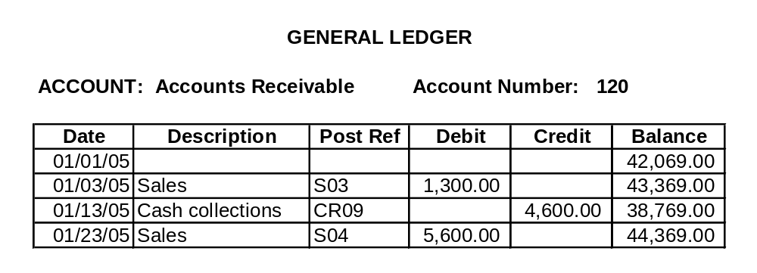
DATA STORAGE
Ledger
  Following is an example of a ledger account for accounts receivable:

Slide 54
DATA STORAGE
Ledger
General ledger
The general ledger is the summary level information for all accounts. Detail information is not kept in this account.

Slide 55
DATA STORAGE
Ledger
General ledger
Example: Suppose XYZ Co. has three customers. Anthony Adams owes XYZ $100. Bill Brown owes $200. And Cory Campbell owes XYZ $300. The balance in accounts receivable in the general ledger will be $600, but you will not be able to tell how much individual customers owe by looking at that account. The detail isn’t there.

Slide 56
DATA STORAGE
Ledger
General ledger
Subsidiary ledger
The subsidiary ledgers contain the detail accounts associated with the related general ledger account. The accounts receivable subsidiary ledger will contain three separate t-accounts—one for Anthony Adams, one for Bill Brown, and one for Cory Campbell.

Slide 57
DATA STORAGE
Ledger
General ledger
Subsidiary ledger
The related general ledger account is often called a “control” account.
The sum of the subsidiary account balances should equal the balance in the control account.

Slide 58
DATA STORAGE
Ledger
General ledger
Subsidiary ledger
Coding techniques
Coding is a method of systematically assigning numbers or letters to data items to help classify and organize them. There are many types of codes including:
  Sequence codes
  Block codes
  Group codes

Slide 59
DATA STORAGE
Ledger
General ledger
Subsidiary ledger
Coding techniques
With sequence codes, items (such as checks or invoices) are numbered consecutively to ensure no gaps in the sequence. The numbering helps ensure that:
  All items are accounted for
  There are no duplicated numbers, which would suggest errors or fraud

Slide 60
DATA STORAGE
Ledger
General ledger
Subsidiary ledger
Coding techniques
When block codes are used, blocks of numbers within a numerical sequence are reserved for a particular category.
EXAMPLE: The first three digits of a Social Security number make up a block code that indicates the state in which the Social Security number was issued:
  001-003 New Hampshire
  004-007 Maine
  008-009 Vermont

Slide 61
DATA STORAGE
Ledger
General ledger
Subsidiary ledger
Coding techniques
When group codes are used, two or more subgroups of digits are used to code an item.
EXAMPLE: The code in the upper, right-hand corner of many checks is a group code organized as follows:
  Digits 1-2 Bank number
  Digit 3 Federal Reserve District
  Digits 4-7 Branch office of Federal Reserve
  Digits 8-9 State

Slide 62
DATA STORAGE
Ledger
General ledger
Subsidiary ledger
Coding techniques
Group coding schemes are often used in assigning general ledger account numbers. The following guidelines should be observed:
  The code should be consistent with its intended use, so make sure you know what users need.
  Provide enough digits to allow room for growth.
  Keep it simple in order to:
    Minimize costs
    Facilitate memorization
    Ensure employee acceptance
  Make sure it’s consistent with:
    The company’s organization structure
    Other divisions of the organization

Slide 63
DATA STORAGE
The chart of accounts is a list of all general ledger accounts an organization uses.
Group coding is often used for these numbers, e.g.:
  The first section identifies the major account categories, such as asset, liability, revenue, etc.
  The second section identifies the primary sub-account, such as current asset or long-term investment.
  The third section identifies the specific account, such as accounts receivable or inventory.
  The fourth section identifies the subsidiary account, e.g., the specific customer code for an account receivable.
The structure of this chart is an important AIS issue, as it must contain sufficient detail to meet the organization’s needs.
Ledger
General ledger
Subsidiary ledger
Coding techniques
Chart of accounts

Slide 64
DATA STORAGE
Table 2-4 in your textbook contains the chart of accounts for S&S.
  What is the account number for federal unemployment taxes payable?
  What is the account number for cost of goods sold?
  What is the range of account numbers for expenses?
  With this chart of accounts, can S&S easily distinguish the costs they incur for automobile insurance from the costs for health insurance?
Ledger
General ledger
Subsidiary ledger
Coding techniques
Chart of accounts

Slide 65
DATA STORAGE
In manual systems and some accounting packages, the first place that transactions are entered is the journal.
  A general journal is used to record:
    Non-routine transactions, such as loan payments
    Summaries of routine transactions
    Adjusting entries
    Closing entries
  A special journal is used to record routine transactions. The most common special journals are:
    Cash receipts
    Cash disbursements
    Credit sales
    Credit purchases
Ledger
General ledger
Subsidiary ledger
Coding techniques
Chart of accounts
Journals

Slide 66
DATA STORAGE
An audit trail exists when there is sufficient documentation to allow the tracing of a transaction from beginning to end or from the end back to the beginning.
The inclusion of posting references and document numbers enable the tracing of transactions through the journals and ledgers and therefore facilitate the audit trail.
Ledger
General ledger
Subsidiary ledger
Coding techniques
Chart of accounts
Journals
Audit trail

Slide 67
DATA STORAGE
Now that we’ve learned some storage terminology, let’s return to the data storage process.
When transaction data is captured on a source document, the next step is to record the data in a journal.
A journal entry is made for each transaction showing the accounts and amounts to be credited.

Slide 68
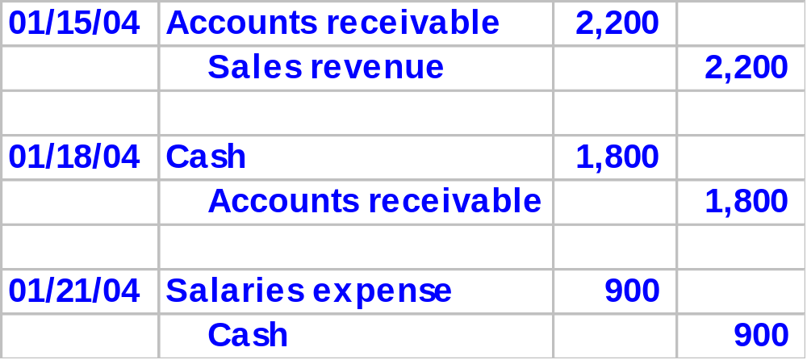
DATA STORAGE
If you took a principles of financial accounting class, you probably worked with journals that looked something like this:

Slide 69
DATA STORAGE
You may not have gotten much experience with special journals, but in most real-world situations, journal entries really work like this.
  Entries are originally made in the general journal only for
    Non-routine transactions.
    Summaries of routine transactions
  Routine transactions are originally entered in special journals. The most common special journals are:
    Credit sales
    Cash receipts
    Credit purchases
    Cash disbursements

Slide 70
DATA STORAGE
Let’s work through an example with a special journal. In this case we’ll use the sales journal.

Slide 71
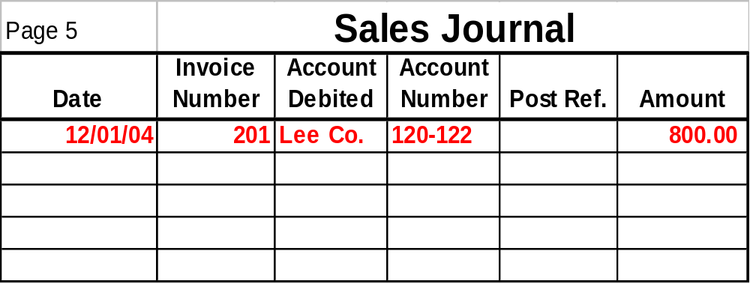
DATA STORAGE
On Dec. 1, a sale is made to Lee Co. for $800. Lee Co. was sent Invoice No. 201.

Slide 72
DATA STORAGE
The general ledger account number for accounts receivable is No. 120. Lee Co. was about the 122nd customer, so their subsidiary account number is 120-122.

Slide 73
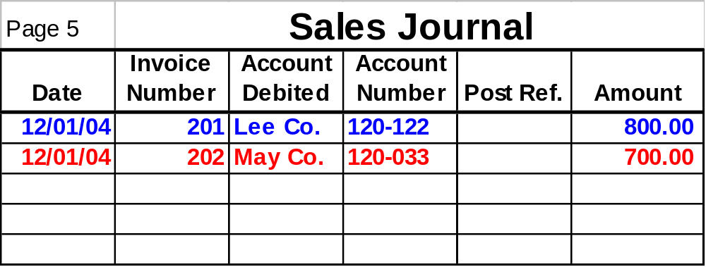
DATA STORAGE
The next sale on Dec. 1 was made to May Co. for $700.

Slide 74
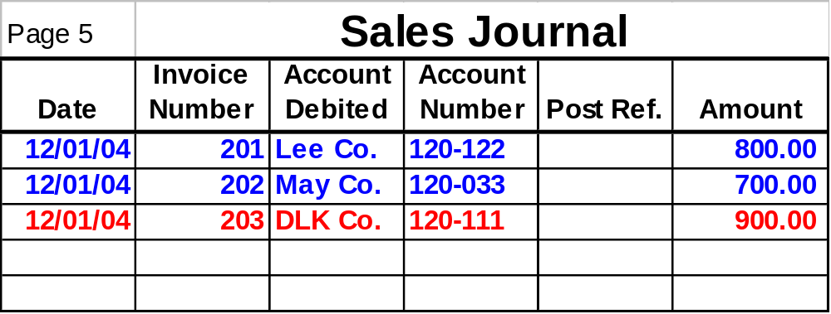
DATA STORAGE
The third and final sale on Dec. 1 was made to DLK Co. for $900.

Slide 75
DATA STORAGE
Suppose the company making these sales posts transactions at the end of each day. Consequently, at day’s end, they will post each individual transaction to the accounts receivable subsidiary ledger:
  An $800 increase in accounts receivable (debit) will be posted to Lee Co.’s subsidiary account (120-122).
  A $700 debit will be posted to May Co.’s subsidiary account (120-033).
  A $900 debit will be posted to DLK Co.’s subsidiary account (120-111).

Slide 76
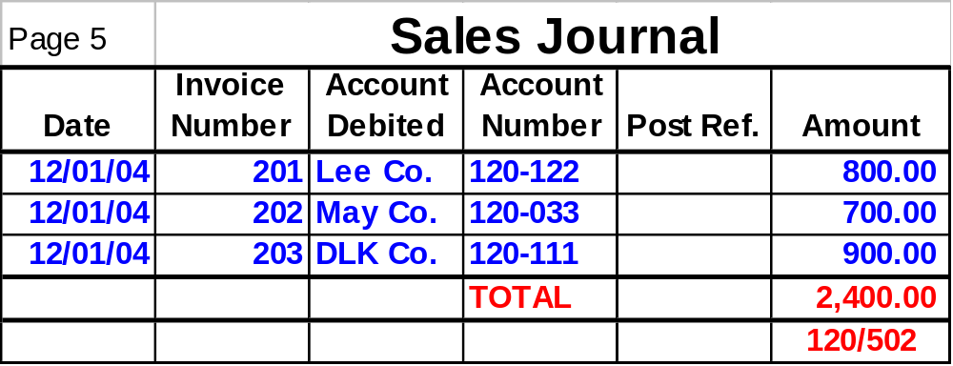
DATA STORAGE
Then a summary journal entry must be made to the general journal. The sales for the period are totaled. In this case, they add up to $2,400.

Slide 77
DATA STORAGE
The “120/502” that appears beneath the total indicates that a summary journal entry is made in the general journal with a debit to accounts receivable (120) and a credit to sales (502).

Slide 78
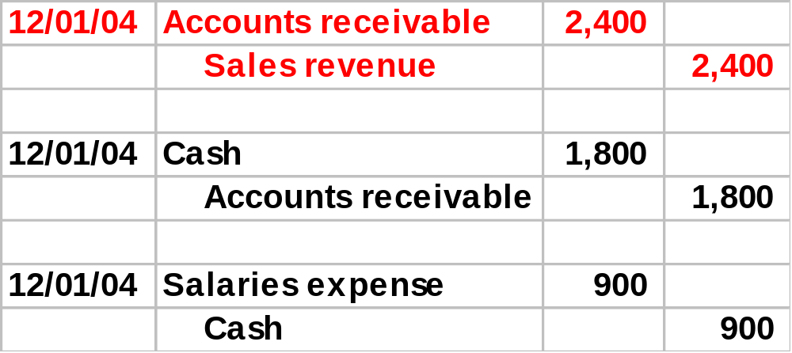
DATA STORAGE
The entries in the general journal are periodically (or automatically) posted to the general ledger. The $2,400 debit to accounts receivable will be posted to the accounts receivable control account, and the $2,400 credit will be posted to the general ledger account for sales.

Slide 79
DATA STORAGE
From time to time, the subsidiary account balances will be added up, and this sum will be compared to the balance of the control account.
What does it mean if they aren’t equal?

Slide 80
DATA STORAGE
Review so far:
  When routine transactions occur, they are recorded in special journals.
  When non-routine transactions occur, they are recorded in the general journal.
  Periodically, the transactions in the special journal are totaled, and a summary entry is made in the general journal.
  The individual line items in the special journal are posted to the subsidiary ledger accounts.
  The items in the general journal are posted to the general ledger.
  Periodically, the balances in the general ledger control accounts are compared to the sums of the balances in the related subsidiary accounts.

Slide 81
DATA STORAGE
Click the button below if you wish to go through a summary of the remaining steps in the accounting cycle:
See Remainder
Of
Accounting Cycle

Slide 82
DATA STORAGE
The Rest of the Story:
  As transactions occur, they are recorded in journals and then posted to ledgers.
  But that’s not the end of the story.
  At the end of each accounting period, we complete the process by carrying out the following steps.

Slide 83
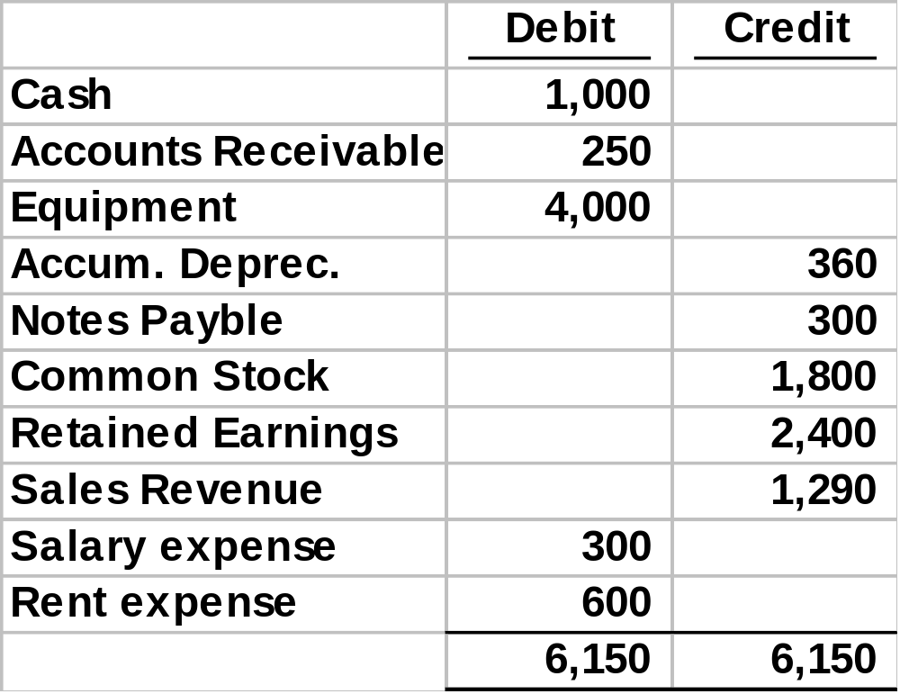
DATA STORAGE
Using the balances in the general ledger, prepare a trial balance.

Slide 84
DATA STORAGE
Prepare the end-of-period adjusting entries.
  Record in journal
  Post to ledger
Make an adjusted trial balance.
Using the numbers in the adjusted trial balance, prepare an income statement.
Prepare closing entries.
Prepare:
  Statement of stockholders’ equity
  Balance sheet
  Statement of cash flows

Slide 85
COMPUTER-BASED STORAGE CONCEPTS
Now let’s moving on to discussing some computer-based storage concepts, including:
  Entity
  Attribute
  Record
  Data Value
  Field
  File
  Master File
  Transaction File
  Database

Slide 86
COMPUTER-BASED STORAGE CONCEPTS
An entity is something about which information is stored.
In your university’s student information system, one entity is the student. The student information system stores information about students.
What are some other entities in your student information system?

Slide 87
COMPUTER-BASED STORAGE CONCEPTS
Attributes are characteristics of interest with respect to the entity.
Some attributes that a student information system typically stores about the student entity are:
  Student ID number
  Phone number
  Address
What are some other attributes about students that a university might store?

Slide 88
COMPUTER-BASED STORAGE CONCEPTS
A field is the physical space where an attribute is stored.
The space where the student ID number is stored is the student ID field.
Col. 1-9 | Col. 10-30 | Col. 31-40 | Col. 41-50
328469993 | SIMPSON | ALICE | 4053721111
328500732 | ANDREWS | BARRY | 4057440236
529036409 | FLANDERS | CARLA | 4057475863

Slide 89
COMPUTER-BASED STORAGE CONCEPTS
A record is the set of attributes stored for a particular instance of an entity.
The combination of attributes stored for Barry Andrews is Barry’s record.
Col. 1-9 | Col. 10-30 | Col. 31-40 | Col. 41-50
328469993 | SIMPSON | ALICE | 4053721111
328500732 | ANDREWS | BARRY | 4057440236
529036409 | FLANDERS | CARLA | 4057475863

Slide 90
COMPUTER-BASED STORAGE CONCEPTS
A data value is the intersection of the row and column.
The data value for Barry Andrews’ phone number is 405-744-0236.
Col. 1-9 | Col. 10-30 | Col. 31-40 | Col. 41-50
328469993 | SIMPSON | ALICE | 4053721111
328500732 | ANDREWS | BARRY | 4057440236
529036409 | FLANDERS | CARLA | 4057475863

Slide 91
COMPUTER-BASED STORAGE CONCEPTS
A file is a group of related records.
The collection of records about all students at the university might be called the student file. If there were only three students and four attributes stored for each student, the file might appear as shown below:
Col. 1-9 | Col. 10-30 | Col. 31-40 | Col. 41-50
328469993 | SIMPSON | ALICE | 4053721111
328500732 | ANDREWS | BARRY | 4057440236
529036409 | FLANDERS | CARLA | 4057475863

Slide 92
COMPUTER-BASED STORAGE CONCEPTS
A master file is a file that stores cumulative information about an organization’s entities.
It is conceptually similar to a ledger in a manual AIS in that:
  The file is permanent
  The file exists across fiscal periods
  Changes are made to the file to reflect the effects of new transactions.

Slide 93
COMPUTER-BASED STORAGE CONCEPTS
A transaction file is a file that contains records of individual transactions (events) that occur during a fiscal period.
It is conceptually similar to a journal in a manual AIS in that:
  The files are temporary
  The files are usually maintained for one fiscal period

Slide 94
COMPUTER-BASED STORAGE CONCEPTS
A database is a set of interrelated, centrally-coordinated files.
When files about students are integrated with files about classes and files about instructors, we have a database.
Student
File
Class
File
Instructor
File

Slide 95
TRANSACTION PROCESSING:
THE DATA PROCESSING CYCLE
The data processing cycle consists of four steps:
  Data input
  Data storage
  Data processing
  Information output

Slide 96
DATA PROCESSING
Once data about a business activity has been collected and entered into a system, it must be processed.

Slide 97
DATA PROCESSING
There are four different types of file processing:
  Updating data to record the occurrence of an event, the resources affected by the event, and the agents who participated, e.g., recording a sale to a customer.
  Changing data, e.g., a customer address
  Adding data, e.g., a new customer.
  Deleting data, e.g., removing an old customer that has not purchased anything in 5 years.

Slide 98
DATA PROCESSING
Updating can be done through several approaches:
  Batch processing

Slide 99
DATA PROCESSING
Batch processing:
  Source documents are grouped into batches, and control totals are calculated.
  Periodically, the batches are entered into the computer system, edited, sorted, and stored in a temporary file.
  The temporary transaction file is run against the master file to update the master file.
  Output is printed or displayed, along with error reports, transaction reports, and control totals.

Slide 100
DATA PROCESSING
Updating can be done through several approaches:
  Batch processing
  On-line Batch Processing

Slide 101
DATA PROCESSING
On-line batch processing:
  Transactions are entered into a computer system as they occur and stored in a temporary file.
  Periodically, the temporary transaction file is run against the master file to update the master file.
  The output is printed or displayed.

Slide 102
DATA PROCESSING
Updating can be done through several approaches:
  Batch processing
  On-line Batch Processing
  On-line, Real-time Processing

Slide 103
DATA PROCESSING
On-line, Real-time Processing
  Transactions are entered into a computer system as they occur.
  The master file is immediately updated with the data from the transaction.
  Output is printed or displayed.

Slide 104
DATA PROCESSING
Updating can be done through several approaches:
  Batch processing
  On-line Batch Processing
  On-line, Real-time Processing
If you’re going through enrollment, which of these approaches would you prefer that your university was using?
Why?

Slide 105
TRANSACTION PROCESSING:
THE DATA PROCESSING CYCLE
The data processing cycle consists of four steps:
  Data input
  Data storage
  Data processing
  Information output

Slide 106
INFORMATION OUTPUT
The final step in the information process is information output.
This output can be in the form of:
  Documents
Documents are records of transactions or other company data.
EXAMPLE: Employee paychecks or purchase orders for merchandise
Documents generated at the end of the transaction processing activities are known as operational documents (as opposed to source documents).
They can be printed or stored as electronic images.

Slide 107
INFORMATION OUTPUT
The final step in the information process is information output.
This output can be in the form of:
  Documents
  Reports
Reports are used by employees to control operational activities and by managers to make decisions and design strategies.
They may be produced:
  On a regular basis
  On an exception basis
  On demand
Organizations should periodically reassess whether each report is needed.

Slide 108
INFORMATION OUTPUT
The final step in the information process is information output.
This output can be in the form of:
  Documents
  Reports
  Queries
Queries are user requests for specific pieces of information.
They may be requested:
  Periodically
  One time
They can be displayed:
  On the monitor, called soft copy
  On the screen, called hard copy

Slide 109
INFORMATION OUTPUT
Output can serve a variety of purposes:
  Financial statements can be provided to both external and internal parties.
  Some outputs are specifically for internal use:
    For planning purposes
Examples of outputs for planning purposes include:
  Budgets
    Budgets are an entity’s formal expression of goals in financial terms
  Sales forecasts

Slide 110
INFORMATION OUTPUT
Output can serve a variety of purposes:
  Financial statements can be provided to both external and internal parties.
  Some outputs are specifically for internal use:
    For planning purposes
    For management of day-to-day operations
Example: delivery schedules

Slide 111
INFORMATION OUTPUT
Performance reports are outputs that are used for control purposes.
These reports compare an organization’s standard or expected performance with its actual outcomes.
Management by exception is an approach to utilizing performance reports that focuses on investigating and acting on only those variances that are significant.
Output can serve a variety of purposes:
  Financial statements can be provided to both external and internal parties.
  Some outputs are specifically for internal use:
    For planning purposes
    For management of day-to-day operations
    For control purposes

Slide 112
INFORMATION OUTPUT
Output can serve a variety of purposes:
  Financial statements can be provided to both external and internal parties.
  Some outputs are specifically for internal use:
    For planning purposes
    For management of day-to-day operations
    For control purposes
    For evaluation purposes
These outputs might include:
  Surveys of customer satisfaction
  Reports on employee error rates

Slide 113
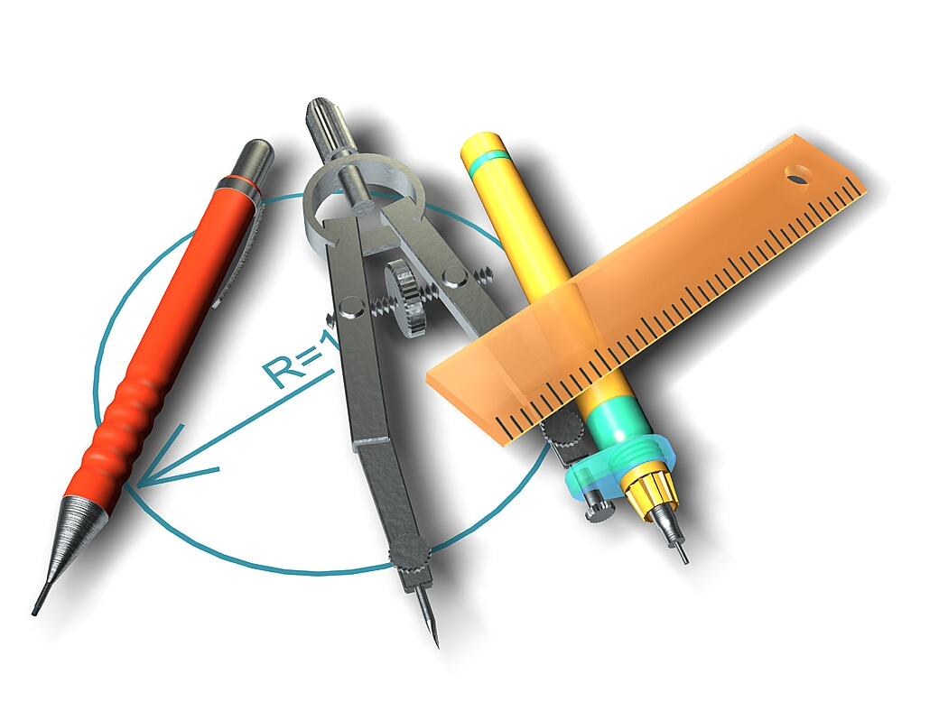
INFORMATION OUTPUT
Behavioral implications of managerial reports:
  YOU GET WHAT YOU MEASURE!

Slide 114
INFORMATION OUTPUT
Suppose an instructor wants to improve student learning.
  He decides to encourage better attendance by grading students on attendance (i.e., measuring it).
  The result will be better student attendance, i.e., you get what you measure.
  The improved attendance may or may not improve learning outcomes.
  Students may be getting better grades when attendance is measured, but not learning more.
  Some students may in fact reduce their studying because they believe they can use the attendance score to boost their grade. This behavior would be a dysfunctional result of the measurement.

Slide 115
INFORMATION OUTPUT
Budgets can cause dysfunctional behavior.
  EXAMPLE: In order to stay within budget, the IT Department did not buy a security package for its system.
  A hacker broke in and devastated some of their data files.
  Critical security measures were foregone in order to meet budgetary goals.
  The resulting costs far outweighed the savings.

Slide 116
INFORMATION OUTPUT
Budgeting can also be dysfunctional in that the focus can be redirected to creating acceptable numbers instead of achieving organizational objectives.
Does this mean organizations shouldn’t budget?

Slide 117

INFORMATION OUTPUT
The saying goes, “Not many people sit around and have a roast goose fall in their lap.”
In other words, if you want a roast goose, you have to aim.
With financial results, you’re also unlikely to achieve when you don’t aim.
Just be careful where you aim!

Slide 118
ROLE OF THE AIS
The traditional AIS captured financial data.
  Non-financial data was captured in other, sometimes-redundant systems
Enterprise resource planning (ERP) systems are designed to integrate all aspects of a company’s operations (including both financial and non-financial information) with the traditional functions of an AIS.

Slide 119
SUMMARY
We’ve learned about the basic business activities in which an organization engages, the decisions that need to be made, and the information required to make those decisions.
We’ve reviewed the data processing cycle and its role in organizing business activities and providing information to users.
Finally, we’ve touched on the role of the information systems in modern organizations and introduced the notion of enterprise resource planning systems.

