Slide 1
HAPTER 3
Data Modeling and Database Design

Slide 2
INTRODUCTION
Questions to be addressed in this chapter include:
  What is the purpose of documentation?
  Why do accountants need to understand documentation?
  What documentation techniques are used in accounting systems?
  What are data flow diagrams and flowcharts?
    How are they alike and different?
    How are they prepared?

Slide 3
INTRODUCTION
Documentation includes the following types of tools:
  Narratives (written descriptions)
  Flowcharts
  Diagrams
  Other written material

Slide 4
INTRODUCTION
Documentation covers the who, what, when, where, why, and how of:
  Data entry
  Processing
  Storage
  Information output
  System controls

Slide 5
INTRODUCTION
How do accountants use documentation?
  At a minimum, they have to read documentation to understand how a system works.
  They may need to evaluate the strengths and weaknesses of an entity’s internal controls.
    Requires heavy reliance on documentation.
  They may peruse documentation to determine if a proposed system meets the needs of its users.
  They may prepare documentation to:
    Demonstrate how a proposed system would work
    Demonstrate their understanding of a system of internal controls

Slide 6
INTRODUCTION
In this chapter, we discuss two of the most common documentation tools:
  Data flow diagrams
Graphical descriptions of the sources and destinations of data. They show:
  Where data comes from
  How it flows
  The processes performed on it
  Where it goes

Slide 7
INTRODUCTION
In this chapter, we discuss two of the most common documentation tools:
  Data flow diagrams
  Flowcharts
Include three types:
  Document flowcharts describe the flow of documents and information between departments or units.
  System flowcharts describe the relationship between inputs, processing, and outputs for a system.
  Program flowcharts describe the sequence of logical operations performed in a computer program.

Slide 8
INTRODUCTION
Documentation techniques are necessary tools for accountants:
  SAS-94 requires that auditors understand the automated and manual procedures an entity uses.
    This understanding can be gleaned through documenting the internal control system—a process that effectively exposes strengths and weaknesses of the system.
  SOX (2002) effectively requires that publicly-traded corporations and their auditors document and test the company’s internal controls.
  Auditing Standard No. 2 promulgated by the PCAOB requires that the external auditor express an opinion on the client’s system of internal controls.

Slide 9
INTRODUCTION
Documentation tools help accountants by:
  Organizing very complicated systems into a form that can be more readily understood
  Helping new team members understand a pre-existing system

Slide 10
INTRODUCTION
Which method should you use—flowcharts or DVDs?
  62.5% of IS professionals use DFDs.
  97.6% use flowcharts.
  Both can be prepared relatively simply using available software.
  Both are tested on professional exams.
  CONCLUSION: You need to know them both.

Slide 11
DATA FLOW DIAGRAMS
A data flow diagram (DFD) graphically describes the flow of data within an organization. It is used to:
  Document existing systems
  Plan and design new systems
There is no black-and-white approach to developing a DFD.

Slide 12
DATA FLOW DIAGRAMS
Example of a data flow diagram of the customer payment process from Figure 3-3 in your textbook
Accounts
Receivable
Customer
Customer
payment
1.0
Process
Payment
Remittance
data
2.0
Update
A/R
Receivables
Information
Credit
Manager
Deposit
Bank

Slide 13
DATA FLOW DIAGRAMS
A data flow diagram consists of four basic elements:
  Data sources and destinations
  Data flows
  Transformation processes
  Data stores

Slide 14
DATA FLOW DIAGRAMS
A data flow diagram consists of four basic elements:
  Data sources and destinations
  Data flows
  Transformation processes
  Data stores

Slide 15
DATA FLOW DIAGRAMS
Data sources and destinations
  Appear as squares
  Represent organizations or individuals that send or receive data used or produced by the system
An item can be both a source and a destination

Slide 16
DATA FLOW DIAGRAMS
Data sources and destinations are marked in red.
Can you tell which are sources and which are destinations?
Accounts
Receivable
Customer
Customer
payment
1.0
Process
Payment
Remittance
data
2.0
Update
A/R
Receivables
Information
Credit
Manager
Deposit
Bank

Slide 17
DATA FLOW DIAGRAMS
A data flow diagram consists of four basic elements:
  Data sources and destinations
  Data flows
  Transformation processes
  Data stores

Slide 18
DATA FLOW DIAGRAMS
Data flows
  Appear as arrows
  Represent the flow of data between sources and destinations, processes, and data stores

Slide 19
DATA FLOW DIAGRAMS
Data flows are shown in red.
Does it appear that a data flow can be two-way?
If so, how is it handled?
Accounts
Receivable
Customer
Customer
payment
1.0
Process
Payment
Remittance
data
2.0
Update
A/R
Receivables
Information
Credit
Manager
Deposit
Bank

Slide 20
DATA FLOW DIAGRAMS
Data flows should always be labeled.
The exception is a data flow moving into or out of a data store.
What symbol is the data store?
Accounts
Receivable
Customer
Customer
payment
1.0
Process
Payment
Remittance
data
2.0
Update
A/R
Receivables
Information
Credit
Manager
Deposit
Bank

Slide 21
DATA FLOW DIAGRAMS
As you probably surmised from the previous slides, if a data flow is two-way, use a bi-directional arrow.
Update
Receiv-
ables
General
Ledger

Slide 22
DATA FLOW DIAGRAMS
If two data elements flow together, then the use of one data flow line is appropriate.
Process
Payment
Customer
Cash Rec’t & Remittance Slip

Slide 23
DATA FLOW DIAGRAMS
If the data elements do not always flow together, then multiple lines will be needed.
Process
Payment
Customer
Customer Inquiry
Customer Payment

Slide 24
DATA FLOW DIAGRAMS
A data flow diagram consists of four basic elements:
  Data sources and destinations
  Data flows
  Transformation processes
  Data stores

Slide 25
DATA FLOW DIAGRAMS
Processes
  Appear as circles
  Represent the transformation of data

Slide 26
DATA FLOW DIAGRAMS
The transformation processes are shown in red.
Every process must have at least one data inflow and at least one data outflow. Why?
What do you notice about how the processes are labeled?
Accounts
Receivable
Customer
Customer
payment
1.0
Process
Payment
Remittance
data
2.0
Update
A/R
Receivables
Information
Credit
Manager
Deposit
Bank

Slide 27
DATA FLOW DIAGRAMS
Data stores
  Appear as two horizontal lines
  Represent a temporary or permanent repository of data

Slide 28
DATA FLOW DIAGRAMS
The data store is shown in red.
Notice that the inflows and outflows to the data store are not labeled.
Accounts
Receivable
Customer
Customer
payment
1.0
Process
Payment
Remittance
data
2.0
Update
A/R
Receivables
Information
Credit
Manager
Deposit
Bank

Slide 29
DATA FLOW DIAGRAMS
Data dictionary:
  Data flows and data stores are typically collections of data elements.
  EXAMPLE: A data flow labeled student information might contain elements such as student name, date of birth, ID number, address, phone number, and major.
  The data dictionary contains a description of all data elements, data stores, and data flows in a system.

Slide 30
DATA FLOW DIAGRAMS
Subdividing the DFD:
  Few systems can be fully diagrammed on one sheet of paper, and users have needs for differing levels of detail.
  Consequently, DFDs are subdivided into successively lower levels to provide increasing amounts of detail.

Slide 31
DATA FLOW DIAGRAMS
The highest level of DFD is called a context diagram.
  It provides a summary-level view of the system.
  It depicts a data processing system and the external entities that are:
    Sources of its input
    Destinations of its output

Slide 32
DATA FLOW DIAGRAMS
Govt.
Agencies
Depart-
ments
Tax report & payment
Time cards
Payroll
Processing
System
Employees
Employee checks
New employee form
Payroll check
Bank
Human
Resources
Employee change form
Payroll report
This is the context diagram for the S&S payroll processing system (Figure 3-5 in your textbook).
Manage-
ment

Slide 33
DATA FLOW DIAGRAMS
Govt.
Agencies
Depart-
ments
Tax report & payment
Time cards
Payroll
Processing
System
Employees
Employee checks
New employee form
Payroll check
Bank
Human
Resources
Employee change form
Payroll report
Manage-
ment
What information comes into this process, and from where?

Slide 34
DATA FLOW DIAGRAMS
Govt.
Agencies
Depart-
ments
Tax report & payment
Time cards
Payroll
Processing
System
Employees
Employee checks
New employee form
Payroll check
Bank
Human
Resources
Employee change form
Payroll report
Manage-
ment
What information is produced by this process, and where does it go?

Slide 35
DATA FLOW DIAGRAMS
Depart-
ments
Employees
Employee
paychecks
Human
Resources
New employee
form
Time
cards
1.0
Update
empl.
Payroll
file
2.0
Pay
Employ-
ees
Employee
Change
form
Payroll
check
Bank
Payroll
Disburse-
ment data
3.0
Prepare
reports
Employee/
Payroll file
5.0
Update
Gen.
Ledger
This diagram shows the next level of detail for the context diagram in Figure 3-5.
Payroll tax
disb. voucher
Payroll
report
4.0
Pay
taxes
General
Ledger
Manage-
ment
Tax report
& payment
Govt.
Agencies

Slide 36
DATA FLOW DIAGRAMS
Depart-
ments
Employees
Employee
paychecks
Human
Resources
New employee
form
Time
cards
1.0
Update
empl.
Payroll
file
2.0
Pay
Employ-
ees
Employee
Change
form
Payroll
check
Bank
Payroll
Disburse-
ment data
3.0
Prepare
reports
Employee/
Payroll file
5.0
Update
Gen.
Ledger
What information comes into these processes and from where?
Payroll tax
disb. voucher
Payroll
report
4.0
Pay
taxes
General
Ledger
Manage-
ment
Tax report
& payment
Govt.
Agencies

Slide 37
DATA FLOW DIAGRAMS
Depart-
ments
Employees
Employee
paychecks
Human
Resources
New employee
form
Time
cards
1.0
Update
empl.
Payroll
file
2.0
Pay
Employ-
ees
Employee
Change
form
Payroll
check
Bank
Payroll
Disburse-
ment data
3.0
Prepare
reports
Employee/
Payroll file
5.0
Update
Gen.
Ledger
What information is produced by these processes, and where does it go?
Payroll tax
disb. voucher
Payroll
report
4.0
Pay
taxes
General
Ledger
Manage-
ment
Tax report
& payment
Govt.
Agencies

Slide 38
DATA FLOW DIAGRAMS
Depart-
ments
Employees
Employee
paychecks
Human
Resources
New employee
form
Time
cards
1.0
Update
empl.
Payroll
file
2.0
Pay
Employ-
ees
Employee
Change
form
Payroll
check
Bank
Payroll
Disburse-
ment data
3.0
Prepare
reports
Employee/
Payroll file
5.0
Update
Gen.
Ledger
How do the sources and destinations differ from the context diagram?
Payroll tax
disb. voucher
Payroll
report
4.0
Pay
taxes
General
Ledger
Manage-
ment
Tax report
& payment
Govt.
Agencies

Slide 39
DATA FLOW DIAGRAMS
Depart-
ments
Employees
Employee
paychecks
Human
Resources
New employee
form
Time
cards
1.0
Update
empl.
Payroll
file
2.0
Pay
Employ-
ees
Employee
Change
form
Payroll
check
Bank
Payroll
Disburse-
ment data
3.0
Prepare
reports
Employee/
Payroll file
5.0
Update
Gen.
Ledger
Notice that each process in the DFD is numbered sequentially.
Payroll tax
disb. voucher
Payroll
report
4.0
Pay
taxes
General
Ledger
Manage-
ment
Tax report
& payment
Govt.
Agencies

Slide 40
DATA FLOW DIAGRAMS
Depart-
ments
Employees
Employee
paychecks
Human
Resources
New employee
form
Time
cards
1.0
Update
empl.
Payroll
file
2.0
Pay
Employ-
ees
Employee
Change
form
Payroll
check
Bank
Suppose we exploded Process 2.0 (pay employees) in the next level. The sub-processes would be numbered 2.1, 2.2, 2.3, etc.
Payroll
Disburse-
ment data
3.0
Prepare
reports
Employee/
Payroll file
5.0
Update
Gen.
Ledger
Payroll tax
disb. voucher
Payroll
report
4.0
Pay
taxes
General
Ledger
Manage-
ment
Tax report
& payment
Govt.
Agencies

Slide 41
DATA FLOW DIAGRAMS
We’re going to go into a partial example of how the first level of detail was created.
But before we do, let’s step through some guidelines on how to create a DFD.

Slide 42
DATA FLOW DIAGRAMS
RULE 1: Understand the system. Observe the flow of information and interview people involved to gain that understanding.
RULE 2: Ignore control processes and control actions (e.g., error corrections). Only very critical error paths should be included.
RULE 3: Determine the system boundaries—where it starts and stops. If you’re not sure about a process, include it for the time being.

Slide 43
DATA FLOW DIAGRAMS
RULE 4: Draw the context diagram first, and then draw successively greater levels of detail.
RULE 5: Identify and label all data flows. The only ones that do not have to be labeled are those that go into or come out of data stores.
RULE 6: Data flows that always flow together should be grouped together. Those that do not flow together should be shown on separate lines.

Slide 44
DATA FLOW DIAGRAMS
RULE 7: Show a process (circle) wherever a data flow is converted from one form to another. Likewise, every process should have at least one incoming data flow and at least one outgoing data flow.
RULE 8: Transformation processes that are logically related or occur simultaneously can be grouped in one bubble.
RULE 9: Number each process sequentially. A process labeled 5.0 would be exploded at the next level into processes numbered 5.1, 5.2, etc. A process labeled 5.2 would be exploded into 5.21, 5.22, etc.

Slide 45
DATA FLOW DIAGRAMS
RULE 10: Process names should include action verbs, such as update, prepare, etc.
RULE 11: Identify and label all data stores, whether temporary or permanent.
RULE 12: Identify and label all sources and destinations. An entity can be both a source and destination. You may wish to include such items twice on the diagram, if needed, to avoid excessive or crossing lines.

Slide 46
DATA FLOW DIAGRAMS
RULE 13: As much as possible, organize the flow from top to bottom and left to right.
RULE 14: You’re not likely to get it beautiful the first time, so plan to go through several iterations of refinements.
RULE 15: On the final copy, lines should not cross. On each page, include:
  The name of the DFD
  The date prepared
  The preparer’s name

Slide 47
DATA FLOW DIAGRAMS
Now that we’ve been through the guidelines for developing DFDs, let’s go back to the chapter example and see if we can re-create a part of it.
You may wish to create a table with the following headings to organize your information:
  Data Inputs
  Processes
  Data Outputs

Slide 48
DATA FLOW DIAGRAMS
Data Inputs | Processes | Data Outputs

Slide 49
DATA FLOW DIAGRAMS
The first paragraph of the narrative for the payroll process reads as follows:
  When employees are hired, they complete a new employee form. When a change to an employee’s payroll status occurs, such as a raise or a change in the number of exemptions, human resources completes an employee change form. A copy of these forms is sent to payroll. These forms are used to create or update the records in the employee/payroll file and are then stored in the file. Employee records are stored alphabetically.

Slide 50
DATA FLOW DIAGRAMS
The first paragraph of the narrative for the payroll process reads as follows:
  When employees are hired, they complete a new employee form. When a change to an employee’s payroll status occurs, such as a raise or a change in the number of exemptions, human resources completes an employee change form. A copy of these forms is sent to payroll. These forms are used to create or update the records in the employee/payroll file and are then stored in the file. Employee records are stored alphabetically.
The portion marked in red relates to activities that go on outside the boundaries of the payroll system. Consequently, these activities will not be included on the DFD.

Slide 51
DATA FLOW DIAGRAMS
The first paragraph of the narrative for the payroll process reads as follows:
  When employees are hired, they complete a new employee form. When a change to an employee’s payroll status occurs, such as a raise or a change in the number of exemptions, human resources completes an employee change form. A copy of these forms is sent to payroll. These forms are used to create or update the records in the employee/payroll file and are then stored in the file. Employee records are stored alphabetically.
The portion marked in red suggests two data flows coming into the payroll process (new employee forms and employee change forms). The source of the inflows is the human resources department.

Slide 52
DATA FLOW DIAGRAMS
Data Inputs | Processes | Data Outputs
New employee forms and employee change forms (from H.R. Dept.)

Slide 53
DATA FLOW DIAGRAMS
The first paragraph of the narrative for the payroll process reads as follows:
  When employees are hired, they complete a new employee form. When a change to an employee’s payroll status occurs, such as a raise or a change in the number of exemptions, human resources completes an employee change form. A copy of these forms is sent to payroll. These forms are used to create or update the records in the employee/payroll file and are then stored in the file. Employee records are stored alphabetically.
The sentence marked in red suggests a process (update employee records) with the data outflow going to a data store (the employee/payroll file).

Slide 54
DATA FLOW DIAGRAMS
Data Inputs | Processes | Data Outputs
New employee forms and employee change forms (from H.R. Dept.) | Update records (read from file and record) | Updated employee/ payroll file

Slide 55
DATA FLOW DIAGRAMS
The first paragraph of the narrative for the payroll process reads as follows:
  When employees are hired, they complete a new employee form. When a change to an employee’s payroll status occurs, such as a raise or a change in the number of exemptions, human resources completes an employee change form. A copy of these forms is sent to payroll. These forms are used to create or update the records in the employee/payroll file and are then stored in the file. Employee records are stored alphabetically.
The final sentence in this paragraph provides information about the physical storage of the data. Physical information is utilized in flowcharts but not in data flow diagrams.

Slide 56
DATA FLOW DIAGRAMS
Data Inputs | Processes | Data Outputs
New employee forms and employee change forms (from H.R. Dept.) | Update records (read from file and record) | Updated employee/ payroll file
We will not do the entire DFD, however, you could finish this table by reading the remainder of the narrative in Table 3-1 in your textbook. The portion of the table completed so far allows us to draw the segment of the DFD that is highlighted on the following slide.

Slide 57
DATA FLOW DIAGRAMS
Depart-
ments
Employees
Employee
paychecks
Human
Resources
New employee
form
Time
cards
1.0
Update
empl.
Payroll
file
2.0
Pay
Employ-
ees
Employee
Change
form
Payroll
check
Bank
Payroll
Disburse-
ment data
3.0
Prepare
reports
Employee/
Payroll file
5.0
Update
Gen.
Ledger
Payroll tax
disb. voucher
Payroll
report
4.0
Pay
taxes
General
Ledger
Manage-
ment
Tax report
& payment
Govt.
Agencies

Slide 58
DATA FLOW DIAGRAMS
Keep the following in mind as you develop your DFD:
  Remember to ignore control activities, such as error correction processes.
  Some data inputs and outputs will not appear on the first level of the DFD but appear as the processes are exploded into greater levels of detail.

Slide 59
DATA FLOW DIAGRAMS
The data flow diagram focuses on the logical flow of data.
Next, we will discuss flowcharts, which place greater emphasis on physical details.

Slide 60
FLOWCHARTS
A flowchart is an analytical technique that describes some aspect of an information system in a clear, concise, and logical manner.
Flowcharts use a set of standard symbols to depict processing procedures and the flow of data.

Slide 61
FLOWCHARTS
Every shape on a flowchart depicts a unique operation, input, processing activity, or storage medium.
In the days of yore, flowcharts were commonly drawn with templates.
Now, it is more common to use a software program such as Visio.
  Microsoft and Power Point are also used
  The software uses pre-drawn shapes, and the developer drags the shapes into the drawing.

Slide 62
FLOWCHARTS
There are four types of flowcharting symbols:
  Input/output symbols
Input/output symbols indicate the type of device or media that provides input to or records output from a process.

Slide 63
FLOWCHARTS
There are four types of flowcharting symbols:
  Input/output symbols
  Processing symbols
Processing symbols indicate the type of device used to process the data or whether the data is processed manually.

Slide 64
FLOWCHARTS
There are four types of flowcharting symbols:
  Input/output symbols
  Processing symbols
  Storage symbols
Storage symbols indicate the type of device used to store data while the system is not using it.

Slide 65
FLOWCHARTS
There are four types of flowcharting symbols:
  Input/output symbols
  Processing symbols
  Storage symbols
  Flow and miscellaneous symbols
Flow and miscellaneous symbols may indicate:
  The flow of data and goods
  The beginning or end of the flowchart
  The location of a decision
  An explanatory note

Slide 66
FLOWCHARTS
Click on buttons below if you wish to review symbols in the various categories.
Input/Output
Symbols
Processing
Symbols
Storage
Symbols
Flow & Misc.
Symbols

Slide 67
INPUT/OUTPUT SYMBOLS
Document Symbol
  Represents a document or report that is prepared by hand or printed by a computer.

Slide 68
INPUT/OUTPUT SYMBOLS
3
2
1
Multiple Copies of One Document
  Indicates multiple copies of a paper document or report.
  The document copies should be numbered in the upper, right-hand corner.

Slide 69
INPUT/OUTPUT SYMBOLS
Input/Output; Journal/Ledger
  Can represent any input or output on a program flowchart.
  Also represents accounting journals or ledgers in a document flowchart.

Slide 70
INPUT/OUTPUT SYMBOLS
Display
  Represents information displayed by an online output device such as a terminal, monitor, or screen.

Slide 71
INPUT/OUTPUT SYMBOLS
Online Keying
  Represents data entry by an online device such as a terminal or personal computer.

Slide 72
INPUT/OUTPUT SYMBOLS
Terminal or Personal Computer
  Combines the display and online keying symbols to represent terminals and personal computers.

Slide 73
INPUT/OUTPUT SYMBOLS
Transmittal Tape
  Represents manually prepared control totals which are to be compared to computer totals for control purposes.
Return to Menu
Processing Symbols
Skip Symbols

Slide 74
PROCESSING SYMBOLS
Computer Processing
  Represents a process performed by a computer, which usually results in a change in data or information.

Slide 75
PROCESSING SYMBOLS
Manual Operation
  Represents a processing operation that is performed manually.

Slide 76
PROCESSING SYMBOLS
Auxiliary Operation
  Represents a processing operation carried out by a device other than a computer, e.g., an optical character scanner.

Slide 77
PROCESSING SYMBOLS
Off-line Keying Operation
  Represents an operation that uses an off-line keying device, such as a cash register or keying to a disk.
Return to Menu
Storage Symbols
Skip Symbols

Slide 78
STORAGE SYMBOLS
Magnetic disk
  Represents data stored permanently on a magnetic disk.
  Frequently used to represent master files and databases.

Slide 79
STORAGE SYMBOLS
Magnetic Tape
  Represents data stored on a magnetic tape.
  Sometimes represents transaction files.

Slide 80
STORAGE SYMBOLS
Diskette
  Represents data stored on a floppy disk or zip disk.

Slide 81
STORAGE SYMBOLS
Online Storage
  Represents data stored in a temporary online file in a direct-access medium such as a magnetic disk.

Slide 82
STORAGE SYMBOLS
A
File
  Represents a file of documents that are manually stored and retrieved.
  Letter indicates the ordering sequence:
    A = Alphabetic order
    D = Date order
    N = Numeric order
Return to Menu
Flow/Misc Symbols
Skip Symbols

Slide 83
FLOW AND MISCELLANEOUS SYMBOLS
Document or Processing Flow
  Represents the direction of processing or document flow.
  Normal flow is top to bottom and left to right.

Slide 84
FLOW AND MISCELLANEOUS SYMBOLS
Data/Information Flow
  Represents the direction of data/information flow.
  Often used to show data being copied from one document to another.

Slide 85
FLOW AND MISCELLANEOUS SYMBOLS
Communication Link
  Represents the transmission of data from one location to another via communication lines.

Slide 86
FLOW AND MISCELLANEOUS SYMBOLS
On-page connector
  Connects processing from one location to another on the same page.
  Used to avoid crisscrossing lines.

Slide 87
FLOW AND MISCELLANEOUS SYMBOLS
Off-page connector
  Connects the processing flow between two different pages.
  Signals the exit from one page and the corresponding entrance on another page.

Slide 88
FLOW AND MISCELLANEOUS SYMBOLS
Terminal
  Represents the beginning, end, or a point of interruption in a process or program.
  Also used to indicate an external party.

Slide 89
FLOW AND MISCELLANEOUS SYMBOLS
Decision
  Represents a decision-making step.
  Used in a program flowchart to show branching to alternate paths.

Slide 90
FLOW AND MISCELLANEOUS SYMBOLS
Annotation
  Provides for the addition of descriptive comments or explanatory notes as clarification.
Return to Menu
Continue

Slide 91
DOCUMENT FLOWCHARTS
A document flowchart shows the flow of documents and information among areas of responsibility in an organization.
These flowcharts trace a document from cradle to grave and show:
  Where a document comes from
  Where it’s distributed
  How it’s used
  It’s ultimate disposition
  Everything that happens as it flows through the system

Slide 92
DOCUMENT FLOWCHARTS
Internal control flowcharts are document flowcharts used to evaluate the adequacy of internal controls, such as segregation of duties or internal checks.
They can reveal weaknesses or inefficiences such as:
  Inadequate communication flows
  Unnecessarily complex document flows
  Procedures that cause wasteful delays
Document flowcharts are also prepared in the system design process.

Slide 93
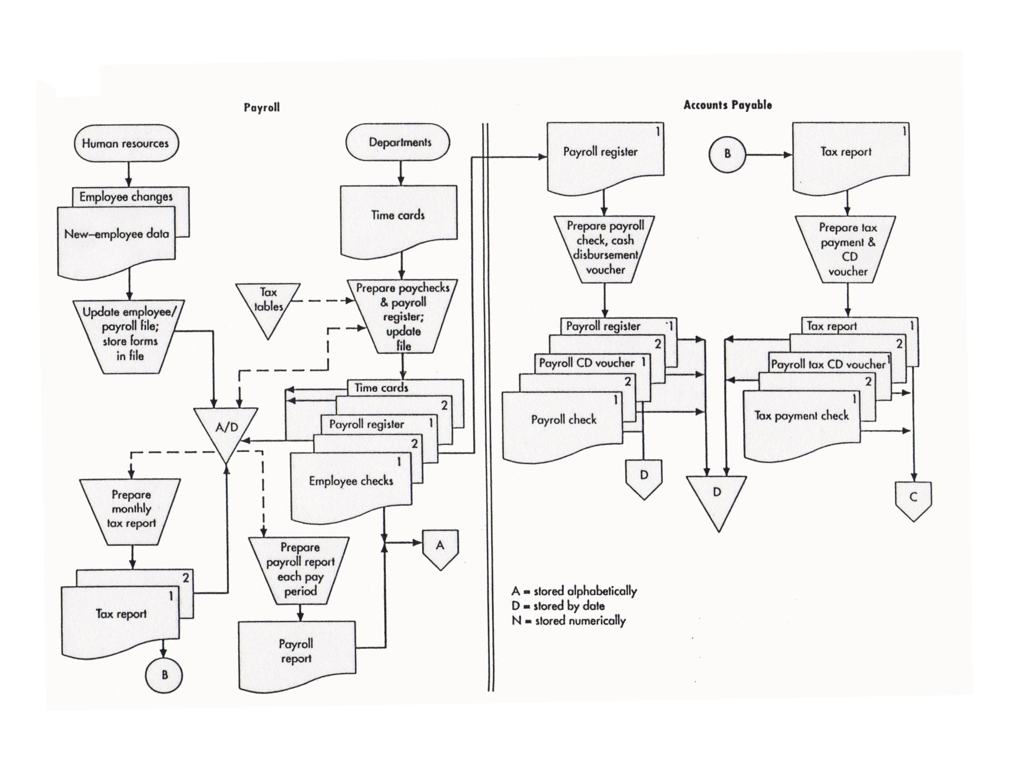
This is part of the document flowchart from Figure 3-9 in your textbook.

Slide 94
GUIDELINES FOR PREPARING FLOWCHARTS
Let’s step through some guidelines for preparing flowcharts:
  As with DFDs, you can’t effectively prepare a flowchart if you don’t understand the system, so:
    Interview users, developers, auditors, and management.
    Administer questionnaires.
    Read through narratives.
    Walk through systems transactions

Slide 95
GUIDELINES FOR PREPARING FLOWCHARTS
  Identify:
    Entities to be flowcharted, e.g., departments, functions, external parties (the parties who “do” things in the story)
    Documents or information flows
    Processes
  As you read through a narrative, you may want to mark the preceding items with different shapes (e.g., drawing a rectangle around entities, circling documents, etc.).

Slide 96
GUIDELINES FOR PREPARING FLOWCHARTS
  Use separate columns for the activity of each entity.
    Example: If there are three different departments or functions that “do” things in the narrative, there would be three columns on the flowchart.

Slide 97
What are the entities in this flowchart?

Slide 98
GUIDELINES FOR PREPARING FLOWCHARTS
  Flowchart the normal course of operations, and identify exceptions with annotations.
  As much as possible, the flow should go from top to bottom and left to right.
  Use standard flowcharting symbols, and draw with a template or computer.
  Clearly label all symbols. Use annotations if necessary to provide adequate explanation.

Slide 99
GUIDELINES FOR PREPARING FLOWCHARTS
  Give the flowchart a clear beginning and ending.
    Show where each document originated and its final disposition.
  One approach you can use is to read through the narrative and for each step define:
    What was (were) the input(s)
    What process was carried out
    What was (were) the output(s)
  Note on the next slide that the flow sequence is input -- process – output.

Slide 100
Identifies where input is coming from

Slide 101
Inputs

Slide 102
Process

Slide 103
Output to
storage

Slide 104
Input for
next
process

Slide 105
Process

Slide 106
Output

Slide 107
GUIDELINES FOR PREPARING FLOWCHARTS
  Every manual process should have at least one input and at least one output.
  Show all data entered into or retrieved from a computer file as passing through a process first.
  Do not show process symbols for:
    Forwarding a document to another entity
    Filing a document

Slide 108
Forwarding
a document

Slide 109
Filing
a document

Slide 110
GUIDELINES FOR PREPARING FLOWCHARTS
  Do not connect two documents except when forwarding to another column.
    When a document is forwarded, show it in both locations.

Slide 111
Show forwarded document in both locations

Slide 112
GUIDELINES FOR PREPARING FLOWCHARTS
  When using multiple copies of a document, place document numbers in the upper, right-hand corner.

Slide 113
What happens to the document numbers as the documents move to other locations?

Slide 114
GUIDELINES FOR PREPARING FLOWCHARTS
  Show on-page connectors and label them clearly to avoid excess flow lines.

Slide 116
GUIDELINES FOR PREPARING FLOWCHARTS
  Use off-page connectors if the flow goes to another page.

Slide 117
Are there other off-page connectors on this flowchart?

Slide 118
GUIDELINES FOR PREPARING FLOWCHARTS
  If a flowchart takes more than one page, label the pages as 1 of 5, 2 of 5, 3 of 5, etc.
  Show documents or reports first in the column where they are created.
  Start with a rough draft; then redesign to avoid clutter and crossed lines.
  Verify the accuracy of your flowchart by reviewing it with users, etc.
  Place the flowchart name, the date, and the preparer’s name on each page of the final copy.

Slide 119
SYSTEM FLOWCHARTS
Now that we’ve looked at document flowcharts and guidelines for creating flowcharts, let’s take a brief look at system flowcharts.

Slide 120
SYSTEM FLOWCHARTS
A system flowchart depicts the relationship among the inputs, processes, and outputs of an AIS.
  The system flowchart begins by identifying the inputs to the system.
These inputs can be:
  New data
  Data stored for future use
  Both

Slide 121
SYSTEM FLOWCHARTS
A system flowchart depicts the relationship among the inputs, processes, and outputs of an AIS.
  The system flowchart begins by identifying the inputs to the system.
  Each input is followed by a process, i.e., the steps performed on the data.
If the process is performed by a computer, the logic of the computer program would be depicted in a program flowchart.

Slide 122
SYSTEM FLOWCHARTS
A system flowchart depicts the relationship among the inputs, processes, and outputs of an AIS.
  The system flowchart begins by identifying the inputs to the system.
  Each input is followed by a process, i.e., the steps performed on the data.
  The process is followed by outputs—the resulting new information.
The output may be:
  Stored for later use
  Displayed on a screen
  Printed on paper
  An input to the next process

Slide 123
SYSTEM FLOWCHARTS
A system flowchart depicts the relationship among the inputs, processes, and outputs of an AIS.
  The system flowchart begins by identifying the inputs to the system.
  Each input is followed by a process, i.e., the steps performed on the data.
  The process is followed by outputs—the resulting new information.
  In other words, it’s the same basic input – process – output pattern that we saw in the document flowchart.

Slide 124
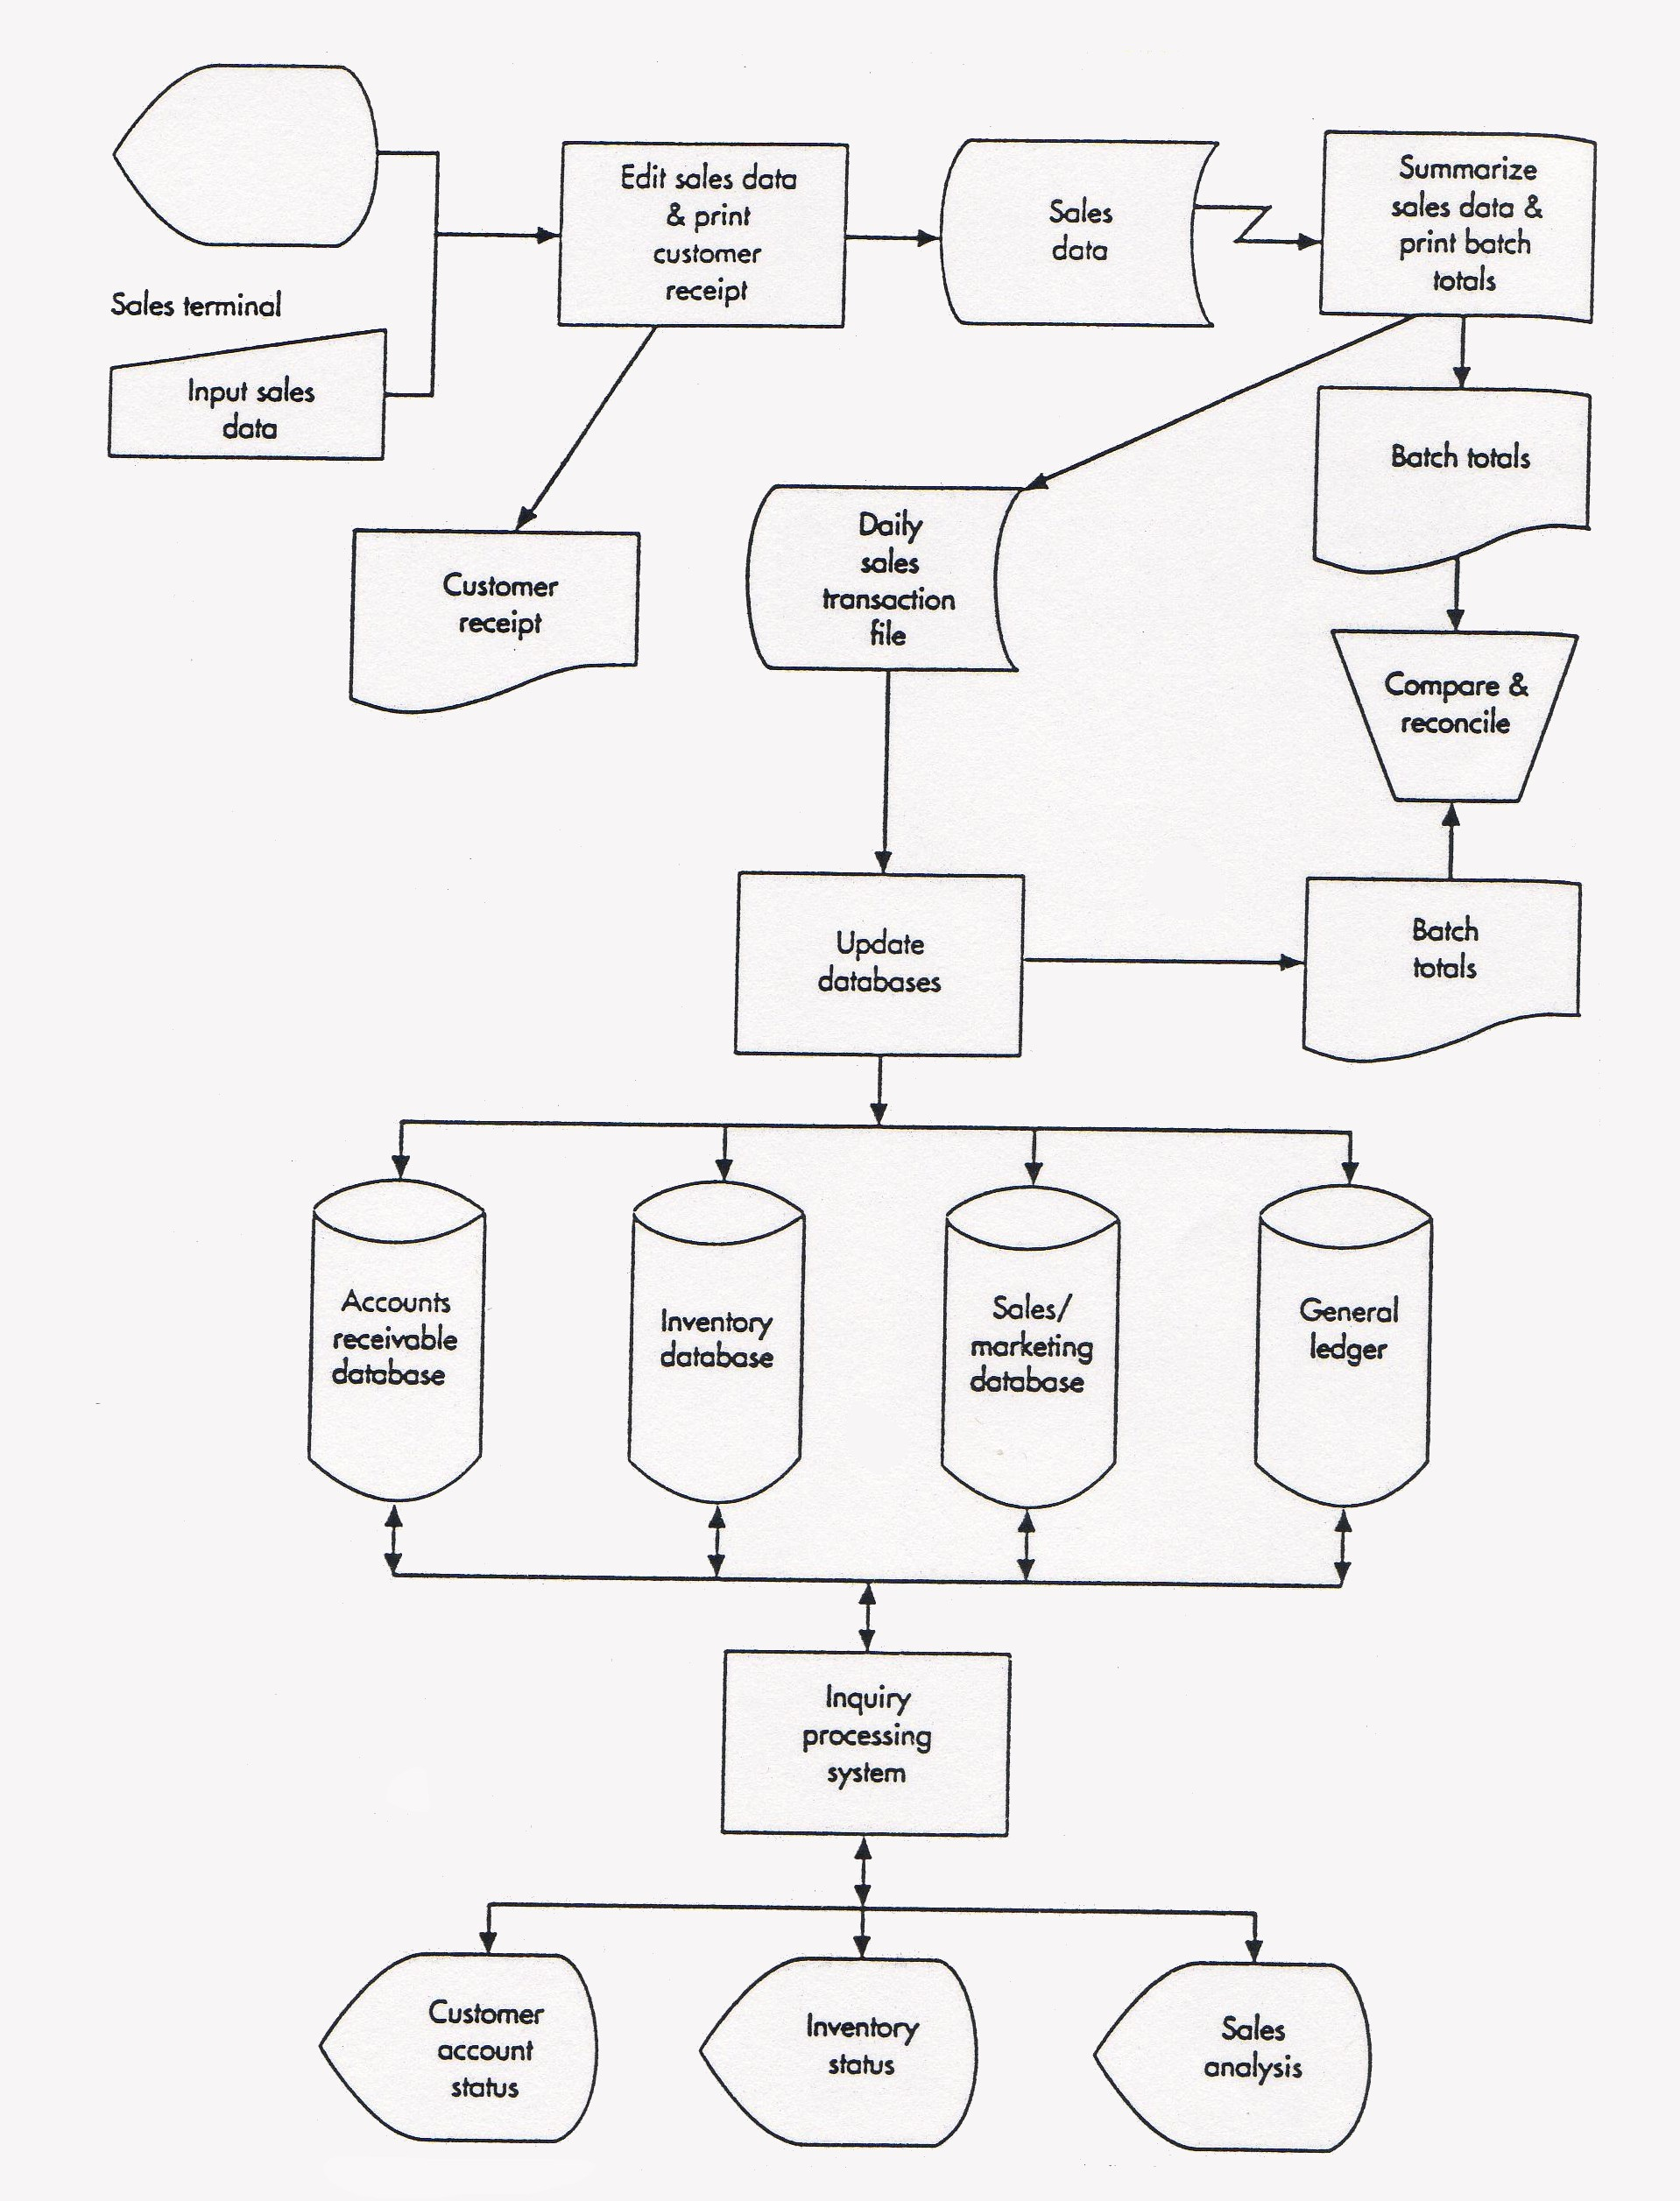
System Flowchart Shown in Figure 3-11 in your textbook
Can you spot the input – process – output pattern?

Slide 125
PROGRAM FLOWCHARTS
Program flowcharts illustrate the sequence of logical operations performed by a computer in executing a program.
They also follow an input – process – output pattern.

Slide 126
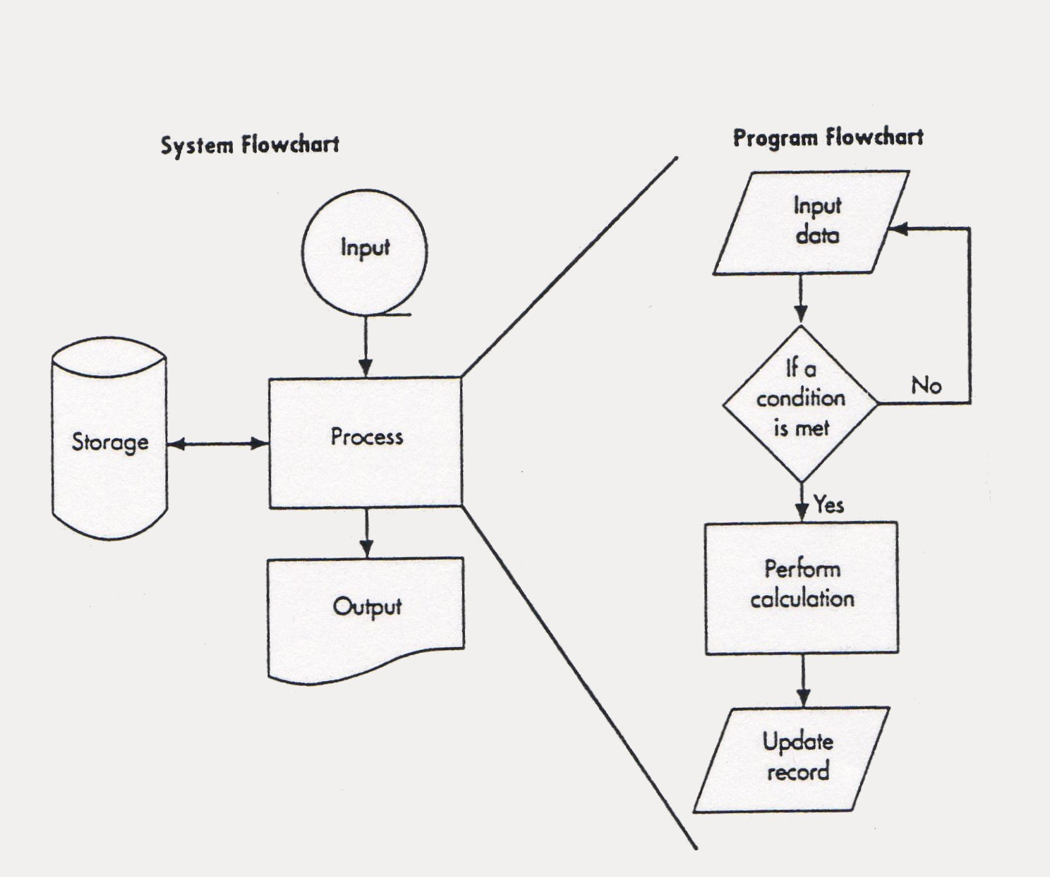
The program flowchart from Figure 3-11 in your textbook is shown on the right.

Slide 127
Note that the program flowchart details the logic of processes performed by the computer.

Slide 128
This flowchart becomes the programmer’s blueprint for writing the actual computer program.

Slide 129
FLOWCHARTS VS. DFDs
Now that we’ve examined both flowcharts and DFDs, it may be useful to discuss the differences again.
DFDs place a heavy emphasis on the logical aspects of a system.
Flowcharts place more emphasis on the physical characteristics of the system.
An example may be useful.

Slide 130
FLOWCHARTS VS. DFDs
EXAMPLE: The registrar’s office of a small college receives paper enrollment forms from students. They sort these records alphabetically and then update the student record file to show the new classes. They also prepare class lists from the same data. The sorted enrollment forms are forwarded to the bursar’s office for billing purposes. Class lists are mailed to faculty members.

Slide 131
Here’s a DFD that goes with the story.
Students
Enrollment
Forms
1.0
Update
Student
Records
Student
Records
Enrollment
Forms
2.0
Prepare
Class Lists
Bursar
Enrollment
Forms
Class
Lists
Faculty

Slide 132
Registrar’s Office
Students
Students
Enrollment
Forms
Sort
Forms
Enrollment
Forms
1.0
Update
Student
Records
A
Update
Student
Records
Sorted
Enrollment
Forms
Student
Records
Enrollment
Forms
Sorted
Enrollment
Forms
Prepare
Class
Lists
2.0
Prepare
Class Lists
Bursar
Here’s a flowchart that goes with the story
Enrollment
Forms
Class
Lists
Sorted
Enrollment
Forms
Class
Lists
Faculty
Faculty
Bursar

Slide 133
FLOWCHARTS VS. DFDs
Now let’s change the story so that students enter enrollment data online. The registrar’s office sends a tape file of the enrollment data to the bursar’s office and continues to send paper class lists to faculty.

Slide 134
Here’s the revised DFD. How has it changed?
Original DFD
Students
Students
Enrollment
Forms
Enrollment
Data
1.0
Update
Student
Records
1.0
Update
Student
Records
Student
Records
Student
Records
Enrollment
Forms
Enrollment
Data
2.0
Prepare
Class Lists
2.0
Prepare
Class Lists
Bursar
Bursar
Enrollment
Forms
Enrollment
Data
Class
Lists
Class
Lists
Faculty
Faculty

Slide 135
Registrar’s Office
Registrar’s Office
Students
Enrollment
Forms
Sort
Forms
Students
Enrollment
Data
Update
Student
Records
Sorted
Enrollment
Forms
Enrollment
Data
Update
Student
Records
A
Sorted
Enrollment
Forms
Prepare
Class
Lists
Bursar
Student
Records
Prepare
Class
Lists
Class
Lists
Sorted
Enrollment
Forms
Here’s the revised flowchart. How has it changed?
Class
Lists
Faculty
Bursar
Faculty
Original Flowchart

Slide 136
FLOWCHARTS VS. DFDs
Moral of the Story: Changes in the physical characteristics of the process do affect the flowchart but have little or no impact on the DFD.
The DFD focuses more on the logic.
When deciding which tool to employ, consider the information needs of those who will view it.

Slide 137

QUIZ QUESTION
How is playing the piano like making DFDs and flowcharts?
  You can’t learn to do it by just watching someone else.
  You can’t learn to do it by just looking at examples.
  Your first attempts are clumsy.
  Practice leads to improvement and maybe even perfection.

Slide 138
SUMMARY
We’ve learned about graphical forms of documentation, particularly:
  Data flow diagrams
  Flowcharts
We’ve learned why these tools are important to accountants and how they are employed.
We’ve learned basic guidelines for creating data flow diagrams and flowcharts.

