Slide 1
HAPTER 10
The Revenue Cycle:
Sales and Cash Collections

Slide 2
INTRODUCTION
Questions to be addressed in this chapter include:
  What are the basic business activities and data processing operations that are performed in the revenue cycle?
  What decisions need to be made in the revenue cycle, and what information is needed to make these decisions?
  What are the major threats in the revenue cycle and the controls related to those threats?

Slide 3
INTRODUCTION
The revenue cycle is a recurring set of business activities and related information processing operations associated with:
  Providing goods and services to customers
  Collecting their cash payments
The primary external exchange of information is with customers.

Slide 4
INTRODUCTION
Information about revenue cycle activities flows to other accounting cycles, e.g.:
  The expenditure and production cycles
Receive information about sales transactions so they’ll know when to initiate the purchase or production of more inventory.

Slide 5
INTRODUCTION
Information about revenue cycle activities flows to other accounting cycles, e.g.:
  The expenditure and production cycles
  The human resources/payroll cycle
Uses information about sales to calculate commissions and bonuses.

Slide 6
INTRODUCTION
Information about revenue cycle activities flows to other accounting cycles, e.g.:
  The expenditure and production cycles
  The human resources/payroll cycle
  The general ledger and reporting function
Uses information produced by the revenue cycle in preparing financial statements and performance reports.

Slide 7
INTRODUCTION
The primary objective of the revenue cycle:
  Provide the right product in the right place at the right time for the right price.

Slide 8
INTRODUCTION
Decisions that must be made:
  Should we customize products?
  How much inventory should we carry and where?
  How should we deliver our product?
  How should we price our product?
  Should we give customers credit? If so, how much and on what terms?
  How can we process payments to maximize cash flow?

Slide 9
INTRODUCTION
Management also has to evaluate the efficiency and effectiveness of revenue cycle processes:
  Requires data about:
    Events that occur
    Resources used
    Agents who participate
  The data needs to be accurate, reliable, and timely.

Slide 10
INTRODUCTION
In this chapter, we’ll look at:
  How the three basic AIS functions are carried out in the revenue cycle, i.e.:
    Capturing and processing data
    Storing and organizing the data for decisions
    Providing controls to safeguard resources (including data)

Slide 11
REVENUE CYCLE BUSINESS ACTIVITIES
Four basic business activities are performed in the revenue cycle:
  Sales order entry
  Shipping
  Billing
  Cash collection

Slide 12
REVENUE CYCLE BUSINESS ACTIVITIES
Four basic business activities are performed in the revenue cycle:
  Sales order entry
  Shipping
  Billing
  Cash collection

Slide 13
SALES ORDER ENTRY
Sales order entry is performed by the sales order department.
The sales order department typically reports to the VP of Marketing.
Steps in the sales order entry process include:
  Take the customer’s order
  Check the customer’s credit
  Check inventory availability
  Respond to customer inquiries (may be done by customer service or sales order entry)

Slide 14
1.1
Take
Order
Customer
Orders
Customer
Rejected Orders
Orders
1.2
Approve
Credit
Response
DFD for
Sales Order Entry
Inquiries
Acknowledgment
Customer
Approved
Orders
1.3
Check
Inv.
Avail.
1.4
Resp. to
Cust. Inq.
Sales Order
Inventory
Back Orders
Sales
Order
Sales
Order
Picking
List
Shipping
Billing
Ware-
house
Purchas-
ing

Slide 15
1.1
Take
Order
Customer
Orders
Customer
Rejected Orders
Orders
1.2
Approve
Credit
Response
DFD for
Sales Order Entry
Inquiries
Acknowledgment
Customer
Approved
Orders
1.3
Check
Inv.
Avail.
1.4
Resp. to
Cust. Inq.
Sales Order
Inventory
Back Orders
Sales
Order
Sales
Order
Picking
List
Shipping
Billing
Ware-
house
Purchas-
ing

Slide 16
1.1
Take
Order
Customer
Orders
Customer
Rejected Orders
Orders
1.2
Approve
Credit
Response
DFD for
Sales Order Entry
Inquiries
Acknowledgment
Customer
Approved
Orders
1.3
Check
Inv.
Avail.
1.4
Resp. to
Cust. Inq.
Sales Order
Inventory
Back Orders
Sales
Order
Sales
Order
Picking
List
Shipping
Billing
Ware-
house
Purchas-
ing

Slide 17
1.1
Take
Order
Customer
Orders
Customer
Rejected Orders
Orders
1.2
Approve
Credit
Response
DFD for
Sales Order Entry
Inquiries
Acknowledgment
Customer
Approved
Orders
1.3
Check
Inv.
Avail.
1.4
Resp. to
Cust. Inq.
Sales Order
Inventory
Back Orders
Sales
Order
Sales
Order
Picking
List
Shipping
Billing
Ware-
house
Purchas-
ing

Slide 18
SALES ORDER ENTRY
Sales order entry is performed by the sales order department.
The sales order department typically reports to the VP of Marketing.
Steps in the process include:
  Take the customer’s order
  Check the customer’s credit
  Check inventory availability
  Respond to customer inquiries (may be done by customer service or sales order entry)

Slide 19
SALES ORDER ENTRY
Take customer orders
  Order data are received on a sales order document which may be completed and received:
    In the store
    By mail
    By phone
    On a website
    By a salesperson in the field

Slide 20
SALES ORDER ENTRY
The sales order (paper or electronic) indicates:
  Item numbers ordered
  Quantities
  Prices
  Salesperson

Slide 21
SALES ORDER ENTRY
To reduce human error, customers should enter data themselves as much as possible:
  On websites
  On OCR forms
  Via phone menus

Slide 22
SALES ORDER ENTRY
How IT can improve efficiency and effectiveness:
  Orders entered online can be routed directly to the warehouse for picking and shipping.
  Sales history can be used to customize solicitations.
  Choiceboards can be used to customize orders.
Initially popular with Dell and Gateway.
Now used for purchases of shoes and jeans!

Slide 23
SALES ORDER ENTRY
  Electronic data interchange (EDI) can be used to link a company directly with its customers to receive orders or even manage the customer’s inventory.
  Email and instant messaging are used to notify sales staff of price changes and promotions.
  Laptops and handheld devices can equip sales staff with presentations, prices, marketing and technical data, etc.

Slide 24
SALES ORDER ENTRY
Recall that one objective of the AIS is to ensure the accuracy and reliability of the data collected. With respect to sales order data, the following edit checks should be performed:
  Validity checks on the customer account and inventory item numbers.
  Completeness test to make sure all needed information was collected.
  Reasonableness tests comparing the quantity ordered to past history.

Slide 25
1.1
Take
Order
Customer
Orders
Customer
Rejected Orders
Orders
1.2
Approve
Credit
Response
Inquiries
Acknowledgment
Customer
Approved
Orders
1.3
Check
Inv.
Avail.
1.4
Resp. to
Cust. Inq.
Sales Order
Inventory
Back Orders
Sales
Order
Sales
Order
Picking
List
Shipping
Billing
Ware-
house
Purchas-
ing

Slide 26
1.1
Take
Order
Customer
Orders
Customer
Rejected Orders
Orders
1.2
Approve
Credit
Response
Inquiries
Acknowledgment
Customer
Approved
Orders
1.3
Check
Inv.
Avail.
1.4
Resp. to
Cust. Inq.
Sales Order
Inventory
Back Orders
Sales
Order
Sales
Order
Picking
List
Shipping
Billing
Ware-
house
Purchas-
ing

Slide 27
SALES ORDER ENTRY
Sales order entry is performed by the sales order department.
The sales order department typically reports to the VP of Marketing.
Steps in the process include:
  Take the customer’s order
  Check the customer’s credit
  Check inventory availability
  Respond to customer inquiries (may be done by customer service or sales order entry)

Slide 28
SALES ORDER ENTRY
Credit sales should be approved before the order is processed any further.
There are two types of credit authorization:
  General authorization
For existing customers below their credit limit who don’t have past-due balances.
Credit limits vary by customer based on past history and ability to pay.
General authorization involves checking the customer master file to verify the account and status.

Slide 29
SALES ORDER ENTRY
Credit sales should be approved before the order is processed any further.
There are two types of credit authorization:
  General authorization
  Specific authorization
For customers who are:
  New
  Have past-due balances
  Are placing orders that would exceed their credit limit
Specific authorization is done by the credit manager, who reports to the treasurer.

Slide 30
SALES ORDER ENTRY
How can IT improve the process?
  Automatic checking of credit limits and balances
  Emails or IMs to the credit manager for accounts needing specific authorization

Slide 31
1.1
Take
Order
Customer
Orders
Customer
Rejected Orders
Orders
1.2
Approve
Credit
Response
Inquiries
Acknowledgment
Customer
Approved
Orders
1.3
Check
Inv.
Avail.
1.4
Resp. to
Cust. Inq.
Sales Order
Inventory
Back Orders
Sales
Order
Sales
Order
Picking
List
Shipping
Billing
Ware-
house
Purchas-
ing

Slide 32
1.1
Take
Order
Customer
Orders
Customer
Rejected Orders
Orders
1.2
Approve
Credit
Response
Inquiries
Acknowledgment
Customer
Approved
Orders
1.3
Check
Inv.
Avail.
1.4
Resp. to
Cust. Inq.
Sales Order
Inventory
Back Orders
Sales
Order
Sales
Order
Picking
List
Shipping
Billing
Ware-
house
Purchas-
ing

Slide 33
SALES ORDER ENTRY
Sales order entry is performed by the sales order department.
The sales order department typically reports to the VP of Marketing.
Steps in the process include:
  Take the customer’s order
  Check the customer’s credit
  Check inventory availability
  Respond to customer inquiries (may be done by customer service or sales order entry)

Slide 34
SALES ORDER ENTRY
When the order has been received and the customer’s credit approved, the next step is to ensure there is sufficient inventory to fill the order and advise the customer of the delivery date.
The sales order clerk can usually reference a screen displaying:
  Quantity on hand
  Quantity already committed to others
  Quantity on order

Slide 35
SALES ORDER ENTRY
If there are enough units to fill the order:
  Complete the sales order
  Update the quantity available field in the inventory file
  Notify the following departments of the sale:
    Shipping
    Inventory
    Billing
  Send an acknowledgment to the customer

Slide 36
SALES ORDER ENTRY
If there’s not enough to fill the order, initiate a back order.
  For manufacturing companies, notify the production department that more should be manufactured.
  For retail companies, notify purchasing that more should be purchased.

Slide 37
SALES ORDER ENTRY
Accurate inventory records are needed so customers can be accurately advised of their order status.
  Requires careful data entry in the sales and shipping processes.
  Can be problematic in retail establishments:
    Clerks running a similar item over the scanner several times instead of running each item
    Mishandling of sales returns such that returned merchandise isn’t re-entered in inventory records

Slide 38
1.1
Take
Order
Customer
Orders
Customer
Rejected Orders
Orders
1.2
Approve
Credit
Response
Inquiries
Acknowledgment
Customer
Approved
Orders
1.3
Check
Inv.
Avail.
1.4
Resp. to
Cust. Inq.
Sales Order
Inventory
Back Orders
Sales
Order
Sales
Order
Picking
List
Shipping
Billing
Ware-
house
Purchas-
ing

Slide 39
1.1
Take
Order
Customer
Orders
Customer
Rejected Orders
Orders
1.2
Approve
Credit
Response
Inquiries
Acknowledgment
Customer
Approved
Orders
1.3
Check
Inv.
Avail.
1.4
Resp. to
Cust. Inq.
Sales Order
Inventory
Back Orders
Sales
Order
Sales
Order
Picking
List
Shipping
Billing
Ware-
house
Purchas-
ing

Slide 40
SALES ORDER ENTRY
Sales order entry is performed by the sales order department.
The sales order department typically reports to the VP of Marketing.
Steps in the process include:
  Take the customer’s order
  Check the customer’s credit
  Check inventory availability
  Respond to customer inquiries (may be done by customer service or sales order entry)

Slide 41
SALES ORDER ENTRY
Another step in the sales order entry process is responding to customer inquiries:
  May occur before or after the order is placed
  The quality of this customer service can be critical to company success

Slide 42
SALES ORDER ENTRY
Many companies use Customer Relationship Management (CRM) systems to support this process:
  Organizes customer data to facilitate efficient and personalized service
  Provides data about customer needs and business practices so they can be contacted proactively about the need to reorder

Slide 43
SALES ORDER ENTRY
The goal of CRM is to retain customers:
  Rule of thumb: It takes 5 times as much effort to attract a new customer as it does to retain an existing one.
  CRMs should be seen as tools to improve the level of customer service and encourage loyalty—not as a way to keep them off your back.

Slide 44
SALES ORDER ENTRY
Transaction processing technology can be used to improve customer relationships:
  POS systems can link to the customer master file to:
    Automatically update accounts receivable.
    Print customized coupons (e.g., if the customer just bought yogurt, print a yogurt coupon to encourage repeat sales).

Slide 45
SALES ORDER ENTRY
IT should be used to automate responses to routine customer requests.
Examples:
  Providing telephone menus or websites that lead customers to answers about
    Account balances
    Order status
    Frequently asked questions (FAQs)
  Online chat or instant messaging
These methods free up customer service reps to deal with less routine issues.
EXAMPLE: Timex includes their watch manuals online, so a customer who’s missing his manual can find out how to reset his watch when Daylight Savings Time rolls around. No human intervention required.

Slide 46
SALES ORDER ENTRY
The effectiveness of a website depends on its design:
  Review records of customer interactions to identify potential problems.
  A poorly-designed, difficult-to-use website can create customer ill will.
  A well-designed site can provide insights that lead to increased sales, e.g., by analyzing website traffic to determine products of greatest interest.

Slide 47
SALES ORDER ENTRY
Sales order entry involved the steps of:
  Taking the customer’s order
  Checking the customer’s credit
  Checking inventory availability
  Responding to customer inquiries
We have now completed sales order entry and are ready to move to the next step.

Slide 48
REVENUE CYCLE BUSINESS ACTIVITIES
Four basic business activities are performed in the revenue cycle:
  Sales order entry
  Shipping
  Billing
  Cash collection

Slide 49
SHIPPING
The second basic activity in the revenue cycle is filling customer orders and shipping the desired merchandise.
The process consists of two steps
  Picking and packing the order
  Shipping the order
The warehouse department typically picks the order
The shipping departments packs and ships the order
Both functions include custody of inventory and ultimately report to the VP of Manufacturing.

Slide 50
Shipping
Sales
Order
Entry
2.1
Pick &
Pack
Picking List
Goods &
Packing
List
Sales
Order
Sales Order
2.2
Ship
Goods
Bill of
Lading &
Packing Slip
Inventory
Billing &
Accts.
Rec.
Goods,
Packing Slip,
& Bill of Lading
Shipments
Carrier

Slide 51
Shipping
Sales
Order
Entry
2.1
Pick &
Pack
Picking List
Goods &
Packing
List
Sales
Order
Sales Order
2.2
Ship
Goods
Bill of
Lading &
Packing Slip
Inventory
Billing &
Accts.
Rec.
Goods,
Packing Slip,
& Bill of Lading
Shipments
Carrier

Slide 52
SHIPPING
The second basic activity in the revenue cycle is filling customer orders and shipping the desired merchandise.
The process consists of two steps
  Picking and packing the order
  Shipping the order
The warehouse department typically picks the order
The shipping departments packs and ships the order
Both functions include custody of inventory and ultimately report to the VP of Manufacturing.

Slide 53
SHIPPING
A picking ticket is printed by sales order entry and triggers the pick-and-pack process
The picking ticket identifies:
  Which products to pick
  What quantity
Warehouse workers record the quantities picked on the picking ticket, which may be a paper or electronic document.
The picked inventory is then transferred to the shipping department.

Slide 54
SHIPPING
Technology can speed the movement of inventory and improve the accuracy of perpetual inventory records:
  Bar code scanners
  Conveyer belts
  Wireless technology so workers can receive instructions without returning to dispatch
  Radio frequency identification (RFID) tags:
    Eliminate the need to align goods with scanner
    Allow inventory to be tracked as it moves through warehouse
    Can store up to 128 bytes of data

Slide 55
Sales
Order
Entry
2.1
Pick &
Pack
Picking List
Goods &
Packing
List
Sales
Order
Sales Order
2.2
Ship
Goods
Bill of
Lading &
Packing Slip
Inventory
Billing &
Accts.
Rec.
Goods,
Packing Slip,
& Bill of Lading
Shipments
Carrier

Slide 56
Sales
Order
Entry
2.1
Pick &
Pack
Picking List
Goods &
Packing
List
Sales
Order
Sales Order
2.2
Ship
Goods
Bill of
Lading &
Packing Slip
Inventory
Billing &
Accts.
Rec.
Goods,
Packing Slip,
& Bill of Lading
Shipments
Carrier

Slide 57
SHIPPING
The second basic activity in the revenue cycle is filling customer orders and shipping the desired merchandise.
The process consists of two steps
  Picking and packing the order
  Shipping the order
The warehouse department typically picks the order
The shipping departments packs and ships the order
Both functions include custody of inventory and ultimately report to the VP of Manufacturing.

Slide 58
SHIPPING
The shipping department compares the following quantities:
  Physical count of inventory
  Quantities indicated on picking ticket
  Quantities on sales order
Discrepancies can arise if:
  Items weren’t stored in the location indicated
  Perpetual inventory records were inaccurate
If there are discrepancies, a back order is initiated.

Slide 59
SHIPPING
The clerk then records online:
  The sales order number
  The item numbers ordered
  The quantities shipped
This process:
  Updates the quantity-on-hand field in the inventory master file
  Produces a packing slip
The packing slip lists the quantity and description of each item in the shipment.

Slide 60
SHIPPING
The clerk then records online:
  The sales order number
  The item numbers ordered
  The quantities shipped
This produces
  Updates the quantity-on-hand field in the inventory master file
  Produces a packing slip
  Produces multiple copies of the bill of lading
The bill of lading is a legal contract that defines responsibility for goods in transit
It identifies:
  The carrier
  The source
  The destination
  Special shipping instructions
  Who pays for the shipping

Slide 61
SHIPPING
The shipment is accompanied by:
  The packing slip
  A copy of the bill of lading
  The freight bill
    (Sometimes bill of lading doubles as freight bill)
What happens to other copies of the bill of lading?
  One is kept in shipping to track and confirm delivery
  One is sent to billing to trigger an invoice
  One is retained by the freight carrier

Slide 62
SHIPPING
A major shipping decision is the choice of delivery methods:
  Some companies maintain a fleet of trucks
  Companies increasingly outsource to commercial carriers
    Reduces costs
    Allows company to focus on core business
  Selecting best carrier means collecting and monitoring carrier performance data for:
    On-time delivery
    Condition of merchandise delivered

Slide 63
SHIPPING
Another decision relates to the location of distribution centers
  Many customers want suppliers to deliver products only when needed
  Logistical software tools can help identify optimal locations to:
    Minimize amount of inventory carried
    Meet customers’ needs
    Also helps optimize the use of delivery vehicles on a day-to-day basis

Slide 64
SHIPPING
Globalization makes outbound logistics more complex:
  Distribution methods differ around the world in terms of efficiency and effectiveness.
  Country-specific taxes and regulations affect distribution choices.
  Logistical software can also help with these issues.
Advanced communications systems can provide real-time info on shipping status and thus add value:
  If you know a shipment will be late and notify the customer, it helps the customer adapt.

Slide 65
REVENUE CYCLE BUSINESS ACTIVITIES
Four basic business activities are performed in the revenue cycle:
  Sales order entry
  Shipping
  Billing
  Cash collection

Slide 66
BILLING
The third revenue cycle activity is billing customers.
This activity involves two tasks:
  Invoicing
  Updating accounts receivable

Slide 67
Sales
Order
Entry
3.1
Billing
Packing Slip &
Bill of Lading
Shipping
Sales Order
Invoice
Sales
General
Ledger &
Rept. Sys.
Customer
Customer
Sales
Monthly Statements
3.2
Maintain
Accts.
Rec.
Mailroom
Billing and
Accounts
Receivable
Remittance
List

Slide 68
Sales
Order
Entry
3.1
Billing
Packing Slip &
Bill of Lading
Shipping
Sales Order
Invoice
Sales
General
Ledger &
Rept. Sys.
Customer
Customer
Sales
Monthly Statements
3.2
Maintain
Accts.
Rec.
Mailroom
Billing and
Accounts
Receivable
Remittance
List

Slide 69
BILLING
The third revenue cycle activity is billing customers.
This activity involves two tasks:
  Invoicing
  Updating accounts receivable

Slide 70
BILLING
Accurate and timely billing is crucial.
Billing is an information processing activity that repackages and summarizes information from the sales order entry and shipping activities
Requires information from:
  Shipping Department on items and quantities shipped
  Sales on prices and other sales terms

Slide 71
BILLING
The basic document created is the sales invoice. The invoice notifies the customer of:
  The amount to be paid
  Where to send payment
Invoices may be sent/received:
  In paper form
  By EDI
    Common for larger companies
    Faster and cheaper than snail mail

Slide 72
BILLING
When buyer and seller have accurate online systems:
  Invoicing process may be skipped
    Seller sends an email when goods are shipped
    Buyer sends acknowledgment when goods are received
    Buyer automatically remits payments within a specified number of days after receiving the goods
  Can produce substantial cost savings

Slide 73
BILLING
An integrated AIS may also merge the billing process with sales and marketing by using data about a customer’s past purchases to send information about related products and services with his monthly statement.

Slide 74
Sales
Order
Entry
3.1
Billing
Packing Slip &
Bill of Lading
Shipping
Sales Order
Invoice
Sales
General
Ledger &
Rept. Sys.
Customer
Customer
Sales
Monthly Statements
3.2
Maintain
Accts.
Rec.
Mailroom
Remittance
List

Slide 75
Sales
Order
Entry
3.1
Billing
Packing Slip &
Bill of Lading
Shipping
Sales Order
Invoice
Sales
General
Ledger &
Rept. Sys.
Customer
Customer
Sales
Monthly Statements
3.2
Maintain
Accts.
Rec.
Mailroom
Remittance
List

Slide 76
BILLING
The third revenue cycle activity is billing customers.
This activity involves two tasks:
  Invoicing
  Updating accounts receivable

Slide 77
BILLING
The accounts receivable function reports to the controller
This function performs two basic tasks
  Debits customer accounts for the amount the customer is invoiced
  Credits customer accounts for the amount of customer payments
Two basic ways to maintain accounts receivable:
  Open-invoice method
  Balance forward method

Slide 78
BILLING
OPEN-INVOICE METHOD:
  Customers pay according to each invoice
  Two copies of the invoice are typically sent to the customer
    Customer is asked to return one copy with payment
    This copy is a turnaround document called a remittance advice
  Advantages of open-invoice method
    Conducive to offering early-payment discounts
    Results in more uniform flow of cash collections
  Disadvantages of open-invoice method
    More complex to maintain

Slide 79
BILLING
BALANCE FORWARD METHOD:
  Customers pay according to amount on their monthly statement, rather than by invoice
  Monthly statement lists transactions since the last statement and lists the current balance
    The tear-off portion includes pre-printed information with customer name, account number, and balance
    Customers are asked to return the stub, which serves as the remittance advice
    Remittances are applied against the total balance rather than against a specific invoice

Slide 80
BILLING
  Advantages of balance-forward method:
    It’s more efficient and reduces costs because you don’t bill for each individual sale
    It’s more convenient for the customer to make one monthly remittance

Slide 81
BILLING
Cycle billing is commonly used with the balance-forward method
  Monthly statements are prepared for subsets of customers at different times.
    EXAMPLE: Bill customers according to the following schedule:
      1st week of month—Last names beginning with A-F
      2nd week of month—Last names beginning with G-M
      3rd week of month—Last names beginning with N-S
      4th week of month—Last names beginning with T-Z

Slide 82
BILLING
Advantages of cycle billing:
  Produces more even cash flow
  Produces more even workload
  Doesn’t tie up computer for several days to print statements

Slide 83
BILLING
Image processing can improve the efficiency and effectiveness of managing customer accounts.
  Digital images of customer remittances and accounts are stored electronically
Advantages:
  Fast, easy retrieval
  Copy of document can be instantly transmitted to customer or others
  Multiple people can view document at once
  Drastically reduces document storage space

Slide 84
BILLING
EXCEPTION PROCEDURES: ACCOUNT ADJUSTMENTS AND WRITE-OFFS:
  Adjustments to customer accounts may need to be made for:
    Returns
    Allowances for damaged goods
    Write-offs as uncollectible
  These adjustments are handled by the credit manager

Slide 85
BILLING
If there’s a return, the credit manager:
  Receives confirmation from the receiving dock that the goods were actually returned to inventory
  Then issues a credit memo which authorizes the crediting of the customer’s account
If goods are slightly damaged, the customer may agree to keep them for a price reduction
  Credit manager issues a credit memo to reflect that reduction

Slide 86
BILLING
Distribution of credit memos:
  One copy to accounts receivable to adjust the customer account
  One copy to the customer
If repeated attempts to collect payment fail, the credit manager may issue a credit memo to write off an account:
  A copy will not be sent to the customer

Slide 87
BILLING
NOTE: Since accounts receivable handles the customer accounts, why does someone else have to issue the credit memos?
  EXAMPLE; An accounts receivable employee could allow a relative or friend (or even himself) to run up an account with the company and then simply write the account off or credit it for returns and allowances.
Having the credit memos issued by the credit manager is good segregation of duties between:
  Authorizing a transaction (write-off)
  Recording the transaction

Slide 88
REVENUE CYCLE BUSINESS ACTIVITIES
Four basic business activities are performed in the revenue cycle:
  Sales order entry
  Shipping
  Billing
  Cash collection

Slide 89
CASH COLLECTIONS
The final activity in the revenue cycle is collecting cash from customers
The cashier, who reports to the treasurer, handles customer remittances and deposits them in the bank
Because cash and checks are highly vulnerable, controls should be in place to discourage theft
  Accounts receivable personnel should not have access to cash (including checks)

Slide 90
CASH COLLECTIONS
Possible approaches to collecting cash:
  Turnaround documents forwarded to accounts receivable
The mailroom opens customer envelopes and forwards to accounts receivable either:
  Remittance advices
  Photocopies of remittance advices
  A remittance list prepared in the mailroom

Slide 91
CASH COLLECTIONS
Customers remit payments to a bank P.O. box
The bank sends the company:
  Remittance advices
  An electronic list of the remittances
  Copies of the checks
Advantages:
  Prevents theft by company employees
  Improves cash flow management
    Lockboxes may be regional, which reduces time in the mail
    Checks are deposited immediately on receipt
    Foreign banks can be utilized for international customers
Possible approaches to collecting cash:
  Turnaround documents forwarded to accounts receivable
  Lockbox arrangements

Slide 92
CASH COLLECTIONS
Possible approaches to collecting cash:
  Turnaround documents forwarded to accounts receivable
  Lockbox arrangements
  Electronic lockboxes
Upon receiving and scanning the checks, the bank immediately sends electronic notification to the company, including:
  Customer account number
  Amount remitted

Slide 93
CASH COLLECTIONS
Customers remit payment electronically to the company’s bank
Eliminates mailing delays
Typically done through banking system’s Automated Clearing House (ACH) network
PROBLEM: Some banks do not have both EDI and EFT capabilities, which complicates the task of crediting the customer’s account on a timely basis.
Possible approaches to collecting cash:
  Turnaround documents forwarded to accounts receivable
  Lockbox arrangements
  Electronic lockboxes
  Electronic funds transfer

Slide 94
CASH COLLECTIONS
Possible approaches to collecting cash:
  Turnaround documents forwarded to accounts receivable
  Lockbox arrangements
  Electronic lockboxes
  Electronic funds transfer
  Financial electronic data interchange (FEDI)
Integrates EFT with EDI
Remittance data and funds transfer instructions are sent simultaneously by the customer
Requires that both buyer and seller use EDI-capable banks

Slide 95
CASH COLLECTIONS
Possible approaches to collecting cash:
  Turnaround documents forwarded to accounts receivable
  Lockbox arrangements
  Electronic lockboxes
  Electronic funds transfer
  Financial electronic data interchange (FEDI)
  Accept credit cards or procurement cards from customers
Speeds collection because credit card issuer usually transfers funds within two days
Typically costs 2-4% of gross sales price

Slide 96
CASH COLLECTIONS
Possible approaches to collecting cash:
  Turnaround documents forwarded to accounts receivable
  Lockbox arrangements
  Electronic lockboxes
  Electronic funds transfer
  Financial electronic data interchange (FEDI)
  Accept credit cards or procurement cards from customers
  Electronic bill payment

Slide 97
REVIEW OF REVENUE CYCLE ACTIVITIES
Before we move on to discuss internal controls in the revenue cycle, let’s do a brief review of the organization chart, including:
  Who does what in the revenue cycle
  To whom they typically report

Slide 98
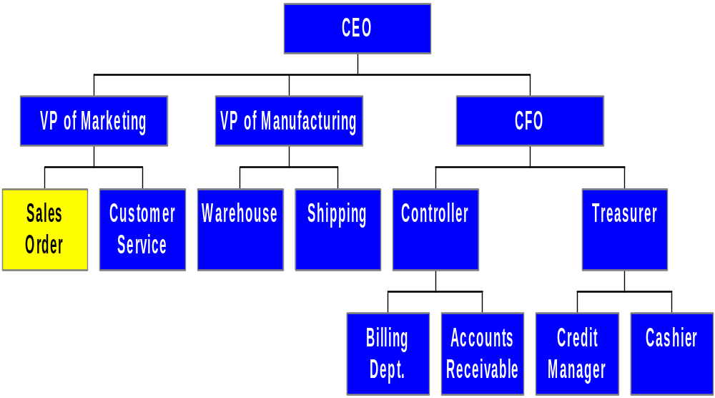
PARTIAL ORGANIZATION CHART FOR UNITS INVOLVED IN REVENUE CYCLE
Takes customer orders
Authorizes credit for existing customers in good standing
Checks inventory availability

Slide 99
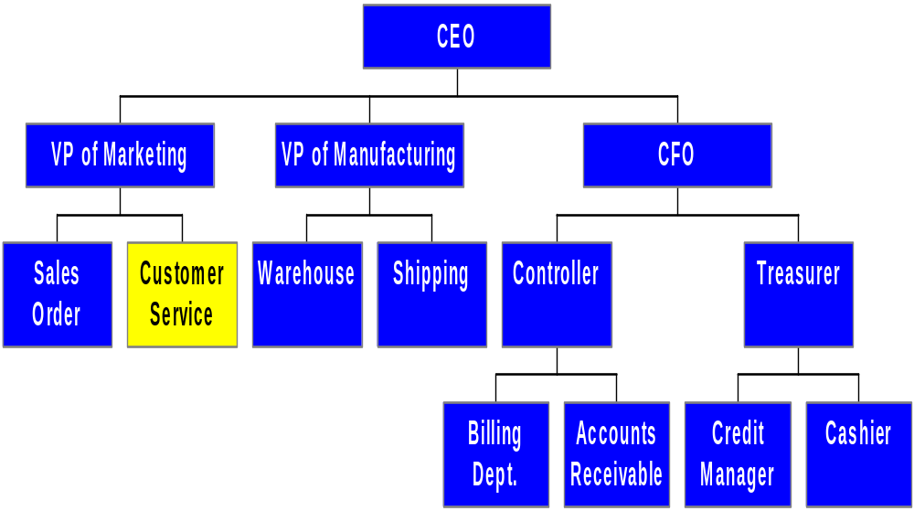
PARTIAL ORGANIZATION CHART FOR UNITS INVOLVED IN REVENUE CYCLE
Responds to customer inquiries

Slide 100
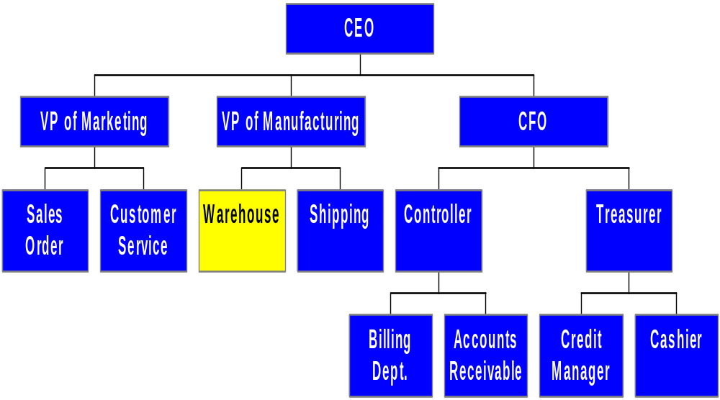
PARTIAL ORGANIZATION CHART FOR UNITS INVOLVED IN REVENUE CYCLE
Picks the order

Slide 101
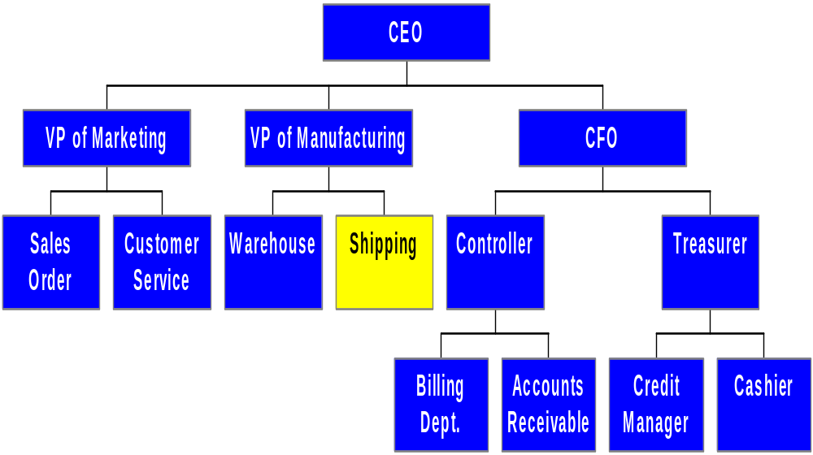
PARTIAL ORGANIZATION CHART FOR UNITS INVOLVED IN REVENUE CYCLE
Packs the order
Ships the order

Slide 102
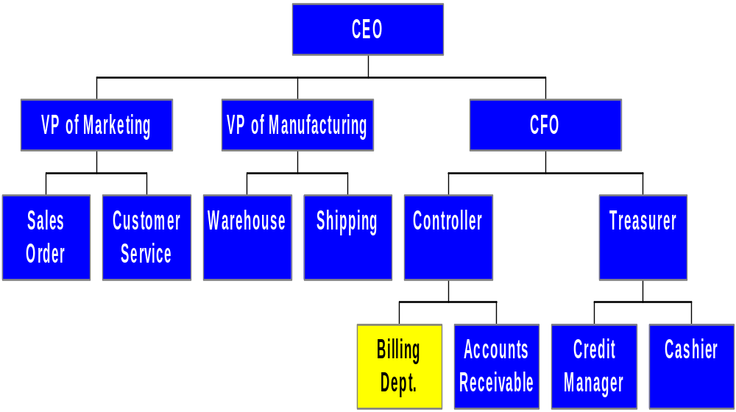
PARTIAL ORGANIZATION CHART FOR UNITS INVOLVED IN REVENUE CYCLE
Invoices the customer

Slide 103
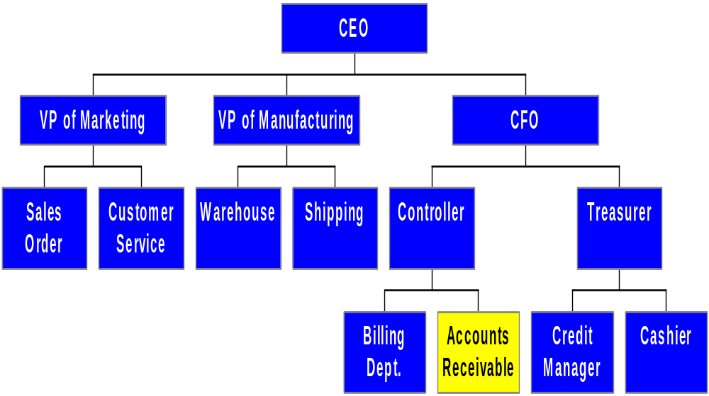
PARTIAL ORGANIZATION CHART FOR UNITS INVOLVED IN REVENUE CYCLE
Maintains the customer’s account:
  Increases customer account when sales are made
  Decreases account when cash is collected

Slide 104
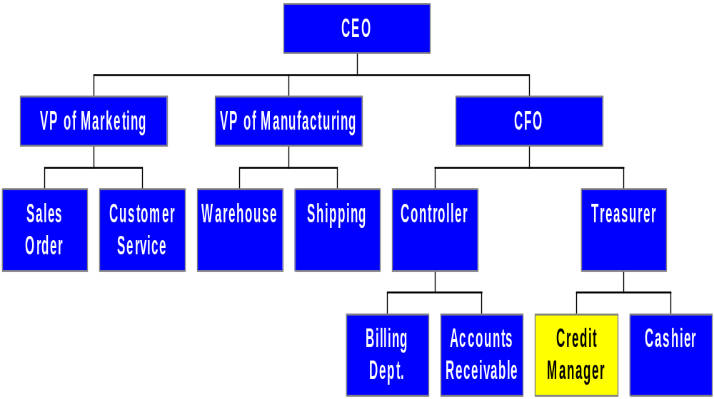
PARTIAL ORGANIZATION CHART FOR UNITS INVOLVED IN REVENUE CYCLE
Approves credit for new customers or existing customers with issues
Authorizes credits to customer accounts for returns, allowances, and write-offs

Slide 105
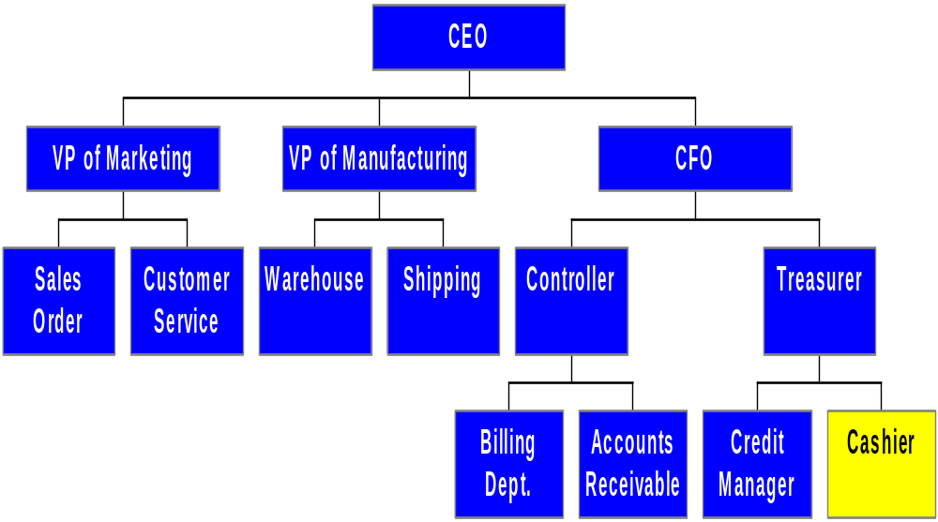
PARTIAL ORGANIZATION CHART FOR UNITS INVOLVED IN REVENUE CYCLE
Deposits cash received from customers

Slide 106
CONTROL: OBJECTIVES, THREATS, AND PROCEDURES
In the revenue cycle (or any cycle), a well-designed AIS should provide adequate controls to ensure that the following objectives are met:
  All transactions are properly authorized
  All recorded transactions are valid
  All valid and authorized transactions are recorded
  All transactions are recorded accurately
  Assets are safeguarded from loss or theft
  Business activities are performed efficiently and effectively
  The company is in compliance with all applicable laws and regulations
  All disclosures are full and fair

Slide 107
CONTROL: OBJECTIVES, THREATS, AND PROCEDURES
We’ll soon be discussing the threats that may occur in the revenue cycle.
If you understand the preceding objectives, you probably won’t have to worry about “memorizing” threats.
Almost every threat represents a violation of one of those control objectives.
Let’s look more closely.

Slide 108
CONTROL: OBJECTIVES, THREATS, AND PROCEDURES
In the revenue cycle (or any cycle), a well-designed AIS should provide adequate controls to ensure that the following objectives are met:
  All transactions are properly authorized
  All recorded transactions are valid
  All valid and authorized transactions are recorded
  All transactions are recorded accurately
  Assets are safeguarded from loss or theft
  Business activities are performed efficiently and effectively
  The company is in compliance with all applicable laws and regulations
  All disclosures are full and fair
A related threat would be that a transaction would go through without proper authorization.
Such a transaction might result from either a mistake or a fraud.
EXAMPLE: An employee might process an unauthorized write-off of his own account, so that he wouldn’t have to pay.

Slide 109
CONTROL: OBJECTIVES, THREATS, AND PROCEDURES
In the revenue cycle (or any cycle), a well-designed AIS should provide adequate controls to ensure that the following objectives are met:
  All transactions are properly authorized
  All recorded transactions are valid
  All valid and authorized transactions are recorded
  All transactions are recorded accurately
  Assets are safeguarded from loss or theft
  Business activities are performed efficiently and effectively
  The company is in compliance with all applicable laws and regulations
  All disclosures are full and fair
The related threat is that a transaction would be recorded that isn’t valid, i.e., it didn’t actually occur.
EXAMPLE 1: An employee records a return of merchandise on his own account when the goods were never really returned.
EXAMPLE 2: Many financial statement frauds involve companies recording totally fictitious revenues in order to make the company’s financial position appear more favorable than it actually is.

Slide 110
CONTROL: OBJECTIVES, THREATS, AND PROCEDURES
The related threat would be that a transaction that actually did occur didn’t get recorded.
EXAMPLE 1: An employee fails to record a sale that the company made to him so he won’t have to pay the receivable.
EXAMPLE 2: In financial statement fraud cases, the company often fails to record transactions that reduce income or net assets, e.g., don’t record returns from customers or discounts granted to them. This omission causes net sales to appear higher than they really are.
In the revenue cycle (or any cycle), a well-designed AIS should provide adequate controls to ensure that the following objectives are met:
  All transactions are properly authorized
  All recorded transactions are valid
  All valid and authorized transactions are recorded
  All transactions are recorded accurately
  Assets are safeguarded from loss or theft
  Business activities are performed efficiently and effectively
  The company is in compliance with all applicable laws and regulations
  All disclosures are full and fair

Slide 111
CONTROL: OBJECTIVES, THREATS, AND PROCEDURES
The threat would be that a transaction is recorded inaccurately. Inaccurate recording typically means that a transaction is recorded either:
  In the wrong amount
  In the wrong account
  In the wrong time period
It could also mean that the transaction was credited to the wrong agents or participants.
In the revenue cycle (or any cycle), a well-designed AIS should provide adequate controls to ensure that the following objectives are met:
  All transactions are properly authorized
  All recorded transactions are valid
  All valid and authorized transactions are recorded
  All transactions are recorded accurately
  Assets are safeguarded from loss or theft
  Business activities are performed efficiently and effectively
  The company is in compliance with all applicable laws and regulations
  All disclosures are full and fair

Slide 112
CONTROL: OBJECTIVES, THREATS, AND PROCEDURES
EXAMPLES: A fraud might involve a company:
  Over-recording the amount of a sale (wrong amount)
  Recording an unearned revenue as an earned revenue (wrong account)
  Recording a sale earlier than it occurs (wrong time period)
  Crediting the wrong salesperson for the sale (wrong agent)
In the revenue cycle (or any cycle), a well-designed AIS should provide adequate controls to ensure that the following objectives are met:
  All transactions are properly authorized
  All recorded transactions are valid
  All valid and authorized transactions are recorded
  All transactions are recorded accurately
  Assets are safeguarded from loss or theft
  Business activities are performed efficiently and effectively
  The company is in compliance with all applicable laws and regulations
  All disclosures are full and fair

Slide 113
CONTROL: OBJECTIVES, THREATS, AND PROCEDURES
In the revenue cycle (or any cycle), a well-designed AIS should provide adequate controls to ensure that the following objectives are met:
  All transactions are properly authorized
  All recorded transactions are valid
  All valid and authorized transactions are recorded
  All transactions are recorded accurately
  Assets are safeguarded from loss or theft
  Business activities are performed efficiently and effectively
  The company is in compliance with all applicable laws and regulations
  All disclosures are full and fair
The reverse side of these activities might include:
  Under-recording a sales return (wrong amount).
  Debiting an asset account instead of sales returns (wrong account)
  Recording the return later than it actually occurred (wrong time period)

Slide 114
CONTROL: OBJECTIVES, THREATS, AND PROCEDURES
In the revenue cycle (or any cycle), a well-designed AIS should provide adequate controls to ensure that the following objectives are met:
  All transactions are properly authorized
  All recorded transactions are valid
  All valid and authorized transactions are recorded
  All transactions are recorded accurately
  Assets are safeguarded from loss or theft
  Business activities are performed efficiently and effectively
  The company is in compliance with all applicable laws and regulations
  All disclosures are full and fair
Threats in this area usually involve theft, destruction, or misuse of assets, including data.

Slide 115
CONTROL: OBJECTIVES, THREATS, AND PROCEDURES
In the revenue cycle (or any cycle), a well-designed AIS should provide adequate controls to ensure that the following objectives are met:
  All transactions are properly authorized
  All recorded transactions are valid
  All valid and authorized transactions are recorded
  All transactions are recorded accurately
  Assets are safeguarded from loss or theft
  Business activities are performed efficiently and effectively
  The company is in compliance with all applicable laws and regulations
  All disclosures are full and fair
The threat is that the activities would be performed inefficiently or ineffectively.

Slide 116
CONTROL: OBJECTIVES, THREATS, AND PROCEDURES
The obvious threat is non-compliance with laws and regulations.
An example in the revenue cycle could be a car dealer who:
  Sells a vehicle to which he doesn’t have clear title; or
  Refuses to allow a customer to return a car in violation of state lemon laws.
Another example might be requesting a credit check on a customer in violation of the Fair Credit Reporting Act (FCRA).
In the revenue cycle (or any cycle), a well-designed AIS should provide adequate controls to ensure that the following objectives are met:
  All transactions are properly authorized
  All recorded transactions are valid
  All valid and authorized transactions are recorded
  All transactions are recorded accurately
  Assets are safeguarded from loss or theft
  Business activities are performed efficiently and effectively
  The company is in compliance with all applicable laws and regulations
  All disclosures are full and fair

Slide 117
CONTROL: OBJECTIVES, THREATS, AND PROCEDURES
In the revenue cycle (or any cycle), a well-designed AIS should provide adequate controls to ensure that the following objectives are met:
  All transactions are properly authorized
  All recorded transactions are valid
  All valid and authorized transactions are recorded
  All transactions are recorded accurately
  Assets are safeguarded from loss or theft
  Business activities are performed efficiently and effectively
  The company is in compliance with all applicable laws and regulations
  All disclosures are full and fair
The threat is incomplete and/or misleading disclosures.
This threat is more important in other areas, particularly those areas that involve liabilities and contingencies.
However, one threat in the revenue cycle could be misleading disclosures about customers’ rights to return product.

Slide 118
CONTROL: OBJECTIVES, THREATS, AND PROCEDURES
While we’re going to step through a number of common threats in the revenue cycle, it’s a good idea to memorize the internal control objectives so you can think of the relevant threats on your own.
If you don’t like the text version, click on the button below to see a rhyming version of the same objectives.
Poet’s
Corner

Slide 119
CONTROL: OBJECTIVES, THREATS, AND PROCEDURES
Internal control is just a ballad.
Are all recorded transactions valid?
Are all valid transactions recorded?
If not, there may be something sordid.
And it should cause severe distraction
If no one’s authorized the transaction.

Slide 120
CONTROL: OBJECTIVES, THREATS, AND PROCEDURES
Are entries in the right amount?
Are they in the right account?
Are they down in the right time?
If not, your little bells should chime.
Are we efficient? Are we effective?
Is our compliance with the law defective?
Are assets really and safely there?
Are all disclosures full and fair?

Slide 121
CONTROL: OBJECTIVES, THREATS, AND PROCEDURES
There are several actions a company can take with respect to any cycle to reduce threats of errors or irregularities. These include:
  Using simple, easy-to-complete documents with clear instructions (enhances accuracy and reliability).
  Using appropriate application controls, such as validity checks and field checks (enhances accuracy and reliability).
  Providing space on forms to record who completed and who reviewed the form (encourages proper authorizations and accountability).

Slide 122
CONTROL: OBJECTIVES, THREATS, AND PROCEDURES
  Pre-numbering documents (encourages recording of valid and only valid transactions).
  Restricting access to blank documents (reduces risk of unauthorized transaction).
In the following sections, we’ll discuss the threats that may arise in the four major steps of the revenue cycle, as well as the controls that can prevent those threats.

Slide 123
THREATS IN SALES ORDER ENTRY
The primary objectives of this process:
  Accurately and efficiently process customer orders.
  Ensure that all sales are legitimate and that the company gets paid for all sales
  Minimize revenue loss arising from poor inventory management

Slide 124
THREATS IN SALES ORDER ENTRY
You can click on any of the threats below to get more information on:
  The types of problems posed by each threat
  The controls that can mitigate the threats.
Threats in the sales order entry process include:
  THREAT 1: Incomplete or inaccurate customer orders
  THREAT 2: Sales to customers with poor credit
  THREAT 3: Orders that are not legitimate
  THREAT 4: Stockouts, carrying costs, and markdowns

Slide 125
THREATS IN SALES ORDER ENTRY
THREAT NO. 1—INCOMPLETE OR INACCURATE CUSTOMER ORDER
  Why is this a problem?
    It’s inefficient. The customer has to be re-contacted, and the order has to be re-entered.
    Causes customer dissatisfaction and may impact future sales.
  Controls:
    Data entry controls, such as completeness checks
    Automatic lookup of reference data like customer address
    Reasonableness tests comparing quantity ordered to past history
Return to
Threat Menu
Go To
Next Threat

Slide 126
THREATS IN SALES ORDER ENTRY
THREAT NO. 2—SALES TO CUSTOMERS WITH POOR CREDIT
  Why is this a problem?
    Sales may be uncollectible, resulting in lost assets or revenues.
  Controls:
    Follow proper authorization procedures for credit sales, e.g.:
      Setting credit limits for each customer.
      Granting general authorization to sales order staff for customers who are:
        Existing customers
        Under their credit limits
        With no outstanding balances

Slide 127
THREATS IN SALES ORDER ENTRY
    Other cases require specific authorization by someone other than the sales rep (usually done by the credit manager). This type of authorization is especially important if the sales rep is paid on commission.
    Salespeople should have read-only access to customer credit data.
    Credit should be approved prior to releasing goods from inventory.
    Accurate records of customer balances and credit limits must be maintained (the decision is only as good as the information provided).
Return to
Threat Menu
Go To
Next Threat

Slide 128
THREATS IN SALES ORDER ENTRY
THREAT NO. 3—ORDERS THAT ARE NOT LEGITIMATE
  Why is this a problem?
    You can’t make good credit decisions or collect from a customer you haven’t properly identified.
    EXAMPLE: An Oklahoma office supply store accepted a telephone order for goods that were subsequently shipped to a woman in Indiana. Afterwards, the store discovered that the order had been called in from a prison inmate for shipment to his mom on Mother’s Day. The inmate had used a stolen credit card number. The office supply store ate the loss.

Slide 129
THREATS IN SALES ORDER ENTRY
    Traditionally, legitimacy of customer orders is established by receipt of a signed purchase order from the customer.
    Digital signatures and digital certificates provide similar control for electronic business transactions.
    Online credit card transactions with retail customers are fraught with issues.

Slide 130
THREATS IN SALES ORDER ENTRY
    Some actions companies are taking with online or phone-order retail customers:
      Requiring the three-digit code on the back of the credit card for confirmation that the customer physically possesses the card.
      Requiring that customers use PayPal.
      Sending emails to the customer to confirm the transaction.
Return to
Threat Menu
Go To
Next Threat

Slide 131
THREATS IN SALES ORDER ENTRY
THREAT NO. 4—STOCKOUTS, CARRYING COSTS, AND MARKDOWNS
  Why is this a problem?
    If you run out of merchandise, you may lose sales.
    If you carry too much merchandise, you incur excess carrying costs and/or have to mark the inventory down to sell it.
  Controls:
    Accurate inventory control and sales forecasting systems.
    Online inventory systems that allow recording of changes to inventory in real time.

Slide 132
THREATS IN SALES ORDER ENTRY
    Periodic physical counts of inventory to verify accuracy of the records.
    Regular review of sales forecasts to make adjustments.
Return to
Threat Menu
Go To
Next Threat

Slide 133
THREATS IN SHIPPING
The primary objectives of the shipping process are:
  Fill customer orders efficiently and accurately
  Safeguard inventory
Threats in the shipping process include:
  THREAT 5: Shipping Errors
  THREAT 6: Theft of Inventory
You can click on any of the threats above to get more information on:
  The types of problems posed by each threat
  The controls that can mitigate the threats.

Slide 134
THREATS IN SHIPPING
THREAT NO. 5—SHIPPING ERRORS
  Why is this a problem?
    Customer dissatisfaction and lost sales may occur if customers are shipped the wrong items or there are delays because of a wrong address.
    Shipping to the wrong address may also result in loss of the assets.
  Controls:
    Online shipping systems can require shipping clerks to enter the quantities being shipped before the goods are actually shipped. Errors can thus be detected and corrected before shipment.

Slide 135
THREATS IN SHIPPING
    Use of bar code scanners and RFID tags to record picking and shipping.
    If data entry is performed manually, application controls such as field checks and completeness tests can reduce errors.
    The packing slip and bill of lading should not be printed until accuracy of the shipment has been verified.
Return to
Threat Menu
Go To
Next Threat

Slide 136
THREATS IN SHIPPING
THREAT NO. 6—THEFT OF INVENTORY
  Why is this a problem?
    Loss of assets
    Inaccurate inventory records (since thieves don’t generally record the reduction in inventory)
  Controls:
    Inventory should be kept in a secure location with restricted access.
    Inventory transfers should be documented.
    Inventory should be released for shipping only with approved sales orders.

Slide 137
THREATS IN SHIPPING
    Employees who handle inventory should sign the documents or enter their codes online so that accountability for losses can be traced.
    Wireless communication and RFID tags can provide real-time tracking, which may reduce thefts while in transit.
    Physical counts of inventory should be made periodically, and employees with custody should be held accountable for shortages.
Return to
Threat Menu
Go To
Next Threat

Slide 138
THREATS IN BILLING
You can click on any of the threats below to get more information on:
  The types of problems posed by each threat
  The controls that can mitigate the threats.
The primary objectives of the billing process are to ensure:
  Customers are billed for all sales
  Invoices are accurate
  Customer accounts are accurately maintained
Threats that relate to this process are:
  THREAT 7: Failure to bill customers
  THREAT 8: Billing errors
  THREAT 9: Errors in maintaining customer accounts

Slide 139
THREATS IN BILLING
THREAT NO. 7—FAILURE TO BILL CUSTOMERS
  Why is this a problem?
    Loss of assets and revenues
    Inaccurate data on sales, inventory, and accounts receivable
  Controls:
    Segregate shipping and billing functions. (An employee who does both could ship merchandise to friends without billing them.)

Slide 140
THREATS IN BILLING
    Sales orders, picking tickets, packing slips, and sales invoices should be sequentially numbered and periodically accounted for. (If you can’t match an invoice to every sales order or packing slip, the customer hasn’t been billed.)
    In invoice-less systems, you must ensure that every shipment is recorded, since the shipment triggers recording of the account receivable.
Return to
Threat Menu
Go To
Next Threat

Slide 141
THREATS IN BILLING
THREAT NO. 8—BILLING ERRORS
  Why is this a problem?
    Loss of assets if you under-bill
    Customer dissatisfaction if you over-bill
  Controls:
    Have the computer retrieve prices from the inventory master file.
    Avoid quantity errors by checking quantities on the packing slip against quantities on the sales order.
    Bar code scanners can also reduce data entry errors.
Return to
Threat Menu
Go To
Next Threat

Slide 142
THREATS IN BILLING
THREAT NO. 9—ERRORS IN MAINTAINING CUSTOMER ACCOUNTS
  Why is this a problem?
    Leads to customer dissatisfaction and loss of future sales
    May indicate theft of cash
  Controls:
    Edit checks such as:
      Validity checks on customer and invoice numbers so amounts are applied to the correct account
      Closed-loop verification
      Field check to ensure payment amounts are numeric

Slide 143
THREATS IN BILLING
    Batch totals to detect posting errors.
    Compare number of accounts updated with number of checks received.
    Reconciliations performed by an independent party.
    Sending monthly statements to every customer to provide independent review.
Return to
Threat Menu
Go To
Next Threat

Slide 144
THREATS IN CASH COLLECTION
The primary objective of the cash collection process:
  Safeguard customer remittances
The major threat to this process:
  THREAT 10: Theft of cash
You can click on the above threat to get more information on:
  The types of problems posed by the threat
  The controls that can mitigate the threat

Slide 145
THREATS IN CASH COLLECTION
THREAT NO. 10—THEFT OF CASH
  Why is this a problem?
    Loss of cash
  Controls:
    Segregation of duties between:
      Handling cash and posting to customer accounts. (A person who can do both can lap accounts.)
      Handling cash and authorizing credit memos. (A person who does both could steal a customer remittance and authorize a credit to the customer’s account, so the customer won’t be notified he’s past due.)
      Authorizing credit memos and maintaining customer accounts. (A person who does both could write of an account for himself, family members, or friends.)

Slide 146
THREATS IN CASH COLLECTION
    Minimizing the handling of money and checks through lockbox arrangements, etc.
    Prompt documentation and restrictive endorsements of customer remittances.
    Two people opening mail together.
    Remittance data sent to accounts receivable while cash and checks are sent to cashier.
    Checking that total credits to accounts receivable equal total debits to cash.
    Sending copy of remittance list to internal auditing to be compared with validated deposit slips and bank statements (verifies all checks were deposited).

Slide 147
THREATS IN CASH COLLECTION
    Sending monthly statements to customers to provide independent review.
    Using cash registers in retail establishments that automatically produce a written record of all cash received.
    Offering inducements to customers to look at their receipts (so they’ll notice if a clerk rings up a sale incorrectly).
    Deposit all remittances in the bank daily (facilitates accurate reconciliations and safeguards cash).
    Having bank reconciliations done by an independent party.
Return to
Threat Menu
Go To
Next Threat

Slide 148
GENERAL CONTROL ISSUES
You can click on any of the threats below to get more information on:
  The types of problems posed by each threat
  The controls that can mitigate the threats.
Two general objectives pertain to activities in every cycle:
  Accurate data should be available when needed
  Activities should be performed efficiently and effectively
The related general threats are:
  THREAT 11: Loss, Alteration, or Unauthorized Disclosure of Data
  THREAT 12: Poor performance

Slide 149
GENERAL CONTROL ISSUES
THREAT NO. 11—LOSS, ALTERATION, OR UNAUTHORIZED DISCLOSURE OF DATA
  Why is this a problem?
    Loss of all accounts receivable data could threaten a company’s continued existence.
    Loss or alteration of data could cause:
      Errors in external or internal reporting.
      Inaccurate responses to customer inquiries.
    Unauthorized disclosure of confidential customer information can cause:
      Dissatisfied customers and loss of future sales
      Legal sanctions and fines

Slide 150
GENERAL CONTROL ISSUES
  Controls:
    The sales file, cash receipts file, accounts receivable master file, and most recent transaction file should be backed up regularly.
      At least one backup on site and one offsite.
    All disks and tapes should have external and internal files to reduce chance of accidentally erasing important data.
    Access controls should be utilized:
      User IDs and passwords
      Compatibility matrices
      Controls for individual terminals (e.g., so the receiving dock can’t enter a sales order)
      Logs of all activities, particularly those requiring specific authorizations

Slide 151
GENERAL CONTROL ISSUES
    Default settings on ERP systems usually allow users far too much access to data, so these systems must be modified to enforce proper segregation of duties.
    Sensitive data should be encrypted in storage and in transmission.
    Websites should use SSL for secure customer communications.
    Parity checks, acknowledgment messages, and control totals should be used to ensure transmission accuracy.
Return to
Threat Menu
Go To
Next Threat

Slide 152
GENERAL CONTROL ISSUES
THREAT NO. 12—POOR PERFORMANCE
  Why is this a problem?
    May damage customer relations
    Reduces profitability
  Controls:
    Prepare and review performance reports
Return to
Threat Menu
Go To
Next Threat

Slide 153
REVENUE CYCLE INFORMATION NEEDS
We’ve examined the various threats in the revenue cycle and the controls that can mitigate those threats.
Let’s move on to summarize the information needs in the revenue cycle.

Slide 154
REVENUE CYCLE INFORMATION NEEDS
Information is needed for the following operational tasks in the revenue cycle:
  Responding to customer inquiries
  Deciding on extending credit to a customer
  Determining inventory availability
  Selecting merchandise delivery methods

Slide 155
REVENUE CYCLE INFORMATION NEEDS
Information is needed for the following strategic decisions:
  Setting prices for products/services
  Establishing policies on returns and warranties
  Deciding on credit terms
  Determining short-term borrowing needs
  Planning new marketing campaigns

Slide 156
REVENUE CYCLE INFORMATION NEEDS
The AIS needs to provide information to evaluate performance of the following:
  Response time to customer inquiries
  Time to fill and deliver orders
  Percentage of sales orders back ordered
  Customer satisfaction rates and trends
  Analyses of market share and sales trends
  Profitability by product, customer, and region
  Sales volume in dollars and market share
  Effectiveness of advertising and promotions
  Sales staff performance
  Bad debt expense and credit policies

Slide 157
REVENUE CYCLE INFORMATION NEEDS
Both financial and non-financial information are needed to manage and evaluate revenue cycle activities.
Likewise, both external and internal information is needed.

Slide 158
REVENUE CYCLE INFORMATION NEEDS
When the AIS integrates information from the various cycles, sources, and types, the reports that can be generated are unlimited. They include reports on:
  Sales order entry efficiency
  Sales breakdowns by salesperson, region, product, etc.
  Profitability by territory, customer, etc.
  Frequency and size of backorders
  Slow-moving products
  Projected cash inflows and outflows (called a cash budget)
  Accounts receivable aging
  Revenue margin (gross margin minus selling costs)

Slide 159
REVENUE CYCLE INFORMATION NEEDS
Accountants should continually refine and improve an organization’s performance reports.

Slide 160
SUMMARY
You’ve learned about the basic business activities and data processing operations in the revenue cycle, including:
  Sales order entry
  Shipping
  Billing
  Cash Collection
You’ve learned how IT can improve the efficiency and effectiveness of those processes.

Slide 161
SUMMARY
You’ve learned about decisions that need to be made in the revenue cycle and what information is required to make these decisions.
You’ve also learned about the major threats that present themselves in the revenue cycle and the controls that can be instigated to mitigate those threats.

