Slide 1
HAPTER 11
The Expenditure Cycle:
Purchasing and Cash Disbursements

Slide 2
INTRODUCTION
Questions to be addressed in this chapter include:
  What are the basic business activities and data processing operations that are performed in the expenditure cycle?
  What decisions need to be made in the expenditure cycle, and what information is needed to make these decisions?
  What are the major threats in the expenditure cycle and the controls related to those threats?

Slide 3
INTRODUCTION
The primary external exchange of information is with suppliers (vendors).
Information flows to the expenditure cycle from other cycles, e.g.:
  The revenue cycle, production cycle, inventory control, and various departments provide information about the need to purchase goods and materials.
Information also flows from the expenditure cycle:
  When the goods and materials arrive, the expenditure cycle provides information about their receipt to the parties that have requested them.
  Information is provided to the general ledger and reporting function for internal and external financial reporting.

Slide 4
INTRODUCTION
The primary objective of the expenditure cycle is to minimize the total cost of acquiring and maintaining inventory, supplies, and services.

Slide 5
INTRODUCTION
Decisions that must be made include:
  What level of inventory and supplies should we carry?
  What vendors provide the best price and quality?
  Where should we store the goods?
  Can we consolidate purchases across units?
  How can IT improve inbound logistics?
  Is there enough cash to take advantage of early payment discounts?
  How can we manage payments to maximize cash flow?

Slide 6
INTRODUCTION
Management also has to evaluate the efficiency and effectiveness of expenditure cycle processes.
  These evaluations require data about:
    Events that occur
    Resources affected
    Agents who participate
  This data needs to be accurate, reliable, and timely.

Slide 7
INTRODUCTION
In this chapter, we’ll look at how the three basic AIS functions are carried out in the expenditure cycle:
  How do we capture and process data?
  How do we store and organize the data for decisions?
  How do we provide controls to safeguard resources (including data)?

Slide 8
EXPENDITURE CYCLE BUSINESS ACTIVITIES
The three basic activities performed in the expenditure cycle are:
  Ordering goods, supplies, and services
  Receiving and storing these items
  Paying for these items
These activities mirror the activities in the revenue cycle.

Slide 9
EXPENDITURE CYCLE BUSINESS ACTIVITIES
The three basic activities performed in the expenditure cycle are:
  Ordering goods, supplies, and services
  Receiving and storing these items
  Paying for these items
These activities mirror the activities in the revenue cycle.

Slide 10
ORDERING GOODS, SUPPLIES, AND SERVICES
Key decisions in this process involve identifying what, when, and how much to purchase and from whom.
Weaknesses in inventory control can create significant problems with this process:
  Inaccurate records cause shortages.
One of the key factors affecting this process is the inventory control method to be used.

Slide 11
ORDERING GOODS, SUPPLIES, AND SERVICES
Alternate Inventory Control Methods
  We will consider three alternate approaches to inventory control:
    Economic Order Quantity (EOQ)
    Just in Time Inventory (JIT)
    Materials Requirements Planning (MRP)

Slide 12
ORDERING GOODS, SUPPLIES, AND SERVICES
Alternate Inventory Control Methods
  We will consider three alternate approaches to inventory control:
    Economic Order Quantity (EOQ)
    Materials Requirements Planning (MRP)
    Just in Time Inventory (JIT)

Slide 13
ORDERING GOODS, SUPPLIES, AND SERVICES
EOQ is the traditional approach to managing inventory.
  Goal: Maintain enough stock so that production doesn’t get interrupted.
  Under this approach, an optimal order size is calculated by minimizing the sum of several costs:
    Ordering costs
    Carrying costs
    Stockout costs
  The EOQ formula is also used to calculate reorder point, i.e., the inventory level at which a new order should be placed.
  Other, more recent approaches try to minimize or eliminate the amount of inventory carried.

Slide 14
ORDERING GOODS, SUPPLIES, AND SERVICES
Alternate Inventory Control Methods
  We will consider three alternate approaches to inventory control:
    Economic Order Quantity (EOQ)
    Materials Requirements Planning (MRP)
    Just in Time Inventory (JIT)

Slide 15
ORDERING GOODS, SUPPLIES, AND SERVICES
MRP seeks to reduce inventory levels by improving the accuracy of forecasting techniques and carefully scheduling production and purchasing around that forecast.

Slide 16
ORDERING GOODS, SUPPLIES, AND SERVICES
Alternate Inventory Control Methods
  We will consider three alternate approaches to inventory control:
    Economic Order Quantity (EOQ)
    Materials Requirements Planning (MRP)
    Just in Time Inventory (JIT)

Slide 17
ORDERING GOODS, SUPPLIES, AND SERVICES
JIT systems attempt to minimize or eliminate inventory by purchasing or producing only in response to actual (as opposed to forecasted) sales.
These systems have frequent, small deliveries of materials, parts, and supplies directly to the location where production will occur.
A factory with a JIT system will have multiple receiving docks for their various work centers.

Slide 18
ORDERING GOODS, SUPPLIES, AND SERVICES
Similarities and differences between MRP and JIT:
  Scheduling production and inventory accumulation
MRP schedules production to meet estimated sales and creates a stock of finished goods inventory to be available for those sales.
JIT schedules production in response to actual sales and virtually eliminates finished goods inventory, because goods are sold before they’re made.

Slide 19
ORDERING GOODS, SUPPLIES, AND SERVICES
Similarities and differences between MRP and JIT:
  Scheduling production and inventory accumulation
  Nature of products
MRP systems are better suited for products that have predictable demand, such as consumer staples.
JIT systems are particularly suited for products with relatively short life cycles (e.g., fashion items) and for which demand is difficult to predict.

Slide 20
ORDERING GOODS, SUPPLIES, AND SERVICES
Similarities and differences between MRP and JIT:
  Scheduling production and inventory accumulation
  Nature of products
  Costs and efficiency
Both can reduce costs and improve efficiency over traditional EOQ approaches.

Slide 21
ORDERING GOODS, SUPPLIES, AND SERVICES
Similarities and differences between MRP and JIT:
  Scheduling production and inventory accumulation
  Nature of products
  Costs and efficiency
  Too much or too little
In either case, you must be able to:
  Quickly accelerate production if there is unanticipated demand
  Quickly stop production if too much inventory is accumulating.

Slide 22
ORDERING GOODS, SUPPLIES, AND SERVICES
Whatever the inventory control system, the order processing typically begins with a purchase request followed by the generation of a purchase order.
A request to purchase goods or supplies is triggered by either:
  The inventory control function; or
  An employee noticing a shortage.
Advanced inventory control systems automatically initiate purchase requests when quantity falls below the reorder point.

Slide 23
ORDERING GOODS, SUPPLIES, AND SERVICES
The need to purchase goods typically results in the creation of a purchase requisition. The purchase requisition is a paper document or electronic form that identifies:
  Who is requesting the goods
  Where they should be delivered
  When they’re needed
  Item numbers, descriptions, quantities, and prices
  Possibly a suggested supplier
  Department number and account number to be charged
Most of the detail on the suppliers and the items purchased can be pulled from the supplier and inventory master files.

Slide 24
ORDERING GOODS, SUPPLIES, AND SERVICES
The purchase requisition is received by a purchasing agent (aka, buyer) in the purchasing department, who typically performs the purchasing activity.
  In manufacturing companies, this function usually reports to the VP of Manufacturing.

Slide 25
ORDERING GOODS, SUPPLIES, AND SERVICES
A crucial decision is the selection of supplier.
Key considerations are:
  Price
  Quality
  Dependability
    Especially important in JIT systems because late or defective deliveries can bring the whole system to a halt.
    Consequently, certification that suppliers meet ISO 9000 quality standards is important. This certification recognizes that the supplier has adequate quality control processes.

Slide 26
ORDERING GOODS, SUPPLIES, AND SERVICES
Once a supplier has been selected for a product, their identity should become part of the product inventory master file so that the selection process does not have to be carried out for every purchase.
  A list of potential alternates should also be maintained.
  For products that are seldom ordered, the selection process may be repeated every time.

Slide 27
ORDERING GOODS, SUPPLIES, AND SERVICES
It’s important to track and periodically evaluate supplier performance, including data on:
  Purchase prices
  Rework and scrap costs
  Supplier delivery performance
The purchasing function should be evaluated and rewarded based on how well it minimizes total costs, not just the costs of purchasing the goods.

Slide 28
ORDERING GOODS, SUPPLIES, AND SERVICES
A purchase order is a document or electronic form that formally requests a supplier to sell and deliver specified products at specified prices.
The PO is both a contract and a promise to pay. It includes:
  Names of supplier and purchasing agent
  Order and requested delivery dates
  Delivery location
  Shipping method
  Details of the items ordered

Slide 29
ORDERING GOODS, SUPPLIES, AND SERVICES
Multiple purchase orders may be completed for one purchase requisition if multiple vendors will fill the request.
The ordered quantity may also differ from the requested quantity to take advantage of quantity discounts.
A blanket order is a commitment to buy specified items at specified prices from a particular supplier for a set time period.
  Reduces buyer’s uncertainty about reliable material sources
  Helps supplier plan capacity and operations

Slide 30
ORDERING GOODS, SUPPLIES, AND SERVICES
IT can help improve efficiency and effectiveness of purchasing function.
  The major cost driver is the number of purchase orders processed. Time and cost can be cut by:
    Using EDI to transmit purchase orders

Slide 31
ORDERING GOODS, SUPPLIES, AND SERVICES
In a vendor-managed inventory (VMI) program:
  Inventory control and purchasing are outsourced to a supplier
  The supplier has access to POS and inventory data and automatically replenishes inventory
  This approach:
    Reduces amount of inventory carried
    Eliminates costs of generating purchase orders
  Requires good controls to ensure accuracy of inventory records
IT can help improve efficiency and effectiveness of purchasing function.
  The major cost driver is the number of purchase orders processed. Time and cost can be cut by:
    Using EDI to transmit purchase orders
    Using vendor-managed inventory systems

Slide 32
ORDERING GOODS, SUPPLIES, AND SERVICES
IT can help improve efficiency and effectiveness of purchasing function.
  The major cost driver is the number of purchase orders processed. Time and cost can be cut by:
    Using EDI to transmit purchase orders
    Using vendor-managed inventory systems
    Reverse auctions
Suppliers compete with each other to meet demand at the lowest price
Best suited to commodities, rather than critical components, where quality, vendor reliability, and delivery performance are not crucial

Slide 33
ORDERING GOODS, SUPPLIES, AND SERVICES
IT can help improve efficiency and effectiveness of purchasing function.
  The major cost driver is the number of purchase orders processed. Time and cost can be cut by:
    Using EDI to transmit purchase orders
    Using vendor-managed inventory systems
    Reverse auctions
    Pre-award audits
Used for large purchases that involve formal bids
Internal auditor visits each potential supplier in final cut to verify accuracy of their bid
May identify mathematical errors in bid which can produce considerable savings

Slide 34
ORDERING GOODS, SUPPLIES, AND SERVICES
IT can help improve efficiency and effectiveness of purchasing function.
  The major cost driver is the number of purchase orders processed. Time and cost can be cut here by:
    Using EDI to transmit purchase orders
    Using vendor-managed inventory systems
    Reverse auctions
    Pre-award audits
    Procurement cards for small purchases
A corporate credit card can be used with specific suppliers for specific types of purchases
Spending limits can be set
Account numbers on cards can be mapped to general ledger accounts

Slide 35
EXPENDITURE CYCLE BUSINESS ACTIVITIES
The three basic activities performed in the expenditure cycle are:
  Ordering goods, supplies, and services
  Receiving and storing these items
  Paying for these items
These activities mirror the activities in the revenue cycle.

Slide 36
RECEIVING AND STORING GOODS
The receiving department accepts deliveries from suppliers.
  Normally reports to warehouse manager, who reports to VP of Manufacturing.
Inventory stores typically stores the goods.
  Also reports to warehouse manager.
The receipt of goods must be communicated to the inventory control function to update inventory records.

Slide 37
RECEIVING AND STORING GOODS
The two major responsibilities of the receiving department are:
  Deciding whether to accept delivery
  Verifying the quantity and quality of delivered goods
The first decision is based on whether there is a valid purchase order.
  Accepting un-ordered goods wastes time, handling and storage.

Slide 38
RECEIVING AND STORING GOODS
Verifying the quantity of delivered goods is important so:
  The company only pays for goods received
  Inventory records are updated accurately
The receiving report is the primary document used in this process:
  It documents the date goods received, shipper, supplier, and PO number
  Shows item number, description, unit of measure, and quantity for each item
  Provides space for signature and comments by the person who received and inspected
Receipt of services is typically documented by supervisory approval of the supplier’s invoice.

Slide 39
RECEIVING AND STORING GOODS
When goods arrive, a receiving clerk compares the PO number on the packing slip with the open PO file to verify the goods were ordered.
  Then counts the goods
  Examines for damage before routing to warehouse or factory
Three possible exceptions in this process:
  The quantity of goods is different from the amount ordered
  The goods are damaged
  The goods are of inferior quality

Slide 40
RECEIVING AND STORING GOODS
If one of these exceptions occurs, the purchasing agent resolves the situation with the supplier.
  Supplier typically allows adjustment to the invoice for quantity discrepancies.
  If goods are damaged or inferior, a debit memo is prepared after the supplier agrees to accept a return or grant a discount.
    One copy goes to supplier, who returns a credit memo in acknowledgment.
    One copy to accounts payable to adjust the account payable.
    One copy to shipping to be returned to supplier with the actual goods.

Slide 41
RECEIVING AND STORING GOODS
IT can help improve the efficiency and effectiveness of the receiving activity:
  Bar-coding
Requiring suppliers to bar-code products speeds the counting process and improves accuracy.

Slide 42
RECEIVING AND STORING GOODS
IT can help improve the efficiency and effectiveness of the receiving activity:
  Bar-coding
  RFID
Passive radio frequency identification (RFID) tags eliminate the need to scan bar codes.

Slide 43
RECEIVING AND STORING GOODS
IT can help improve the efficiency and effectiveness of the receiving activity:
  Bar-coding
  RFID
  EDI and satellite technology
EDI and satellite technology make it possible to track the exact location of incoming shipments and have receiving staff on hand to unload trucks.
Also enables drivers to be directed to specific loading docks where goods will be used.

Slide 44
RECEIVING AND STORING GOODS
IT can help improve the efficiency and effectiveness of the receiving activity:
  Bar-coding
  RFID
  EDI and satellite technology
  Audits
Audits can identify opportunities to cut freight costs and can ensure that suppliers are not billing for transportation costs they are supposed to assume.

Slide 45
EXPENDITURE CYCLE BUSINESS ACTIVITIES
The three basic activities performed in the expenditure cycle are:
  Ordering goods, supplies, and services
  Receiving and storing these items
  Paying for these items
These activities mirror the activities in the revenue cycle.

Slide 46
PAYING FOR GOODS AND SERVICES
There are two basic sub-processes involved in the payment process:
  Approval of vendor invoices
  Actual payment of the invoices

Slide 47
PAYING FOR GOODS AND SERVICES
There are two basic sub-processes involved in the payment process:
  Approval of vendor invoices
  Actual payment of the invoices

Slide 48
PAYING FOR GOODS AND SERVICES
Approval of vendor invoices is done by the accounts payable department, which reports to the controller.
The legal obligation to pay arises when goods are received.
  But most companies pay only after receiving and approving the invoice.
  This timing difference may necessitate adjusting entries at the end of a fiscal period.

Slide 49
PAYING FOR GOODS AND SERVICES
Objective of accounts payable:
  Authorize payment only for goods and services that were ordered and actually received.
Requires information from:
  Purchasing—about existence of valid purchase order
  Receiving—for receiving report indicating goods were received

Slide 50
PAYING FOR GOODS AND SERVICES
There are two basic approaches to processing vendor invoices:
  Non-voucher system
Each invoice is stored in an open invoice file.
When a check is written, the invoice is marked “paid” and then stored in a paid invoice file.

Slide 51
PAYING FOR GOODS AND SERVICES
There are two basic approaches to processing vendor invoices:
  Non-voucher system
  Voucher system
A disbursement voucher is prepared which lists:
  Outstanding invoices for the supplier
  Net amount to be paid after discounts and allowances
The disbursement voucher effectively shows which accounts will be debited and credited, along with the account numbers.

Slide 52
PAYING FOR GOODS AND SERVICES
There are two basic approaches to processing vendor invoices:
  Non-voucher system
  Voucher system
Advantages of a voucher system:
  Several invoices may be paid at once, which reduces number of checks written
  Vouchers can be pre-numbered which simplifies the audit trail for payables
  Invoice approval is separated from invoice payment, which makes it easier to schedule both to maximize efficiency

Slide 53
PAYING FOR GOODS AND SERVICES
There are two basic sub-processes involved in the payment process:
  Approval of vendor invoices
  Actual payment of the invoices

Slide 54
PAYING FOR GOODS AND SERVICES
Payment of the invoices is done by the cashier, who reports to the treasurer.
The cashier receives a voucher package, which consists of the vendor invoice and supporting documentation, such as purchase order and receiving report.
This voucher package authorizes issuance of a check or EFT to the supplier.

Slide 55
PAYING FOR GOODS AND SERVICES
Referred to as Evaluated Receipt Settlement.
Payments are issued based on what is ordered and received.
Requires that:
  Suppliers quote accurate prices when orders are placed.
  Receiving personnel count accurately and inspect merchandise received.
Typically incorporates very timely communications about shipments and receipts.
Processing efficiency can be improved by:
  Requiring suppliers to submit invoices by EDI
  Having the system automatically match invoices to POs and receiving reports
  Eliminating vendor invoices

Slide 56
PAYING FOR GOODS AND SERVICES
Processing efficiency can be improved by:
  Requiring suppliers to submit invoices by EDI
  Having the system automatically match invoices to POs and receiving reports
  Eliminating vendor invoices
  Using procurement cards for non-inventory purchases

Slide 57
PAYING FOR GOODS AND SERVICES
Processing efficiency can be improved by:
  Requiring suppliers to submit invoices by EDI
  Having the system automatically match invoices to POs and receiving reports
  Eliminating vendor invoices
  Using procurement cards for non-inventory purchases
  Using company credit cards and electronic forms for travel expenses

Slide 58
PAYING FOR GOODS AND SERVICES
Processing efficiency can be improved by:
  Requiring suppliers to submit invoices by EDI
  Having the system automatically match invoices to POs and receiving reports
  Eliminating vendor invoices
  Using procurement cards for non-inventory purchases
  Using company credit cards and electronic forms for travel expenses
  Preparing careful cash budgets to take advantage of early-payment discounts

Slide 59
PAYING FOR GOODS AND SERVICES
Processing efficiency can be improved by:
  Requiring suppliers to submit invoices by EDI
  Having the system automatically match invoices to POs and receiving reports
  Eliminating vendor invoices
  Using procurement cards for non-inventory purchases
  Using company credit cards and electronic forms for travel expenses
  Preparing careful cash budgets to take advantage of early-payment discounts
  Using FEDI to pay suppliers

Slide 60
REVIEW OF EXPENDITURE CYCLE ACTIVITIES
Before we move on to discuss internal controls in the expenditure cycle, let’s do a brief review of the organization chart, including:
  Who does what in the expenditure cycle
  To whom they typically report

Slide 61
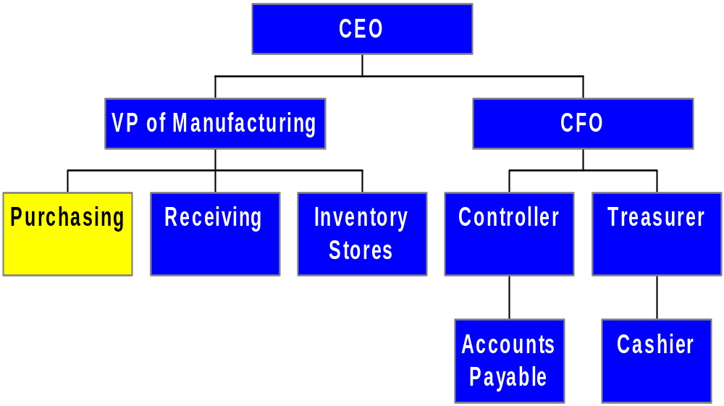
PARTIAL ORGANIZATION CHART FOR UNITS INVOLVED IN EXPENDITURE CYCLE
Selects suitable suppliers
Issues purchase orders

Slide 62
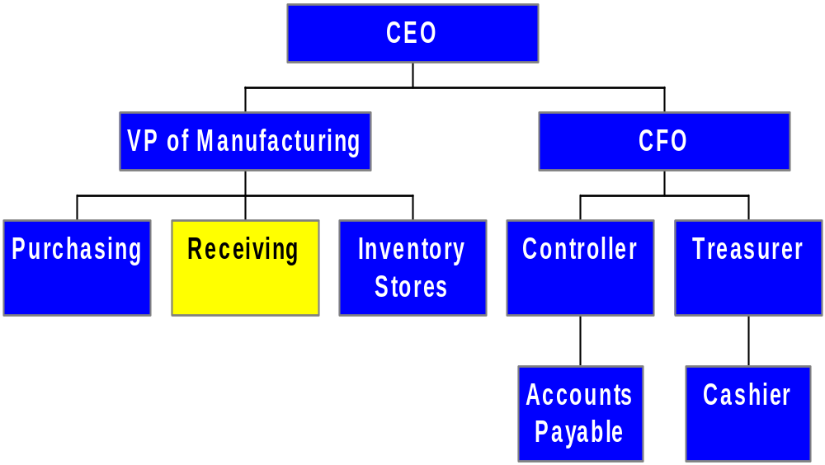
PARTIAL ORGANIZATION CHART FOR UNITS INVOLVED IN EXPENDITURE CYCLE
Decides whether to accept deliveries
Counts and inspects deliveries

Slide 63
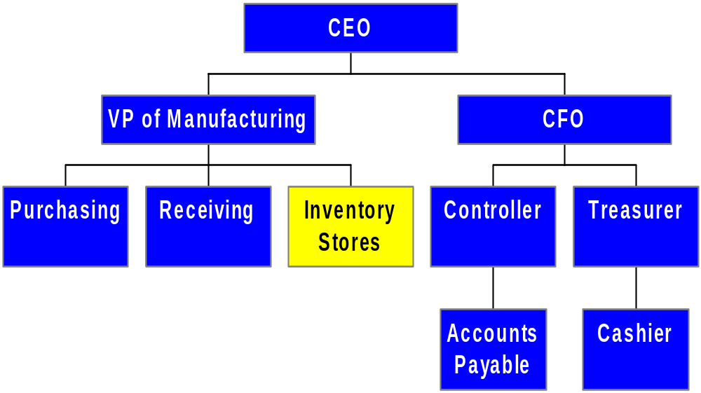
PARTIAL ORGANIZATION CHART FOR UNITS INVOLVED IN EXPENDITURE CYCLE
Stores goods that have been delivered and accepted

Slide 64
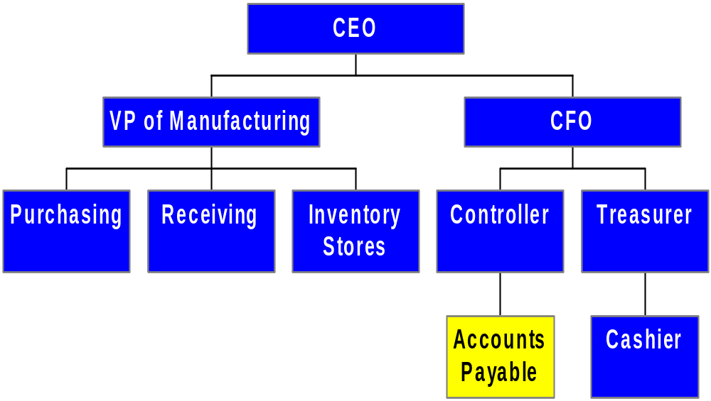
PARTIAL ORGANIZATION CHART FOR UNITS INVOLVED IN EXPENDITURE CYCLE
Approves invoices for payment

Slide 65
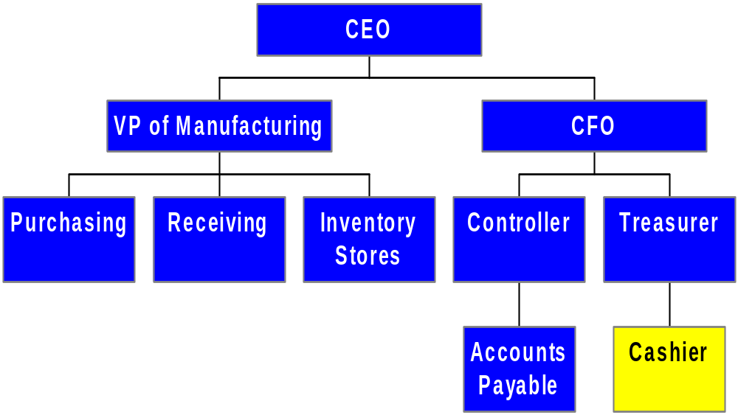
PARTIAL ORGANIZATION CHART FOR UNITS INVOLVED IN EXPENDITURE CYCLE
Issues payment to vendors

Slide 66
CONTROL: OBJECTIVES, THREATS, AND PROCEDURES
In the expenditure cycle (or any cycle), a well-designed AIS should provide adequate controls to ensure that the following objectives are met:
  All transactions are properly authorized
  All recorded transactions are valid
  All valid and authorized transactions are recorded
  All transactions are recorded accurately
  Assets are safeguarded from loss or theft
  Business activities are performed efficiently and effectively
  The company is in compliance with all applicable laws and regulations
  All disclosures are full and fair

Slide 67
CONTROL: OBJECTIVES, THREATS, AND PROCEDURES
There are several actions a company can take with respect to any cycle to reduce threats of errors or irregularities. These include:
  Using simple, easy-to-complete documents with clear instructions (enhances accuracy and reliability).
  Using appropriate application controls, such as validity checks and field checks (enhances accuracy and reliability).
  Providing space on forms to record who completed and who reviewed the form (encourages proper authorizations and accountability).

Slide 68
CONTROL: OBJECTIVES, THREATS, AND PROCEDURES
  Pre-numbering documents (encourages recording of valid and only valid transactions).
  Restricting access to blank documents (reduces risk of unauthorized transaction).
In the following sections, we’ll discuss the threats that may arise in the three major steps of the expenditure cycle, as well as general threats, EDI-related threats, and threats related to purchases of services.

Slide 69

CRIME TIME
Before we discuss specific threats, it may be helpful to have some background on a form of occupational fraud and abuse which is broadly referred to as corruption.
Corruption cases often involve arrangements between a company’s purchasing agent and a sales representative for one of the company’s vendors.

Slide 70
CRIME TIME
The vendor’s representative may try to induce the purchasing agent to buy goods that:
  Are over-priced
  Are of inferior quality
  Aren’t even needed
  Aren’t even delivered
In exchange, the vendor’s rep typically offers the purchasing agent something of value. That “something” might be money, payment of a debt, a job offer, an expensive vacation, or anything the purchasing agent might value.

Slide 71
CRIME TIME
According to the Fraud Examiner’s Manual published by the Association of Certified Fraud Examiners, these schemes usually take four forms:
  Bribery
Typically involves the vendor offering a kickback (something of value) to the buyer to buy inflated, substandard, un-needed, or un-delivered goods, etc.
Alternately, may involve an inducement to the buyer to rig a competitive bidding process so that the vendor gets the bid.

Slide 72
CRIME TIME
According to the Fraud Examiner’s Manual published by the Association of Certified Fraud Examiners, these schemes usually take four forms:
  Bribery
  Conflict of interest
In conflict of interest cases, the purchasing agent is usually arranging for his employer to make purchases from a company in which he has a concealed interest.
For example, perhaps his wife owns the vendor company.

Slide 73
CRIME TIME
According to the Fraud Examiner’s Manual published by the Association of Certified Fraud Examiners, these schemes usually take four forms:
  Bribery
  Conflict of interest
  Economic extortion
Economic extortion is basically the reverse of a bribe.
Instead of the vendor making an offer of something of value to the purchasing agent, the purchasing agent may tell the vendor that he must provide something of value to the purchasing agent if he wants to continue to do business with his employer.

Slide 74
CRIME TIME
According to the Fraud Examiner’s Manual published by the Association of Certified Fraud Examiners, these schemes usually take four forms:
  Bribery
  Conflict of interest
  Economic extortion
  Illegal gratuities
Illegal gratuities involve gifts that are given to the purchasing agent by a vendor after the vendor has been selected.
There was no intent by the vendor to influence the selection process; the gift was provided after the fact.
But the problem is that the gift is too likely to impact future decisions by the purchasing agent.

Slide 75
CRIME TIME
According to the Fraud Examiner’s Manual published by the Association of Certified Fraud Examiners, these schemes usually take four forms:
  Bribery
  Conflict of interest
  Economic extortion
  Illegal gratuities
How do you think these activities relate to the Foreign Corrupt Practices Act?

Slide 76
THREATS IN ORDERING GOODS
You can click on any of the threats below to get more information on:
  The types of problems posed by each threat
  The controls that can mitigate the threats.
Threats in the process of ordering goods include:
  THREAT 1: Stockouts and/or Excess Inventory
  THREAT 2: Ordering Unnecessary Items
  THREAT 3: Purchasing Goods at Inflated Prices
  THREAT 4: Purchasing Goods of Inferior Quality
  THREAT 5: Purchasing from Unauthorized Suppliers
  THREAT 6: Kickbacks
  EDI-Related Threats
  Threats Related to Purchases of Services

Slide 77
THREATS IN ORDERING GOODS
THREAT NO. 1—STOCKOUTS AND/OR EXCESS INVENTORY
  Why is this a problem?
    If you run out of merchandise, you may lose sales
    If you carry too much merchandise, you incur excess carrying costs and/or have to mark the inventory down.
  Controls:
    Accurate inventory control and sales forecasting systems
    Use of the perpetual inventory method

Slide 78
THREATS IN ORDERING GOODS
    Supplier performance reports that highlight deviations in product quality, price, and on-time delivery
    Online accounting information systems to record changes to inventory in real time
    Bar-coding of inventory to improve accuracy
    Periodic physical counts of inventory to verify accuracy of the records
Return to
Threat Menu
Go To
Next Threat

Slide 79
THREATS IN ORDERING GOODS
THREAT NO. 2—ORDERING UNNECESSARY ITEMS
  Why is this a problem?
    Excess carrying costs
    Obsolete inventory that can’t be sold or has to be marked down
    A related problem is multiple purchases of the same item by different units of the organization
      Often occurs when different departments or divisions have different numbering systems for parts
      Causes company to miss out on volume discounts

Slide 80
THREATS IN ORDERING GOODS
  Controls:
    Design the AIS to integrate the databases of various units
    Produce reports that link item descriptions to part numbers
Return to
Threat Menu
Go To
Next Threat

Slide 81
THREATS IN ORDERING GOODS
THREAT NO. 3—PURCHASING GOODS AT INFLATED PRICES
  Why is this a problem?
    Increases product costs
    Reduces profitability and/or damages competitive position
  Controls:
    Price lists for frequently purchased items—stored in master file and consulted
    Prices of low-cost items determined from catalogs

Slide 82
THREATS IN ORDERING GOODS
    Bids should be solicited for high-cost and specialized products
    Purchase orders should be reviewed to be sure policies have been followed
    Budgetary controls and responsibility accounting should be utilized to achieve accountability for cost overruns
    Performance reports should highlight significant variances for investigation
Return to
Threat Menu
Go To
Next Threat

Slide 83
THREATS IN ORDERING GOODS
THREAT NO. 4—PURCHASING GOODS OF INFERIOR QUALITY
  Why is this a problem?
    Can result in costly production delays
    Scrap and rework costs may make these materials more expensive than high-quality alternatives
  Controls:
    Compile list of approved suppliers known to provide goods of acceptable quality.
    Review purchase orders to ensure use of approved suppliers

Slide 84
THREATS IN ORDERING GOODS
    Track and review supplier performance
    Hold purchasing managers responsible for the total cost of purchases, including rework and scrap costs
      Requires that the AIS can track these costs.
Return to
Threat Menu
Go To
Next Threat

Slide 85
THREATS IN ORDERING GOODS
THREAT NO. 5—PURCHASING FROM UNAUTHORIZED SUPPLIERS
  Why is this a problem?
    May result in goods of inferior quality
    May cause legal issues such as violation of import quotas
  Controls:
    Review purchase orders for use of approved suppliers
    Restrict access to approved supplier list

Slide 86
THREATS IN ORDERING GOODS
    Periodically review approved supplier list for unauthorized changes
    Work with issuers of procurement cards to control which suppliers can accept the card
Return to
Threat Menu
Go To
Next Threat

Slide 87
THREATS IN ORDERING GOODS
THREAT NO. 6—KICKBACKS
  Why is this a problem?
    Kickbacks are gifts from suppliers to purchasing agents for the purpose of influencing their choice of suppliers. They typically result in many of the preceding threats, including:
      Paying inflated prices
      Buying unneeded items
      Buying goods of inferior quality

Slide 88
THREATS IN ORDERING GOODS
  Controls:
    Prohibit purchasing agents from accepting gifts from suppliers.
    Train employees to respond appropriately to gifts from suppliers.
    Rotate jobs so the same purchasing agent does not deal with the same suppliers indefinitely.
    Audit the activities of purchasing agents.
    Enforce mandatory vacations.
    Have purchasing agents review and sign annual conflict of interest statements.
    Include clauses allowing vendor audits in contracts with suppliers.
Return to
Threat Menu
Go To
Next Threat

Slide 89
THREATS IN ORDERING GOODS
EDI-RELATED THREATS
  Why is this a problem?
    Users who have malicious intent and/or have unauthorized access to EDI can submit multiple unauthorized transactions quickly.
  Controls:
    Access to the EDI system should be limited to authorized personnel through passwords, user IDs, access control matrices, and physical access controls.
    Procedures should be in place to verify and authenticate EDI transactions.

Slide 90
THREATS IN ORDERING GOODS
    EDI systems should send an acknowledgment for each transaction:
      Provides an accuracy check
      Helps protect against transmission problems that could result in loss of an order
    A log of all EDI transactions should be maintained and reviewed by an independent party
    Encryption should be used to ensure privacy, particularly for competitive bids
    Digital signatures should be used to ensure authenticity
    Companies should have agreements with suppliers over EDI-related concerns
Return to
Threat Menu
Go To
Next Threat

Slide 91
THREATS IN ORDERING GOODS
THREATS RELATED TO PURCHASES OF SERVICES
  Why is this a problem?
    Services are not a physical product and can’t be counted. It can be difficult to “audit” whether they were provided.
  Controls:
    Hold supervisors responsible for all costs incurred by their departments.
    Compare actual vs. budgeted expenses, and investigate discrepancies.
    Conduct periodic reviews of contracts for services, including audits of supplier records.
Return to
Threat Menu
Go To
Next Threat

Slide 92
THREATS IN RECEIVING AND STORING GOODS
The primary objectives of this process are to:
  Verify the receipt of ordered inventory
  Safeguard the inventory against loss or theft
Threats in the process of receiving and storing goods include:
  THREAT 7: Receiving unordered goods
  THREAT 8: Errors in counting received goods
  THREAT 9: Theft of inventory
You can click on any of the threats above to get more information on:
  The types of problems posed by each threat
  The controls that can mitigate the threats.

Slide 93
THREATS IN RECEIVING AND STORING GOODS
THREAT NO. 7—RECEIVING UNORDERED GOODS
  Why is this a problem?
    Results in unnecessary costs to unload, store, and return the items
  Controls:
    Instruct receiving department to accept goods only if there is an approved copy of the purchase order
Return to
Threat Menu
Go To
Next Threat

Slide 94
THREATS IN RECEIVING AND STORING GOODS
THREAT NO. 8—ERRORS IN COUNTING RECEIVED GOODS
  Why is this a problem?
    Company pays for goods that weren’t received
    Inventory records are inaccurate, possibly leading to stockouts and lost sales
  Controls:
    Bar coding of ordered goods
    Design receiving forms so clerks cannot see the quantity ordered
    Require receiving clerks to sign receiving reports to create accountability

Slide 95
THREATS IN RECEIVING AND STORING GOODS
    Offer bonuses for catching discrepancies
    Have inventory control count the items transferred from receiving
Return to
Threat Menu
Go To
Next Threat

Slide 96
THREATS IN RECEIVING AND STORING GOODS
THREAT NO. 9—THEFT OF INVENTORY
  Why is this a problem?
    Loss of assets
    Inaccurate records
  Controls:
    Store inventory in secure locations with restricted access
    Document all intra-company inventory transfers, e.g.:
      Goods moving from receiving to warehouse
      Goods moving from warehouse to production floor

Slide 97
THREATS IN RECEIVING AND STORING GOODS
    Periodic physical count of inventory and comparison to records
      More critical items should be counted more frequently
    Segregation of duties
      Separate those who have physical access to inventory from those who keep records
      Separate both those who have custody and those who can authorize inventory adjustments from those who work in the receiving and shipping functions
Return to
Threat Menu
Go To
Next Threat

Slide 98
THREATS IN APPROVING AND PAYING VENDOR INVOICES
You can click on any of the threats below to get more information on:
  The types of problems posed by each threat
  The controls that can mitigate the threats.
The primary objectives of this process are to:
  Pay only for goods and services that were ordered and received
  Safeguard cash
Threats in the process of approving and paying vendor invoices include:
  THREAT 10: Failing to catch errors in vendor invoices
  THREAT 11: Paying for goods not received
  THREAT 12: Failing to take available purchase discounts
  THREAT 13: Paying the same invoice twice
  THREAT 14: Recording and posting errors to accounts payable
  THREAT 15: Misappropriating cash, checks, or EFTs

Slide 99
THREATS IN APPROVING AND PAYING VENDOR INVOICES
THREAT NO. 10: Failing to Catch Errors in Vendor Invoices
  Why is this a problem?
    Overpaying for merchandise
  Controls:
    Check mathematical accuracy of invoices
    Obtain receipts from procurement card users and verify monthly statement accuracy
    Adopt Evaluated Receipt Settlement ( ERS) approach—i.e., pay for goods when received at the price stated in the purchase order

Slide 100
THREATS IN APPROVING AND PAYING VENDOR INVOICES
    Freight-related terminology can be challenging, so provide accounts payable staff with training on transportation practices and terminology
    When freight is paid by the purchaser, use the same carrier in order to receive discounts
Return to
Threat Menu
Go To
Next Threat

Slide 101
THREATS IN APPROVING AND PAYING VENDOR INVOICES
THREAT NO. 11: Paying for Goods Not Received
  Why is this a problem?
    Increased costs
  Controls:
    Compare quantities on invoice with quantities reported by receiving and inventory control departments
    Use ERS
    With respect to services, have tight budgetary controls and provide careful review of departmental expenses
Return to
Threat Menu
Go To
Next Threat

Slide 102
THREATS IN APPROVING AND PAYING VENDOR INVOICES
THREAT NO. 12: Failing to Take Available Purchase Discounts
  Why is this a problem?
    Reduces profitability
  Controls:
    File approved invoices by due date and track that way
    Prepare cash flow budgets to determine whether the company has adequate cash flow to take advantage of early payment discounts
Return to
Threat Menu
Go To
Next Threat

Slide 103
THREATS IN APPROVING AND PAYING VENDOR INVOICES
THREAT NO. 13: Paying the Same Invoice Twice
  Why is this a problem?
    Reduces profitability
    Can create a cash crunch if a large invoice is paid twice
  Controls:
    Approve invoices for payment only when accompanied by a complete voucher package (PO & receiving report)
    Only pay on original copies of invoices

Slide 104
THREATS IN APPROVING AND PAYING VENDOR INVOICES
    Cancel the invoice once the check is signed
    Have internal auditors or consultants help detect and recover overpayments
    In invoice-less accounts payable systems, control access to the master file and monitor all changes
Return to
Threat Menu
Go To
Next Threat

Slide 105
THREATS IN APPROVING AND PAYING VENDOR INVOICES
THREAT NO. 14: Recording and Posting Errors to Accounts Payable
  Why is this a problem?
    May result in disgruntled suppliers
    Causes errors in financial and performance reports
  Controls:
    Appropriate data entry and processing controls, such as comparing the differences in vendor balances before and after processing checks with the total amount of invoices processed
    Reconcile supplier balances (or unpaid vouchers) with the accounts payable control account
Return to
Threat Menu
Go To
Next Threat

Slide 106
THREATS IN APPROVING AND PAYING VENDOR INVOICES
THREAT NO. 15: Misappropriating Cash, Checks, or EFTs
  Why is this a problem?
    Loss of assets
    Potentially misleading financial statements if theft is large enough
  Controls:
    Restrict access to cash, blank checks, and check signing machines
    Have checks numbered sequentially and periodically accounted for by the cashier

Slide 107
THREATS IN APPROVING AND PAYING VENDOR INVOICES
    To prevent schemes where an employees causes his employer to issue a fraudulent check:
      Use proper segregation of duties:
        Accounts payable authorizes payment
        The treasurer or cashier signs and mails checks
      Require two signatures for checks over a certain amount
      Restrict access to the approved supplier list; have changes reviewed and approved
      Cancel all documents in the voucher package when payment is made
      Have an independent party (e.g., internal auditing) reconcile the bank statements

Slide 108
THREATS IN APPROVING AND PAYING VENDOR INVOICES
    To prevent check alteration and forgery:
      Use check protection machines that imprint amounts
      Use inks that are difficult to alter
      Print checks on watermarked paper
      Set up a positive pay arrangement with the bank
        The company provides the bank with a list of checks it has written
        The bank will only honor checks that are on that list
      Do bank reconciliations promptly

Slide 109
THREATS IN APPROVING AND PAYING VENDOR INVOICES
    If a petty cash fund is needed:
      It should be handled by an employee who has no other cash-handling or accounting responsibilities
      It should be set up as an imprest fund (fixed amount that gets replenished on presentation of vouchers)
      Vouchers should be canceled when the fund is replenished
      Periodic surprise counts should be made and the custodian should be held responsible for shortages

Slide 110
THREATS IN APPROVING AND PAYING VENDOR INVOICES
    Electronic funds transfer requires additional control procedures, including:
      Strict physical and logical access controls
      Change password and user IDs regularly
      Log user and location of originating terminal
      Transactions should be encrypted
      Transactions should be time stamped and numbered
      A control group should monitor the transactions and the EFT controls
      Embedded audit modules can be incorporated to electronically monitor the transactions and flag suspicious items
Return to
Threat Menu
Go To
Next Threat

Slide 111
GENERAL CONTROL ISSUES
You can click on any of the threats below to get more information on:
  The types of problems posed by each threat
  The controls that can mitigate the threats.
Two general objectives pertain to activities in every cycle:
  Accurate data should be available when needed
  Activities should be performed efficiently and effectively
The related general threats are:
  THREAT 16: Loss, Alteration, or Unauthorized Disclosure of Data
  THREAT 17: Poor performance

Slide 112
GENERAL CONTROL ISSUES
THREAT NO. 16—LOSS, ALTERATION, OR UNAUTHORIZED DISCLOSURE OF DATA
  Why is this a problem?
    Loss or alteration of data could cause:
      Errors in external or internal reporting.
      Inaccurate payment of vendors
    Unauthorized disclosure of confidential vendor information can cause:
      Legal sanctions and fines
      Vendor bidding irregularities

Slide 113
GENERAL CONTROL ISSUES
  Controls:
    The purchases file, cash disbursements file, accounts payable master file, and most recent transaction file should be backed up regularly.
      At least one backup on site and one offsite.
    All disks and tapes should have external and internal file labels to reduce chance of accidentally erasing important data.
    Access controls should be utilized:
      User IDs and passwords
      Compatibility matrices
      Controls for individual terminals (e.g., so the sales order department can’t create a receiving report)
      Logs of all activities, particularly those requiring specific authorizations

Slide 114
GENERAL CONTROL ISSUES
    Default settings on ERP systems usually allow users far too much access to data, so these systems must be modified to enforce proper segregation of duties.
    Sensitive data should be encrypted in storage and in transmission.
    Parity checks, acknowledgment messages, and control totals should be used to ensure transmission accuracy.
Return to
Threat Menu
Go To
Next Threat

Slide 115
GENERAL CONTROL ISSUES
THREAT NO. 17—POOR PERFORMANCE
  Why is this a problem?
    May damage vendor relations
    Reduces profitability
  Controls:
    Prepare and review performance reports
Return to
Threat Menu
Go To
Next Threat

Slide 116
EXPENDITURE CYCLE INFORMATION NEEDS
Information is needed for the following operational tasks in the expenditure cycle, including:
  Deciding when and how much inventory to order
  Deciding on appropriate suppliers
  Determining if vendor invoices are accurate
  Deciding whether to take purchase discounts
  Determining whether adequate cash is available to meet current obligations

Slide 117
EXPENDITURE CYCLE INFORMATION NEEDS
Information is also needed for the following strategic decisions:
  Setting prices for products/services
  Establishing policies on returns and warranties
  Deciding on credit terms
  Determining short-term borrowing needs
  Planning new marketing campaigns

Slide 118
EXPENDITURE CYCLE INFORMATION NEEDS
The AIS needs to provide information to evaluate the following:
  Purchasing efficiency and effectiveness
  Supplier performance
  Time taken to move goods from receiving to production
  Percent of purchase discounts taken
Both financial and operating information are needed to manage and evaluate these activities
Both external and internal information are needed

Slide 119
EXPENDITURE CYCLE INFORMATION NEEDS
When the AIS integrates information from the various cycles, sources, and types, the reports that can be generated are unlimited. They include reports on:
  Supplier performance
  Outstanding invoices
  Performance of expenditure cycle employees
  Number of POs processed by purchasing agent
  Number of invoices processed by A/P clerk
  Number of deliveries handled by receiving clerk

Slide 120
EXPENDITURE CYCLE INFORMATION NEEDS
  Number of inventory moves by warehouse worker
  Inventory turnover
  Classification of inventory based on contribution to profitability
Accountants should continually refine and improve these performance reports

Slide 121
SUMMARY
You’ve learned about the basic business activities and data processing operations that are performed in the expenditure cycle, including:
  Ordering goods, supplies, and services
  Receiving and storing them
  Approving invoices and paying for them
You’ve learned how IT can improve the efficiency and effectiveness of these processes

Slide 122
SUMMARY
You’ve learned about decisions that need to be made in the expenditure cycle and what information is required to make these decisions
You’ve also learned about the major threats that present themselves in the expenditure cycle and the controls that can mitigate those threats

