Slide 1
HAPTER 14
General Ledger and Reporting System

Slide 2
INTRODUCTION
Questions to be addressed in this chapter include:
  What information processing operations are required to update the general ledger and produce reports for internal and external users?
  How do IT developments impact the general ledger and reporting system?
  What are the major threats in the general ledger and reporting system and the controls that can mitigate those threats?

Slide 3
INTRODUCTION
  What is a balanced scorecard and how is it used?
  What are data warehouses, and how do they support business intelligence?
  How can the design of financial graphs affect business decisions?

Slide 4
INTRODUCTION
The general ledger and reporting system (GLARS) includes the processes in place to update general ledger accounts and prepare reports that summarize results of the organization’s activities.

Slide 5
INTRODUCTION
One of the primary functions of GLARS is to collect and organize data from:
  Each of the accounting cycle subsystems, which provide summary entries related to the routine activities in those cycles.
  The treasurer, who provides entries with respect to non-routine activities such as transactions with creditors and investors.
  The budget department, which provides budget numbers.
  The controller, who provides adjusting entries.

Slide 6
INTRODUCTION
The information must be organized to meet the needs of internal and external users.
The system must be designed to produce regular periodic reports and to support real-time inquiries.

Slide 7
GENERAL LEDGER AND REPORTING SYSTEM
The basic activities in the GLARS are:
  Update the general ledger
  Post adjusting entries
  Prepare financial statements
  Produce managerial reports
The first three represent the basic steps in the accounting cycle

Slide 8
GENERAL LEDGER AND REPORTING SYSTEM
The basic activities in the GLARS are:
  Update the general ledger
  Post adjusting entries
  Prepare financial statements
  Produce managerial reports
The first three represent the basic steps in the accounting cycle.

Slide 9
UPDATE THE GENERAL LEDGER
Updating the general ledger consists of posting journal entries from two sources:
  Summary journal entries of routine transactions from the accounting subsystems
  Individual journal entries for non-routine transactions from the treasurer. Examples:
    Issuances of or payment of debt and the associated interest.
    Issuances of or repurchases of company stock and paying dividends on that stock.

Slide 10
UPDATE THE GENERAL LEDGER
Journal entries are often documented on a form called a journal voucher.
After updating the general ledger (GL), journal entries are stored in a journal voucher file.

Slide 11
GENERAL LEDGER AND REPORTING SYSTEM
The basic activities in the GLARS are:
  Update the general ledger
  Post adjusting entries
  Prepare financial statements
  Produce managerial reports
The first three represent the basic steps in the accounting cycle

Slide 12
POST ADJUSTING ENTRIES
Adjusting entries originate in the controller’s office at the end of each accounting period (month, quarter, year, etc.) and after the initial trial balance has been prepared.
The trial balance lists the balances for all of the GL accounts.
If properly recorded, the total of all debit balances equal the total of all credit balances.

Slide 13
POST ADJUSTING ENTRIES
There are five types of adjusting entries:
  Accruals
An accrual involves an event that has occurred for which the related cash flow has not yet taken place.
  Accrued revenue—The company has delivered a product or service to a customer but has not yet been paid.
  Accrued expense—The company has used up a good or service but not yet paid for it.

Slide 14
POST ADJUSTING ENTRIES
There are five types of adjusting entries:
  Accruals
  Deferrals
A deferral involves a situation where the cash flow takes place before the related revenue is earned or the expense is incurred.
  Deferred revenue—The company received payment for a product or service that was not yet been completely delivered to the customer (aka, “unearned revenue”).
  Deferred expense—The company paid for a good or service which they had not yet completely used up (aka, “prepaid expense”).

Slide 15
POST ADJUSTING ENTRIES
There are five types of adjusting entries:
  Accruals
  Deferrals
  Estimates
Estimates are used to recognize expenses that cannot be directly attributed to a related revenue and must be allocated in a more subjective or systematic manner.
Examples:
  Depreciation expense
  Bad debt expense.

Slide 16
POST ADJUSTING ENTRIES
There are five types of adjusting entries:
  Accruals
  Deferrals
  Estimates
  Re-evaluations
Re-evaluations result from:
  Reconciling actual and recorded values of assets
    EXAMPLE: Making a lower-of-cost-or-market adjustment to inventory
    Recording an asset impairment
  Recording changes in accounting principles.

Slide 17
POST ADJUSTING ENTRIES
There are five types of adjusting entries:
  Accruals
  Deferrals
  Estimates
  Re-evaluations
  Error corrections
Error corrections involve correction of errors previously made in the general ledger.

Slide 18
POST ADJUSTING ENTRIES
Journal vouchers for adjusting entries should be stored in the journal voucher file.
Once adjusting entries have been recorded, an adjusted trial balance is prepared from the new balances in the general ledger.
The adjusted trial balance serves as the input for the next step—preparation of the financial statements.

Slide 19
GENERAL LEDGER AND REPORTING SYSTEM
The basic activities in the GLARS are:
  Update the general ledger
  Post adjusting entries
  Prepare financial statements
  Produce managerial reports
The first three represent the basic steps in the accounting cycle

Slide 20
PREPARE FINANCIAL STATEMENTS
Activities in the preparation of financial statements are as follows:
  Prepare an income statement
The Income Statement is prepared using the balances in the revenue, expense, gain, and loss accounts listed on the adjusted trial balance.

Slide 21
PREPARE FINANCIAL STATEMENTS
Activities in the preparation of financial statements are as follows:
  Prepare an income statement
  Prepare closing entries
After preparation of the income statement, the revenue, expense, gain, and loss accounts are closed.
Their balances are transferred to retained earnings, so that this account will have the correct ending balance.
If a separate account is kept for dividends, that account is also closed to retained earnings.
Most companies perform monthly and annual closes.

Slide 22
PREPARE FINANCIAL STATEMENTS
Activities in the preparation of financial statements are as follows:
  Prepare an income statement
  Prepare closing entries
  Prepare a statement of stockholders’ equity
Reconciles the changes in the stockholders equity accounts (paid-in capital and retained earnings) for the year.

Slide 23
PREPARE FINANCIAL STATEMENTS
Activities in the preparation of financial statements are as follows:
  Prepare an income statement
  Prepare closing entries
  Prepare a statement of stockholders’ equity
  Prepare a balance sheet
Presents the balances in the permanent accounts:
  Assets
  Liabilities
  Owners’ Equity

Slide 24
PREPARE FINANCIAL STATEMENTS
Activities in the preparation of financial statements are as follows:
  Prepare an income statement
  Prepare closing entries
  Prepare a statement of stockholders’ equity
  Prepare a balance sheet
  Prepare a statement of cash flows
Presents changes in cash for the period categorized by:
  Operating activities
  Investing activities
  Financing activities

Slide 25
GENERAL LEDGER AND REPORTING SYSTEM
The basic activities in the GLARS are:
  Update the general ledger
  Post adjusting entries
  Prepare financial statements
  Produce managerial reports
The first three represent the basic steps in the accounting cycle

Slide 26
PRODUCE MANAGERIAL REPORTS
The final step is prepare of reports for internal purposes, including:
  Reports to verify the accuracy of the posting process.
Examples:
  Lists of journal vouchers by numerical sequence, account number, or date.
  Lists of general ledger account balances.

Slide 27
PRODUCE MANAGERIAL REPORTS
The final step is prepare of reports for internal purposes, including:
  Reports to verify the accuracy of the posting process.
  Budgets for planning and evaluating performance

Slide 28
PRODUCE MANAGERIAL REPORTS
The final step is prepare of reports for internal purposes, including:
  Reports to verify the accuracy of the posting process.
  Budgets for planning and evaluating performance:
    Operating budget
Depicts planned revenues and expenses for each unit

Slide 29
PRODUCE MANAGERIAL REPORTS
The final step is prepare of reports for internal purposes, including:
  Reports to verify the accuracy of the posting process.
  Budgets for planning and evaluating performance:
    Operating budget
    Capital expenditure budget
Shows planned cash inflows and outflows for each project.

Slide 30
PRODUCE MANAGERIAL REPORTS
The final step is prepare of reports for internal purposes, including:
  Reports to verify the accuracy of the posting process.
  Budgets for planning and evaluating performance:
    Operating budget
    Capital expenditure budget
    Cash flow budget
Shows anticipated cash inflows and outflows for use in determining borrowing needs.

Slide 31
PRODUCE MANAGERIAL REPORTS
The final step is prepare of reports for internal purposes, including:
  Reports to verify the accuracy of the posting process.
  Budgets for planning and evaluating performance:
    Operating budget
    Capital expenditure budget
    Cash flow budget
What’s the difference between the operating budget and the cash flow budget?

Slide 32
PREPARE MANAGERIAL REPORTS
Budgets and performance reports should be developed on the basis of responsibility accounting, i.e., reporting results on the basis of the manager responsible:
  Breaks down financial results by subunit.
  Shows actual costs and variances for current month and year-to-date for items the subunit controls.
  The cost of a sub-unit is displayed as a single line item on the report for the next level up.

Slide 33
PREPARE MANAGERIAL REPORTS
Contents of the budgetary performance reports should be tailored to the nature of the unit being evaluated.
  Cost centers
Examples: Production, service, and administrative departments.
Present actual vs. budgeted costs, focusing only on controllable costs.

Slide 34
PREPARE MANAGERIAL REPORTS
Contents of the budgetary performance reports should be tailored to the nature of the unit being evaluated.
  Cost centers
  Revenue centers
Example: Sales department.
Present actual vs. forecasted sales by product, geographical category, etc.

Slide 35
PREPARE MANAGERIAL REPORTS
Contents of the budgetary performance reports should be tailored to the nature of the unit being evaluated.
  Cost centers
  Revenue centers
  Profit centers
Examples: IT and utilities that charge other units for their services.
Compare actual vs. budgeted revenues, expenses, and profits.

Slide 36
PREPARE MANAGERIAL REPORTS
Contents of the budgetary performance reports should be tailored to the nature of the unit being evaluated.
  Cost centers
  Revenue centers
  Profit centers
  Investment centers
Examples: Plants, divisions, and other autonomous operating units.
Provide calculations of return on investment.

Slide 37
PRODUCE MANAGERIAL REPORTS
The method used to calculate the budget standard is crucial:
  Can use a fixed target and compare actual results to the fixed budget.
  Problem: Does not adjust for unforeseen changes in operating environment and may penalize manager for factors beyond his control.

Slide 38
PRODUCE MANAGERIAL REPORTS
Example:
  A unit forecasts sales of 1,000 units of its product.
  Actual sales are 1,200 units.
  Because sales rose, the cost of goods sold also rose.
  The outcome is good for the profitability of the company, but the production manager may be penalized because production costs were higher than the fixed target.

Slide 39
PRODUCE MANAGERIAL REPORTS
Solution:
  Develop a flexible budget.
    Break each item into fixed and variable components.
    Adjust the variable components for variations in sales or production.
    See example on next slide.

Slide 40
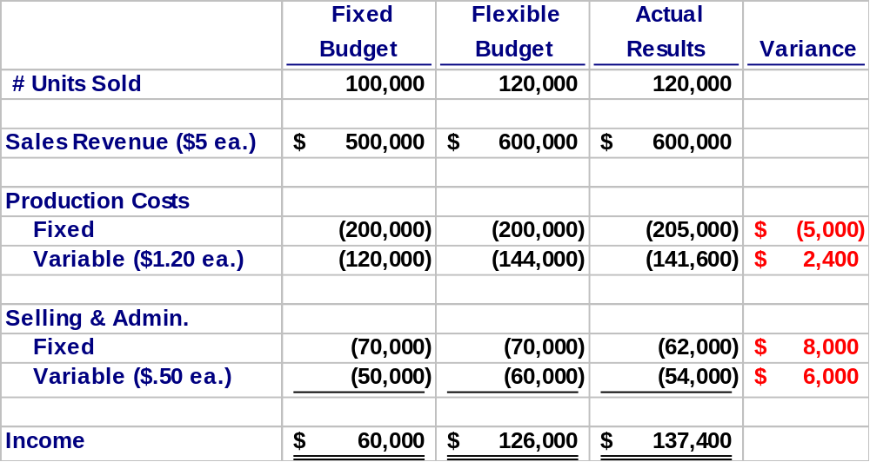
SAMPLE FLEXIBLE BUDGET

Slide 41
XBRL: REVOLUTIONIZING THE REPORTING PROCESS
While financial statements appear electronically in a variety of formats, until recently disseminating this information was cumbersome and inefficient.
  Recipients (SEC, IRS, etc.) required the information in a variety of formats which was time-consuming.
  Also conducive to errors, since re-entry of the information was often necessary.
Underlying problem: lack of standards for identifying the content of data.

Slide 42
XBRL: REVOLUTIONIZING THE REPORTING PROCESS
Solution: Extensible Business Reporting Language (XBRL)
  A variant of XML designed specifically to communicate the contents of financial data.
  Creates tags for each data item much like HTML tags.
    Tag names specify line items in financial statements.
    Other fields in the tag provide information such as the year, units of measure, etc.
Major software vendors are developing tools to automatically generate XBRL codes so accountants won’t need to write code.

Slide 43
XBRL: REVOLUTIONIZING THE REPORTING PROCESS
XBRL provides two major benefits:
  Organizations can publish their financial statements on time in a format that anyone can use.
  Recipients will no longer need to manually reenter data they acquired electronically so that decision support tools can analyze them.
    Means search for data on the Internet will be more efficient and accurate.

Slide 44
XBRL: REVOLUTIONIZING THE REPORTING PROCESS
Benefits of XBRL apply to exchanging financial information both externally and internally.
XBRL provides a great example of how accountants can actively participate in IT development, since the accounting profession spearheaded its development.

Slide 45
CONTROL: OBJECTIVES, THREATS, AND PROCEDURES
In the general ledger and reporting system (or any cycle), a well-designed AIS should provide adequate controls to ensure that the following objectives are met:
  All transactions are properly authorized
  All recorded transactions are valid
  All valid and authorized transactions are recorded
  All transactions are recorded accurately
  Assets are safeguarded from loss or theft
  Business activities are performed efficiently and effectively
  The company is in compliance with all applicable laws and regulations
  All disclosures are full and fair

Slide 46
CONTROL: OBJECTIVES, THREATS, AND PROCEDURES
There are several actions a company can take with respect to any cycle to reduce threats of errors or irregularities. These include:
  Using simple, easy-to-complete documents with clear instructions (enhances accuracy and reliability).
  Using appropriate application controls, such as validity checks and field checks (enhances accuracy and reliability).
  Providing space on forms to record who completed and who reviewed the form (encourages proper authorizations and accountability).

Slide 47
CONTROL: OBJECTIVES, THREATS, AND PROCEDURES
  Pre-numbering documents (encourages recording of valid and only valid transactions).
  Restricting access to blank documents (reduces risk of unauthorized transaction).

Slide 48
CONTROL: OBJECTIVES, THREATS, AND PROCEDURES
In the following sections, we’ll discuss the threats that may arise in the general ledger and reporting system, as well as the controls that can prevent those threats.

Slide 49
THREATS IN THE GENERAL LEDGER AND REPORTING SYSTEM
The primary threats in the general ledger and reporting system are:
  THREAT 1: Errors in Updating the General Ledger and Generating Reports
  THREAT 2: Loss, Alteration, or Unauthorized Disclosure of Financial Data
  THREAT 3: Poor Performance
You can click on any of the threats above to get more information on:
  The types of problems posed by each threat
  The controls that can mitigate the threats.

Slide 50
THREATS IN THE GENERAL LEDGER AND REPORTING SYSTEM
THREAT 1: ERRORS IN UPDATING THE GENERAL LEDGER AND GENERATING REPORTS
  Why is this a problem?
    Can lead to poor decisions based on incorrect information
  Controls:
    Input edit and processing controls
      Checking that the summary journal entries from the accounting cycles represent activity for the most recent time period.

Slide 51
THREATS IN THE GENERAL LEDGER AND REPORTING SYSTEM
      For non-routine entries from the treasurer and controller:
        Validity checks on the general ledger account numbers.
        Field checks for numeric data in the amount fields.
        Zero balance checks (debits = credits).
        Completeness tests to ensure all data is entered.
        Closed-loop verification matching account numbers with account descriptions.
        Standard adjusting entry file for recurring adjusting entries.
        Sign checks on the ledger account balance.
        Run-to-run totals to verify the accuracy of journal voucher batch processing, i.e., account balance before entries, adjusted for total debits and credits entered, should equal balance after adjustments.

Slide 52
THREATS IN THE GENERAL LEDGER AND REPORTING SYSTEM
    Reconciliations and control report
      Trial balances.
      Checking that clearing and suspense accounts have zero balances.
      Checking balances in control accounts against totals of subsidiary accounts.
      Examining transactions near year end for proper timing.
      Listings of:
        Journal vouchers by account number to identify cause of errors in a particular account.
        Journal voucher by sequence to look for missing entries.
        General journal to check that total debits to the ledger = total credits.

Slide 53
THREATS IN THE GENERAL LEDGER AND REPORTING SYSTEM
    Audit trail
      Depicts the path of a transaction through the accounting system. Facilitates:
        Tracing transaction from origin to any reports or documents produced.
        Tracing any item in a report back to its origin.
        Tracing all account changes from beginning balance to ending balance.
      The journal voucher file provides information about the source of all entries to the general ledger.
      Various master files can also help verify accuracy of general ledger.

Slide 54
THREATS IN THE GENERAL LEDGER AND REPORTING SYSTEM
      Usefulness of the audit trail depends on its integrity, so you need to:
        Make periodic backups.
        Control access.
Return to
Threat Menu
Go To
Next Threat

Slide 55
THREATS IN THE GENERAL LEDGER AND REPORTING SYSTEM
THREAT 2: LOSS, ALTERATION, OR UNAUTHORIZED DISCLOSURE OF DATA
  Why is this a problem?
    Can result in leaks of confidential data.
    Can conceal a theft of assets.
  Controls:
    Back up and recovery procedures:
      At least one backup of general ledger on site and one offsite.
      Disaster recovery plan should be developed and practiced.
    All disks and tapes should have external and internal file labels to reduce chance of accidentally erasing important data.

Slide 56
THREATS IN THE GENERAL LEDGER AND REPORTING SYSTEM
    Access controls should be utilized
      User IDs and passwords.
      Compatibility matrices.
      Controls for individual terminals (e.g., so the receiving dock can’t enter a sales order).
      Logs of all activities, particularly those requiring specific authorizations, should be maintained.
    Default settings on ERP systems usually allow users far too much access to data, so these systems must be modified to enforce proper segregation of duties.

Slide 57
THREATS IN THE GENERAL LEDGER AND REPORTING SYSTEM
    Sensitive data should be encrypted in storage and in transmission.
    Parity checks, acknowledgment messages, and control totals should be used to ensure transmission accuracy.
Return to
Threat Menu
Go To
Next Threat

Slide 58
THREATS IN THE GENERAL LEDGER AND REPORTING SYSTEM
THREAT 3: POOR PERFORMANCE
  Why is this a problem?
    The company might provide tainted or late information to government agencies, regulatory bodies, investors, creditors, etc..
    May not get internal reports on a timely basis.
    Reduces profitability.
  Controls:
    Prepare and review performance reports.
    Implement XBRL.
    Redesign business processes.
Return to
Threat Menu
Go To
Next Threat

Slide 59
SUPPORTING MANAGEMENT’S INFORMATION NEEDS
Three tools or abilities can be particularly useful to management in decision making:
  The balanced scorecard
  Data warehouses
  Proper design of graphs of financial data

Slide 60
SUPPORTING MANAGEMENT’S INFORMATION NEEDS
Three tools or abilities can be particularly useful to management in decision making:
  The balanced scorecard
  Data warehouses
  Proper design of graphs of financial data

Slide 61
THE BALANCED SCORECARD
A balanced scorecard is a report that provides a multi-dimensional perspective on organizational performance.
Contains measures relating to four perspectives of the organization:
  Financial
  Customer
  Internal operations
  Innovation and learning

Slide 64
THE BALANCED SCORECARD
The balanced scorecard shows:
  The organization’s goals for each of the four dimensions
  Specific measures of performance in attaining those goals.
It provides a more comprehensive overview of organizational performance than financial measures alone.
Properly designed, it measures key aspects of the organization’s strategy and reflects important causal links.

Slide 65
THE BALANCED SCORECARD
With respect to the goals:
  Many organizations mistakenly use industry benchmarks in designing their balanced scorecards.
  This approach limits the company’s performance to that of its competitors and fails to consider the organization’s unique strengths and weaknesses.

Slide 66
THE BALANCED SCORECARD
EXAMPLE: Dumbledore Insurance Company’s top management agreed on three key financial goals:
  Increased revenue streams through the sale of new products.
  Increased profitability as reflected in return on equity.
  Maintaining adequate cash flows to meet obligations.

Slide 67
THE BALANCED SCORECARD
They then created the following hypotheses (or causal links) as to how these goals could be achieved:
  If we increase employee training (innovation and learning dimension), that should improve our service quality (internal operations dimension).
  If we increase our service quality (internal operations dimension), that should improve our customer satisfaction (customer dimension) and cause us to pick up a greater market share.
  Improved customer satisfaction and market share (customer dimension) should therefore result in improved profitability (financial dimension).

Slide 68
THE BALANCED SCORECARD
Given these hypotheses, Dumbledore designs and implements the scorecard shown on the following slide.

Slide 69
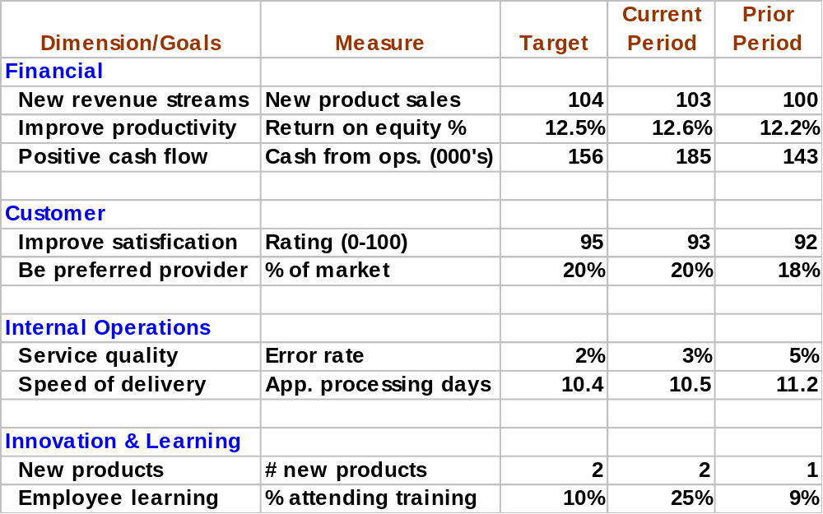
THE BALANCED SCORECARD

Slide 70
THE BALANCED SCORECARD
Analyzing trends in the actual measures allows Dumbledore’s management to test the validity of their hypotheses:
  If improvements in one perspective don’t generate expected improvements in other areas, top management should reevaluate and revise their hypotheses.
  The ability to test and refine their strategy is one of the major benefits of the balanced scorecard.

Slide 71
THE BALANCED SCORECARD
In developing a balanced scorecard:
  Top management should specify the goals to be pursued in each dimension
  Accountants and IS professionals:
    Help them choose appropriate measures for tracking attainment of these goals.
    Provide input on the feasibility of collecting data to implement the various measures.

Slide 72
SUPPORTING MANAGEMENT’S INFORMATION NEEDS
Three tools or abilities can be particularly useful to management in decision making:
  The balanced scorecard
  Data warehouses
  Proper design of graphs of financial data

Slide 73
USING DATA WAREHOUSES FOR BUSINESS INTELLIGENCE
Management must constantly monitor and reevaluate the organization’s financial and operating performance in light of strategic goals and must be able to alter plans quickly when the environment changes.
They may adopt ERP systems and integrated AIS systems to facilitate these activities.
However, these systems are designed primarily to support transaction processing needs, and typically contain data only for the current fiscal year and maybe an extra month.

Slide 74
USING DATA WAREHOUSES FOR BUSINESS INTELLIGENCE
But strategic decision making requires access to large amounts of historical data.
  To fill this need, organizations are building separate databases called data warehouses.
  These are typically huge databases that contain both detailed and summarized data for a number of years.
  They are separate from the AIS.
  Organizations may also build separate, smaller warehouses, called data marts, for individual functions such as finance or human resources.

Slide 75
USING DATA WAREHOUSES FOR BUSINESS INTELLIGENCE
  Data warehouses and data marts are updated periodically to reflect the results of transactions that have occurred since the last update.
  They are structured differently than transaction processing databases:
    Transaction processing databases are designed to minimize redundancy and maximize efficiency of updates.
    Data warehouses are purposely designed to be redundant in order to maximize query efficiency.
      They are usually dimensional in nature.
      Most use a star schema

Slide 76
Dimension Table
Item number
Item name
Description
Category
Subcategory
Dimension Table
Location ID
Location name
Budget
Storage Capacity
State
Region
Country
Address
Dimension Table
Buyer Number
Buyer Name
Department
Division
City
State
Region
Country
Fact Table
Location ID
Item number
Buyer number
Supplier number
Time period
Dollar purchases
Unit purchases
Dimension Table
Time period
Date
Month
Year
Quarter
Fiscal Year
Day
Dimension Table
Supplier Number
Supplier Name
Industry Category
Subcategory
State
Region
Country
Address
At the center of the star is a single fact table that represents the most important variable of interest.

Slide 77
Dimension Table
Item number
Item name
Description
Category
Subcategory
Dimension Table
Location ID
Location name
Budget
Storage Capacity
State
Region
Country
Address
Dimension Table
Buyer Number
Buyer Name
Department
Division
City
State
Region
Country
Fact Table
Location ID
Item number
Buyer number
Supplier number
Time period
Dollar purchases
Unit purchases
Dimension Table
Time period
Date
Month
Year
Quarter
Fiscal Year
Day
Dimension Table
Supplier Number
Supplier Name
Industry Category
Subcategory
State
Region
Country
Address
The fact table contains multiple views or measures of a variable and a number of foreign keys that link it to the factors that influence it.

Slide 78
Dimension Table
Item number
Item name
Description
Category
Subcategory
Dimension Table
Location ID
Location name
Budget
Storage Capacity
State
Region
Country
Address
Dimension Table
Buyer Number
Buyer Name
Department
Division
City
State
Region
Country
Fact Table
Location ID
Item number
Buyer number
Supplier number
Time period
Dollar purchases
Unit purchases
Dimension Table
Time period
Date
Month
Year
Quarter
Fiscal Year
Day
Dimension Table
Supplier Number
Supplier Name
Industry Category
Subcategory
State
Region
Country
Address
This fact table contains info on purchases of raw materials in units and dollars.

Slide 79
Dimension Table
Item number
Item name
Description
Category
Subcategory
Dimension Table
Location ID
Location name
Budget
Storage Capacity
State
Region
Country
Address
Dimension Table
Buyer Number
Buyer Name
Department
Division
City
State
Region
Country
Fact Table
Location ID
Item number
Buyer number
Supplier number
Time period
Dollar purchases
Unit purchases
Dimension Table
Time period
Date
Month
Year
Quarter
Fiscal Year
Day
Dimension Table
Supplier Number
Supplier Name
Industry Category
Subcategory
State
Region
Country
Address
Relevant dimensions include location of storage, item, purchasing agent, department, supplier, and time period (in red).

Slide 80
Dimension Table
Item number
Item name
Description
Category
Subcategory
Dimension Table
Location ID
Location name
Budget
Storage Capacity
State
Region
Country
Address
Dimension Table
Buyer Number
Buyer Name
Department
Division
City
State
Region
Country
Fact Table
Location ID
Item number
Buyer number
Supplier number
Time period
Dollar purchases
Unit purchases
Dimension Table
Time period
Date
Month
Year
Quarter
Fiscal Year
Day
Dimension Table
Supplier Number
Supplier Name
Industry Category
Subcategory
State
Region
Country
Address
Data warehouses consist of many stars—one for each important set of data.

Slide 81
USING DATA WAREHOUSES FOR BUSINESS INTELLIGENCE
Business intelligence is the process of accessing data in a warehouse and using it for strategic decision making. Two basic techniques:
  Online analytical processing (OLAP)
The user employs queries to investigate hypothesized relationships in the data.
Can drill down to deeper levels with each query.

Slide 82
USING DATA WAREHOUSES FOR BUSINESS INTELLIGENCE
Business intelligence is the process of accessing data in a warehouse and using it for strategic decision making. Two basic techniques:
  Online analytical processing (OLAP)
  Data mining
Uses sophisticated statistical analysis and artificial intelligence techniques such as neural networks to discover unhypothesized relationships in the data.
“Let’s just dig and see what we find!”

Slide 83
USING DATA WAREHOUSES FOR BUSINESS INTELLIGENCE
Proper controls are needed for data warehouses:
  Data validation controls are essential to ensuring data accuracy.
    The process of verifying the accuracy of the data, aka scrubbing, is often one of the most time-consuming and expensive steps.
  Information should be protected from competitors or from destruction by using:
    Access controls
    Encryption
    Backup provisions

Slide 84
SUPPORTING MANAGEMENT’S INFORMATION NEEDS
Three tools or abilities can be particularly useful to management in decision making:
  The balanced scorecard
  Data warehouses
  Proper design of graphs of financial data

Slide 85
PRINCIPLES OF GRAPH DESIGN
Accountants and IS professionals can help management deal with information overload by preparing graphs that highlight and summarize important facts.
Well-designed graphs make it easy to identify and understand trends and relationships.
Poorly-designed graphs can impair decision making.

Slide 86
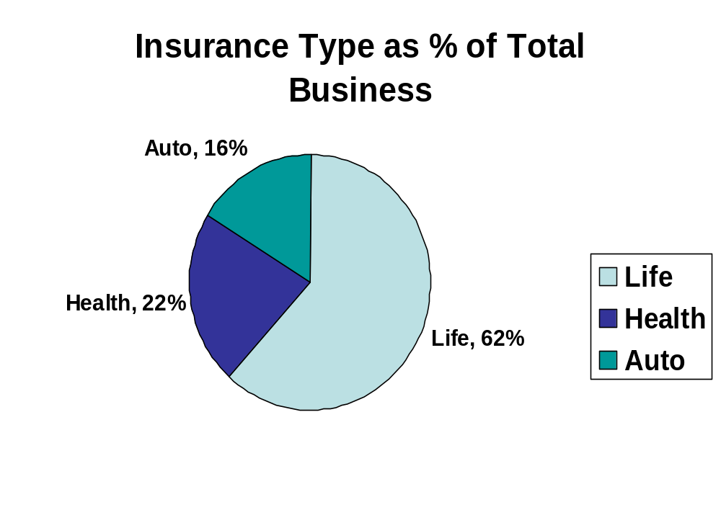
Pie charts show the relative size of sub-components.

Slide 87
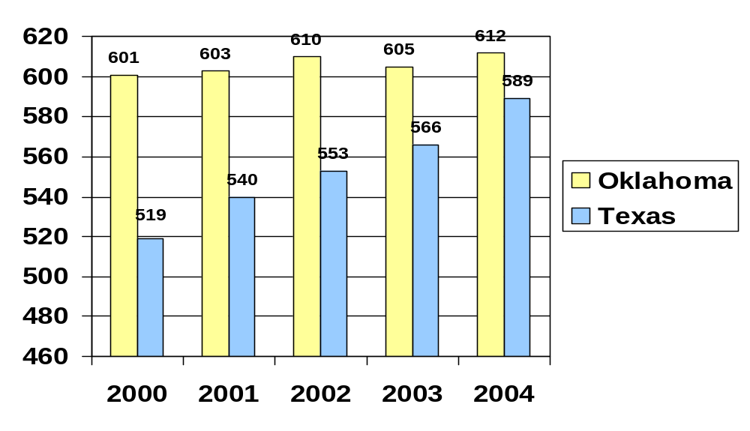
Auto Insurance Sales (In Thousands) By State
Bar charts are the most common type and are used to display trends.

Slide 88
PRINCIPLES OF GRAPH DESIGN
Principles that make bar charts easy to read:
  Use titles that summarize the basic message.

Slide 89
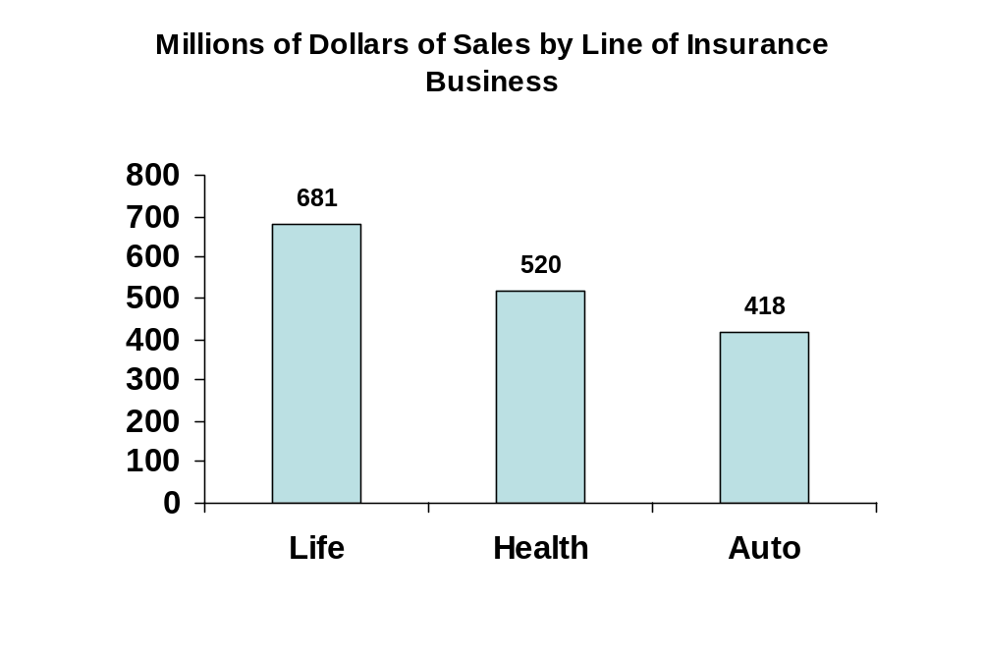

Slide 90
PRINCIPLES OF GRAPH DESIGN
Principles that make bar charts easy to read:
  Use titles that summarize the basic message.
  Include data values with each element instead of labeling the vertical axis. This practice facilitates mental calculations and analyses

Slide 91
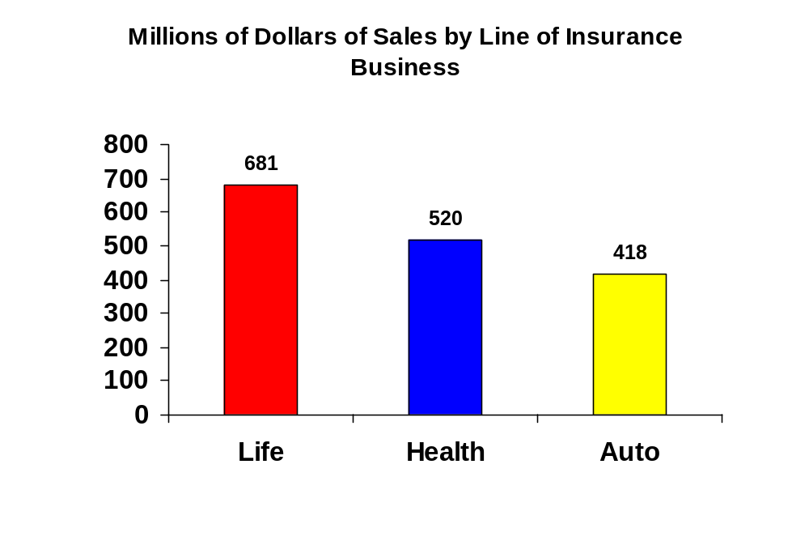

Slide 92
PRINCIPLES OF GRAPH DESIGN
Principles that make bar charts easy to read:
  Use titles that summarize the basic message.
  Include data values with each element instead of labeling the vertical axis—facilitates mental calculations and analyses
  Use 2-dimensional, instead of 3-dimensional, bars. This practice makes it easier to accurately assess magnitude of changes and trends.

Slide 93
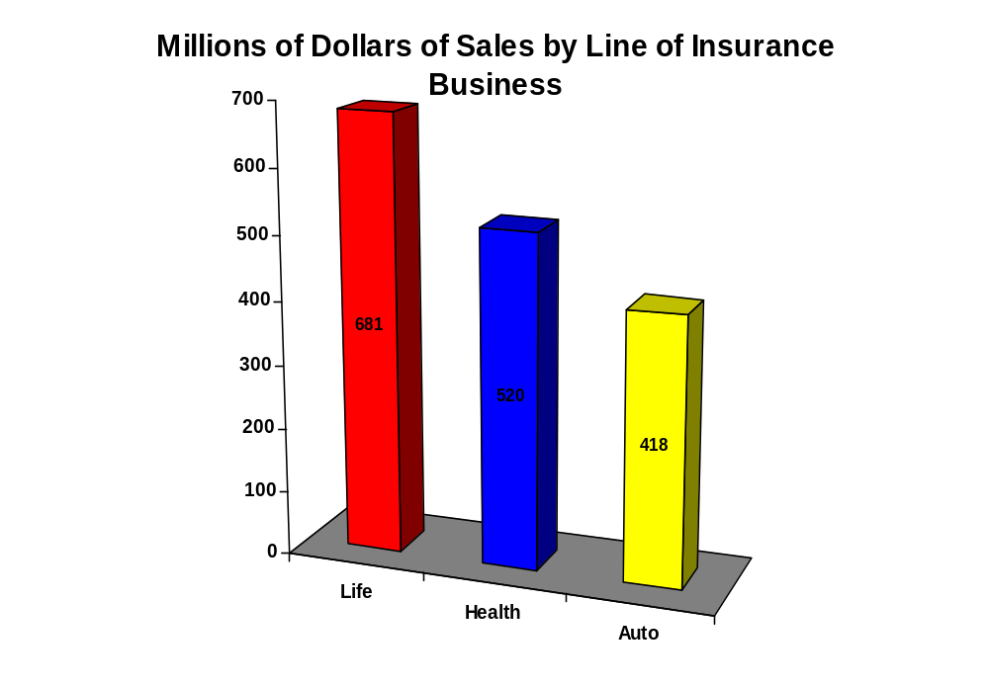

Slide 94
PRINCIPLES OF GRAPH DESIGN
Principles that make bar charts easy to read:
  Use titles that summarize the basic message.
  Include data values with each element instead of labeling the vertical axis—facilitates mental calculations and analyses
  Use 2-dimensional, instead of 3-dimensional, bars—makes it easier to accurately assess magnitude of changes and trends.
  Use different shades of gray or colors instead of patterns, dots, or stripes. They are easier to distinguish

Slide 95
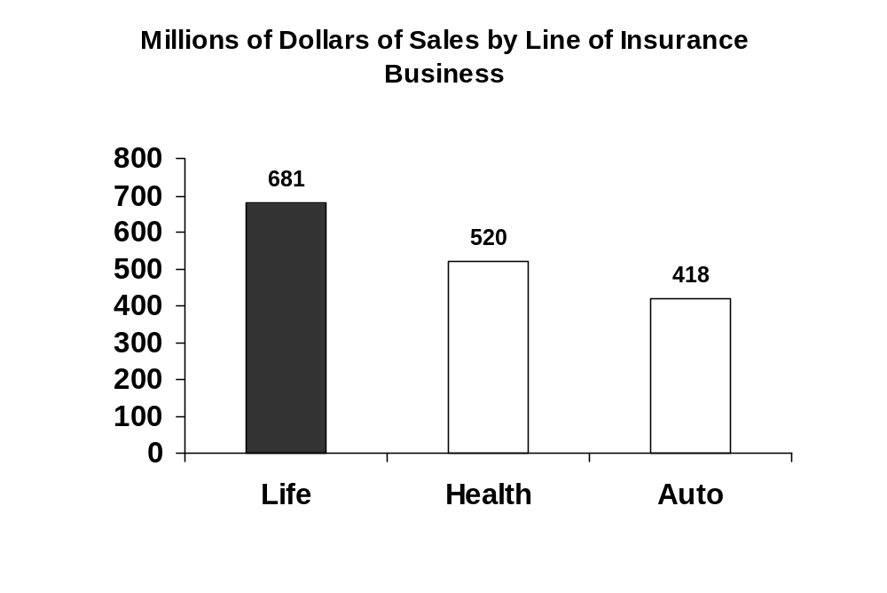

Slide 96
PRINCIPLES OF GRAPH DESIGN
While readability is important, the ultimate value of graphs is to support decision making. Two principles are essential to accurate interpretation:
  Begin vertical axis at zero

Slide 98
PRINCIPLES OF GRAPH DESIGN
While readability is important, the ultimate value of graphs is to support decision making. Two principles are essential to accurate interpretation:
  Begin vertical axis at zero
  For graphs that depict time-series data, order the x-axis chronologically from left to right.

Slide 99
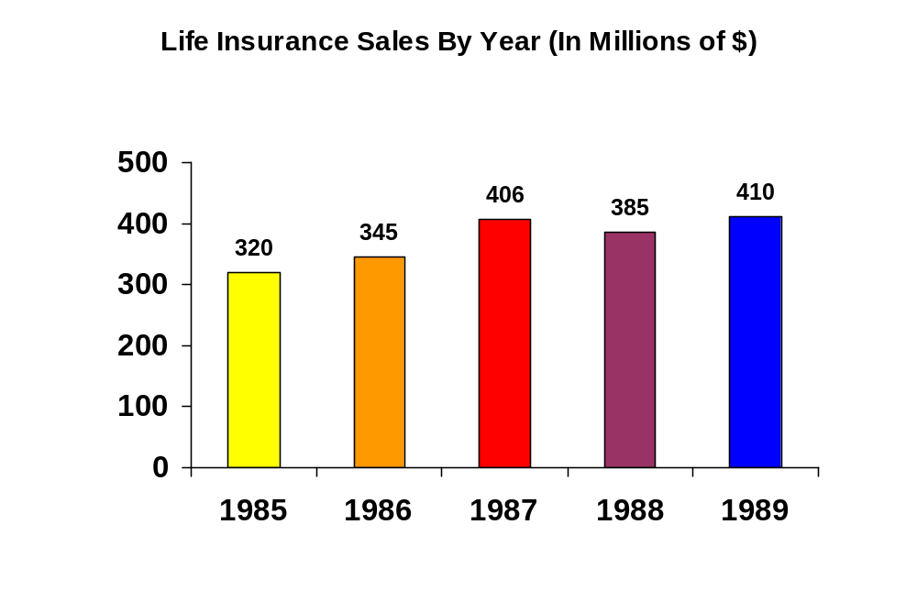

Slide 100
PRINCIPLES OF GRAPH DESIGN
Many annual reports contain graphs that violate these principles:
  Some done automatically by software.
  Some done intentionally.
There are no authoritative guidelines in GAAP or auditing standards that prohibit these behaviors, even though the results can be deceptive.

Slide 101
SUMMARY
You’ve learned about the information processing operations that are required to update the general ledger and produce reports for internal and external users.
You’ve learned how IT developments impact the general ledger and reporting system.
You’ve learned about the major threats in the general ledger and reporting system and the controls that can mitigate those threats.

Slide 102
SUMMARY
You’ve learned how data warehouses and data marts support business intelligence.
You’ve learned how the design of financial graphs can affect business decisions.

