Slide 1
HAPTER 16
Implementing an REA Model In a Relational Database

Slide 2
INTRODUCTION
Questions to be addressed in this chapter:
  How are REA diagrams for individual transaction cycles integrated into a single comprehensive organization-wide REA diagram?
  How are tables constructed from the REA model of an AIS in a relational database?
  How can queries be written to retrieve information from an AIS relational database built according to the REA data model?

Slide 3
INTRODUCTION
In the previous chapter, you learned how to develop an REA diagram for an individual transaction cycle.
This chapter demonstrates how to implement an REA diagram in a database.
We focus on relational databases because:
  They are commonly used to support transaction processing systems.
  They are familiar to most business students.
But REA modeling can also be used to design object-oriented databases.

Slide 4
INTEGRATING REA DIAGRAMS ACROSS CYCLES
In Chapter 15, we looked at REA diagrams for the revenue and expenditure cycles.
Before we integrate these diagrams with the payroll cycle, let’s take a look at the HR/payroll cycle activities.

Slide 5
INTEGRATING REA DIAGRAMS ACROSS CYCLES
Employee
(Supervisor)
Record Time Worked
Employee Time
Employees
Employee (Payroll Clerk)
Disburse Cash
Cash

Slide 6
INTEGRATING REA DIAGRAMS ACROSS CYCLES
The basic economic exchange:
  Get employee time and skills
  Give a paycheck
Employee
(Supervisor)
Record Time Worked
Employee Time
Employees
Employee (Payroll Clerk)
Disburse Cash
Cash

Slide 7
INTEGRATING REA DIAGRAMS ACROSS CYCLES
The record time worked event must be linked to a particular employee and supervisor for a (1,1) cardinality.
Employee
(Supervisor)
Record Time Worked
Employee Time
Employees
Employee (Payroll Clerk)
Disburse Cash
Cash

Slide 8
INTEGRATING REA DIAGRAMS ACROSS CYCLES
However, each agent can be linked to zero or many record time worked events. The zero minimum allows for inclusion of a new employee or supervisor who has not yet been involved in a time recording.
Employee
(Supervisor)
Record Time Worked
Employee Time
Employees
Employee (Payroll Clerk)
Disburse Cash
Cash

Slide 9
INTEGRATING REA DIAGRAMS ACROSS CYCLES
A similar situation exists with the disburse cash event. (We regard each individual paycheck as a separate cash disbursement.)
Employee
(Supervisor)
Record Time Worked
Employee Time
Employees
Employee (Payroll Clerk)
Disburse Cash
Cash

Slide 10
INTEGRATING REA DIAGRAMS ACROSS CYCLES
The assumption is made that employees record time worked on a daily basis.
Record time worked is therefore linked to a maximum of one cash disbursement, since employees aren’t paid for half a day on one paycheck and the other half of the day on another check.
Employee
(Supervisor)
Record Time Worked
Employee Time
Employees
Employee (Payroll Clerk)
Disburse Cash
Cash

Slide 11
INTEGRATING REA DIAGRAMS ACROSS CYCLES
For each cash disbursement, however, there are one-to-many record time worked events.
In other words, a paycheck could pay an employee for anywhere from one day’s work to many.
Employee
(Supervisor)
Record Time Worked
Employee Time
Employees
Employee (Payroll Clerk)
Disburse Cash
Cash

Slide 12
INTEGRATING REA DIAGRAMS ACROSS CYCLES
The employee time entity requires some explanation.
The resource being acquired by the record time worked event is the use of an employee’s skills and knowledge for a particular period of time.
Employee
(Supervisor)
Record Time Worked
Employee Time
Employees
Employee (Payroll Clerk)
Disburse Cash
Cash

Slide 13
INTEGRATING REA DIAGRAMS ACROSS CYCLES
Time is different from inventory and other assets in that it cannot be stored.
There are only a few relevant attributes about employee time:
  Hours worked
  How the time was used
Employee
(Supervisor)
Record Time Worked
Employee Time
Employees
Employee (Payroll Clerk)
Disburse Cash
Cash

Slide 14
INTEGRATING REA DIAGRAMS ACROSS CYCLES
The record time worked and disburse cash events capture all the information about employee time that it is practical to collect and monitor.
Consequently, the employee time resource entity is almost never implemented in an actual database, which is why it is depicted with dotted lines.
Employee
(Supervisor)
Record Time Worked
Employee Time
Employees
Employee (Payroll Clerk)
Disburse Cash
Cash

Slide 15
INTEGRATING REA DIAGRAMS ACROSS CYCLES
In the relationship between cash disbursement and the cash resource:
  This relationship is identical to the expenditure cycle.
  Each check or EFT must be linked to at least one cash account (and usually only one), leading to a (1:1) cardinality.
  Each cash account can be linked to:
    As few as zero cash disbursements (e.g., a new account);
    And up to many.
    Means a (0,N) cardinality.
Employee
(Supervisor)
Record Time Worked
Employee Time
Employees
Employee (Payroll Clerk)
Disburse Cash
Cash

Slide 16
RULES FOR COMBINING REA DIAGRAMS
Some entities appear in more than one transaction cycle diagram.
  Inventory appears in the revenue and expenditure cycles.
  Cash disbursements appear in the expenditure and payroll cycles.
  Employees (agent) and cash (resource) appear in all three cycles.
  These redundancies provide the basis for combining the diagrams.

Slide 17
Call on Customer
Employees (Salesperson)
Suppliers
Take Cust. Order
Customer
Inventory
Employees
Order Inventory
Employees (Salesperson)
Suppliers
Receive Inventory
Sales
Customer
Employees (Cashier)
Disburse Cash
Cash
Receive Cash
Employees (Cashier)
Employees (as Payees)
Record Time Worked
Employee Time
In this integrated diagram, we see three separate cycles.
Employees (Supervisor)

Slide 18
Call on Customer
Employees (Salesperson)
Suppliers
Take Cust. Order
Customer
Inventory
Employees
Order Inventory
Employees (Salesperson)
Suppliers
Receive Inventory
Sales
Customer
Employees (Cashier)
Disburse Cash
Cash
Receive Cash
Employees (Cashier)
Employees (as Payees)
Record Time Worked
Employee Time
Employees (Supervisor)
The revenue cycle appears in yellow.

Slide 19
Call on Customer
Employees (Salesperson)
Suppliers
Take Cust. Order
Customer
Inventory
Employees
Order Inventory
Employees (Salesperson)
Suppliers
Receive Inventory
Sales
Customer
Employees (Cashier)
Disburse Cash
Cash
Receive Cash
Employees (Cashier)
Employees (as Payees)
Record Time Worked
Employee Time
The expenditure cycle appears in blue.
Employees (Supervisor)

Slide 20
Call on Customer
Employees (Salesperson)
Suppliers
Take Cust. Order
Customer
Inventory
Employees
Order Inventory
Employees (Salesperson)
Suppliers
Receive Inventory
Sales
Customer
Employees (Cashier)
Disburse Cash
Cash
Receive Cash
Employees (Cashier)
Employees (as Payees)
Record Time Worked
Employee Time
Employees (Supervisor)
The payroll cycle appears in pink.

Slide 21
Call on Customer
Employees (Salesperson)
Suppliers
Take Cust. Order
Customer
Inventory
Employees
Order Inventory
Employees (Salesperson)
Suppliers
Receive Inventory
Sales
Customer
Employees (Cashier)
Disburse Cash
Cash
Receive Cash
Employees (Cashier)
Employees (as Payees)
Record Time Worked
Employee Time
The integrated diagram merges multiple copies of resource and event entities but retains multiple copies of agent entities.
Employees (Supervisor)

Slide 22
Call on Customer
Employees (Salesperson)
Suppliers
Take Cust. Order
Customer
Inventory
Employees
Order Inventory
Employees (Salesperson)
Suppliers
Receive Inventory
Sales
Customer
Employees (Cashier)
Disburse Cash
Cash
Receive Cash
Employees (Cashier)
Employees (as Payees)
Record Time Worked
Employee Time
Let’s look at how to combine redundant resource and event entities.
Employees (Supervisor)

Slide 23
RULES FOR COMBINING REA DIAGRAMS
Merging Redundant Resource Entities
  The REA diagrams for individual transaction cycles are built around basic give-get economic exchanges.
  Diagrams for individual cycles provide only partial information.
    Example: The expenditure cycle tells you how the company gets inventory, but doesn’t tell you what becomes of the inventory.
  To integrate the cycles, we redraw the REA diagram to place common resources between the events that affect them.
  Reflects the economic duality that every resource must be connected to at least one event that increases the resource and at least one event that decreases it.

Slide 24
Call on Customer
Employees (Salesperson)
Suppliers
Take Cust. Order
Customer
Inventory
Employees
Order Inventory
Employees (Salesperson)
Suppliers
Receive Inventory
Sales
Customer
Employees (Cashier)
Disburse Cash
Cash
Receive Cash
Employees (Cashier)
Employees (as Payees)
Record Time Worked
Employee Time
Inventory has been shown in green here, because it is increased by the expenditure cycle and decreased by the revenue cycle.
Employees (Supervisor)

Slide 25
Call on Customer
Employees (Salesperson)
Suppliers
Take Cust. Order
Customer
Inventory
Employees
Order Inventory
Employees (Salesperson)
Suppliers
Receive Inventory
Sales
Customer
Employees (Cashier)
Disburse Cash
Cash
Receive Cash
Employees (Cashier)
Employees (as Payees)
Record Time Worked
Employee Time
Cash is increased by the revenue cycle and decreased by both the expenditure and payroll cycles.
Employees (Supervisor)

Slide 26
RULES FOR COMBINING REA DIAGRAMS
Merging Redundant Event Entities
  Some events (e.g., disburse cash) may appear in multiple transaction cycles.
  Merging these multiple occurrences improves the legibility of the resulting diagram.

Slide 27
Our integrated diagram shows the disburse cash event (shown in purple) is linked to both receive inventory (in the expenditure cycle) and record time worked (from payroll cycle).
Call on Customer
Employees (Salesperson)
Suppliers
Take Cust. Order
Customer
Inventory
Employees
Order Inventory
Employees (Salesperson)
Suppliers
Receive Inventory
Sales
Customer
Employees (Cashier)
Disburse Cash
Cash
Receive Cash
Employees (Cashier)
Employees (as Payees)
Record Time Worked
Employee Time
Employees (Supervisor)

Slide 28
RULES FOR COMBINING REA DIAGRAMS
Difference between merging redundant events and merging redundant resources:
  Merging redundant resources does not affect any cardinalities.
  Merging redundant events alters minimum cardinalities associated with the other events that are related to the merged event.

Slide 29
Call on Customer
Employees (Salesperson)
Suppliers
Take Cust. Order
Customer
Inventory
Employees
Order Inventory
Employees (Salesperson)
Suppliers
Receive Inventory
Sales
Customer
Employees (Cashier)
Disburse Cash
Cash
Receive Cash
Employees (Cashier)
Employees (as Payees)
Record Time Worked
Employee Time
Cardinalities between inventory and each of the four events to which it is related are the same as before.
Employees (Supervisor)

Slide 30
Call on Customer
Employees (Salesperson)
Suppliers
Take Cust. Order
Customer
Inventory
Employees
Order Inventory
Employees (Salesperson)
Suppliers
Receive Inventory
Sales
Customer
Employees (Cashier)
Disburse Cash
Cash
Receive Cash
Employees (Cashier)
Employees (as Payees)
Record Time Worked
Employee Time
Cardinality between the cash disbursement event and other events with which it is linked are different.
Employees (Supervisor)

Slide 31
Call on Customer
Employees (Salesperson)
Suppliers
Take Cust. Order
Customer
Inventory
Employees
Order Inventory
Employees (Salesperson)
Suppliers
Receive Inventory
Sales
Customer
Employees (Cashier)
Disburse Cash
Cash
Receive Cash
Employees (Cashier)
Employees (as Payees)
Record Time Worked
Employee Time
The cardinality between disburse cash and receive inventory is now (0,N) instead of (1,N) as it was in the expenditure cycle.
Employees (Supervisor)

Slide 32
Call on Customer
Employees (Salesperson)
Suppliers
Take Cust. Order
Customer
Inventory
Employees
Order Inventory
Employees (Salesperson)
Suppliers
Receive Inventory
Sales
Customer
Employees (Cashier)
Disburse Cash
Cash
Receive Cash
Employees (Cashier)
Employees (as Payees)
Record Time Worked
Employee Time
The cardinality between disburse cash and record hours worked is now (0,N) instead of (1,N) as it was in the payroll cycle.
Employees (Supervisor)

Slide 33
RULES FOR COMBINING REA DIAGRAMS
Reason lies in the semantics.
  A resource entity can and usually is linked to multiple events.
    Example: Inventory is linked to a receive inventory event in the expenditure cycle and a sales (or deliver inventory) event in the sales cycle.
    Since both links are possible, none of the cardinalities in the individual diagrams need to change when the diagrams are merged.

Slide 34
RULES FOR COMBINING REA DIAGRAMS
An event that occurs in one cycle can be linked to:
  An event that is part of one transaction cycle; or
  An event that is part of another transaction cycle;
  But not both!
  EXAMPLE: A cash disbursement is to pay an employee (payroll) or buy inventory (expenditure), but not both.
  The minimum cardinality associated with the other event must be zero in the integrated diagram.

Slide 35
RULES FOR COMBINING REA DIAGRAMS
Remember: A minimum of one means that each instance of that entity has to be associated with at least one instance of the other entity.
Each cash disbursement is linked to either a recording of hours or a receipt of inventory, but not both.

Slide 36
RULES FOR COMBINING REA DIAGRAMS
Merging two transaction cycles on a common event may also affect the minimum cardinalities between the merged event and the agent participating.
Same basic reasoning:
  A cash disbursement in the expenditure cycle is a payment to a supplier, so every cash event is linked to at least one supplier.
  A cash disbursement in the payroll cycle is a payment to an employee, so every cash event is linked to at least one employee.
  A cash disbursement in the two cycles combined is linked either to a supplier or an employee, but not both.
  Changes the minimum cardinality between event and agent from 1 to 0.

Slide 37
Call on Customer
Employees (Salesperson)
Suppliers
Take Cust. Order
Customer
Inventory
Employees
Order Inventory
Employees (Salesperson)
Suppliers
Receive Inventory
Sales
Customer
Employees (Cashier)
Disburse Cash
Cash
Receive Cash
Employees (Cashier)
Employees (as Payees)
Record Time Worked
Employee Time
The cardinality between disburse cash and suppliers is now (0,N) instead of (1,N) as it was in the expenditure cycle.
Employees (Supervisor)

Slide 38
Call on Customer
Employees (Salesperson)
Suppliers
Take Cust. Order
Customer
Inventory
Employees
Order Inventory
Employees (Salesperson)
Suppliers
Receive Inventory
Sales
Customer
Employees (Cashier)
Disburse Cash
Cash
Receive Cash
Employees (Cashier)
Employees (as Payees)
Record Time Worked
Employee Time
The cardinality between disburse cash and employees (payees) is now (0,N) instead of (1,N) as it was in the payroll cycle.
Employees (Supervisor)

Slide 39
RULES FOR COMBINING REA DIAGRAMS
Validating the Accuracy of Integrated REA Diagrams
  Chapter 15 presented three basic principles for drawing REA diagrams for individual cycles.
  The preceding discussion on combining diagrams adds two more rules.

Slide 40
RULES FOR COMBINING REA DIAGRAMS
An integrated REA diagram must satisfy these five rules:
  Every event must be linked to at least one resource.
  Every event must be linked to at least two agents.
  Every event that involves disposition of a resource must be linked to an event that involves acquiring a resource. (Reflects give-get economic duality).
  Every resource must be linked to at least one event that increases the resource and one that decreases it.
  If a specific event, referred to as the focal event, can be linked to more than one other type of event, but cannot be linked simultaneously to all of those other events, then the minimum cardinality between the focal event and the other linked events, must be zero.

Slide 41
RULES FOR COMBINING REA DIAGRAMS
The preceding five rules can be used to develop an integrated REA diagram and can also be used as “check figures” to validate the accuracy of a completed diagram.
Our integrated diagram is not yet complete because the fourth rule is not satisfied for the employee time resource.
  Rule 4: Every resource must be linked to at least one event that increases it and one event that decreases it.
This situation will be corrected in Chapter 17.

Slide 42
IMPLEMENTING AN REA DIAGRAM IN A RELATIONAL DATABASE
Once an REA diagram has been developed, it can be used to design a well-structured relational database.
Creating a set of tables from an REA diagram automatically results in a well-structured relational database that is not subject to the update, insert, and delete anomalies.

Slide 43
IMPLEMENTING AN REA DIAGRAM IN A RELATIONAL DATABASE
The three steps to implementing an REA diagram in a relational database are:
  Create a table for:
    Each distinct entity in the diagram
    Each many-to-many relationship
  Assign attributes to appropriate tables
  Use foreign keys to implement one-to-one and one-to-many relationships.
As discussed previously, REA diagrams will differ across organizations because of differences in business policies.

Slide 44
IMPLEMENTING AN REA DIAGRAM IN A RELATIONAL DATABASE
The three steps to implementing an REA diagram in a relational database are:
  Create a table for:
    Each distinct entity in the diagram
    Each many-to-many relationship
  Assign attributes to appropriate tables
  Use foreign keys to implement one-to-one and one-to-many relationships.
As discussed previously, REA diagrams will differ across organizations because of differences in business policies.

Slide 45
Call on Customer
Employees (Salesperson)
Suppliers
Take Cust. Order
Customer
Inventory
Employees
Order Inventory
Employees (Salesperson)
Suppliers
Receive Inventory
Sales
Customer
Employees (Cashier)
Disburse Cash
Cash
Receive Cash
Employees (Cashier)
Employees (as Payees)
Record Time Worked
Employee Time
Our integrated diagram has eight event entities.
Employees (Supervisor)

Slide 46
Call on Customer
Employees (Salesperson)
Suppliers
Take Cust. Order
Customer
Inventory
Employees
Order Inventory
Employees (Salesperson)
Suppliers
Receive Inventory
Sales
Customer
Employees (Cashier)
Disburse Cash
Cash
Receive Cash
Employees (Cashier)
Employees (as Payees)
Record Time Worked
Employee Time
There are three distinct agent entities.
The first is the customer.
Employees (Supervisor)

Slide 47
Call on Customer
Employees (Salesperson)
Suppliers
Take Cust. Order
Customer
Inventory
Employees
Order Inventory
Employees (Salesperson)
Suppliers
Receive Inventory
Sales
Customer
Employees (Cashier)
Disburse Cash
Cash
Receive Cash
Employees (Cashier)
Employees (as Payees)
Record Time Worked
Employee Time
The second agent entity is the supplier.
Employees (Supervisor)

Slide 48
Call on Customer
Employees (Salesperson)
Suppliers
Take Cust. Order
Customer
Inventory
Employees
Order Inventory
Employees (Salesperson)
Suppliers
Receive Inventory
Sales
Customer
Employees (Cashier)
Disburse Cash
Cash
Receive Cash
Employees (Cashier)
Employees (as Payees)
Record Time Worked
Employee Time
The third agent entity is the employee. We label the types of employees to make the diagram more understandable, but they all go in one table.
Employees (Supervisor)

Slide 49
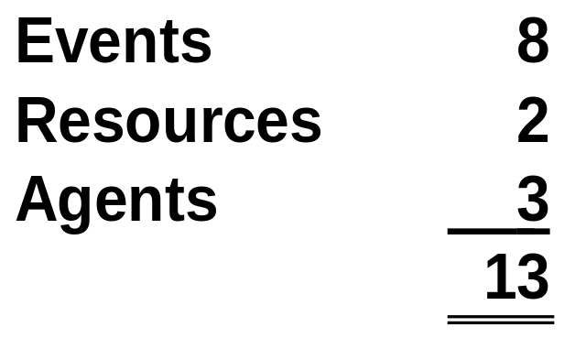
IMPLEMENTING AN REA DIAGRAM IN A RELATIONAL DATABASE
Total entities to be represented in separate tables:

Slide 50
IMPLEMENTING AN REA DIAGRAM IN A RELATIONAL DATABASE
The three steps to implementing an REA diagram in a relational database are:
  Create a table for:
    Each distinct entity in the diagram
    Each many-to-many relationship
  Assign attributes to appropriate tables
  Use foreign keys to implement one-to-one and one-to-many relationships.
As discussed previously, REA diagrams will differ across organizations because of differences in business policies.

Slide 51
Call on Customer
Employees (Salesperson)
4
Suppliers
Take Cust. Order
Customer
2
Inventory
5
Employees
Order Inventory
Employees (Salesperson)
3
6
Suppliers
Receive Inventory
Sales
Customer
1
7
Employees (Cashier)
Disburse Cash
Cash
Receive Cash
Employees (Cashier)
Employees (as Payees)
Record Time Worked
Employee Time
Let’s count the many-to-many relationships.
Employees (Supervisor)

Slide 52
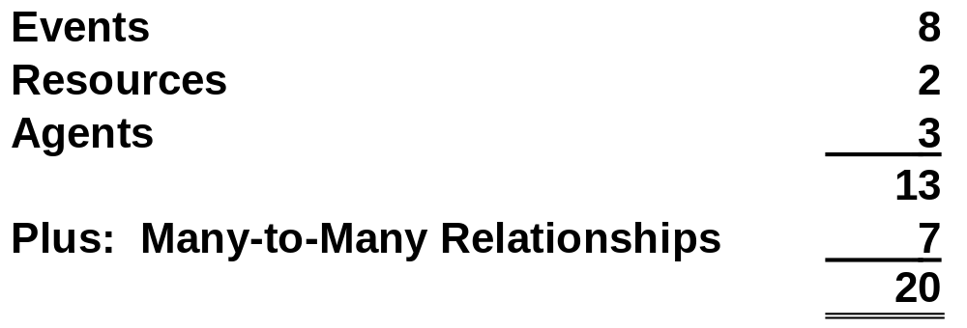
IMPLEMENTING AN REA DIAGRAM IN A RELATIONAL DATABASE
Total number of tables in database:

Slide 53
IMPLEMENTING AN REA DIAGRAM IN A RELATIONAL DATABASE
Table names for these 20 entities correspond to the names of the entities in the REA diagram.
  The tables for M:N relationships are hyphenated concantenations of the entities involved in the relationship.
  Makes it easier:
    To verify that all necessary tables have been created.
    To use the REA diagram as a guide when querying the database.

Slide 54
IMPLEMENTING AN REA DIAGRAM IN A RELATIONAL DATABASE
Table names for our integrated diagram:
Call on Customer
Take Customer Order
Sales
Receive Cash
Order Inventory
Receive Inventory
Disburse Cash
Record Time Worked
Inventory
Cash
Customer
Supplier
Employee
Call on Customer-Inventory
Take Order-Inventory
Sales-Inventory
Sales-Receive Cash
Order Inventory-Inventory
Receive Inventory-Inventory
Receive Inventory-Disburse Cash

Slide 55
IMPLEMENTING AN REA DIAGRAM IN A RELATIONAL DATABASE
The three steps to implementing an REA diagram in a relational database are:
  Create a table for:
    Each distinct entity in the diagram
    Each many-to-many relationship
  Assign attributes to appropriate tables
  Use foreign keys to implement one-to-one and one-to-many relationships.
As discussed previously, REA diagrams will differ across organizations because of differences in business policies.

Slide 56
IMPLEMENTING AN REA DIAGRAM IN A RELATIONAL DATABASE
Step 2: Assign Attributes to Each Table
  The next step is to determine which attributes should be included in each table.
  The designer needs to interview users and management to identify which facts need to be included in the database.
  Should use the REA diagram to determine in which tables those facts should be placed.
  Depends on whether the fact is a primary key or just a descriptive attribute.

Slide 57
IMPLEMENTING AN REA DIAGRAM IN A RELATIONAL DATABASE
Identify Primary Keys
  Every table in a relational database must have a primary key.
    The primary key is an attribute or combination of attributes that uniquely identifies each row in a table.
    It is typically a numeric identifier.
  The primary key is usually a single attribute.
  However for M:N relationship tables, it consists of two attributes that represent the primary key of each linked entity.
  EXAMPLE: The primary key for a sales-inventory table might be Invoice No-Item No.
  These multiple-attribute primary keys are called concantenated keys.

Slide 58
IMPLEMENTING AN REA DIAGRAM IN A RELATIONAL DATABASE
Keys for the entity tables we’ve identified might be specified as follows:
  CALL ON CUSTOMER—Call No.
  TAKE CUSTOMER ORDER—Sales Order No.
  SALES—Invoice No.
  RECEIVE CASH—Cash Receipt No.
  RECEIVE INVENTORY—Receiving Report No.
  DISBURSE CASH—Check No.
  RECORD TIME WORKED—Timecard No.
  INVENTORY—Item No.
  CASH—Account No.
  CUSTOMER—Customer No.
  SUPPLIER—Supplier No.
  EMPLOYEE—Employee No.
The M:N relationship tables would have keys that are combinations of the keys for the two related tables.

Slide 59
IMPLEMENTING AN REA DIAGRAM IN A RELATIONAL DATABASE
Keys for the entity tables we’ve identified might be specified as follows:
  CALL ON CUSTOMER—Call No.
  TAKE CUSTOMER ORDER—Sales Order No.
  SALES—Invoice No.
  RECEIVE CASH—Cash Receipt No.
  RECEIVE INVENTORY—Receiving Report No.
  DISBURSE CASH—Check No.
  RECORD TIME WORKED—Timecard No.
  INVENTORY—Item No.
  CASH—Account No.
  CUSTOMER—Customer No.
  SUPPLIER—Supplier No.
  EMPLOYEE—Employee No.
EXAMPLE: The primary key for the sales-receive cash table would be invoice no.-cash receipt no.

Slide 60
IMPLEMENTING AN REA DIAGRAM IN A RELATIONAL DATABASE
Assign Other Attributes to Appropriate Tables
  Attributes other than the primary key are also included in tables:
    To provide for accurate transaction processing and the production of financial statements; or
    To facilitate effective management of the entity’s resources, events, and agents.
  Any attribute in a table must be a fact about the object represented by the primary key.
  EXAMPLE: Information about the customer, such as his address or phone number, should be included in the customer table, not the sales table.

Slide 61
IMPLEMENTING AN REA DIAGRAM IN A RELATIONAL DATABASE
Some non-key attributes even need to be stored in M:N tables.
Example: The inventory-sales table may include a “quantity sold” attribute.
  The quantity sold can’t be placed in the inventory table, because there can be many sales of any particular inventory item, and each sale produces a different quantity ordered.
  The quantity sold can’t be placed in the sales table, because an individual sale can include several inventory items.
  The quantity sold is placed in the sales-inventory table so that you can determine how much of EACH inventory item was ordered with EACH sale.

Slide 62
IMPLEMENTING AN REA DIAGRAM IN A RELATIONAL DATABASE
Price and Cost Data
  Information about prices and costs are stored as attributes in several different tables.
  The inventory table stores the suggested list price, which is generally constant for the fiscal period.
  The sales-inventory table stores the actual sales price, which can vary during the year.

Slide 63
IMPLEMENTING AN REA DIAGRAM IN A RELATIONAL DATABASE
  Just like sales prices, the standard and actual purchase costs of each item are stored in different tables.
  General rule:
    Time-independent data (such as standard costs or list prices) should be stored as an attribute of a resource or agent.
    Data that vary across time (such as actual costs and prices) should be stored with event entities or in M:N relationships that involve at least one event.

Slide 64
IMPLEMENTING AN REA DIAGRAM IN A RELATIONAL DATABASE
Cumulative Data
  Attributes like “quantity on hand” or “account balance” are cumulative data.
  Quantity on hand is calculated as:
    Sum of quantities purchased from the table linking inventory to the receive inventory event.
    LESS: Sum of quantity sold from the sales-inventory table.
  Customer balance:
    Sum of all sales to the customer.
    LESS: Sum of all cash receipts from customer.

Slide 65
IMPLEMENTING AN REA DIAGRAM IN A RELATIONAL DATABASE
The preceding types of items do not have to be stored and can be calculated.
However, explicitly storing them may improve response time to queries.
  Should be done if the DBMS has the capability to automatically update these summary values as each new event occurs.
  Otherwise they will be incorrect.

Slide 66
IMPLEMENTING AN REA DIAGRAM IN A RELATIONAL DATABASE
The three steps to implementing an REA diagram in a relational database are:
  Create a table for:
    Each distinct entity in the diagram
    Each many-to-many relationship
  Assign attributes to appropriate tables
  Use foreign keys to implement one-to-one and one-to-many relationships.
As discussed previously, REA diagrams will differ across organizations because of differences in business policies.

Slide 67
IMPLEMENTING AN REA DIAGRAM IN A RELATIONAL DATABASE
Step 3: Use foreign keys to implement 1:1 and 1:N relationships.
  Many-to-many relationships have been implemented by the creation of separate tables.
  One-to-one and one-to-many relationships still need to be implemented in the database.
  But it is usually more efficient to implement them by the creation of foreign keys.
  A foreign key is an attribute of one entity that is the primary key of another entity.
  Customer Number might appear in the customer table as a primary key and in the sales table as a foreign key.

Slide 68
IMPLEMENTING AN REA DIAGRAM IN A RELATIONAL DATABASE
Using Foreign Keys to Implement One-to-One Relationships
  Can be implemented by including the primary key of one entity as a foreign key in the other.
  Minimum cardinalities may suggest which choice is more efficient.
    Usually best to insert the primary key of the entity that can occur a minimum of one time as a foreign key in the entity that can occur a minimum of zero times.
    When there are two sequential events, the primary key of the event that occurs first is usually the foreign key in the event that occurs second.
    Provides better control, as the employee who updates the table for the second event does not have to access the table for the event that occurred first.

Slide 69
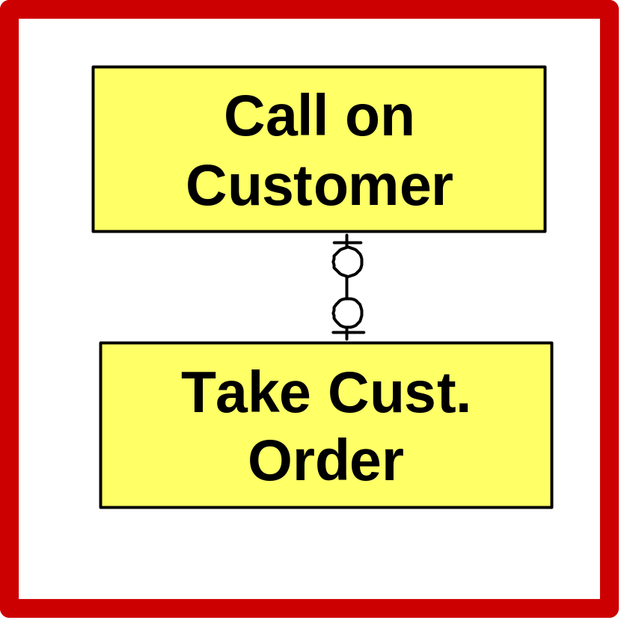
Call on Customer
Employees (Salesperson)
Suppliers
Take Cust. Order
Customer
Inventory
Employees
Order Inventory
Employees (Salesperson)
Suppliers
Receive Inventory
Sales
Customer
Employees (Cashier)
Disburse Cash
Cash
Receive Cash
Employees (Cashier)
This relationship is a 1:1 relationship, but the minimum on both sides is zero.
Because the entities represent sequential events, we will follow the practice of placing the primary key of the event that occurs first (call on customer) as a foreign key in the event that occurs second (take customer order).
Employees (as Payees)
Record Time Worked
Employee Time
Let’s zoom in on the relationship between call on customer and take customer order.
Employees (Supervisor)

Slide 70
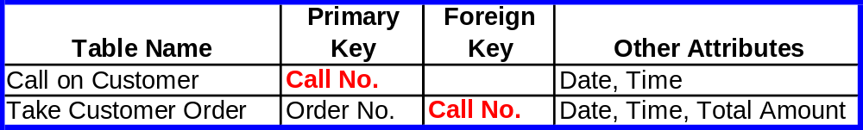
IMPLEMENTING AN REA DIAGRAM IN A RELATIONAL DATABASE

Slide 71
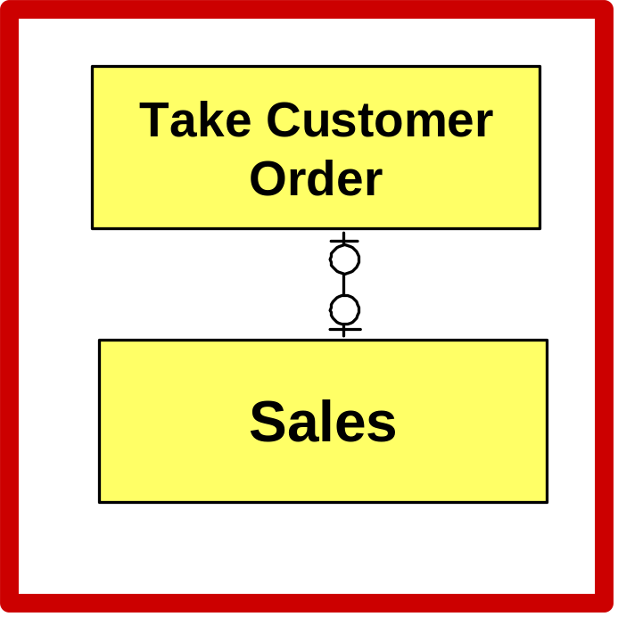
Call on Customer
Employees (Salesperson)
Suppliers
Take Cust. Order
Customer
Inventory
Employees
Order Inventory
Employees (Salesperson)
Suppliers
Receive Inventory
Sales
Customer
Employees (Cashier)
Disburse Cash
Cash
Receive Cash
Employees (Cashier)
The same situation exists in the relationship between take customer order and sales, so the primary key for take customer order will be placed as a foreign key in the sales table.
Employees (as Payees)
Record Time Worked
Employee Time
Employees (Supervisor)

Slide 72
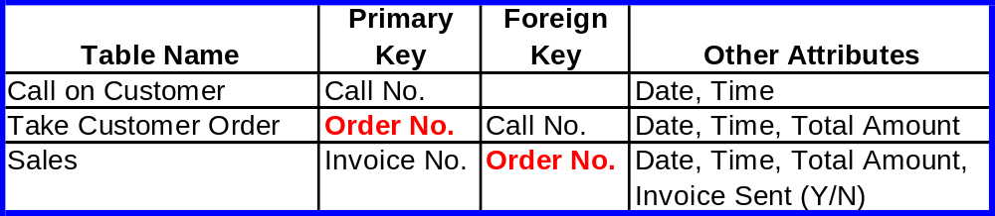
IMPLEMENTING AN REA DIAGRAM IN A RELATIONAL DATABASE

Slide 73
IMPLEMENTING AN REA DIAGRAM IN A RELATIONAL DATABASE
Using Foreign Keys to Implement One-to-Many Relationships
  Place the primary key of the entity that can occur only once as a foreign key in the entity that can occur many times.
  EXAMPLE: The primary key for salesperson (which can occur only once per sale) is a foreign key in the sales table (which can occur many times for a particular salesperson).
  If you tried to do the opposite, you would not have flat tables.

Slide 74
IMPLEMENTING AN REA DIAGRAM IN A RELATIONAL DATABASE
Possible exception:
  If you have two sequential events with a one-to-many relationship and the event that occurs first is the event that can occur many times, you may wish to implement the relationship with a separate table.
  Again, provides better internal control in that the individual who updates the table with respect to the second event will not need to update the table that relates to the first event.

Slide 75

Call on Customer
Employees (Salesperson)
Suppliers
Take Cust. Order
Customer
Inventory
Employees
Order Inventory
Employees (Salesperson)
The relationship between call on customer and salesperson is a one-to-many relationship.
Every call on a customer involves one and only one salesperson.
Every salesperson can be involved in zero to many sales.
Suppose the salesperson has called on 50 customers. If you wanted to place the call no. (primary key for call on customer) in the salesperson table, which call no. would you place there? You can’t place all 50 there.
So you place the employee number (primary key for salesperson) in the call on customer table, because each call involves only one salesperson.
Suppliers
Receive Inventory
Sales
Customer
Employees (Cashier)
Disburse Cash
Cash
Receive Cash
Employees (Cashier)
Employees (as Payees)
Record Time Worked
Employee Time
Employees (Supervisor)

Slide 76
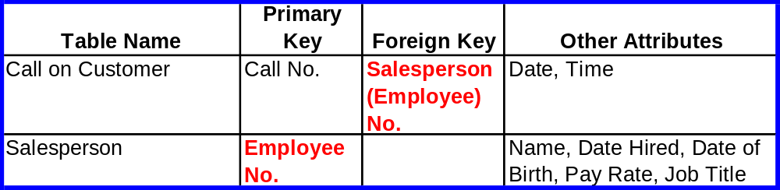
IMPLEMENTING AN REA DIAGRAM IN A RELATIONAL DATABASE

Slide 77
Call on Customer
Employees (Salesperson)
Suppliers
Take Cust. Order
Customer
Inventory
Employees
Order Inventory
Employees (Salesperson)
Suppliers
Receive Inventory
Sales
Customer
Employees (Cashier)
Disburse Cash
Cash
Receive Cash
Employees (Cashier)
Employees (as Payees)
Record Time Worked
Employee Time
For the preceding reason, in most of the relationships between events and agents, the primary key for the agent will be a foreign key in the event table.
Employees (Supervisor)

Slide 78
IMPLEMENTING AN REA DIAGRAM IN A RELATIONAL DATABASE
It would be useful to step through a complete process of converting an REA diagram into a database model.
The integrated diagram is too extensive to provide a good, short example.
Therefore, let’s use a simple, individual transaction cycle for purposes of this example only.

Slide 79
EXAMPLE
Below is a sample REA diagram for a very simple revenue cycle.
Customer
Inventory
Sale
Employee
Cash
Receive
Cash
Customer

Slide 80
EXAMPLE
Our first step is to create a table for each event, resource, agent, and many-to-many relationship.
Customer
Inventory
Sale
Employee
Cash
Receive
Cash
Customer

Slide 81
EXAMPLE
There are two events.
Customer
Inventory
Sale
Employee
Cash
Receive
Cash
Customer

Slide 82
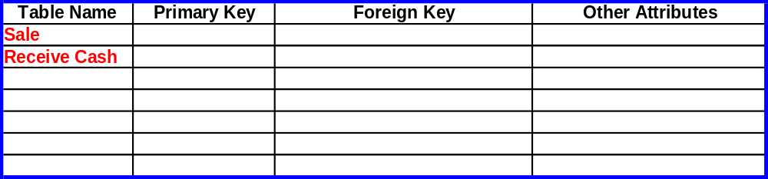
EXAMPLE

Slide 83
EXAMPLE
There are two resources.
Customer
Inventory
Sale
Employee
Cash
Receive
Cash
Customer

Slide 84
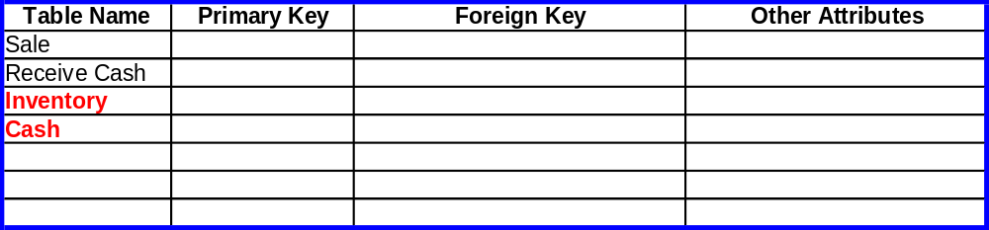
EXAMPLE

Slide 85
EXAMPLE
There are two types of agents: customers and employees.
Customer
Inventory
Sale
Employee
Cash
Receive
Cash
Customer

Slide 86
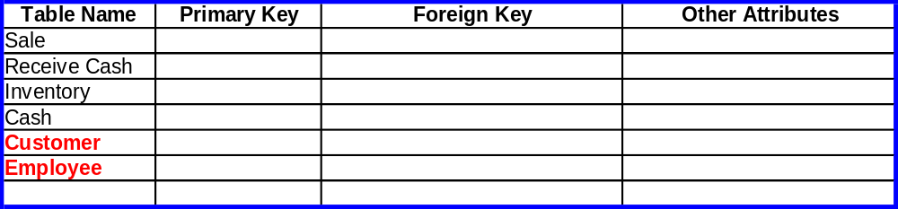
EXAMPLE

Slide 87
EXAMPLE
There is one many-to-many relationship.
Customer
Inventory
Sale
Employee
Cash
Receive
Cash
Customer

Slide 88
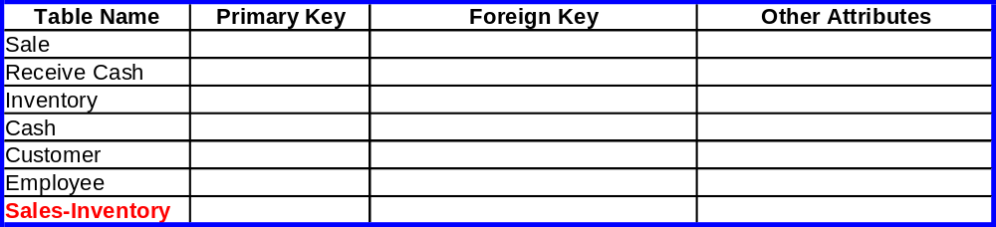
EXAMPLE

Slide 89
EXAMPLE
The next step is to assign attributes to each table.
These attributes include the assignment of primary keys.

Slide 90
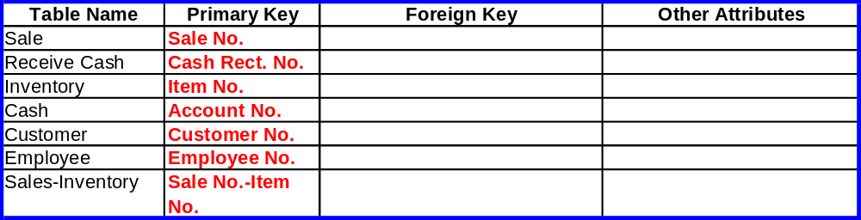
EXAMPLE

Slide 91
EXAMPLE
The other attributes include facts the company wishes to collect that describe each entity.

Slide 92
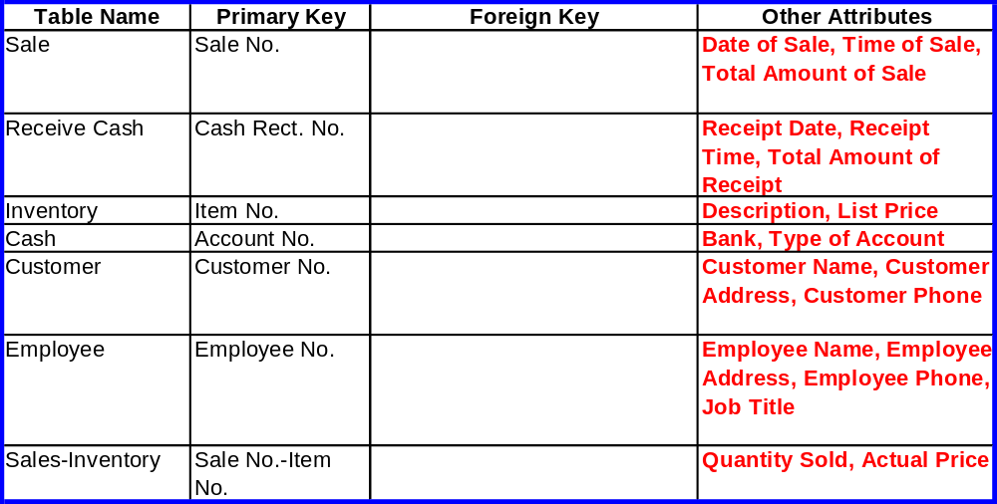
EXAMPLE

Slide 93
EXAMPLE
The final step involves using foreign keys to implement the 1:1 and 1:N relationships.

Slide 94
The relationship between customer and sales is a 1:N relationship. We make the primary key for the entity that occurs only once (customer) serve as a foreign key in the entity that can occur many times (sale).
Customer
Inventory
Sale
Employee
Cash
Receive
Cash
Customer

Slide 95
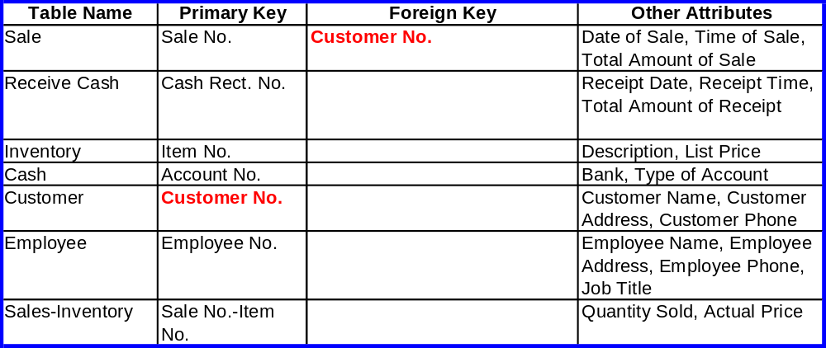
EXAMPLE

Slide 96
EXAMPLE
Likewise, the primary key for employee should be a foreign key in the sales table.
Customer
Inventory
Sale
Employee
Cash
Receive
Cash
Customer

Slide 97
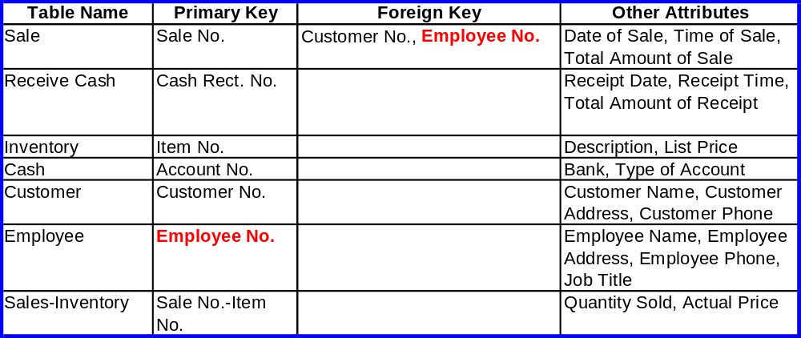
EXAMPLE

Slide 98
EXAMPLE
The primary key for employee should also be a foreign key in the receive cash table.
Customer
Inventory
Sale
Employee
Cash
Receive
Cash
Customer

Slide 99
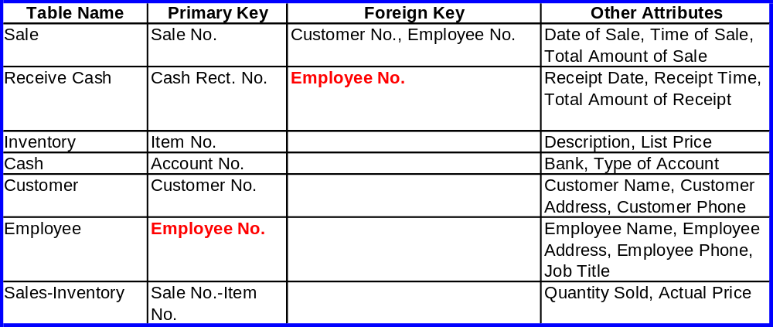
EXAMPLE

Slide 100
EXAMPLE
The primary key for customer should also be a foreign key in the receive cash table.
Customer
Inventory
Sale
Employee
Cash
Receive
Cash
Customer

Slide 101
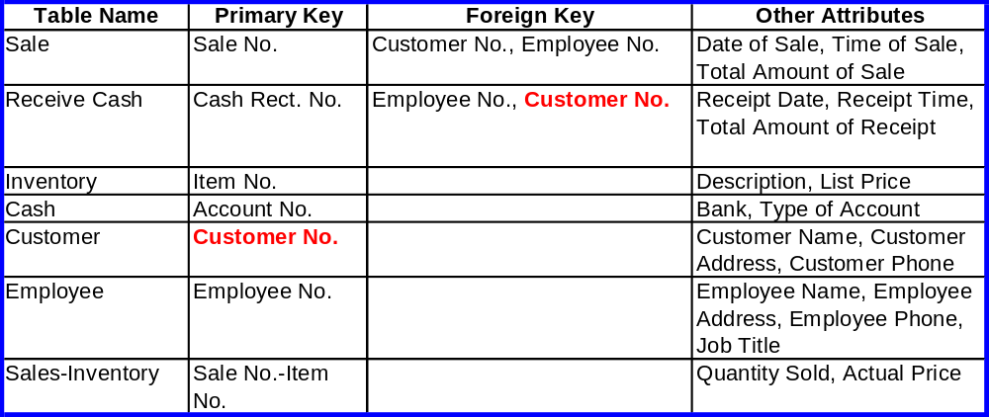
EXAMPLE

Slide 102
The relationship between sales and receive cash is 1:1. Two guidelines will produce the same result.
  Put the primary key of the event with the minimum of one (sales) as a foreign key in the event with the minimum of zero (receive cash); or
  Put the primary key of the event that occurs first (sales) as a foreign key in the event that occurs second (receive cash).
Customer
Inventory
Sale
Employee
Cash
Receive
Cash
Customer

Slide 103
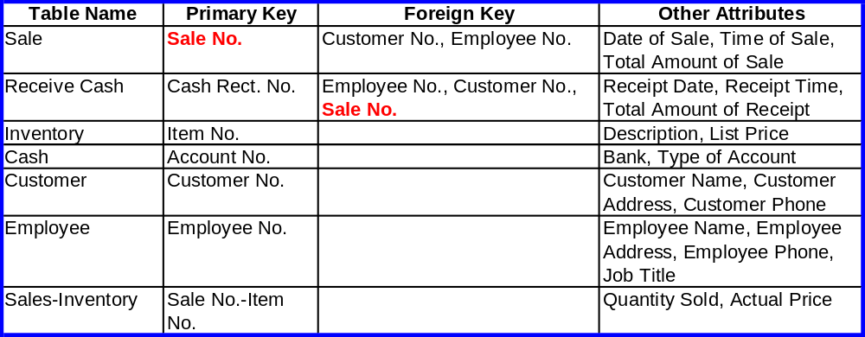
EXAMPLE

Slide 104
EXAMPLE
The relationship between sales and inventory is a many-to-many relationship and was already implemented by the creation of a separate table..
Customer
Inventory
Sale
Employee
Cash
Receive
Cash
Customer

Slide 105
EXAMPLE
In the relationship between cash and receive cash, the primary key for the event that occurs once (cash) should be a foreign key in the event that occurs many times (receive cash).
Customer
Inventory
Sale
Employee
Cash
Receive
Cash
Customer

Slide 106
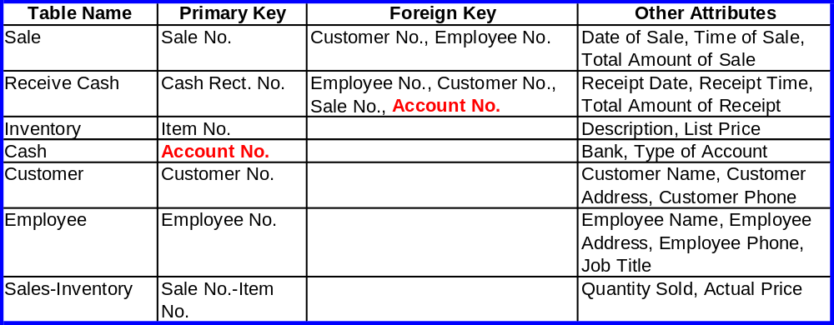
EXAMPLE

Slide 107
IMPLEMENTING AN REA DIAGRAM IN A RELATIONAL DATABASE
Completeness Check
  The list of attributes that users and management want included in the database provide a means to check and validate the implementation process.
  Each of those attributes should appear in at least one table as a primary key or an other attribute.
  Checking this list may reveal that a particular attribute has not been assigned or may even indicate the need to modify the REA diagram itself.

Slide 108
IMPLEMENTING AN REA DIAGRAM IN A RELATIONAL DATABASE
The need to modify the REA diagram as a result of this completeness check is not unusual.
In fact, it is often helpful to create tables and assign attributes before completion of the REA diagram—helps clarify what each entity represents.
When all attributes have been assigned, the basic requirements for a well-structured relational database can be used as a final accuracy check:
  Every table has a primary key.
  Other attributes in the table are either a fact that describes the entity or a foreign key used to link tables.
  Every attribute in every table is single-valued.

Slide 109
USING REA DIAGRAMS TO RETRIEVE INFORMATION FROM A DATABASE
We have shown how to use the REA data model to guide design of an AIS that will efficiently store information about an organization’s business activities.
Let’s now discuss how to use our completed diagrams and tables to retrieve information for performance evaluation.
It may appear that a number of traditional AIS elements are missing, e.g.:
  Journals
  Ledgers
  Accounts receivable balances
The information is simply present in a different format.

Slide 110
USING REA DIAGRAMS TO RETRIEVE INFORMATION FROM A DATABASE
Creating Journals and Ledgers
  Although journals and ledgers do not appear explicitly in an REA diagram, they can be created through appropriate queries.

Slide 111
USING REA DIAGRAMS TO RETRIEVE INFORMATION FROM A DATABASE
Deriving Journals from Queries
  In a traditional AIS, journals provide a chronological listing of transactions.
  In a relational database designed via an REA model, event entities store information about transactions.
    The information found in a journal is contained in the tables used to record data about events.
    Each row in the sales journal, for example, contains information about a particular sales transaction.

Slide 112
USING REA DIAGRAMS TO RETRIEVE INFORMATION FROM A DATABASE
Consequently:
  A sales journal can be produced by writing a query that displays the appropriate entries in the sales table for a given period.
  A purchases journal can be produced from the order inventory table.
  A cash disbursements journal can be produced from the cash disbursement table.

Slide 113
USING REA DIAGRAMS TO RETRIEVE INFORMATION FROM A DATABASE
The simplest query would display every entry in the event table.
But doing so would not necessarily create the traditional journal.
For example:
  The traditional sales journal includes only credit sales.
  The sales event table, however, includes both cash and credit sales.

Slide 114
USING REA DIAGRAMS TO RETRIEVE INFORMATION FROM A DATABASE
To create a traditional sales journal from the sales event table, you would:
  Create a query that prints only sales transactions for which there is not a matching transaction in the cash receipts table for:
    The same customer
    The same date
    The same amount
  In another words, if a cash receipt was not obtained from that customer on the same date in the exact amount of the sale, the assumption is made that the transaction was a credit sale.
Similar processes can be followed to write queries to produce other special journals.

Slide 115
USING REA DIAGRAMS TO RETRIEVE INFORMATION FROM A DATABASE
Ledgers
  Ledgers are master files that contain cumulative information about specific accounts.
  In a relational database designed with the REA model, resource and agent entities contain permanent information carried from one year to the next.
  Much information about assets that is traditionally recorded in ledgers would be stored in the resource tables.

Slide 116
USING REA DIAGRAMS TO RETRIEVE INFORMATION FROM A DATABASE
Example:
  Each row in the equipment table would contain information about a specific piece or class of machinery, including cost, useful life, depreciation method, and estimated salvage value.
  Each row in the cash table contains information about a specific account for cash or cash equivalents.
  Each row in the inventory table contains information about a specific inventory item.

Slide 117
USING REA DIAGRAMS TO RETRIEVE INFORMATION FROM A DATABASE
Each resource account is affected by increment and decrement events:
  Equipment is bought and used.
  Cash is received and paid out.
  Inventory is bought and sold.
Queries to display the current cumulative balances for these accounts must reference:
  The appropriate table for that resource entity; and
  The event tables that affect it.

Slide 118
USING REA DIAGRAMS TO RETRIEVE INFORMATION FROM A DATABASE
EXAMPLE: A query to display the current balance in a specific bank account would reference:
  The cash resource table to identify the account number and beginning balance for the period.
  The cash receipts table to identify inflows to the account.
  The cash disbursements tables to identify outflows during the period.

Slide 119
USING REA DIAGRAMS TO RETRIEVE INFORMATION FROM A DATABASE
Many financial statement accounts are represented as resources in the REA model.
Claims are an important exception.
  There is not an entity for accounts receivable (claims we have against our customers) or accounts payable (claims our suppliers have against us).

Slide 120
USING REA DIAGRAMS TO RETRIEVE INFORMATION FROM A DATABASE
Accounts receivable represents sales transactions for which customer payments have not yet been paid.
Can be calculated as:
  Total sales (from the sales table)
  Less: Total cash receipts (from the cash receipts table)
If there is a foreign key for cash receipts in the sales table, a shortcut would be to add up all sales in the sales table where the foreign key for cash receipts is null (i.e., the cash has not been received).

Slide 121
USING REA DIAGRAMS TO RETRIEVE INFORMATION FROM A DATABASE
Accounts payable represents purchase transactions for which cash disbursements have not yet been made.
Can be calculated as:
  Total receipts of inventory from the receive inventory table
  Less: Total cash disbursements from the cash disbursements table

Slide 122
USING REA DIAGRAMS TO RETRIEVE INFORMATION FROM A DATABASE
To derive account receivable balances for each customer, the query logic must be expanded to reference the customer table and include a “group by” command to perform the calculation separately for each customer.
  Result would be a table with a row for each customer and a column showing the customer’s outstanding balance.
  Another query could sum the balances in this table to determine total accounts receivable.
A similar procedure can be followed to determine individual supplier balances in accounts payable.

Slide 123
USING REA DIAGRAMS TO RETRIEVE INFORMATION FROM A DATABASE
The procedures for calculating the accounts receivable balance can be written once, stored, and then utilized whenever needed.
Because information about temporal imbalances between two events, such as sales and accounts receivable, is needed frequently, calculated values are sometimes stored as attributes in the appropriate tables.

Slide 124
USING REA DIAGRAMS TO RETRIEVE INFORMATION FROM A DATABASE
Including calculated values as stored attributes is referred to as implementation compromise because it violates the principles of designing well-structured relational databases:
  The value of the calculated attribute does not depend on the primary key, but on attributes stored in other tables.
  Example: A customer’s account balance is not a function of his customer number but of the difference between the sales and cash receipts events associated with the customer.

Slide 125
USING REA DIAGRAMS TO RETRIEVE INFORMATION FROM A DATABASE
These compromises increase the complexity of transaction processing, because special procedures must be written to update the value of the calculated attribute whenever changes occur in the appropriate event tables.
  The complexity may be justified by the resulting simplification of queries to display ledger values.
  EXAMPLES:
    You would only need to query the customer table to determine accounts receivable balances.
    You would only need to query the inventory table to determine inventory value.

Slide 126
USING REA DIAGRAMS TO RETRIEVE INFORMATION FROM A DATABASE
Generating Financial Statements
  We’ve established that queries can be written to generate journals and ledgers, which produce information to be included in financial statements.
  Many financial statement items can be displayed by querying a single table.
    EXAMPLE: Summing the amount column in the sales table would yield sales revenue for the current period.

Slide 127
USING REA DIAGRAMS TO RETRIEVE INFORMATION FROM A DATABASE
Other account balances, such as accounts receivable or cost of goods sold, may require queries of several tables.
To produce the desired outputs, it is necessary to have both:
  Knowledge about the structure of financial statements and the meanings of individual accounts; and
  An understanding of the REA data model, especially the meaning of various cardinalities.

Slide 128
USING REA DIAGRAMS TO RETRIEVE INFORMATION FROM A DATABASE
Creating Managerial Reports
  A major advantage of the REA model is its integration of non-financial and financial data to make both types of data easily accessible to management.
  For example, if the sales table includes the time of sale, this information could be used to plan staffing needs.
  Other non-financial data from internal and external sources can be included in the system.

Slide 129
USING REA DIAGRAMS TO RETRIEVE INFORMATION FROM A DATABASE
The general ledger in traditionally designed AISs contains data only about the financial aspects of transactions, and non-financial data has to be stored in a separate database or information system.
  The existence of separate systems makes it more difficult for management to easily and quickly access the needed information.
  Also creates opportunities for more data entry errors and inconsistencies, reducing the utility of the reports.
It is vitally important that an AIS be capable of storing both traditional financial measures and other operational measures.

Slide 130
USING REA DIAGRAMS TO RETRIEVE INFORMATION FROM A DATABASE
Advances in information technology have significantly changed the nature of accounting over the past decade.
  IT changes will continue to affect the process of accounting.
  Although the accounting mechanics may change, the need for outputs (managerial reports and financial statements) will continue.
  Techniques like REA data modeling can provide accountants with a method for more easily adapting the AIS to these changes.

Slide 131
SUMMARY
In this chapter, you’ve learned:
  How REA diagrams for individual transaction cycles are integrated into a single comprehensive organization-wide REA diagram.
  How tables are constructed from the REA model of an AIS in a relational database.
  How queries can be written to retrieve information from an AIS relational database built according to the REA data model.

