Slide 1
HAPTER 17
Special Topics in REA Modeling

Slide 2
INTRODUCTION
Questions to be addressed in this chapter:
  How are REA data models developed for organizations other than retail stores?
  How are REA data models developed for the HR/payroll, manufacturing, and capital asset transaction cycles?

Slide 3
INTRODUCTION
The previous two chapters introduced the topic of REA data modeling and explained how to implement an REA model in a relational database.
We focused on revenue and expenditure cycle activities for a typical retail organization.
This chapter extends those basic concepts to other types of businesses and transaction cycles.

Slide 4
ADDITIONAL REVENUE CYCLE MODELING TOPICS
The revenue cycle REA models we’ve already developed focused on activities performed by a typical retail store. Events included:
  Taking customer orders
  Filling those orders
  Collecting payment

Slide 5
MANUFACTURERS AND DISTRIBUTORS
Manufacturers, distributors, and other types of businesses often engage in additional activities that management wants to monitor, such as:
  Sales calls on customers
  Picking and packing orders

Slide 6
Call on Customer
Customer
Employee (Salesperson)
Take Customer Order
Customer
Inventory
Fill Customer Order
Employee (Warehouse)
Employee (Shipping)
Many of the entities and relationships depicted in in this diagram have already been discussed, so we’ll focus on the new ones or ones we’ve not discussed in depth.
The call on customer event collects information about activities of the sales staff.
Each customer call represents a visit by a salesperson to a specific customer.
Ship Order
Carrier
Customer
Cash
Receive Cash
Employee (Cashier)

Slide 7
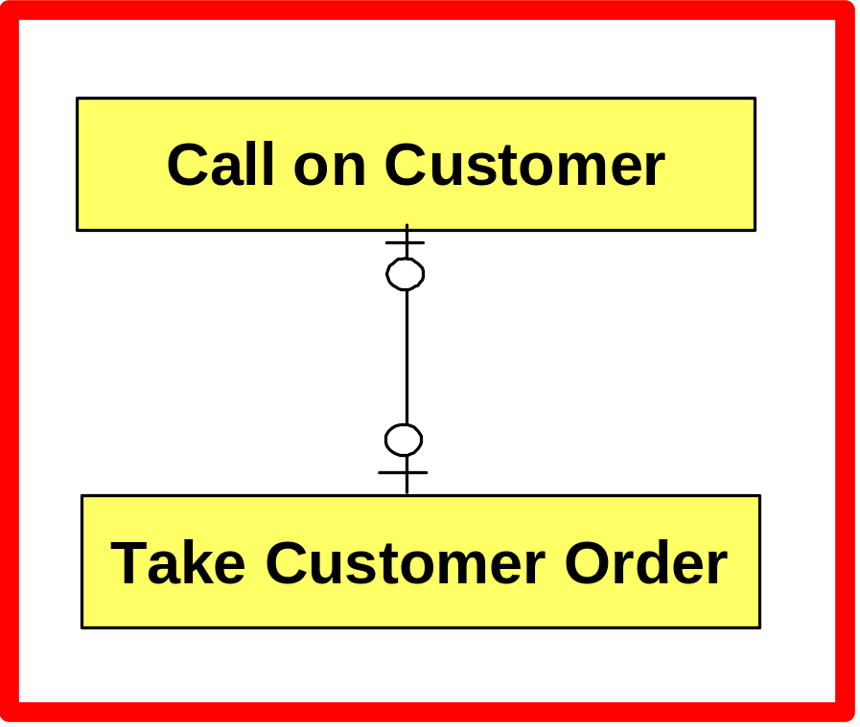
Call on Customer
Customer
Employee (Salesperson)
Take Customer Order
Customer
Inventory
Fill Customer Order
Employee (Warehouse)
Sales calls do not always result in orders, so the minimum cardinality from the call on customer event to the take order event is 0.
Though a single call may be followed by many orders, it is easier to evaluate sales force productivity by linking each call only to orders placed at the time the call is made, so the maximum cardinality here is 1.
Employee (Shipping)
Ship Order
Carrier
Customer
Cash
Receive Cash
Employee (Cashier)

Slide 8
Call on Customer
Customer
Employee (Salesperson)
Take Customer Order
Customer
Inventory
Fill Customer Order
Employee (Warehouse)
Orders are often received by phone, fax, or via the company’s website, rather than as a result of a sales call. So the minimum between take order and call on customer is 0.
It may take many sales calls to obtain the first order, but it’s customary to associate the order only with the particular sales call that generated it. So the maximum is 1.
Employee (Shipping)
Ship Order
Carrier
Customer
Cash
Receive Cash
Employee (Cashier)

Slide 9
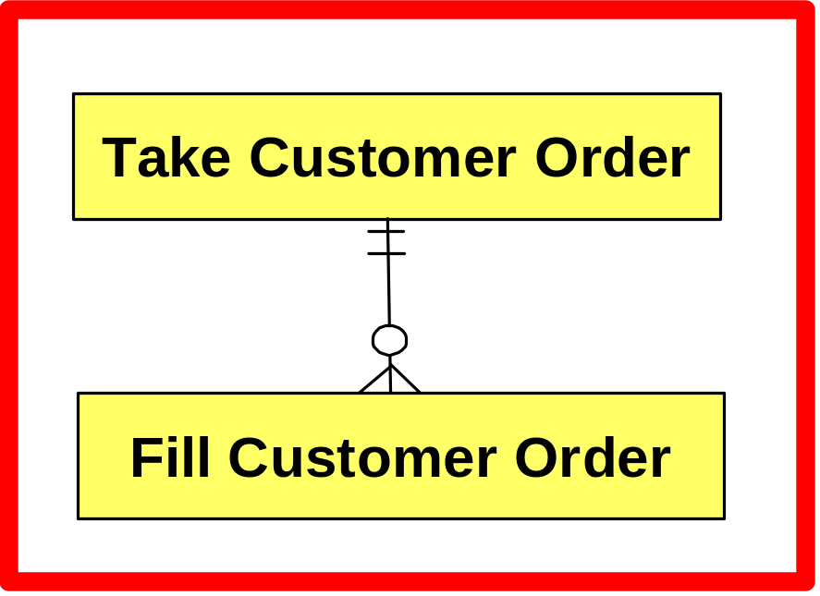
Call on Customer
Customer
Employee (Salesperson)
Take Customer Order
Customer
Inventory
Fill Customer Order
Employee (Warehouse)
Employee (Shipping)
Ship Order
Carrier
Customer
The relationship between take order and fill order is one-to-many.
  The two events occur sequentially, so for every order taken, the order can be filled a minimum of zero times.
  The maximum cardinality is N, because some items may not be in stock and will have to be filled later.
Cash
Receive Cash
Employee (Cashier)

Slide 10
Call on Customer
Customer
Employee (Salesperson)
Take Customer Order
Customer
Inventory
Fill Customer Order
Employee (Warehouse)
Employee (Shipping)
Ship Order
Carrier
Customer
For every time an order is filled, there must be at least one order (minimum of 1), and because best practice is to fill each order immediately, there should be a maximum of one take order for every fill order event.
Cash
Receive Cash
Employee (Cashier)

Slide 11
The warehouse activity of filling an order is separate from the activity of actually shipping (or delivering) the order.
The fill order event represents the picking and packing activity.
Call on Customer
Customer
Employee (Salesperson)
Take Customer Order
Customer
Inventory
Fill Customer Order
Employee (Warehouse)
Employee (Shipping)
Ship Order
Carrier
Customer
Cash
Receive Cash
Employee (Cashier)

Slide 12
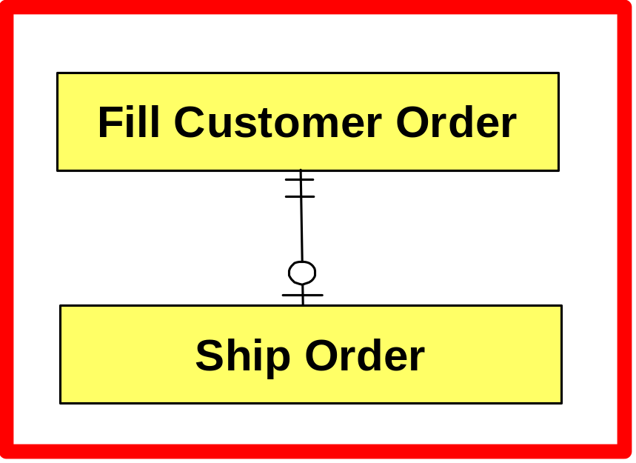
The relationship between fill order and ship order is one-to-one.
The fill order event occurs first, so for every order filled, there is a minimum of zero shipping events.
Each order is typically sent as one shipment, so for every order filled, there is a maximum of one shipment.
Call on Customer
Customer
Employee (Salesperson)
Take Customer Order
Customer
Inventory
Fill Customer Order
Employee (Warehouse)
Employee (Shipping)
Ship Order
Carrier
Customer
Cash
Receive Cash
Employee (Cashier)

Slide 13
Each shipment is typically linked to one and only one fill order event.
Call on Customer
Customer
Employee (Salesperson)
Take Customer Order
Customer
Inventory
Fill Customer Order
Employee (Warehouse)
Employee (Shipping)
Ship Order
Carrier
Customer
Cash
Receive Cash
Employee (Cashier)

Slide 14
MANUFACTURERS AND DISTRIBUTORS
Attribute Placement
  The primary key of the shipping event is the shipment number.
  The bill of lading number is another attribute in the shipping event.
    The bill of lading number is not the primary key because it can be null for deliveries made with the company’s own vehicles.
  The sales invoice number is another attribute of the shipping event.
    The invoice number is not the primary key because some companies use electronic invoices or eliminate invoices altogether.
    Also, if the invoice number were used as the primary key, it would be null until such time as an invoice were actually issued, which may often occur after shipment.

Slide 15
MANUFACTURERS AND DISTRIBUTORS
For companies which still use invoices, the invoice number serves an important internal control function.
  This attribute can be examined to determine whether all goods that have been shipped have been billed.
  If it’s null, the billing hasn’t occurred.

Slide 16
MANUFACTURERS AND DISTRIBUTORS
Information about prices and costs is stored in several places.
  The inventory table contains information about the standard (list) price and standard cost of each item because those values are typically constant for the fiscal year.
  The take order-inventory table contains the quantities ordered for each item, as well as the actual price and accounting cost assigned to each, because these change during the year.

Slide 17
The REA diagram identifies different employees who participate in each event by their job functions.
Makes it easier to use the diagram as a guide to verify whether duties are properly segregated.
However, only one employee table is required, which includes the attribute “job title” to identify each employee’s primary function.
Call on Customer
Customer
Employee (Salesperson)
Take Customer Order
Customer
Inventory
Fill Customer Order
Employee (Warehouse)
Employee (Shipping)
Ship Order
Carrier
Customer
Cash
Receive Cash
Employee (Cashier)

Slide 18
SALE OF SERVICES
We’ve focused so far on businesses that sell tangible inventory.
Many businesses sell services, such as auto repair or veterinary services.
A partial REA model for the revenue cycle of a service company is shown on the following slide.

Slide 19
SALE OF SERVICES
Services
Employee
Sales
Inventory
Customer
Cash
Receive
Cash
Employee

Slide 20
SALE OF SERVICES
Services
Employee
Sales
The relationship between the sale event and the services resource is likely to be M:N.
  For each sale, many services can be provided.
  For each service the company offers, they are likely to have sold it many times.
Inventory
Customer
Cash
Receive
Cash
Employee

Slide 21
The minimum cardinality between the service resource and the sale event is typically 0, because some services may never be sold.
SALE OF SERVICES
Services
Employee
Sales
Inventory
Customer
Cash
Receive
Cash
Employee

Slide 22
The minimum cardinality between the sales event and the services inventory will probably be 0 if the entity offers any tangible product. For example:
  A veterinarian could provide a service to a customer’s pet without selling any tangible product.
  A veterinarian could sell flea-and-tick medicine (inventory) to a customer without providing any services.
  A veterinarian could provide both a service and a tangible product.
  But for each sale, the minimum amount of service or tangible product provided is zero.
SALE OF SERVICES
Services
Employee
Sales
Inventory
Customer
Cash
Receive
Cash
Employee

Slide 23
DIGITAL ASSETS
Companies that sell software, music, or digital photographs over the Internet give up a digital copy of these resources, but not the actual resource.
They still need to collect information about orders for delivery of those digital assets, along with receipt of customer payments.
They need an inventory table so customers can see what products are available.
The structure of the table is very similar to tables for tangible products, except there is no need for quantity-on-hand fields or any data on re-order points.
The inventory table will still include information about standard list prices of each item.

Slide 24
RENTAL TRANSACTIONS
Some businesses generate revenue through rental transactions rather than sales.
The give-to-get exchange involves the temporary use of a resource in return for:
  The receipt of cash; and
  The subsequent return of the resource being rented.

Slide 25
Return
Item
Customer
Each row in the rent item event entity records information about the rental of one specific item, such as date and time of rental, rental price, and terms.
If a customer rents multiple items, each item is treated as a separate rental event, since the items must be tracked individually.
Rental
Inventory
Employee
Rent
Item
Customer
Cash
Receive
Cash
Employee

Slide 26
Return
Item
Customer
Rental
Inventory
Employee
Rent
Item
The rent item event is linked to both the receive cash and return item events.
Customer
Cash
Receive
Cash
Employee

Slide 27
In the cardinality between rent item and receive cash:
  The minimum cardinality of 1 reflects that the customers typically pay first before taking possession.
  The maximum of N reflects that there may be additional charges when the rental item is returned.
Return
Item
Customer
Rental
Inventory
Employee
Rent
Item
Customer
Cash
Receive
Cash
Employee

Slide 28
In the cardinality between receive cash and rent item:
  The minimum cardinality is 0, because payment is made before the rental is provided.
  The maximum is 1, assuming the receive cash event is linked to one and only one rental.
Return
Item
Customer
Rental
Inventory
Employee
Rent
Item
Customer
Cash
Receive
Cash
Employee

Slide 29
The relationship between rent item and return rental is 1:1. Assumes:
  The rental of each item is tracked separately.
  Each item can only be returned once.
  Minimums represent the temporal sequence of events.
Return
Item
Customer
Rental
Inventory
Employee
Rent
Item
Customer
Cash
Receive
Cash
Employee

Slide 30
ADDITIONAL EVENTS
An expanded expenditure cycle REA diagram includes internal requests for purchases.

Slide 31
Supplier
Request Goods
Inventory Control
Employee (Supervisor)
Order Goods
Employee (Purch. Clerk)
Inventory
Supplier
Employee (Receiving)
Warehouse
Receive Goods
Employee (Warehouse)
Financial Institution
Most of the entities and relationships were explained in previous chapters.
The request goods event provides a way to collect data about the formal process that exists in many larger organizations to request the purchase of goods.
Supplier
Cash
Pay for Goods
Employee (Cashier)

Slide 32
Supplier
Request Goods
Inventory Control
Employee (Supervisor)
Order Goods
Employee (Purch. Clerk)
Inventory
Supplier
Employee (Receiving)
Warehouse
Receive Goods
Employee (Warehouse)
Financial Institution
The cardinality between request goods and order goods:
  Has a minimum of 0 because of time sequence and the denial of some requests.
  Has a maximum of N, because a particular request can result in multiple orders, often from different vendors.
Supplier
Cash
Pay for Goods
Employee (Cashier)

Slide 33
Supplier
Request Goods
Inventory Control
Employee (Supervisor)
Order Goods
Employee (Purch. Clerk)
Inventory
Supplier
Employee (Receiving)
Warehouse
Receive Goods
Employee (Warehouse)
The cardinality between order goods and request goods:
  Has a minimum of zero because some orders are generated automatically by the inventory control system without the issuance of a request.
  Has a maximum of N because an order may consolidate several requests.
Financial Institution
Supplier
Cash
Pay for Goods
Employee (Cashier)

Slide 34
ATTRIBUTE PLACEMENT
Cost information is stored in several tables.
Standard cost is stored in the inventory table because it is the same for all units of an inventory item for the fiscal year.
Actual cost is stored in the order-inventory table, because it can vary with every order.
  Allows the system to calculate cost of ending inventory and cost of goods sold under the accepted cost-flow assumption (FIFO, LIFO, etc.)

Slide 35
The relationship between receive goods and receiving employees is M:N because:
  When a shipment is received, several employees may work to unload the shipment.
  An individual employee may unload several shipments.
Supplier
Request Goods
Inventory Control
Employee (Supervisor)
Order Goods
Employee (Purch. Clerk)
Inventory
Supplier
Employee (Receiving)
Warehouse
Receive Goods
Employee (Warehouse)
Financial Institution
Supplier
Cash
Pay for Goods
Employee (Cashier)

Slide 36
Two new entities, warehouses and financial institutions, appear in this diagram.
These entities store information about the location where resources are stored and where certain events occur.
Companies may have multiple warehouses.
Supplier
Request Goods
Inventory Control
Employee (Supervisor)
Order Goods
Employee (Purch. Clerk)
Inventory
Supplier
Employee (Receiving)
Warehouse
Receive Goods
Employee (Warehouse)
Financial Institution
Supplier
Cash
Pay for Goods
Employee (Cashier)

Slide 37
In the cardinality between warehouse and inventory:
  The minimum is 0, because a warehouse could be empty.
  The maximum is N, because a warehouse could store many inventory items.
Supplier
Request Goods
Inventory Control
Employee (Supervisor)
Order Goods
Employee (Purch. Clerk)
Inventory
Supplier
Employee (Receiving)
Warehouse
Receive Goods
Employee (Warehouse)
Financial Institution
Supplier
Cash
Pay for Goods
Employee (Cashier)

Slide 38
In the cardinality between inventory and warehouse:
  The minimum is 0, because an inventory item may be tracked by the company although there is none in stock.
  The maximum is N, because some items could be stored in multiple warehouses.
Supplier
Request Goods
Inventory Control
Employee (Supervisor)
Order Goods
Employee (Purch. Clerk)
Inventory
Supplier
Employee (Receiving)
Warehouse
Receive Goods
Employee (Warehouse)
Financial Institution
Supplier
Cash
Pay for Goods
Employee (Cashier)

Slide 39
Linking the receive goods event to the warehouse entity makes it possible to evaluate performance at different locations.
Supplier
Request Goods
Inventory Control
Employee (Supervisor)
Order Goods
Employee (Purch. Clerk)
Inventory
Supplier
Employee (Receiving)
Warehouse
Receive Goods
Employee (Warehouse)
Financial Institution
Supplier
Cash
Pay for Goods
Employee (Cashier)

Slide 40
Each row in the cash table would correspond to a specific general ledger account that is aggregated in the balance sheet under the heading “Cash and Cash Equivalents.”
Supplier
Request Goods
Inventory Control
Employee (Supervisor)
Order Goods
Employee (Purch. Clerk)
Inventory
Supplier
Employee (Receiving)
Warehouse
Receive Goods
Employee (Warehouse)
Financial Institution
Supplier
Cash
Pay for Goods
Employee (Cashier)

Slide 41
In the cardinality from the cash resource to financial institutions:
  The minimum is zero, because the account “petty cash” is not stored at a financial institution.
  Since an account can only be located at one financial institution, the maximum is 1.
Supplier
Request Goods
Inventory Control
Employee (Supervisor)
Order Goods
Employee (Purch. Clerk)
Inventory
Supplier
Employee (Receiving)
Warehouse
Receive Goods
Employee (Warehouse)
Financial Institution
Supplier
Cash
Pay for Goods
Employee (Cashier)

Slide 42
In the cardinality from financial institutions to cash:
  The minimum is zero, because the company may include information on a financial institution in which they do not yet have an account or have recently closed an account.
  The maximum is zero, because multiple accounts can be kept at one bank.
Supplier
Request Goods
Inventory Control
Employee (Supervisor)
Order Goods
Employee (Purch. Clerk)
Inventory
Supplier
Employee (Receiving)
Warehouse
Receive Goods
Employee (Warehouse)
Financial Institution
Supplier
Cash
Pay for Goods
Employee (Cashier)

Slide 43
The relationship between the inventory resource and supplier agent reflects the best practice of having several alternate suppliers for a particular inventory item.
Supplier
Request Goods
Inventory Control
Employee (Supervisor)
Order Goods
Employee (Purch. Clerk)
Inventory
Supplier
Employee (Receiving)
Warehouse
Receive Goods
Employee (Warehouse)
Financial Institution
Supplier
Cash
Pay for Goods
Employee (Cashier)

Slide 44
ACQUISITION OF INTANGIBLE SERVICES
An organization may acquire intangible services such as Internet access, phone service, and utilities.
The give-to-get exchange involves acquiring services and paying for them.

Slide 45
ACQUISITION OF INTANGIBLE SERVICES
General and
Admin.
Services
Employee
Acquire
Services
Payments appear in the cash disbursements table.
Supplier
Cash
Disburse
Cash
Employee

Slide 46
A separate event, acquire services, is used to collect data about the acquisition of those services.
The acquire services table stores information about the actual amount of services consumed and the actual prices charged.
ACQUISITION OF INTANGIBLE SERVICES
General and
Admin.
Services
Employee
Acquire
Services
Supplier
Cash
Disburse
Cash
Employee

Slide 47
Acquire services is linked to a general and administrative services resource entity.
The resource entity includes information such as:
  Length of contract (if any).
  Starting date.
  Budgeted cost for the service.
  Budgeted or standard amount to be provided each period.
  Limitations or special requirements.
ACQUISITION OF INTANGIBLE SERVICES
General and
Admin.
Services
Employee
Acquire
Services
Supplier
Cash
Disburse
Cash
Employee

Slide 48
The relationship between acquire services and the resource is typically 1:N because each service is typically acquired separately from a different supplier.
ACQUISITION OF INTANGIBLE SERVICES
General and
Admin.
Services
Employee
Acquire
Services
Supplier
Cash
Disburse
Cash
Employee

Slide 49
The relationship between acquire services and cash disbursement is modeled as 1:1 to reflect that the organization obtains the use of a service for a particular period and makes a payment each month for the services it acquired and used that month.
ACQUISITION OF INTANGIBLE SERVICES
General and
Admin.
Services
Employee
Acquire
Services
Supplier
Cash
Disburse
Cash
Employee

Slide 50
RENTING RESOURCES
Organizations sometimes rent resources rather than purchase.
The basic give-to-get involves:
  Pay the supplier
  Get the right to the resource for a period
Information on payments is in the cash disbursements table.
A separate rent resource event may be created to represent acquisition of the resource.
Although it is rented, the resource will also be included in the model as a separate entity, because the company needs to maintain information about it.

Slide 51
RENTING RESOURCES
Rented and owned resources may be maintained in separate entities because different information is maintained about each.
If the rented resource must be returned, another event is included in the REA diagram to record the return event.

Slide 52
PRODUCTION CYCLE MODEL
Let’s look at a data model for the production cycle activities of a manufacturing company.
Detailed information must be collected about the use of raw materials, labor, and machinery in order to produce accurate cost management and performance evaluation.

Slide 53
There are four main events of interest:
  Issue raw materials
  Perform job operations (use labor)
  Perform machine operations
  Produce new finished products (represented by the work-in-process event)
Raw Materials
Bill of Materials
Employee (Inventory Control)
Issue Raw Materials
Employee (Factory)
Perform Job Operations
Work in Process
Finished Goods Inventory
Employee (Supervisor)
Employee Time
Job Operations List
Equipment
Perform Mach. Operations
Machine Operations List

Slide 54
Raw Materials
Bill of Materials
Employee (Inventory Control)
Issue Raw Materials
Employee (Factory)
Perform Job Operations
Work in Process
Finished Goods Inventory
There are three special types of entities in the production cycle:
The bill of materials:
  Contains information about the raw materials used to make a finished product.
  This list itself cannot manufacture a product.
  Instructions are needed on how to combine the components, including the proper sequence of steps.
Employee (Supervisor)
Employee Time
Job Operations List
Equipment
Perform Mach. Operations
Machine Operations List

Slide 55
The job operations list stores the instructions concerning labor activities.
Raw Materials
Bill of Materials
Employee (Inventory Control)
Issue Raw Materials
Employee (Factory)
Perform Job Operations
Work in Process
Finished Goods Inventory
Employee (Supervisor)
Employee Time
Job Operations List
Equipment
Perform Mach. Operations
Machine Operations List

Slide 56
The machine operations list stores the instructions for actions to be performed with the equipment.
Raw Materials
Bill of Materials
Employee (Inventory Control)
Issue Raw Materials
Employee (Factory)
Perform Job Operations
Work in Process
Finished Goods Inventory
Employee (Supervisor)
Employee Time
Job Operations List
Equipment
Perform Mach. Operations
Machine Operations List

Slide 57
The job operations and machine operations lists store data about the standard time it should take to perform the operations.
Raw Materials
Bill of Materials
Employee (Inventory Control)
Issue Raw Materials
Employee (Factory)
Perform Job Operations
Work in Process
Finished Goods Inventory
Employee (Supervisor)
Employee Time
Job Operations List
Equipment
Perform Mach. Operations
Machine Operations List

Slide 58
Raw Materials
Bill of Materials
Each row in the bill of materials entity represents one line on the bill of materials..
Employee (Inventory Control)
Issue Raw Materials
Employee (Factory)
Perform Job Operations
Work in Process
Finished Goods Inventory
Employee (Supervisor)
Employee Time
Job Operations List
Equipment
Perform Mach. Operations
Machine Operations List

Slide 59
Raw Materials
Bill of Materials
Employee (Inventory Control)
Issue Raw Materials
Employee (Factory)
Perform Job Operations
Work in Process
Finished Goods Inventory
The relationship between bill of materials and issue raw materials is M:N.
  One line in the bill of materials can be associated with many different events of issuing the raw materials.
  One issuance of raw materials can include items for several different lines in a bill of materials.
Employee (Supervisor)
Employee Time
Job Operations List
Equipment
Perform Mach. Operations
Machine Operations List

Slide 60
The relationship between finished goods resource and both tie job operations list and machine operations list is 1:N.
  Each row in the list entities represents information about a specific activity required to make a specific product.
  Multiple steps are often required to make a single product.
  So one finished good could be linked to many rows in either of the two lists.
Raw Materials
Bill of Materials
Employee (Inventory Control)
Issue Raw Materials
Employee (Factory)
Perform Job Operations
Work in Process
Finished Goods Inventory
Employee (Supervisor)
Employee Time
Job Operations List
Equipment
Perform Mach. Operations
Machine Operations List

Slide 61
Data about raw materials used in production is stored in the raw materials issuance entity.
Raw Materials
Bill of Materials
Employee (Inventory Control)
Issue Raw Materials
Employee (Factory)
Perform Job Operations
Work in Process
Finished Goods Inventory
Employee (Supervisor)
Employee Time
Job Operations List
Equipment
Perform Mach. Operations
Machine Operations List

Slide 62
Information about actual labor performed and the time required to do so are stored in the job operations entity.
Raw Materials
Bill of Materials
Employee (Inventory Control)
Issue Raw Materials
Employee (Factory)
Perform Job Operations
Work in Process
Finished Goods Inventory
Employee (Supervisor)
Employee Time
Job Operations List
Equipment
Perform Mach. Operations
Machine Operations List

Slide 63
Information about actual machine operations performed and the time required to do so are stored in the machine operations entity.
Raw Materials
Bill of Materials
Employee (Inventory Control)
Issue Raw Materials
Employee (Factory)
Perform Job Operations
Work in Process
Finished Goods Inventory
Employee (Supervisor)
Employee Time
Job Operations List
Equipment
Perform Mach. Operations
Machine Operations List

Slide 64
Performance can be evaluated by comparing data in the preceding three event entities with information about standards stored in the corresponding information entities:
  Bill of materials
  Job operations list
  Machine operations list.
Raw Materials
Bill of Materials
Employee (Inventory Control)
Issue Raw Materials
Employee (Factory)
Perform Job Operations
Work in Process
Finished Goods Inventory
Employee (Supervisor)
Employee Time
Job Operations List
Equipment
Perform Mach. Operations
Machine Operations List

Slide 65
PRODUCTION CYCLE MODEL
The job operations event entity is an example of a “give” event.
  Records the use of employee time.
  Each row in the table records info about how much time an employee spent working on a particular job.
  If an employee worked on 3 different jobs in a day, there would be three rows in the table for that employee on that day.
  Collecting this detailed info about how factory employees use time enables manufacturers to accurately assign labor costs to different production batches and product lines.

Slide 66
PRODUCTION CYCLE MODEL
The machine operations event is similar to the job operations event except it records information about the use of a specific piece of equipment.
Useful to:
  Assign costs to products
  Schedule maintenance
The machine operations event is not used to record depreciation.
  Depreciation does not correspond to actual equipment use.
  Depreciation is not modeled as an event.
  Data needed to calculate depreciation (expected life, residual value, etc.) are stored in the resource entity, but the calculation is not treated as an event.

Slide 67
The relationship between the job operations event and the job operations list is modeled as 1:N.
  The lists store information about standard time, while the events store information about actual time.
  Each actual event can be linked to only one standard.
  However, each standard is likely to be linked to many actual performances of the activity.
Raw Materials
Bill of Materials
Employee (Inventory Control)
Issue Raw Materials
Employee (Factory)
Perform Job Operations
Work in Process
Finished Goods Inventory
Employee (Supervisor)
Employee Time
Job Operations List
Equipment
Perform Mach. Operations
Machine Operations List

Slide 68
The same can be said of the relationship between the machine operations event and the machine operations list.
Raw Materials
Bill of Materials
Employee (Inventory Control)
Issue Raw Materials
Employee (Factory)
Perform Job Operations
Work in Process
Finished Goods Inventory
Employee (Supervisor)
Employee Time
Job Operations List
Equipment
Perform Mach. Operations
Machine Operations List

Slide 69
The work-in-process entity collects and summarizes data about the raw materials, labor, and machine operations used to produce a batch of goods.
Raw Materials
Bill of Materials
Employee (Inventory Control)
Issue Raw Materials
Employee (Factory)
Perform Job Operations
Work in Process
Finished Goods Inventory
Employee (Supervisor)
Employee Time
Job Operations List
Equipment
Perform Mach. Operations
Machine Operations List

Slide 70
The relationship between W-I-P and the three event entities are 1:N.
Each production run may involve a number of raw materials issuances, labor operations, and machine operations.
Each activity is linked to a particular production run.
Raw Materials
Bill of Materials
Employee (Inventory Control)
Issue Raw Materials
Employee (Factory)
Perform Job Operations
Work in Process
Finished Goods Inventory
Employee (Supervisor)
Employee Time
Job Operations List
Equipment
Perform Mach. Operations
Machine Operations List

Slide 71
Internal events differ from other events in that they are typically linked to only one agent.
  They do not involve exchange or transfer of resources.
  They represent consumption of resources such as an employee’s time or use of equipment.
  The event is linked to the agent about whom management wishes to collect information for product costing or performance evaluation measures.
Raw Materials
Bill of Materials
Employee (Inventory Control)
Issue Raw Materials
Employee (Factory)
Perform Job Operations
Work in Process
Finished Goods Inventory
Employee (Supervisor)
Employee Time
Job Operations List
Equipment
Perform Mach. Operations
Machine Operations List

Slide 72
Relationships between internal agents may be created to model lines of responsibility.
  This diagram depicts a 1:N relationship between employees and supervisors.
    Each employee has one supervisor.
    A supervisor can have many subordinates.
  In a matrix style of organization, this relationship would be M:N, since each employee could have multiple supervisors.
Raw Materials
Bill of Materials
Employee (Inventory Control)
Issue Raw Materials
Employee (Factory)
Perform Job Operations
Work in Process
Finished Goods Inventory
Employee (Supervisor)
Employee Time
Job Operations List
Equipment
Perform Mach. Operations
Machine Operations List

Slide 73
RELATIONSHIPS BETWEEN AGENTS
Relationships between internal and external agents can also occur.
  Example: Insurance companies often assign their customers to a servicing agent.
Relationships between external agents are rare but can occur.
  A health insurer may need to link the primary insured on a health policy to the dependents on the policy (e.g., spouse and children).

Slide 74
COMBINED HR/PAYROLL MODEL
Now let’s take a look at an REA model that integrates human resources and payroll activities.

Slide 75
The record time worked event is necessary to calculate payroll.
Training
Providers
Track Time Used
Employees
Employee Time
Skills
Recruit Applicants
Applicants
Record Time Worked
Cash
Interview Applicants
Employees
Disburse Cash
Employee (Cashier)
Hire Applicants
Applicants
Evaluate Perform-ance
Employee (Supv.)

Slide 76
Training
Providers
Track Time Used
Employees
Employee Time
Skills
Recruit Applicants
The track time used event is utilized in cost accounting in order to properly assign labor costs (referred to as job operations in a manufacturer).
Applicants
Record Time Worked
Cash
Interview Applicants
Employees
Disburse Cash
Employee (Cashier)
Hire Applicants
Applicants
Evaluate Perform-ance
Employee (Supv.)

Slide 77
The other events represent important HR activities.
Training
Providers
Track Time Used
Employees
Employee Time
Skills
Recruit Applicants
Applicants
Record Time Worked
Cash
Interview Applicants
Employees
Disburse Cash
Employee (Cashier)
Hire Applicants
Applicants
Evaluate Perform-ance
Employee (Supv.)

Slide 78
Training
Providers
Track Time Used
Employees
Employee Time
Skills
Recruit Applicants
The employee entity is linked to almost every other entity in the diagram, reflecting the importance of employees to the organization.
Applicants
Record Time Worked
Cash
Interview Applicants
Employees
Disburse Cash
Employee (Cashier)
Hire Applicants
Applicants
Evaluate Perform-ance
Employee (Supv.)

Slide 79
COMBINED HR/PAYROLL MODEL
The employee entity stores much of the data typically found in the payroll master file, including:
  Name
  Date hired
  Date of birth
  Pay rate
  Job title
  Supervisor
  Number of dependents
  Withholding allowances
  Voluntary deductions

Slide 80
Training
Providers
Track Time Used
Employees
Employee Time
Skills
Recruit Applicants
The skills entity contains data about the different job skills of interest to the organization.
  There is a row in the table for each major skill.
  Each employee can have several skills.
  Every skill can be attained by numerous employees.
  Therefore the relationship between skills and employees is M:N.
Applicants
Record Time Worked
Cash
Interview Applicants
Employees
Disburse Cash
Employee (Cashier)
Hire Applicants
Applicants
Evaluate Perform-ance
Employee (Supv.)

Slide 81
Training
Providers
Track Time Used
Employees
Employee Time
Skills
Recruit Applicants
Applicants
Record Time Worked
Cash
Interview Applicants
The training event entity represents the workshops, training programs, etc., provided to employees to develop their skills.
  This entity stores data for use in evaluating effectiveness and cost of training efforts.
  Each employee can go to numerous events.
  Each training event can involve multiple employees.
  So the relationship between training event and employees is M:N.
Employees
Disburse Cash
Employee (Cashier)
Hire Applicants
Applicants
Evaluate Perform-ance
Employee (Supv.)

Slide 82
Training
Providers
Track Time Used
Employees
Employee Time
Skills
Recruit Applicants
Applicants
Record Time Worked
Cash
Interview Applicants
Employees
Disburse Cash
Employee (Cashier)
Let’s look at the relationship between skills and the training event.
  Each course is designed to develop one skill.
  Each skill may be taught at many training events.
  Therefore, the relationship between skills and training event is 1:N.
Hire Applicants
Applicants
Evaluate Perform-ance
Employee (Supv.)

Slide 83
Training
Providers
Track Time Used
Employees
Employee Time
Skills
Recruit Applicants
Applicants
Record Time Worked
Cash
Interview Applicants
Employees
Disburse Cash
Employee (Cashier)
The recruiting event entity stores data about activities performed to notify the public of job openings.
Data recorded in this entity help document compliance with employment laws and evaluate various methods of announcing openings.
Hire Applicants
Applicants
Evaluate Perform-ance
Employee (Supv.)

Slide 84
Training
Providers
Track Time Used
Employees
Employee Time
Skills
Recruit Applicants
Applicants
Record Time Worked
Cash
Interview Applicants
Employees
Disburse Cash
Employee (Cashier)
In the relationship between skills and recruiting event.
  Each advertisement may seek several skills.
  Each skill may be sought in multiple recruiting events.
  Therefore, the relationship is M:N.
Hire Applicants
Applicants
Evaluate Perform-ance
Employee (Supv.)

Slide 85
Training
Providers
Track Time Used
Employees
Employee Time
Skills
Recruit Applicants
Applicants
Record Time Worked
Cash
Interview Applicants
Employees
Disburse Cash
Employee (Cashier)
In the relationship between recruiting event and job applicants.
  A recruiting event can result in many job applicants.
  A job applicant can attend multiple recruiting events.
  Therefore, this is an M:N relationship.
Hire Applicants
Applicants
Evaluate Perform-ance
Employee (Supv.)

Slide 86
The interview event stores data about each job interview.
  This event is linked to the hire employees event.
  Each hiring event occurs only once but may result from multiple interviews.
  The relationship between the interview and hiring event is a many-to-one relationship.
Training
Providers
Track Time Used
Employees
Employee Time
Skills
Recruit Applicants
Applicants
Record Time Worked
Cash
Interview Applicants
Employees
Disburse Cash
Employee (Cashier)
Hire Applicants
Applicants
Evaluate Perform-ance
Employee (Supv.)

Slide 87
A job operations event tracks how factory workers spend their time so labor costs can be allocated to products.
Professional services firms, such as legal and accounting firms, track how members spend their time in order to accurately bill clients.
The track time used event serves this purpose.
Training
Providers
Track Time Used
Employees
Employee Time
Skills
Recruit Applicants
Applicants
Record Time Worked
Cash
Interview Applicants
Employees
Disburse Cash
Employee (Cashier)
Hire Applicants
Applicants
Evaluate Perform-ance
Employee (Supv.)

Slide 88
COMBINED HR/PAYROLL MODEL
Similar to the job operations table.
  Each row of the track time used table indicates the employee, client, task performed, time started, and time ended.
  Most professional services firms record time in fractions of an hour.
  The nature of the task is important for performance evaluation and to apply the appropriate billing rate.

Slide 89
Training
Providers
Track Time Used
Employees
Employee Time
Skills
Recruit Applicants
The track time used entity is not needed if the organization does not collect detailed data about their employees’ use of time.
When such an event is included, the employee time resource is seldom implemented as a table.
Applicants
Record Time Worked
Cash
Interview Applicants
Employees
Disburse Cash
Employee (Cashier)
Hire Applicants
Applicants
Evaluate Perform-ance
Employee (Supv.)

Slide 90
FINANCING ACTIVITIES DATA MODEL
Most organizations issue stock and debt to finance their operations.
Let’s look at a data model for these activities.

Slide 91
The issue debt event is a special kind of cash receipt, so it is connected to the cash resource entity.
Issue Debt
Transfer Agent
Employee
Cash
Disburse Cash
Transfer Agent
Issue Stock
Employee

Slide 92
FINANCING ACTIVITIES DATA MODEL
Issue debt is often modeled as a separate event entity because it contains distinctly different attributes from those associated with cash receipts from sales.
Attributes might include:
  Face amount of debt issued
  Total amount of cash received
  Issue date
  Maturity date
  Interest rate

Slide 93
Issue Debt
Transfer Agent
Employee
Cash
Disburse Cash
Transfer Agent
Most companies sell debt instruments through a financial intermediary (transfer agent) rather than deal directly with individual creditors.
This transfer agent maintains the necessary information about individual creditors, so that interest payments and principal repayments can be made correctly.
Therefore, an issue debt event contains data only about the aggregate amount received, not the amount issued to each individual creditor.
Issue Stock
Employee

Slide 94
Issue Debt
Transfer Agent
Employee
Cash
Disburse Cash
Transfer Agent
Debt-related payments of interest and principal are written to the transfer agent for the aggregate payments on a particular bond or note.
The transfer agent handles issuance of the individual checks.
Therefore, on the company’s part, the transfer of funds is recorded as a single row in the cash disbursements table.
So the cardinality between issue debt and disburse cash is (1:1).
Issue Stock
Employee

Slide 95
Equity transactions are modeled in a manner similar to debt transactions.
  Issue stock is a special type of cash receipt.
  Dividend payments are a special type of cash disbursement.
  Most companies deal with transfer agents to handle these events, so the agents typically involved in the transactions are:
    The treasurer (internal agent); and
    The transfer agent.
Issue Debt
Transfer Agent
Employee
Cash
Disburse Cash
Transfer Agent
Issue Stock
Employee

Slide 96
SUMMARY
In this chapter, you’ve learned how REA data models are developed for organizations other than retail stores.
You’ve learned how REA models are developed for the HR/payroll, manufacturing, and capital asset transaction cycles.
The creation of these types of models significantly increases the flexibility of an organization’s information storage, querying, and reporting capabilities.

