Slide 1
HAPTER 4
Relational Databases

Slide 2
INTRODUCTION
Questions to be addressed in this chapter:
  How are databases different than file-based legacy systems?
  Why are databases important and what is their advantage?
  What is the difference between logical and physical views of a database?
  What are the fundamental concepts of database systems such as DBMS, schemas, the data dictionary, and DBMS languages?
  What is a relational database, and how does it organize data?
  How are tables structured to properly store data in a relational database?

Slide 3
INTRODUCTION
Relational databases underlie most modern integrated AISs.
  They are the most popular type of database used for transaction processing.
  In this chapter, we’ll define the concept of a database.

Slide 4
FILE VS. DATABASES
Let’s examine some basic principles about how data are stored in computer systems.
  An entity is anything about which the organization wishes to store data. At your college or university, one entity would be the student.
STUDENTS
Student ID | Last Name | First Name | Phone Number | Birth Date
333-33-3333 | Simpson | Alice | 333-3333 | 10/11/84
111-11-1111 | Sanders | Ned | 444-4444 | 11/24/86
123-45-6789 | Moore | Artie | 555-5555 | 04/20/85

Slide 5
FILE VS. DATABASES
  Information about the attributes of an entity (e.g., the student’s ID number and birth date) are stored in fields.
STUDENTS
Student ID | Last Name | First Name | Phone Number | Birth Date
333-33-3333 | Simpson | Alice | 333-3333 | 10/11/84
111-11-1111 | Sanders | Ned | 444-4444 | 11/24/86
123-45-6789 | Moore | Artie | 555-5555 | 04/20/85

Slide 6
FILE VS. DATABASES
  All the fields containing data about one entity (e.g., one student) form a record.
  The example below shows the record for Artie Moore.
STUDENTS
Student ID | Last Name | First Name | Phone Number | Birth Date
333-33-3333 | Simpson | Alice | 333-3333 | 10/11/84
111-11-1111 | Sanders | Ned | 444-4444 | 11/24/86
123-45-6789 | Moore | Artie | 555-5555 | 04/20/85

Slide 7
FILE VS. DATABASES
  A set of all related records forms a file (e.g., the student file).
  If this university only had three students and five fields for each student, then the entire file would be depicted below.
STUDENTS
Student ID | Last Name | First Name | Phone Number | Birth Date
333-33-3333 | Simpson | Alice | 333-3333 | 10/11/84
111-11-1111 | Sanders | Ned | 444-4444 | 11/24/86
123-45-6789 | Moore | Artie | 555-5555 | 04/20/85

Slide 8
FILE VS. DATABASES
  A set of interrelated, centrally coordinated files forms a database.
Student
File
Class
File
Advisor
File

Slide 9
FILE VS. DATABASES
Database systems were developed to address the problems associated with the proliferation of master files.
  For years, each time a new information need arose, companies created new files and programs.
  The result: a significant increase in the number of master files.

Slide 10
FILE VS. DATABASES
Master File 1
Fact A
Fact B
Fact C
This proliferation of master files created problems:
  Often the same information was stored in multiple master files.
  Made it more difficult to effectively integrate data and obtain an organization-wide view of the data.
  Also, the same information may not have been consistent between files.
    If a student changed his phone number, it may have been updated in one master file but not another.
Enrollment
Program
Master File 2
Fact A
Fact D
Fact F
Fin. Aid
Program
Master File 1
Fact A
Fact B
Fact F
Grades
Program

Slide 11
FILE VS. DATABASES
Database
Fact A Fact B
Fact C Fact D
Fact E Fact F
A database is a set of inter-related, centrally coordinated files.
Database
Management
System
Enrollment
Program
Fin. Aid
Program
Grades
Program

Slide 12
FILE VS. DATABASES
Database
Fact A Fact B
Fact C Fact D
Fact E Fact F
The database approach treats data as an organizational resource that should be used by and managed for the entire organization, not just a particular department.
A database management system (DBMS) serves as the interface between the database and the various application programs.
Database
Management
System
Enrollment
Program
Fin. Aid
Program
Grades
Program

Slide 13
FILE VS. DATABASES
Database
Fact A Fact B
Fact C Fact D
Fact E Fact F
The combination of the database, the DBMS, and the application programs that access the database is referred to as the database system.
Database
Management
System
Enrollment
Program
Fin. Aid
Program
Grades
Program

Slide 14
FILE VS. DATABASES
Database
Fact A Fact B
Fact C Fact D
Fact E Fact F
The person responsible for the database is the database administrator.
As technology improves, many large companies are developing very large databases called data warehouses.
Database
Management
System
Enrollment
Program
Fin. Aid
Program
Grades
Program

Slide 15
IMPORTANCE AND ADVANTAGES OF DATABASE SYSTEMS
Database technology is everywhere.
  Most new AISs implement a database approach.
  Virtually all mainframe computer sites use database technology.
  Use of databases with PCs is growing also.

Slide 16
IMPORTANCE AND ADVANTAGES OF DATABASE SYSTEMS
As accountants, you are likely to audit or work for companies that use database technology to store, process, and report accounting transactions.
  Many accountants work directly with databases and will enter, process, and query databases.
  Some will develop and evaluate internal controls necessary to ensure database integrity.
  Others will be involved in the design and management of databases.

Slide 17
IMPORTANCE AND ADVANTAGES OF DATABASE SYSTEMS
Database technology provides the following benefits to organizations:
  Data integration
Achieved by combining master files into larger pools of data accessible by many programs.

Slide 18
IMPORTANCE AND ADVANTAGES OF DATABASE SYSTEMS
Database technology provides the following benefits to organizations:
  Data integration
  Data sharing
It’s easier to share data that’s integrated.

Slide 19
IMPORTANCE AND ADVANTAGES OF DATABASE SYSTEMS
Database technology provides the following benefits to organizations:
  Data integration
  Data sharing
  Reporting flexibility
Reports can be revised easily and generated as needed.
The database can easily be browsed to research problems or obtain detailed information.

Slide 20
IMPORTANCE AND ADVANTAGES OF DATABASE SYSTEMS
Database technology provides the following benefits to organizations:
  Data integration
  Data sharing
  Reporting flexibility
  Minimal data redundancy and inconsistencies
Because data items are usually stored only once.

Slide 21
IMPORTANCE AND ADVANTAGES OF DATABASE SYSTEMS
Database technology provides the following benefits to organizations:
  Data integration
  Data sharing
  Reporting flexibility
  Minimal data redundancy and inconsistencies
  Data independence
Data items are independent of the programs that use them.
Consequently, a data item can be changed without changing the program and vice versa.
Makes programming easier and simplifies data management.

Slide 22
IMPORTANCE AND ADVANTAGES OF DATABASE SYSTEMS
Database technology provides the following benefits to organizations:
  Data integration
  Data sharing
  Reporting flexibility
  Minimal data redundancy and inconsistencies
  Data independence
  Central management of data
Data management is more efficient because the database administrator is responsible for coordinating, controlling, and managing data.

Slide 23
IMPORTANCE AND ADVANTAGES OF DATABASE SYSTEMS
Database technology provides the following benefits to organizations:
  Data integration
  Data sharing
  Reporting flexibility
  Minimal data redundancy and inconsistencies
  Data independence
  Central management of data
  Cross-functional analysis
Relationships can be explicitly defined and used in the preparation of management reports.
EXAMPLE: Relationship between selling costs and promotional campaigns.

Slide 24
DATABASE SYSTEMS
Logical and Physical Views of Data
  In file-oriented systems, programmers must know the physical location and layout of records used by a program.
    They must reference the location, length, and format of every field they utilize.
    When data is used from several files, this process becomes more complex.

Slide 25
DATABASE SYSTEMS
Database systems overcome this problem by separating the storage and use of data elements.
  Two separate views of the data are provided:
    Logical view
How the user or programmer conceptually organizes and understands the data.

Slide 26
DATABASE SYSTEMS
Database systems overcome this problem by separating the storage and use of data elements.
  Two separate views of the data are provided:
    Logical view
    Physical view
How and where the data are physically arranged and stored.

Slide 27
DATABASE SYSTEMS
Database systems overcome this problem by separating the storage and use of data elements.
  Two separate views of the data are provided:
    Logical view
    Physical view
  Separating these views facilitates application development, because programmers can focus on coding the logic and not be concerned with storage details.

Slide 28
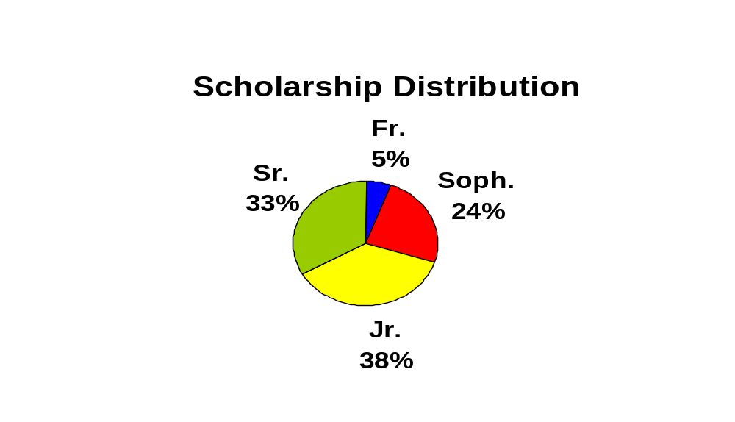
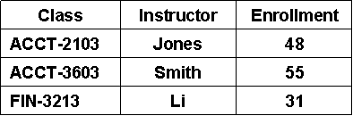
Logical View—User A
Logical View—User B
Enrollment by Class
DBMS
The DBMS translates users’ logical views into instructions as to which data should be retrieved from the database.
Operating
System
Database

Slide 29
Logical View—User A
Logical View—User B
Enrollment by Class
DBMS
The operating system translates DBMS requests into instructions to physically retrieve data from various disks.
Operating
System
Database

Slide 30
DATABASE SYSTEMS
The DBMS handles the link between the physical and logical views of the data.
  Allows the user to access, query, and update data without reference to how or where it is physically stored.
  The user only needs to define the logical data requirements.

Slide 31
DATABASE SYSTEMS
Separating the logical and physical views of data also means users can change their conceptualizations of the data relationships without making changes in the physical storage.
The database administrator can also change the physical storage of the data without affecting users or application programs.

Slide 32
DATABASE SYSTEMS
Schemas
  A schema describes the logical structure of a database.
  There are three levels of schema.
    Conceptual level
The organization-wide view of the entire database—i.e., the big picture.
Lists all data elements and the relationships between them.

Slide 33
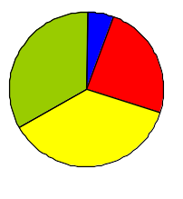
Subschema--User A
Subschema--User B
Subschema--User C
Smith . . . A
Jones . . . B
Arnold . . .D
Mapping external-level views to conceptual-level schema
Classes
Enroll
Student
Cash
Receipt
Mapping conceptual-level items to internal-level descriptions

Slide 34
DATABASE SYSTEMS
Schemas
  A schema describes the logical structure of a database.
  There are three levels of schema.
    Conceptual level
    External level
A set of individual user views of portions of the database, i.e., how each user sees the portion of the system with which he interacts.
These individual views are referred to as subschema.

Slide 35
Subschema--User A
Subschema--User B
Subschema--User C
Smith . . . A
Jones . . . B
Arnold . . .D
Mapping external-level views to conceptual-level schema
Classes
Enroll
Student
Cash
Receipt
Mapping conceptual-level items to internal-level descriptions

Slide 36
DATABASE SYSTEMS
Schemas
  A schema describes the logical structure of a database.
  There are three levels of schema.
    Conceptual level
    External level
    Internal level
A low-level view of the database.
It describes how the data are actually stored and accessed including:
  Record layouts
  Definitions
  Addresses
  Indexes

Slide 37
Subschema--User A
Subschema--User B
Subschema--User C
Smith . . . A
Jones . . . B
Arnold . . .D
Mapping external-level views to conceptual-level schema
Classes
Enroll
Student
Cash
Receipt
Mapping conceptual-level items to internal-level descriptions

Slide 38
Subschema--User A
Subschema--User B
Subschema--User C
Smith . . . A
Jones . . . B
Arnold . . .D
Mapping external-level views to conceptual-level schema
The bidirectional arrows represent mappings between the schema.
Classes
Enroll
Student
Cash
Receipt
Mapping conceptual-level items to internal-level descriptions

Slide 39
DATABASE SYSTEMS
The DBMS uses the mappings to translate a request by a user or program for data (expressed in logical names and relationships) into the indexes and addresses needed to physically access the data.

Slide 40
DATABASE SYSTEMS
Accountants are frequently involved in developing conceptual- and external-level schema.
An employee’s access to data should be limited to the subschema of data that is relevant to the performance of his job.

Slide 41
DATABASE SYSTEMS
The Data Dictionary
  A key component of a DBMS is the data dictionary.
    Contains information about the structure of the database.
    For each data element, there is a corresponding record in the data dictionary describing that element.

Slide 42
DATABASE SYSTEMS
Information provided for each element includes:
  A description or explanation of the element.
  The records in which it is contained.
  Its source.
  The length and type of the field in which it is stored.
  The programs in which it is used.
  The outputs in which it is contained.
  The authorized users of the element.
  Other names for the element.

Slide 43
DATABASE SYSTEMS
Accountants should participate in the development of the data dictionary because they have a good understanding of the data elements in a business organization, as well as where those elements originate and how they are used.

Slide 44
DATABASE SYSTEMS
The DBMS usually maintains the data dictionary.
  It is often one of the first applications of a newly implemented database system.
  Inputs to the dictionary include:
    Records of new or deleted data elements.
    Changes in names, descriptions, or uses of existing elements.
  Outputs include:
    Reports that are useful to programmers, database designers, and IS users in:
      Designing and implementing the system.
      Documenting the system.
      Creating an audit trail.

Slide 45
DATABASE SYSTEMS
DBMS Languages
  Every DBMS must provide a means of performing the three basic functions of:
    Creating a database
    Changing a database
    Querying a database

Slide 46
DATABASE SYSTEMS
DBMS Languages
  Every DBMS must provide a means of performing the three basic functions of:
    Creating a database
    Changing a database
    Querying a database

Slide 47
DATABASE SYSTEMS
Creating a database:
  The set of commands used to create the database is known as data definition language (DDL). DDL is used to:
    Build the data dictionary
    Initialize or create the database
    Describe the logical views for each individual user or programmer
    Specify any limitations or constraints on security imposed on database records or fields

Slide 48
DATABASE SYSTEMS
DBMS Languages
  Every DBMS must provide a means of performing the three basic functions of:
    Creating a database
    Changing a database
    Querying a database

Slide 49
DATABASE SYSTEMS
Changing a database
  The set of commands used to change the database is known as data manipulation language (DML). DML is used for maintaining the data including:
    Updating data
    Inserting data
    Deleting portions of the database

Slide 50
DATABASE SYSTEMS
DBMS Languages
  Every DBMS must provide a means of performing the three basic functions of:
    Creating a database
    Changing a database
    Querying a database

Slide 51
DATABASE SYSTEMS
Querying a database:
  The set of commands used to query the database is known as data query language (DQL). DQL is used to interrogate the database, including:
    Retrieving records
    Sorting records
    Ordering records
    Presenting subsets of the database
  The DQL usually contains easy-to-use, powerful commands that enable users to satisfy their own information needs.

Slide 52
DATABASE SYSTEMS
Report Writer
  Many DBMS packages also include a report writer, a language that simplifies the creation of reports.
  Users typically specify:
    What elements they want printed
    How the report should be formatted
  The report writer then:
    Searches the database
    Extracts specified data
    Prints them out according to specified format

Slide 53
DATABASE SYSTEMS
Users typically have access to both DQL and report writer.
Access to DQL and DML are typically restricted to employees with administrative and programming responsibilities.

Slide 54
RELATIONAL DATABASES
A DBMS is characterized by the type of logical data model on which it is based.
  A data model is an abstract representation of the contents of a database.
  Most new DBMSs are called relational databases because they use the relational model developed by E.F. Codd in 1970.

Slide 55
RELATIONAL DATABASES
The relational data model represents everything in the database as being stored in the forms of tables (aka, relations).

Slide 56
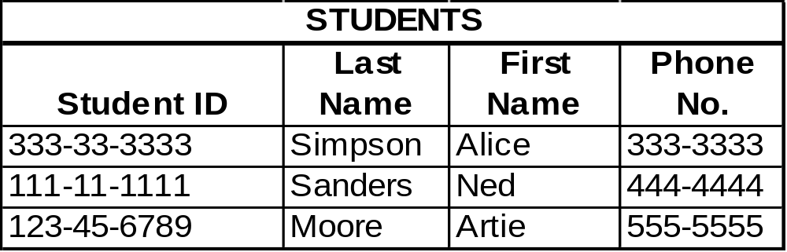
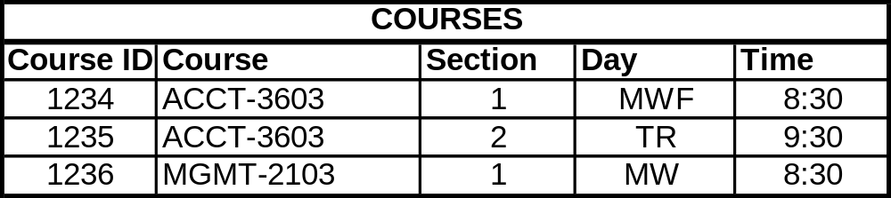
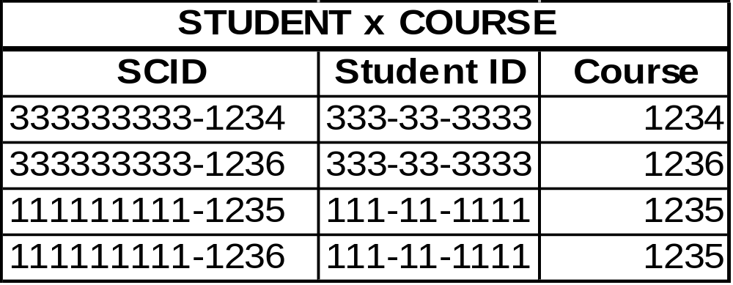
Relation

Slide 57
RELATIONAL DATABASES
This model only describes how the data appear in the conceptual- and external-level schemas.
The data are physically stored according to the description in the internal-level schema.

Slide 58
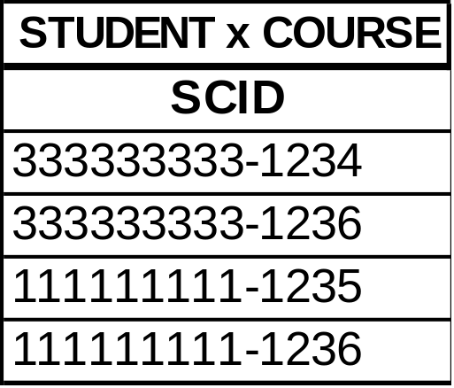
Each row is called a tuple, which rhymes with “couple.”

Slide 59
Each row contains data about a specific occurrence of the type of entity in the table.

Slide 60
Each column in a table contains information about a specific attribute of the entity.

Slide 61
A primary key is the attribute or combination of attributes that uniquely identifies a specific row in a table.

Slide 62
In some tables, two or more attributes may be joined to form the primary key.

Slide 63
STUDENTS
Student ID | Last Name | First Name | Phone No. | Advisor No.
333-33-3333 | Simpson | Alice | 333-3333 | 1418
111-11-1111 | Sanders | Ned | 444-4444 | 1418
123-45-6789 | Moore | Artie | 555-5555 | 1503
ADVISORS
Advisor No. | Last Name | First Name | Office No.
1418 | Howard | Glen | 420
1419 | Melton | Amy | 316
1503 | Zhang | Xi | 202
1506 | Radowski | J.D. | 203
A foreign key is an attribute in one table that is a primary key in another table.

Slide 64
STUDENTS
Student ID | Last Name | First Name | Phone No. | Advisor No.
333-33-3333 | Simpson | Alice | 333-3333 | 1418
111-11-1111 | Sanders | Ned | 444-4444 | 1418
123-45-6789 | Moore | Artie | 555-5555 | 1503
ADVISORS
Advisor No. | Last Name | First Name | Office No.
1418 | Howard | Glen | 420
1419 | Melton | Amy | 316
1503 | Zhang | Xi | 202
1506 | Radowski | J.D. | 203
Foreign keys are used to link tables together.

Slide 65
STUDENTS
Student ID | Last Name | First Name | Phone No. | Advisor No.
333-33-3333 | Simpson | Alice | 333-3333 | 1418
111-11-1111 | Sanders | Ned | 444-4444 | 1418
123-45-6789 | Moore | Artie | 555-5555 | 1503
ADVISORS
Advisor No. | Last Name | First Name | Office No.
1418 | Howard | Glen | 420
1419 | Melton | Amy | 316
1503 | Zhang | Xi | 202
1506 | Radowski | J.D. | 203
Other non-key attributes in each table store important information about the entity.

Slide 66
RELATIONAL DATABASES
Alternatives for Storing Data
  One possible alternate approach would be to store all data in one uniform table.
  For example, instead of separate tables for students and classes, we could store all data in one table and have a separate line for each student x class combination.

Slide 67
Student ID | Last Name | First Name | Phone No. | Course No. | Section | Day | Time
333-33-3333 | Simpson | Alice | 333-3333 | ACCT-3603 | 1 | M | 9:00 AM
333-33-3333 | Simpson | Alice | 333-3333 | FIN-3213 | 3 | Th | 11:00 AM
333-33-3333 | Simpson | Alice | 333-3333 | MGMT-3021 | 11 | TH | 12:00 PM
111-11-1111 | Sanders | Ned | 444-4444 | ACCT-3433 | 2 | T | 10:00 AM
111-11-1111 | Sanders | Ned | 444-4444 | MGMT-3021 | 5 | W | 8:00 AM
111-11-1111 | Sanders | Ned | 444-4444 | ANSI-1422 | 7 | F | 9:00 AM
123-45-6789 | Moore | Artie | 555-5555 | ACCT-3433 | 2 | T | 10:00 AM
123-45-6789 | Moore | Artie | 555-5555 | FIN-3213 | 3 | Th | 11:00 AM
Using the suggested approach, a student taking three classes would need three rows in the table.
In the above, simplified example, a number of problems arise.

Slide 68
Student ID | Last Name | First Name | Phone No. | Course No. | Sect. | Day | Time
333-33-3333 | Simpson | Alice | 333-3333 | ACCT-3603 | 1 | M | 9:00 AM
333-33-3333 | Simpson | Alice | 333-3333 | FIN-3213 | 3 | Th | 11:00 AM
333-33-3333 | Simpson | Alice | 333-3333 | MGMT-3021 | 11 | TH | 12:00 PM
111-11-1111 | Sanders | Ned | 444-4444 | ACCT-3433 | 2 | T | 10:00 AM
111-11-1111 | Sanders | Ned | 444-4444 | MGMT-3021 | 5 | W | 8:00 AM
111-11-1111 | Sanders | Ned | 444-4444 | ANSI-1422 | 7 | F | 9:00 AM
123-45-6789 | Moore | Artie | 555-5555 | ACCT-3433 | 2 | T | 10:00 AM
123-45-6789 | Moore | Artie | 555-5555 | FIN-3213 | 3 | Th | 11:00 AM
Suppose Alice Simpson changes her phone number. You need to make the change in three places. If you fail to change it in all three places or change it incorrectly in one place, then the records for Alice will be inconsistent.
This problem is referred to as an update anomaly.

Slide 69
Student ID | Last Name | First Name | Phone No. | Course No. | Sect. | Day | Time
333-33-3333 | Simpson | Alice | 333-3333 | ACCT-3603 | 1 | M | 9:00 AM
333-33-3333 | Simpson | Alice | 333-3333 | FIN-3213 | 3 | Th | 11:00 AM
333-33-3333 | Simpson | Alice | 333-3333 | MGMT-3021 | 11 | TH | 12:00 PM
111-11-1111 | Sanders | Ned | 444-4444 | ACCT-3433 | 2 | T | 10:00 AM
111-11-1111 | Sanders | Ned | 444-4444 | MGMT-3021 | 5 | W | 8:00 AM
111-11-1111 | Sanders | Ned | 444-4444 | ANSI-1422 | 7 | F | 9:00 AM
123-45-6789 | Moore | Artie | 555-5555 | ACCT-3433 | 2 | T | 10:00 AM
123-45-6789 | Moore | Artie | 555-5555 | FIN-3213 | 3 | Th | 11:00 AM
What happens if you have a new student to add, but he hasn’t signed up for any courses yet?
Or what if there is a new class to add, but there are no students enrolled in it yet? In either case, the record will be partially blank.
This problem is referred to as an insert anomaly.

Slide 70
Student ID | Last Name | First Name | Phone No. | Course No. | Sect. | Day | Time
333-33-3333 | Simpson | Alice | 333-3333 | ACCT-3603 | 1 | M | 9:00 AM
333-33-3333 | Simpson | Alice | 333-3333 | FIN-3213 | 3 | Th | 11:00 AM
333-33-3333 | Simpson | Alice | 333-3333 | MGMT-3021 | 11 | TH | 12:00 PM
111-11-1111 | Sanders | Ned | 444-4444 | ACCT-3433 | 2 | T | 10:00 AM
111-11-1111 | Sanders | Ned | 444-4444 | MGMT-3021 | 5 | W | 8:00 AM
111-11-1111 | Sanders | Ned | 444-4444 | ANSI-1422 | 7 | F | 9:00 AM
123-45-6789 | Moore | Artie | 555-5555 | ACCT-3433 | 2 | T | 10:00 AM
123-45-6789 | Moore | Artie | 555-5555 | FIN-3213 | 3 | Th | 11:00 AM
If Ned withdraws from all his classes and you eliminate all three of his rows from the table, then you will no longer have a record of Ned. If Ned is planning to take classes next semester, then you probably didn’t really want to delete all records of him.
This problem is referred to as a delete anomaly.

Slide 71
RELATIONAL DATABASES
Alternatives for Storing Data
  Another possible approach would be to store each student in one row of the table and create multiple columns to accommodate each class that he is taking.

Slide 72
Student ID0 | Last Name | First Name | Phone No. | Class 1 | Class 2 | Class 3 | Class 4
333-33-3333 | Simpson | Alice | 333-3333 | ACCT-3603 | FIN-3213 | MGMT-3021
111-11-1111 | Sanders | Ned | 444-4444 | ACCT-3433 | MGMT-3021 | ANSI-1422
123-45-6789 | Moore | Artie | 555-5555 | ACCT-3433 | FIN-3213
This approach is also fraught with problems:
  How many classes should you allow for in building the table?
  The above table is quite simplified. In reality, you might need to allow for 20 or more classes (assuming a student could take many 1-hour classes). Also, more information than just the course number would be stored for each class. There would be a great deal of wasted space for all the students taking fewer than the maximum possible number of classes.
  Also, if you wanted a list of every student taking MGMT-3021, notice that you would have to search multiple attributes.

Slide 73
The solution to the preceding problems is to use a set of tables in a relational database.
Each entity is stored in a separate table, and separate tables or foreign keys can be used to link the entities together.

Slide 74
RELATIONAL DATABASES
Basic Requirements of a Relational Database
  Every column in a row must be single valued.
    In other words, every cell can have one and only one value.
    In the student table, you couldn’t have an attribute named “Phone Number” if a student could have multiple phone numbers.
    There might be an attribute named “local phone number” and an attribute named “permanent phone number.”
    You could not have an attribute named “Class” in the student table, because a student could take multiple classes.

Slide 75
RELATIONAL DATABASES
Basic Requirements of a Relational Database
  The primary key cannot be null.
    The primary key uniquely identifies a specific row in the table, so it cannot be null, and it must be unique for every record.
    This rule is referred to as the entity integrity rule.

Slide 76
Note that within each table, there are no duplicate primary keys and no null primary keys.
Consistent with the entity integrity rule.

Slide 77
RELATIONAL DATABASES
Basic Requirements of a Relational Database
  A foreign key must either be null or correspond to the value of a primary key in another table.
    This rule is referred to as the referential integrity rule.
    The rule is necessary because foreign keys are used to link rows in one table to rows in another table.

Slide 78
STUDENTS
Student ID | Last Name | First Name | Phone No. | Advisor No.
333-33-3333 | Simpson | Alice | 333-3333 | 1418
111-11-1111 | Sanders | Ned | 444-4444 | 1418
123-45-6789 | Moore | Artie | 555-5555 | 1503
ADVISORS
Advisor No. | Last Name | First Name | Office No.
1418 | Howard | Glen | 420
1419 | Melton | Amy | 316
1503 | Zhang | Xi | 202
1506 | Radowski | J.D. | 203
Advisor No. is a foreign key in the STUDENTS table. Every incident of Advisor No. in the STUDENTS table either matches an instance of the primary key in the ADVISORS table or is null.

Slide 79
RELATIONAL DATABASES
Basic Requirements of a Relational Database
  All non-key attributes in a table should describe a characteristic of the object identified by the primary key.
    Could nationality be a non-key attribute in the student table?
    Could advisor’s nationality be a non-key attribute in the student table?

Slide 80
RELATIONAL DATABASES
The preceding four constraints produce a well-structured (normalized) database in which:
  Data are consistent.
  Redundancy is minimized and controlled.
In a normalized database, attributes appear multiple times only when they function as foreign keys.
The referential integrity rule ensures there will be no update anomaly problem with foreign keys.

Slide 81
RELATIONAL DATABASES
An important feature is that data about various things of interest (entities) are stored in separate tables.
  Makes it easier to add new data to the system.
    You add a new student by adding a row to the student table.
    You add a new course by adding a row to the course table.
    Means you can add a student even if he hasn’t signed up for any courses.
    And you can add a class even if no students are yet enrolled in it.
  Makes it easy to avoid the insert anomaly.
Space is also used more efficiently than in the other schemes. There should be no blank rows or attributes.

Slide 82
Add a student here.
Leaves no blank spaces.
Add a course here.
Leaves no blank spaces.
When a particular student enrolls for a particular course, add that info here.

Slide 83
RELATIONAL DATABASES
Deletion of a class for a student would cause the elimination of one record in the student x class table.
  The student still exists in the student table.
  The class still exists in the class table.
  Avoids the delete anomaly.

Slide 84
Ned still exists in the student table.
Even if Ned was the only student in the class, ACCT-3603 still exists in the course table.
If Ned Sanders drops ACCT-3603, remove Ned’s class from this table.

Slide 85
RELATIONAL DATABASES
There are two basic ways to design well-structured relational databases.
  Normalization
  Semantic data modeling

Slide 86
RELATIONAL DATABASES
There are two basic ways to design well-structured relational databases.
  Normalization
  Semantic data modeling

Slide 87
RELATIONAL DATABASES
Normalization
  Starts with the assumption that everything is initially stored in one large table.
  A set of rules is followed to decompose that initial table into a set of normalized tables.
  Objective is to produce a set of tables in third-normal form (3NF) because such tables are free of update, insert, and delete anomalies.
  Approach is beyond the scope of this book but can be found in any database textbook.

Slide 88
RELATIONAL DATABASES
There are two basic ways to design well-structured relational databases.
  Normalization
  Semantic data modeling

Slide 89
RELATIONAL DATABASES
Semantic data modeling (covered in detail in Chapter 15)
  Database designer uses knowledge about how business processes typically work and the information needs associated with transaction processing to draw a graphical picture of what should be included in the database.
  The resulting graphic is used to create a set of relational tables that are in 3NF.

Slide 90
RELATIONAL DATABASES
Advantages over simply following normalization rules:
  Semantic data modeling uses the designer’s knowledge about business processes and practices; it therefore facilitates efficient design of transaction processing databases.
  The resulting graphical model explicitly represents information about the organization’s business processes and policies and facilitates communication with intended users.

Slide 91
RELATIONAL DATABASES
Creating Relational Database Queries
  Databases store data for people and organizations.
  To retrieve the data, you query the database and its tables.
  Chapter 4 of your textbooks provides some samples of database queries in Microsoft Access.
  Try these on your own and/or with your instructor in class.

Slide 92
DATABASE SYSTEMS AND THE FUTURE OF ACCOUNTING
Database systems may profoundly affect the fundamental nature of accounting:
  May lead to abandonment of double-entry accounting, because the redundancy of the double entry is not necessary in computer data processing.
  May also alter the nature of external reporting.
    EXAMPLE: External users could have access to the company’s database and manipulate the data to meet their own reporting needs.

Slide 93
DATABASE SYSTEMS AND THE FUTURE OF ACCOUNTING
The use of accounting information in decision making will be enhanced by:
  Powerful querying capabilities that accompany database packages.
  The ability to accommodate multiple views of the same underlying phenomenon.
  The ability to integrate financial and operational data.

Slide 94
DATABASE SYSTEMS AND THE FUTURE OF ACCOUNTING
Accountants must become knowledgeable about databases so they can participate in developing the AIS of the future.
They must help ensure that adequate controls are included to safeguard the data and assure its reliability.

Slide 95
SUMMARY
You’ve learned how databases differ from file-based legacy systems.
You’ve learned why databases are important and what advantages they offer.
You’ve learned how the logical and physical views of a database differ.
You’ve learned about fundamental concepts of database systems such as DBMS, schemas, the data dictionary, and DBMS languages.
You’ve learned what a relational database is and how it organizes data.
You’ve learned how tables are structured to properly store data in a relational database.

