Slide 1
Accounting
Information
Systems
9th Edition
Marshall B. Romney
Paul John Steinbart

Slide 2
Introduction to e-Business
Chapter 3

Slide 3
Chapter 3: Learning Objectives
Explain what e-business is and how it affects organizations.
Discuss methods for increasing the likelihood of success and for minimizing the potential risks associated with e-business.
Describe the networking and communications technologies that enable e-business.

Slide 4
Learning Objective 1
Explain what e-business is and how it affects organizations.

Slide 5
Introduction: E-Business
E-business refers to all uses of advances in information technology (IT), particularly networking and communications technology, to improve the ways in which an organization performs all of its business processes.

Slide 6
Introduction: E-Business
E-business encompasses an organization’s external interactions with its:
  Suppliers
  Customers
  Investors
  Creditors
  The government
  Media

Slide 7
Introduction: E-Business
E-business includes the use of IT to redesign its internal processes.
For organizations in many industries, engaging in e-business is a necessity.
Engaging in e-business in and of itself does not provide a competitive advantage.
However, e-business can be used to more effectively implement its basic strategy and enhance the effectiveness and efficiency of its value-chain activities.

Slide 8
E-Business Models
Business to Consumers (B2C): Interactions between individuals and organizations.
Business to Business (B2B): Interorganizational e-business.

Slide 9
Categories of E-Business
Type of E-Business | Characteristics
B2C | Organization-individual Smaller dollar value One-time or infrequent transactions Relatively simple
B2B B2G B2E | Interorganizational Larger dollar value Established, on-going relationships Extension of credit by seller to customer More complex

Slide 10
E-Business Effects on Business Processes
Electronic Data Interchange (EDI): Standard protocol, available since the 1970s, for electronically transferring information between organizations and across business processes.
EDI:
  Improves accuracy
  Cuts costs

Slide 11
Recent EDI Facilitators
Traditional EDI was expensive. New developments that have removed this cost barrier are:
The Internet: Eliminates the need for special proprietary third-party networks.
XML: Extensible Markup Language – Set of standards for defining the content of data on Web pages.

Slide 12
Recent EDI Facilitators
ebXML:
  Defines standards for coding common business documents.
  Eliminates need for complex software to translate documents created by different companies.

Slide 13
Integrated Electronic Data Interchange (EDI)
Reaping the full benefits of EDI requires that it be fully integrated with the company’s AIS.
EDI
Company
Suppliers
Purchase orders
AIS
EDI
Customers
Customer orders

Slide 14
E-Business Effects on Value Chain Activities
Value Chain – Primary Activities | E-Business Opportunity
Inbound logistics | Acquisition of digitizable products Reduced inventory “buffers”
Operations | Faster, more accurate production
Outbound logistics | Distribution of digitizable products Continuous status tracking
Sales and Marketing | Improved customer support Reduced advertising costs More effective advertising
Post-sale Support and Service | Reduced costs 24/7 Service availability

Slide 15
E-Business Effects on Value Chain Activities
Value Chain – Support Activities | E-Business Opportunity
Purchasing Human Resources Infrastructure | Source identification and reverse auctions Employee self-service EFT, FEDI, other electronic payments

Slide 16
Purchasing and Inbound Logistics
The Internet improves the purchasing activity by making it easier for a business to identify potential suppliers and to compare prices.
  Purchase data from different organizational subunits can be centralized.
    This information can be used to negotiate better prices.
    Number of suppliers can be reduced.
    Reverse auctions can be held
  For products that can be entirely digitized, the entire inbound logistics function can be performed electronically.

Slide 17
Internal Operations, Human Resources, and Infrastructure
Advanced communications technology can significantly improve:
  The efficiency of internal operations.
  Planning.
  The efficiency and effectiveness of the human resource support activity.
  The efficiency and effectiveness of customer payments.

Slide 18
Information Flows in Electronic Commerce
1. Inquiries
Buyer
Seller
2. Responses
3. Orders
4. Acknowledgment
5. Billing
6. Remittance data
Explanations:
EDI = Steps 1-6
EFT = Step 7
FEDI = Steps 1-7
7. Payments

Slide 19
Financial Electronic Data Interchange (FEDI)
The use of EDI to exchange information is only part of the buyer-seller relationship in business-to-business electronic commerce.
Electronic funds transfer (EFT) refers to making cash payments electronically, rather than by check.
EFT is usually accomplished through the banking system’s Automated Clearing House (ACH) network.

Slide 20
Financial Electronic Data Interchange (FEDI)
An ACH credit is an instruction to your bank to transfer funds from your account to another account.
An ACH debit is an instruction to your bank to transfer funds from another account into yours.

Slide 21
Financial Electronic Data Interchange (FEDI)
Company A
Company B
Remittance data and payment instruction
Company A’s
bank
Company B’s
bank
Remittance data and funds

Slide 22
ASPs
An Application Service Provider (ASP) is a company that provides access to and use of application programs via the Internet.
The ASP owns and hosts the software; the contracting organization accesses the software via the Internet.

Slide 23
Factors to Consider When Evaluating ASPs
Advantages
Lower costs
Automatic upgrading to current version of software
Need fewer in-house IT staff
Reduced hardware needs
Flexibility
Knowledge support
Security and privacy of data
Disadvantages
Viability of ASP
Security and privacy of data
Availability and reliability of service
Inadequate support or poor responsiveness to problems
Standard software that may not meet all customized needs

Slide 24
Factors to Include in Service Level Agreements
Detailed specification of expected ASP performance
  Uptime
  Frequency of backups
  Use of encryption
  Data access controls
Remedies for failure of ASP to meet contracted service levels
Ownership of data stored at ASP

Slide 25
Outbound Logistics
E-Business can improve the efficiency and effectiveness of sellers’ outbound logistical activities.
  Timely and accurate access to detailed shipment information.
  Inventory optimization.
  For goods and services that can be digitized, the outbound logistics function can be performed entirely electronically.

Slide 26
Sales and Marketing
Companies can create electronic catalogs to automate sales order entry.
Significantly reduce staffing needs.
Customization of advertisements

Slide 27
Post-Sale Support and Service
Consistent information to customers.
Provide answers to frequently asked questions (FAQs).

Slide 28
Learning Objective 2
Discuss methods for increasing the likelihood of success and for minimizing the potential risks associated with E-Business.

Slide 29
E-Business Success Factors
The degree to which e-business activities fit and support the organization’s overall business strategy.
The ability to guarantee that e-business processes satisfy the three key characteristics of any business transaction
  Validity
  Integrity
  Privacy

Slide 30
Encryption
There are two principal types of encryption systems:
  Single-key systems: Same key is used to encrypt and decrypt the message
    Simple, fast, and efficient
    Example: the Data Encryption Standard (DES) algorithm
  Public Key Infrastructure (PKI): Uses two keys:
    Public key is publicly available and usually used to encode message
    Private key is kept secret and known only by the owner of that pair of keys. Usually used to decode message

Slide 31
Advantages & Disadvantages of PKI
Advantages
No sharing of key necessary
More secure than single-key systems
Disadvantages
Much slower than single-key systems

Slide 32
Digital Signatures and Digests
Digital signature: An electronic message that uniquely identifies the sender of that message.
Digest: The message that is used to create a digital signature or digital summary.
  If any individual character in the original document changes, the value of the digest also changes. This ensures that the contents of a business document have not been altered or garbled during transmission

Slide 33
Digital Certificates & Certificate Authorities
Digital Certificate: Used to verify the identity of the public key’s owner.
  A digital certificate identifies the owner of a particular private key and the corresponding public key, and the time period during which the certificate is valid.
Digital certificates are issued by a reliable third party, called a Certificate Authority, such as:
  Verisign
  Entrust
  Digital Signature Trust
The certificate authority’s digital signature is also included on the digital certificate so that the validity of the certificate can also be verified.

Slide 34
Learning Objective 3
Describe the networking and communications technologies that enable e-business.

Slide 35
Types of Networks
The global networks used by many companies to conduct electronic commerce and to manage internal operations consist of two components:
Private portion owned or leased by the company
The Internet

Slide 36
Types of Networks
The private portion can be further divided into two subsets:
Local area network (LAN) — a system of computers and other devices, such as printers, that are located in close proximity to each other.
Wide area network (WAN) — covers a wide geographic area.

Slide 37
Types of Networks
Companies typically own all the equipment that makes up their local area network (LAN).
They usually do not own the long-distance data communications connections of their wide area network (WAN).
They either contract to use a value-added network (VAN) or use the Internet.

Slide 38
Types of Networks
The Internet is an international network of computers (and smaller networks) all linked together.
What is the Internet’s backbone?
  the connections that link those computers together
Portions of the backbone are owned by the major Internet service providers (ISPs).

Slide 39
Types of Networks
What is an Intranet?
The term Intranet refers to internal networks that connect to the main Internet.
They can be navigated with the same browser software, but are closed off from the general public.
What are Extranets?

Slide 40
Types of Networks
Extranets link the intranets of two or more companies.
Either the Internet or a VAN can be used to connect the companies forming the extranet.
Value-added networks (VAN) are more reliable and secure than the Internet, but they are also expensive.

Slide 41
Types of Networks
Companies build a virtual private network (VPN) to improve reliability and security, while still taking advantage of the Internet.
Company A
VPN
equipment
ISP
AIS
Internet

Slide 42
Data Communications System Components
There are five basic components in any data communication network (whether it is the Internet, a LAN, a WAN, or a VAN):
The sending device
The communications interface device
The communications channel
The receiving device
Communication software

Slide 43
Data Communications System Components
The following are components of the data communications model:
interface devices
communications software
communications channel

Slide 44
Interface Devices
There are six basic communication interface devices that are used in most networks:
Network interface cards
Modems
Remote access devices
Hubs
Switches
Routers

Slide 45
Interface Devices
Company A
Internet service provider
PC-1
PC-2
PC-3
NIC
NIC
NIC
Remote access
device
Hub 1
Frame relay
switch
Other
LANs
Switch
Hub 1
Router
Router

Slide 46
Interface Devices
Home PC
Internet service provider
Modem
Remote access
device
Frame relay
switch
Home PC
Modem
Router

Slide 47
Communications Software
Communications software manages the flow of data across a network.
It performs the following functions:
access control
network management
data and file transmission
error detection and control
data security

Slide 48
Communications Channels
A communications channel is the medium that connects the sender and the receiver.
standard telephone lines
coaxial cables
fiber optics
microwave systems
communications satellites
cellular radios and telephones

Slide 49

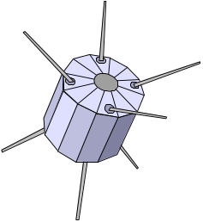
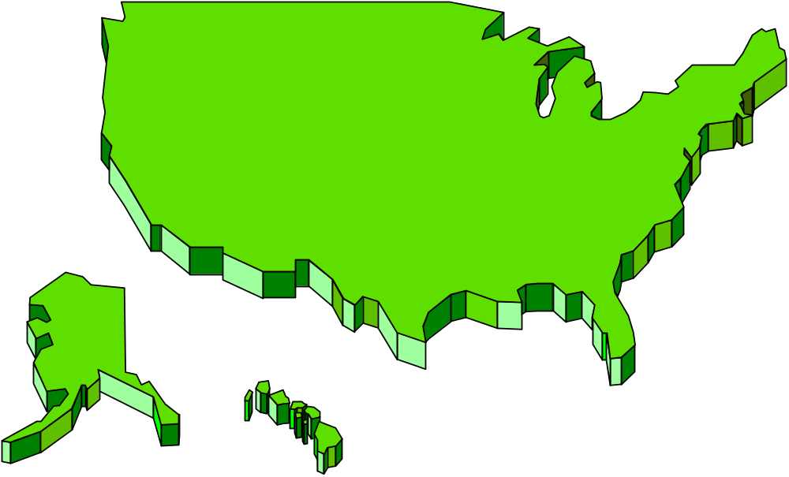


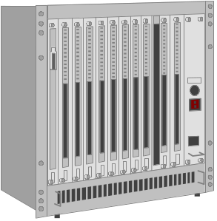
Communications Channels
Satellite
Microwave stations

Slide 50
Network Configuration Options
Local area networks (LANs) can be configured in one of three basic ways:
Star configuration
Ring configuration
Bus configuration

Slide 51
Network Configuration Options
A star configuration is a LAN configured as a star; each device is directly connected to the central server.
All communications between devices are controlled by and routed through the central server.
Typically, the server polls each device to see if it wants to send a message.

Slide 52
Network Configuration Options
The star configuration is the most expensive way to set up a LAN, because it requires the greatest amount of wiring.
A
B
C
Host computer
or server
H
D
G
F
E

Slide 53
Network Configuration Options
In a LAN configured as a ring, each node is directly linked to two other nodes
B
A
C
H
D
G
E
F

Slide 54
Network Configuration Options
In a LAN configured as a bus, each device is connected to the main channel, or bus.
Communication control is decentralized on bus networks.
A
B
C
D
Bus channel
Host computer
or server
E
F
G
H

Slide 55
Network Configuration Options
Wide area networks (WANs) can be configured in one of three basic ways:
Centralized system
Decentralized system
Distributed data processing

Slide 56

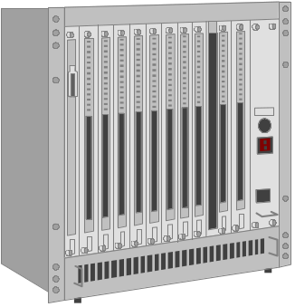
Network Configuration Options
In a centralized WAN, all terminals and other devices are connected to a central corporate computer.

Slide 57

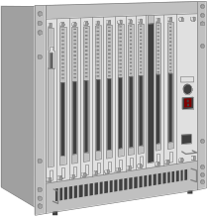
Network Configuration Options
In a decentralized WAN, each departmental unit has its own computer and LAN.
Decentralized systems usually are better able to meet individual department and user needs than are centralized systems.

Slide 58

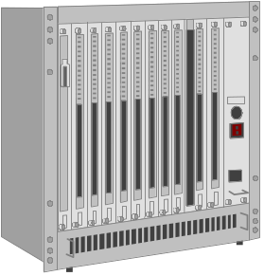

Network Configuration Options
A distributed data processing system WAN is essentially a hybrid of the centralized and decentralized approaches

Slide 59
Network Configuration Options
Many WANs, and most LANs, are set up as client/server systems.
Each desktop computer is referred to as a client.
The client sends requests for data to the servers.
The servers perform preprocessing on the database and send only the relevant subset of data to the client for local processing.

Slide 60
End of Chapter 3

