Slide 1
Accounting
Information
Systems
9th Edition
Marshall B. Romney
Paul John Steinbart

Slide 2
Data Modeling and
Database Design
Chapter 5

Slide 3
Learning Objectives
Discuss the steps for designing and implementing a database system.
Use the REA data model to design an AIS database.
Draw an Entity-Relationship (E-R) diagram of an AIS database.
Build a set of tables to implement an REA model of an AIS in a relational database.
Read an E-R diagram and explain what it reveals about the business activities and policies of the organization being modeled.

Slide 4
Introduction
Ashton Fleming, the accountant for S&S, is learning that designing a relational database for S&S is not as easy as the computer store salesperson made it seem.
He is planning to attend a seminar to teach accountants the basics on how to design a relational database.

Slide 5
Introduction
Ashton hopes to have answers for the following questions by the end of the seminar:
  What are the basic steps to follow when designing a database?
  When creating a relational database, how exactly do you decide which attributes belong in which tables?

Slide 6
Introduction
  How can you document an AIS that is implemented as a relational database?
This chapter explains how to design and document a relational database for an accounting information system.
It focuses on one of the aspects of database design, data modeling.

Slide 7
Introduction
This chapter also introduces the REA accounting model and Entity-Relationship (E-R) diagrams.
It shows how to use these tools to build a data model of an AIS.
Finally, it describes how to implement the resulting data model in a relational database.

Slide 8
Learning Objective 1
Discuss the steps for designing and implementing a database system.

Slide 9
Designing and Implementing a Database System
Six basic steps in designing and implementing a database system:
  Initial planning to determine the need for and feasibility of developing a new system (planning stage).
  Identifying user needs (requirements analysis stage).
  Developing the contextual-, external-and internal- level schemas (design stage).

Slide 10
Designing and Implementing a Database System
  Translating the internal-level schema into the actual database structures that will be implemented in the new system (coding stage).
  Transferring all data from the existing system to the new database (implementation stage).
  Using and maintaining the new system (operation and maintenance stage).

Slide 11
Learning Objective 2
Use the REA data model to design an AIS database.

Slide 12

The REA Data Model
Data modeling is the process of defining a database so that it faithfully represents all aspects of the organization, including its interactions with the external environment.
The REA (Resources, Data, Events) data model is a conceptual modeling tool that focuses on the business semantics underlying an organization’s value chain activities.

Slide 13
The REA Data Model
Data Modeling in the database Design Process
Planning
Operation and
maintenance
Requirements
analysis
Implementation
Data modeling occurs here
Design
Coding

Slide 14
The REA Data Model
The REA data model provides structure in two ways:
By identifying what entities should be included in the AIS database
By prescribing how to structure relationships among the entities in the AIS database

Slide 15
Types of Entities
An entity is any class of objects about which data is collected.
The REA data model classifies entities into three distinct categories:
  Resources acquired and used by an organization
  Events engaged in by the organization
  Agents participating in these events

Slide 16
Types of Entities
Resources are defined as those things that have economic value to the organization.
What are some examples?
  cash
  inventory
  equipment

Slide 17
Types of Entities
Events are the various business activities about which management wants to collect information for planning or control purposes.
What are some examples?
  sales events
  taking customer orders

Slide 18
Types of Entities
Agents are the third type of entity in the REA model.
Agents are the people and organizations that participate in events and about whom information is desired.
What are some examples?
  employees
  customers

Slide 19
Developing an REA Diagram
Developing an REA diagram for a specific transaction cycle consists of four steps:
Identify the pair of events that represent the basic give-to-get economic duality relationship in that cycle.
Identify the resources affected by each event and the agents who participate in those events.

Slide 20
Developing an REA Diagram
Four steps (continued):
  Analyze each economic exchange event to determine whether it should be decomposed into a combination of one or more commitment events and an economic exchange event. If necessary, replace the original economic exchange event with the resulting set of commitment and economic exchange events.
  Determine the cardinalities of each relationship.

Slide 21
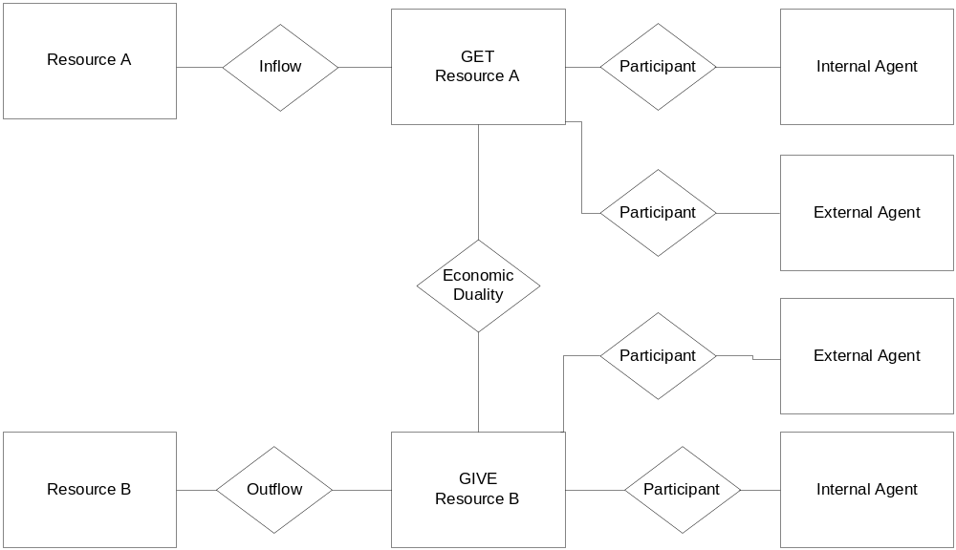
Basic REA template

Slide 22
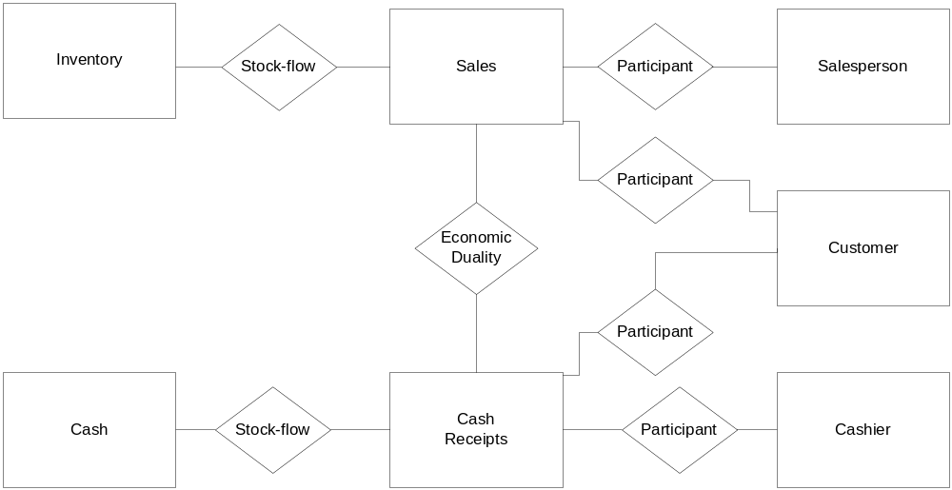
Sample REA diagram

Slide 23
REA Diagram, Step 1:
Identify Economic Exchange Events
In drawing an REA diagram for an individual cycle, it is useful to divide the paper into three columns, one for each type of entity.
  Left column should be used for resources.
  Middle column should be used for events.
  Right column should be used for agents.

Slide 24
REA Diagram, Step 1:
Identify Economic Exchange Events
The basic economic exchange in the revenue cycle involves the sale of goods or services and the subsequent receipt of cash in payment for those sales.
The REA diagram for S&S’s revenue cycle shows the drawing of sales and cash receipts events entities as rectangles and the relationship between them as a diamond.

Slide 25
REA Diagram, Step 2:
Identify Resources and Agents
Once the events of interest have been specified, the resources that are affected by those events need to be identified.
The sales event involves the disposal of inventory.
The cash receipts event involves the acquisition of cash.

Slide 26
REA Diagram, Step 2:
Identify Resources and Agents
After specifying the resources affected by each event, the next step is to identify the agents who participate in those events.
There will always be at least one internal agent (employee) and, in most cases, an external agent (customer).

Slide 27
REA Diagram, Step 3:
Include Commitment Events
The third step in drawing an REA diagram is analyzing each economic exchange event to determine whether it can be decomposed into a combination of one or more commitment exchange events.
Example: The sales event may be decomposed into the “take order” commitment event and the “deliver order” economic exchange event

Slide 28
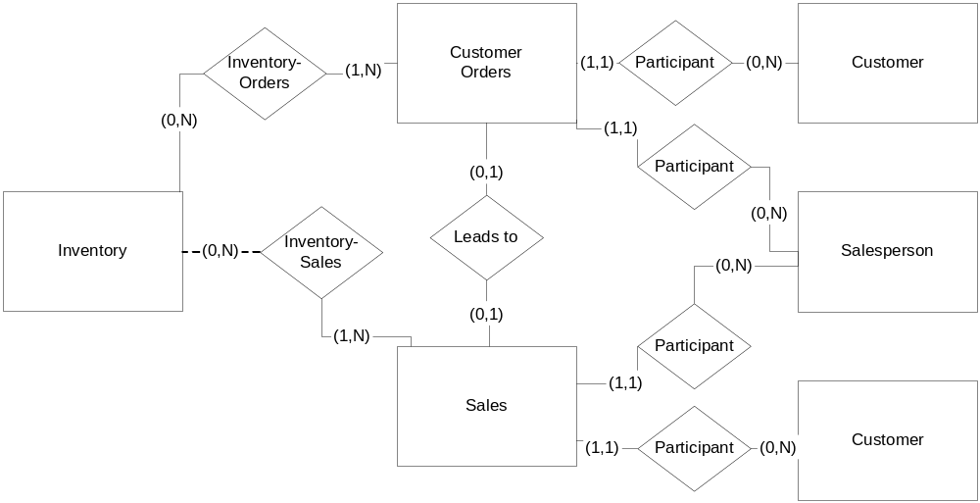
Decomposing Sales into Orders and Sales

Slide 29
REA Diagram, Step 4:
Determine Cardinalities
Cardinalities indicate how many instances of one entity can be linked to one specific instance of another entity.
Cardinalities are often expressed as a pair of numbers.
The first number is the minimum, and the second number is the maximum.

Slide 30
REA Diagram, Step 4:
Determine Cardinalities
The minimum cardinality of a relationship indicates whether each row in that entity MUST be linked to a row in the entity on the other side of the relationship.
Minimum cardinalities can be either 0 or 1.
A minimum cardinality of zero means that a new row can be added to that table without being linked to any rows in the other table.
A minimum cardinality of 1 means that each row in that table MUST be linked to at least one row in the other table

Slide 31
REA Diagram, Step 4:
Determine Cardinalities
The minimum cardinality of zero in the (0, N) cardinality pair to the left of the customer entity in the customer-sales relationship indicates that a new customer may be added to the database without being linked to any sales events.
Sales
(0, N)
Made to
Customer

Slide 32
REA Diagram, Step 4:
Determine Cardinalities
The minimum cardinality of 1 in the
(1, 1) cardinality pair to the right of the sales entity in the customer-sales relationship indicates that a new sales transaction CAN ONLY be added if it is linked to a customer.
Sales
(1,1)
(0, N)
Made to
Customer

Slide 33
REA Diagram, Step 4:
Determine Cardinalities
The maximum cardinality of a relationship indicates whether each row in that entity CAN be linked to more than one row in the entity on the other side of the relationship.
Maximum cardinalities can be either 1 or N.
A minimum cardinality of 1 means that each row in that table can be linked to at most only 1 row in the other table.
A maximum cardinality of N means that each row in that table MAY be linked to more than one row in the other table.

Slide 34
REA Diagram, Step 4:
Determine Cardinalities
The maximum cardinality of N in the (0, N) cardinality pair to the left of the customer entity in the customer-sales relationship indicates that a given customer MAY be linked to many sales events.
Sales
(0, N)
Made to
Customer

Slide 35
REA Diagram, Step 4:
Determine Cardinalities
The maximum cardinality of 1 in the
(1, 1) cardinality pair to the right of the sales entity in the customer-sales relationship indicates that a given sales transaction can only be linked to one customer.
Sales
(1,1)
(0, N)
Made to
Customer

Slide 36
REA Diagram, Step 4:
Determine Cardinalities
Cardinalities are not arbitrarily chosen by the database designer.
They reflect facts about the organization being modeled and its business practices obtained during the requirements analysis stage of the database design process.

Slide 37
Relationships between Entities
Three basic types of relationships between entities are possible, depending on the maximum cardinality associated with each entity. They are:
A one-to-one relationship (1:1)
A one-to-many relationship (1:N)
A many-to-many relationship (M:N)

Slide 38
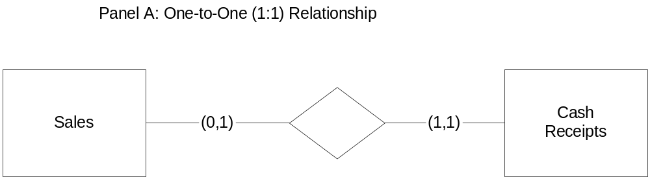
Different types of relationships

Slide 39
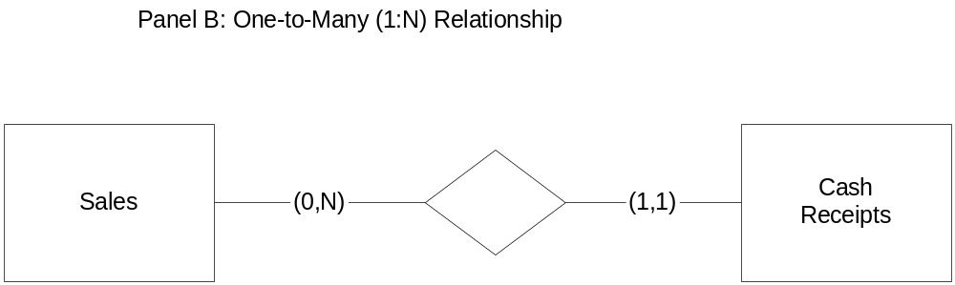
Different types of relationships

Slide 40
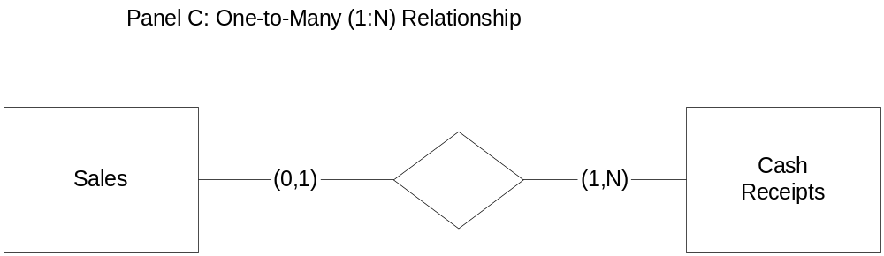
Different types of relationships

Slide 41
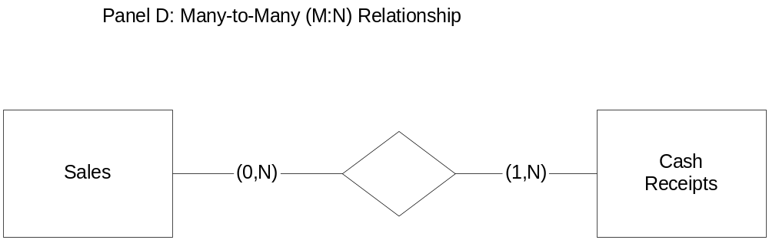
Different types of relationships

Slide 42
Learning Objective 3
Draw an Entity-Relationship (E-R) diagram of an AIS database.

Slide 43
Entity-Relationship Diagram
An Entity-Relationship (E-R) diagram is one method for portraying a database schema.
It is called an E-R diagram because it shows the various entities being modeled and the important relationships among them.
In an E-R diagram, entities appear as rectangles, and relationships between entities are represented as diamonds.

Slide 44
Sample E-R Diagrams
Managed
By
Employers
Supervisors
Part of
Manages
Departments
Customer Orders
Part of
Part of
Cash Receipts
Sales
Part of
Part of
Players
Teams
League

Slide 45
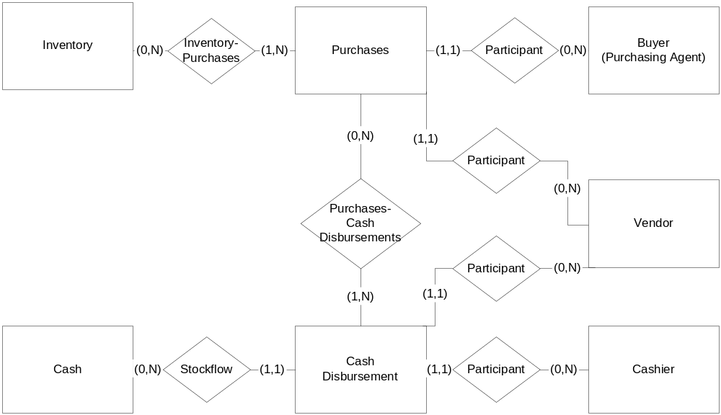
Sample E-R Diagram based on REA model

Slide 46
Learning Objective 4
Build a set of tables to implement an REA model of an AIS in a relational database.

Slide 47
Implementing an REA Diagram in a Relational Database
An REA diagram can be used to design a well-structured relational database.
A well-structured relational database is one that is not subject to update, insert, and delete anomaly problems.

Slide 48
Implementing an REA Diagram in a Relational Database
Implementing an REA diagram in a relational database is a three-step process:
  Create a table for each distinct entity and for each many-to many relationship
  Assign attributes to appropriate tables
  Use foreign keys to implement one-to-one and one-to-many relationships

Slide 49
Implementing an REA model

Slide 50
Create Tables
From the previously discussed REA diagram, nine tables would be created: one for each of the seven entities and one for each of the many-to-many relationships.
Inventory
Purchases
Employees
Vendors
Cashier
Cash disbursements
Cash
Purchases-inventory
Purchases-cash disbursements

Slide 51
Assign Attributes for Each Table
Primary keys: Usually, the primary key of a table representing an entity is a single attribute.
Other Attributes: Additional attributes are included in each table to satisfy transaction processing requirements.

Slide 52
Implement One-to-One and One-to-Many Relationships
One-to-One Relationships: In a relational database, one-to-one relationships between entities can be implemented by including the primary key of one entity as a foreign key in the table representing the other entity.
No examples of 1:1 relationships in the sample diagram

Slide 53
Implement One-to-One and One-to-Many Relationships
One-to-Many Relationships: In a relational database, one-to-many relationships can be also implemented in relation to databases by means of foreign keys.
The primary key of the entity with the maximum cardinality of N becomes a foreign key in the entity with a maximum cardinality of 1
Examples: Employee number and vendor number are foreign keys in the purchases event and in the cash disbursement event

Slide 54
Learning Objective 5
Read an E-R diagram and explain what it reveals about the business activities and policies of the organization being modeled.

Slide 55
Documentation of
Business Practices
REA diagrams are especially useful for documenting an advanced AIS built using databases.
REA diagrams provide information about the organization’s business practices

Slide 56
Documentation of
Business Practices
The zero minimum for the sales event indicates that credit sales are made
The N maximum for the sales event means that customers may make installment payments
Cash
Receipts
Sales
Sales-
Cash Receipts
(1, N)
(0, N)

Slide 57
Documentation of
Business Practices
The one minimum for the cash receipts event indicates that cash is not received prior to delivering the merchandise
The N maximum for the cash receipts event means that customers may pay for several sales with one check
Cash
Receipts
Sales
Sales-
Cash Receipts
(1, N)
(0, N)

Slide 58
Organization Specificity of REA Diagrams
Due to the fact that S&S sells mass-produced goods, its REA diagram models the relationship between sales and inventory as being many-to-many.
An REA diagram for a rare art dealer would depict the relationship between sales and inventory as being one-to-many.

Slide 59
Extracting Information
From the AIS
A complete REA diagram serves as a useful guide for querying an AIS database.
Queries can be used to generate journals and ledgers from a relational database built on the REA model.

Slide 60
Extracting Information
From the AIS
Sales
(0, 1)
(1, N)
Cash
collections
Each sales transaction is paid in full by a cash collection event.
Each customer payment may be for more than one sale.
What is the query logic?
Total accounts receivable is the sum of all sales for which there is no remittance number.

Slide 61
Extracting Information
From the AIS
Sales
(0, N)
(1, 1)
Cash
collections
Each sales transaction can be paid in installments.
Each customer payment is for just one sale.
What is the query logic?
(1) sum all sales; (2) sum cash collections; then A/R = (1)-(2)

Slide 62
Extracting Information
From the AIS
Sales
(0, 1)
(1, 1)
Cash
collections
Each sales transaction is paid in full by a cash collection event.
Each customer payment is for one sale.
What is the query logic?
Total accounts receivable is the sum of all sales for which there is no remittance number.

Slide 63
Extracting Information
From the AIS
Sales
(0, N)
(1, N)
Cash
collections
Each sales transaction may be paid for in installments.
Each customer payment may be for more than one sale.
What is the query logic?
(1) Sum all sales; (2) Sum all cash collections; Then A/R = (1)-(2)

Slide 64
End of Chapter 5

