Slide 1
Accounting
Information
Systems
9th Edition
Marshall B. Romney
Paul John Steinbart

Slide 2
Systems Development and Documentation Techniques
Chapter 6

Slide 3
Learning Objectives
Prepare and use data flow diagrams to understand, evaluate, and design information systems.
Draw flowcharts to understand, evaluate, and design information systems.

Slide 4
Introduction
S&S opened a year ago.
Ashton Fleming has been very busy.
Kimberly Serra from Computer Applications explained to Ashton that her company developed systems ranging from simple general ledger operations to highly integrated software.

Slide 5
Introduction
Ashton’s first priority is to understand S&S’s information needs more clearly.
Ashton was given the following assignments:
What types of tools and techniques should S&S use to document its existing system so it is easy to understand and evaluate?
What development tools and techniques should S&S use to design its new computer-based information system?

Slide 6
Introduction
This chapter explains the most common systems documentation tools and techniques.
They include data flow diagrams and flowcharts.
These tools save both time and money, adding value to an organization.

Slide 7
Introduction
The chapter discusses the following five documentation tools:
  Data flow diagrams
  Document flowcharts
  Computer system flowcharts
  Program flowcharts

Slide 8
Learning Objective 1
Prepare and use data flow diagrams to understand, evaluate, and design information systems.

Slide 9
Data Flow Diagrams
A data flow diagram (DFD) graphically describes the flow of data within an organization.
It is used to document existing systems and to plan and design new ones.
There is no ideal way to develop a DFD.

Slide 10
Data Flow Diagrams
A data flow diagram (DFD) is composed of the following four basic elements:
  Data sources and destinations
  Data flows
  Transformation processes
  Data stores

Slide 11
Guidelines for
Drawing a DFD
Understand the system.
Ignore certain aspects of the system.
Determine system boundaries.
Develop a context diagram.
Identify data flows.
Group data flows.
Identify transformation processes.
Group transformation processes.

Slide 12
Guidelines for
Drawing a DFD, continued
Identify all files or data stores.
Identify all data sources and destinations.
Name all DFD elements.
Subdivide the DFD.
Give each process a sequential number.
Repeat the process.
Prepare a final copy.

Slide 13
Data Flow Diagram Symbols
Data Source and destinations
Data Flows
Transformation Processes
Data Stores

Slide 14
Data Flow Diagram Symbols
A data source or data destination symbol on the DFD represents an organization or individual that sends or receives data that they system uses or produces.
A data flow represents the flow of data between processes, data stores and data sources and destinations.
A transformation process represents the transformations of data.
A data store is a temporary or permanent repository of data.
A data dictionary contains description of all the elements, stores, and flows in a system.

Slide 15
Data Flow Diagrams
Data
source
(A)
Process
(C)
Data flow (B)
Data flow (D)
Data flow (E)
Data
destination
(J)

Slide 16
Data Flow Diagrams
Data store (H)
Data flow (G)
Process
(F)
Data
destination
(K)
Data flow (D)
Data flow (I)

Slide 17
Data Flow Diagrams
Customer payment (B)
Remittance data (D)
Customer
(A)
Process
payment
(C)
Deposit (E)
Bank
(J)

Slide 18
Data Flow Diagrams
Accounts receivable (H)
(G)
Remittance data (D)
Receivables information (I)
Update
receivables
(F)
Credit
manager
(K)

Slide 19
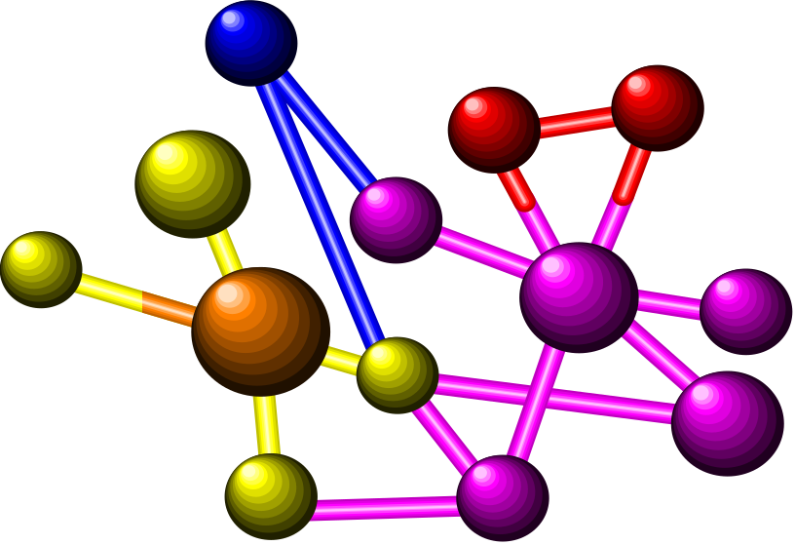
Data Flow Diagrams
Data flow diagrams are subdivided into successively lower levels in order to provide increasing amounts of detail.

Slide 20
Data Flow Diagrams
The highest-level DFD is referred to as a context diagram.
What is the context diagram for S&S payroll processing?

Slide 21
Data Flow Diagrams
Time cards
Departments
Payroll
processing
system
Human
resources
Employee data

Slide 22
Data Flow Diagrams
Tax reports and payments
Government
agencies
Payroll
processing
system
Employees
Employee paychecks
Payroll check
Bank
Management
Payroll report

Slide 23
Data Flow Diagrams
The context diagram for S&S payroll processing shows that the payroll processing system...
  receives time cards from different departments.
  receives employee data from the human resources department.

Slide 24
Data Flow Diagrams
When these data are processed, the system produces...
  tax reports and payments for governmental agencies.
  employee paychecks.
  a check to deposit in the payroll account at the bank.
  management payroll reports.

Slide 25
Learning Objective 2
Draw flowcharts to understand, evaluate, and design information systems.

Slide 26
Flowcharts
A flowchart is an analytical technique used to describe some aspect of an information system in a clear, concise, and logical manner.
Flowcharts use a standard set of symbols to pictorially describe transaction processing procedures.

Slide 27
Flowchart Symbols
Flowcharting symbols can be divided into the following four categories:
  Input/output symbols
  Processing symbols
  Storage symbols
  Flow and miscellaneous symbols

Slide 28
Flowcharting Symbols:
Some Input Output Symbols
Symbol
Name
Document
Online keying
Display
Input/output; Journal/ledger

Slide 29
Flowchart Symbols:
Some Processing Symbols
Symbol
Name
Manual operations
Computer processing
Auxiliary operation

Slide 30

Flowchart Symbols:
Some Storage Symbols
Symbol
Name
Magnetic disk
Magnetic tape

Slide 31
Flowchart Symbols: Some Flow and Miscellaneous Symbols
Symbol
Name
Document or processing flow
On-page connector
Off-page connector
Terminal
Decision

Slide 32
What are Document Flowcharts?
A document flowchart illustrates the flow of documents and information between areas of responsibility within an organization.
A document flowchart is particularly useful in analyzing the adequacy of control procedures.
Flowcharts that describe and evaluate internal controls are often referred to as internal control flowcharts.

Slide 33
What are System Flowcharts?
System flowcharts depict the relationship among the input, processing, and output of an AIS.
A system flowchart begins by identifying both the inputs that enter the system and their origins.
The input is followed by the processing portion of the flowchart.

Slide 34

What are Computer
System Flowcharts?
The resulting new information is the output component.
System flowcharts are an important tool of system analysis, design, and evaluation.

Slide 35
What are Computer
System Flowcharts?
Input
Storage
Process
Output

Slide 36
What are Program Flowcharts?
A program flowchart describes the specific logic to perform a process shown on a systems flowchart.
A flow line connects the symbols and indicates the sequence of operations.
The processing symbol represents a data movement or arithmetic calculation.

Slide 37
What are Program Flowcharts?
Input data
No
If a condition is met
Yes
Perform calculation
Update record

Slide 38
What are Program Flowcharts?
The input/output symbol represents either reading of input or writing of output.
The decision symbol represents a comparison of one or more variables and the transfer of flow to alternative logic paths.
All points where the flow begins or ends are represented by the terminal symbol.

Slide 39
Flowchart for Processing
Credit Orders
Enter
sales
order
Start
No
Reject
order
Approved
for credit?
Yes
No
Back-
order
Inventory
available?
Yes
Fill order
Stop

Slide 40
Differences Between
DFDs and Flowcharts
DFDs emphasize the flow of data and what is happening in a system, whereas a flowchart emphasizes the flow of documents or records containing data.
A DFD represents the logical flow of data, whereas a flowchart represents the physical flow of data.

Slide 41
Differences Between
DFDs and Flowcharts
Flowcharts are used primarily to document existing systems.
DFDs, in contrast, are primarily used in the design of new systems and do not concern themselves with the physical devices used to process, store, and transform data.

Slide 42

Differences Between
DFDs and Flowcharts
DFDs make use of only four symbols.
Flowcharts use many symbols and thus can show more detail.

Slide 43
End of Chapter 6

