Slide 1
Accounting
Information
Systems
9th Edition
Marshall B. Romney
Paul John Steinbart

Slide 2
The Revenue Cycle:
Sales and Cash Collections
Chapter 11

Slide 3
Learning Objectives
Describe the basic business activities and related data processing operations performed in the revenue cycle.
Discuss the key decisions that need to be made in the revenue cycle and identify the information needed to make those decisions.
Document your understanding of the revenue cycle.
Identify major threats in the revenue cycle and evaluate the adequacy of various control procedures for dealing with those threats.
Read and understand a data model (REA diagram) of the revenue cycle.

Slide 4
Introduction
Alpha Omega Electronics (AOE) is a manufacturer of consumer electronic products.
For three years, AOE lost market share.
Cash-flow problems have necessitated increased short-term borrowing.

Slide 5
Introduction
Elizabeth Venko, the controller, Trevor, and Ann were asked to investigate several issues:
  How could AOE improve customer service? What information does Marketing need to perform its tasks better?
  How could AOE identify its most profitable customers and markets?
  How can AOE improve its monitoring of credit accounts? How would any changes in credit policy affect both sales and uncollectible accounts?
  How could AOE improve its cash collection procedures?

Slide 6
Learning Objective 1
Describe the basic business activities and related data processing operations performed in the revenue cycle.

Slide 7
Revenue Cycle
Business Activities
The revenue cycle is a recurring set of business activities and related information processing operations associated with providing goods and services to customers and collecting cash in payment for those sales.

Slide 8
Revenue Cycle
Business Activities
What are the four basic revenue cycle business activities?
Sales order entry
Shipping
Billing and accounts receivable
Cash collections

Slide 9
Revenue Cycle Business Activities:
Sales Order Entry
Sales order entry process entails three steps:
  Taking the customer’s order
  Checking and approving the customer’s credit
  Checking inventory availability

Slide 10
Revenue Cycle Business Activities:
Shipping
The second basic activity in the revenue cycle – filling customer orders and shipping the desired merchandise – entails two steps:
  Picking and packing the order
  Shipping the order

Slide 11
Revenue Cycle Business Activities:
Billing and Accounts Receivable
The third basic activity in the revenue cycle involves:
  Billing customers
  Updating accounts receivable

Slide 12
Revenue Cycle Business Activities:
Cash Collections
The fourth step in the revenue cycle is cash collections. It involves:
  Handling customer remittances
  Depositing remittances in the bank

Slide 13
Learning Objective 2
Discuss the key decisions that need to be made in the revenue cycle and identify the information required to make those decisions.

Slide 14
Revenue Cycle –
Key Decisions
The revenue cycle’s primary objective is to provide the right product in the right place at he right time for the right price.
  How does a company accomplish this objective?
    To accomplish the revenue cycle’s primary objective, management must make the following key decisions:

Slide 15
Revenue Cycle –
Key Decisions
To what extent can and should products be customized to individual customers’ needs and desires?
How much inventory should be carried, and where should that inventory be located?
How should merchandise be delivered to customers? Should the company perform the shipping function itself or outsource it to a third party that specializes in logistics?

Slide 16
Revenue Cycle –
Key Decisions
Key decisions, continued
Should credit be extended to customers?
How much credit should be given to individual customers?
What credit terms should be offered?
How can customer payments be processed to maximize cash flow?

Slide 17
Learning Objective 3
Document your understanding of the revenue cycle.

Slide 18
Sales Order Entry (Activity 1)
This step includes all the activities involved in soliciting and processing customer orders.
Key decisions and information needs:
  decisions concerning credit policies, including the approval of credit
  information about inventory availability and customer credit status from the inventory control and accounting functions, respectively

Slide 19
Sales Order Entry (Activity 1)
The sales order entry function involves three main activities:
Responding to customer inquiries
Checking and approving customer credit
Checking inventory available

Slide 20
Information Needs and Procedures
The AIS should provide the operational information needed to perform the following functions:
  Respond to customer inquires about account balances and order status.
  Decide whether to extend credit to a customer.

Slide 21
Sales Order Entry (Activity 1)
Regardless of how customer orders are initially received, the following edit checks are necessary:
  Validity checks
  A Completeness test
  Reasonableness tests
  Credit approval
    General authorization
    Credit limit
    Specific authorization
      Limit checks

Slide 22
Sales Order Entry (Activity 1)
Next, the system checks whether the inventory is sufficient to fill accepted orders.
Internally generated documents produced by sales order entry:
  sales order
  packing slip
  picking ticket

Slide 23
Information Needs and Procedures
Determine inventory availability.
Decide what types of credit terms to offer.
Set prices for products and services.
Set policies regarding sales returns and warranties.
Select methods for delivering merchandise.

Slide 24
Shipping (Activity 2)
Warehouse workers are responsible for filling customer orders by removing items from inventory.
Key decisions and information needs:
  Determine the delivery method.
    in-house
    outsource

Slide 25
Shipping (Activity 2)
Documents, records, and procedures:
  The picking ticket printed by the sales order entry triggers the shipping process and is used to identify which products to remove from inventory.
  A physical count is compared with the quantities on the picking ticket and packing slip.
  Some spot checks are made and a bill of lading is prepared.

Slide 26
Billing and Accounts
Receivable (Activity 3)
Two activities are performed at this stage of the revenue cycle:
  Invoicing customers
  Maintaining customer accounts
Key decisions and information needs:
    Accurate billing is crucial and requires information identifying the items and quantities shipped, prices, and special sales terms.

Slide 27
Billing and Accounts
Receivable (Activity 3)
The sales invoice notifies customers of the amount to be paid and where to send payment.
A monthly statement summarizes transactions that occurred and informs customers of their current account balance.
A credit memo authorizes the billing department to credit a customer’s account.

Slide 28
Billing and Accounts
Receivable (Activity 3)
Types of billing systems:
  In a postbilling system, invoices are prepared after confirmation that the items were shipped.
  In a prebilling system, invoices are prepared (but not sent) as soon as the order is approved.
The inventory, accounts receivable, and general ledger files are updated at this time.

Slide 29
Billing and Accounts
Receivable (Activity 3)
Methods for maintaining accounts receivable:
  open invoice method
  balance-forward method
To obtain a more uniform flow of cash receipts, many companies use a process called cycle billing.

Slide 30
Information Needs and Procedures
What are examples of additional information the AIS should provide?
  response time to customer inquires
  time required to fill and deliver orders
  percentage of sales that require back orders
  customer satisfaction
  analysis of market share and trends
  profitability analyses by product, customer, and sales region

Slide 31
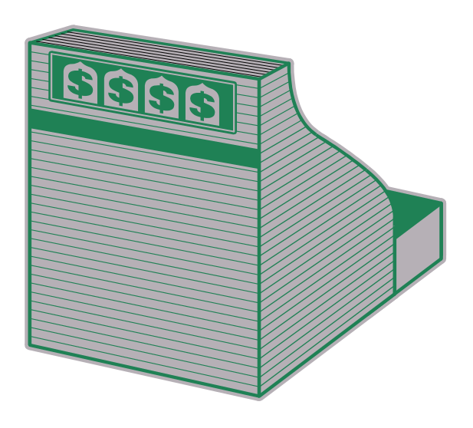
Cash Collections (Activity 4)
Two areas are involved in this activity:
  The cashier
  The accounts receivable function

Slide 32
Cash Collections (Activity 4)
Key decisions and information needs:
  Reduction of cash theft is essential.
  The billing/accounts receivable function should not have physical access to cash or checks.
  The accounts receivable function must be able to identify the source of any remittances and the applicable invoices that should be credited.

Slide 33
Cash Collections (Activity 4)
Documents, records, and procedures:
  Checks are received and deposited.
  A remittance list is prepared and entered on-line showing the customer, invoice number, and the amount of each payment.
  The system performs a number of on-line edit checks to verify the accuracy of data entry.

Slide 34
Learning Objective 4
Identify major threats in the revenue cycle and evaluate the adequacy of various control procedures for dealing with those threats.

Slide 35
Control: Objectives,
Threats, and Procedures
The second function of a well-designed AIS is to provide adequate controls to ensure that the following objectives are met:
  Transactions are properly authorized.
  Recorded transactions are valid.

Slide 36
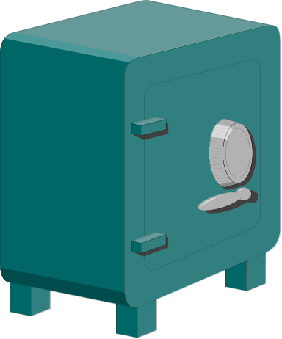
Control: Objectives,
Threats, and Procedures
Objectives, continued
  Valid, authorized transactions are recorded.
  Transactions are recorded accurately.
  Assets (cash, inventory, and data) are safeguarded from loss or theft.
  Business activities are performed efficiently and effectively.

Slide 37
Threats and Applicable Control Procedures to Sales Order Entry
Threat | Applicable Control Procedures
1. Incomplete or inaccurate customer orders | Data entry edit checks
2. Credit sales to customers with poor credit | Credit approval by credit manager, not by sales function; accurate records of customer account balances
3. Legitimacy of orders | Signatures on paper documents; digital signatures and digital certificates for e-business
4. Stockouts, carrying costs and markdowns | Inventory control systems

Slide 38
Threats and Applicable Control Procedures to Shipping
Threat | Applicable Control Procedures
1. Shipping errors: Wrong merchandise Wrong quantities Wrong address | Reconciliation of sales order with picking ticket and packing slip; bar code scanners; data entry application controls
2. Theft of inventory | Restrict physical access to inventory; Documentation of all internal transfers of inventory; periodic physical counts of inventory and reconciliation of counts of recorded amounts

Slide 39
Threats and Applicable Control Procedures to Billing and
Accounts Receivable
Threat | Applicable Control Procedures
1. Failure to bill customers | Separation of shipping and billing functions; Prenumbering of all shipping documents and periodic reconciliation to invoices; reconciliation of picking tickets and bills of lading with sales orders
2. Billing errors | Data entry edit control Price lists
3. Posting errors in updating accounts receivable | Reconciliation of subsidiary accounts receivable ledger with general ledger; monthly statements to customers

Slide 40
Threat and Applicable Control Procedures to Cash Collections
Threat | Applicable Control Procedures
1. Theft of Cash | Segregation of duties; minimization of cash handling; lockbox arrangements; prompt endorsement and deposit of all receipts Periodic reconciliation of bank statement with records by someone not involved in cash receipts processing

Slide 41
General Control Issues
Threat | Applicable Control Procedures
1. Loss of Data | Backup and disaster recovery procedures; access controls (physical and logical)
2. Poor performance | Preparation and review of performance reports

Slide 42
Learning Objective 5
Read and understand a data model (REA diagram) of the revenue cycle.

Slide 43
Revenue Cycle Data Model
The REA data model provides one method for designing a data base that efficiently integrates both financial and operating data.
A simplified REA data model for the revenue cycle of a manufacturing company should include the following information:
the two major resources (cash and inventory) used in the revenue cycle

Slide 44
Revenue Cycle Information Needs and Data Model
An AIS is designed to collect, process and store data abut business activities to present management with information to support decision making.

Slide 45
Revenue Cycle Information Needs: Operational Data
Operational Data are needed to monitor performance and to perform the following recurring tasks:
  Respond to customer inquiries about account balances and order status
  Decide whether to extend credit to a particular customer
  Determine inventory availability
  Select methods for delivering merchandise

Slide 46
Revenue Cycle Information Needs: Current and Historical Information
Current and historical information is needed to enable management of make the following strategic decisions:
  Setting prices for products and services
  Establishing policies regarding sales returns and warranties
  Deciding what types of credit terms to offer
  Determining the need for short-term borrowing
  Planning new marketing campaigns

Slide 47
Revenue Cycle Information Needs: Performance Evaluation
The AIS must also supply the information needed to evaluate performance of the following critical processes:
Respond time to customer inquiries
Time required to fill and deliver orders
Percentage of sales that required back orders
Customer satisfaction rates and trends
Profitability analyses by product, customer, and sales region
Sales volume in both dollars and number of customers
Effectiveness of advertising and promotions
Sales staff performance
Bad debt expenses and credit policies

Slide 48
Revenue Cycle Data Model
The four major business events in the revenue cycle (orders, filling the orders, shipping [sales], and cash collections)
The primary external agent (customer) as well as the various internal agents involved in revenue cycle activities

Slide 49
Revenue Cycle Data Model
Partial REA Diagram of the Revenue Cycle
Inventory order
(0, N)
(0, N)
Inventory
fill order
Inventory
(0, N)
Inventory ship

Slide 50
Revenue Cycle Data Model
Partial REA Diagram of the Revenue Cycle
Cash
(1, N)
(1, 1)
Deposits in
Collects
cash
(1, 1)
by
Cashier
(1, N)

Slide 51
Case Conclusion
What are the key points that Elizabeth Venko proposed?
  Equip the sales force with pen-based laptop computers.
  Improve billing process efficiency by increasing the number of customers who agree to participate in invoiceless sales relationships.

Slide 52
Case Conclusion, con’t
  Work with major customers to obtain access to their POS data.
  Periodically survey customers about their satisfaction with AOE’s products and performance.
  Improve the efficiency of cash collections by encouraging EDI-capable customers to move to FED.

Slide 53
End of Chapter 11

