Slide 1
Accounting
Information
Systems
9th Edition
Marshall B. Romney
Paul John Steinbart

Slide 2
Systems Design, Implementation, and Operation
Chapter 18

Slide 3
Learning Objectives
Discuss the conceptual systems design process and the activities in this phase.
Discuss the physical systems design process and the activities in this phase.
Discuss the systems implementation and conversion process and the activities in this phase.

Slide 4
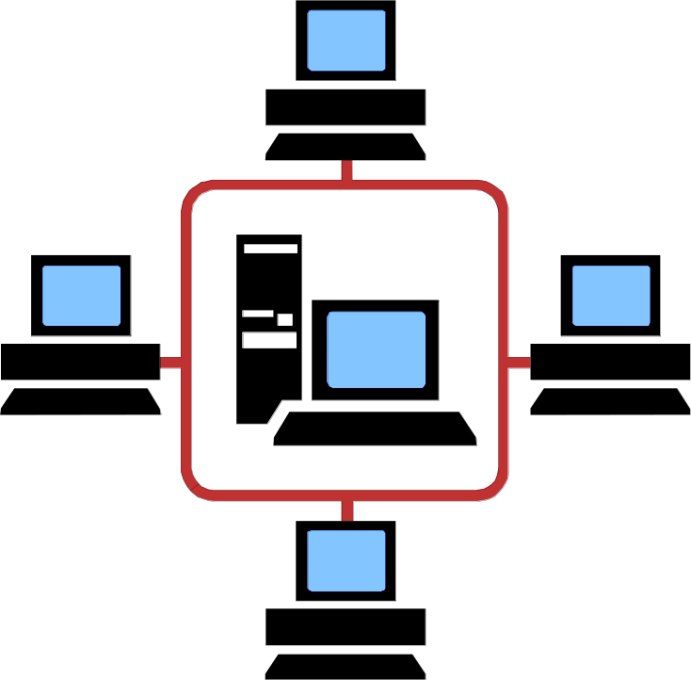
Learning Objectives
Discuss the systems operation and maintenance process and the activities in this phase.

Slide 5
Introduction
Ann Christy, the controller at shoppers mart, scheduled a meeting with the head of systems development to discuss the following questions:
  What type of system will best meet shoppers mart’s needs?
  Should her team develop what they consider to be the best approach to meeting SM’s need?

Slide 6
Introduction
  Should they develop several approaches?
  What can be done to ensure that system output will meet user needs? When and how should input, such as accounting transaction, be captured, and who should capture it?
  Where should AIS data be stored, and how should it be organized and accessed?
  How should SM convert to its new AIS?

Slide 7
Introduction
This chapter discusses the last four steps in the SDLC: conceptual systems design, physical systems design, systems implementation and conversion, and operation and maintenance.

Slide 8
Learning Objective 1
Discuss the conceptual systems design process and the activities in this phase.

Slide 9
Conceptual Systems Design
In the conceptual systems design phase, a general framework is developed for implementing user requirements and solving problems identified in the analysis phase.
What are the three steps in conceptual design?
  Evaluate design alternatives.
  Prepare design specifications.
  Prepare conceptual systems design report.

Slide 10
Conceptual Systems Design
Systems
analysis
Evaluate
design
alternatives
Prepare
design
specifications
Prepare
conceptual
systems
design report

Slide 11
Conceptual Systems Design
Evaluate design alternatives:
The design team should identify and evaluate design alternatives using the following criteria:
  How well it meets organizational and system objectives
  How well it meets users’ needs
  Whether it is economically feasible
  Its advantages and disadvantages

Slide 12
Conceptual Systems Design
Prepare design specifications:
Once a design alternative has been selected, the team develops the conceptual design specifications for the following elements:
  Output
  Data storage
  Input
  Processing procedures and operations

Slide 13
Conceptual Systems Design
Prepare conceptual systems design report:
At the end of the conceptual design a conceptual systems design report is developed and submitted.
  To guide physical systems design activities
  To communicate how management and user information needs will be met
  To help assess systems’ feasibility

Slide 14
Learning Objective 2
Discuss the physical systems design processes and the activities in this phase.

Slide 15
Physical Systems Design
Physical design translates the broad, user-oriented AIS requirements of conceptual design into detailed specifications that are used to code and test the computer program.
Conceptual
systems design
Physical
systems design

Slide 16
Physical Systems Design
Output
design
Program
design
File and data
base design
Procedures
design
Input
design
Controls
design

Slide 17
Physical Systems Design: Output Design
The objective of output design is to determine the characteristics of reports, documents, and screen displays.
Output fits into one of four categories:
  Scheduled reports
  Special-purpose analysis
  Triggered exception reports
  Demand reports

Slide 18
Physical Systems Design: File and Database Design
What are some file and database design considerations?
  medium of storage
  organization and access
  processing mode
  maintenance
  size and activity level

Slide 19
Physical Systems Design: Input Design
When evaluating input design, the design team must identify the different types of data input and optimal input method.
What are the two principal types of data input?
  Forms
  Computer screens

Slide 20
Physical Systems Design: Program Design
Program design is one of the most time-consuming activities in the entire SDLC.
Programs should be subdivided into small, well-defined modules to reduce complexity.
What is this referred to as?
  structured programming
Modules should interact with a control module rather than with each other.

Slide 21
Physical Systems Design: Procedures Design
Procedures design should answer the who, what, where, and how questions related to all AIS activities.
What should procedures cover?
  input preparation
  transaction processing
  error detection and corrections
  controls

Slide 22
Physical Systems Design: Procedures Design
What should procedures cover? (continued)
reconciliation of balances
database access
output preparation and distribution
computer operator instructions

Slide 23
Physical Systems Design: Control Design
What are some control design considerations?
Validity | Authorization
Accuracy | Security
Numerical Control | Availability
Maintainability | Integrity
Audit Control

Slide 24
Physical Systems
Design Report
At the end of the physical design phase the team prepares a physical systems design report.
This report becomes the basis for management’s decision whether to proceed to the implementation phase.

Slide 25
Learning Objective 3
Discuss the systems implementation and conversion process and the activities in this phase.

Slide 26
Systems Implementation
Systems implementation is the process of installing hardware and software and getting the AIS up and running.

Slide 27
Systems Implementation
Implementation planning
Develop and
test software
programs
Prepare site;
install and
test hardware
Select
and train
personnel
Complete
documentation
Test system
Conversion

Slide 28
Systems Implementation: Implementation Planning
An implementation plan consists of implementation tasks, expected completion dates, cost estimates, and the person or persons responsible for each task.
Planning should include adjustments to the company’s organizational structure.

Slide 29
Systems Implementation: Develop and test software programs
Seven steps are followed when developing and testing software programs.
  Determine user needs.
  Develop a plan.
  Write program instructions (code).
  Test the program.
  Document the program.
  Train program users.
  Install and use the system.

Slide 30
Systems Implementation:
Site Preparation
A PC requires little site preparation.
A large system may require extensive changes, such as additional electrical outlets.
Site preparation should begin well in advance of the installation date.

Slide 31
Systems Implementation:
Select and train personnel
Employees can be hired from outside the company or transferred internally.
Effective AIS training should include employees’ orientation to new policies and operations.
Training should occur before systems testing and conversion.

Slide 32
Systems Implementation:
Complete Documentation
Three types of documentation must be prepared for new systems.
  Development documentation
  Operations documentation
  User documentation

Slide 33
Systems Implementation: Test the System
There are three common forms of testing.
  Walk-through
  Processing of test transactions
  Acceptance tests

Slide 34
Systems Implementation: Conversion
There are four conversion approaches.
  Direct conversion
  Parallel conversion
  Phase-in conversion
  Pilot conversion

Slide 35
Systems Implementation
Direct Conversion Method
Old system
New system

Slide 36
Systems Implementation
Parallel Conversion Method
Old system New system

Slide 37
Systems Implementation
Phase-in Conversion Method
Old system
New system

Slide 38
Systems Implementation
Pilot Conversion Method
1
2
3
1
2
3
Old
Old
Old
Old
Old
New
1
2
3
1
2
3
Old
New
New
New
New
New

Slide 39
Systems Implementation: Data Conversion
Data files may need to be modified in three ways:
  Files may be moved to a different storage
  Data content may be changed
  File format may be changed

Slide 40
Learning Objective 4
Discuss the systems operation and maintenance process and the activities in this phase.

Slide 41
Operation and Maintenance
The final step in the SDLC is to operate and maintain the new system.
A postimplementation review should be conducted on a newly installed system.
Implementation
and conversion
Operation and
maintenance

Slide 42
Operation and Maintenance
What are some factors to consider during the postimplementation review?
  Goals and objectives
  Satisfaction
  Benefits
  Costs
  Reliability
  Documentation
  Timeliness
  Controls and security
  Errors
  Training
  Communications
  Organizational changes
  Accuracy
  Compatibility

Slide 43
Case Conclusion
Did Ann buy a software package?
  No.
  The team developed conceptual design specifications for the output, input, processing, and data storage elements.
  The company decided to utilize screen-based output as much as possible and to capture data electronically.

Slide 44
Case Conclusion
During physical design, the development team designed each report identified during conceptual design.
What format did they use?
  Screen
  Hard copy
What conversion strategy did Ann use?
  Parallel

Slide 45
End of Chapter 18

