Slide 1

Mind Track: A Mental Health Website for Students
Team Name: NeuroNinija
Team Members: Vidya Jaiswal
Tanima Sadhu
Urmi Mishra
Hackathon: MetaMorph
Theme: Open Innovation

Slide 2

Problem Statement:
Many students face mental health problems like stress, anxiety, and sadness, but they don't have a simple way to check in with their feelings every day.
Students feel shy or scared to share emotions
No easy and private tool to track feelings
Current apps are confusing or not made for students

Slide 3
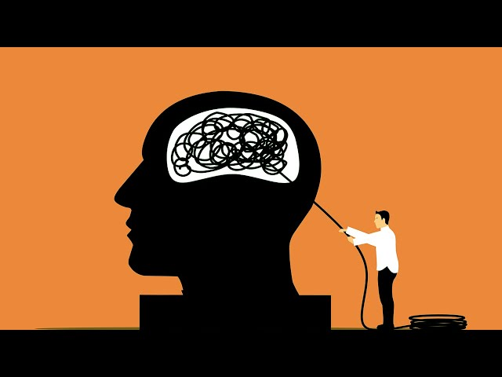
Our Solution- Mind Track
A simple and private website made for students to:
Choose an emoji daily to show how they feel 😄😐😔😭😡
Write a short journal to express thoughts freely
See mood history through graphs
Get motivational quotes, songs, and helpful tips based on mood
Solve small puzzles to feel better
Find useful links for mental health help

Slide 4

How It Works
Simple System Flow:
User ➡️ Mind Track Website ➡️ Select Mood + Journal
Entry
⬇️
Data Saved using Firebase/
Sheets
⬇️
Tips + Songs + puzzles ⬅️ Show Mood Graph

Slide 5
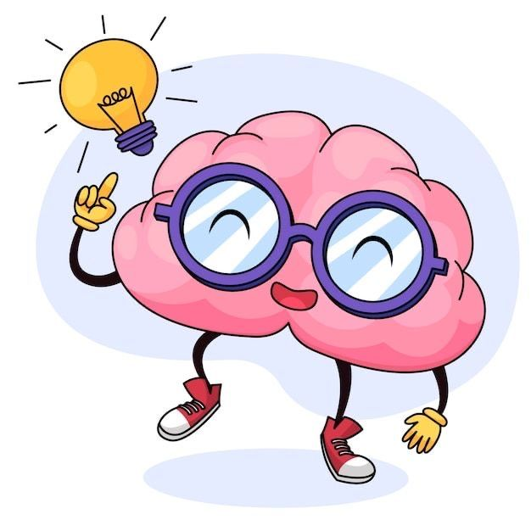
Features
Main Features:
😄Emoji Mood Check-In
📗Daily Journal Writing
📊Mood Graph Tracker
💡Motivational Tips, Quotes & Songs
🧩Fun Puzzles (Mood-based)
🔗Helpful Mental Health Links
👥About Team & Contact Form
🌃Dark Mode for night use
🛡️No login required (Privacy-first)
🎯Weekly Mood Goals

Slide 6

Business
Freemium Model:-
Core features like mood tracking, Al-based insights, and mental health tips will remain free.
Paid Psychologist Consultation:-
A separate business page will allow users to directly connect with certified psychologists for one-to-one paid sessions.

Slide 7
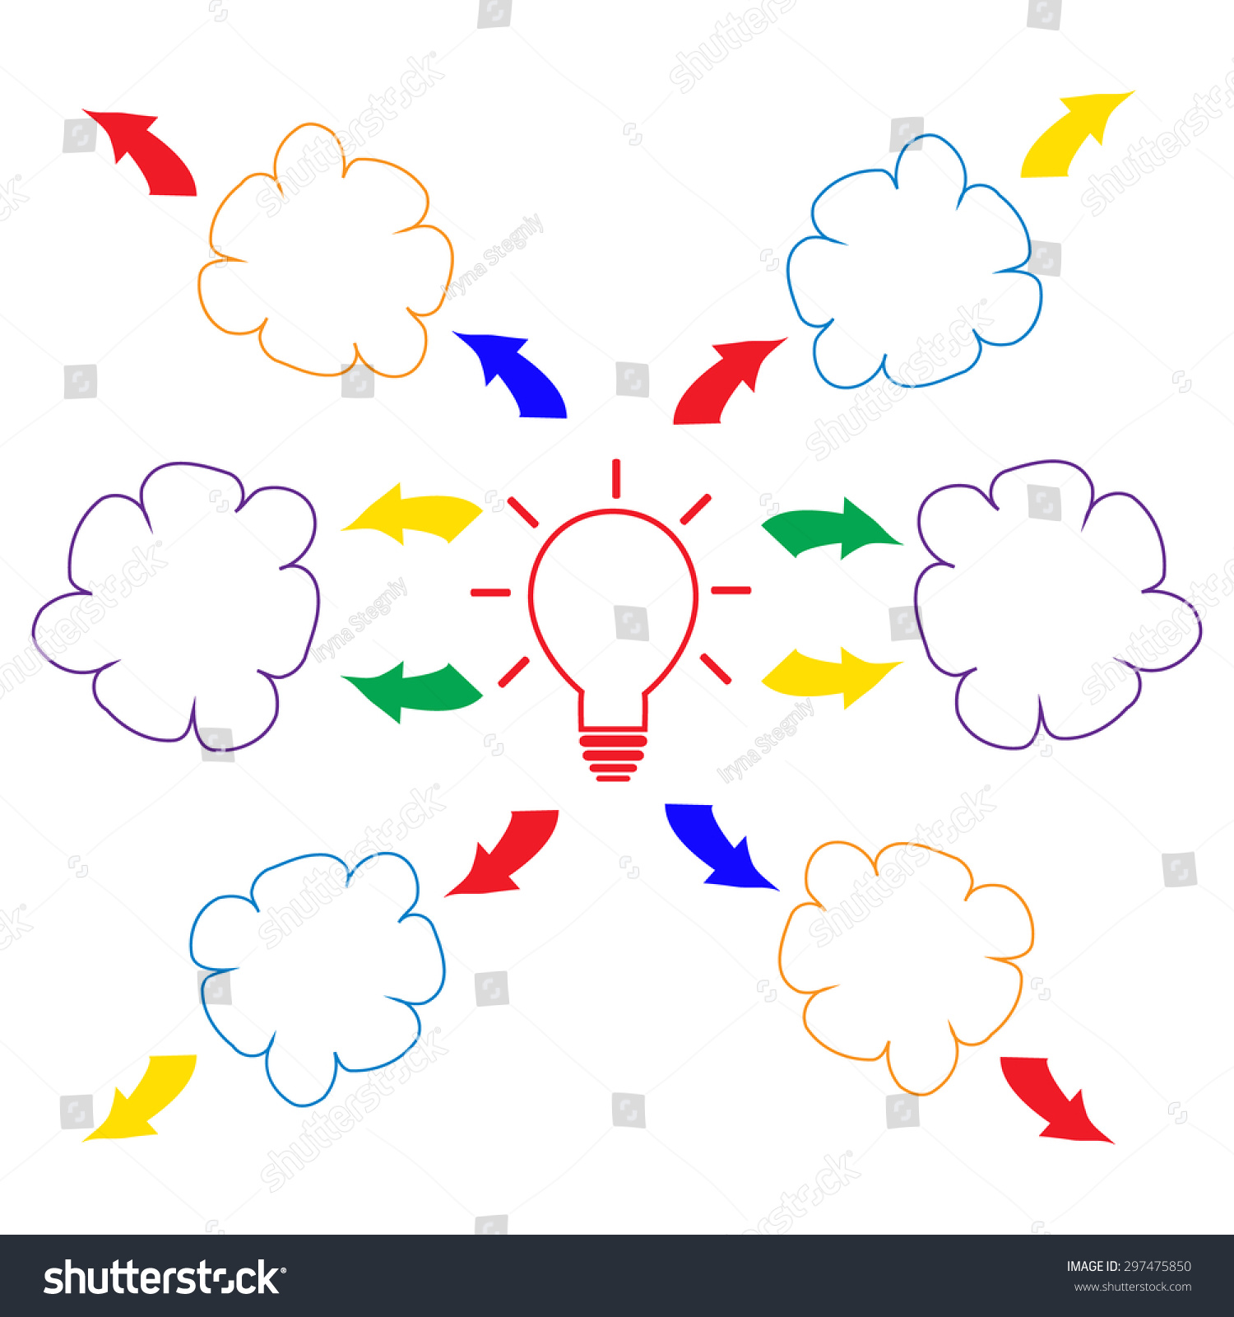
What's Special?
Why Mind Track is Different:
Made by beginners
Simple and clean for students to use
No need to log in or create an account
Mood-based quotes, songs, and puzzles
Free to use and lightweight
Designed for daily emotional tracking
Compared to other apps like Wysa, Mindshift, or Headspace:
MindTrack is fully anonymous
No paid plans or subscriptions
Includes fun activities like puzzles
Web-based, so easy to use from any device

Slide 8

Future Plans:
What's Next:
📱Android App (using Flutter)
🔔Mood-based daily reminders
⌚Connect with smartwatch
🧠Smart mood suggestions using ML (Machine Learning)
👩🏻‍⚕️Option to talk to psychologist
🧘🏻‍♀️Meditation and breathing video library

Slide 9
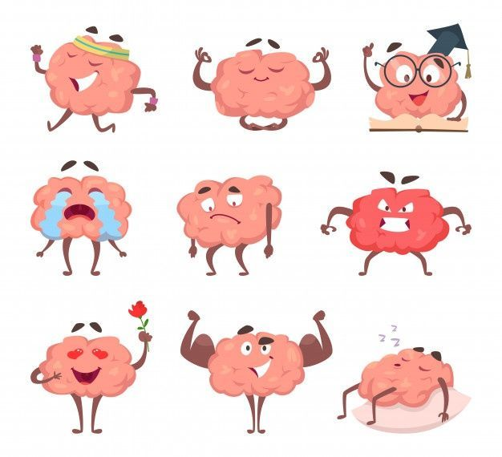
Demo:
Features Included:-
Mood Check-In Page
Journal Writing Box
Mood History Graph
Tips, Quotes, Songs & Puzzles
We will connect the website to Firebase to make it fully functional

Slide 10

Bibliography
https://www.mayoclinic.org
https://drsagnikmukherjee.com
https://chat.openai.com

Slide 11

Thank You
Let's help people check-in with their feelings every day.
Contact Us: (Coming Soon)
Instagram: (Page Coming Soon)

