Slide 1

Nafiz Al Mamun
2232050642
Mustakim Ahmed Hasan
2421349042
Tanim Ahmed
2312597042
Ahamad Osman Asif
2031080642

Slide 2
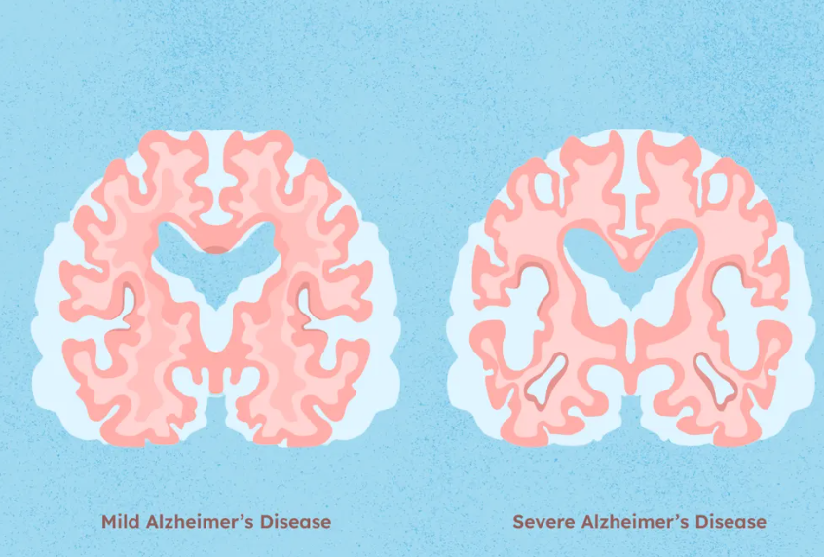
Why rethink Alzheimer's detection?
Alzheimer's detection (AD) causes progressive brain degeneration
MRI is widely used but data is 3D, complex and subtle. Also manual analysis is slow and expert dependent
Classical deep CNNs achieve high accuracy BUT require millions of parameters, heavy computation and large datasets
Question arises: Can we detect AD using far few parameters and a lighter model?

Slide 3
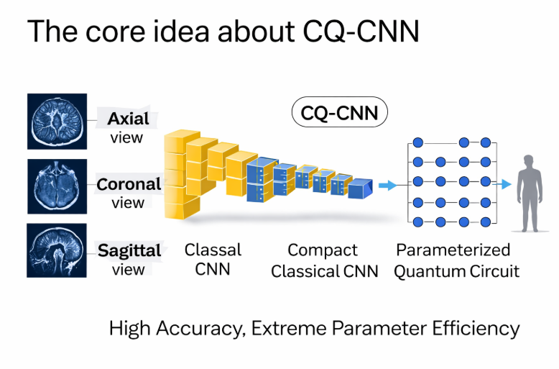
The core idea about CQ-CNN
A lightweight hybrid classical quantum model convert 3D MRI to 2D informative slices where there are axial, coronal and sagittal views which avoids heavy 3D CNNs.
It uses a compact classical CNN for feature selection
It replaces the final classifier with a parameterized quantum circuit (PQC)
This creates a CQ-CNN, where a classical CNN acts as the feature extractor and a quantum circuit serves as a compact, expressive decision maker
Main goal is high accuracy with extreme parameter efficiency

Slide 4
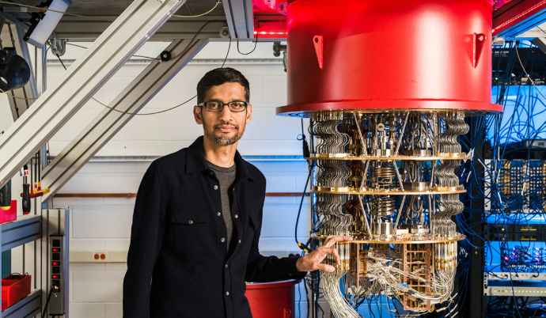
How the quantum part works?
What does quantum layer actually do?
CNN features are mapped to qubits
Features encoded using ZZFeatureMap which introduces entanglement and captures complex feature relationships
A small trainable quantum circuit of 2-3qubits learns non-linear decision boundaries and optimized using classical descent(Adam)
Measurement replacement softmax output class probabilities directly
Quantum layer adds representational power, not noise or hype

Slide 5
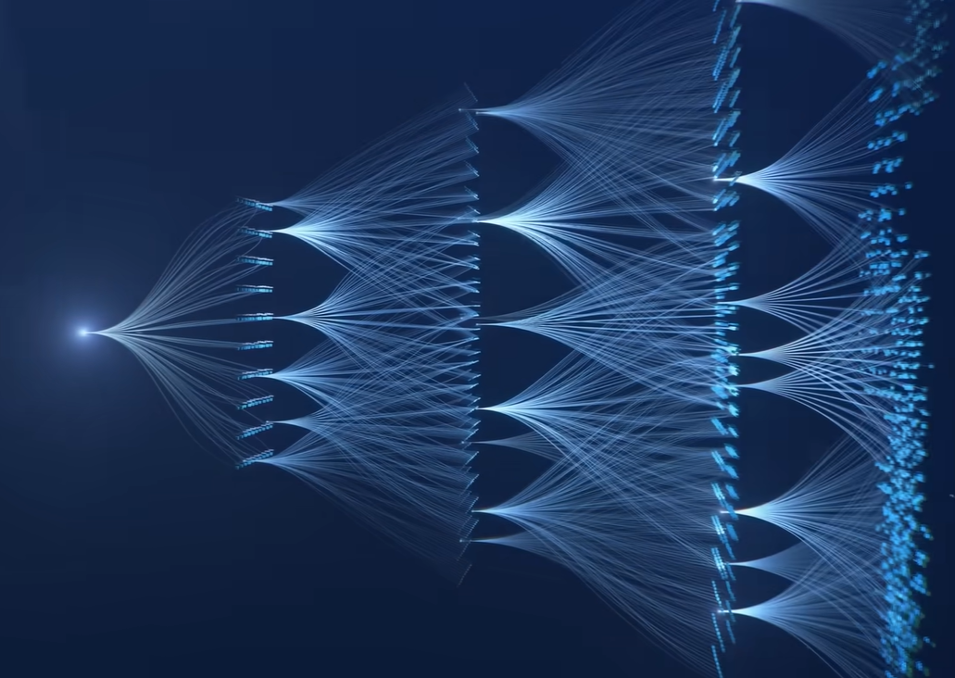
What worked VS what didn't
Best model:
  2-qubit CQ-CNN (3-plane MRI)
  ≈ 97.5% accuracy
  Only ~13.7K parameters (~0.05 MB)
Comparable to state-of-the-art CNNs using millions of parameters
Critical insights:
  Small quantum circuits help
  More qubits often hurt (instability, long training)
  Quantum models struggle when classes are extremely similar
Control experiments (MNIST):
  Stable convergence proves issues are data-driven, not architectural

Slide 6

THE PROBLEM STATEMENT
Alzheimer’s Disease (AD) is a progressive neurodegenerative disorder that causes memory loss and cognitive decline, making early and accurate detection critical.
MRI is a powerful imaging modality for AD diagnosis, but MRI data is inherently 3D, complex, and computationally demanding.
Existing deep learning approaches, especially 3D CNNs, achieve high accuracy but suffer from:
Extremely large numbers of parameters
High computational and memory costs
Dependence on large, well-annotated datasets
These limitations reduce practical deploy ability in real-world clinical settings.
Research Gap:
Can Alzheimer’s Disease be detected accurately and efficiently from MRI data using a lighter, parameter-efficient model without sacrificing performance?

Slide 7


