Slide 1


Analysis of Nifty / Sensex Historical Data Using R
Tanish Jagtap | Roll No. 58 | PRN 23610060
Guide : Prof. Bhagyashree Gore
Department of Artificial Intelligence & Data Science, AISSMS IOIT
Artificial Intelligence for Investments | Case Study 01

Slide 2
Introduction
▪ The Nifty 50 and the Sensex are the two main share market indexes in India. Mutual funds, index funds and many other investment products are based on them.
▪ Most risk calculations used with these indexes assume two things: that daily returns follow a normal curve, and that risk stays at one fixed level.
▪ The past data does not agree. The Nifty 50 gained 76 per cent in 2009 and lost 52 per cent in 2008. Its yearly risk level moved between 9 and 45 per cent.
▪ This case study checks both assumptions using real data and the R software.
▪ Main idea: the direction of the market cannot be predicted, but the risk level can be.
Data used: Nifty 50 from 2007-09-17 (4,647 days) and Sensex from 2000-01-03 (6,570 days), up to 2026-08-27.

Slide 3
Problem Statement
▪ Risk limits, position sizes and stop loss levels used by investors in India are based on assumptions about the index data that are never actually checked against the data itself.
▪ Why it matters: a wrong risk number is wrong exactly on the days when it matters the most, that is on the days of a large fall.
▪ Why it can be checked: each question has a standard statistical test with a fixed table value, so the answer is either yes or no. There is no guesswork.
▪ The test that decides: if the ARCH test does not show a problem, then risk is steady and a single risk number is fine. In this data the test value is 485, which is very large, so it does show a problem.

Slide 4
Objectives
▪ Collect the daily closing prices of the Nifty 50 and the Sensex.
▪ Change the prices into daily returns.
▪ Check whether the returns follow a normal curve.
▪ Check whether the data is stationary, using the ADF test.
▪ Check whether the direction of the market can be predicted, using the variance ratio test.
▪ Check whether big moves come together, using the Ljung-Box and ARCH tests.
▪ Fit the GARCH(1,1) model and check it again after fitting.
▪ Find the risk numbers, such as the worst daily loss and the largest fall from a peak.

Slide 5
Literature Review — Part 1
▪ [1] Engle (1982), ARCH model. Made a model in which the risk level can change with time, and gave a test for it. Found that risk is not fixed. The ARCH test is used here to decide whether a GARCH model is needed.
▪ [2] Bollerslev (1986), GARCH model. Improved the ARCH model by adding the previous risk level. Found that GARCH(1,1) with three values works as well as a long ARCH model. This is the model fitted in this study.
▪ [3] Nelson (1991), EGARCH model. Allowed a fall in price to affect risk differently from a rise. Found that a fall raises risk more. Mentioned here as a limitation, because the model used treats both the same.
▪ [4] Dickey and Fuller (1979), unit root test. Gave the correct table values for testing whether data is stationary. Found that normal t table values cannot be used. The ADF test in this study uses these values.
▪ [5] Fama (1970), efficient market idea. Collected the work on whether prices already contain all known information. Found that if a market is efficient, past prices cannot predict the future direction.
These papers created the tests and the models used in this study.

Slide 6
Literature Review — Part 2
▪ [6] Lo and MacKinlay (1988), variance ratio test. Gave a test based on how the spread of returns grows over longer periods. Found the test must be corrected for changing risk. The corrected form is used in the code here.
▪ [7] Srinivasan and Ibrahim (2010), Sensex study. Compared GARCH, EGARCH and TGARCH on daily Sensex returns. Found the simple GARCH(1,1) worked well. This is the closest earlier study, but it uses a shorter period.
▪ [8] Mahajan and others (2022), Nifty 50 study. Compared GARCH models with a neural network on the Nifty 50. Found GARCH was still as good as the neural network. It shows GARCH(1,1) is a fair choice for this index.
▪ [9] Satapathy (2025), random walk test. Tested the Nifty and 50 large shares with variance ratio and Hurst tests. Could not prove that prices are predictable. This is the most recent study of this type and it agrees with the result found here.
These papers applied the same tests to the Indian market.

Slide 7
Gap Found
▪ Papers on market efficiency: they check whether the direction can be predicted, and stop there. They do not look at the risk level at all.
▪ Papers on volatility: they fit a model for risk but do not test efficiency on the same data, and do not say how much the wrong assumption can cost.
▪ Papers on the Indian market: most of them end before 2020, so they leave out the Covid period. That period had the highest risk level in this whole data set, about 92 per cent.
▪ What is missing: no paper does all these checks together, on both indexes, on data that includes 2020 and after.
This case study fills that gap.

Slide 8
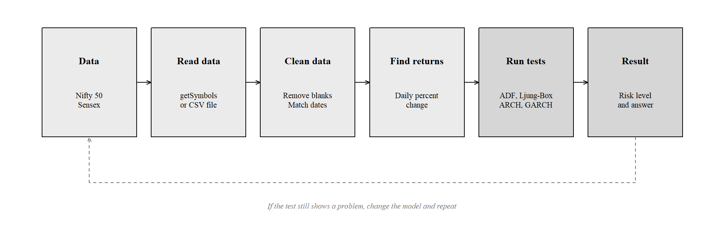
Method
▪ Each test decides whether the next test is useful. The GARCH model is fitted only if the ARCH test shows a problem, and the model is checked once more after fitting.
The dotted line shows that the model is changed and checked again if the problem is still there.

Slide 9
Data and Tools Used
Index | Symbol | Period | Days
Nifty 50 | ^NSEI | 2007-09-17 to 2026-08-27 | 4,648
Sensex | ^BSESN | 2000-01-03 to 2026-08-27 | 6,571
R package | What it is used for
quantmod | Downloads the price data of both indexes
tseries | ADF test and Jarque-Bera test
FinTS | ARCH test, to check if the risk level changes
rugarch | Fits the GARCH(1,1) model
PerformanceAnalytics | Risk numbers such as loss limits and falls
Base R | Ljung-Box test and all the graphs. No package needed
A second version of the code is also given that needs no packages at all, so it can run on any online R compiler.

Slide 10
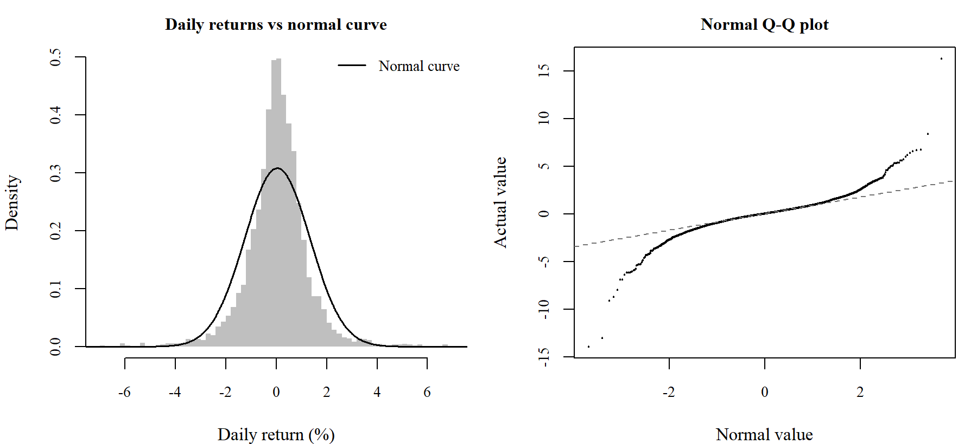
Result 1 — Do Returns Follow a Normal Curve?
Item | Nifty 50 | Sensex | If it were a normal curve
Skewness | -0.280 | -0.392 | 0
Extra peakedness | 15.14 | 10.07 | 0
Jarque-Bera value | 44,429 | 27,911 | near 0
Days with a very large move | 70 | 107 | 13 and 18
Answer: No. If returns followed a normal curve, about 13 days with a very large move were expected, but 70 days actually happened.

Slide 11
Result 2 — Can the Direction Be Predicted?
Test | Series | Nifty 50 | Sensex | Result
ADF | Price | -0.18 | -0.39 | Not stationary
ADF | Returns | -12.19 | -13.91 | Stationary
Variance ratio, q = 2 | Returns | 1.037 | 1.051 | Close to 1
Variance ratio, q = 4 | Returns | 1.036 | 1.043 | Close to 1
Variance ratio, q = 8 | Returns | 0.994 | 1.027 | Close to 1
Variance ratio, q = 16 | Returns | 1.034 | 1.071 | Close to 1
▪ Prices are not stationary but returns are, so all later work is done on returns. The 5 per cent table value for the ADF test is -2.86.
▪ The variance ratio stays close to 1. This means the direction of the market cannot be predicted from past prices in any useful way.

Slide 12
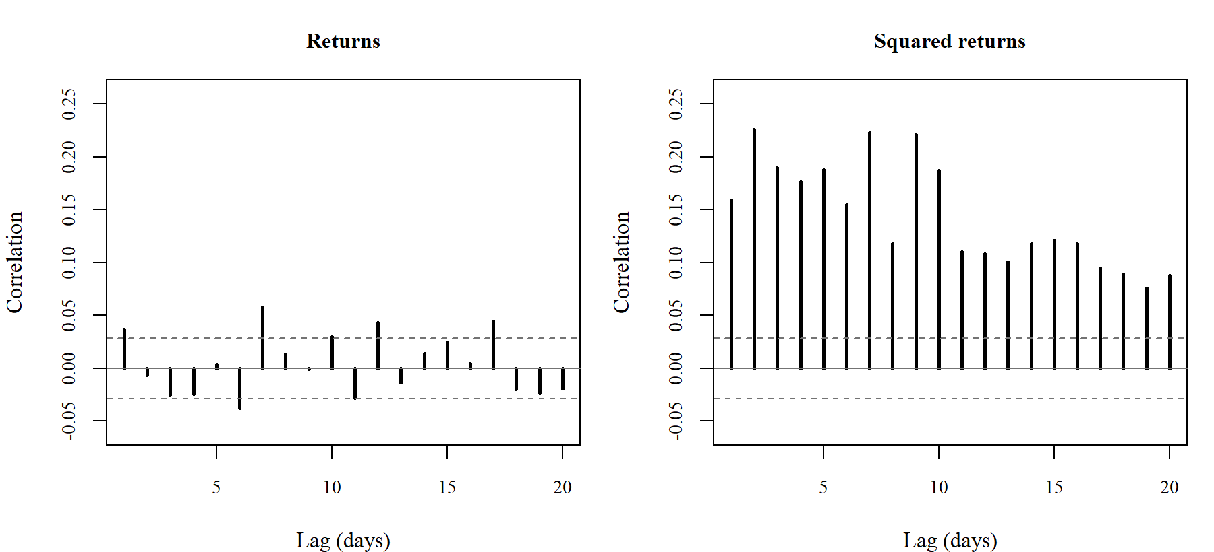
Result 3 — Do Big Moves Come Together?
Test | Nifty 50 | p value | Sensex | p value
Ljung-Box on returns | 39.4 | below 0.001 | 48.3 | below 0.001
Ljung-Box on squared returns | 1,625 | below 0.001 | 2,585 | below 0.001
ARCH test (5 lags) | 485 | below 0.001 | 790 | below 0.001
Answer: Yes. The test on plain returns gives only 39.4, but on squared returns it gives 1,625, about forty times more. So the size of the move can be predicted even though the direction cannot.

Slide 13
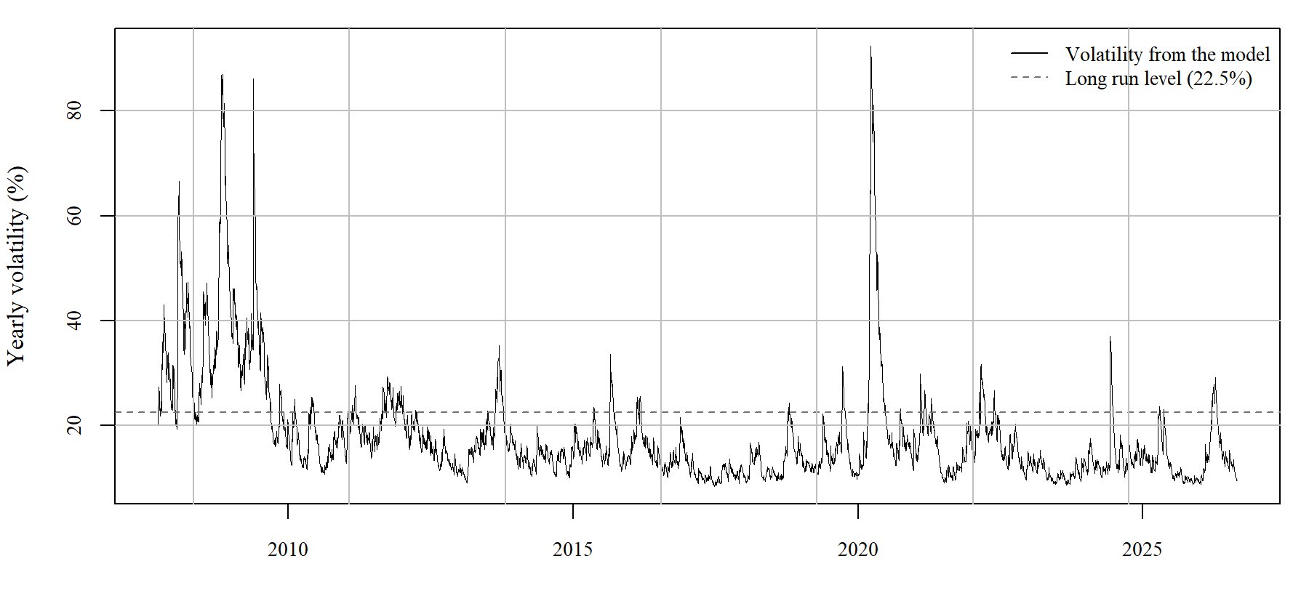
Result 4 — The GARCH(1,1) Model
Value | Nifty 50 | Sensex | Meaning
alpha | 0.0952 | 0.1063 | Effect of yesterday's move
beta | 0.8975 | 0.8850 | Effect of yesterday's risk level
alpha + beta | 0.9927 | 0.9913 | Below 1, so risk comes back to normal
Half life (days) | 95 | 80 | Time for a shock to reduce by half
Long run risk level (%) | 22.5 | 24.4 | Level the risk returns to
ARCH test after fitting (p) | 0.48 | 0.20 | Above 0.05, so the model is fine
The half life is about 95 trading days, close to four and a half months. A shock keeps the risk level high for months, not for a day or two.

Slide 14
Result 5 — Risk Numbers
Item | Nifty 50 | Sensex
Worst 1% daily loss, from real data (%) | -3.62 | -4.05
Worst 1% daily loss, using normal curve (%) | -2.98 | -3.15
Average loss on such bad days (%) | -5.46 | -5.69
Times this limit was crossed | 82 | 134
Times it should have been crossed | 46 | 66
Biggest fall from a peak (%) | -59.9 | -60.9
Days taken to recover from it | 1,036 | 1,031
▪ The loss limit based on the normal curve was crossed 82 times when it should have been crossed only about 46 times.
▪ The largest fall was 59.9 per cent and it took about 2.8 years to come back to the old level.

Slide 15
Conclusion and Future Work
▪ Result: returns do not follow a normal curve, the direction of the market cannot be predicted, but big moves come together and can be modelled with GARCH(1,1).
▪ Meaning: the part everyone tries to guess, that is the direction, cannot be guessed. The part most people treat as fixed, that is the risk, is the part that can be predicted.
▪ Limits: dividends are not included, the model treats a rise and a fall as the same, and one set of values is used for the whole period.
▪ Future work: use the EGARCH model to handle rises and falls differently, use a Student-t curve instead of the normal curve, and run the same tests on sector indexes.

Slide 16
References
[1] R. F. Engle, "Autoregressive conditional heteroscedasticity with estimates of the variance of United Kingdom inflation," Econometrica, vol. 50, no. 4, pp. 987-1007, 1982.
[2] T. Bollerslev, "Generalized autoregressive conditional heteroskedasticity," Journal of Econometrics, vol. 31, no. 3, pp. 307-327, 1986.
[3] D. B. Nelson, "Conditional heteroskedasticity in asset returns: a new approach," Econometrica, vol. 59, no. 2, pp. 347-370, 1991.
[4] D. A. Dickey and W. A. Fuller, "Distribution of the estimators for autoregressive time series with a unit root," JASA, vol. 74, no. 366, pp. 427-431, 1979.
[5] E. F. Fama, "Efficient capital markets: a review of theory and empirical work," Journal of Finance, vol. 25, no. 2, pp. 383-417, 1970.
[6] A. W. Lo and A. C. MacKinlay, "Stock market prices do not follow random walks," Review of Financial Studies, vol. 1, no. 1, pp. 41-66, 1988.
[7] G. M. Ljung and G. E. P. Box, "On a measure of lack of fit in time series models," Biometrika, vol. 65, no. 2, pp. 297-303, 1978.
[8] P. Srinivasan and P. Ibrahim, "Forecasting stock market volatility of BSE-30 index using GARCH models," Asia-Pacific Business Review, vol. 6, no. 3, 2010.
[9] V. Mahajan, S. Thakan and A. Malik, "Modeling and forecasting the volatility of NIFTY 50 using GARCH and RNN models," Economies, vol. 10, no. 5, art. 102, 2022.
[10] A. Satapathy, "Test of random walk hypothesis in Indian stock market," Global Business Review, 2025.
[11] A. Ghalanos, "rugarch," CRAN R package; J. A. Ryan and J. M. Ulrich, "quantmod," CRAN R package; R Core Team, Vienna. Data: www.nseindia.com, www.bseindia.com.

Slide 17
Thank You
Tanish Jagtap | Roll No. 58 | PRN 23610060 Guide : Prof. Bhagyashree Gore

