Slide 1

Customer Shopping Behavior Analysis
End-to-End Data Analytics Project — From Raw Transactions to Business Insights

Slide 2

Project Scope: 3,900 Transactions Analyzed
Dataset Scale
Data Sources
3,900 transactions across 18 features — demographics, purchase details, and behavioral metrics
Customer profiles, transactional records, and behavioral metrics combined into a single analytical dataset
Data Quality
37 missing values in Review Rating — resolved via category-based median imputation

Slide 3

Data Preparation & Feature Engineering
01
Python (Pandas)
Loaded, cleaned, and standardized all 3,900 records for downstream analysis
02
Feature Engineering
Created age group bins and purchase frequency days from raw transactional data
03
Data Validation
Identified and removed redundant columns (promo_code_used) to avoid analytical noise
04
MySQL Integration
Loaded the clean dataset into MySQL to enable structured SQL-based business querying

Slide 4




SQL Analysis: 10 Business Questions
Revenue Segmentation
Behavior Patterns
Broken down by gender, age group, and subscription status to reveal hidden value drivers
Discount usage, preferred shipping methods, and repeat purchase frequency across segments
Product Performance
Customer Segmentation
Top-rated items and category-level sales trends to guide inventory and pricing strategy
Classified customers as New, Returning, or Loyal based on purchase history patterns

Slide 5
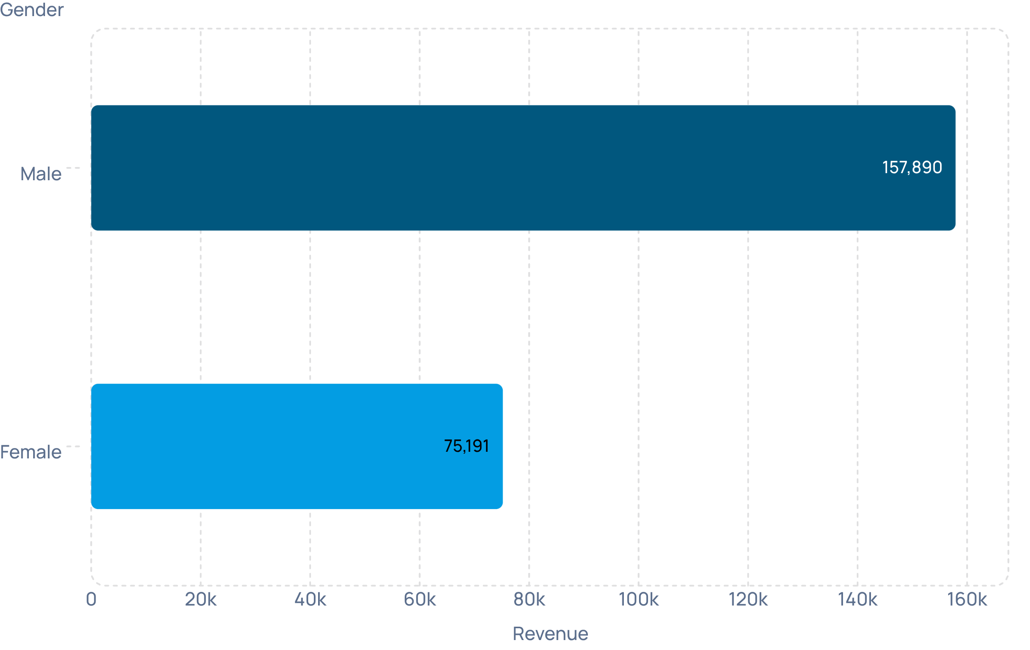

Key Finding: Male Customers Drive 2x Revenue
REVENUE BY GENDER
A Striking Disparity
Male customers generated $157,890 versus $75,191 from female customers — a gap of more than 2x in total revenue contribution.
This gender-based revenue disparity signals a significant untapped marketing opportunity within the female customer segment.

Slide 6
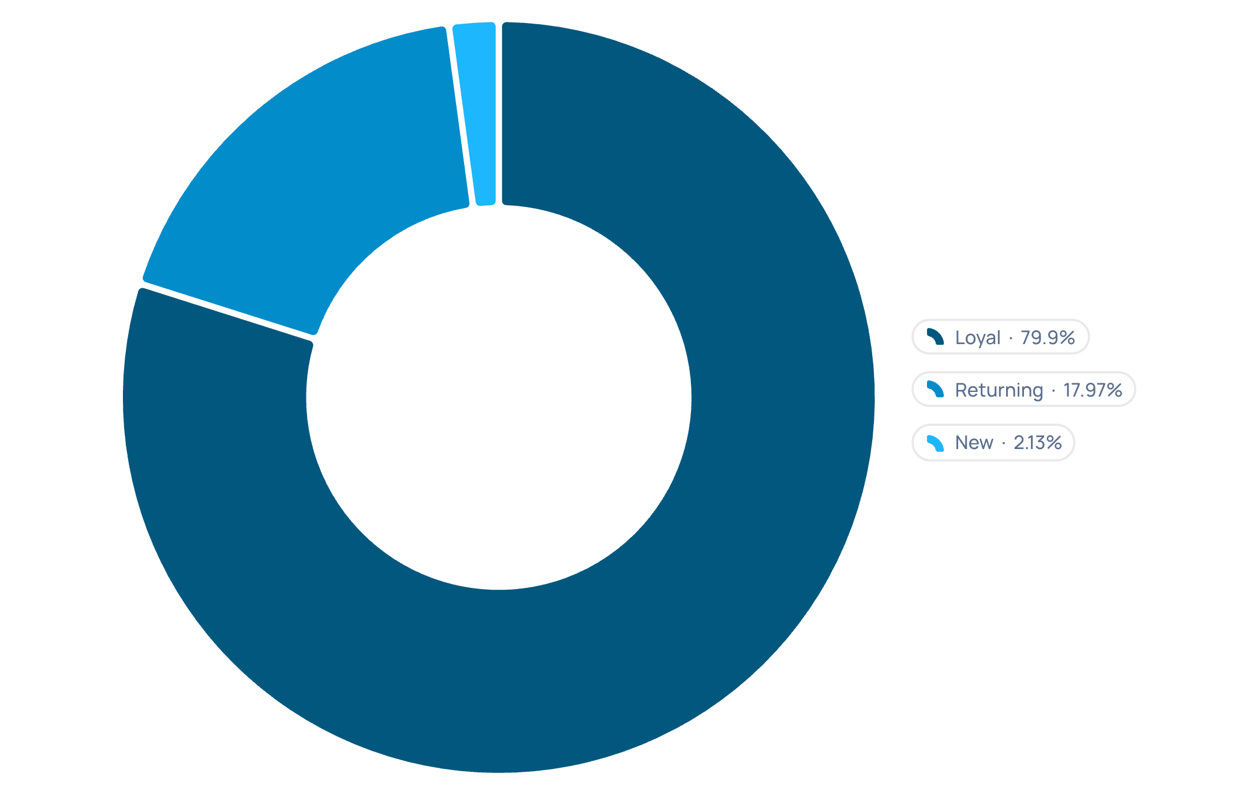
Customer Segmentation: 80% Loyal Base
SEGMENTATION BREAKDOWN
Loyalty Dominates the Mix
The vast majority of the customer base are Loyal customers — those with 10+ purchases. Returning and New customers represent a much smaller share.
Loyal: 3,116 customers (80%)
Returning: 701 customers (18%)
New: 83 customers (2%)
Opportunity: Strengthen loyalty programs to retain and grow this dominant customer base.

Slide 7
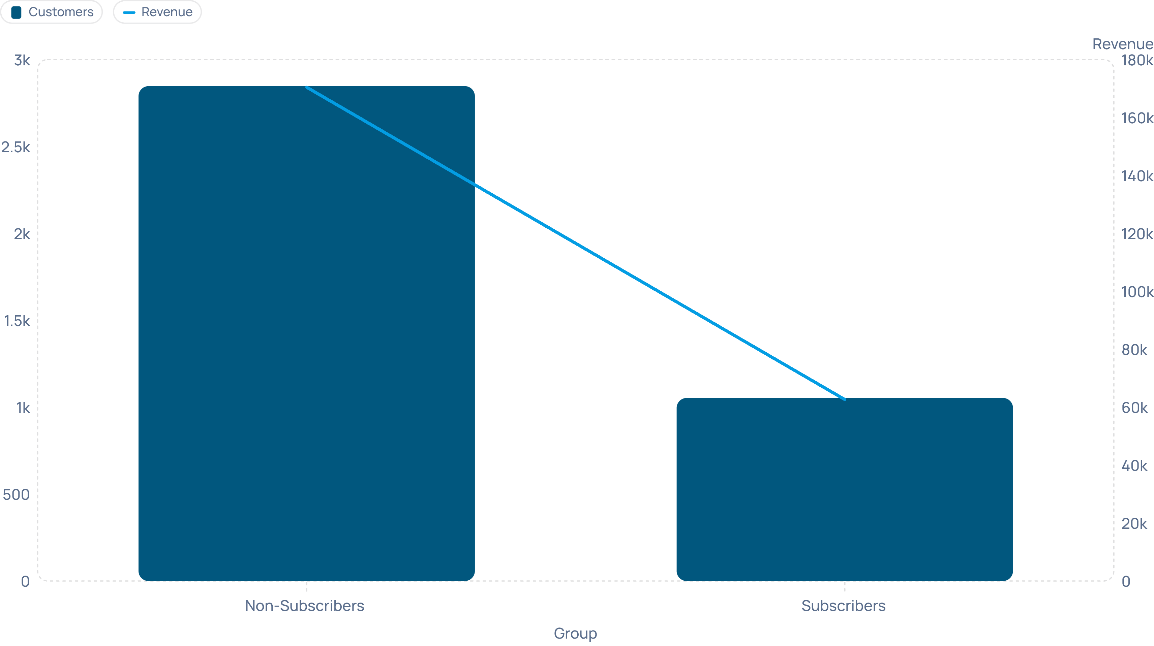
Subscription Paradox: Volume vs. Value
Non-Subscribers
Subscribers
Strategic Action
2,847 customers generating $170,436 — that's 73% of total revenue from those without a subscription
1,053 customers generating $62,645 — only 27% of revenue despite the formal subscription relationship
Develop targeted subscription incentives to convert high-volume non-subscribers and close the revenue gap

Slide 8

Product Insights: Top Performers & Discount Dependency
TOP RATED PRODUCTS
DISCOUNT DEPENDENCY ALERT
Customer Favorites
High-Discount Items
Five products show a 47–50% discount rate — Hat, Sneakers, Coat, Sweater, and Pants are heavily reliant on promotions to drive sales volume.
Gloves — 3.86 ★
Jacket — 3.84 ★
Shirt — 3.82 ★
Review pricing strategy for discount-heavy products to protect margin without sacrificing volume.

Slide 9
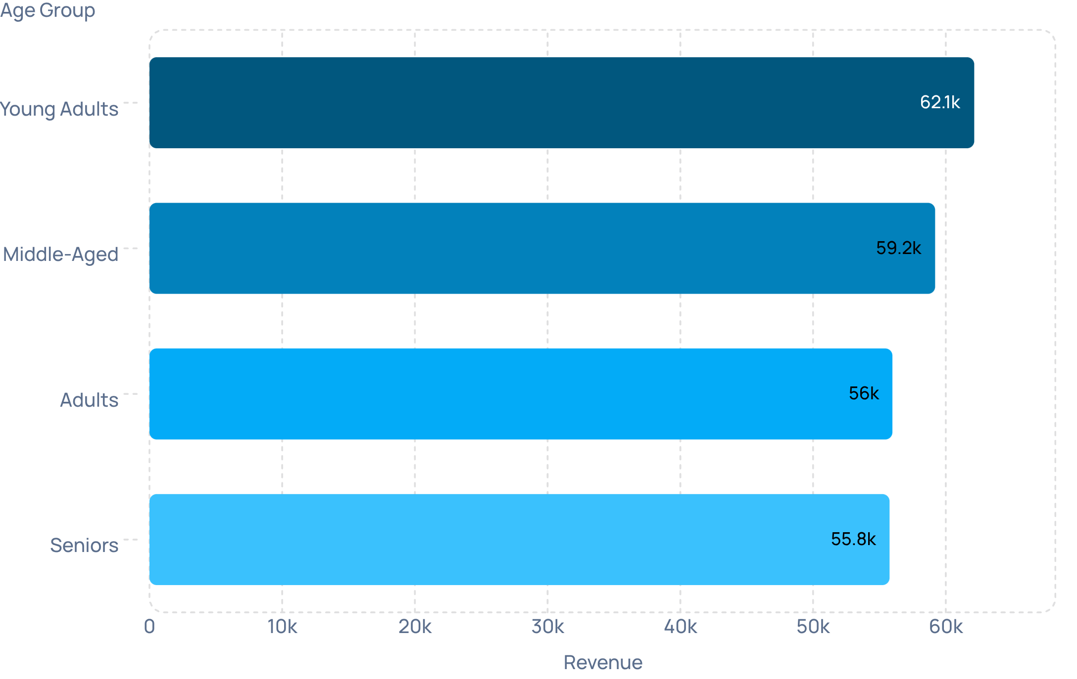
Age Group Revenue Distribution
REVENUE BY AGE GROUP
Young Adults Lead the Way
Young Adults are the highest-value demographic, generating $62,143 in revenue — outpacing all other age segments.
Young Adults: $62,143
Middle-Aged: $59,197
Adults: $55,978
Seniors: $55,763
Insight: Prioritize Young Adult-targeted campaigns while maintaining broad engagement across all cohorts.

Slide 10
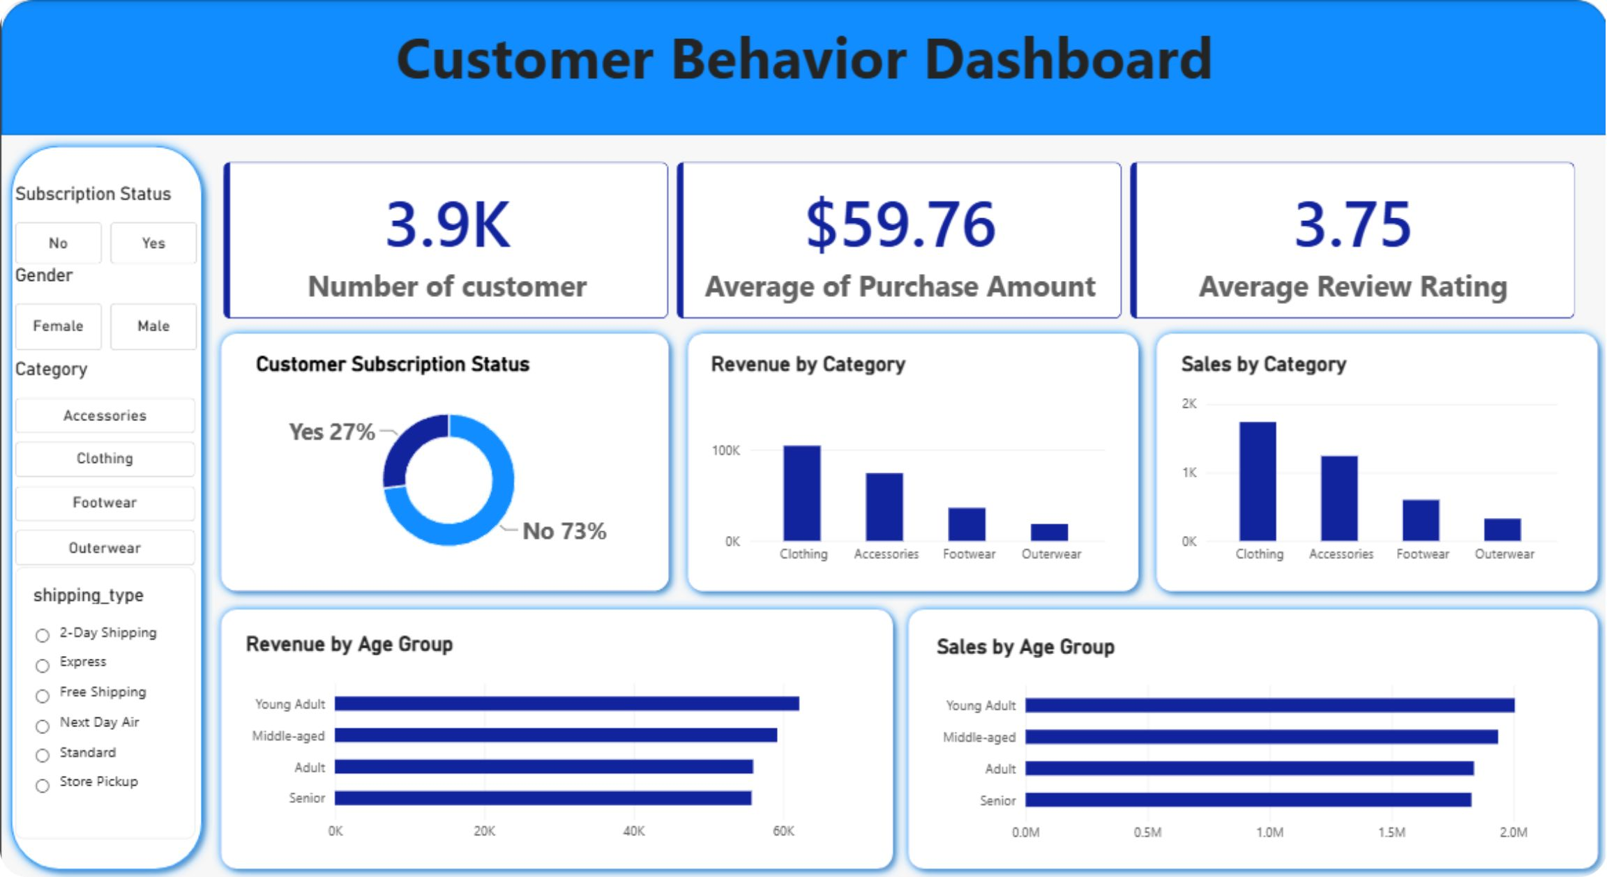
Power BI Dashboard: Interactive Insights
DASHBOARD KPIS
3.9K
$59.76
3.75★
Customers
Avg. Purchase
Avg. Rating
Total profiles analyzed in the dataset
Average transaction value across all customers
Mean product rating across all reviews
The Power BI dashboard enables multi-dimensional exploration across subscription status, product category, age group, and more — delivering self-service insights for business stakeholders.

