Slide 1

Project Presentation of Industry Oriented Hand on Experience (22CS422)
On
CIE-Vault
Presented By:
1. Tanish (2211981428)
2. Tanish Kumar (2211981429)
3. Sahil Akhtar (2211981330)
4. Sourabh Kumar (2211981401)
Supervised By:
Dr. Swati Goel
Assistant Professor
Chitkara University, Rajpura
Department of Computer Science and Engineering,
Chitkara University, Punjab
1

Slide 2
Introduction
CIE-Vault is a secure platform for managing academic copyright filling between students and mentors.
Students can safely upload project reports and copyright filing receipts.
Different access levels for students and mentors ensure data privacy and security.
Files and sensitive information and protected using strong encryption.
Students can track status, while mentors review, give feedback, and approve efficiently.
2

Slide 3
Problem Statement
Problem Statement
The academic copyright submission process is mostly manual, causing unorganized data and security risks. Students often share login credentials through insecure channels. Lack of a centralized system leads to lost documents, errors, and poor transparency, while secure external peer review is difficult to manage.
4

Slide 4
Problem Solution
Problem Solution
CIE-Vault is a MERN-based system that automates academic copyright management. It uses automated extraction to read details from uploaded receipts. Features like dual-role authentication, college-based routing, and hybrid access control ensure security, while only authorized mentors can view sensitive information and credentials.
5

Slide 5
Key Features
Automated Metadata Extraction: Instantly extracts filing numbers and research titles from uploaded PDFs.
Hybrid Access Control: Manages secure interaction between students, mentors, and external reviewers.
Zero-Trust Security Vault: Protects research data using AES-256 encryption and secure authentication.
Embedded PDF Viewer: Read documents directly within the platform.
Dual Role Dashboards: Separate dashboards for students and mentors for smooth collaboration.
Safe Document Viewer: Allows secure and protected viewing of research documents.
Responsive UI: Works smoothly on desktop and mobile devices.
6

Slide 6
System Architecture
The system follows a 3-tier architecture: Frontend, Backend, and Database.
Frontend (React.js + Tailwind CSS) handles user interface and interactions.
Users can upload PDFs, view documents, and access AI features through UI.
Backend (Node.js + Express.js) processes requests and manages application logic.
Encryption Module AES-256 encryption secures uploaded documents and sensitive credentials.
Database (MongoDB) stores user details, documents, metadata, and notification securely.
Data flows from User → Frontend → Backend → Database → Frontend.
8

Slide 7
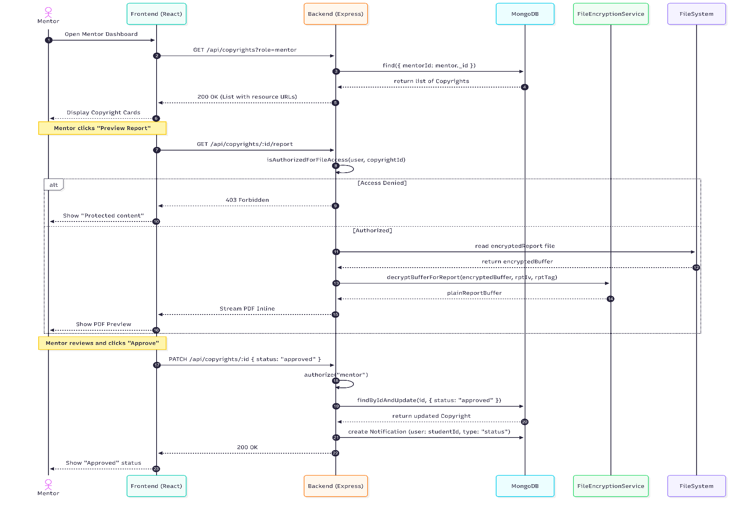
Workflow Diagram
11

Slide 8
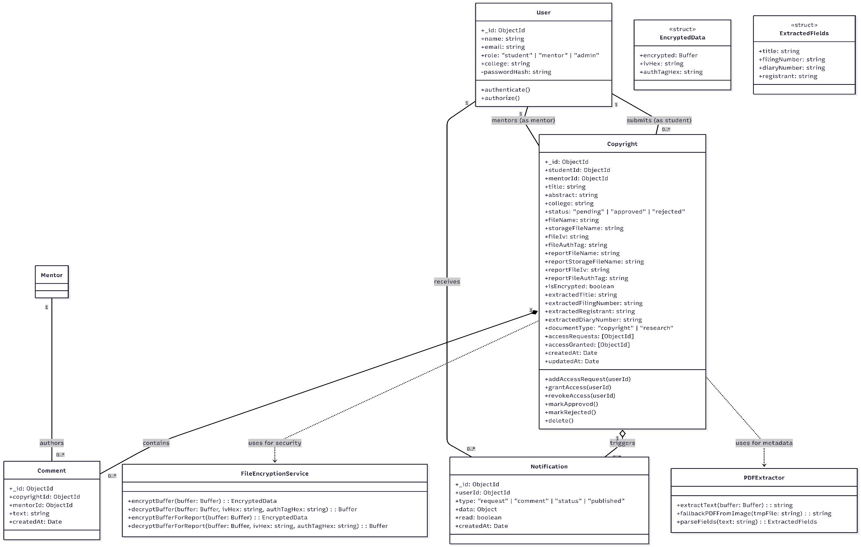
Class Diagram
12

Slide 9
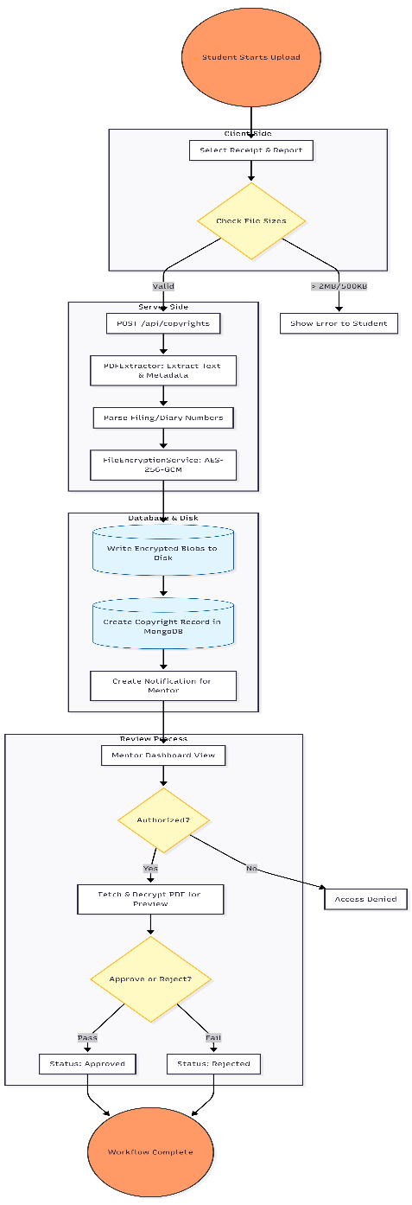
Flow Chart
13

Slide 10

Technology Used
Describe your Technology Stack here:
Front-End Frameworks: For Front-End we use the frameworks like React, HTML, CSS, JavaScript.
Front-End Technology: In this we use the HTML, CSS ,JavaScript for the Front-end work for our website in this Project.
DataBase: For database We use the MongoDB Database which is officially provided by the Google Company at free of Cost to store our data of our websites.
Back-End Technology: For Back-end we use the Node Js, Express. Js etc.
3

Slide 11
Future Scope & Conclusion
Future Scope:
AI can provide smart suggestions and automatic research summaries.
Cloud storage can improve scalability, security, and easy data access.
Blockchain technology can be used to improve copyright verification and ownership tracking.
Develop a mobile application for better accessibility.
Conclusion:
CIE-Vault improves academic copyright management with secure and smart automation.
16

Slide 12
Thank You
17

