Slide 1
Machine Learning · DA 3011L
Uncertainty-Aware Self-Paced Ensemble
for Imbalanced Classification
Tanish Anand
240150037
Tumu Sai Seshi Kiran
240150038
Course project presentation · October 2026
Notes:
[About 40 s] Good morning. I am Tanish Anand, and with me is Tumu Sai Seshi Kiran. Our Machine Learning project is about an Uncertainty-Aware Self-Paced Ensemble for imbalanced classification. We started from a published method called Self-Paced Ensemble, or SPE, and tested one small change to it: using how much the classifiers agree when choosing training rows. We will explain SPE, our change, how we tested it, and what we found, including where the result was not conclusive.

Slide 2
Why imbalanced classification is difficult
Credit-card fraud: 473 frauds in 283,726 transactions, about 1 in 599
Predicting "genuine" for every transaction is 99.83% accurate but catches no fraud
Training is dominated by genuine rows, so the model pays little attention to fraud
Accuracy is misleading; we need methods and metrics that focus on the rare class
DA 3011L · Uncertainty-Aware Self-Paced Ensemble
2
Notes:
[About 60 s] Our data is the credit-card fraud dataset. After removing duplicates there are 283,726 transactions and only 473 frauds, about 1 in 599. In the training split that is 169,951 genuine rows against 284 frauds; the fraud bar on the chart is almost invisible. A model that always says "genuine" would be 99.83 percent accurate and still catch no fraud. Because genuine rows dominate the training loss, a normal classifier pays little attention to fraud. So accuracy is the wrong measure, and we need methods and metrics that focus on the rare class.

Slide 3
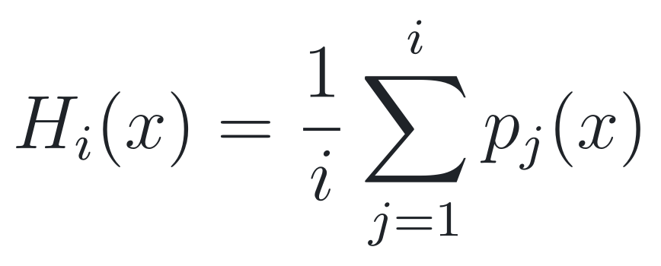
The main idea behind Self-Paced Ensemble (SPE)
Undersampling: train on all 284 frauds plus only 284 genuine rows
Random undersampling picks mostly easy genuine rows and wastes information
SPE (Liu et al., ICDE 2020) trains 10 classifiers one after another and chooses each new genuine sample using its hardness
Early classifiers see rows of all hardness levels; later classifiers focus more on hard rows
Hardness of a genuine row x
p_{j}(x): fraud probability from classifier j
High H: a genuine row that the classifiers think looks like fraud
DA 3011L · Uncertainty-Aware Self-Paced Ensemble
3
Notes:
[About 70 s] A simple fix is undersampling: keep all 284 frauds and use only 284 genuine rows. Random undersampling has two problems. Most genuine rows are easy, so a random sample is mostly easy rows, and a lot of information is thrown away. SPE, from Liu and others at ICDE 2020, trains ten classifiers one after another. Before each new classifier it measures the hardness of every genuine row: the average fraud probability given by the classifiers trained so far. A hard genuine row is one that looks like fraud. SPE uses hardness to choose the next sample. Early classifiers see rows from all hardness levels, and later ones focus more on hard rows. That gradual shift is why it is called self-paced.

Slide 4
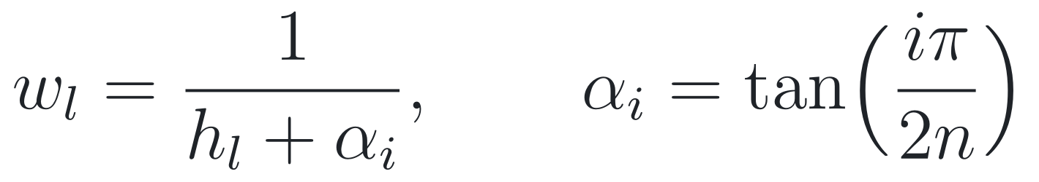
How SPE works
Initial balanced
sample
Train classifier
Estimate hardness H
of every genuine row
Divide genuine rows
into 20 hardness bins
Allocate the 284-row
budget across bins
next round
Average the 10
predicted probabilities
done
Repeat until 10
classifiers
Train the next
classifier
Select genuine rows
inside each bin
UA-SPE changes only this step
Budget per bin is proportional to the bin weight:
h_{l} = average hardness of the rows in bin l
α_{i} grows from 0.16 to 6.31: later rounds give harder bins more rows
In SPE, rows inside a bin are then chosen uniformly
DA 3011L · Uncertainty-Aware Self-Paced Ensemble
4
Notes:
[About 90 s] Here is the full loop. The first classifier is trained on all frauds and 284 random genuine rows. We then compute the hardness of every genuine training row and put each row into one of 20 equal-width bins between 0 and 1. The 284-row budget is shared across bins in proportion to the weight at the bottom: one over the bin's average hardness plus alpha. Alpha grows with the round number, from about 0.16 to 6.31, so in later rounds the weights become more even and harder bins get a larger share. Inside each bin, SPE picks rows uniformly at random. We train the next classifier on the new sample and repeat until there are ten. The final prediction is the average of the ten probabilities. The highlighted box is the only place UA-SPE changes anything: how rows are chosen inside a bin.

Slide 5
Why we considered adding uncertainty
Hardness only uses the average prediction. Three genuine rows with the same hardness:
Row | Predictions of 4 classifiers | Hardness H | Ũ
X | 0.50 0.50 0.50 0.50 | 0.50 | 1.00
Y | 0.10 0.90 0.15 0.85 | 0.50 | 0.44
Z | 0.00 1.00 0.00 1.00 | 0.50 | 0.00
Ũ = 1: the classifiers agree
Ũ = 0: they disagree as much as possible for this H
SPE treats X, Y and Z the same: they fall in the same bin
Our question: inside a bin, does it help to prefer rows on which the classifiers agree?
The score uses p(1 − p), an idea taken from Data-IQ (Seedat et al., NeurIPS 2022); our method is not Data-IQ itself
We did not assume these rows are more useful; this is what the experiment tests
DA 3011L · Uncertainty-Aware Self-Paced Ensemble
5
Notes:
[About 70 s] Hardness only looks at the average prediction. These three rows all have hardness 0.5. For row X all four classifiers say 0.5, so they agree. For row Y they disagree a lot, and for row Z they disagree as much as possible. SPE puts all three in the same bin and treats them the same. Our question was: inside a bin, does it help to prefer rows on which the classifiers agree? The p times one-minus-p score comes from Data-IQ, a NeurIPS 2022 paper, but we only borrowed that idea; we did not implement Data-IQ. We also did not assume that agreed-on rows are more useful. That is exactly what the experiment checks.

Slide 6
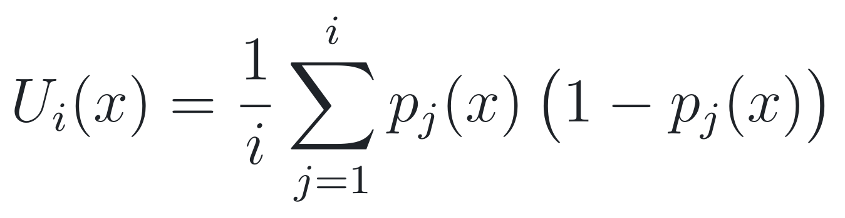
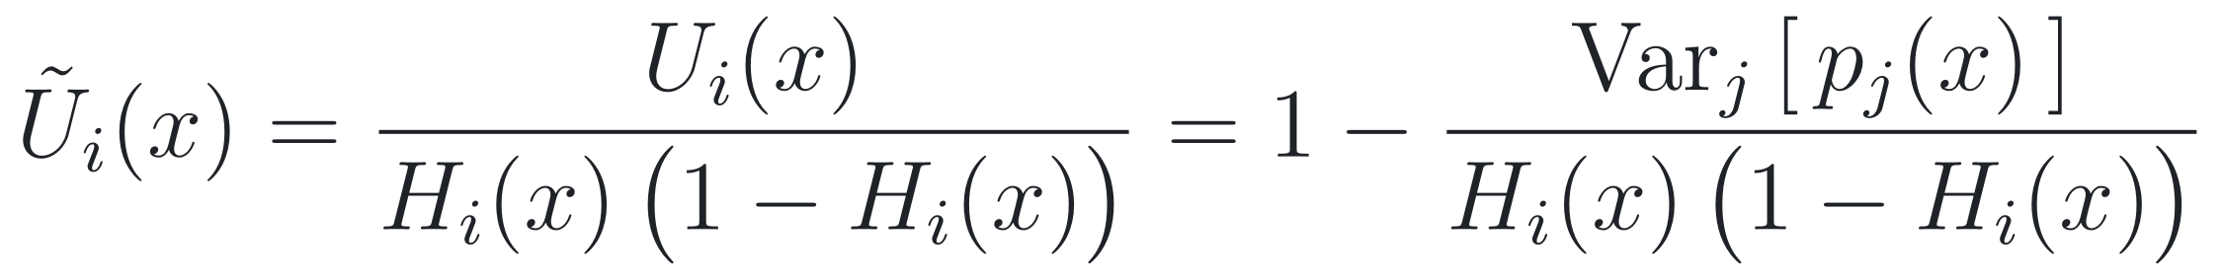
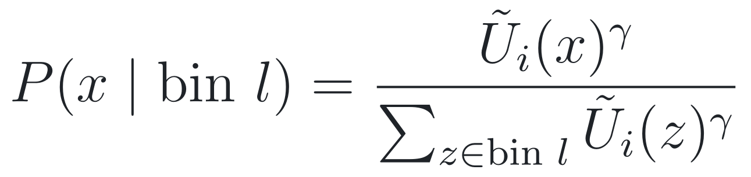
How UA-SPE works
1. Average uncertainty of the classifiers so far
Values of γ
γ = 0: all weights equal 1, so this is exactly SPE (control)
γ = 1, 2, 4: increasingly strong preference for rows with high Ũ
2. Normalise by hardness (0 ≤ Ũ ≤ 1; Ũ = 0 if H(1 − H) = 0)
3. Inside bin l, draw rows with probability
What Ũ measures
How much the classifiers agree, relative to the row's hardness. A high Ũ does not guarantee that a row is informative.
Bins, bin weights, the 284-row budget and the 10 classifiers are unchanged.
DA 3011L · Uncertainty-Aware Self-Paced Ensemble
6
Notes:
[About 90 s] UA-SPE adds three steps. First, for each genuine row, we average p times one minus p over the classifiers so far; this is U. Second, we divide U by H times one minus H. This equals one minus the variance of the predictions divided by H times one minus H, so it lies between 0 and 1. It is 1 when all classifiers give the same probability and 0 when they disagree as much as possible for that hardness. Third, inside each bin, rows are drawn with probability proportional to U-tilde to the power gamma. With gamma 0 every weight is 1, so the code takes exactly the SPE path; we use it as a control. Gamma 1, 2 and 4 give a stronger and stronger preference for high U-tilde. Two cautions: U-tilde only measures agreement relative to hardness, and a high value does not guarantee a row is informative. Everything else in SPE stays the same.

Slide 7
Experimental setup
Item | What we used
Dataset | Credit Card Fraud (ULB): 284,807 rows; 1,081 duplicates removed → 283,726 rows, 473 frauds
Split | One stratified 60/20/20 split (seed 42). Train: 170,235 rows (284 frauds). Test: 56,746 rows (95 frauds). Validation part not used
Classifier | HistGradientBoosting, 10 boosting rounds, no early stopping; the same for every method
SPE / UA-SPE | 10 classifiers, 20 hardness bins, 284 genuine rows each; γ ∈ {0, 1, 2, 4}
Baselines | Plain training; random undersampling (1 and 10 classifiers); random oversampling; SMOTE; class-weighted training
Seeds | 5 sampling seeds (0–4) for every method: 11 methods × 5 = 55 runs
DA 3011L · Uncertainty-Aware Self-Paced Ensemble
7
Notes:
[About 60 s] We used one stratified 60/20/20 split with seed 42. The training part has 170,235 rows with 284 frauds, and the test part has 56,746 rows with 95 frauds. We did not use the validation part. Every method uses the same classifier: histogram gradient boosting with ten boosting rounds and no early stopping. SPE and UA-SPE use ten classifiers, twenty bins and 284 genuine rows per classifier. We compared against six baselines: plain training, random undersampling with one and with ten classifiers, random oversampling, SMOTE, and class weights. Each of the 11 methods was run with five seeds, 55 runs in total.

Slide 8
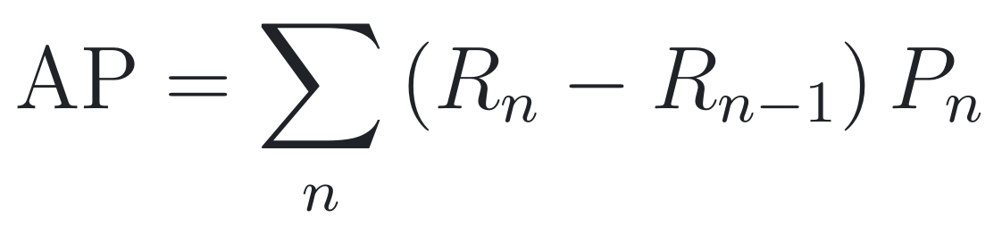
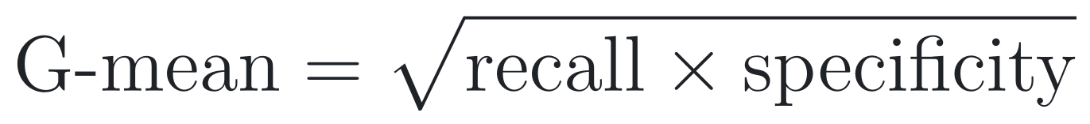
Evaluation metrics
Average Precision (main)
G-mean at threshold 0.5
False alarms at 0.5
FP = genuine predicted as fraud
Area under the precision–recall curve. Uses only the ranking of the probabilities, so no threshold. Random guessing gives about 0.002 here.
Balances frauds caught (recall) and genuine rows left alone (specificity).
Genuine test transactions flagged as fraud, out of 56,651.
AP does not depend on a threshold; G-mean and false alarms do
We first planned G-mean as the main metric and switched to AP after seeing the baseline results; we report both
Variability: mean ± sd over 5 seeds, per-seed comparisons, and 1,000 bootstrap resamples of the test set
DA 3011L · Uncertainty-Aware Self-Paced Ensemble
8
Notes:
[About 60 s] Our main metric is average precision, the area under the precision-recall curve. It only depends on how the frauds are ranked, so it needs no threshold, and random guessing scores about 0.002 here. We also report G-mean, the square root of recall times specificity, and the number of false alarms, both at threshold 0.5. Note that G-mean and false alarms depend on the threshold but AP does not. To be transparent: we first planned G-mean as the main metric and switched to AP after seeing the baseline results, so we report both. For variability we show the standard deviation over five seeds, per-seed comparisons, and a bootstrap with 1,000 resamples of the test set.

Slide 9
SPE versus the tested baselines
Method | AP ± sd | G-mean | False alarms
SPE | 0.842 ± 0.013 | 0.911 | 8
RUS, 10 classifiers | 0.735 ± 0.026 | 0.926 | 2,302
SMOTE | 0.716 ± 0.001 | 0.917 | 495
Random oversampling | 0.698 ± 0.009 | 0.929 | 311
Class-weighted | 0.673 (fixed) | 0.926 | 356
Plain training | 0.580 (fixed) | 0.839 | 98
RUS, 1 classifier | 0.552 ± 0.237 | 0.924 | 2,811
G-mean and false alarms at threshold 0.5. "Fixed": no randomness, same result on every seed.
SPE had the highest AP on all 5 seeds. Five baselines had a higher G-mean, but with 311 to 2,811 false alarms instead of about 8.
DA 3011L · Uncertainty-Aware Self-Paced Ensemble
9
Notes:
[About 90 s] This slide compares SPE with the baselines. SPE has the highest average precision, 0.842. The next best is the random undersampling ensemble with ten classifiers at 0.735, then SMOTE at 0.716. SPE's AP was higher than every baseline on all five seeds. The G-mean column tells a different story: five of the six baselines have a slightly higher G-mean at threshold 0.5. But they get it by flagging many more genuine transactions: from 311 to 2,811 false alarms, compared with about 8 for SPE. So at 0.5 they sit at a different operating point. Also note the single random undersampling model varies a lot between seeds, with AP standard deviation 0.237. Class weights and plain training have no randomness, so their results are the same on every seed.

Slide 10
SPE versus UA-SPE for different values of γ
Method | AP ± sd | G-mean | False alarms
SPE (= γ = 0) | 0.842 ± 0.013 | 0.911 | 8.2
UA-SPE γ = 1 | 0.841 ± 0.014 | 0.911 | 8.2
UA-SPE γ = 2 | 0.849 ± 0.004 | 0.913 | 8.0
UA-SPE γ = 4 | 0.841 ± 0.006 | 0.907 | 9.0
γ = 2 versus SPE
AP difference +0.007; higher on 3 of 5 seeds
Bootstrap 95% interval [−0.003, 0.018] includes zero
UA-SPE had a slightly higher score, but we cannot conclude that the improvement is reliable
γ = 0 gave exactly the same results as SPE on every seed (control check).
DA 3011L · Uncertainty-Aware Self-Paced Ensemble
10
Notes:
[About 80 s] Now SPE against UA-SPE. Each grey dot is one seed and the navy dot is the mean. Gamma 1 and gamma 4 are essentially the same as SPE. Gamma 2 has the highest mean AP, 0.849 against 0.842, a difference of 0.007. But it was better on only three of five seeds, and the bootstrap 95 percent interval for the difference, minus 0.003 to plus 0.018, includes zero. UA-SPE had a slightly higher score, but we cannot conclude that the improvement is reliable. Gamma 2's smaller spread across seeds is based on only five values, so we do not build a claim on it. As a check, gamma 0 gave exactly the same results as SPE on every seed.

Slide 11
Why the uncertainty-based improvement was small
Most Ũ values were close to 1: median 0.991, and 90% of rows above 0.97
The 10 classifiers gave very similar probabilities (average variance about 0.0025)
Numbers close to 1 stay close to 1 after raising them to a power, so the weights were almost equal
Selection probability moved away from SPE: 1.3%, 2.5% and 5.1% for γ = 1, 2 and 4
So the sampling distribution changed only modestly
Note: bins have unequal widths.
DA 3011L · Uncertainty-Aware Self-Paced Ensemble
11
Notes:
[About 70 s] Why was the effect so small? The chart shows U-tilde for all genuine training rows at the last step of one run. Almost all values are close to 1: the median is 0.991 and 90 percent of rows are above 0.97. The ten classifiers gave very similar probabilities; the average variance between them was only about 0.0025. Raising numbers close to 1 to a power still gives numbers close to 1, so the selection weights were nearly equal. We measured how much selection probability moved compared with SPE: 1.3 percent for gamma 1, 2.5 for gamma 2 and 5.1 for gamma 4. So the sampling distribution changed only modestly. This is a result for this dataset and classifier; we did not test settings where the classifiers disagree more.

Slide 12
Conclusions and limitations
What we found
Limitations
SPE ranked frauds better than all six baselines on every seed (AP 0.842 vs 0.55–0.74)
Baselines with a higher G-mean at 0.5 raised many more false alarms
UA-SPE γ = 2 had the highest mean AP (0.849), but the gain over SPE is small and not statistically conclusive
γ = 1 and γ = 4 did not improve on SPE
One dataset, one fixed split, five seeds
Only 95 test frauds: one fraud changes recall by about 0.01
One classifier type, fixed threshold 0.5, no tuning
Ũ is computed partly on rows the classifiers were trained on
Our plain-training AP (0.580) is lower than the SPE paper's (0.803); we did not investigate why
DA 3011L · Uncertainty-Aware Self-Paced Ensemble
12
Notes:
[About 60 s] To conclude. SPE ranked frauds better than all six baselines on every seed. Baselines with a higher G-mean at 0.5 achieved it with many more false alarms. UA-SPE with gamma 2 had the highest mean AP, but the gain is small and not statistically conclusive, and gamma 1 and 4 did not improve on SPE. The main limitations: one dataset, one split and five seeds; only 95 test frauds; one classifier type with a fixed threshold; and U-tilde is partly computed on rows the classifiers were trained on. Finally, our plain-training AP of 0.580 is lower than the 0.803 in the SPE paper, and we did not investigate why. Thank you; we are happy to take questions.

Slide 13
Implementation overview
File | Role
uaspe/data.py | Load data, remove duplicates, stratified split
uaspe/spe.py | Hardness bins, weights, allocation, Ũ, SPE / UA-SPE training
uaspe/baselines.py | Plain, RUS, ROS, SMOTE, class-weighted
uaspe/metrics.py | AP, G-mean, confusion counts
run_experiment.py | Runs all 55 runs, saves results
analyze_results.py | Paired differences, bootstrap, figures
tests/ | 52 unit and integration tests
def within_bin_weights(normalized_uncertainty, gamma):
"""U~^gamma. gamma = 0 returns None so the caller
samples uniformly, exactly as SPE."""
if gamma == 0:
return None
return np.asarray(normalized_uncertainty,
dtype=float) ** gamma
# Step 8: choose rows inside each bin.
u_tilde = None if gamma is None else \
normalized_uncertainty(history)
chosen = []
for l in range(k):
if allocation[l] == 0:
continue
in_bin = np.flatnonzero(bins == l)
row_weights = None if gamma is None else \
within_bin_weights(u_tilde[in_bin], gamma)
chosen.append(select_within_bin(
in_bin, allocation[l], rng, row_weights))
Excerpt from uaspe/spe.py; long lines wrapped and the loop shown without its outer indentation.
DA 3011L · Uncertainty-Aware Self-Paced Ensemble
13
Notes:
[Backup] Show this if asked about the code. spe.py contains the whole algorithm. The excerpt shows the only place UA-SPE differs from SPE: gamma 0 returns None, so the same uniform sampler as SPE is used. For gamma above 0 the weighted draw uses the random numbers differently, so the selected rows can differ from the first selection onwards. Rows are drawn without replacement one at a time, so inclusion probabilities are not exactly proportional to the weights. The test suite has 52 tests.

Slide 14
References
Z. Liu, W. Cao, Z. Gao, J. Bian, H. Chen, Y. Chang, T.-Y. Liu. Self-paced Ensemble for Highly Imbalanced Massive Data Classification. ICDE 2020, pp. 841–852.
N. Seedat, J. Crabbé, I. Bica, M. van der Schaar. Data-IQ: Characterizing Subgroups with Heterogeneous Outcomes in Tabular Data. NeurIPS 2022.
N. V. Chawla, K. W. Bowyer, L. O. Hall, W. P. Kegelmeyer. SMOTE: Synthetic Minority Over-sampling Technique. JAIR 16:321–357, 2002.
X.-Y. Liu, J. Wu, Z.-H. Zhou. Exploratory Undersampling for Class-Imbalance Learning. IEEE TSMC-B 39(2):539–550, 2009.
A. Dal Pozzolo, O. Caelen, R. A. Johnson, G. Bontempi. Calibrating Probability with Undersampling for Unbalanced Classification. IEEE SSCI 2015, pp. 159–166.
F. Pedregosa et al. Scikit-learn: Machine Learning in Python. JMLR 12:2825–2830, 2011.
DA 3011L · Uncertainty-Aware Self-Paced Ensemble
14
Notes:
[Backup] References used in the talk.

