Slide 1









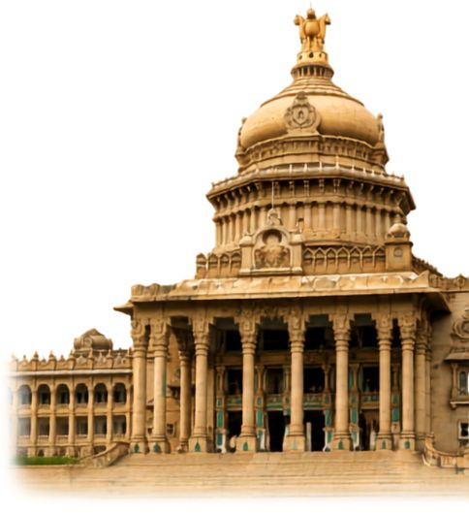


MANIPAL
  ACADEMY OF HIGHER EDUCATION
HackSprint
  Institution of Embrace Diamant in the University
24-Hour Hackathon
17-18
VENUE DETAILS
SATURDAY
Manipal Academy of Higher Education (MAHE)
09 A.M. Onwards
OCTOBER
YOUR NAME: Tanish Renuka Suragihalli
TEAM NAME: GGs
TRACK NO: PS42 Build a scalable, multi-modal AI system using Google Gemini AI and integrated Google Cloud tools (such as Vertex AI, Cloud Storage, and BigQuery) that can process real-time, fragmented data (text, images, and documents) and deliver accurate, context-aware, and explainable decisions in complex and dynamic environments
REGISTER NOW
Team Size
1-4 Members
ORGANIZED BY:
MANIPAL
  ACADEMY OF HIGHER EDUCATION
  Institution of Embrace Diamant in the University

Slide 2
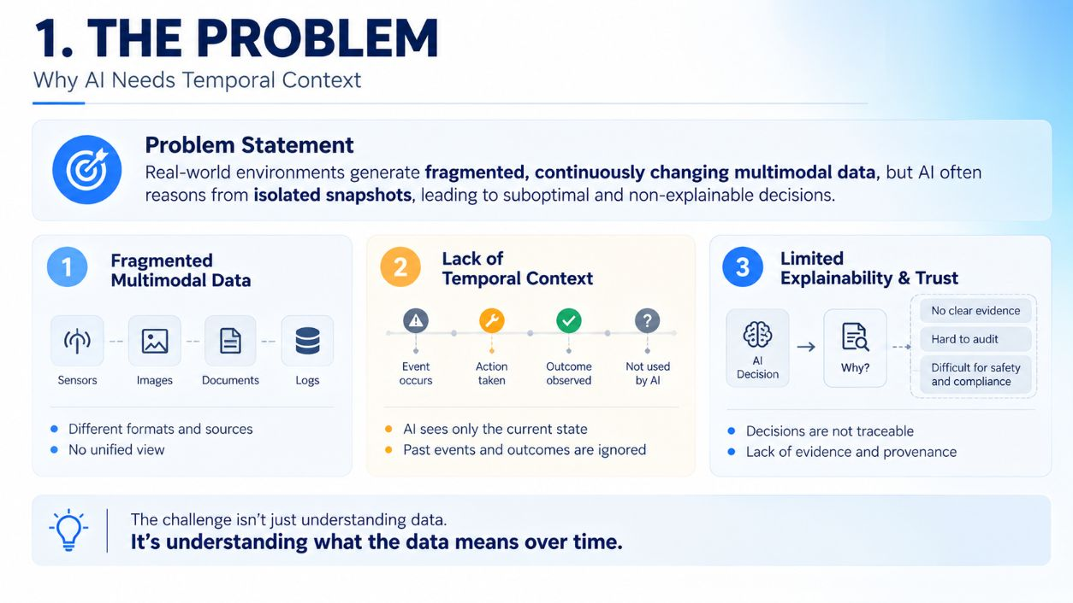

Slide 3
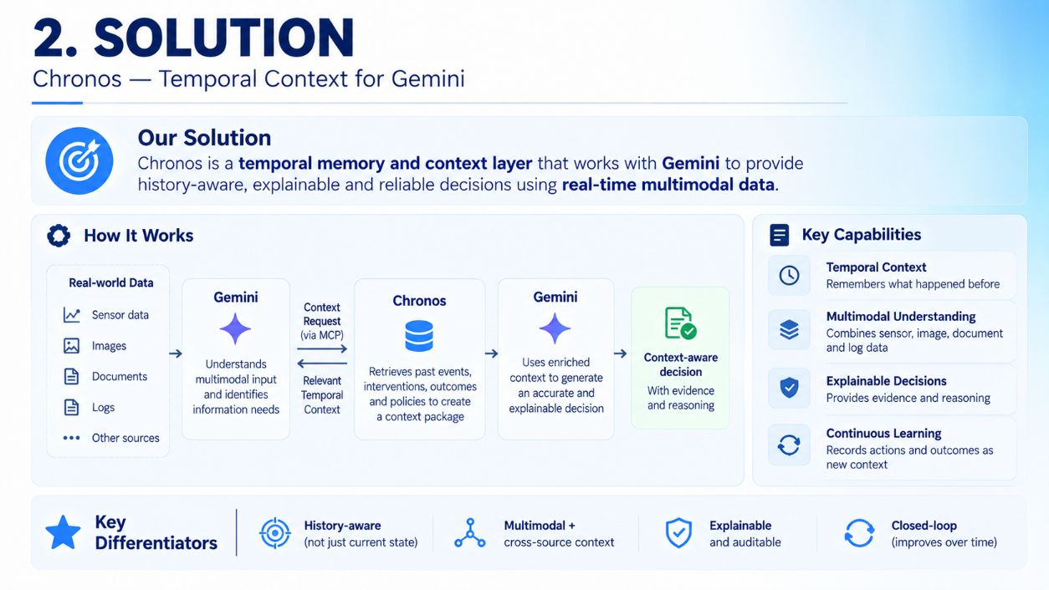

Slide 4
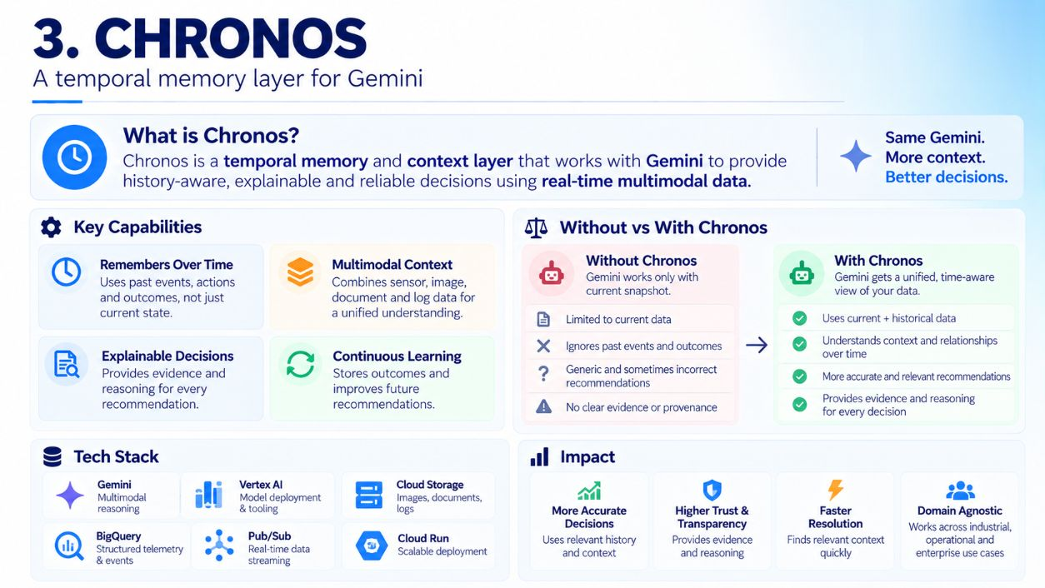

Slide 5
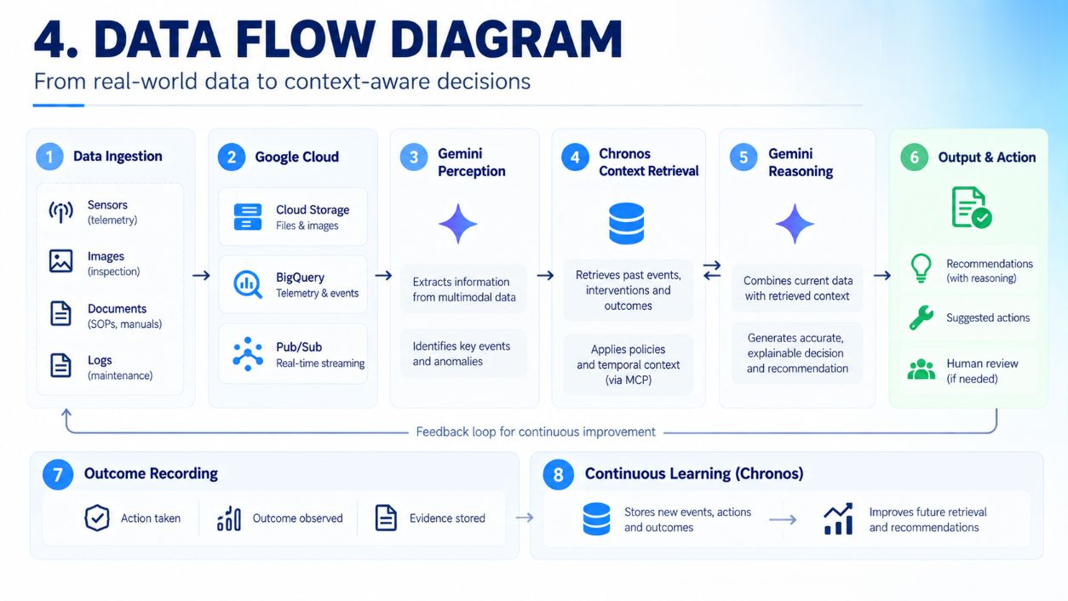

Slide 6
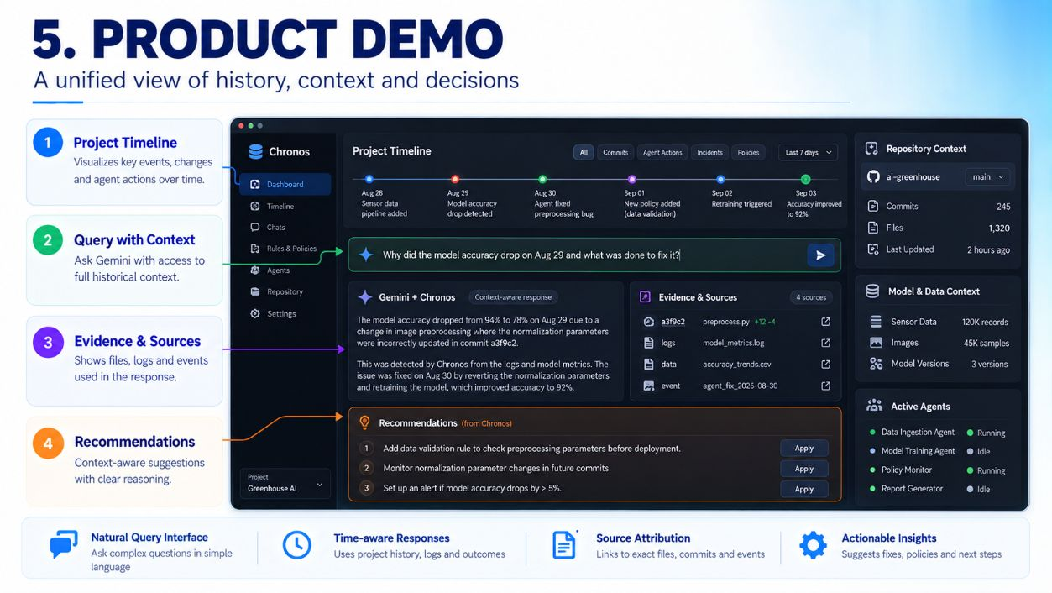

Slide 7
