Slide 1
CPU Scheduling
Chitkara University Institute of Engineering and Technology
Chitkara University, Punjab

Slide 2
Contents
CPU Scheduling: Basic Concepts
Scheduling Criteria
Scheduling Algorithms -
First In first Out
Shortest Job First
Priority Scheduling
Round-robin Scheduling
Multilevel Queue Scheduling

Slide 3
Overview of Scheduling
In a single-processor system, only one process can run at a time. Others must wait until the CPU is free, the CPU then just sits idle.
waiting time is wasted;
no useful work is accomplished.
With multiprogramming, Several processes are kept in memory at a time.
When one process has to wait, the OS takes the CPU away from that process and provides the CPU to another process. This pattern continues.

Slide 4
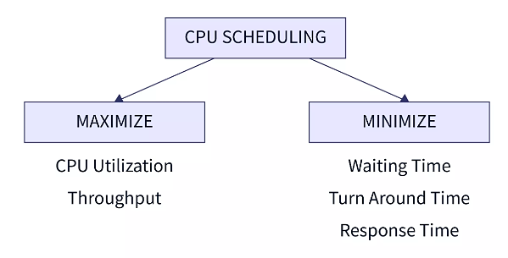
CPU Scheduling
CPU scheduling is the process of deciding which process will own the CPU to use while another process is on hold.
The objectives of CPU Scheduling are;
Process execution consists of a cycle of CPU execution and I/O wait.
Processes alternate between these two states.

Slide 5
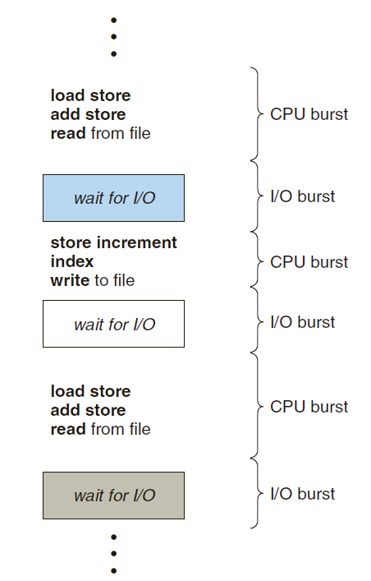
CPU Scheduling
Process execution begins with a CPU burst, followed by an I/O burst and so on.
In a multi-programmed computer system, multiple process compete for the CPU at a given time, to complete their current CPU bursts.

Slide 6
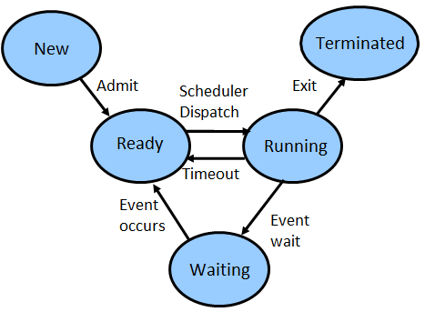
When to Schedule ??
Four conditions under which CPU Scheduling decisions are taken:
If a process is switching from running to waiting state. (may be for an I/O request, or for wait() operation).
If a process is switching from running to ready state (when an interrupt occurs).
If a process is switching from waiting to ready state (when its I/O request is completed).
If a process terminates.

Slide 7
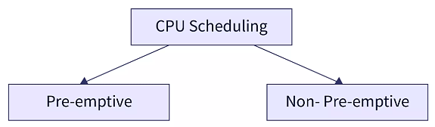
Types of Scheduling
Non Pre-emptive Scheduling: new process can executed only after the current process has completed its execution. The process holds the resources of the CPU till its state changes to terminated or is pushed to waiting state.
Pre-emptive Scheduling: some processes may have higher priority and hence must be executed before the processes that have lower priority. CPU resource is allocated to a process for only a limited period of time.

Slide 8
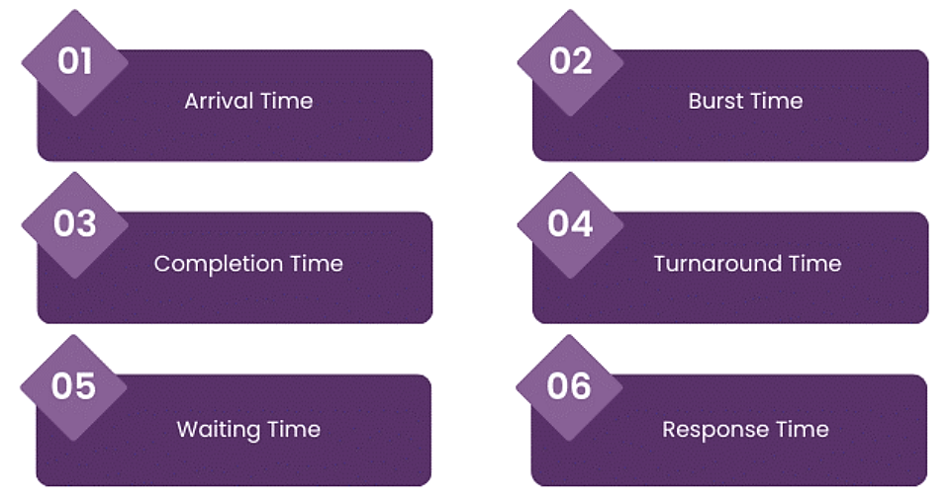
Scheduling Terminologies

Slide 9
Scheduling Criteria
CPU utilization: keep the CPU as busy as possible.
Throughput: No. of processes completed their execution per unit time.
Arrival time: time at which a process arrives at the ready queue.
Burst Time: time required by process to complete its execution.
Completion Time: time at when a process completes its execution.
Turn-Around Time (TAT): difference between completion time and arrival time.
Waiting Time: amount of time a process waits to get CPU resources in the ready queue. (difference between turn around time and burst time).
Response Time: time from the submission of a request until the first response is produced, not it takes to output the response.

Slide 10
Scheduling Optimization Criteria
Maximize
the CPU utilization
the throughput
Minimize
the (average) turnaround time
the (average) waiting time
the (average) response time

Slide 11
Scheduling Algorithms
First Come, First Serve (FCFS) Scheduling
Shortest Job First (SJF) Scheduling
Priority Scheduling
Round Robin (RR) Scheduling
Multilevel Queue Scheduling

Slide 12
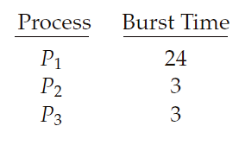
FCFS Scheduling
FCFS is simplest to implement and understand.
Easily managed with a FIFO queue.
FCFS scheduling algorithm is non pre-emptive.
Average waiting time depends on the order of processes enter the system.
Example;
Consider the following set of processes that arrive at time 0, with the length of the CPU burst given in milliseconds:

Slide 13
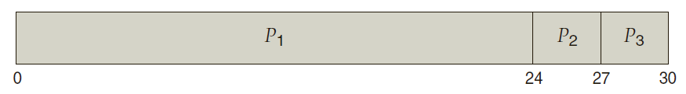
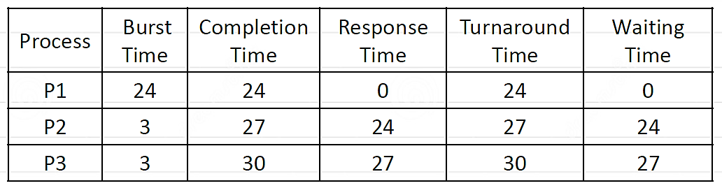
FCFS Scheduling (Example)
If the processes arrive in the order P1, P2, P3, the resulting Gantt chart is;
Average response time: (0 + 24 + 27)/3 = 17
Average waiting time: (0 + 24 + 27)/3 = 17
Average turnaround time: (24 + 27 + 30)/3 = 27

Slide 14
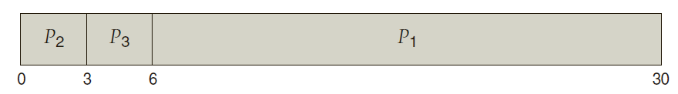
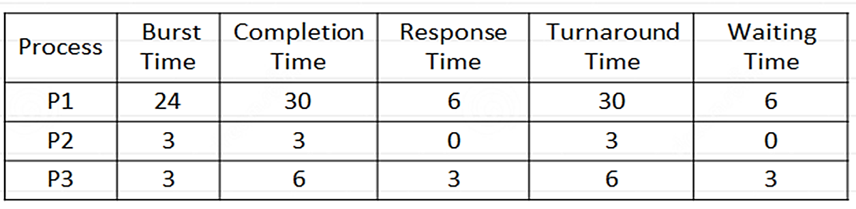
FCFS Scheduling (Example contd..)
If the processes arrive in the order P2, P3, P1, the resulting Gantt chart is;
Average response time: (6 + 0 + 3)/3 = 3
Average waiting time: (6+ 0 + 3)/3 = 3
Average turnaround time: (30 + 3 + 6)/3 = 13

Slide 15
FCFS Scheduling
Advantages:
It is simplest and basic form of scheduling algorithms.
It is easy to implement, it doesn’t require complex data structures.
Since processes are executed in order they arrive, there’s no risk of starvation.
Disadvantages:
As it is a Non pre-emptive Scheduling Algorithm, it can result in long waiting times.
If a long process arrives before a shorter one. Then other processes will have to wait more, this will result in more average waiting time. i.e.; known as convoy effect.
It is not suitable for time-sharing OS.

Slide 16
SJF Scheduling
It associates each process with the length of next CPU burst.
Also known as Shortest Job Next.
The CPU is assigned to the process with the smallest CPU burst.
FCFS can be used to break ties.
It may or may not be pre-emptive.

Slide 17
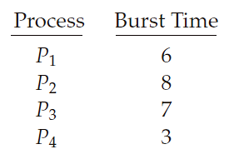
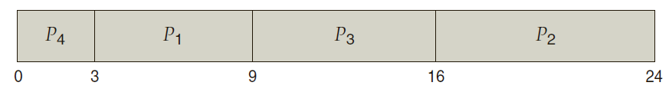
SJF Scheduling (Example)
Consider the following set of processes with the length of the CPU burst given in milliseconds:
Sort all the processes according to the minimum Burst time.
Average waiting time: (3 + 16 + 9 + 0)/4 = 7 ms.
In comparison with FCFS, the average waiting time = 10.25 ms.

Slide 18
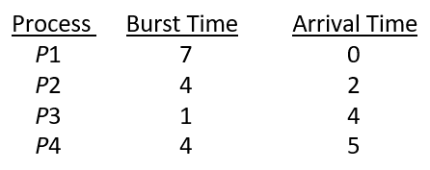
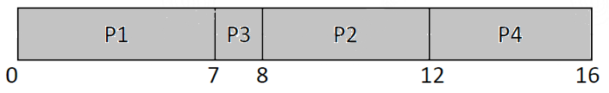
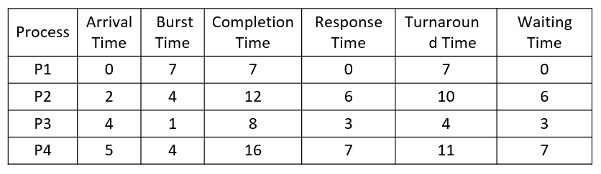
Non Pre-emptive SJF (Example)
Consider the following set of processes with the length of the CPU burst given in milliseconds:

Slide 19

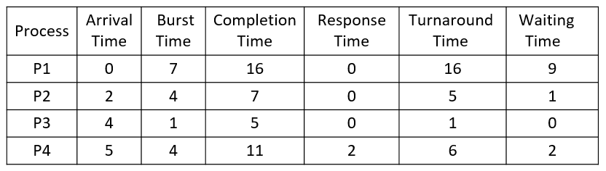
Pre-emptive SJF (SRTF) Example
Consider the following set of processes with the length of the CPU burst given in milliseconds:

Slide 20
SJF Scheduling
Advantages:
SJF is better than the FCFS as it reduces the average waiting time.
Frequently used for long term scheduling.
Suitable for jobs running in batches, where run times are already known.
Disadvantages:
Job completion time must be known earlier, but it is hard to predict.
May cause starvation, if shorter processes keep coming.
Cannot be implemented at the level of short term scheduling.

Slide 21
Practice Questions
Q1. Consider three processes: Process P1 arrives at time 0 with a burst time of 5 ms, P2 arrives at time 1 with a burst time of 3 ms, and P3 arrives at time 5 with a burst time of 8 ms. Calculate the average waiting time.
Average TT Time = 7.66 ms / Average Waiting Time = 2.33 ms
Q2. Consider the following four processes with burst times: P1 = 6 ms, P2 = 2 ms, P3 = 6 ms, P4 = 3 ms. Assume all arrive at time 0. Find the average waiting time using SJF scheduling.
Average TT Time = (2+5+11+17)/4 = 8.75 ms / Average Waiting Time = 4.5 ms
Q3. Given:
• P1 = (Arrival = 1, Burst = 8ms)
• P2 = (Arrival = 2, Burst = 4ms)
• P3 = (Arrival = 3, Burst = 2ms)
• P4 = (Arrival = 4, Burst = 1ms)
Find average turnaround and waitind time for SRTF.
Average TT Time = 6.5 ms / Average Waiting Time = 2.75ms

