Slide 1
Threads
Chitkara University Institute of Engineering and Technology,
Chitkara University, Punjab

Slide 2
Content
Overview of Threads
Multicore Programming
Multithreading Models
Threading Issues
Linux Threads

Slide 3
Overview of Threads
In computers, a single process might have multiple functionalities running in parallel where each functionality can be considered as a thread.
A thread is the smallest unit of execution within a program.
A process can contain one or more threads.
There can be multiple threads in a single process having the same or different functionality.
A thread is a single sequence stream within a process.
Threads have the same properties as the process so they are called lightweight processes.
On single core processor, threads are are rapidly switched giving the illusion that they are executing in parallel. In multi-core systems, threads can execute truly in parallel across different cores.
Each thread has different states.

Slide 4
Cont...
Threads are executed one after another, but it gives the illusion that they are executing in parallel.
Threads are small units of a computer program that can run independently.
They allow a program to perform multiple tasks at the same time, like having different parts of the program run simultaneously.
This makes programs more efficient and responsive, especially for tasks that can be divided into smaller parts.

Slide 5
Cont...
A thread, sometimes called a light weight process (LWP), is a basic unit of CPU utilization.
Each thread has:
A program counter
A register set
A stack space
Threads allow multiple tasks to be performed simultaneously within a process, making them a fundamental concept in modern operating systems.

Slide 6
Cont...
Many software packages that run on modern desktop PCs are multithreaded.
An application typically is implemented as a separate process with several threads of control.
Examples:
A web browser might have one thread display images or text while an other thread retrieves data from the network.
A word processor may have a thread for displaying graphics, another for reading keystrokes from the user, and a third thread for performing spelling and grammar checking in the background.

Slide 7
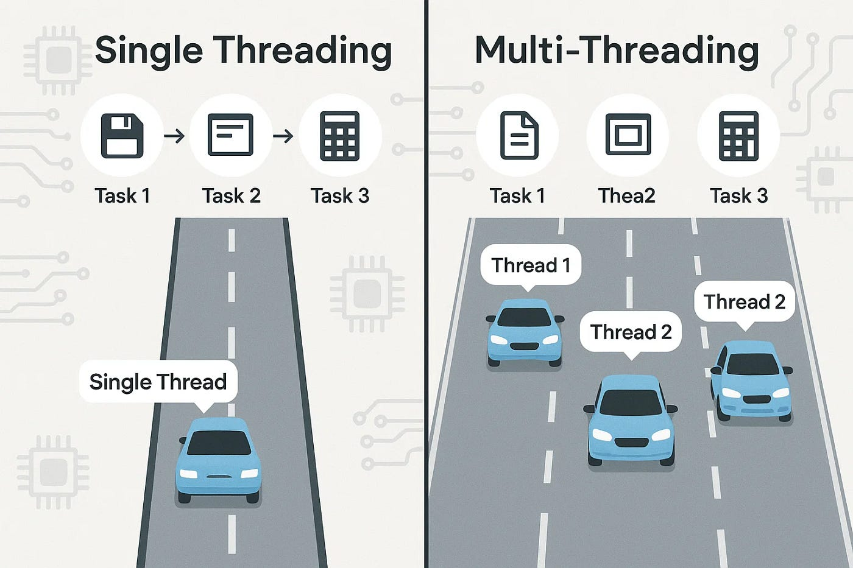
Single & Multi threaded Processes
A single-threaded application executes one task at a time, following a linear sequence. The CPU processes each instruction one after another, meaning if one task is slow, everything else has to wait.
A multi-threaded application can execute multiple tasks simultaneously by splitting processes into separate threads, which improves performance and responsiveness.
If you’re working on a simple application with minimal processing needs, single-threading is often sufficient. However, for high-performance applications like gaming, web servers, and real-time processing, multi-threading is essential for efficiency.

Slide 8
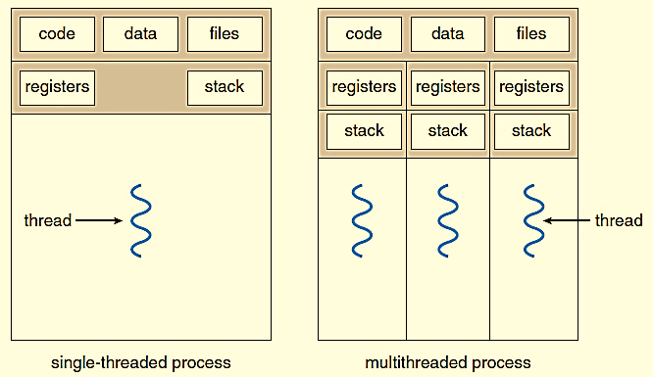
Single & Multi threaded Processes

Slide 9
Components of Threads
A thread is an independent unit of execution. To execute correctly, each thread must maintain its own execution context, which consists of the following three components:
Program Counter
The Program Counter holds the address of the next instruction that the thread will execute.
Why it is needed
Multiple threads may execute the same program code.
Each thread may be at a different point in the execution.
The PC ensures that when a thread is paused and later resumed, it continues from the correct instruction.

Slide 10
Cont..
Register Set
The register set contains the values of all CPU registers required by the thread.
Includes:
General-purpose registers
Accumulator
Index registers
Status / flag registers
Why it is needed
Registers store temporary data and intermediate results during execution.
During a context switch, the OS saves the register set of the current thread and restores another thread’s register set.
Key point
Each thread must have its own register set so it can resume execution correctly after interruption.

Slide 11
Cont...
Stack space
The stack is a memory area used by the thread to manage function calls.
Stack stores:
Local variables
Function parameters
Return addresses
Function call information
Why it is needed
Threads execute functions independently.
Each thread requires a separate stack to avoid interference with other threads.
Important
Even though threads share the process memory, stack space is private to each thread.

Slide 12
Benefits of Threads
Better resource utilization: Threads can run in parallel, allowing the system to make better use of multiprocessor architecture.
Improved performance: Threads allow for concurrent execution, which increases the efficiency of the system.
Improved communication: Threads share resources, which allows for faster communication and data sharing.
Increased responsiveness: Threads allow for multitasking, which makes the system more responsive.
Faster context switching: Threads within the same process share memory, so switching is faster between threads as compared to processes.

Slide 13
Process Vs Threads
S. No. | Process | Thread
1 | Processes use more resources and hence they are termed as heavyweight processes. | Threads share resources and hence they are termed as lightweight processes.
2 | Process switching needs interaction with OS. | Thread switching does not need to interact with OS.
3 | Creation and termination times of processes are slower. | Creation and termination times of threads are faster compared to processes.
4 | Processes have their own code and data/file. | Threads share code and data/file within a process.
5 | Communication between processes is slower. | Communication between threads is faster.
6 | In multiple processes each process operates independently of the others. | One thread can read, write or change another thread's data.

Slide 14
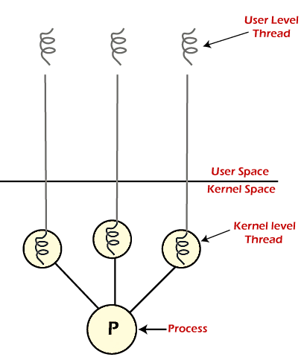
Types of Threads
Threads are mainly classified based on who manages them and how they are mapped to the operating system.
User Level Thread
Kernel Level Thread

Slide 15
User Level Thread
Implemented and managed by the user using user-level libraries.
Kernel is not aware of it and OS does not recognize these threads.
Faster to create and manage compared to kernel-level thread.
Context switching is faster.
If one user-level thread performs a blocking operation then the entire process gets blocked.
For eg: POSIX threads, Java threads, etc.

Slide 16
Kernel Level Thread
Implemented using system calls and recognized by OS.
Slower to create and manage compared to user-level threads.
The implementation is more difficult than user thread.
Context switch time is longer in the kernel thread.
Even if one kernel-level thread performs a blocking operation, it does not affect other threads.
For eg: Window, Solaris, Linux.

Slide 17
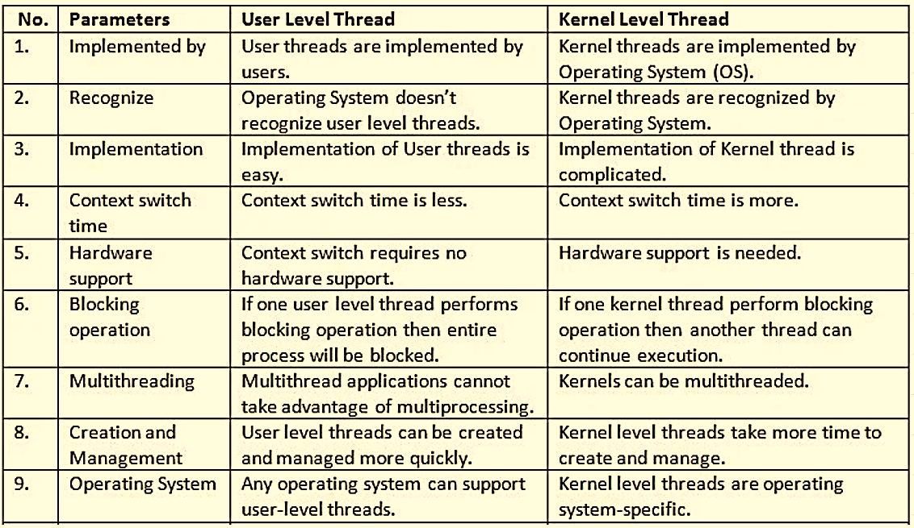
User Level Vs Kernel Level Thread

Slide 18
Multicore Programming Concept
Earlier in the history of computer design, in response to the need for more computing performance, single-CPU systems evolved into multi-CPU systems.
A more recent, similar trend in system design is to place multiple computing cores on a single chip.
Each core appears as a separate processor to the OS.
Whether the cores appear across CPU chips or within CPU chips, we call these systems multicore or multiprocessor systems.
Why Multicore Programming is Needed
Modern CPUs have multiple cores instead of higher clock speeds
Single-threaded programs cannot fully utilize CPU resources
Parallel execution reduces execution time

Slide 19
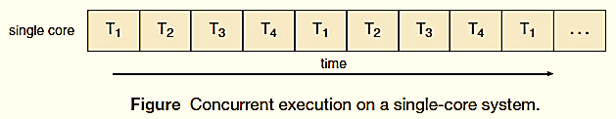
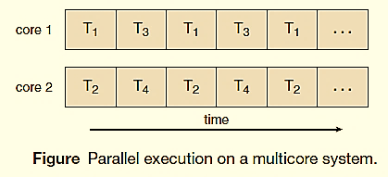
Concurrency vs. Parallelism
Multithreaded programming provides a mechanism for more efficient use of these multiple computing cores and improved concurrency.

Slide 20
Programming Challenges
In general, five areas present challenges in programming for multicore systems:
Identifying tasks
Balance
Data splitting
Data dependency
Testing and debugging

Slide 21
Multi-Threading Models
Multithreading models describe how user-level threads are mapped to kernel-level threads. These models define how threads are scheduled, managed, and executed by the operating system.
Multithreading models are of three types;
Many to many relationship.
Many to one relationship.
One to one relationship.

Slide 22
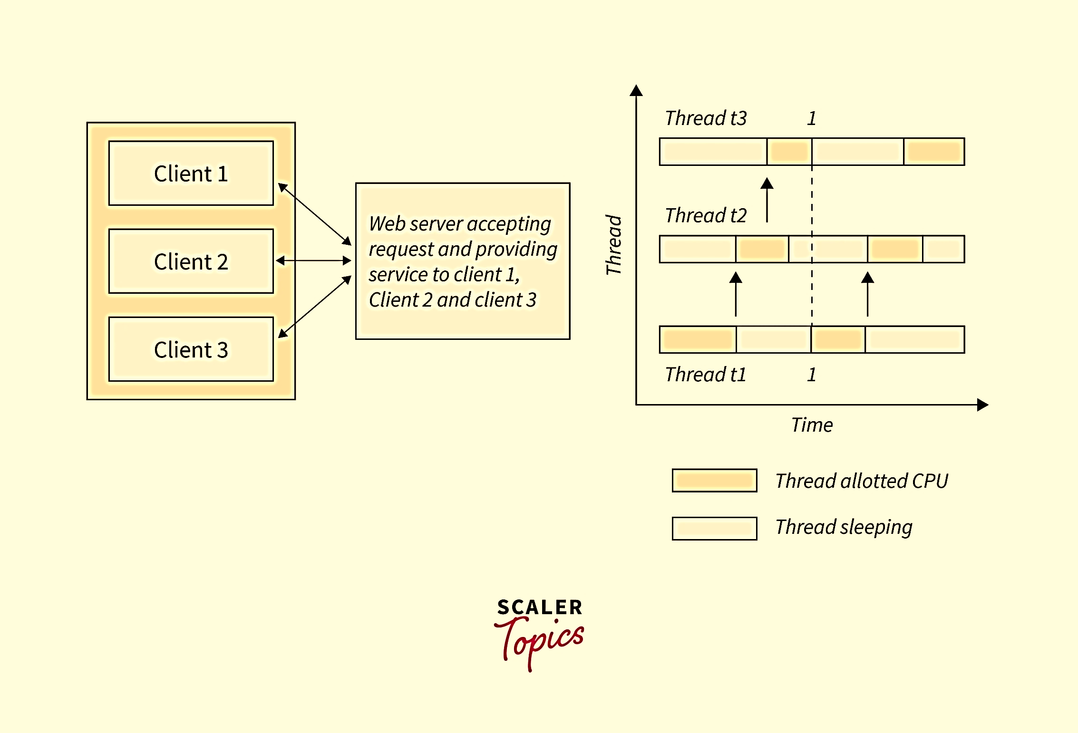
Multi-Threading (Example)
For example, client 1, client 2, and client 3 are accessing the web server without having to wait for other tasks to be complete.
The threads are divided into user-level and kernel-level threads.

Slide 23
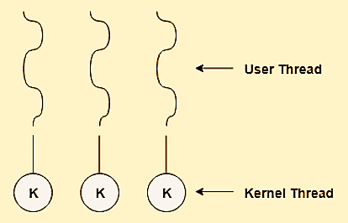
Multi-Threading Models (contd…)
One to One Relationship:
Each of User thread is mapped to kernel thread.
It facilitates the running of multiple threads in parallel.
Provides more concurrency.
Whole process does not gets blocked when 1 thread makes a blocking call as other threads can run.
Creates Overhead as every User thread requires to create the corresponding Kernel Thread for it.
Implemented by Linux and Windows.

Slide 24
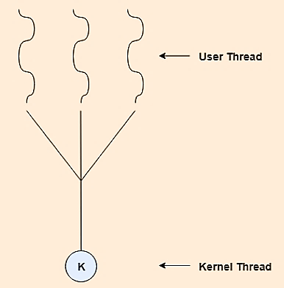
Multi-Threading Models (contd…)
Many to One Relationship:
Many User Level Threads are mapped to one Kernel level Thread.
Does not support parallel processing of threads in Multicore systems, Because only 1 thread can access kernel at a particular time.
If 1 thread makes a blocking call, then entire process will stop.
This is rarely used, mainly cause it does not support Multicore system.

Slide 25
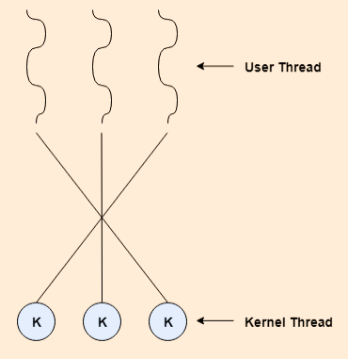
Multi-Threading Models (contd…)
Many to Many Relationship:
Multiple User Threads are multiplexed to same or less number of Kernel threads.
No. of kernel threads depends on the application or machine.
There is no issue of process blocking and threads can run parallelly in multi-process system unlike Many to One Model.

Slide 26
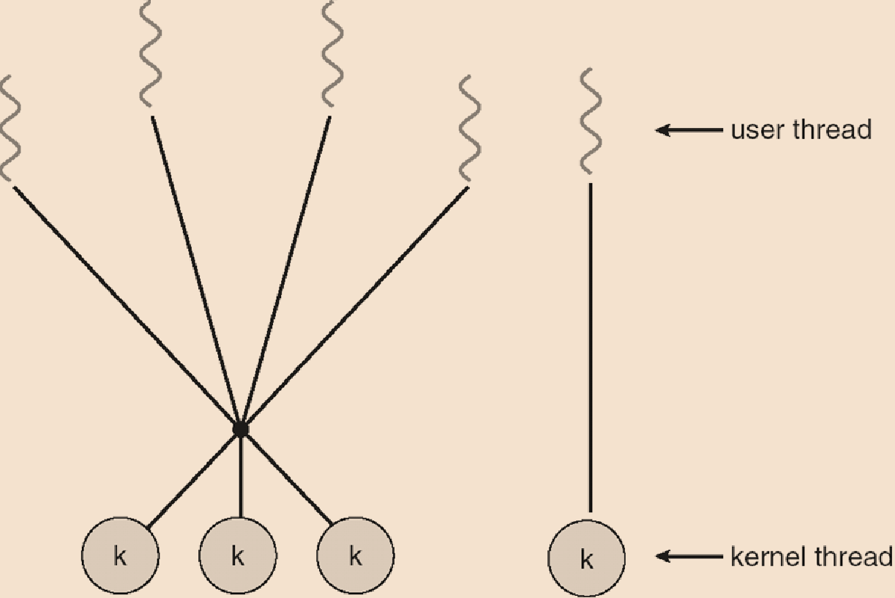
Multi-Threading Models (contd…)
Two Level model:
One popular variation on the many-to-many model (called Two-level model).
It also allows a user thread to be bound to a kernel thread.
Examples:
─ IRIX
─ HP-UX
─ Tru64UNIX
─ Solaris 8 and earlier

Slide 27
Threads Library
Thread library is a thread API (Application Programming Interface) which is a set of functions, methods and routine provided by OS for creating, managing and co-ordination of the threads.
There are two primary ways of implementing thread library−
The first approach is to provide a library entirely in user space with kernel support. All code and data structures for the library exist in a local function call in user space and not in a system call.
The second approach is to implement a kernel level library supported directly by the operating system. In this case the code and data structures for the library exist in kernel space.

Slide 28
Threads Library (contd…)
Invoking a function in the application program interface for the library typically results in a system call to the kernel.
The main thread libraries which are used are given below −
POSIX threads − Pthreads, the threads extension of the POSIX standard, may be provided as either a user level or a kernel level library.
WIN 32 thread − The windows thread library is a kernel level library available on windows systems.
JAVA thread − The JAVA thread API allows threads to be created and managed directly as JAVA programs.

Slide 29
Threading Issues
Semantics of fork() and exec() system calls
Signal handling
Synchronous and Asynchronous
Thread cancellation of target thread
Asynchronous or deferred
Thread-local storage
Scheduler Activations

Slide 30
Threading Issues (contd…)
fork() and exec() system calls:
Some UNIX systems have chosen to have two versions of fork();
One that duplicates all threads.
Another that duplicates only the thread that invoked the fork() system call.
If a thread invokes the exec() system call, the program specified in the parameter to exec() will replace the entire process—including all threads.
Which of the two versions of fork() to use?, depends on the application.

Slide 31
Threading Issues (contd…)
Signal handling:
A signal is used in UNIX systems to notify a process that a particular event has occurred.
A signal may be received either synchronously or asynchronously, depending on the source.
All signals follow the same pattern:
1. A signal is generated by the occurrence of a particular event.
2. The signal is delivered to a process.
3. Once delivered, the signal must be handled.
A signal may be handled by one of two possible handlers:
1. A default signal handler
2. A user-defined signal handler

Slide 32
Threading Issues (contd…)
Signal handling (contd…):
Every signal has a default signal handler that the kernel runs when handling that signal.
Signals are always delivered to a process. However, delivering signals is more complicated in multithreaded programs.
Where should a signal be delivered for Multi-threaded?
1. Deliver the signal to the thread to which the signal applies.
2. Deliver the signal to every thread in the process.
3. Deliver the signal to certain threads in the process.
4. Assign a specific thread to receive all signals for the process.

Slide 33
Threading Issues (contd…)
Thread cancellation:
Thread cancellation involves terminating a thread before it has completed.
A thread that is to be cancelled is referred as target thread.
Cancellation of a target thread may occur in two different scenarios:
Asynchronous cancellation. One thread immediately terminates the target thread.
Deferred cancellation. The target thread periodically checks whether it should terminate, allowing it an opportunity to terminate itself in an orderly fashion.

Slide 34
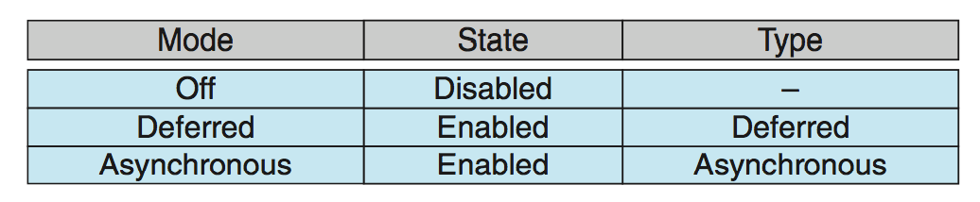
Threading Issues (contd…)
Thread cancellation (contd…):
In Pthreads, thread cancellation is initiated using the Pthread cancel() function.
Pthreads supports three cancellation modes.
The default cancellation type is deferred cancellation.
Cancellation occurs only when a thread reaches a cancellation point.

Slide 35
Threading Issues (contd…)
Thread Local Storage (TLS):
TLS allows each thread to have its own copy of data.
Useful when you do not have control over the thread creation process (i.e., when using a thread pool).
Local variables are visible only during a single function invocation whereas TLS data are visible across function invocations.
Most thread libraries including Windows, Java and Pthreads provide support for TLS.

Slide 36
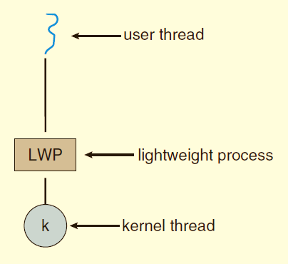
Threading Issues (contd…)
Scheduler Activations:
Both Many-to-Many and Two-level models require communication to maintain the appropriate number of kernel threads allocated to the application.
These models place an intermediate DS between the user and kernel threads- known as a Light-Weight Process, or LWP.

Slide 37
Threading Issues (contd…)
Scheduler Activations:
LWP appears to be a virtual processor on which the application can schedule a user thread to run.
Each LWP is attached to a kernel thread.
If a kernel thread blocks, the LWP blocks as well.
Scheduler Activation mechanism is used for communication between the user-thread library and the kernel.
Scheduler Activation provides upcalls are handled by the thread library with an upcall handler.

Slide 38
Linux Threads
Linux threads are implemented using the kernel-supported threading model, where each thread is treated as an independent schedulable entity by the operating system.
Linux uses a 1:1 threading model, meaning each user-level thread maps directly to a kernel-level thread.
Internally, Linux implements threads using the clone() system call, which allows fine-grained control over what resources are shared between threads.

Slide 39
Linux Thread Implementation
In Linux:
Threads are also known as Light Weight Processes (LWP)
Each thread has:
Its own thread ID (TID)
Own register set and stack
Threads share:
Code section
Data section
Heap
Open files
Address space
From the kernel’s perspective, threads and processes are treated similarly, differing mainly in the degree of resource sharing.

Slide 40
Linux Thread Model (1:1 Model)
Linux follows the One-to-One threading model:
Each user thread corresponds to exactly one kernel thread
Kernel schedules threads directly
Blocking of one thread does not block the entire process
Supports true parallelism on multicore processors
This model provides high concurrency and scalability, making Linux suitable for modern multicore systems.

Slide 41
POSIX Threads (Pthreads) in Linux
Linux provides thread support through the POSIX Threads (Pthreads) library.
Features of Pthreads:
Standardized thread API
Portable across UNIX-based systems
Supports thread creation, synchronization, and termination
Common Pthread functions:
pthread_create() – create a thread
pthread_exit() – terminate a thread
pthread_join() – wait for thread completion
pthread_mutex_lock() / pthread_mutex_unlock() – synchronization

Slide 42
Scheduling of Linux Threads
Linux scheduler schedules threads, not processes
Each thread competes independently for CPU time
Scheduling policies:
Time-sharing (CFS – Completely Fair Scheduler)
Real-time scheduling
Threads can run simultaneously on different cores
This ensures efficient CPU utilization and responsiveness.

Slide 43
Advantages of Linux Threads
True parallel execution on multicore systems
Faster context switching compared to processes
Efficient resource sharing
Better performance and responsiveness
Suitable for high-performance and server applications

Slide 44
Disadvantages of Linux Threads
Complex programming model
Synchronization issues (race conditions, deadlocks)
Debugging multithreaded programs is difficult
Failure of one thread can affect the entire process

Slide 45
Applications of Linux Threads
Web servers (handling multiple client requests)
Database management systems
Operating system services
Real-time and embedded systems
Scientific and parallel computing applications

Slide 46
MCQ
Q1. A thread is the smallest unit of:
A. Memory allocation
B. Scheduling
C. Execution
D. Storage
Answer: C
Q2. Threads are called lightweight processes because they:
A. Do not require CPU
B. Share process resources
C. Have no stack
D. Run slower than processes
Answer: B
Q3. On a single-core processor, threads appear to run in parallel due to:
A. Multicore execution
B. Time slicing / rapid switching
C. Pipelining
D. Instruction-level parallelism
Answer: B

Slide 47
Q4. Which of the following is NOT a component of a thread?
A. Program Counter
B. Register Set
C. Stack Space
D. Heap
Answer: D
Q5. The program counter of a thread contains:
A. Thread ID
B. Address of next instruction
C. Stack base address
D. Memory size
Answer: B
Q6. Each thread has its own register set to:
A. Reduce context switch time
B. Improve security
C. Resume execution correctly
D. Share CPU registers
Answer: C

Slide 48
Q7. Stack space of a thread stores:
A. Global variables
B. Heap memory
C. Local variables and return addresses
D. Shared data
Answer: C
Q8. Which application is a classic example of multithreading?
A. Calculator
B. Compiler
C. Web browser
D. Text editor without background tasks
Answer: C
Q9. A single-threaded process:
A. Executes multiple tasks simultaneously
B. Executes one task at a time
C. Cannot be blocked
D. Uses multiple CPUs
Answer: B

Slide 49
Q10. Which of the following is a benefit of threads?
A. Increased blocking
B. Faster context switching
C. Higher memory usage
D. Slower execution
Answer: B
Q11. User-level threads are managed by:
A. Kernel
B. Hardware
C. User-level libraries
D. BIOS
Answer: C
Q12. A disadvantage of user-level threads is that:
A. Context switching is slow
B. Kernel is not involved
C. Blocking one thread blocks the entire process
D. They cannot be created quickly
Answer: C

Slide 50
Q13. Kernel-level threads are:
A. Not recognized by OS
B. Faster to manage
C. Implemented using system calls
D. Invisible to scheduler
Answer: C
Q14. In the One-to-One threading model:
A. Many user threads map to one kernel thread
B. One user thread maps to one kernel thread
C. Threads cannot run in parallel
D. Kernel is unaware of threads
Answer: B
Q15. Which multithreading model does not support parallelism on multicore systems?
A. One-to-One
B. Many-to-Many
C. Two-Level
D. Many-to-One
Answer: D

Slide 51
Q16. In the Many-to-Many model:
A. Each user thread has a kernel thread
B. Multiple user threads map to fewer kernel threads
C. Kernel threads are not used
D. Process always blocks
Answer: B
Q17. Thread cancellation means:
A. Pausing a thread
B. Restarting a thread
C. Terminating a thread before completion
D. Suspending all threads
Answer: C
Q18. In deferred cancellation, a thread is cancelled:
A. Immediately
B. By kernel only
C. At cancellation points
D. After process termination
Answer: C

