Slide 1

Embedded Systems and Internet of Things (ES&IOT) Lab
Title of the Project
Manya, 2310992146
Tanish Wadhwa, 2310992149
Mehak Singla, 2310992151
Monal, 2310992156
Namita, 2310992161
Navya, 2310992164
Class Group: G24-b
Project Guide Name (ES&IOT Faculty Name):
Dr. Jyoti
Designation
Department of Interdisciplinary Courses in Engineering

Slide 2
Problem Statement
Society/Industry Problem Identified
1. Drunk Driving: A major cause of road accidents leading to fatalities and injuries.
2. Driver Fatigue: Drowsiness causes loss of control, especially during long drives.
3. Lack of Real-time Monitoring: Absence of automated systems to detect unsafe driving behavior.
4. Delayed Alerts: Families and authorities are not immediately informed of risks.
Problem to be Addressed
1. Prevent vehicle ignition when alcohol is detected.
2. Detect driver drowsiness in real time and trigger alerts.
3. Send immediate notifications to family members or authorities.
4. Enhance road safety and reduce accidents through IoT-based monitoring systems.

Slide 3
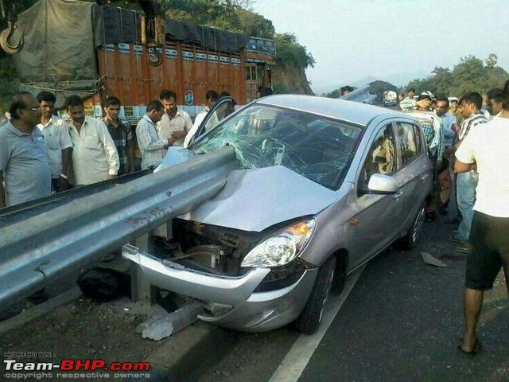
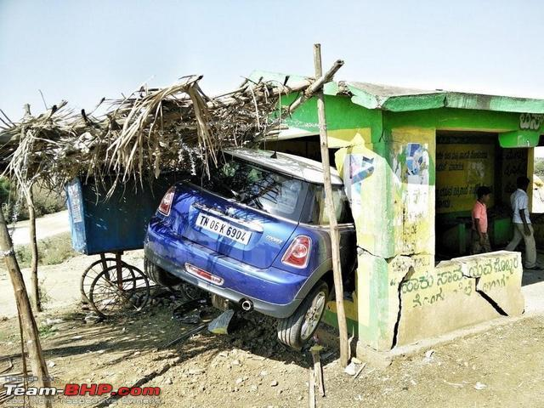
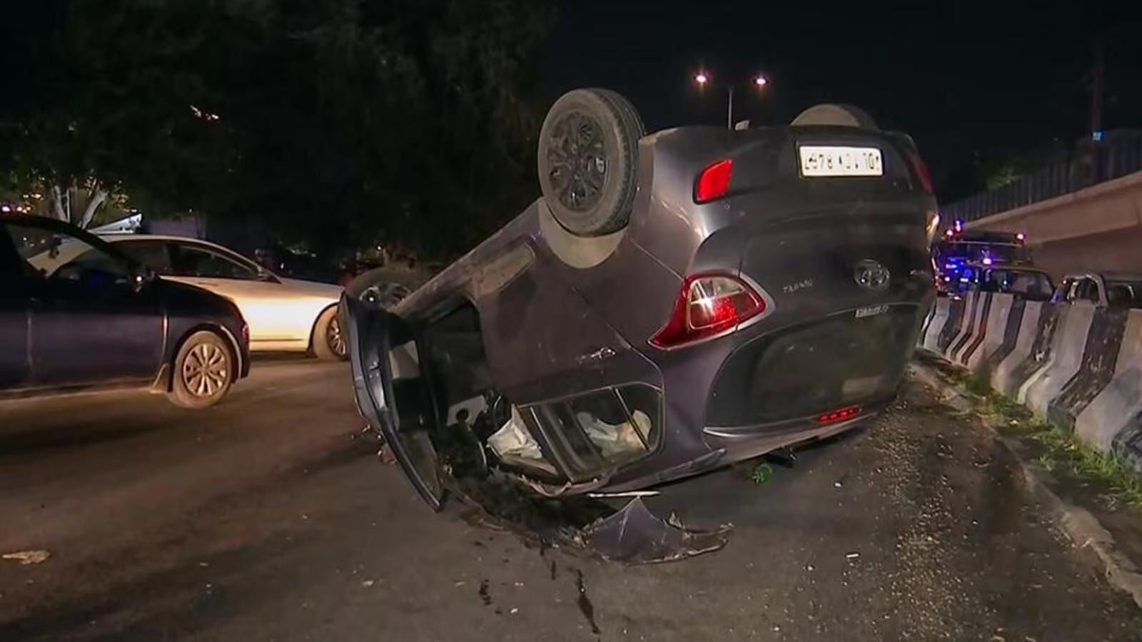
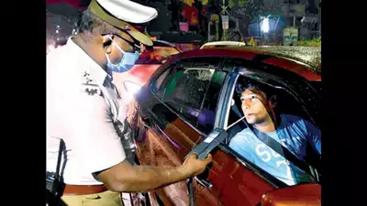
Problem Statement

Slide 4
Proposed Solution
Proposed Solution
The proposed solution is an IoT-based vehicle safety system designed to prevent drunken and drowsy driving, thereby enhancing road safety. The system focuses on two principal functions: alcohol detection and sleep detection. It prevents a vehicle from being ignited when alcohol is detected in the breath of the driver and will alert the driver and all family members in case of sleeping during driving.
How It Works
Alcohol Detection System:
A breath alcohol sensor such as MQ-3 or MQ-135 is mounted close to the driver seat or steering.
Whenever the driver breathes in, the sensor detects the alcohol level.
Once the alcohol level crosses a threshold level, the system immediately cuts off the car ignition by utilizing a relay module.
Along with this, an alert notification along with the location of the driver is sent to family members through GSM/GPRS or IoT cloud platforms.

Slide 5
Proposed Solution
Sleep Detection System:
A camera module or infrared sensor is employed to track the driver's eye movement and head position.
The system will then analyze real-time data using OpenCV or machine learning algorithms for detecting protracted eye closure or head tilting, which indicate drowsiness.
Once the system detects drowsiness, it will automatically sound an audible siren/buzzer to alert the driver.
Notifications can also be sent to family members for further intervention.
Communication and Integration:
The system uses IoT technologies such as Wi-Fi or GSM to send real-time alerts to a mobile application or SMS platform.
A GPS module helps track the location of the driver in case of emergency alerts.
Control Mechanism:
A relay module integrated with the car's ignition system will ensure that the vehicle will not start when alcohol is detected.
The system works smoothly without any manual intervention, which will ensure automation and reliability.

Slide 6
Proposed Solution
Key Components
Microcontroller: Arduino/ESP32/NodeMCU for data processing and control.
Alcohol Sensor: MQ-3 or MQ-135 for detecting alcohol levels.
Sleep Detection Sensor: Camera module/IR sensor for eye and head movement tracking.
Relay Module: Disables vehicle ignition if alcohol is detected.
Alert Mechanism:
- Buzzer/Siren for immediate driver alerts.
- GSM/GPRS module or IoT cloud for family notifications.
GPS Module: Tracks and sends driver location.
Software Tools: Arduino IDE, OpenCV, and cloud/mobile dashboard for alerts.
Unique or Innovative Aspects
Dual-Functionality: Alcohol and sleep detection in a single system.
Automated Ignition Control: Prevents vehicle ignition when alcohol is detected.
Real-time Alerts: Instant notifications with location details for family/emergency contacts.
Cost-Effective: Affordable components for easy integration into vehicles.
Advanced Algorithms: Machine learning/image processing for accurate drowsiness detection.
IoT Integration: Real-time monitoring and notifications for enhanced safety.

Slide 7
SDG’s Covered
SDG Goals Addressed
1. SDG 3: Good Health and Well-being
Reduces accidents by drunk and drowsy driving, thus allowing people to travel safer with less casualties. (Target 3.6).
2. SDG 9: Industry, Innovation, and Infrastructure
Encourages technology developments within the automotive industry by use of IoT, sensors, and machine learning in building more safety transportation systems.
3. SDG 11: Sustainable Cities and Communities
Improves road safety, contributing to safer and more sustainable urban mobility (Target 11.2).
4.SDG 12: Responsible Consumption and Production
Promotes responsible use of vehicles and decreases waste and environmental damage caused by accidents.
5. SDG 13: Climate Action
- Avoids traffic congestion and pollution resulting from accidents, promoting environmental sustainability.
6. SDG 16: Peace, Justice, and Strong Institutions-
Promotes law enforcement work to prevent drunk driving, leading to safer and more responsible communities.

Slide 8
Technology and Tools
Technology and Tools
Programming Languages:
Python (for data processing and control logic).
C/C++ (for microcontroller programming).
IoT Platforms: ThingSpeak, Blynk, or AWS IoT Core (for cloud-based monitoring and notifications).
Database: Firebase or MySQL (to store alert and sleep detection logs).
Mobile App Development: Flutter or React Native (to create a mobile interface for family notifications and monitoring).
2. Sensors and IoT Components
Alcohol Detection:
MQ-3 or MQ-135 Gas Sensor (to detect alcohol concentration in the driver's breath).
Sleep Detection: IR Sensor or Camera Module with Eye Tracking (e.g., Raspberry Pi Camera and OpenCV).
Heart Rate Sensor (like MAX30100 or MAX30102) to monitor signs of drowsiness.

Slide 9
Technology and Tools
3. Embedded Systems and Microcontrollers
Microcontroller : Arduino Uno/Nano or ESP32 (for sensor integration and control logic).
Raspberry Pi (for advanced processing like eye-tracking algorithms).
Relay Module : To control car ignition circuits.
4. Communication Protocols
Bluetooth or Wi-Fi (for transmitting data to the family’s mobile app).
MQTT or HTTP (for cloud integration and notifications).
5. Siren/Alert System
Buzzer or Siren Module : to generate audio alerts inside the vehicle.
SMS/Email API Integration (e.g., Twilio, IFTTT) to notify family members.
6. Additional Tools
Power Supply:
Battery module for powering sensors and microcontrollers.
Debugging Tools:
Serial Monitor (Arduino IDE) or Logic Analyzers.

Slide 10
Implementation Plan
Phase 1: Planning and Requirements Gathering
Define the Project Goals:
Detect alcohol concentration in breath. Prevent car ignition when alcohol is detected.
Sleep detection should be implemented with a siren alert.
Notifications to family members should be sent.
2. Select Appropriate Components:
Sensors: MQ-3 for alcohol detection and IR sensor/Camera for drowsiness.
Microcontrollers: Arduino, ESP32, or Raspberry Pi.
Communication tools: Wi-Fi/Bluetooth for alerts and notifications.
3. Generate System Flow Diagram: Design the workflows of alcohol detection, sleep detection, and alert systems.
Phase 2: Hardware Implementation
Setup for Alcohol Detection: Connect the MQ-3 sensor with a microcontroller. Write the program on the microcontroller to read the analog readings of the sensor.
Setup for Integration of Sleep Detection System:- Utilize an IR sensor or camera module with a microcontroller. Implement eye-tracking (for the sake of accuracy: through OpenCV on Raspberry Pi). Include a buzzer or siren for alerts.
Control Ignition System: Connect a relay module for simulating car ignition control and to program that it will shut down ignition if alcohol is present.
Power Management: Use stable supply or battery configuration for the parts of the hardware.

Slide 11
Implementation Plan
Phase 3: Software Development
1. Microcontroller Programming:
Arduino IDE or MicroPython could be used to command the sensor and logic flow.
Program the threshold alcohol levels and sleep detection triggers.
2. Alerting Notification System:
Implement APIs such as Twilio/IFTTT to make alerts via SMS/Email sent to family members.
3. Mobile App or Dashboard Optional:
Create a low-level app for monitoring based on Flutter/React Native.
Display real-time sensor information, with a log of alerts
4. Testing and Debugging :
Test alcohol detection with ignition control.
Validate the sleep detection and siren system.
Ensure family notification triggers work reliably.
Phase 4: Deployment
Assemble the complete system in a vehicle prototype.
Monitor and test its reliability in real driving conditions.
Optimize power usage and sensor sensitivity.

Slide 12
Impact and Benefits
Expected Benefits of the Project
Improved Road Safety:
Detecting alcohol and preventing car ignition will reduce the risk of accidents caused by drunk driving.
Sleep detection systems will prevent accidents caused by drowsy driving.
Real-Time Alerts for Families:
Instant notifications to family members will improve response time and ensure the driver’s well-being is closely monitored.
Automated Prevention Mechanisms:
By automating ignition lock and triggering sirens, the system eliminates human errors, ensuring reliable preventive measures.
2. How the Solution Will Improve Lives or Solve the Problem
Reducing Drunk Driving Incidents:
Drivers who attempt to start the car after consuming alcohol will be restricted, directly reducing road fatalities.
Drowsiness Prevention:
Monitoring for sleep or fatigue ensures drivers remain alert, preventing collisions due to loss of focus or control.
Peace of Mind for Families:
Families will receive real-time updates, reducing anxiety regarding the safety of their loved ones.

Slide 13
Impact and Benefits
3. Social, Economic, and Environmental Impacts
Social Impact:
Decrease in accidents caused by impaired or fatigued driving.
Improved public awareness about road safety and responsible driving behavior.
Protection of lives, particularly in high-risk areas with a history of alcohol-related crashes.
Economic Impact:
Lower economic costs for society related to accidents (e.g., medical expenses, insurance claims, and property damage).
Fewer vehicle repairs and replacements, saving individuals and insurance companies significant costs.
Increased adoption of safety-focused IoT systems, driving innovation in the automotive and tech industries.
Environmental Impact:
Reduction in vehicle crashes and subsequent emissions (from fires, repairs, or vehicle replacements).
Long-term sustainability by creating safer transportation systems and reducing accidents that pollute ecosystems.

Slide 14
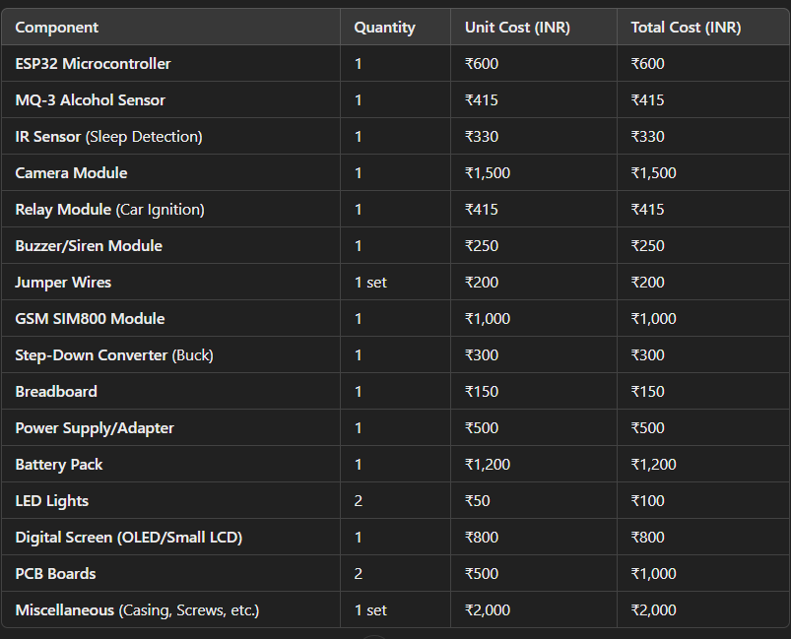
Budget

Slide 15
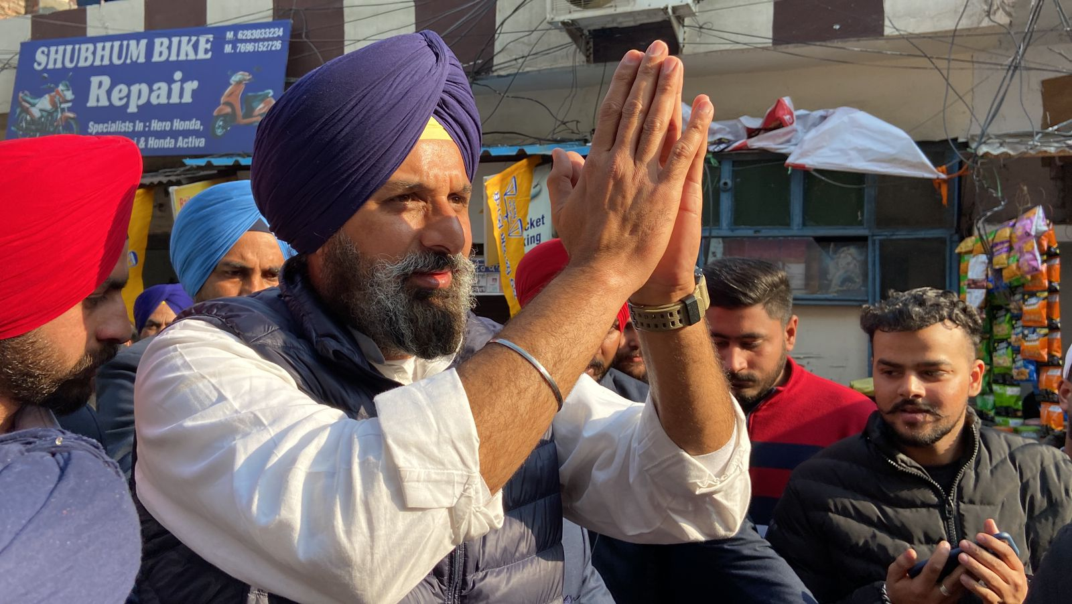
Thank You

