Slide 1

Embedded Systems and Internet of Things (ES&IOT) Lab
Title of the Project
Manya, 2310992146
Tanish Wadhwa, 2310992149
Mehak Singla, 2310992151
Monal, 2310992156
Namita, 2310992161
Navya, 2310992164
Class Group: G24-b
Project Guide Name (ES&IOT Faculty Name):
Dr. Jyoti
Designation
Department of Interdisciplinary Courses in Engineering

Slide 2
Problem Statement
Society/Industry Problem Identified
1. Drunk Driving: A major cause of road accidents leading to fatalities and injuries.
2. Driver Fatigue: Drowsiness causes loss of control, especially during long drives.
3. Lack of Real-time Monitoring: Absence of automated systems to detect unsafe driving behavior.
4. Delayed Alerts: Families and authorities are not immediately informed of risks.
Problem to be Addressed
1. Prevent vehicle ignition when alcohol is detected.
2. Detect driver drowsiness in real time and trigger alerts.
3. Send immediate notifications to family members or authorities.
4. Enhance road safety and reduce accidents through IoT-based monitoring systems.

Slide 3
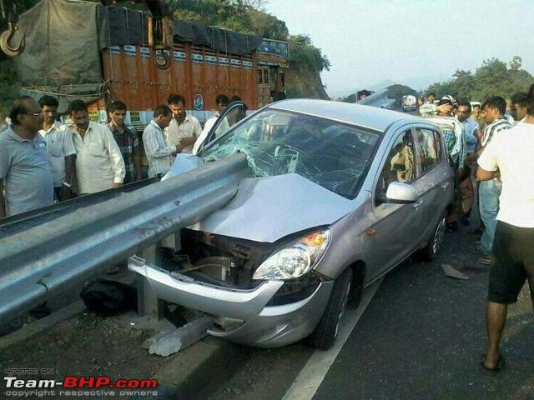
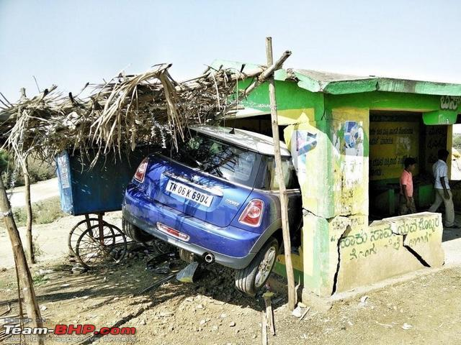
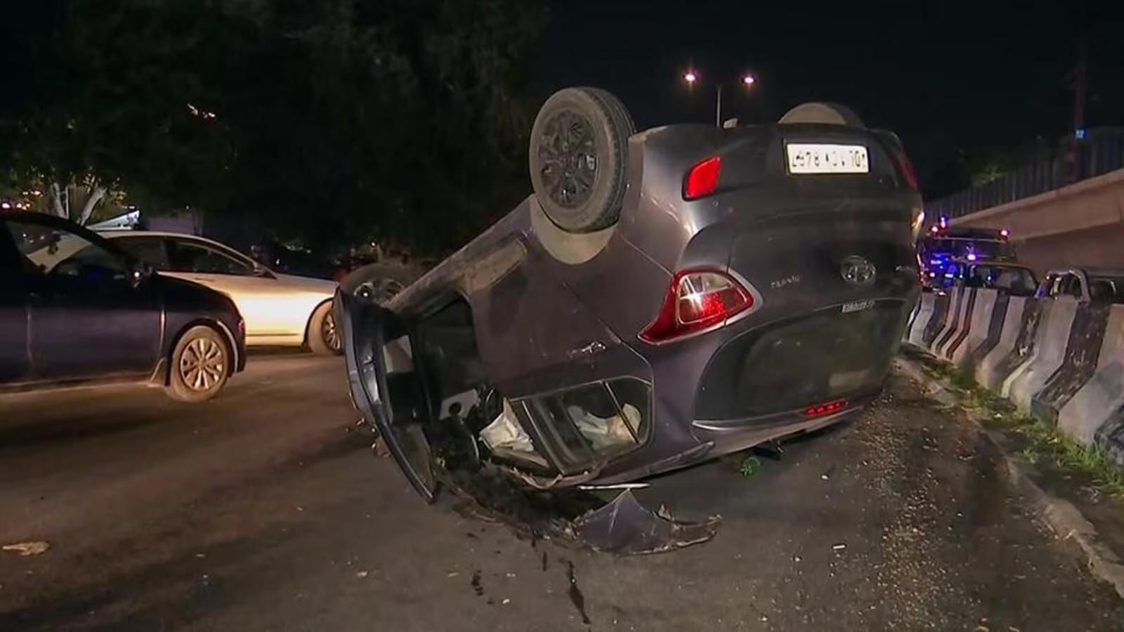
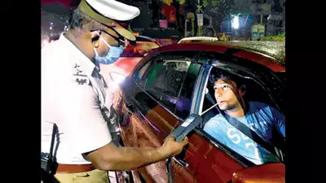
Problem Statement

Slide 4
Proposed Solution
Proposed Solution
The proposed solution is an IoT-based vehicle safety system designed to prevent drunken and drowsy driving, thereby enhancing road safety. The system focuses on two principal functions: alcohol detection and sleep detection. It prevents a vehicle from being ignited when alcohol is detected in the breath of the driver and will alert the driver and all family members in case of sleeping during driving.
How It Works
Alcohol Detection System:
A breath alcohol sensor such as MQ-3 or MQ-135 is mounted close to the driver seat or steering.
Whenever the driver breathes in, the sensor detects the alcohol level.
Once the alcohol level crosses a threshold level, the system immediately cuts off the car ignition by utilizing a relay module.
Along with this, an alert notification along with the location of the driver is sent to family members through GSM/GPRS or IoT cloud platforms.

Slide 5
Proposed Solution
Sleep Detection System:
A camera module or infrared sensor is employed to track the driver's eye movement and head position.
The system will then analyze real-time data using OpenCV or machine learning algorithms for detecting protracted eye closure or head tilting, which indicate drowsiness.
Once the system detects drowsiness, it will automatically sound an audible siren/buzzer to alert the driver.
Notifications can also be sent to family members for further intervention.
Communication and Integration:
The system uses IoT technologies such as Wi-Fi or GSM to send real-time alerts to a mobile application or SMS platform.
A GPS module helps track the location of the driver in case of emergency alerts.
Control Mechanism:
A relay module integrated with the car's ignition system will ensure that the vehicle will not start when alcohol is detected.
The system works smoothly without any manual intervention, which will ensure automation and reliability.

Slide 6
Proposed Solution
Key Components
Microcontroller: Arduino/ESP32/NodeMCU for data processing and control.
Alcohol Sensor: MQ-3 or MQ-135 for detecting alcohol levels.
Sleep Detection Sensor: Camera module/IR sensor for eye and head movement tracking.
Relay Module: Disables vehicle ignition if alcohol is detected.
Alert Mechanism:
- Buzzer/Siren for immediate driver alerts.
- GSM/GPRS module or IoT cloud for family notifications.
GPS Module: Tracks and sends driver location.
Software Tools: Arduino IDE, OpenCV, and cloud/mobile dashboard for alerts.
Unique or Innovative Aspects
Dual-Functionality: Alcohol and sleep detection in a single system.
Automated Ignition Control: Prevents vehicle ignition when alcohol is detected.
Real-time Alerts: Instant notifications with location details for family/emergency contacts.
Cost-Effective: Affordable components for easy integration into vehicles.
Advanced Algorithms: Machine learning/image processing for accurate drowsiness detection.
IoT Integration: Real-time monitoring and notifications for enhanced safety.

Slide 7
SDG’s Covered
SDG Goals Addressed
1. SDG 3: Good Health and Well-being
Reduces accidents by drunk and drowsy driving, thus allowing people to travel safer with less casualties. (Target 3.6).
2. SDG 9: Industry, Innovation, and Infrastructure
Encourages technology developments within the automotive industry by use of IoT, sensors, and machine learning in building more safety transportation systems.
3. SDG 11: Sustainable Cities and Communities
Improves road safety, contributing to safer and more sustainable urban mobility (Target 11.2).
4.SDG 12: Responsible Consumption and Production
Promotes responsible use of vehicles and decreases waste and environmental damage caused by accidents.
5. SDG 13: Climate Action
- Avoids traffic congestion and pollution resulting from accidents, promoting environmental sustainability.
6. SDG 16: Peace, Justice, and Strong Institutions-
Promotes law enforcement work to prevent drunk driving, leading to safer and more responsible communities.

Slide 8
Technology and Tools
Write List the technologies, tools, and platforms you plan to use.
Mention any IoT components, sensors, or embedded systems involved.

Slide 9
Implementation Plan
Outline the steps required to implement your solution.
Provide on which level project is to be implemented

Slide 10
Impact and Benefits
Describe the expected benefits of your project.
Explain how your solution will improve lives or solve the identified problem.
Highlight any social, economic, or environmental impacts.

Slide 11
Budget
Provide a budget estimate for your project.

Slide 12
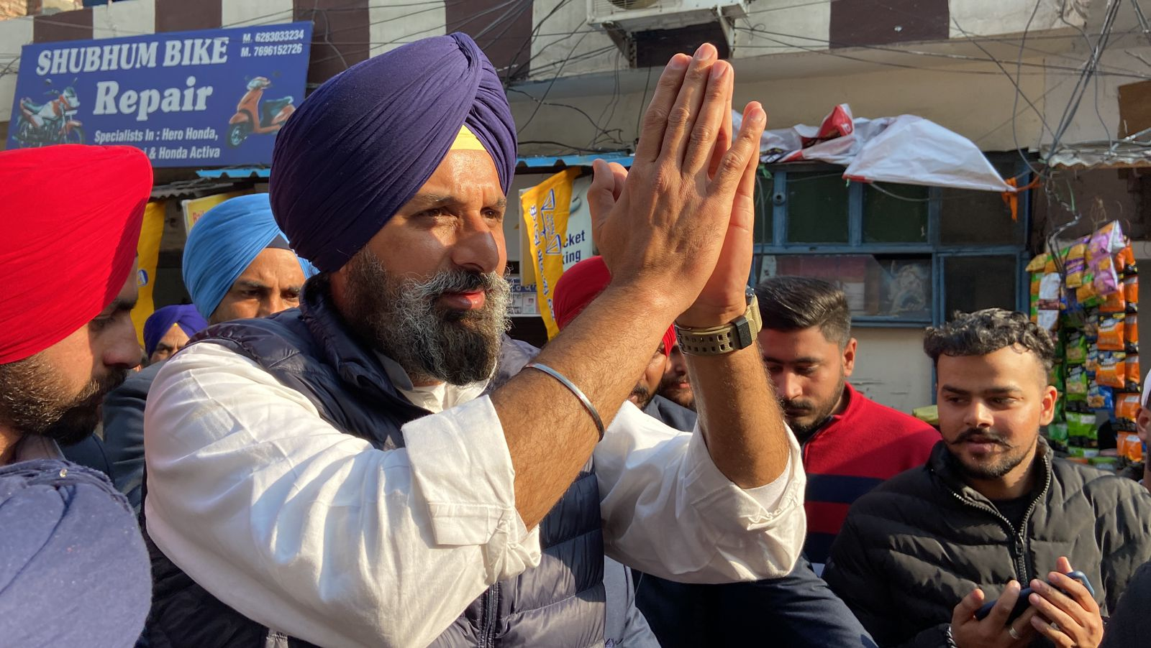
Thank You

