Slide 1
E-COMMERCE
500
Orders
DASHBOARD PROJECT
Data analysis and business performance overview
171
Customers
PROJECT PRESENTATION
295
Orders • Customers • Returns • Delivery • Payments
Delivered
Prepared from the supplied dashboard screenshot
Tanish Kushwaha

Slide 2
01 | Project Overview
Purpose, scope and questions addressed by the dashboard
Project purpose
Business value
Dashboard scope
Turn e-commerce order data into a clear, at-a-glance view of sales operations and fulfilment performance.
Help stakeholders spot order-status patterns, compare regions and delivery partners, and monitor returns.
Order volume, customer reach, return rate, delivery status, device usage, region and payment method.
Key questions
• How many orders and unique customers are represented?
• What is the distribution of orders by status and device?
• Which regions and delivery partners stand out?
• How are payment methods and return requests distributed?
Scope note: this presentation interprets the visible dashboard. Detailed row-level validation would require the source workbook.
Tanish Kushwaha
02

Slide 3
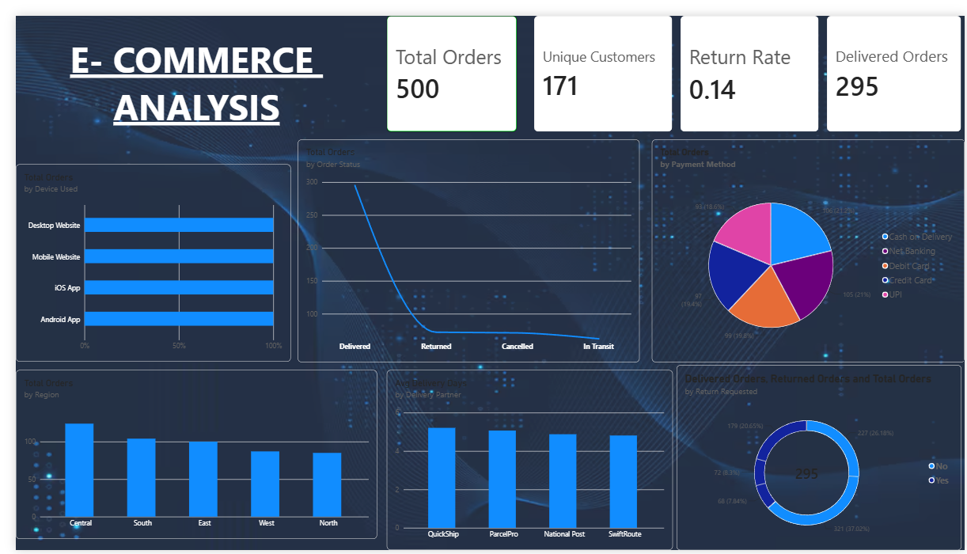
02 | Dashboard at a Glance
Original dashboard provided for the project
Tanish Kushwaha
03

Slide 4
03 | KPI Scorecard
Headline figures visible in the supplied dashboard
500
Total Orders
171
Unique Customers
Overall order volume
Distinct customers shown
0.14
Return Rate
295
Delivered Orders
Displayed as 0.14; confirm format/definition
Delivered status count
Interpretation
These KPIs give a compact view of scale and fulfilment. The return-rate value is shown exactly as displayed and should be checked for whether it represents 14%, 0.14%, or a ratio.
Tanish Kushwaha
04

Slide 5
04 | Order & Channel Analysis
Order status and device mix help explain customer activity
Order status
Device used
The status chart compares Delivered, Returned, Cancelled and In Transit orders. Delivered appears to be the largest category; follow-up should focus on reducing exceptions and tracking pending shipments.
The dashboard compares Desktop Website, Mobile Website, iOS App and Android App. The bars appear equal at 100% in the screenshot, so the underlying measure or axis should be validated before drawing channel-share conclusions.
Recommended checks
• Confirm whether status bars represent counts, percentages or a normalized scale.
• Compare conversion and return rates across website and app channels.
• Review cancelled and in-transit orders by age to identify avoidable delays.
Tanish Kushwaha
05

Slide 6
05 | Regional, Payment & Delivery Insights
Comparisons visible in the lower and right-side charts
Regional orders
Payment methods
Delivery partners
Central appears to have the highest order count, followed by South and East. West and North are lower in the displayed comparison.
The pie chart suggests a relatively balanced mix across Cash on Delivery, Net Banking, Debit Card, Credit Card and UPI.
Average delivery days are compared for QuickShip, ParcelPro, National Post and SwiftRoute; the bars look broadly similar.
How to use these views
• Investigate why the Central region leads and test whether the pattern is stable over time.
• Compare payment mix with failed payments, cancellations and customer segment.
• Use delivery-day differences alongside shipment volume and late-delivery rate—not in isolation.
Tanish Kushwaha
06

Slide 7
06 | Recommendations & Action Plan
Practical next steps to turn the dashboard into decisions
01
Validate definitions
Document how Total Orders, Return Rate and Delivered Orders are calculated; confirm units and date range.
02
Improve fulfilment monitoring
Track in-transit ageing, delivery delays and cancellation reasons by partner and region.
03
Segment customer behaviour
Compare order frequency, returns and payment preferences across customer and device groups.
04
Add time-based trends
Introduce daily/monthly order volume, return-rate trends and period-over-period comparisons.
Tanish Kushwaha
07

Slide 8
07 | Conclusion
Summary and limitations
Project takeaway
Important limitations
The dashboard brings several operational measures into one view: order volume, customer reach, returns, order status, regional activity, payment methods and delivery partners.
• Insights are based on the visible screenshot.
• Underlying data rows and calculations were not independently audited.
• Some chart labels/scales may need validation before formal reporting.
The next step is to validate metric definitions and connect the dashboard to reliable time-based comparisons so the team can track improvement.
Thank you
E-Commerce Dashboard Project
Tanish Kushwaha
08

