Slide 1
INTEL PRODUCT SENTIMENT ANALYSIS
USER SENTIMENT
Harnessing the Power of Reviews: How Sentiment Analysis Shapes Intel's Future

Slide 2
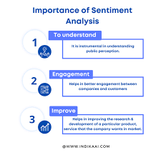
Why sentiment analysis matters?
Knows what customers REALLY think: Uncovers emotions and
opinions behind reviews.
Identifies weaknesses: Helps pinpoint areas for improvement
based on customer feedback.
Smarter decisions: Informs product development, marketing, and
customer service.
Happier customers: Shows you listen, leading to loyalty and
satisfaction.
Competitive edge: Understand customer needs better than competitors.

Slide 3
Methodology
Data is Collected from Amazon, Flipkart, PC Benchmark and stored in CSV and JSON Files.
Data is preprocessed using Enhanced AI like Chatgbt, Monica, Claud to clean the data.
Using Natural Language Processing Toolkit ,Predictive analytics and sentiment tracking we classified into negative or positive sentiments.
We used EDA as the base so MODELS used is Support Vector Machine(SVM) and little of LSTM.
Basic tools used are pandas, Numpy and Python along with some NLP tools.

Slide 4
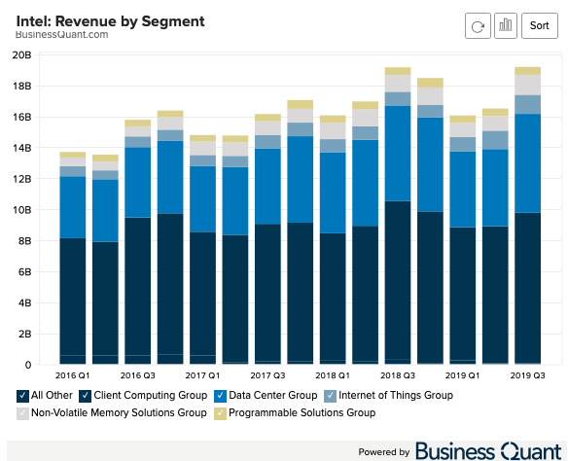
Insights
Positive Sentiment: Brand recognition, reliability, strong
performance (depending on the product)
Negative Sentiment: Pricing competitiveness, occasional performance issues

Slide 5
FUTURE OF INTEL
Execute on their foundry and process technology plans.
Stay ahead of the innovation curve, particularly in AI and HPC.
Adapt to the evolving tech landscape and address user concerns.
Focus on specific markets, sustainability

