Slide 1
Customer Churn Analysis
Retention metrics, Churn Rate and recommendations
Student Name: Tanisha Rawat
Internship Organization: Workora Labs
Task: Customer Churn Analysis
Data source: customer_churn_sample.csv • 15 customers

Slide 2
Key Findings
Contract type is the strongest churn signal
Every Month-to-Month customer in the sample churned; annual and two-year contract holders did not churn at all.
Support friction precedes churn
Churned customers logged 4.3 support tickets on average vs. 1.0 for retained customers (r = 0.88).
Risk concentrates in the first year
100% churn among customers under 12 months tenure, dropping to 0% past 25 months.
Payment method tracks with churn risk
Debit Card and UPI customers churn far more than Credit Card or Bank Transfer customers — likely a proxy for segment, not a cause.
2

Slide 3
Baseline Retention Metrics
46.67%
53.33%
2,088.48
409.93
Churn Rate
Retention Rate
Avg. CLV
MRR Lost to Churn
7 of 15 customers
8 of 15 customers
MonthlyCharges × Tenure
3

Slide 4
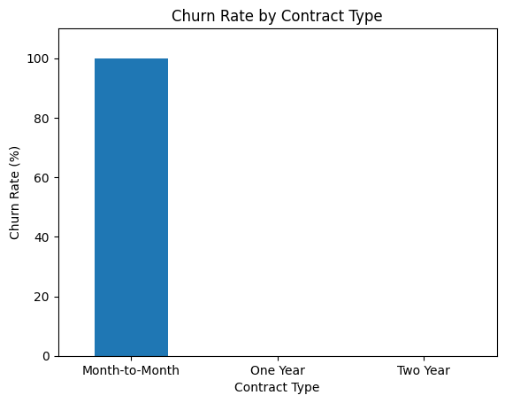
Churn Rate by Contract Type
Takeaway
100% of Month-to-Month customers in this sample churned. Zero customers on One Year or Two Year contracts churned.
This is the single clearest lever available: moving customers off month-to-month plans should be the top retention priority.
4

Slide 5
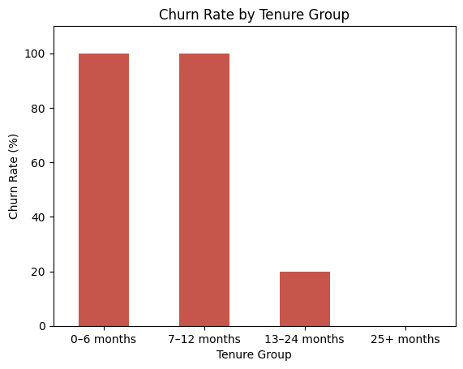
Churn Rate by Tenure Group
Takeaway
Churn risk is heavily front-loaded: customers under 12 months tenure churn at 100% in this sample, falling sharply after month 12.
A structured onboarding and early check-in program for the first year could directly target this window.
5

Slide 6
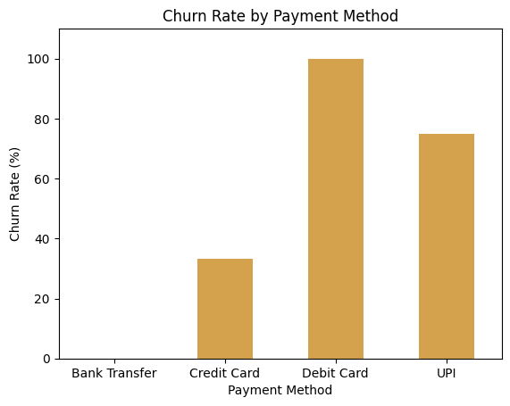
Churn Rate by Payment Method
Takeaway
Debit Card and UPI users churn far more than Bank Transfer or Credit Card users.
This is likely correlation, not causation — these payment methods may simply be more common among younger, shorter-tenure, or more price-sensitive customers. Worth segmenting further before acting on it directly.
6

Slide 7
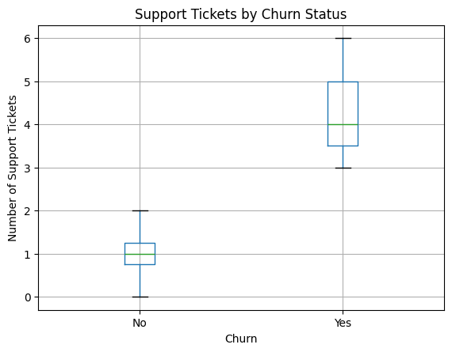
Support Tickets by Churn Status
Takeaway
Churned customers averaged 4.3 support tickets vs. 1.0 for retained customers.
Support ticket volume correlates strongly with churn (r = 0.88) — among the strongest relationships in the dataset.
Proactive outreach after a customer's 2nd support ticket could be an early intervention point.
7

Slide 8
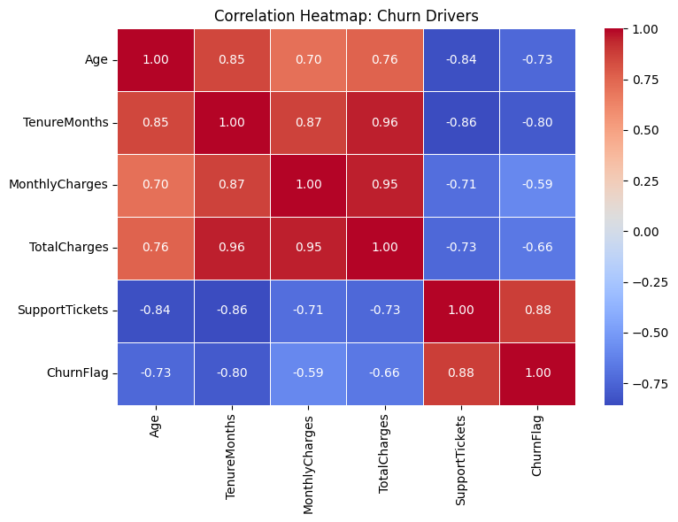
Correlation Heatmap: Churn Drivers
Reading the map
Support Tickets ↔ Churn: +0.88 (strongest driver)
Tenure ↔ Churn: -0.80
Age ↔ Churn: -0.73
Monthly Charges ↔ Churn: -0.59
Negative tenure/age correlations confirm that newer, younger accounts are highest risk.
8

Slide 9
🎯 Key findings
1
High sample churn
2
Contract type
46.67% of the customers in the sample have churned.
Month-to-month customers show 100% churn in this sample, while one-year and two-year customers show 0%.
3
Tenure
4
Payment method
Build structured check-ins across months 1–12, where churn risk is highest.
UPI and Debit Card customers show higher churn percentages than Credit Card and Bank Transfer customers in this sample.
9

Slide 10
Recommendations
1
Push contract upgrades
2
Intervene on support friction
Incentivize Month-to-Month customers toward annual plans — the single strongest lever in this dataset.
Trigger proactive outreach or account review after a customer's 2nd support ticket.
3
Strengthen first-year onboarding
4
Investigate payment-method segments
Build structured check-ins across months 1–12, where churn risk is highest.
Treat UPI/Debit Card churn as a signal to segment further, not a direct cause to fix.
9

