Slide 1

Indian Institute of Technology, Kanpur
Department of Computer Science and Engineering
Project Report
CS738: Advanced Compiler Optimizations
Academic Year 2020 - 2021
Ankita Dey (20111013)
Tamal Deep Maity (20111068)
Tanisha Rastogi (20111069)

Slide 2
Table of Contents
Introduction
Implementation Overview
Translating SQL Query to C++
Shapes and their Propagation rules
Conformability Analysis
Data Dependence Graph
Algorithm
Evaluation and Conclusion

Slide 3
Introduction
We have tried to reimplement the paper:
'Improving database query performance with automatic fusion'
(link: https://dl.acm.org/doi/abs/10.1145/3377555.3377892)
by Hanfeng Chen, Alexander Krolik, Bettina Kemme, Clark Verbrugge, and Laurie Hendren.
We think this project is relevant to CS738A since we have used a data dependence graph generated from an array based Intermediate Representation called HorseIR to optimize SQL query and generate fused and optimised C++ code.

Slide 4
Implementation Overview
Since the HyPer’s execution engine is no longer publicly available (also declared in the paper itself) and we do not have access to HorseIR, we have translated the SQL query to a C++ program.
We start by writing a C++ program as equivalent as possible to the test SQL query.
We create a data dependence graph from the HorseIR and give it as an input to the algorithm mentioned in the paper to obtain the optimized C++ program as our final output.

Slide 5
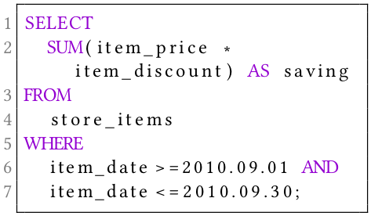
Translating SQL Query to C++
Taking an idea from the example SQL query given in paper:
Created 10000000 X 3 table in C++
1st row -> Item Price
2nd row -> Item Discount
3rd row -> Item Date
We used >=33% and <=66% in our Where clause

Slide 6
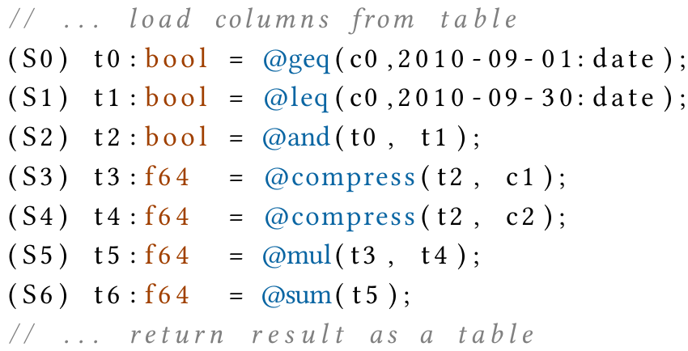
Translating SQL Query to C++ cont.
Core part of HorseIR code for SQL query shown.
Each of the statements S0 to S6 has been implemened in the C++ code.

Slide 7
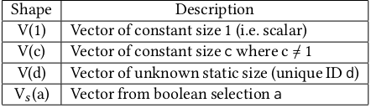
Shapes in HorseIR
HorseIR defines two kinds of shape: Vectors and Lists
Vector is of interest to us
A vector shape describes a fixed-length one-dimensional array of homogeneous data
Shapes tell us what will be the form of result on executing HorseIR statement

Slide 8
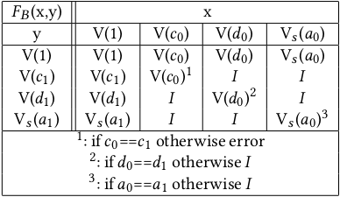
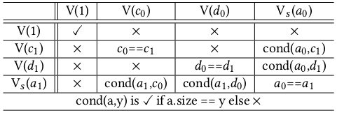
Shape propagation and Conforming rules
Shape propagation rules
Shape Conforming rules

Slide 9
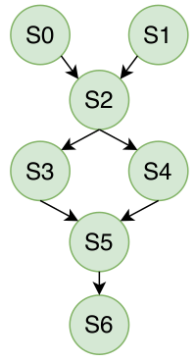
Data dependence graph
Data dependence graph created from the HorseIR as shown.
Fusible sections are determined from DDG using the algorithm given in next page

Slide 10
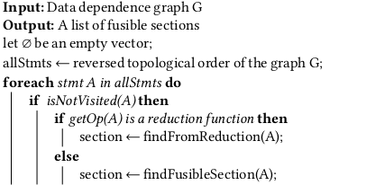
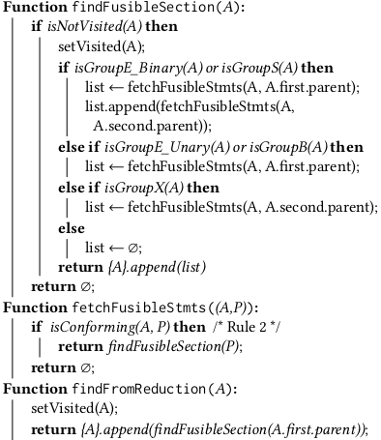
Algorithm for finding Fusible Sections

Slide 11
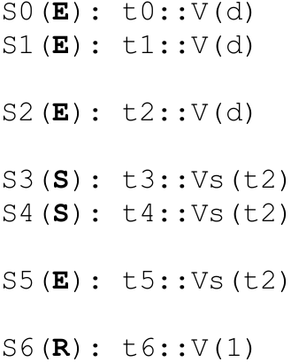
Fusible Sections
Finally the following fusible sections found:
S0 and S1
S3 and S4

Slide 12
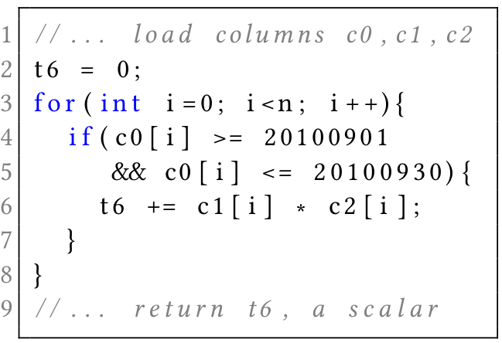
Optimized Code Generation
Optimized C++ code written after finding fusible sections.
Same table with 3 columns and 10000000 rows created and processed as shown.

Slide 13
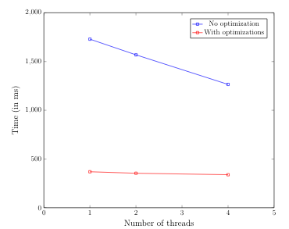
Evaluation
On running the unoptimized c++ code and this optimized C++ code we saw the following difference in time taken:

Slide 14
Conclusion and Future Work
Optimizations implemented in this paper improve run time of column based database systems.
It exploits areas of IR that low level optimizations can’t do.
It improves performance of both single and multiprocessor programs.
Future Works include scope of expanding the rules of fusing array based propagation

Slide 15
THANK YOU

