Slide 1
DETECTION OF CROP DISEASE IN TOMATO USING CONVOLUTIONAL NEURAL NETWORKS
UNDER THE GUIDANCE OF
Dr. Priti Bansal
Anshu Yadav (2016UIT2599)
Tanisha Rastogi(2016UIT2609)

Slide 2
Overview
INTRODUCTION
MOTIVATION
PROBLEM STATEMENT
DATASET
METHODOLOGY
IMPLEMENTATION
CONCLUSION
FUTURE WORK

Slide 3
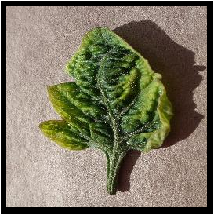
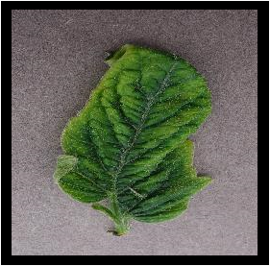
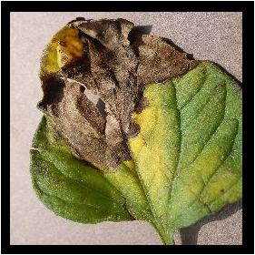
INTRODUCTION
? ? ?
NOT POSSIBLE TO IDENTIFY TYPES OF DISEASES IN PLANTS BY MERE OBSERVATION

Slide 4
MOTIVATION OF WORK
AN IMPORTANT FIELD OF STUDY
ALREADY EXISTING WORK USING :
K-MEANS CLUSTERING
SVM
FUZZY CLASSIFICATION etc.
ACCURACY OF CNN

Slide 5
PAPERS REVIEWED AND METHODOLOGY USED
Paper | Methodology | Future Work
1. Detecting Jute Plant Disease Using Image Processing and Machine Learning [2] | Color co-occurrence methods, Multi SVM classifier. | Nil
2. Detection and measurement of paddy leaf disease symptoms using image pro-cessing. [3] | ANN, FUZZY classification, SVM, K-means algorithm, color co-occurrence meth-od. | It evaluates the techniques in image processing, detecting diagnosing of crop leaf disease.
3. Detection of leaf disease and classifi-cation using digital image processing. [4] | GLCM, SVM, K-means | Classifying different plant disease and improve the classification accuracy.
4. Deep Residual Learning for Tomato Plant Leaf Disease Identification [5] | CNN- Deep Residual Learning Method from scratch, Pre-trained CNN (Vgg16, Vgg19) | Devising methods to automate the assessing of CNN settings instead of carrying it out empirically.
Tabular list of names of reviewed paper, their methodology and future works is presented below [2-5]

Slide 6
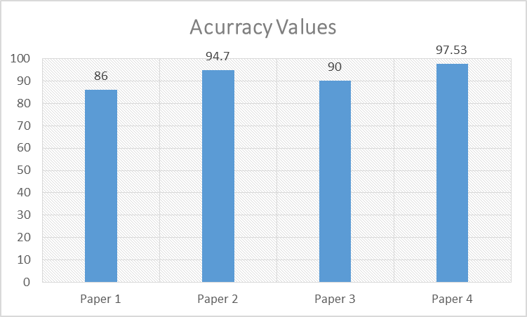
PAPERS REVIEWED AND METHODOLOGY USED
Paper Number | Methods | Accuracy Value
Paper 1 | Color co-occurrence meth-od, Multi SVM classifier | 86%
Paper 2 | ANN, FUZZY classifica-tion, SVM, K-means algo-rithm, Color co-occurrence method. | 94.70%
Paper 3 | GLCM, SVM, K-means | 90%
Paper 4 | CNN- Deep Residual Learning Method from scratch, Pre-trained CNN (Vgg16, Vgg19) | 97.53%
List of reviewed papers with accuracy values and used methods.
Graph Representation of accuracy values of reviewed paper

Slide 7
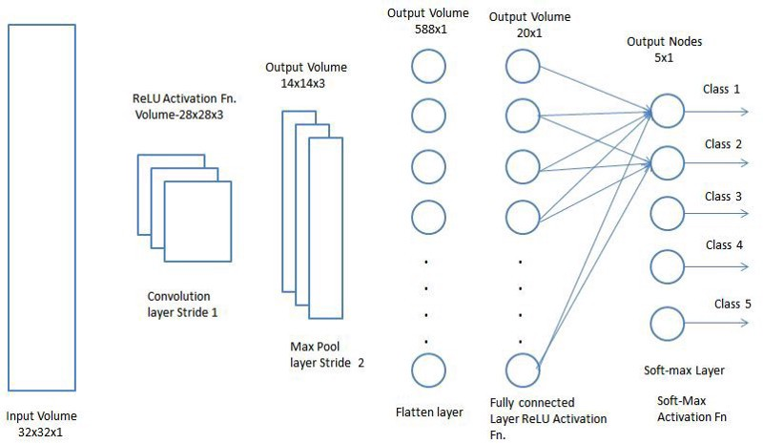

PROBLEM STATEMENT
Detection of diseases in crops of tomato with the use of deep learning network , i.e. Convolutional Neural Network

Slide 8
DATASET
Dataset used for analysis is PLANT VILLAGE DATASET[1]
It constitues of
16012 mixed (healthy+diseased) images of tomato crop
4627 images of other(potato + pepper bell) crop
77% of images used for training the dataset
Rest 23% for testing of images

Slide 9
BREAKDOWN OF DATASET
Pepper__bell___Bacterial_spot ---997 - - - - - - - - - - -- -| ---→ ( PEPPER BELL)
Pepper__bell___healthy -- 1478- - - - - - - - - - - - -|
Potato___Early_blight --- 1000- - - - - - - - - - - -|
Potato___healthy --- 152 | --→ (POTATO)
Potato___Late_blight --- 1000- - - - - - - - - - - -|
Tomato__Target_Spot --- 1404 - - - - - - - - - - -- -|
Tomato__Tomato_mosaic_virus --- 373 |
Tomato__Tomato_YellowLeaf__Curl_Virus --- 3209 |
Tomato_Bacterial_spot --- 2127 |
Tomato_Early_blight --- 1000 | -->16012( TOMATO )
Tomato_healthy --- 1591 |
Tomato_Late_blight --- 1909 |
Tomato_Leaf_Mold --- 952 |
Tomato_Septoria_leaf_spot --- 1771 |
Tomato_Spider_mites_Two_spotted_spider_mite --- 1676 - - - - - - - - - - - - |
-------------------------------------------------------
20639
-------------------------------------------------------

Slide 10
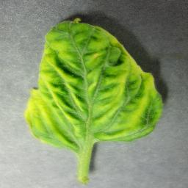
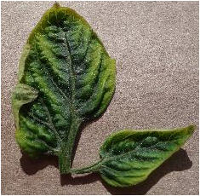
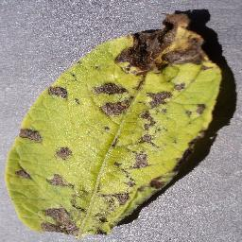
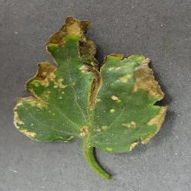



DATASET
PLANT VILLAGE DATASET USED FOR ANALYSIS EARLY-BLIGHT

Slide 11
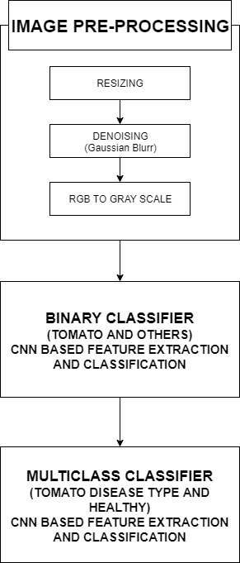
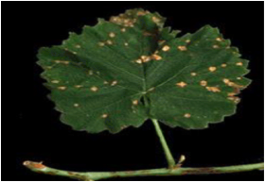
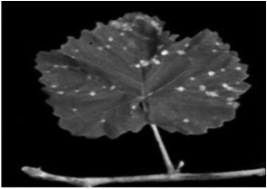


WORKFLOW

Slide 12
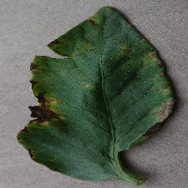
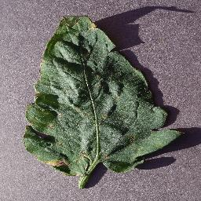
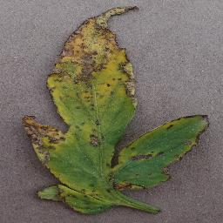




IMAGE PREPROCESSING
IMAGES RESIZING

Slide 13


IMAGE PREPROCESSING
DENOISING OF DATA AND CONVERSION TO GRAY-SCALE

Slide 14
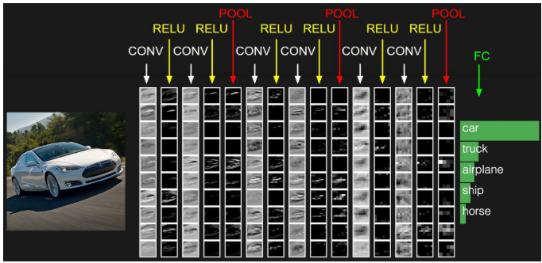
WHAT ARE CONVOLUTIONAL NEURAL NETWORKS
Also called CovNets
Used in image and object detection

Slide 15
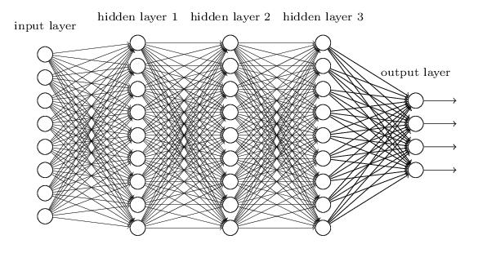
WHAT ARE CONVOLUTIONAL NEURAL NETWORKS
COMPLEX STRUCTURE WITH ONE OR MORE HIDDEN LAYERS

Slide 16



USING CNN→
PEPPER BELL POTATO EARLY TOMATO MOSAIC
BACTERIAL SPOT BLIGHT VIRUS

Slide 17
STEPS OF CNN

Slide 18
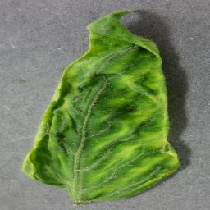
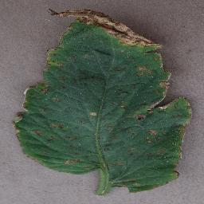

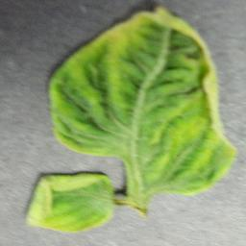


BINARY CLASSIFIER USING CNN
DISTINGUISH BETWEEN TOMATO AND NON-TOMATO CROP IMAGES
CNN

Slide 19
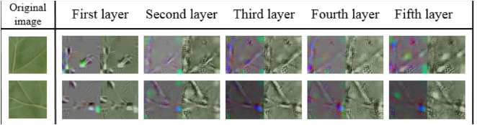

BINARY CLASSIFIER USING CNN

Slide 20
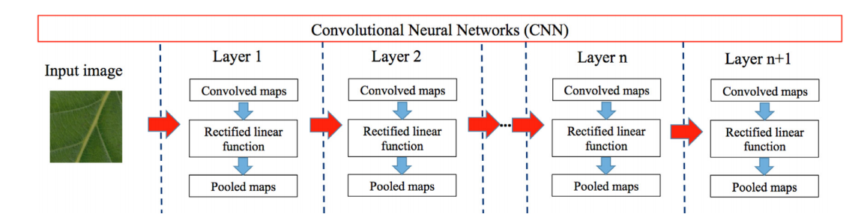
BINARY CLASSIFIER USING CNN
USE OF CONVOLUTION , RELU AND POOLING LAYER TO CLASSIFY IMAGES

Slide 21





MULTICLASSIFICATION CLASSIFIER USING CNN
CNN

Slide 22
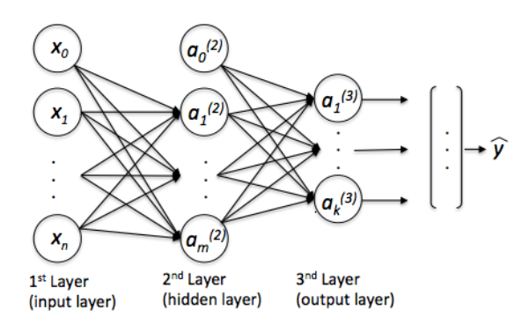
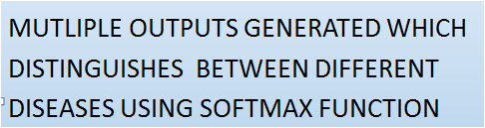
MULTICLASSIFICATION CLASSIFIER USING CNN

Slide 23
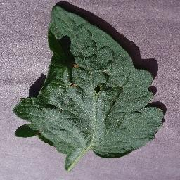
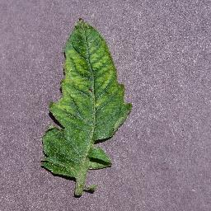
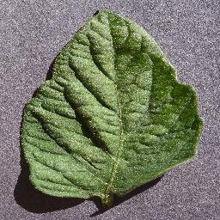
MULTILABEL CLASSIFIER USING CNN
Target Spot , Tomato
CNN
Mosaic Virus , Tomato
Healthy, Tomato

Slide 24
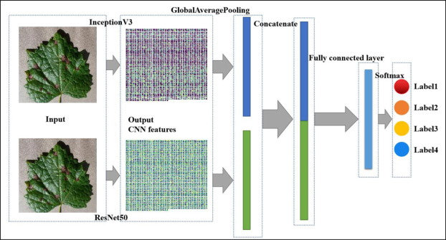
MULTILABEL CLASSIFIER USING CNN
MULTIPLE OUTPUTS ARE GENERATED WHICH ASSIGNS MULTIPLE LABELS TO THE INPUT AT THE SAME TIME

Slide 25
MODEL COMPARISION
MODEL | Model 1 | Model 2 (WITHOUT DROPOUT) | Model 2 (WITH DROPOUT) | Model 3
MODEL NAME | Binary Classifier | Multi-class classifier | Multi-class classifier | Multi-label classifier
NO OF CLASSES | 2 | 10 | 10 | 12
MOTIVE | Identification b/w tomato and non-tomato | Identifying type of disease or healthy | Identifying type of disease or healthy | Identifying multiple labels in one model
NO OF EPOCHS | 20 | 30 | 30 | 20
ACCURACY | 0.9604 | 0.8080 | 0.7971 | 0.9222
LOSS | 0.1002 | 0.5494 | 0.5656 | 0.2074

Slide 26
CONCLUSION
From the comparison table, we conclude that Model 2 that is multi-class classifier is performing approximately same with and without dropout. Since, dropout is used for bringing generalization to the model on the cost of accuracy. Therefore, out of the two sub models of multi-class classifier, model with dropout of 0.2 is be preferred over model without dropout.

Slide 27
REFERENCES
Tairu Oluwafemi Emmanuel .[n.d]. Plant Village Dataset , Dataset of diseased plant leaf images and corresponding labels. Retrieved from https://www.kaggle.com/emmarex/plantdisease
Meena Prakash R. , G.P. Saraswathy , G. Ramalakshmi , K.H. Mangaleswari [2017, March] . Detection of Leaf Diseases and Classifications using Digital Image Processing. Retrieved from https://www.researchgate.net/publication/323000855_Detection_of_leaf_diseases_and_classification_using_digital_image_processing
Neha Mangla, Priyanka B Raj, Soumya J Hegde [2019,Feb]. Paddy leaf disease detection using Image Processing and Machine Learning. Retrieved from https://www.researchgate.net/publication/333292667_Paddy_Leaf_Disease_Detection_Using_Image_Processing_and_Machine_Learning
Zarreen Naowal Reza , Faiza Nuzhat , Nuzhat Ashfat Mahsa , Md. Haider Ali . Detecting Jute Plant Disease Using Image Processing and MachineLearning.Retrievedfromhttps://www.researchgate.net/publication/314176336_Detecting_Jute_Plant_Disease_Using_Image_Processing_and_Machine_Learning
K.Vinoth Kumar and T.Jayasankar.[n.d.]. An identification of crop disease using image segmentation. Retrieved from https://ijpsr.com/bft-article/an-identification-of-crop-disease-using-image-segmentation/?view=fulltext

Slide 28
FUTURE WORK
Further improve the efficiency of multilabel classification by performing more number of epochs and improving the input images further by applying more extensive techniques

Slide 29


