Slide 1


THE MYSTERIES OF THE
DEEP LEARNING FOR SINGLE IMAGE SUPER RESOLUTION USING SATELLITE IMAGES
SUBMITTED BY: TANISHA JAIN
YUVIKA AGARWAL
REGISTRATION NUMBER: 2427030775
2427030008
COURSE: PBL-2
DEPARTMENT: COMPUTER SCIENCE ENGINEERING
GUIDE: MS NEHA
SATELLITE IMAGING

Slide 2
WHY IS SATELLITE IMAGE SUPER -RESOLUTION IMPORTANT ?
Satellite images are critical to a wide range of real-world applications, including agriculture monitoring, disaster management, environmental assessment, and urban planning.
These images are acquired through remote sensing technology from satellites orbiting the Earth; however, they frequently suffer from low spatial resolution .
To address this challenge, image super-resolution (SR) techniques are employed to enhance image quality.
Classical methods such as bicubic and nearest-neighbour interpolation can increase image dimensions but fail to recover fine structural details.
In recent years, deep learning-based SR models — particularly ESRGAN (Enhanced Super-Resolution Generative Adversarial Network) — have demonstrated substantially superior results by learning to synthesise high-frequency texture information from low-resolution (LR) inputs.

Slide 3
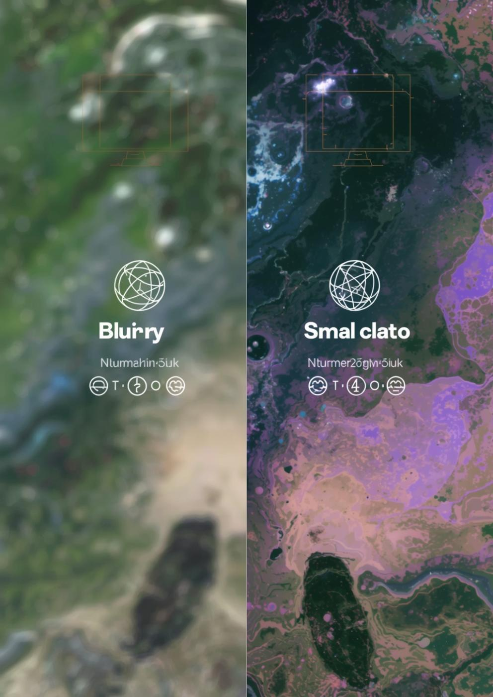

Enhancing Satellite Imagery
Satellite images are widely used in applications such as agriculture monitoring, disaster management, and urban planning. However, these images often suffer from low resolution due to sensor limitations and environmental factors.
This project aims to improve the quality of low resolution satellite images using deep learning based Single Image Super Resolution techniques. The system converts low resolution images into high resolution images while preserving image details.

Slide 4
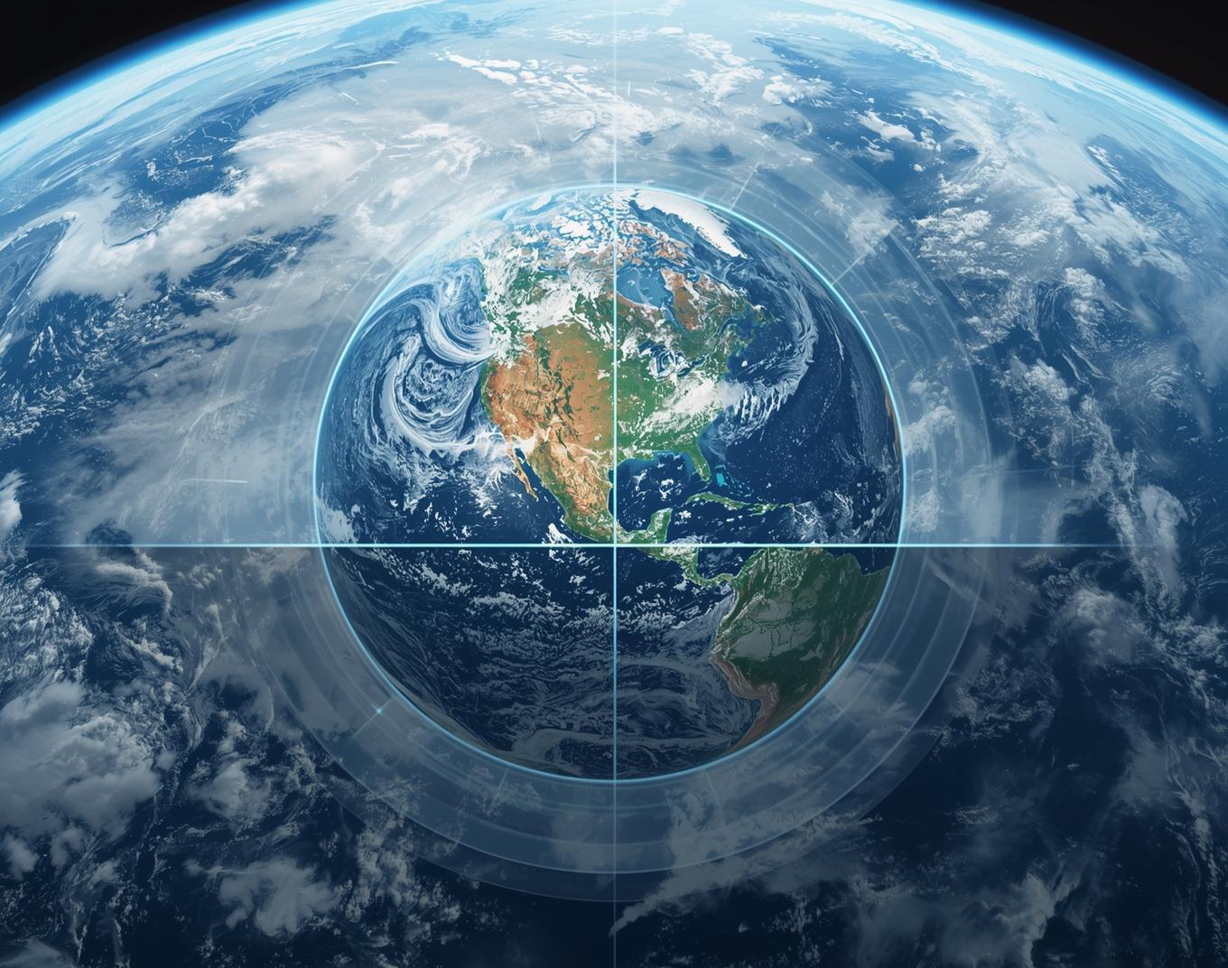
Challenges in Satellite Imaging
Satellite images captured from remote sensing devices often have low resolution due to hardware limitations, noise, and atmospheric disturbances.
Low resolution images lack important visual details and reduce accuracy in applications such as object detection and land analysis.
Therefore, there is a need for techniques that can enhance satellite image resolution and improve image quality.

Slide 5


Slide 6
Authors / Source | Approach Used | Data / Context | Main Findings | Limitation
Traditional Methods | Nearest Neighbor and Bicubic Interpolation | General image upscaling | Baseline methods for increasing resolution; nearest neighbor is fast while bicubic produces smoother images | Cannot recover fine details; results in blocky or blurry outputs
European Geosciences Union (EGU) | Remote sensing analysis | Satellite environmental data | Highlights challenges such as low resolution, atmospheric disturbances, and sensor limitations | Does not propose a direct enhancement technique
European Geosciences Union (EGU) | Multi-satellite fusion with deep learning | Multi-source satellite datasets | Combines multiple satellites to improve spatial and temporal resolution and handle missing data | Requires large datasets
Im and Lee | Super-resolution with deep feature matching | Multi-sensor satellite images | Improves edge detection and image registration accuracy | Computationally intensive
Zheng et al. | Self-supervised super-resolution with uncertainty estimation | SkySat dataset | Generates high-resolution images without ground truth and estimates uncertainty | Requires careful tuning
LITERATURE OVERVIEW

Slide 7
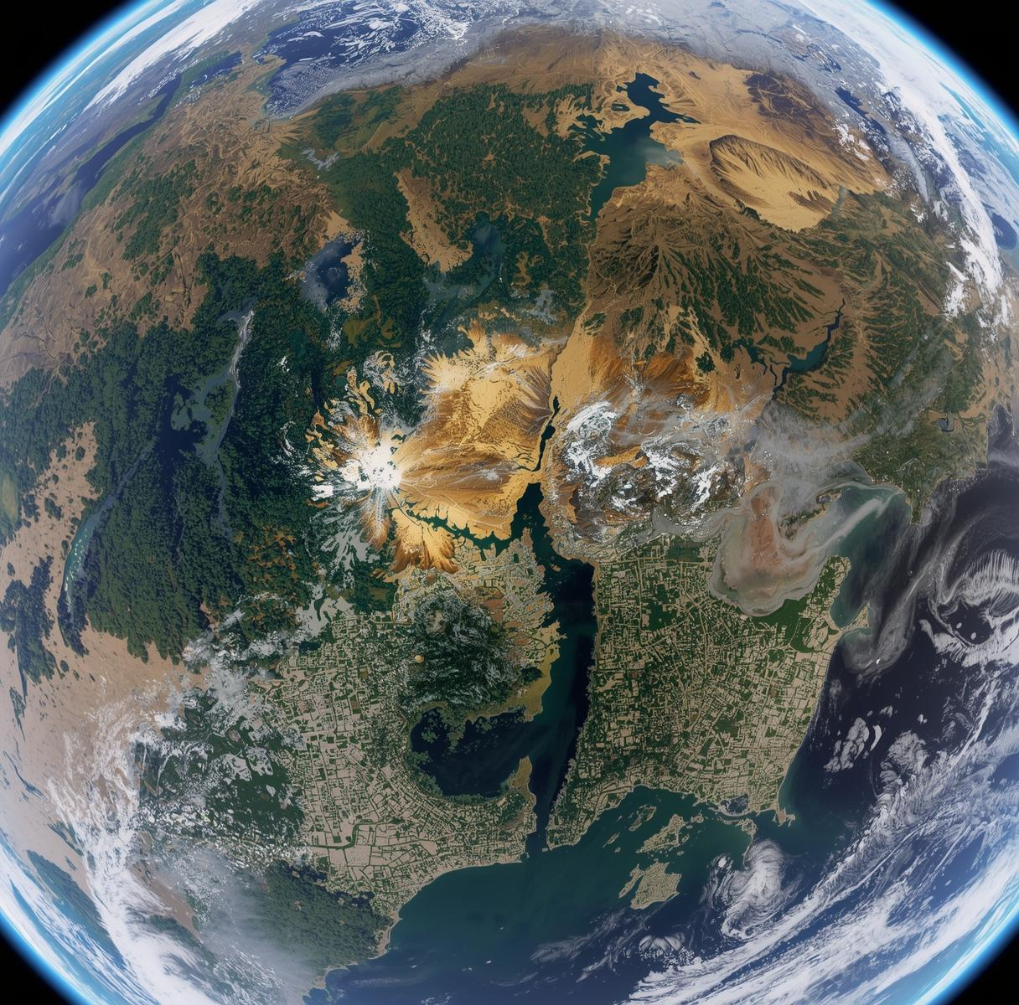
Satellite Image Datasets
The dataset used in this project is the /kaggle/input/satellite-nc-x10-dataset. It contains paired low resolution and high resolution satellite images used for training and testing the super resolution model. The dataset helps the model learn mapping between low quality and high quality images.

Slide 8
Methodological Issues
Research Challenge & Limitation
Current research often suffers from inconsistent methodologies, leading to difficulties in replicating studies and validating results.Existing super resolution methods mainly focus on natural images and do not specifically address satellite image challenges.
Current models cannot recover very small objects and sometimes generate unrealistic structures. These methods require large computational resources and do not generalize well across different satellite datasets.
There is a need to develop efficient and accurate deep learning models specifically designed for satellite image enhancement.
INNOVATION
The innovation of this project is the application of deep learning based super resolution techniques specifically for satellite images.
Unlike traditional approaches designed for natural images, this work focuses on satellite image characteristics such as noise and structural complexity.
The project aims to improve image clarity and reconstruction quality while addressing limitations of existing models.

Slide 9
METHODOLOGY
.Step 1: Dataset Collection
Satellite image dataset is collected from Kaggle containing paired low resolution and high resolution images. These images are used for training and testing the model.
Step 2: Data Preprocessing
The satellite images are resized and normalized to prepare them for model training. Image pairs are organized into input (low resolution) and target (high resolution) images.
Step 3: Model Training using ESRGAN
The Enhanced Super Resolution Generative Adversarial Network (ESRGAN) model is used to learn mapping between low resolution and high resolution images. The generator network enhances image resolution while the discriminator evaluates image quality.
Step 4: Image Reconstruction
The trained model converts low resolution satellite images into high resolution images by reconstructing missing details and improving image clarity.
Step 5: Performance Evaluation
The output images are evaluated using image quality metrics such as PSNR and SSIM to measure improvement in resolution and structural similarity.
Step 6: Result Analysis
The enhanced images are compared with original low resolution images to analyze improvement in visual quality and detail preservation.

Slide 10







Project Timeline Path
Five sequential phases mark project progress milestones
Phase 1
Phase 2
Phase 3
Phase 4
Phase 5
LOW RESOLUTION
SATELLITE IMAGE
DATASET COLLECTION AND
IMAGE PREPROCESSING
ESRGAN MODEL TRAINING AND
HIGH RESOLUTION IMAGE GENERATION
PERFORMACE EVALUATION
RESULT ANALYSIS

Slide 11

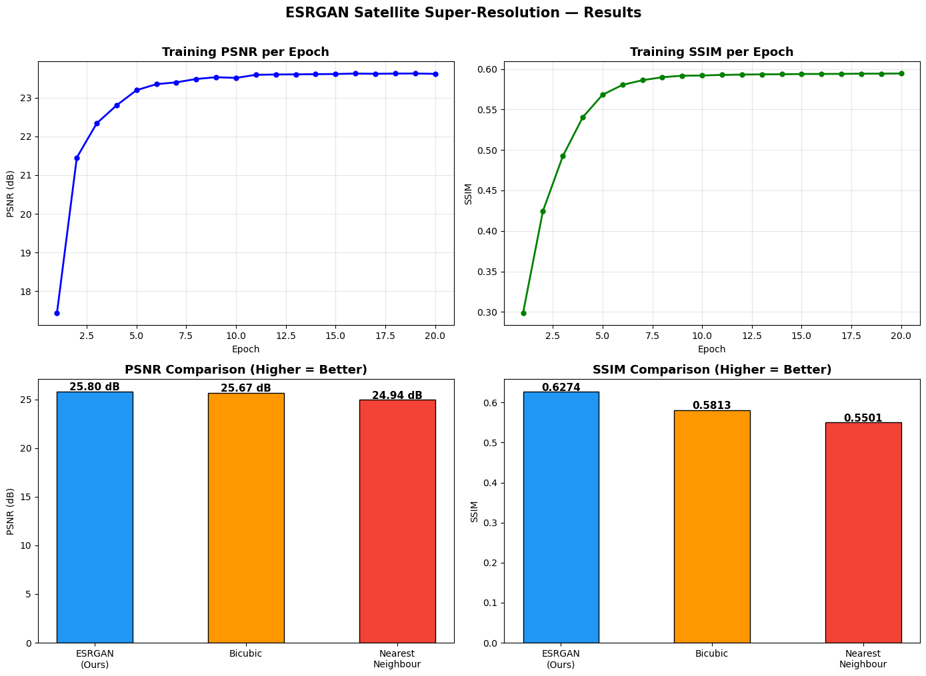

Expected Results Overview

Slide 12
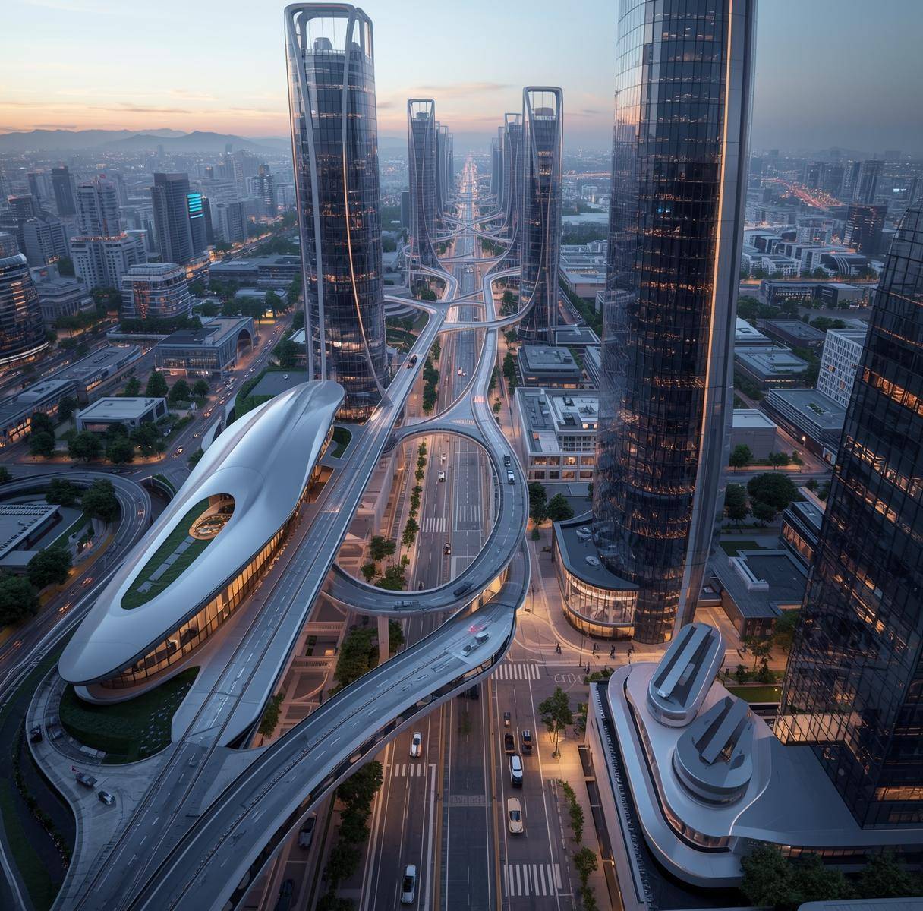
The Future
Embrace innovation and explore the technologies shaping tomorrow's world.
The proposed work can be further extended by implementing more advanced deep learning models such as transformer based super resolution methods and diffusion models to improve image reconstruction accuracy.
Future work can focus on developing lightweight and efficient models for real time satellite image processing with reduced computational cost. The system can also be improved by training on larger and more diverse satellite image datasets to enhance generalization performance.
Hybrid approaches combining multiple deep learning techniques such as convolutional neural networks and generative adversarial networks can be explored to improve image quality.
The proposed system can also be applied to other domains such as medical imaging, surveillance systems, and video resolution enhancement. Further research can focus on improving reconstruction of very small objects and reducing noise in satellite images.

Slide 13
THANKYOU

