Slide 1
Universal File Information Extractor
By:- Tanisha Sharma

Slide 2
Summary
Simple web tool that can analyze documents in an instant.
Handles Word, Excel, PowerPoint, and PDF documents.
Shows content summaries such as text, tables, and images.
Handles structured report downloads in JSON and Excel formats.

Slide 3
Why This Tool?
Makes document analysis easy for everyone—no technical expertise needed.
Saves time summarizing large files automatically.
Makes reviewing, sharing, and storing critical information easy.
Perfect for students, teachers, businesses, and researchers.

Slide 4
Key Features
File Upload: Choose a file to analyze (PDF, DOCX, PPTX, XLSX).
Content Breakdown: See word and character counts, tables, and images.
Interactive Display: See content page by page or slide by slide.
Download Options: Download summaries in Excel or full data in JSON.

Slide 5
How to use?
Step 1: You upload a document.
Step 2: The tool reads the file and extracts text, images, and tables.
Step 3: It counts and arranges this information into a tidy summary.
Step 4: You review the results and save reports if needed.
(No coding for the user.)

Slide 6
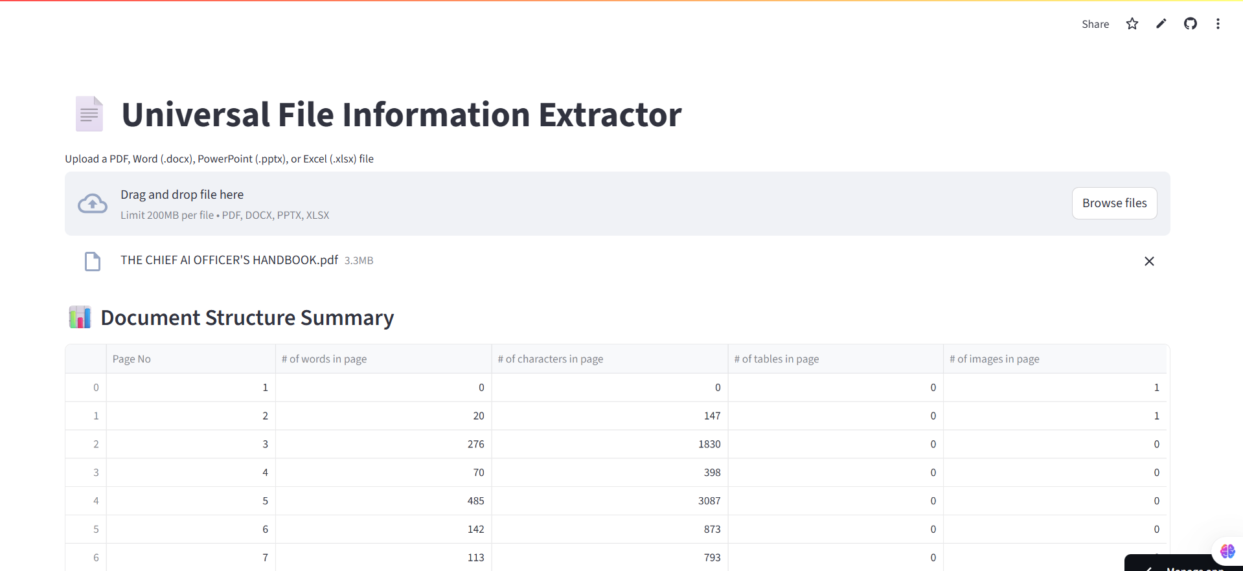
Example of Output

Slide 7
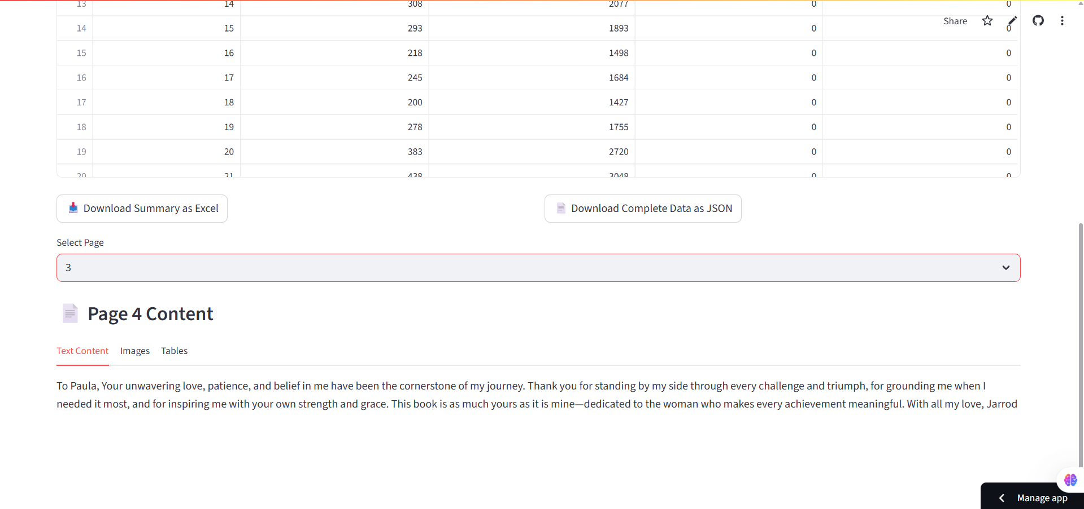
Example of Output

Slide 8
Thank You

