Slide 1
SWIGGY DELIVERY CHALLENGE
AVOID REJECTS
Name : Tanisha Medewala

Slide 2
SWIGGY DELIVERY OVERVIEW
Identifying the Problem Statement
Data Description & Sourcing
Data Cleaning & Manipulation
Univariate Analysis & Bivariate Analysis
Model Building
Model Evaluation
Recommendations

Slide 3
Identifying the Problem Statement
Swiggy has a bold vision to elevate the quality of life of urban customers by offering and aiming at assigning the right delivery partners to the right set of orders at the right time
Here delivery partners have the option to reject an order which increases the delivery time for the customer and hence we want to avoid rejects.
Business Objective : To find the patterns which leads to rejection of order by delivery partners.
Additional Details – Every 2 mins, all non assigned orders are input to the assignment module, for each order, a set of Des are evaluated and order finally assigned to one of the DEs. Delivery partners are allowed one reject per day beyond which they are penalized, No payout is made to DE for rejection of order and every instance of DE reject is stored in production table.
Input: Two csv files : Assignment and Delivery partners data

Slide 4
Data Description & Sourcing
Read the data dictionary to understand the variables used such as delivery assignment, payout etc.
Import data from the given assignment.csv file and delivery_partners.csv. Create dataframe named df_assignment (132394 rows , 17 columns) and df_delivery_partners (991 rows, 6 columns).
Merge the dataframe as df_master on the bases of DE_ID column (132394 rows, 22 columns).
After carefully checking the data, the count of NA in columns less than 15-20%
Data Cleaning & Manipulation
reject_ind column has binary values (0, 1) where 0 comprise of 124346
observation , 1 comprise of 8048 observations.
reject_type comprise of all types 1-4 for only reject_ind 1 but NANs for
reject_ind 0 . So replacing NaN with a category type-0
As there is only 6% records of reject_ind 1 , we will not drop the columns having
low amount of NaNs instead based on distribution and value counts , we
imputed customer_zone with mode, de_zone_id with mode, delivered_time
with mode, lastmile and firstmile with median. Payout made to DE was having 3
rows as NaN with reject_ind 0 so we dropped that as we have more accepted orders.
Derived new metrics to handle date,month,year,hr,min and sec variables.
New derived column for penalizing the DE in the records where they are more than
1 reject per day named as penalty check and also no payout given to DE for rejected
ones.

Slide 5
Univariate Analysis
Numerical columns such last Mile,first Mile Distance , payout made to DE are analyzed through box plot and dist plot for checking outliers and imputing NA values with metrics which is better representative.
For categorical columns such as reject_type, customer_zone, de_zone_id are analyzed through the countplot.
Dummy variables are connected for the category columns and also performed sanity checks for the additional details given for the business requirement.
Bivariate Analysis
Analysis of customer_zone, zone_id, reject_type is done based on reject_ind.
As per the plot, reject ind 0 has more counts for all customer zone than the reject
ind 1 in all catplots.
Multicollinearity is found among the metrics that are derived from same date
objects .
High correlation observed between last ping last 10 min with assignment start time
mins and last ping last 10 min with placed time.
High correlation observed between delivery time and assignment time.
There is a positive relation observed between payout made to de and last mile
distance.

Slide 6
Model Building
Data set is divided into train and test sets where train is of 70% and 30% of whole observations.
Used standard scaling on numeric columns.
There is a highly imbalanced classification found in the data.
We build model using Logistic Regression, Ridge and Lasso Regression.
While building Logistic Regression model, we get ROC of area 1 and metrics suggest that model able to detect perfect separation.
While building Ridge and Lasso Regression, best estimator comes to be 0.0001. Based on estimator, features which affects the rejection are considered for RFE.

Slide 7
Model Evaluation
Logistic Regression-
1. R2 score Prediction on Train and Test data – 1.0
2. MSE – 0.0
Ridge Regression
1. R2 score
Prediction on Train data : 0.9999999999999615
Prediction on Test data : 0.9999995675786236
2. MSE - 2.4971211569610695e-08
Lasso Regression
1. R2 Score
Prediction on Train data : 0.9997982564554204
Prediction on Test data : -2581.4539227113078
2. MSE - 149.13000790664407

Slide 8
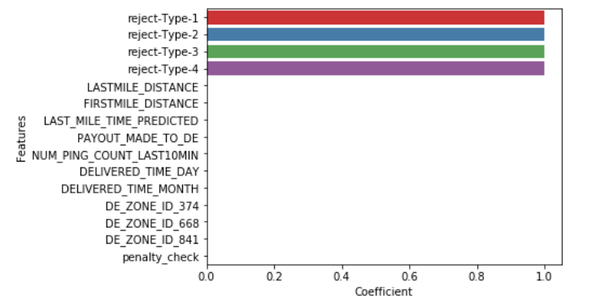
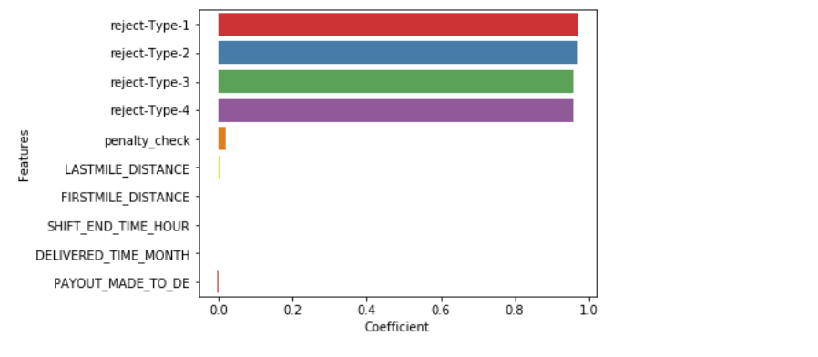
Ridge Regression Selected Features
Lasso Regression
Selected Features.

Slide 9
Recommendations
Variables such as Reject Types, Payout made to DE, delivery time, Last mile distance, DE rejecting more than 1 per day are impacting the rejection of the order. (Pair plot and heat map can take more time)
As we have highly balanced classification, we need to build the model using penalizing algorithms and other different algorithms, or generating synthetic samples for SMOTE technique or resampling of data.
While during model deployments, we have different challenges:
1. Poor visibility of model performance
2. Code that doesn’t play nice in different environments
3. IT gaps within your infrastructure
4. Disjointed software and approaches to production Machine Learning (MLOps)
Workflows that can’t move between cloud and on-prem infrastructure.
We can overcome the model deployment challenges through different ways:
Registering the Model in the workspace.
Prepare to deploy (specify assets, usage, computer targets)
Deploy the model to the computer target.
Building of Large and automated data pipelines.

