Slide 1

Invoice Management System
By Rizan K.C.
UWE ID: 24071142

Slide 2
Introduction
C++ based invoice management system.
Customer management, item categorization
Generates detailed invoices and records transaction history.
Implementation of Object-oriented programming principles like polymorphism, encapsulation, inheritance.

Slide 3
Objective
Accurate invoice handling for businesses.
Menu Driven UI to make it easy to use.
Demonstrate practical application of OOP principles.

Slide 4

System Design
Secured with login functionality, which can be used only when the valid credentials are filled in the login page.
After successful login: Generate Invoice : Takes name, contact, products, their details, calculate total amount and save all the details to file. Invoice History : View the entire transactions history stored in a file.

Slide 5
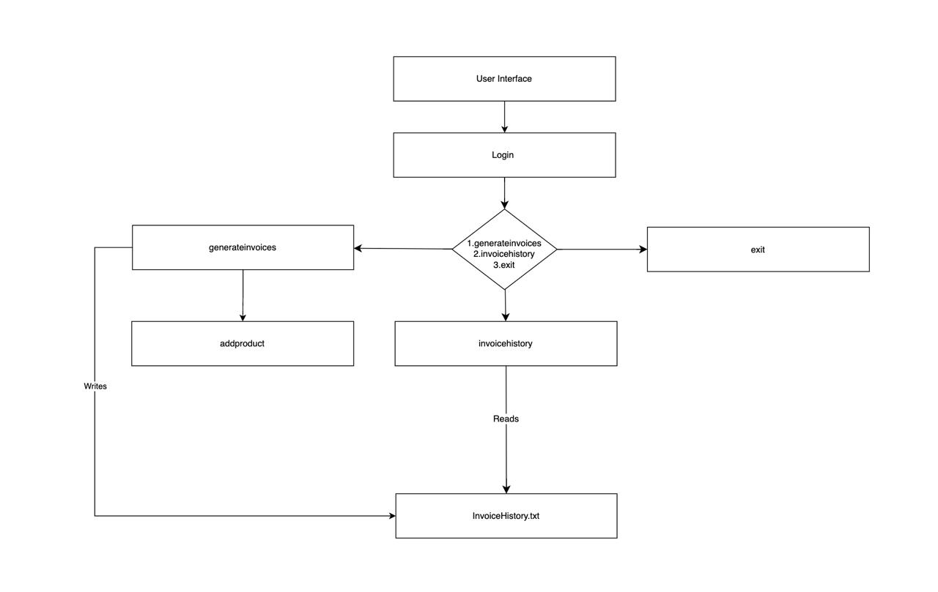
Component Diagram of the System

Slide 6
Implementation
File Handling: Saves invoices in InvoiceHistory.txt automatically and reads the transaction history.
OOP: A) Abstract class: products and derived classes Electronics and Clothing. B) Encapsulation through Customer.

Slide 7
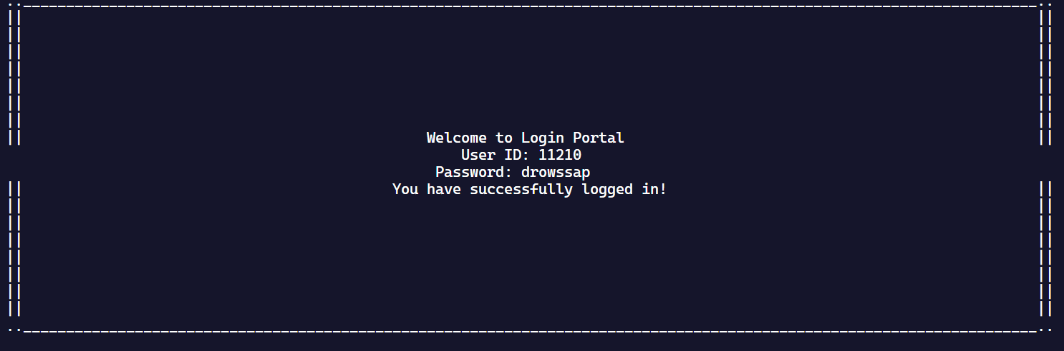
Demonstration
Login page in Console.

Slide 8
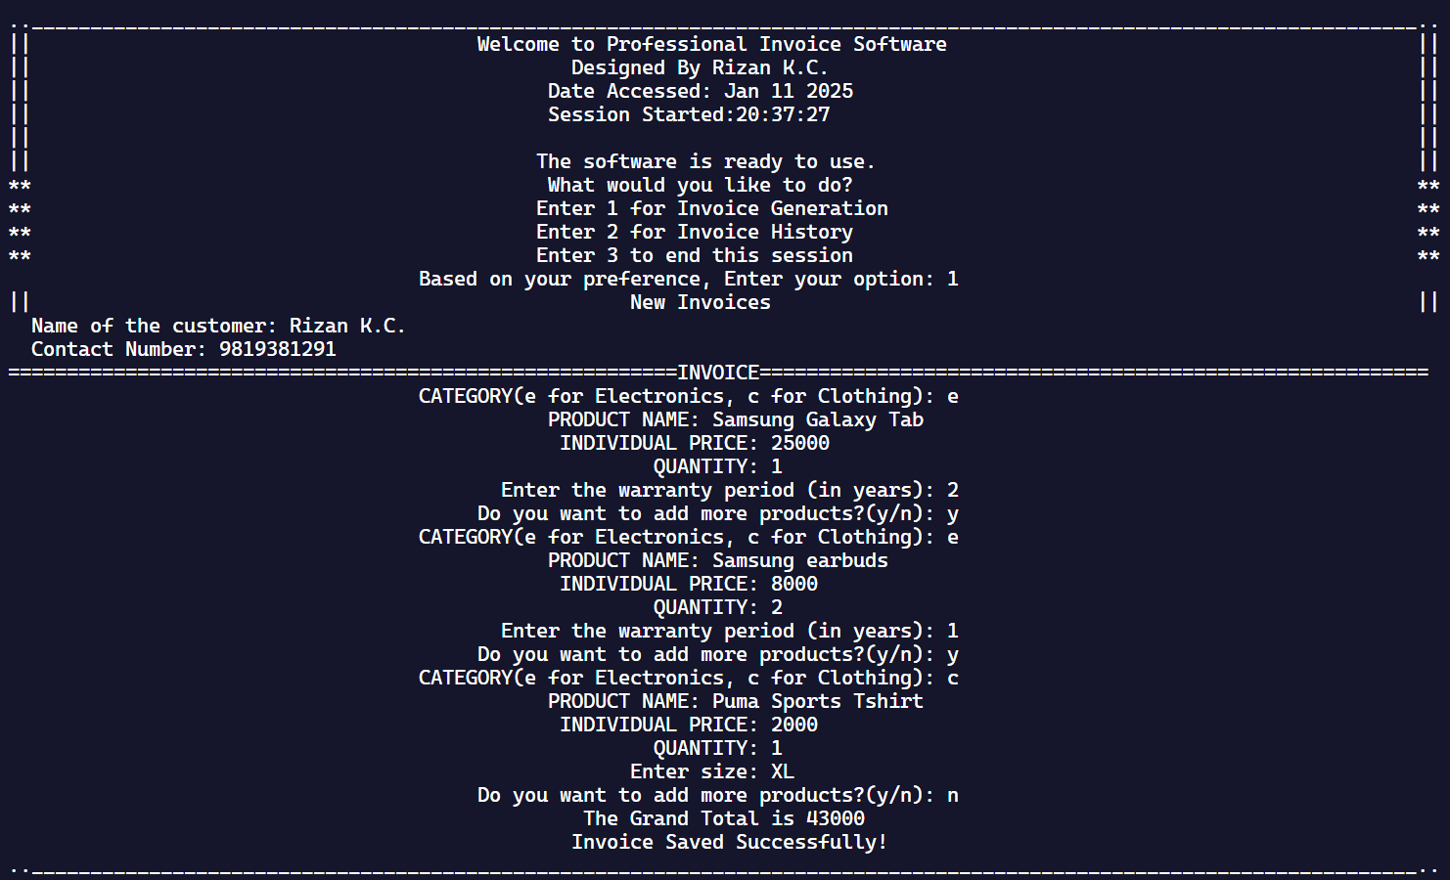
Demonstration
Main menu page along with invoice details entry which is later saved automatically.

Slide 9
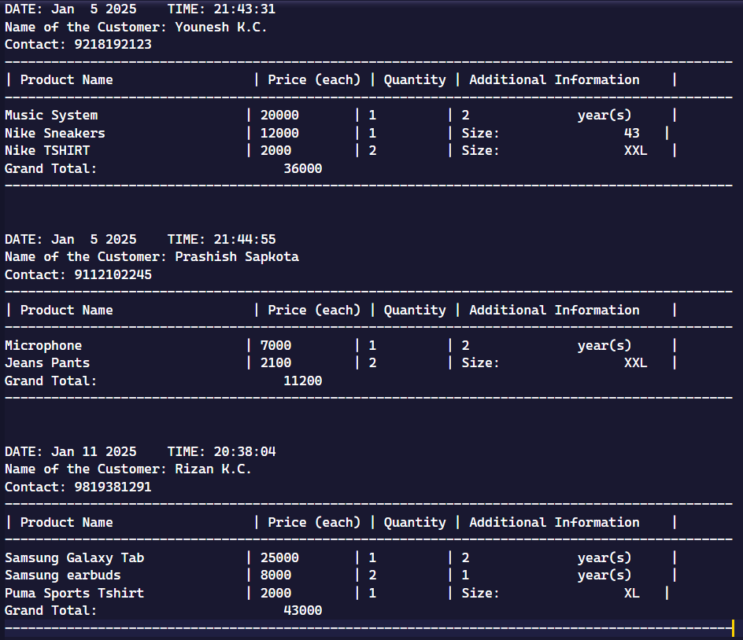
Demonstration
Invoice in the file.

Slide 10
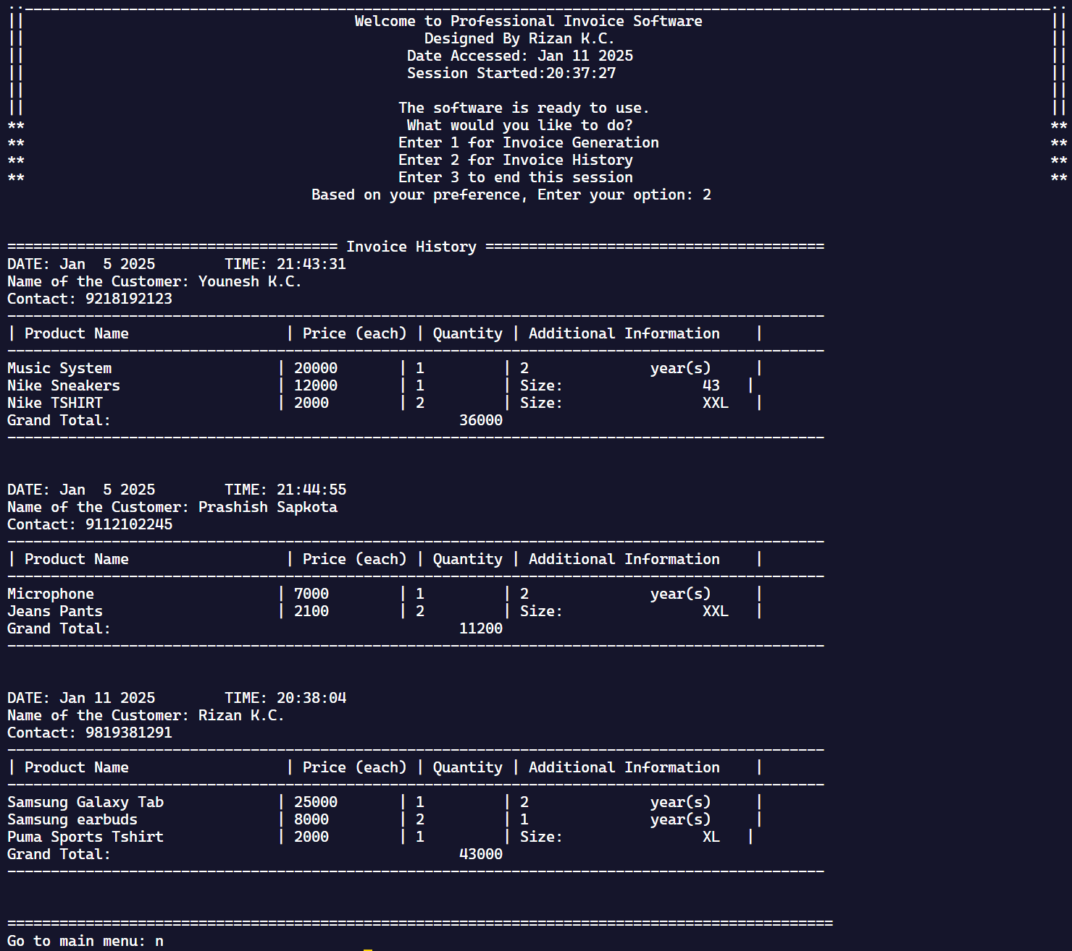
Demonstration
Invoice saved in file can be accessed/read using invoicehistory() function.

Slide 11
Testing and Debugging
The first test was done on the login page. Incorrect credentials prompted the failure message. While with correct credential, the system worked as expected.
The issue of incorrect time arise when the macro __TIME__ was used, to show the starting of the system time along with end time. This resulted in constant time, as both start time and end time was same. This was fixed using ctime header file, which allowed us to provide current time accurately.

Slide 12
Challenges faced
Formatting in the files and console screen outputs for clarity.
Code modularity for maintainability.
These challenges were solved by repetitive testing and adjusting based on every tests output.

Slide 13
Future Improvements
Adding search mechanism in transaction history (by name and date).
Improving login security: Less login attempts.
Support for more categories and advanced features like discounting and taxing.

Slide 14

Conclusion
Successfully developed an invoice system.
Successfully shows the practical use of C++ programming along with the OOP principles.
This system can be further improved by working on it with broader adaptability.

Slide 15

References
https://www.geeksforgeeks.org/object-oriented-programming-in-cpp /
https://www.geeksforgeeks.org/ctime-function-in-c-c/

Slide 16
THANK YOU!

