Slide 1



Types of Computer Networks
Presented by: Sara Dutt

Slide 2


What is a Network?
  Group of connected devices
  Shares information and resources
  Uses wired or wireless connections

Slide 3
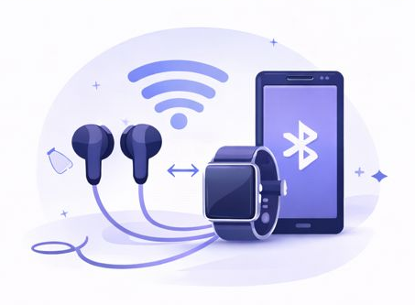
PAN (Personal Area Network)
  Stands for Personal Area Network
  Works within short distance (10 meters)
  Connects personal devices
  Uses Bluetooth
Example: Phone <-> Earbuds/Smartwatch

Slide 4
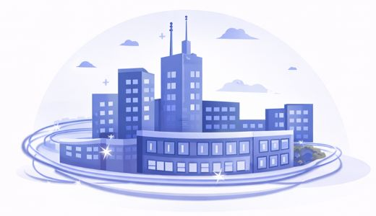
CAN (Campus Area Network)
  Stands for Campus Area Network
  Covers a school or office campus
  Connects multiple buildings
  Uses high-speed fiber cables

Slide 5

VAN (Virtual Area Network)
  Stands for Virtual Area Network
  Works over the internet
  Acts like a local network
  Secure Connection
Uses: Remote work, Online gaming

Slide 6
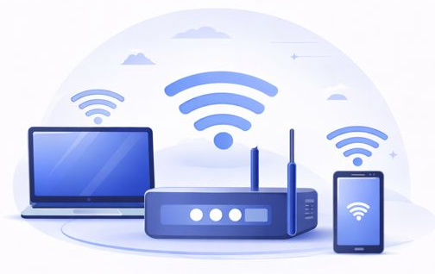
WLAN (Wireless Local Area Network)
  Stands for Wireless Local Area Network
  Uses Wi-Fi
  No cables required
  Range up to 100 meters
Examples: Home and School Wi-Fi

Slide 7
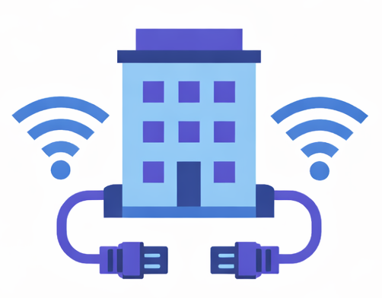
LAN (Local Area Network)
  Stands for Local Area Network
  Covers one building
  Uses cables or Wi-Fi
  Fast file sharing
Examples: Classroom, Computer Lab

Slide 8
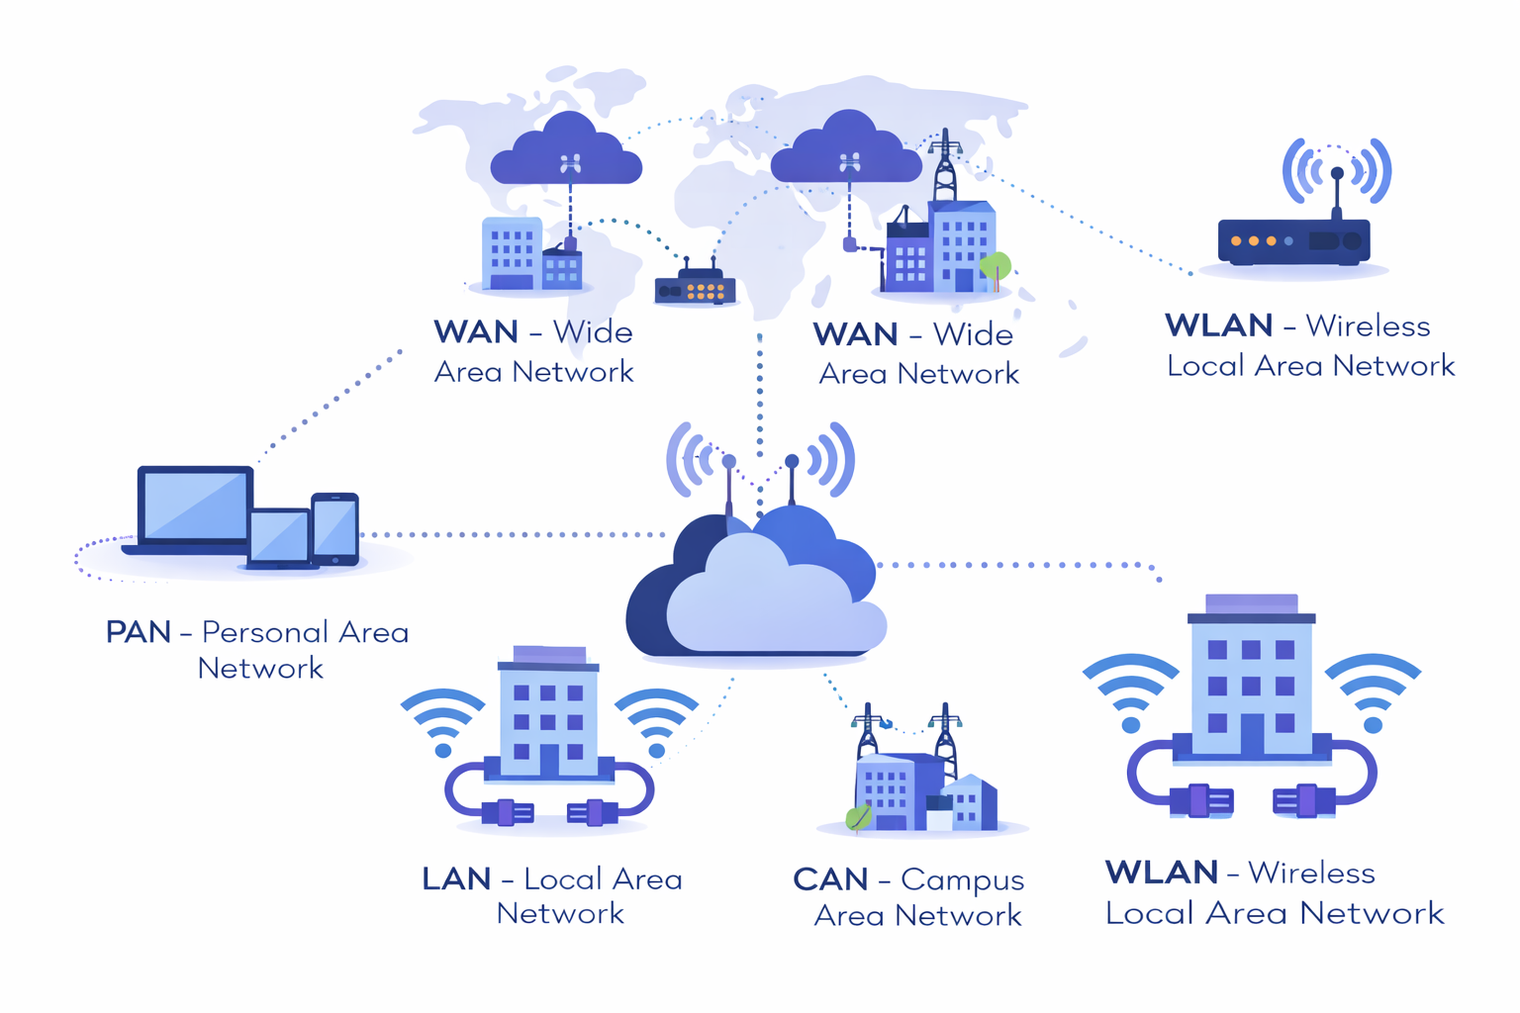
Summary
  PAN- Personal devices
  LAN-One building
  WLAN-Wireless LAN
  CAN-Campus network
  VAN-Virtual network
Networks connect our digital world

Slide 9

Thank You

