Slide 1
Loan Approval Dashboard Analysis
A summary and visual analysis of loan approvals

Slide 2

Dashboard Overview
The Loan Approval Dashboard provides insights into loan data across different cities and income groups. It highlights the approval rate, total loan amount, and various distribution trends.

Slide 3
Key Performance Metrics
• Total Applicants: 2000
• Approval Rate: 44%
• Total Loan Amount: ₹51 Million
• Average Loan Amount per Applicant: ₹17,475

Slide 4
Approval Distribution by Income Group
• Medium-income applicants form the largest group of approvals.
• Low-income applicants also show a significant approval rate.
• High-income applicants represent the smallest segment of approvals.

Slide 5
City-wise Loan Distribution
• Cities like Northland, Leamouth, and Chrinton show the highest loan amounts.
• Distribution of loan and income across cities appears consistent.
• The variation in approval rates may depend on local economic factors.

Slide 6
Approval by Years Employed
• Employment tenure influences approval rates.
• Applicants with longer employment duration have higher approval chances.
• This reflects a stable income and reduced default risk.

Slide 7
Insights and Recommendations
• Target medium and low-income groups with tailored loan schemes.
• Encourage cities with lower loan distribution to increase financial awareness.
• Consider employment history as a strong approval factor.
• Optimize loan offerings based on regional economic activity.

Slide 8
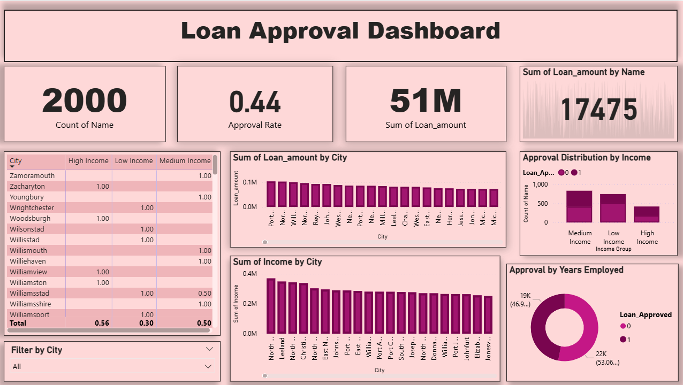
Dashboard Snapshot

Slide 9
THANK YOU!!!

