Slide 1
ReconX
Enterprise Trade Reconciliation Platform
Team Members:
Tanisha Dusane
Nagachinmayeii
Sai Prasanna Gunda
Ruchi Chandhak
Anshika Chaudhary

Slide 2




OVERVIEW
Problem Statement & Solution
⚠️ The Problem
✅ The ReconX Solution
Manual trade reconciliation creates significant operational risk across financial institutions.
ReconX automates the end-to-end reconciliation pipeline with enterprise-grade reliability.
Secure Authentication
Slow & Inefficient
JWT-based login with Role-Based Access Control ensures only authorized users act on trades.
Manual matching of trades is time-consuming and creates bottlenecks at month-end close.
Event-Driven Processing
Error-Prone
Kafka pipelines route trade events to the reconciliation engine in real time, eliminating batch delays.
Human entry leads to mismatches, incorrect positions, and costly financial discrepancies.
Full Audit Trail
Poor Auditability
Every reconciliation action is logged immutably, enabling on-demand compliance reporting.
Lack of traceable logs makes it difficult to meet compliance and regulatory requirements.
Real-Time Monitoring
Delayed Resolution
Prometheus and Grafana dashboards surface anomalies instantly, enabling rapid remediation.
Issues surface late in the cycle, leaving no time for correction before settlement deadlines.

Slide 3
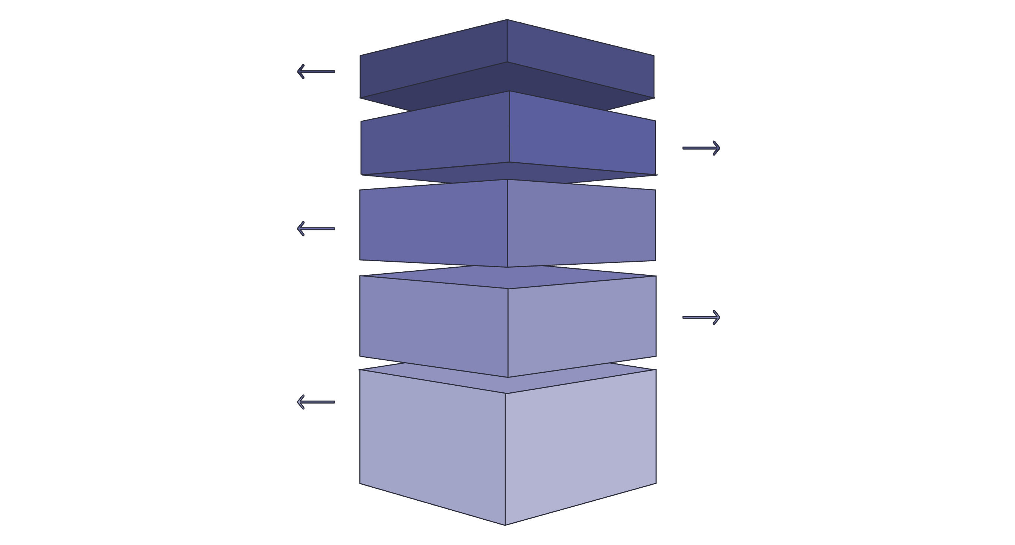
ARCHITECTURE
System Architecture
Frontend
React UI for user interactions and dashboards.
API Gateway
Spring Boot gateway handling requests and routing.
Security Layer
JWT authentication and authorization for all traffic.
Core Services
Trade Service (Postgres) and Kafka event bus.
Processing & Monitoring
Reconciliation engine (audit log) and Prometheus+Grafana.
High-Level System Architecture

Slide 4










WORKFLOW
Application Workflow
Login
JWT Auth
Create Trade
User credentials submitted
Token issued & validated
Trade data submitted via API
PostgreSQL
Kafka
Trade persisted to DB
Event published to topic
Recon Engine
Audit Log
Dashboard
Automated matching & validation
Immutable record written
Status shown in React UI
Prometheus
Grafana
Metrics scraped & stored
Visual observability layer

Slide 5
STACK
Technology Stack
Category
Technologies
⚙️ Backend
Java · Spring Boot · Spring Security · Hibernate · Apache Kafka
🖥️ Frontend
React · Vite · JavaScript · HTML · CSS
🗄️ Database
PostgreSQL · Liquibase
🔐 Security
JWT (JSON Web Tokens) · RBAC (Role-Based Access Control)
📊 Monitoring
Prometheus · Grafana · Micrometer
🐳 DevOps
Docker · Git
📄 API Docs
Swagger / OpenAPI

Slide 6
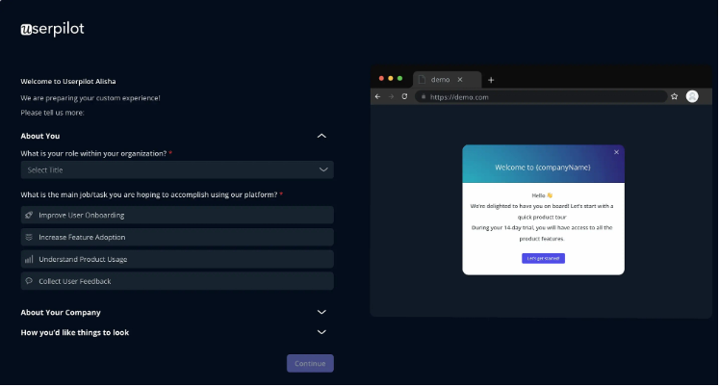
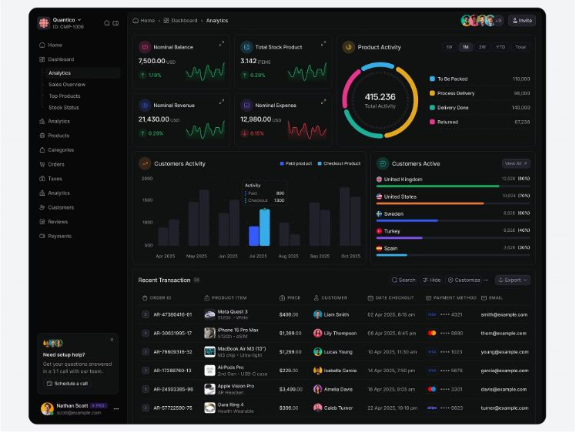
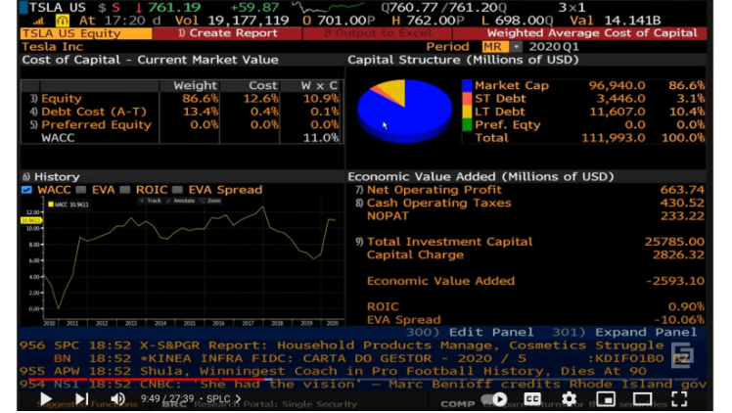
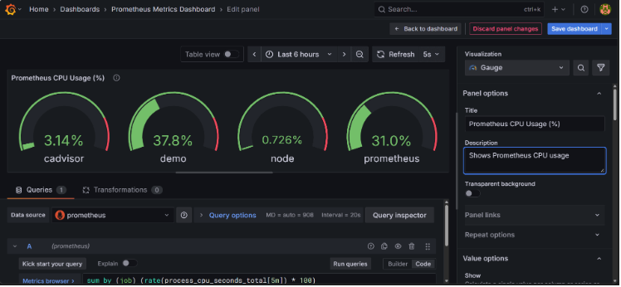
DEMO
Project Demo
Grafana Dashboard
Live observability and system metrics
Login Page
Secure JWT-authenticated entry point
Trade Management
Create, view, and manage trade records
Dashboard
Real-time reconciliation status overview

Slide 7








RETROSPECTIVE
Challenges & Learnings
🚧 Challenges Faced
🎓 Key Learnings
Kafka Setup
JWT Integration
Spring Boot
Event-Driven Design
Configuring producers, consumers, and topic partitioning in a local environment.
Implementing stateless authentication with token refresh and role validation.
Built production-grade REST APIs with layered architecture and dependency injection.
Applied asynchronous, decoupled communication patterns using Kafka for scalability.
Docker Networking
Git Conflicts
React Frontend
Observability
Linking multi-service containers and managing environment-specific configurations.
Resolving merge conflicts across parallel feature branches during team collaboration.
Developed dynamic, component-based UIs consuming secured backend APIs.
Instrumented services with Micrometer and visualised performance in Grafana.

Slide 8
CONCLUSION
Conclusion & Future Scope
✅ Key Achievements
🚀 Future Enhancements
01
01
Automated Reconciliation Pipeline
AI-Based Anomaly Detection
End-to-end trade matching with zero manual intervention from submission to audit log.
Integrate ML models to automatically flag unusual trade patterns before settlement.
02
02
Secure, Role-Based Access
Cloud Deployment
JWT + RBAC ensuring only authorised users perform sensitive reconciliation actions.
Deploy on AWS or Azure with managed services for database, messaging, and monitoring.
03
03
Real-Time Event Processing
Kubernetes Orchestration
Kafka-driven architecture decouples services and processes trades at enterprise scale.
Containerise all services under Kubernetes for auto-scaling and high availability.
04
04
Full Observability Stack
Advanced Analytics
Prometheus metrics and Grafana dashboards provide production-ready visibility.
Embed business intelligence dashboards for trade volume trends and SLA reporting.

Slide 9
Thank You!
Questions?
ReconX – Enterprise Trade Reconciliation Platform

