Slide 1
Using Neural Networks for
Security Attack Detection
Reproducing a CS229 intrusion-detection network on NSL-KDD, with extensions
UE24CS352A Machine Learning - Mini-Project
Tanisha Khoria (PES2UG24CS551) | Sparsha Arun (PES2UG24CS513)
Notes:
Introduce the team and the topic. One line: we reproduce the neural network from a Stanford CS229 report on NSL-KDD and compare it with a Random Forest.

Slide 2
Problem: spot attacks in network traffic
Why it matters
Our task
Systems and data are constant targets for attackers
Signature-based IDS miss new attack variants
Anomaly-based IDS catch more, but raise false alarms
Input: one connection record (41 features)
Output: normal, or which attack
Reproduce the paper's neural network
Extend: ReLU MLP vs Random Forest
Notes:
Reference: 'Using Neural Network for Security Attacks Detection', CS229 Spring 2021. Their goal is detecting attacks, including previously unseen ones.

Slide 3
Dataset: NSL-KDD
Split | Normal | DoS | Probe | R2L | U2R
Train | 67,343 | 45,927 | 11,656 | 995 | 52
Test | 9,711 | 7,460 | 2,421 | 2,752 | 200
Train 125,973 / test 22,544 records
41 features: 3 categorical, rest numeric
No duplicate records (fixed KDD'99)
The hard part
Test set holds 17 attack types never seen in training. R2L and U2R are rare in training but common in test.
Notes:
Highlight the class imbalance: only 52 U2R training records, yet 200 in test. And 17 unseen attack types, which is why test accuracy is far below train accuracy.

Slide 4
Approach: one pipeline, two experiments
1
2
3
4
5
Load
Encode
Scale
Train
Evaluate
KDDTrain+ / KDDTest+
One-hot protocol, service, flag -> 122 features
Standardise (fit on train only)
Neural net + baselines
Accuracy, F1, confusion matrix
Part 1: paper reproduction
Part 2: extensions
24 classes (normal + 22 known attacks + 'other'). Same network, same hyper-parameters. 10 seeds.
ReLU MLP vs Random Forest on 5-class (Normal/DoS/Probe/R2L/U2R) and binary tasks.
Notes:
Scaler is fit on training data only to avoid leakage. The 'other' class in the paper's setup represents attacks not seen during training.

Slide 5
The paper's network: 122 - 500 - 24
Input
Hidden
Output
122 features
500 units, sigmoid
24 units, softmax
Training setup (as in the paper)
Mini-batch gradient descent, learning rate 0.5, batch size 1000, 10 epochs, L2 regularisation
24 outputs = normal + 22 training attacks + 'other'; Normal/Abnormal verdict = output is normal or not
Paper warns results depend on random initialisation, so we repeat with 10 seeds
Notes:
Explain forward pass: 122 inputs -> sigmoid hidden layer of 500 -> softmax over 24 classes. Stopping at 10 epochs is a deliberate choice in the paper because test accuracy stops improving cleanly.

Slide 6
Reproduction: close to the paper
68.6%
75.2%
~98%
24-class test accuracy (paper: ~70%)
Normal/Abnormal accuracy (paper: ~80%)
Train accuracy (paper: ~100%)
Mean over 10 seeds: 68.6% +/- 0.1 (24-class), 75.2% +/- 0.5 (Normal/Abnormal, range 74.3 - 76.3)
Big train/test gap: 17 test attacks are unseen, so the network cannot name them
Not reproduced: the paper's occasional runs above 85% - we saw no such outliers
Notes:
Our numbers sit slightly below the paper's. Possible reasons: library differences (scikit-learn SGD vs their implementation), initialisation scheme, exact label handling. We report this honestly rather than tuning to hit their number.

Slide 7
Extensions: MLP vs Random Forest
What we see
+3.1 pts (5-class), +3.5 pts (binary)
ReLU MLP: 122-128-64, Adam, early stopping
RF: 200 trees
Both weak on R2L / U2R
Notes:
Axis starts at 60% to make the gap readable - say so out loud. Fixed seed 42. 5-class macro-F1: MLP 0.567, RF 0.492.

Slide 8
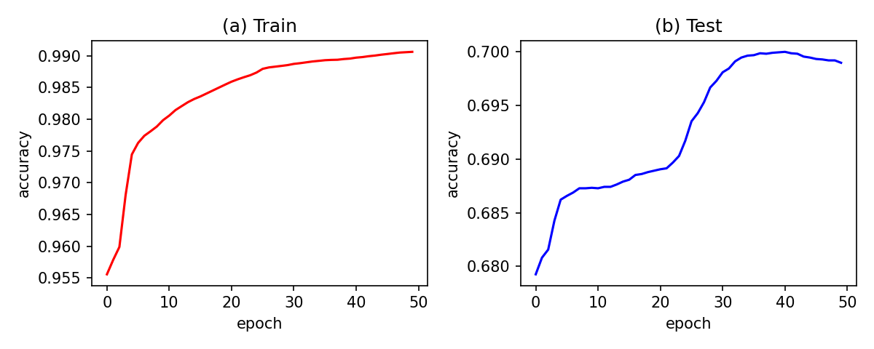
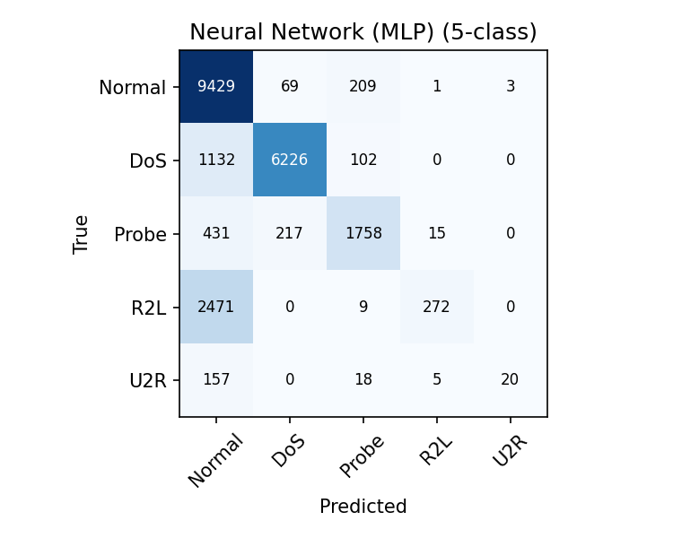
Where it fails: unseen and rare attacks
Paper network, accuracy per epoch (seed 0). Test accuracy creeps up to ~70% by epoch 50.
R2L / U2R recall is only ~10%: those attacks look like normal traffic, so Normal is over-predicted (recall 97%, precision 69%).
ReLU MLP confusion matrix (5-class)
Notes:
Walk through the confusion matrix: DoS and Probe are detected well (F1 0.89 and 0.78). R2L and U2R rows are mostly predicted as Normal.

Slide 9
Conclusions and next steps
Conclusions
Future work
Paper's network reproduced: 68.6% (24-class), 75.2% (Normal/Abnormal)
Neural net outperforms Random Forest on both tasks
Unseen and rare attacks cap accuracy near 80%
Class weighting / oversampling for R2L and U2R
Feature selection to shrink 122 inputs
Newer data (e.g. CIC-IDS2017)
Notes:
Close by stating the main takeaway: neural networks help, but detecting unseen attacks remains the open problem.

Slide 10
Live demo
python src/demo.py
Classifies random test records: true label vs predicted, ALERT / ok verdict
Then: questions
Notes:
Run the demo script. First run trains for ~20 s, so run it once before the review so the model is cached.

